Slide 1
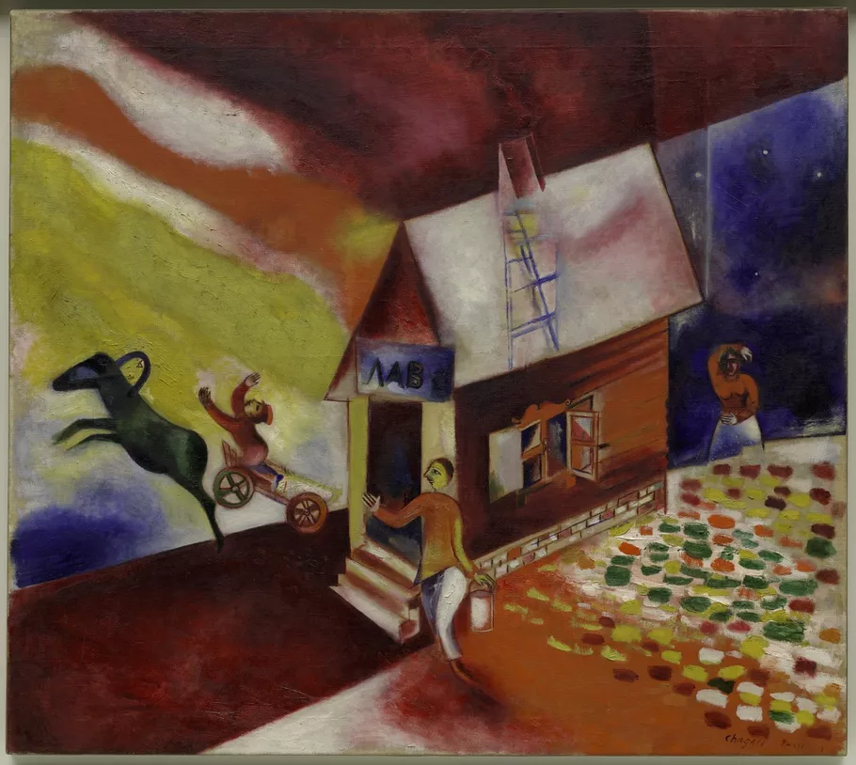
Minority Modernisms
18 October 2023
… Jewish Primitivism, ‘real Bohemians’, visibility and the power of representation
Marc Chagall, The Flying Carriage, 1913.© Guggenheim Bilbao.

Slide 2
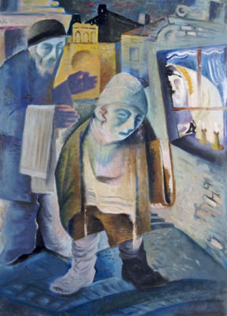
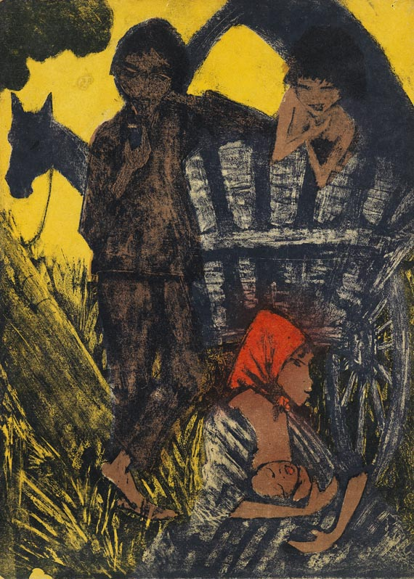
Take 10 minutes to reflect on these images in writing (no need to share the details).
František Reichentál, Sabbath in Bratislava, n.d.
Otto Müller, Gypsy Album (1927)
How might these works relate to minority modernism? And why?

Slide 3
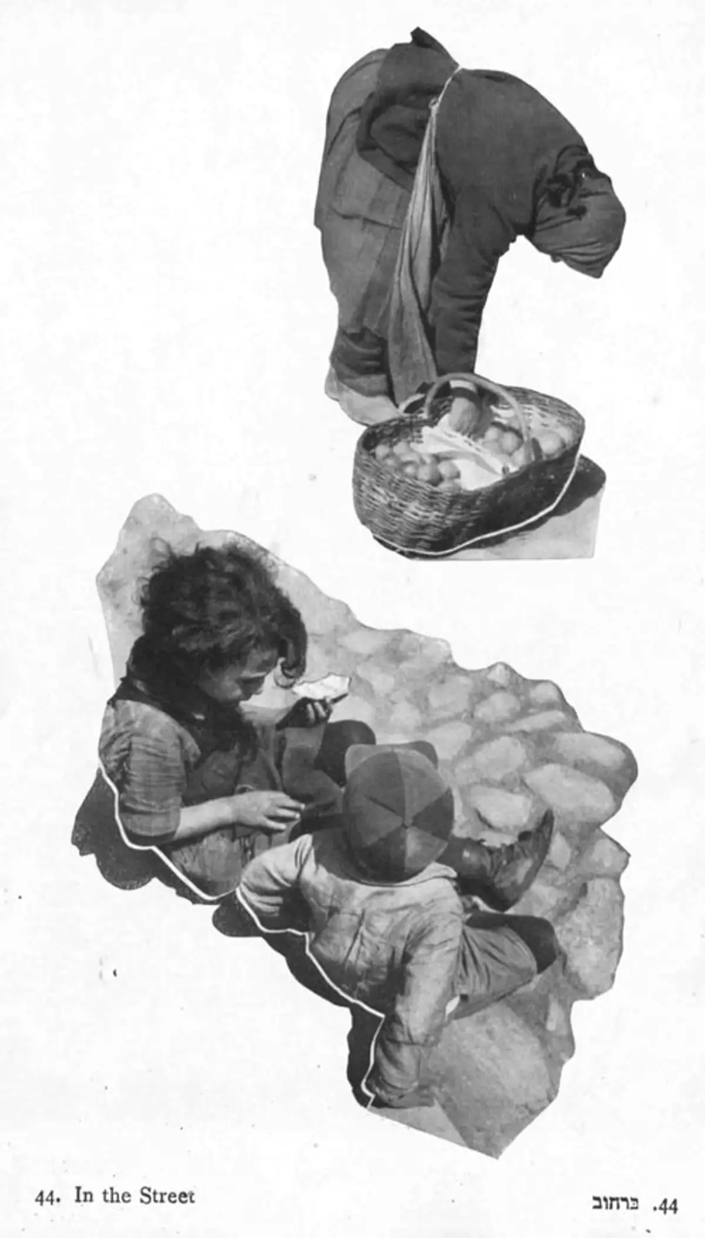
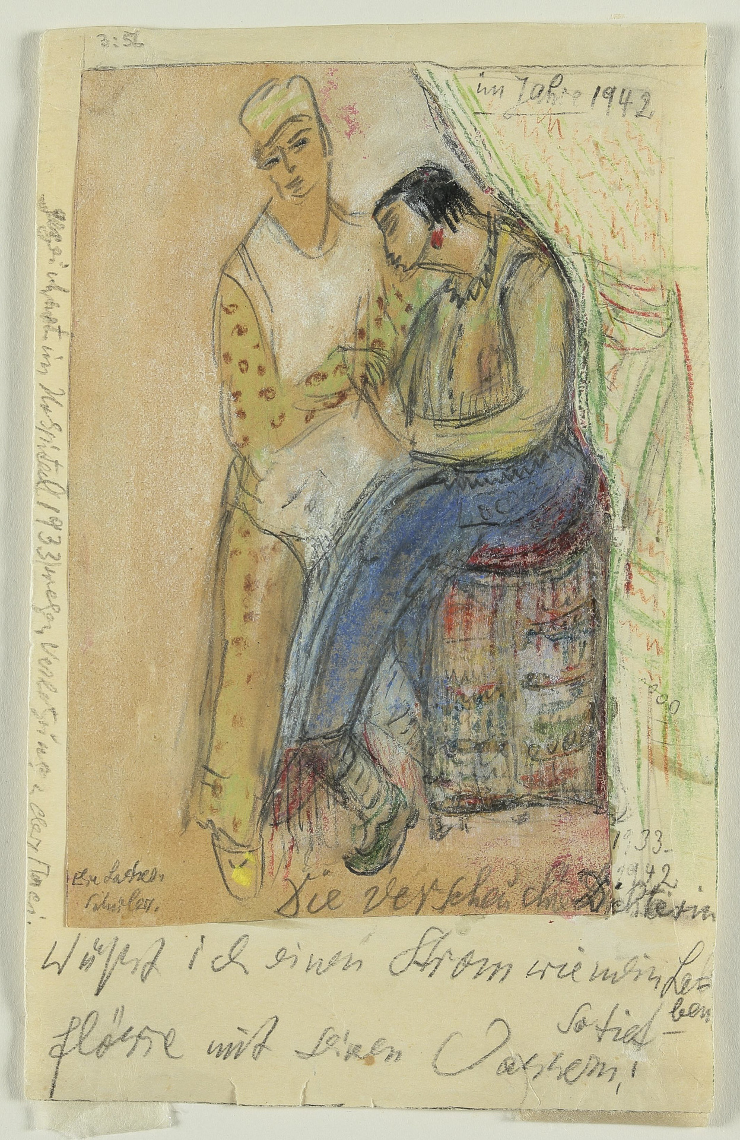
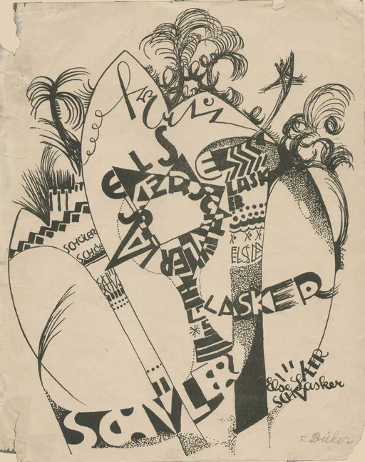
Jewish Primitivism
Friedl Dicker-Brandeis, Poster for a reading by Else Lasker-Schüler at the Bauhaus in Weimar, 1920
Moshé Raviv-Vorobeichic (Moï Ver, 1904–1995)
Else Lasker-Schüler, The Banished Poet, 1925–1942
“The face of modernism is turned outwards, while folk art turns inward.”
Abram Efros (1888-1954), “Aladdin’s Magic Lantern” (1917)

Slide 4
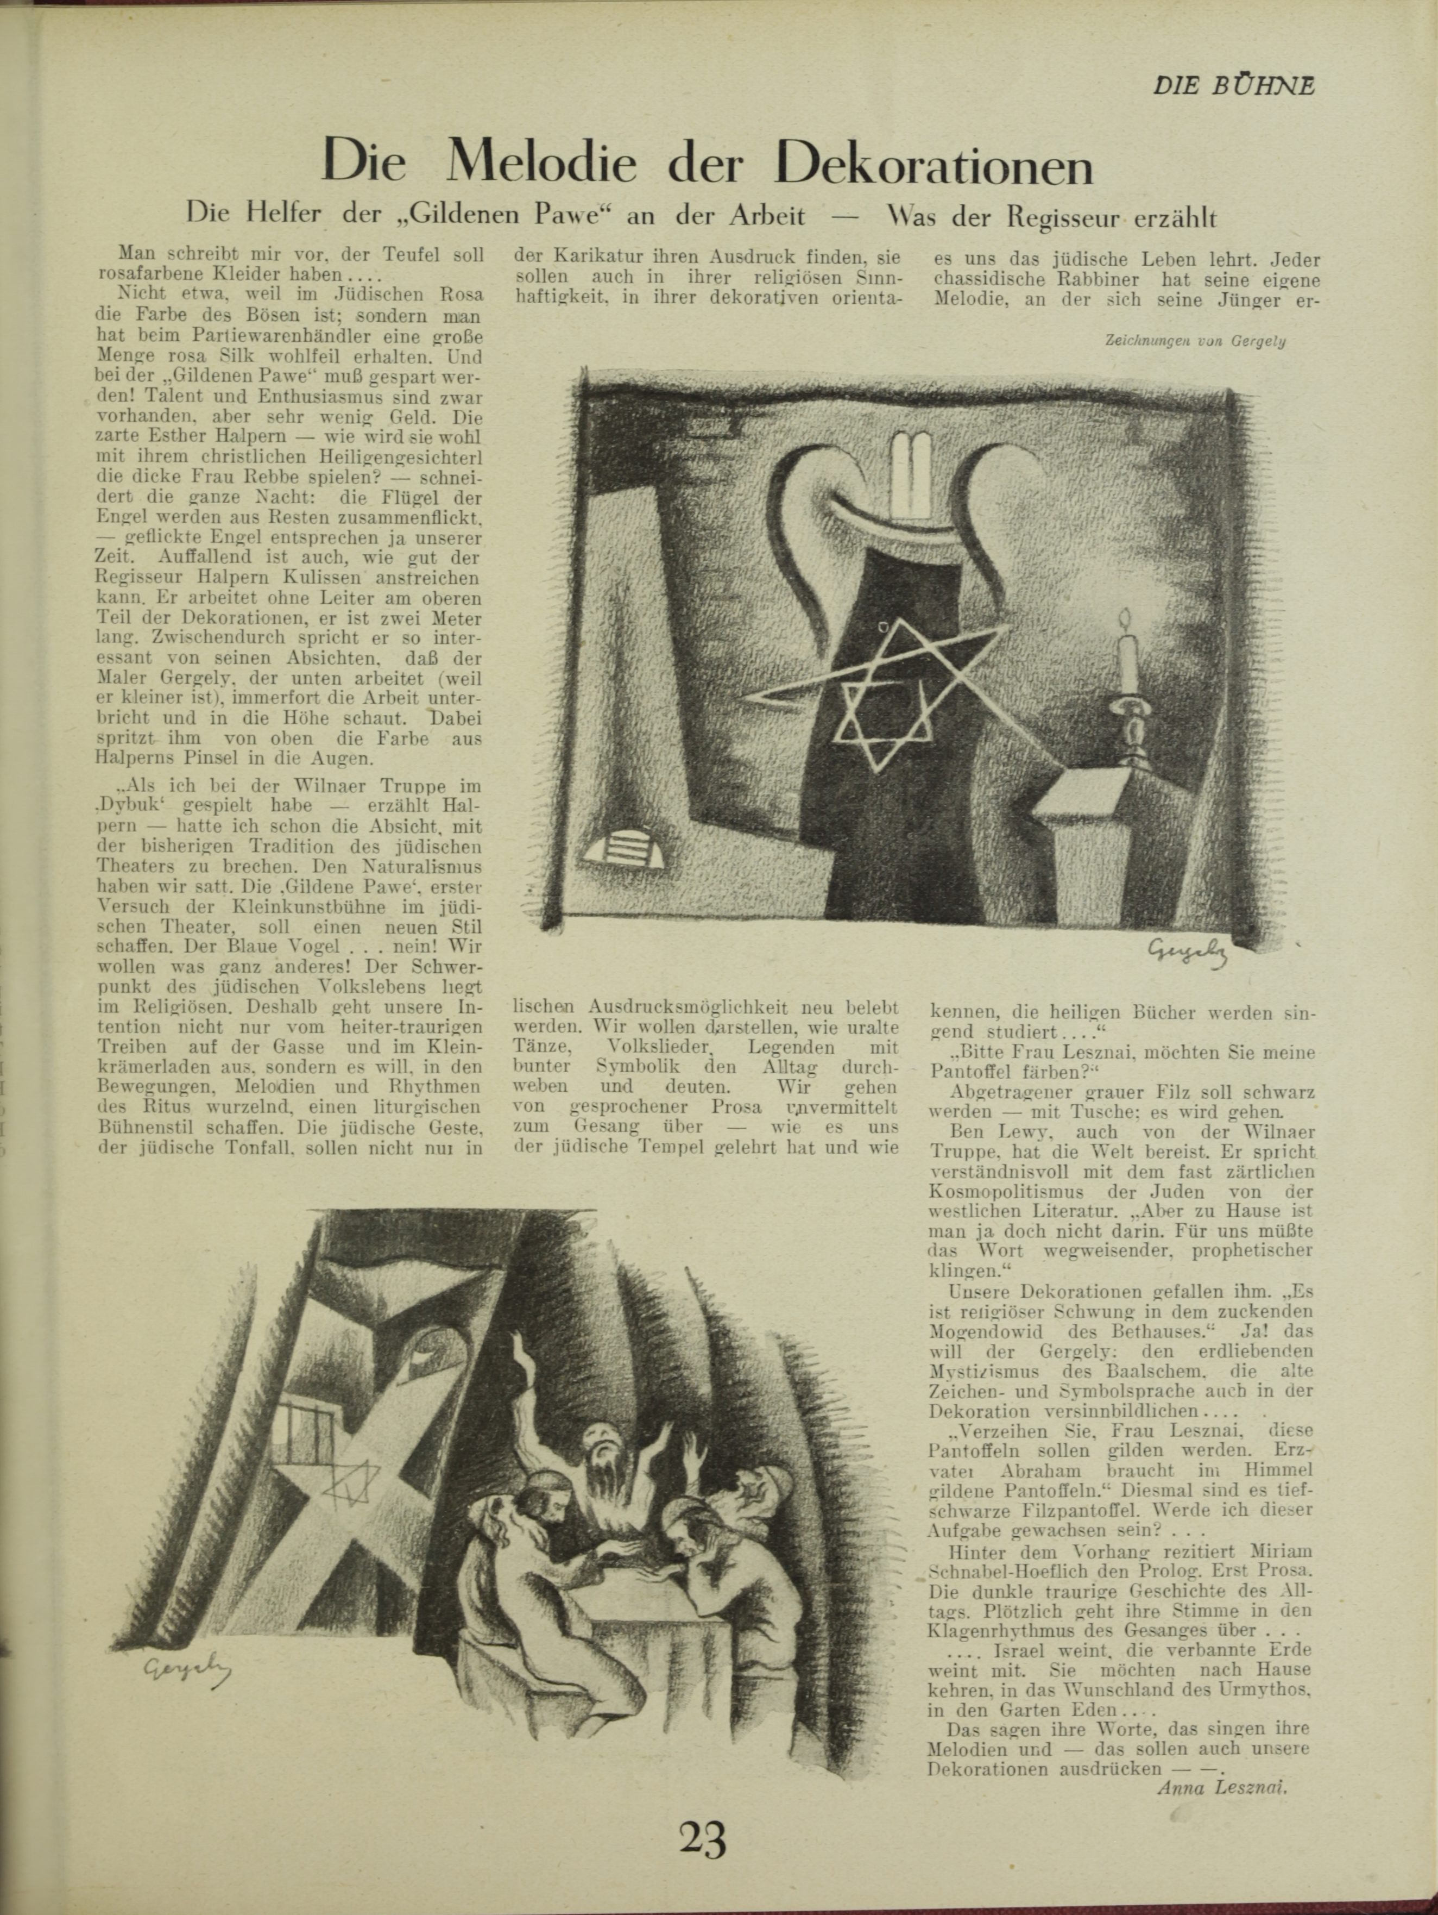
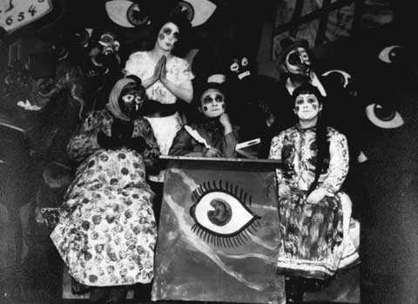
‘Israel cries, the abandoned Earth cries with it. They want to return home, to the country of desire of ancient myth, to Garden Eden … this is also what our decorations should express.’
Lesznai, “Die Melodie der Dekorationen,” 25
Klara Meisels, Esther Perelmann and Lea Weintraub-Graf in Ossip Dymow's Der Sänger seiner Trauer (Der singer fun sayn troyer), directed by Shmuel Iris. Jüdischer Künstlerspiele, Vienna, May 1929.
Anna Lesznai, ‘Die Melodie der Dekorationen’, Die Bühne 13 (1925)

Slide 5
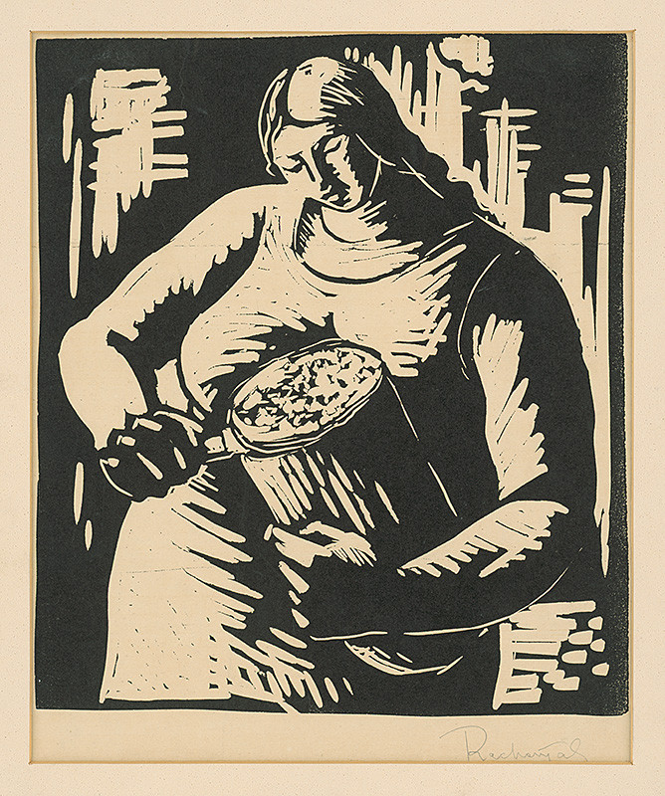
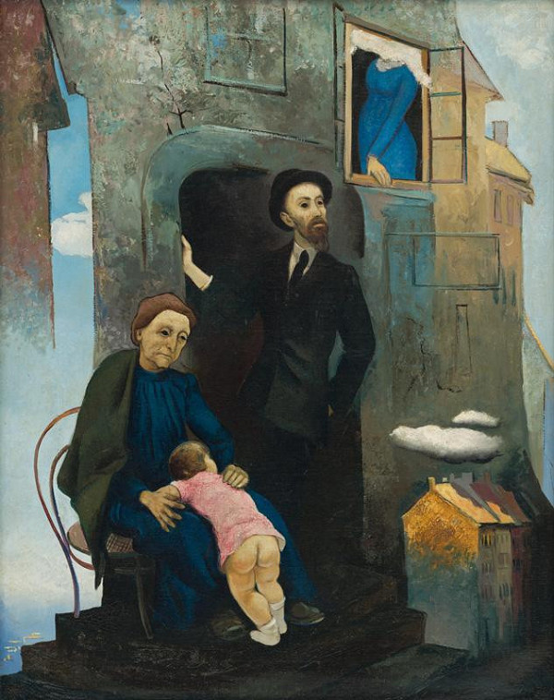
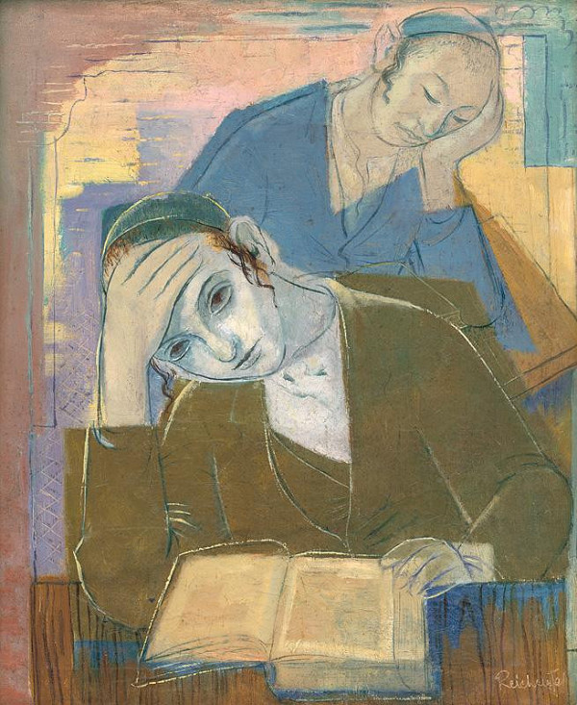
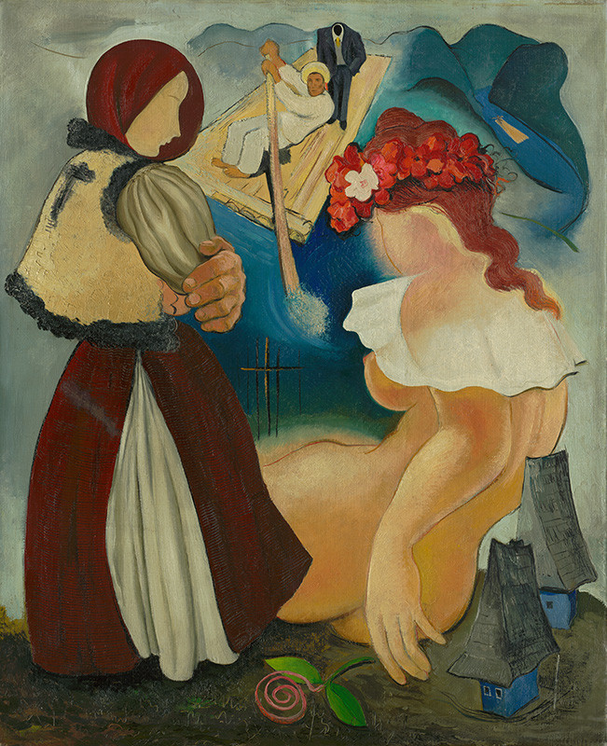
FR, Slicing Bread, 1930–1935
Imrich Weiner-Kráľ, Židovská Street III, c1935
František Reichentál, Two Talmudists, 1932
IWK, Rachovo (Raftman’s dream), c 1935,

Slide 6
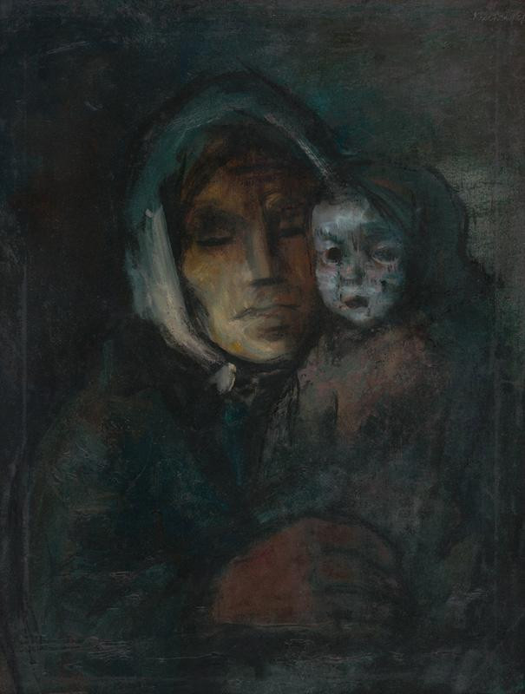
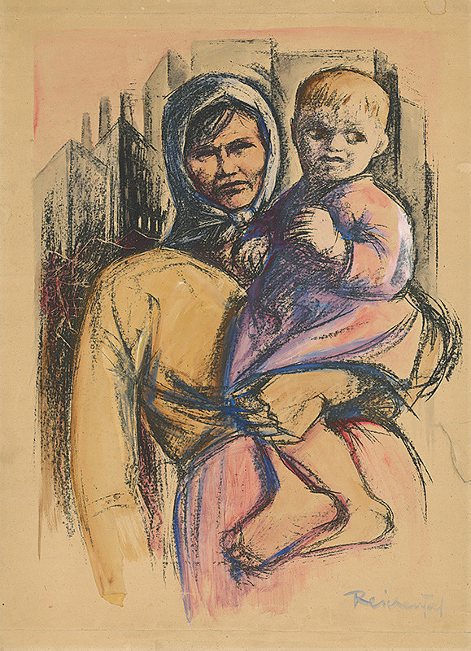
František Reichentál (1895-1971)
Slicing Bread, 1930–1935, Slovak National Gallery https://www.webumenia.sk/dielo/SVK:SNG.G_1882
Poverty, 1930-1939, Slovak National Gallery, https://www.webumenia.sk/dielo/SVK:SNG.O_2019
Mother and Child,1930-1935, Slovak National Gallery https://www.webumenia.sk/dielo/SVK:SNG.G_9039

Slide 7
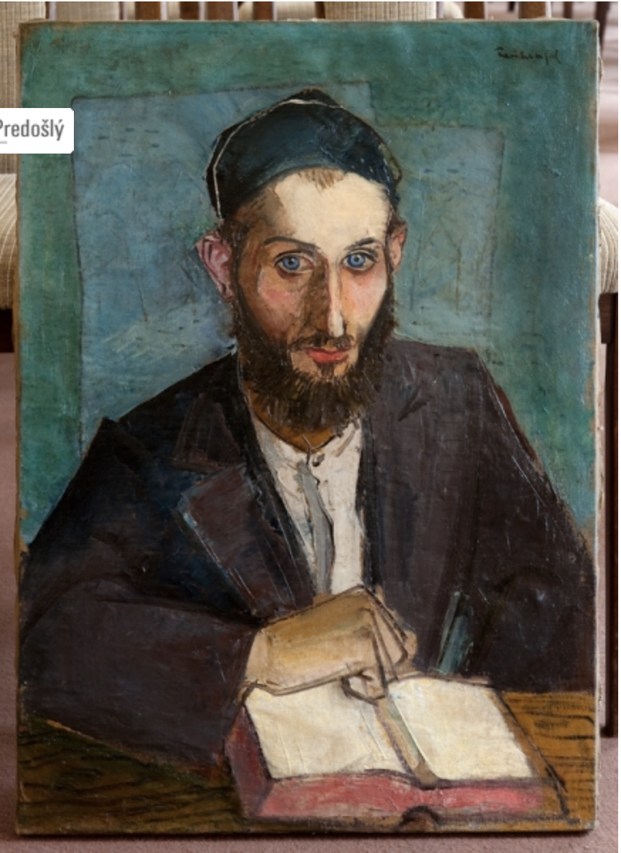
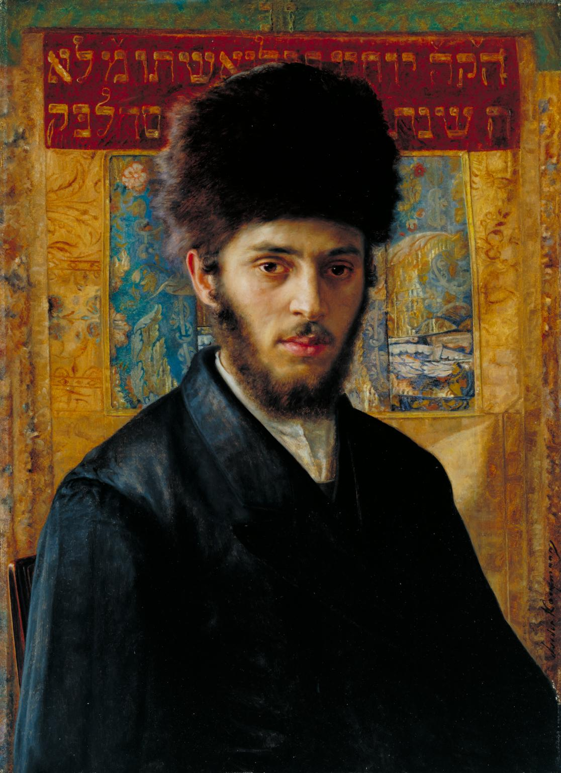
František Reichentál, Jewish teacher in Subcarpathian Ruthenia, 1931, Bratislava City Gallery
Isidor Kaufmann, Young Rabbi from N. c.1910, Tate Images

Slide 8
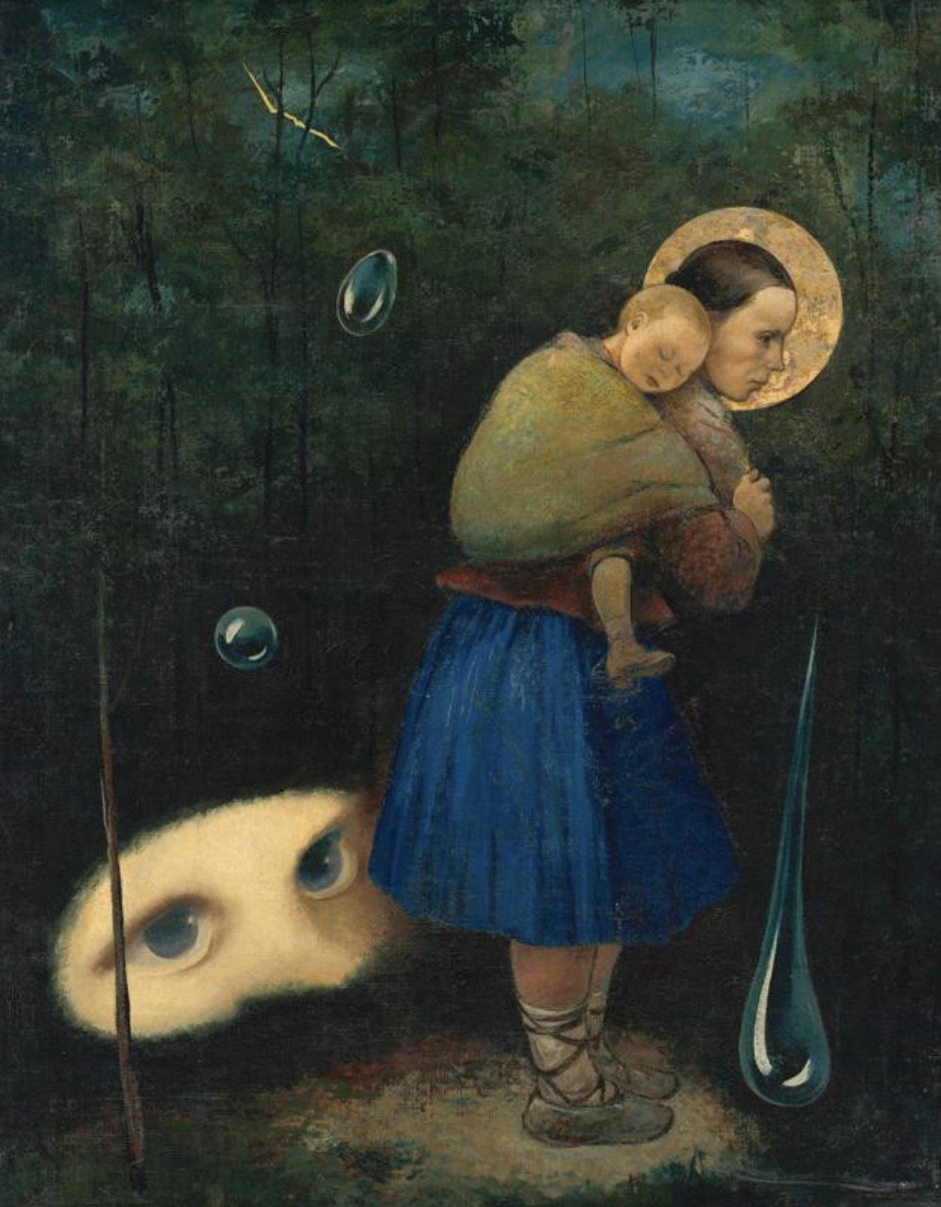
Imrich/Imro Weiner-Kráľ (1901-1978)
Rachovo (Raftman’s dream), c 1935, Slovak National Gallery, https://www.webumenia.sk/dielo/SVK:SNG.O_189
Thunderstorm, 1937, Slovak National Gallery
https://www.webumenia.sk/dielo/SVK:SNG.O_2162

Slide 9
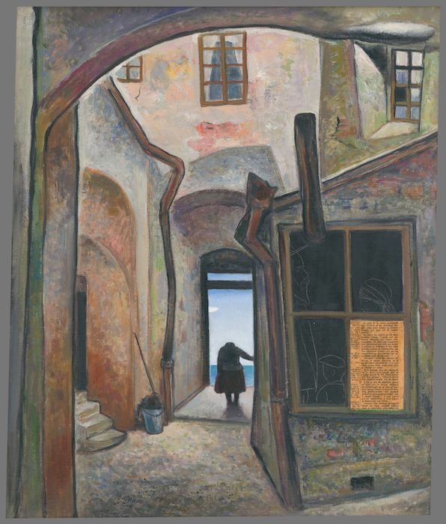
Židovská Street II, c1935, Slovak National Gallery
Židovská Street III, c1935, Slovak National Gallery

Slide 10
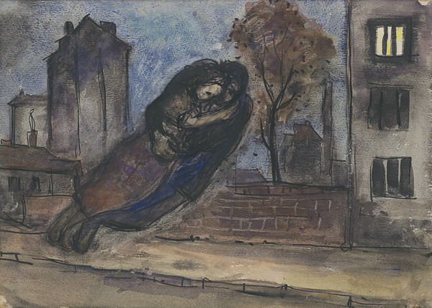
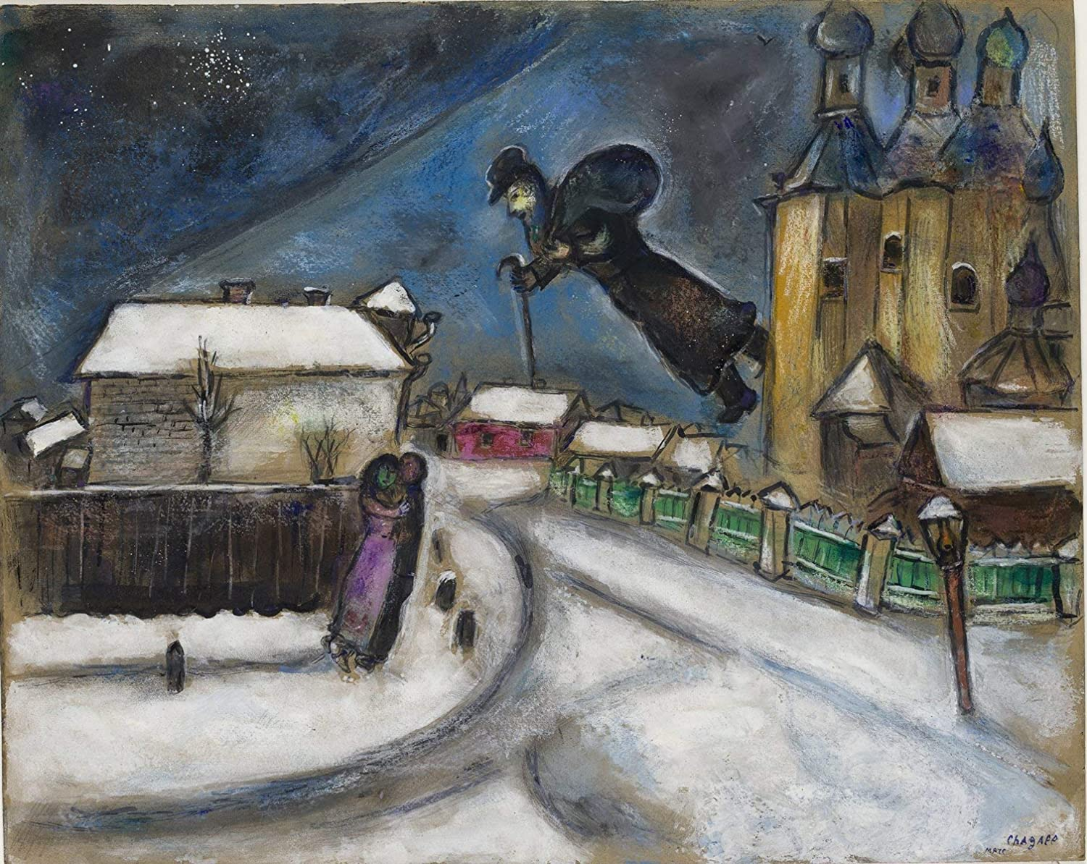
Imrich Weiner-Kráľ, Night, 1928-1932. Považská Art Gallery.
https://www.webumenia.sk/dielo/SVK:PGU.O_333
Marc Chagall, Over Vitebsk, c 1914, Israel Museum, Jerusalem

Slide 11
Who are the “real Bohemians”?
“When Albert Besnard returned back home to France from his Indian tour, and I saw the types he collected, I even told him that he needn’t travel that far, he can find figures like this in Hungary.”
Lajos Kunffy, Visszaemlékezéseim szerk: Horváth János. Kaposvár, Somogy Megyei Múzeumok igazgatósága 2006, pp. 108–109. English translation in Junghaus, ‘Towards a new art history’
“The gypsies are the Bedouins of the Hungarian basin. They do not have any possessions. They are as poor as a dervish in the desert. The have worn tents or bad huts, one or two horses, many children – they enjoy life and take it as it comes.”
Dezső Rózsaffy in Pirsig, ‘Otto Mueller. Mythos und Wahrheit’, 26.

Slide 12
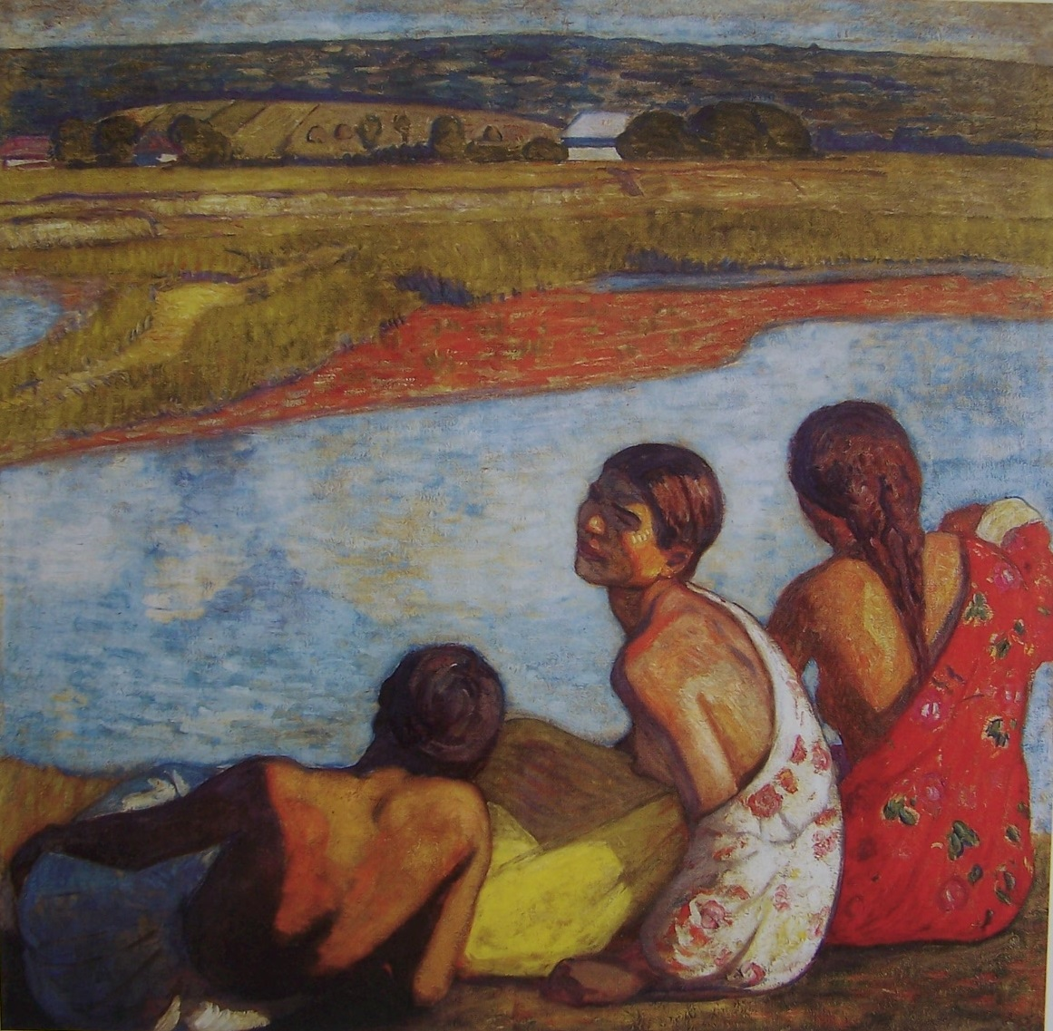
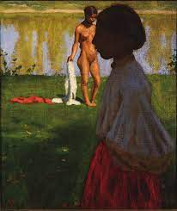
János Göröncsér Gundel, Gypsy Girl and Nude Model, (c. 1907 )
Béla Iványi Grünwald, Gypsy Girls by the Banks of Lápos (1909)

Slide 13
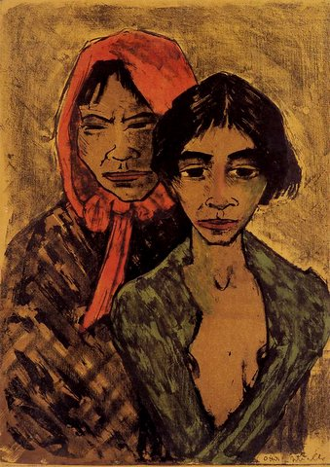
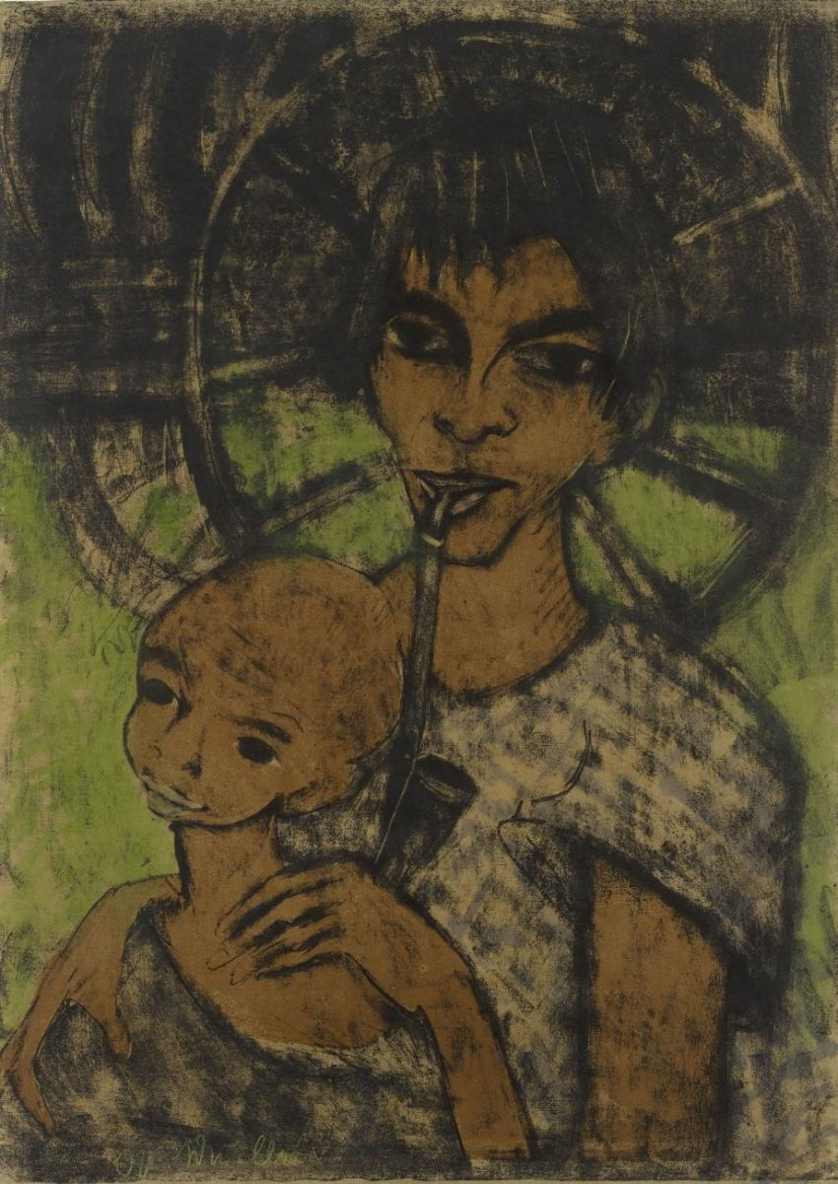
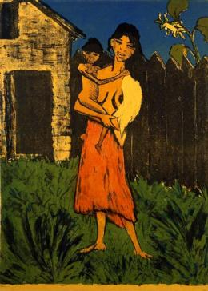
Otto Müller Gypsy Album (1927)

Slide 14
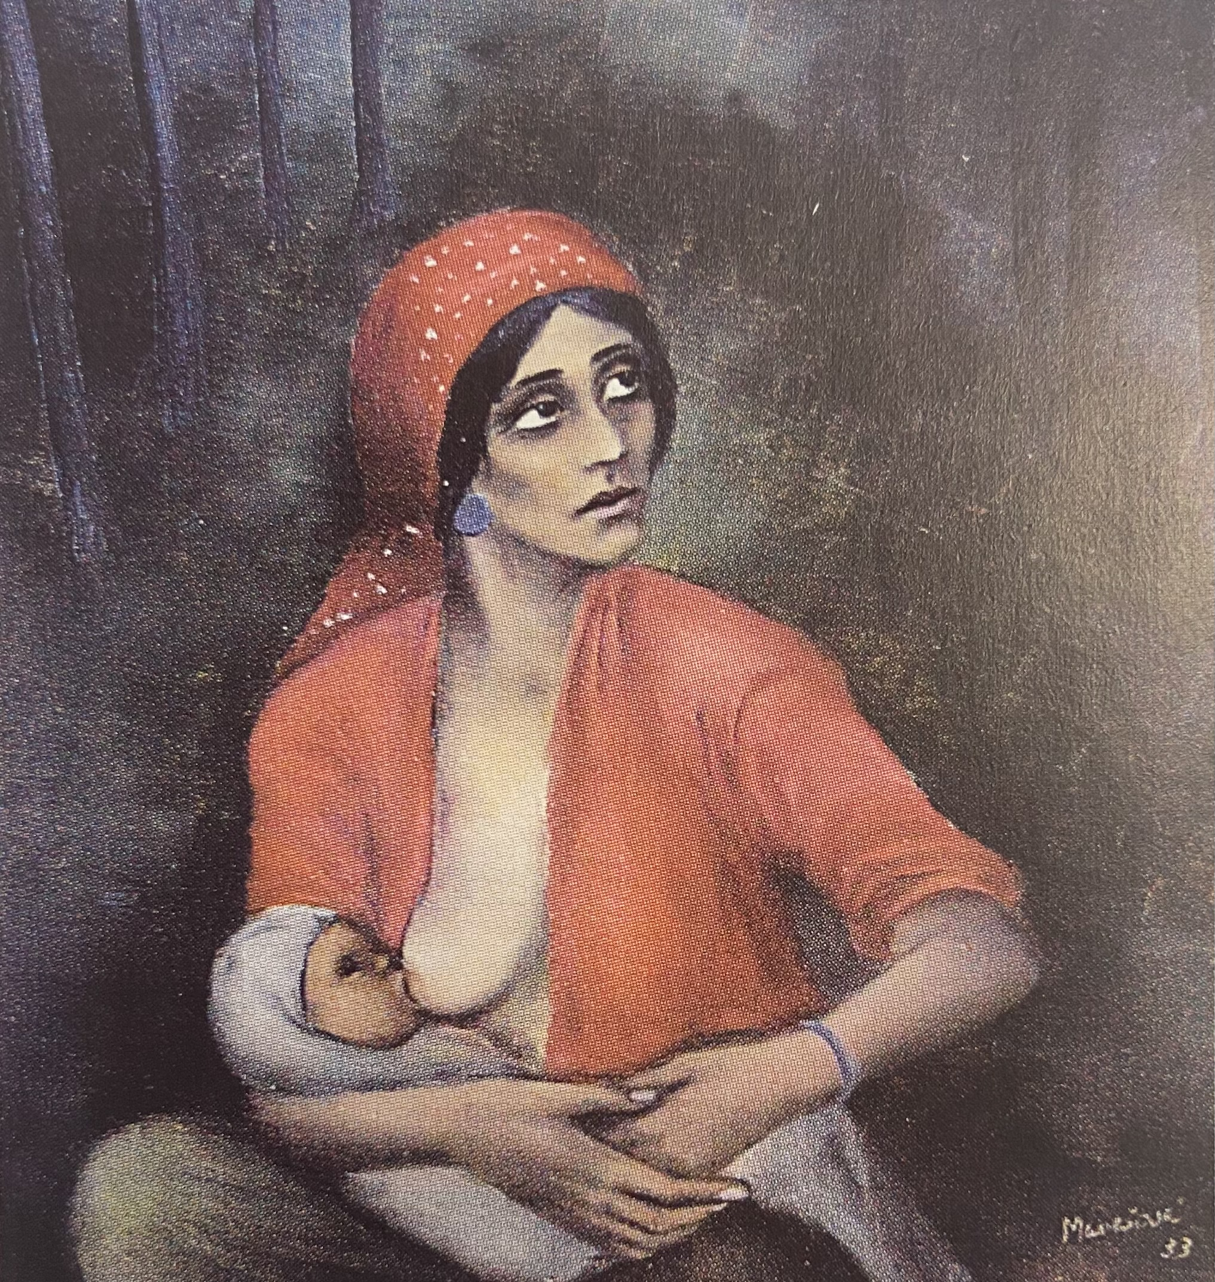
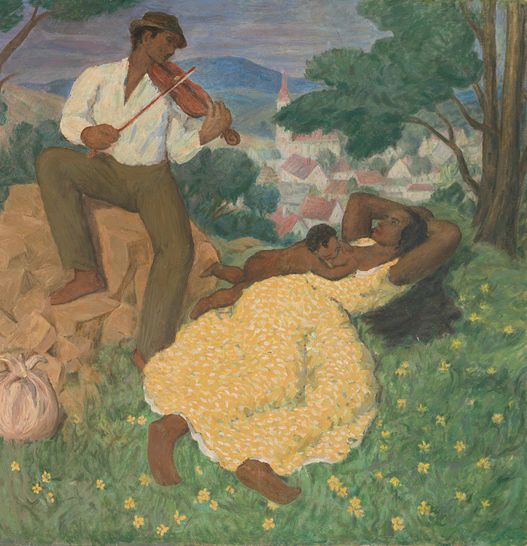
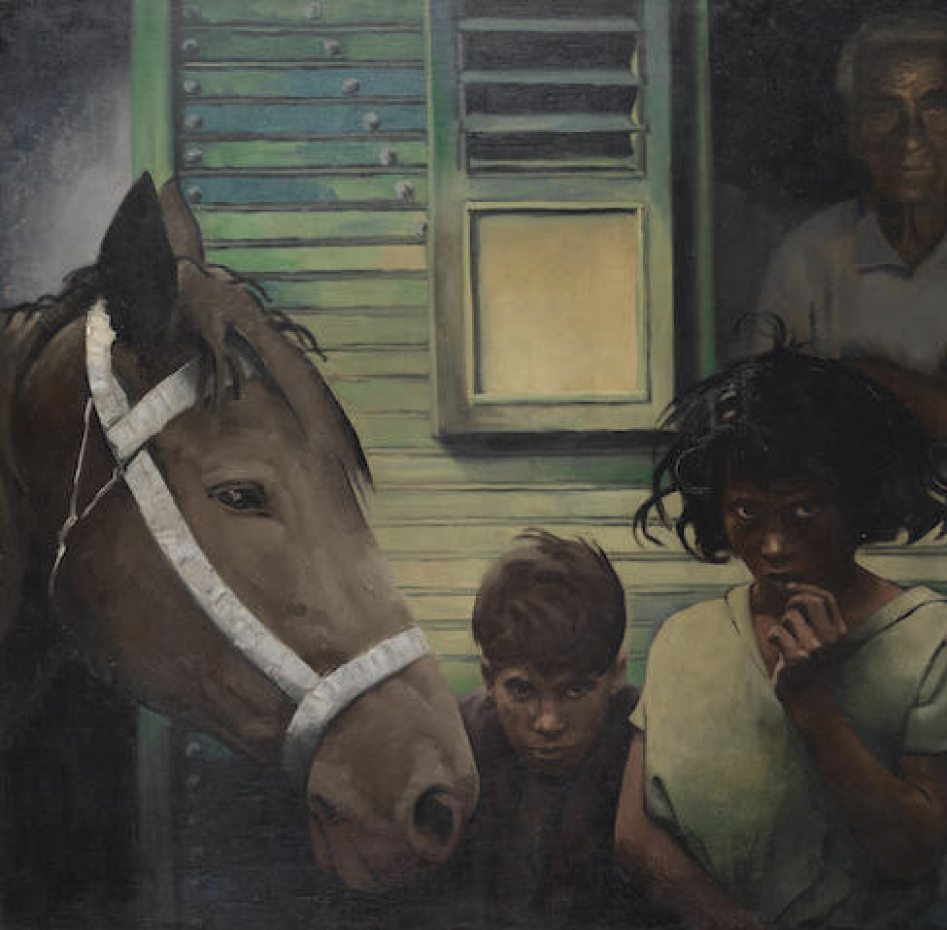
Milada Marešová, Gypsy Woman (1933)
Josef Bendík, Gypsy Idyll (1938)
Erst Neuschul, Gypsies, n.d.

Slide 15
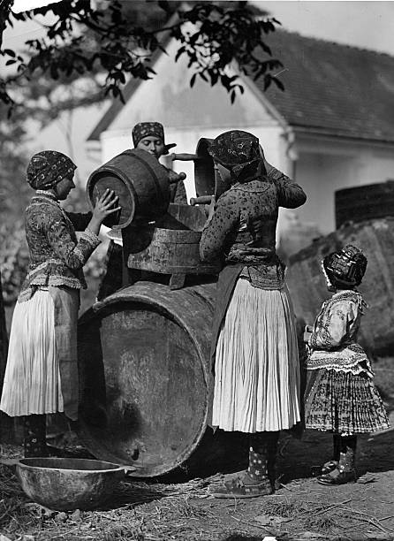
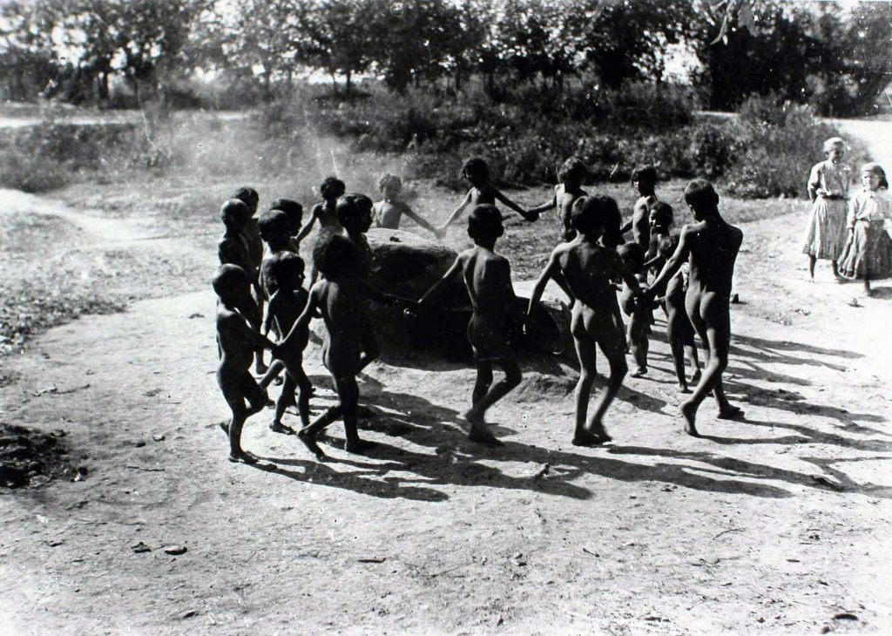
(Social) Photography
Rudolf Balogh, Women fill a barrel (c.1931)
Rudolf Balogh, untitled, 1920s-30s

Slide 16
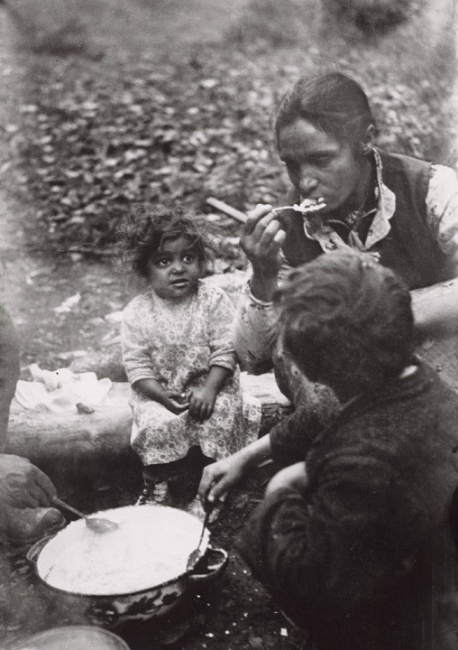
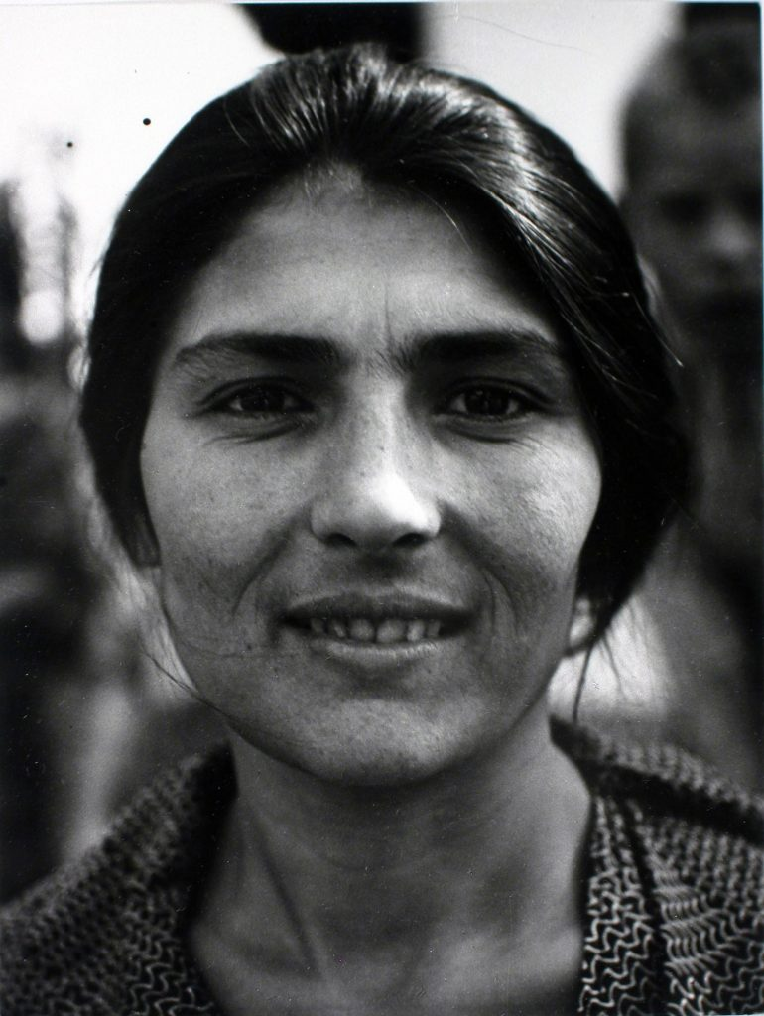
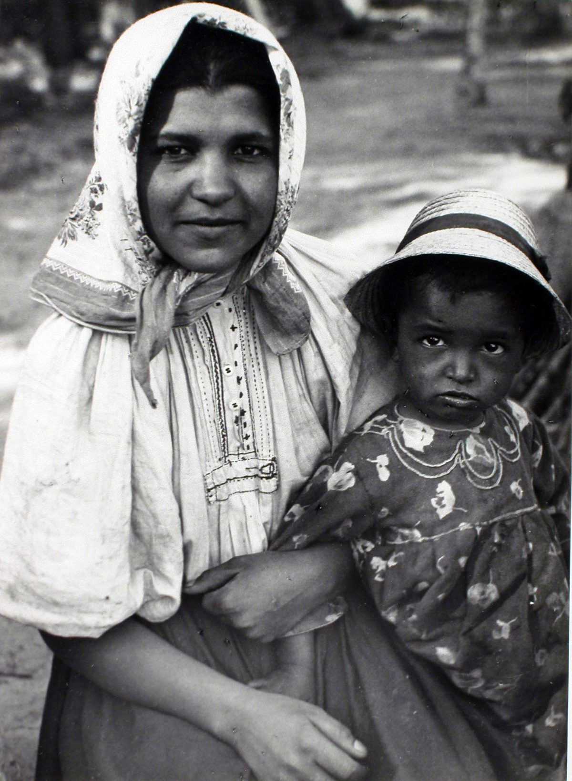
https://rofodia.oronk.hu
Kata Kálmán, Tiborc, 1937
Kata Kálmán, Tiborc, 1937
Irena Blühová, Dinner in the Forest (1929)

Slide 17
Reflect on your writing from earlier.
What do you think about your interpretations now?
František Reichentál, Sabbath in Bratislava, n.d.
Otto Müller, Gypsy Album (1927)

Slide 18
Further reading
Thomas Soxberger, Revolution am Donaukanal. Jiddische Kultur und Politik in Wien 1904 bis 1938, 2013.
John Rouse and James M Harding, Not the Other Avant-Garde: The Transnational Foundations of Avant-Garde Performance. Ann Arbor : University of Michigan Press. 2006.
Samuel, J.Spinner, Jewish Primitivism. Standford: Standford University Press, 2021.
Éva Kovács, ‘Black Bodies, White Bodies – ‘Gypsy’ Images in Central Europe at the Turn of the Twentieth Century (1880–1920)’, Critical Romani Studies, 3:2 (2021), 72-93. https://doi.org/10.29098/crs.v3i2.75

