Slide 1
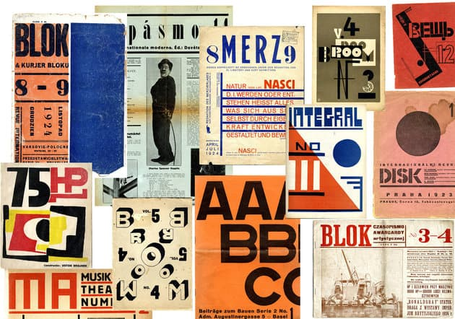
Caricature, popular illustration and magazine cultures
25 October 2023
Clockwise, from top left: Blok (Warsaw, 1924); Pasmo (Brno, 1925); Merz (Hannover, 1924); Broom (Berlin, 1923); Veshch/Gegenstand/Objet (Berlin, 1922); Integral (Bucharest, 1925); Disk (Prague, 1923); Blok (Warsaw, 1924); ABC: Beiträge zum Bauen (Basel, 1926); Broom (Berlin, 1923); MA (Vienna, 1924); 75HP (Bucharest, 1924). The Museum of Modern Art Library

Slide 2
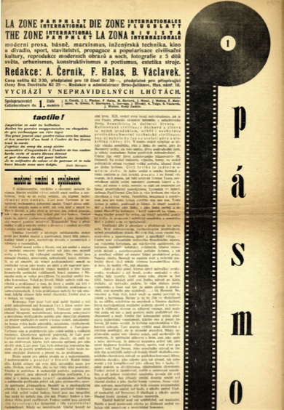
Pásmo, 1924, no. 1.
The avant-garde and modernist magazines
The content of this journal is the new form of life that can in many ways be realized already today. This new form of life determines a complete re-evaluation and continuation of all researches and accomplishments in all fields of human work. All available powers are to be placed into their service. There are two necessary reasons for this. First, we want to place our individually crafted will to work into the service of collectivity. Second, the nature of the present life’s tasks makes it impossible for a single person or a few individuals to master them even to one’s individual satisfaction. But our life and the lives of all can be built in a most economical, most potentiated and most constructive manner by way of a concentration of all powers. In other words, we no longer need to yield to the pressure of all possible events; we must shape them.
László Moholy-Nagy, ‘Richtlinien für eine Synthetische Zeitschrift,’ Pásmo (Brno), 1, 1925, no. 7-8, 5.

Slide 3
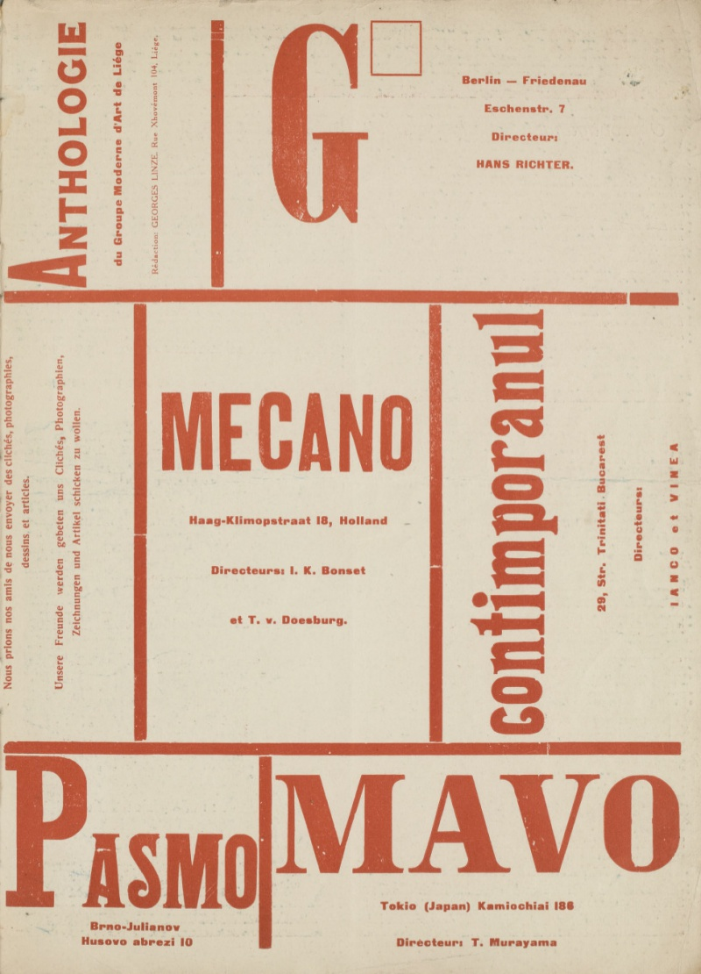

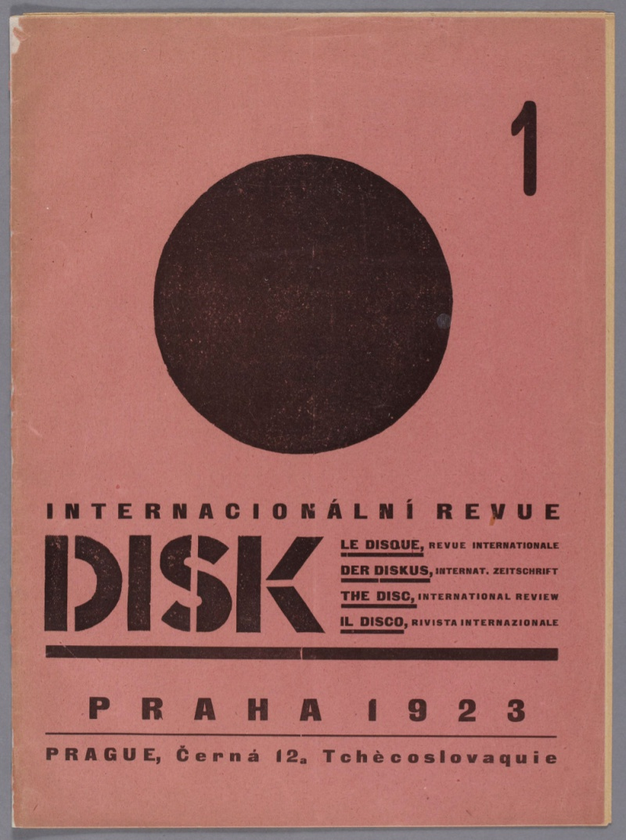
The avant-garde and modernist magazines
Inside back cover of Blok 6-7, Warsaw, 1924.
ReD 1:2 (November 1927): The Russian issue.
Disk 1 (1923)

Slide 4
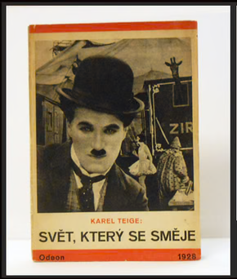
“We can make fun about the tragic and nonsensical situation of the world, we can abuse our own poverty by uncurbed jokes. We need the happy and entertaining humourist art as salt. It is certain that modern Muses are light Muses. Today’s human being who struggles with difficulties for his existence has too little time and will to engage with dull and ostentatious academic works. A human being enslaved and mechanized by the capitalist system naturally wants short, wild and poetic signs, which should also be provided by humourist art which, like most modern art, has to work with abbreviations, and be synthetic and surprising. And, as a matter of fact, a new era has given birth to new forms of humour. . . . Mockery is a weapon of libertarian and revolting spirit against the rotten and corrupted bourgeois society and morality.”
Karel Teige, “On Humor, Clowns, and Dadaists.”
Avantgarda známá a neznámá, vol. I (Prague: Svoboda, 1971), 571-572.

Slide 5
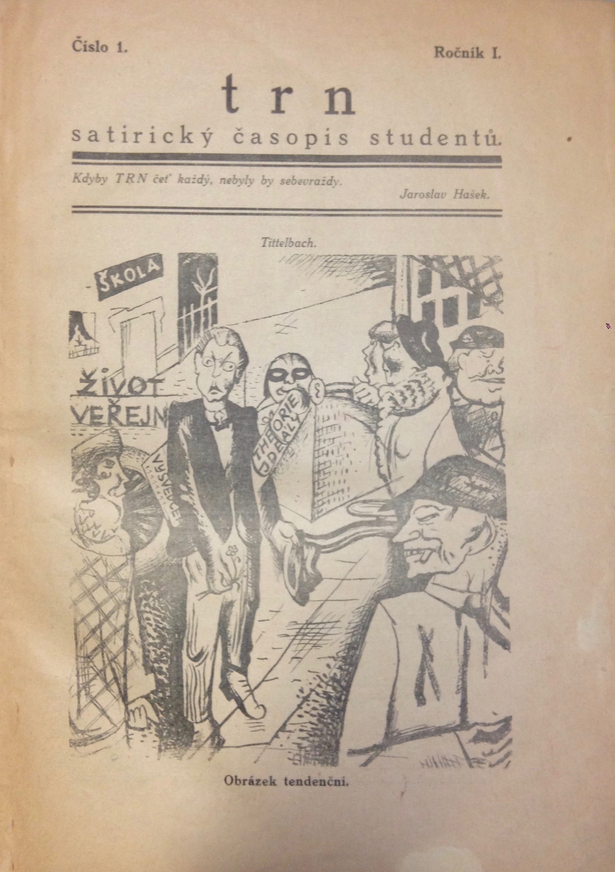
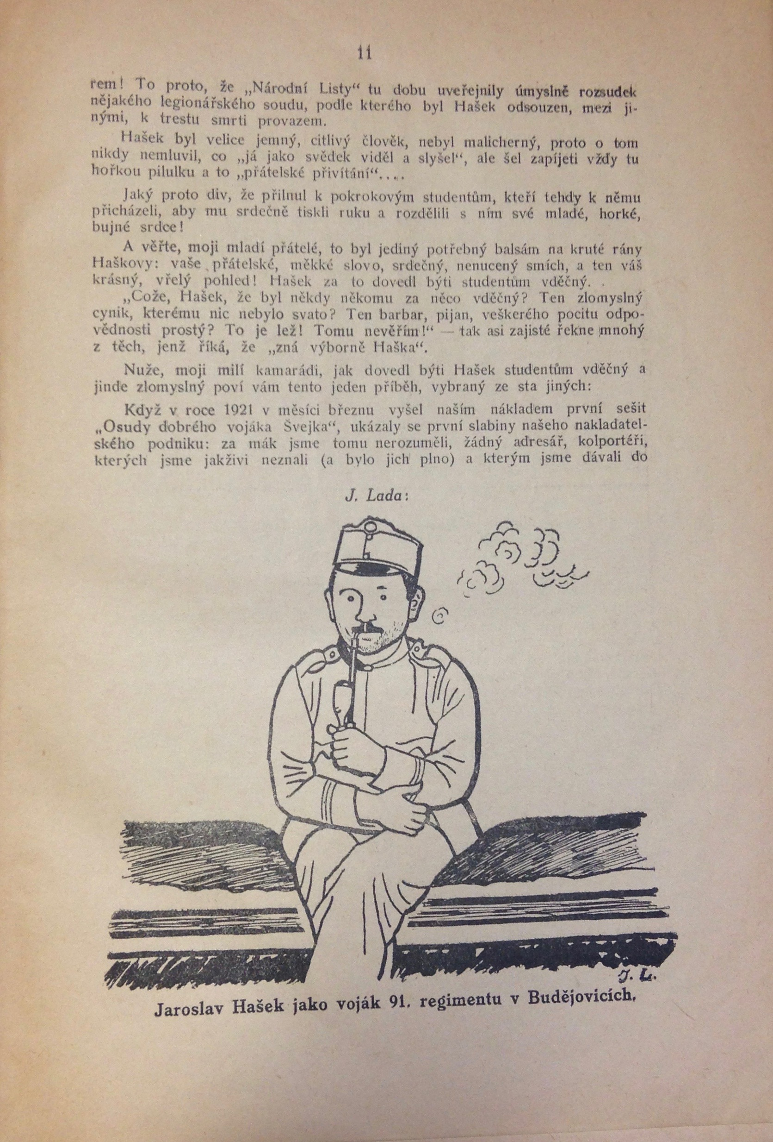
Trn Vol. 1 No.1 (1924) cover and page 3

Slide 6
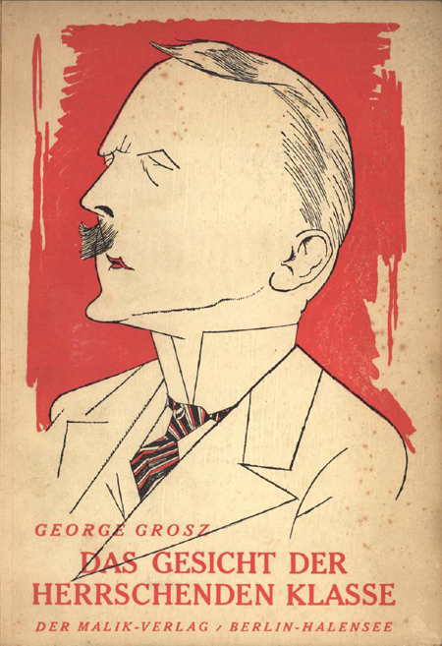
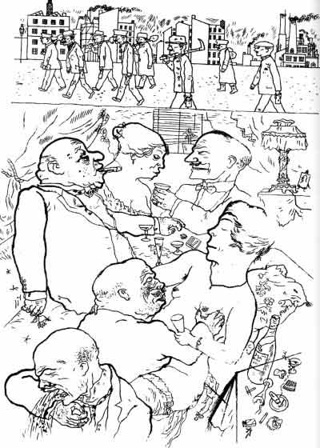
George Grosz Das Gesicht der herrschenden Klasse (Berlin: Malik, 1921)

Slide 7
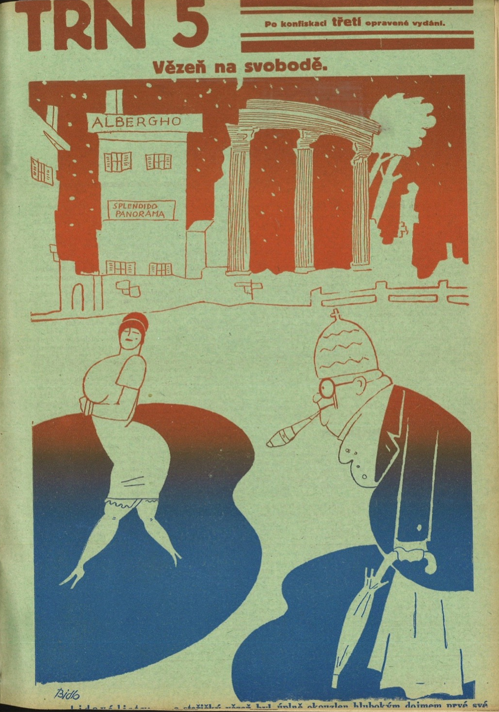
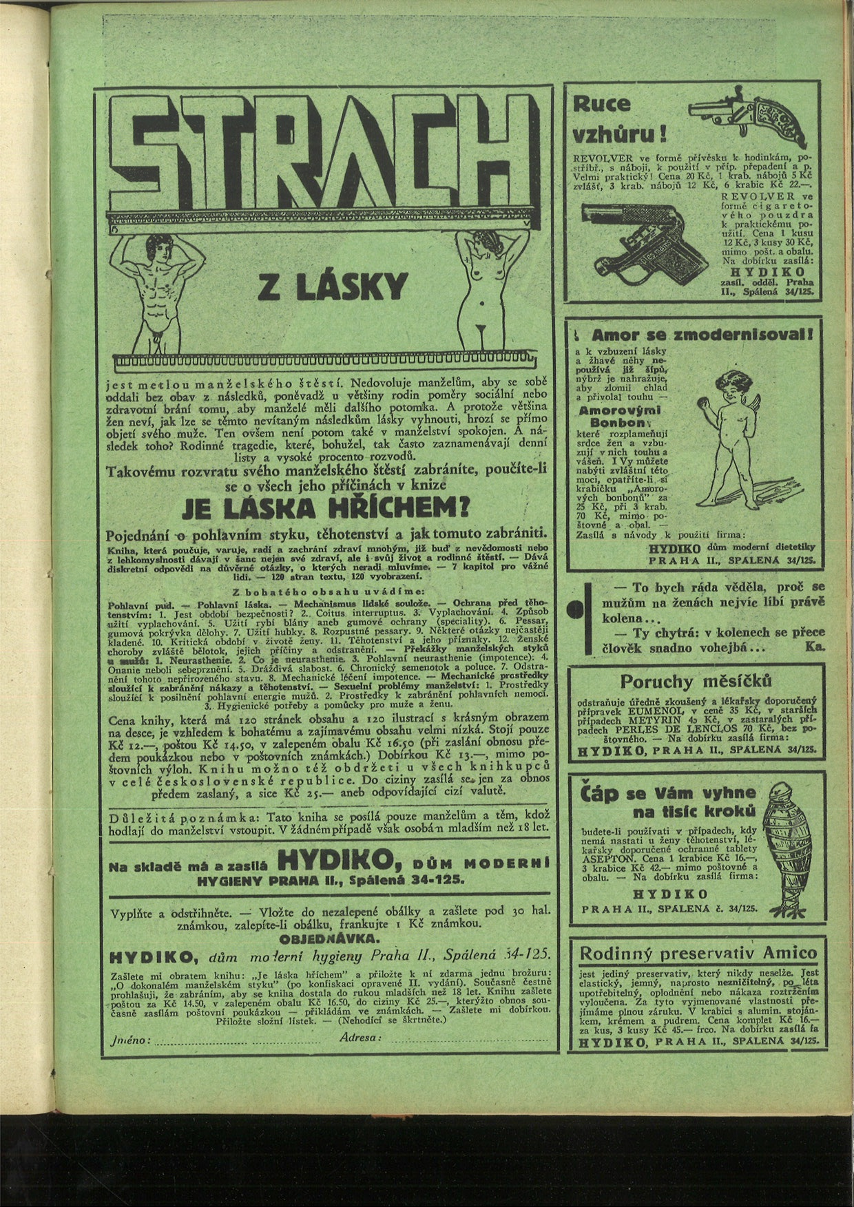
Trn 5:20, (1929)

Slide 8
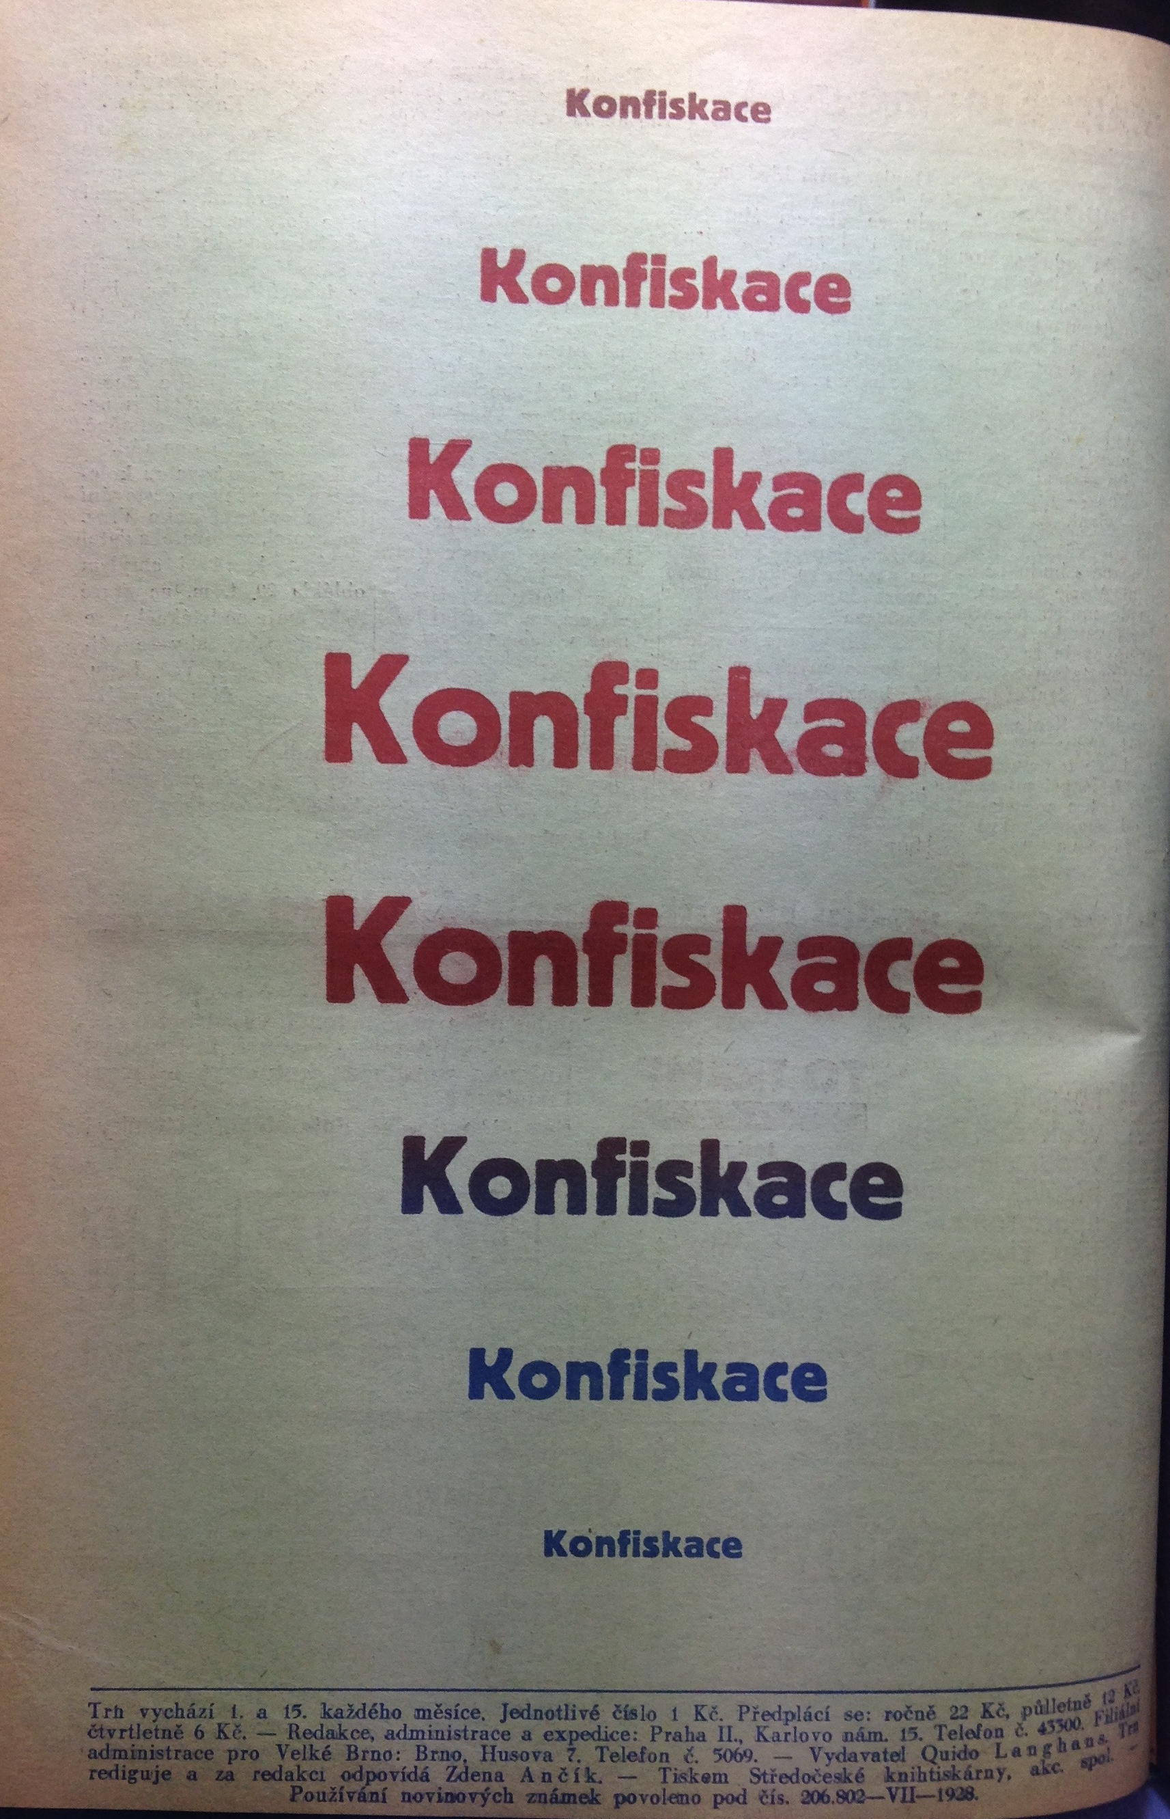
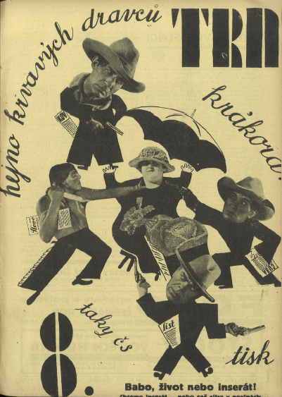
Trn, 5:8 (April 1929)

Slide 9
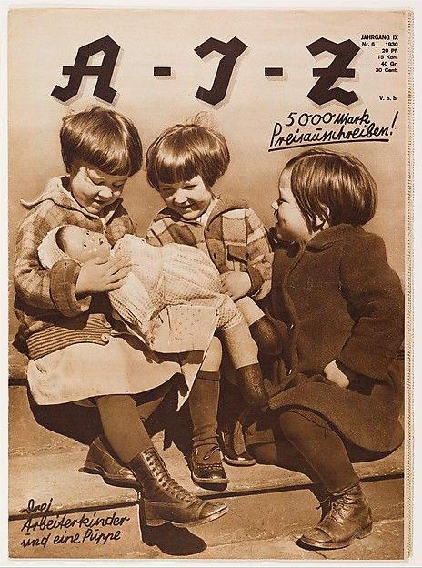
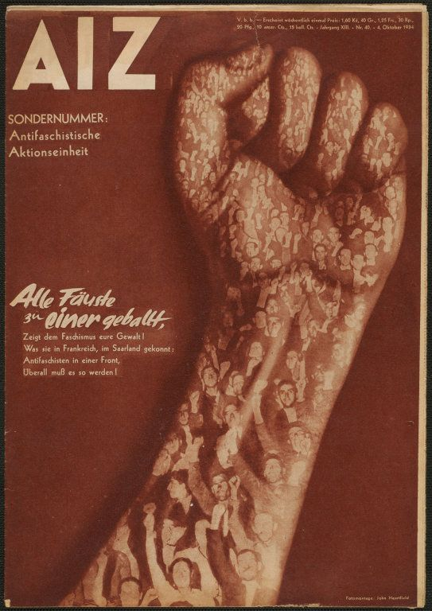
Arbeiter Illustrierte Zeitung, 9:6 (1930).
Arbeiter Illustrierte Zeitung, 13:40 (1934). Photomontage by John Heartfield.

Slide 10
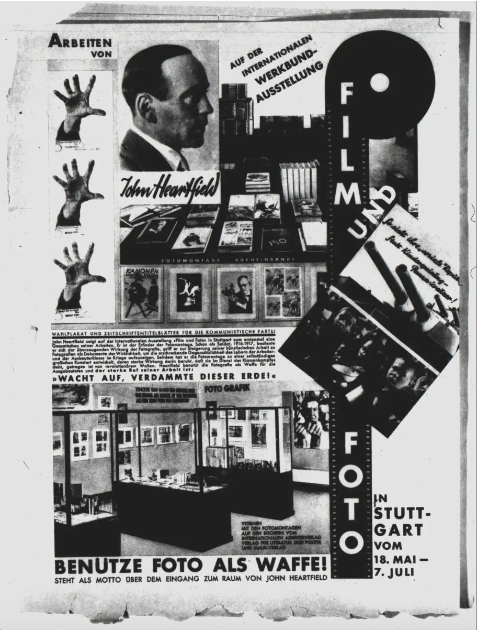
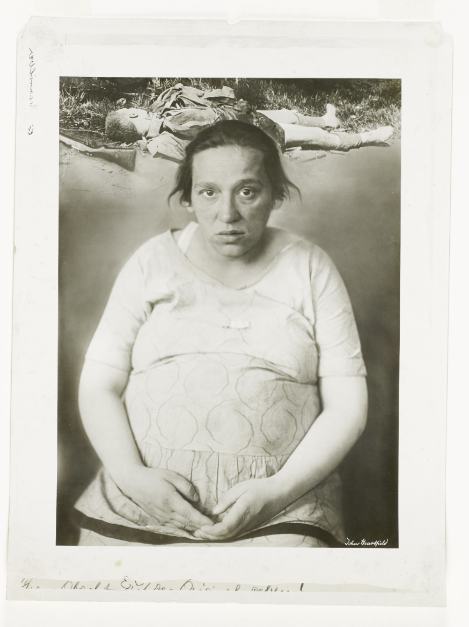
John Heartfield (1891 – 1986)
Zwangslieferantin von Menschenmaterial (Montagefotografie der Fotomontage für die AIZ, 1930, Nr. 10), https://heartfield.adk.de/node/3404

Slide 11
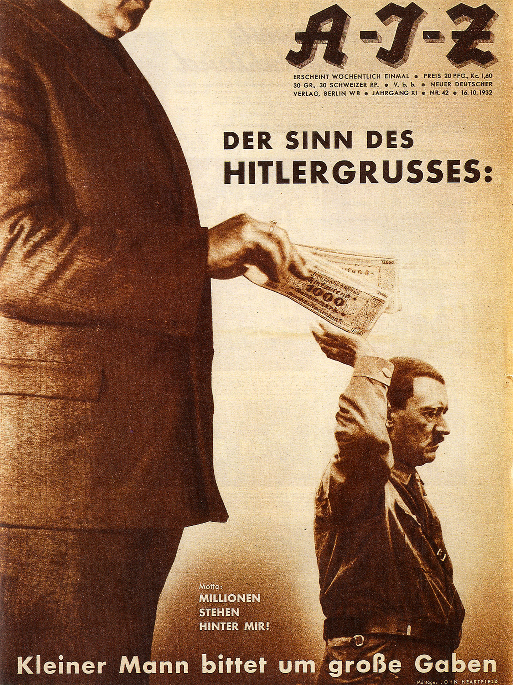
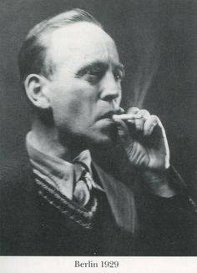
John Heartfield, 1929
Arbeiter Illustrierte Zeitung (AIZ), 16 October 1932, cover by John Heartfield: Der Sinn des Hitlergrußes: Kleiner Mann bittet um große Gaben. Motto: Millionen stehen hinter mir!(The Meaning Behind the Hitler Salute: Little Man Asks for Big Donations. Motto: Millions Stand Behind Me!)

Slide 12
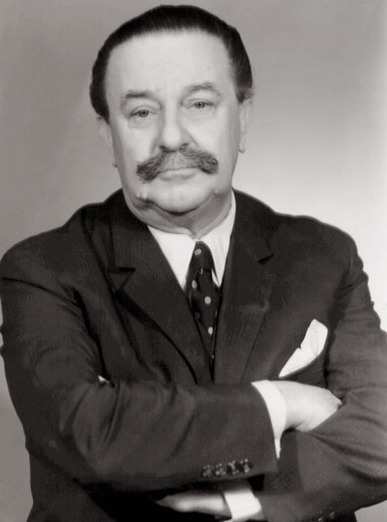
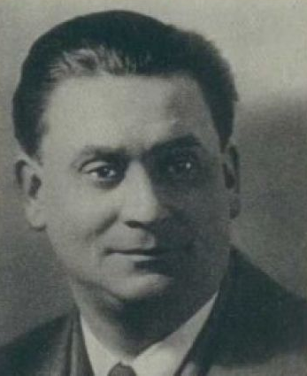
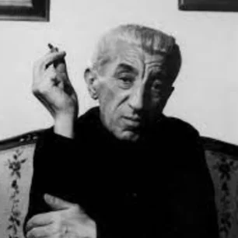
Antonín Pelc
František Bidlo, 1932
Adolf Hoffmeister, 1948

Slide 13
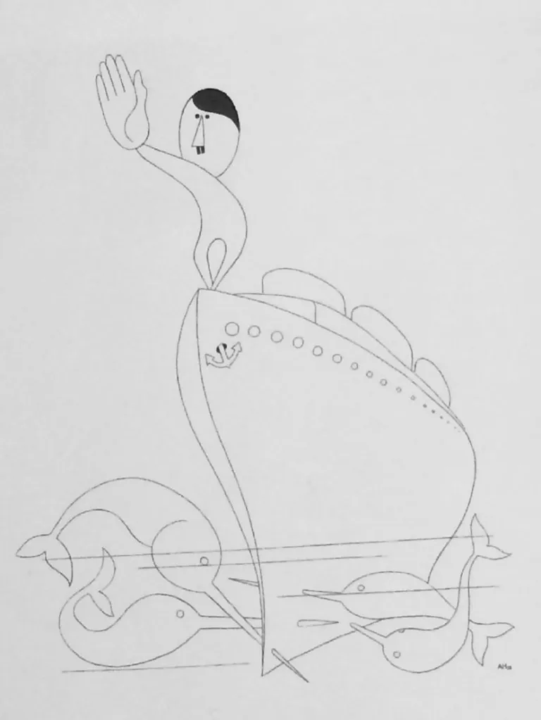
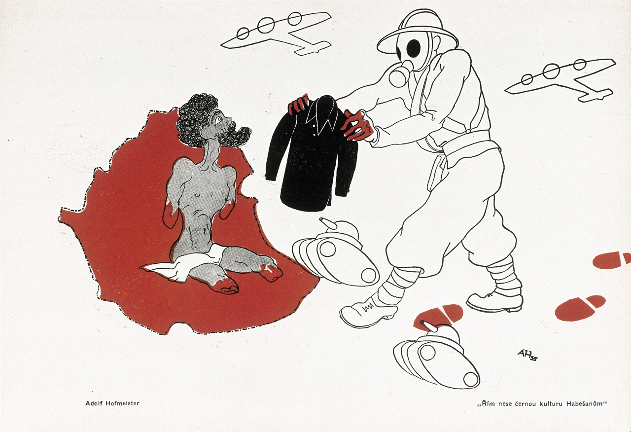
Adolf Hoffmeister, Rome brings black culture to the Abyssinians, 1936
Adolf Hoffmeister, Silently does it, 1933 © Galerie výtvarného uměni v Havlíčkové Brode

Slide 14
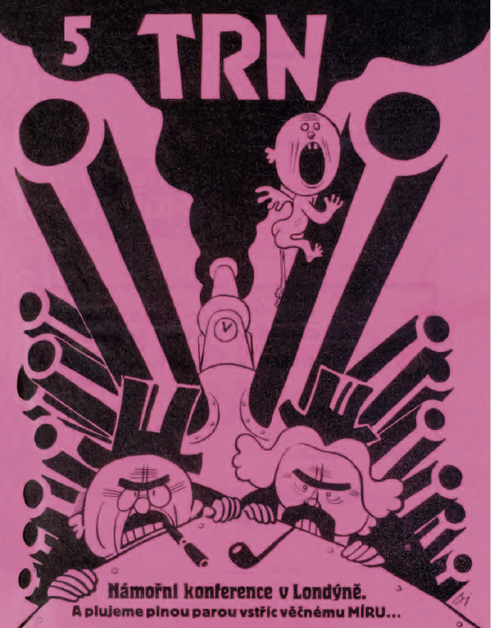
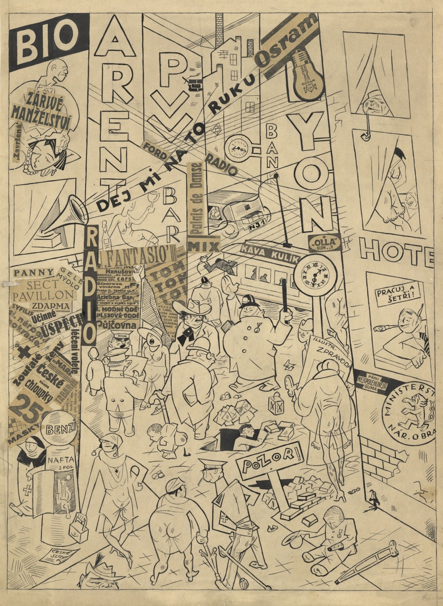
František Bidlo: Vzpomínka na Prahu. Věnováno Georgu Groszovi, 1926

Slide 15
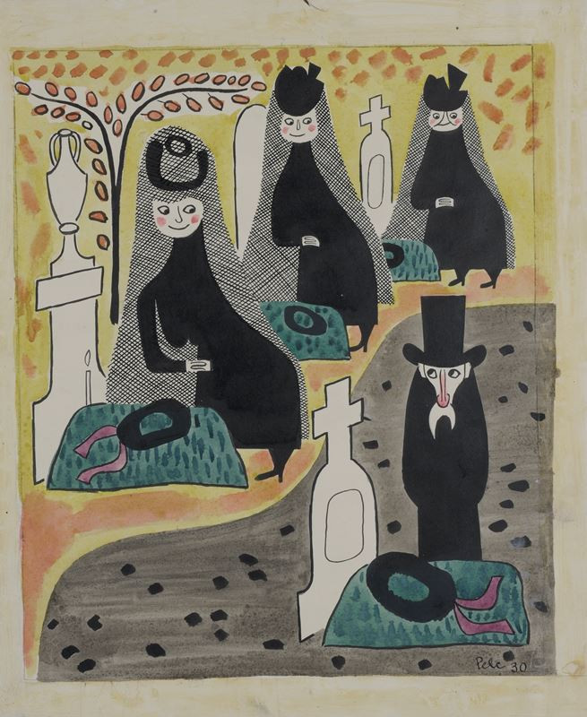
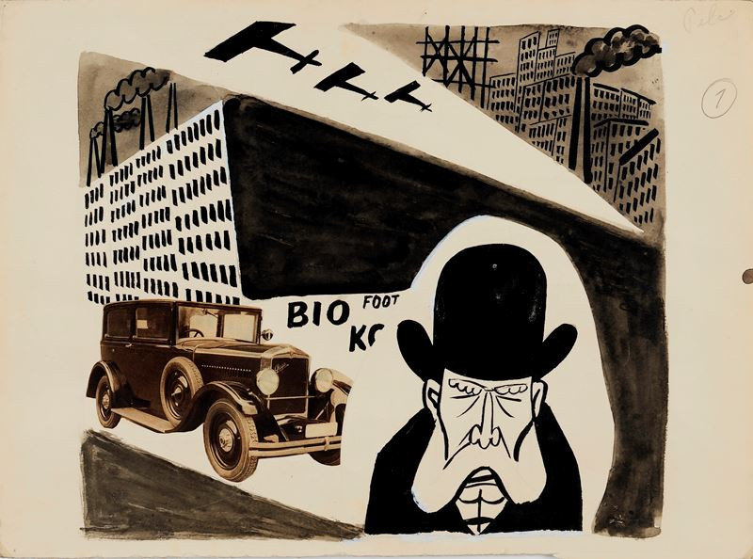
Antonín Pelc, Satirická kresba
Antonín Pelc, At the cemetery, 1930

Slide 16
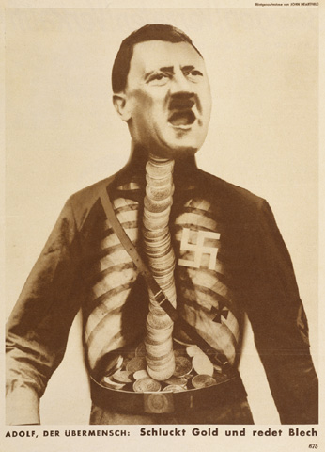
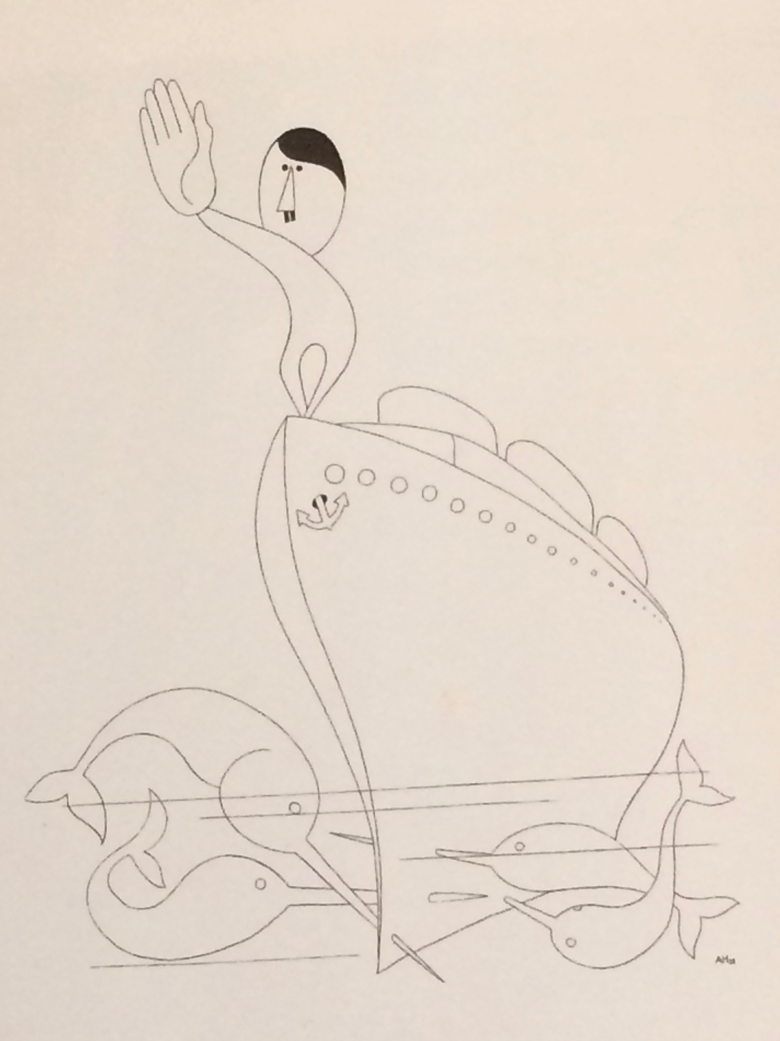
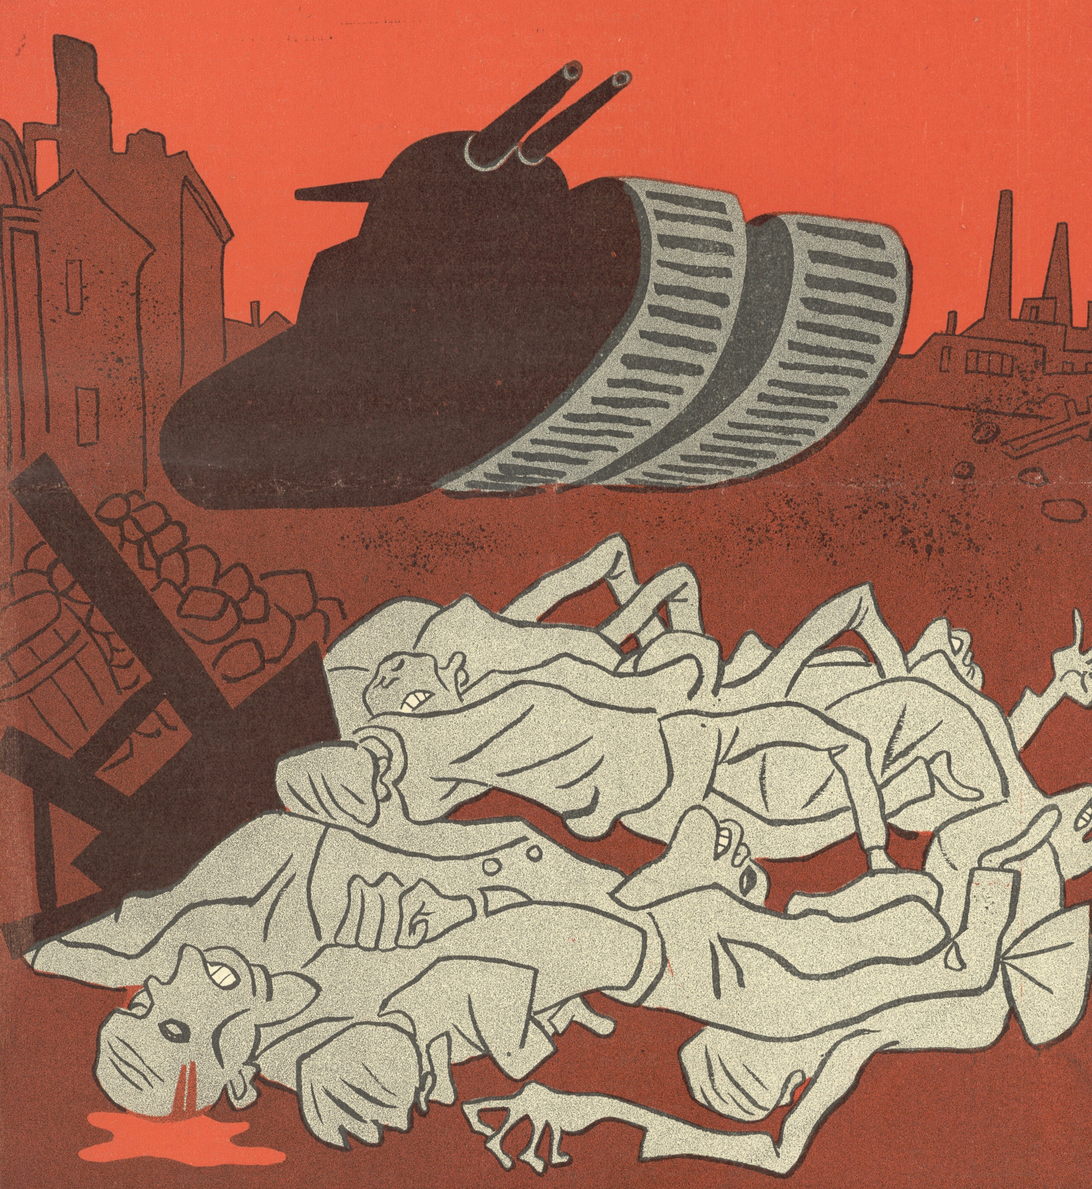
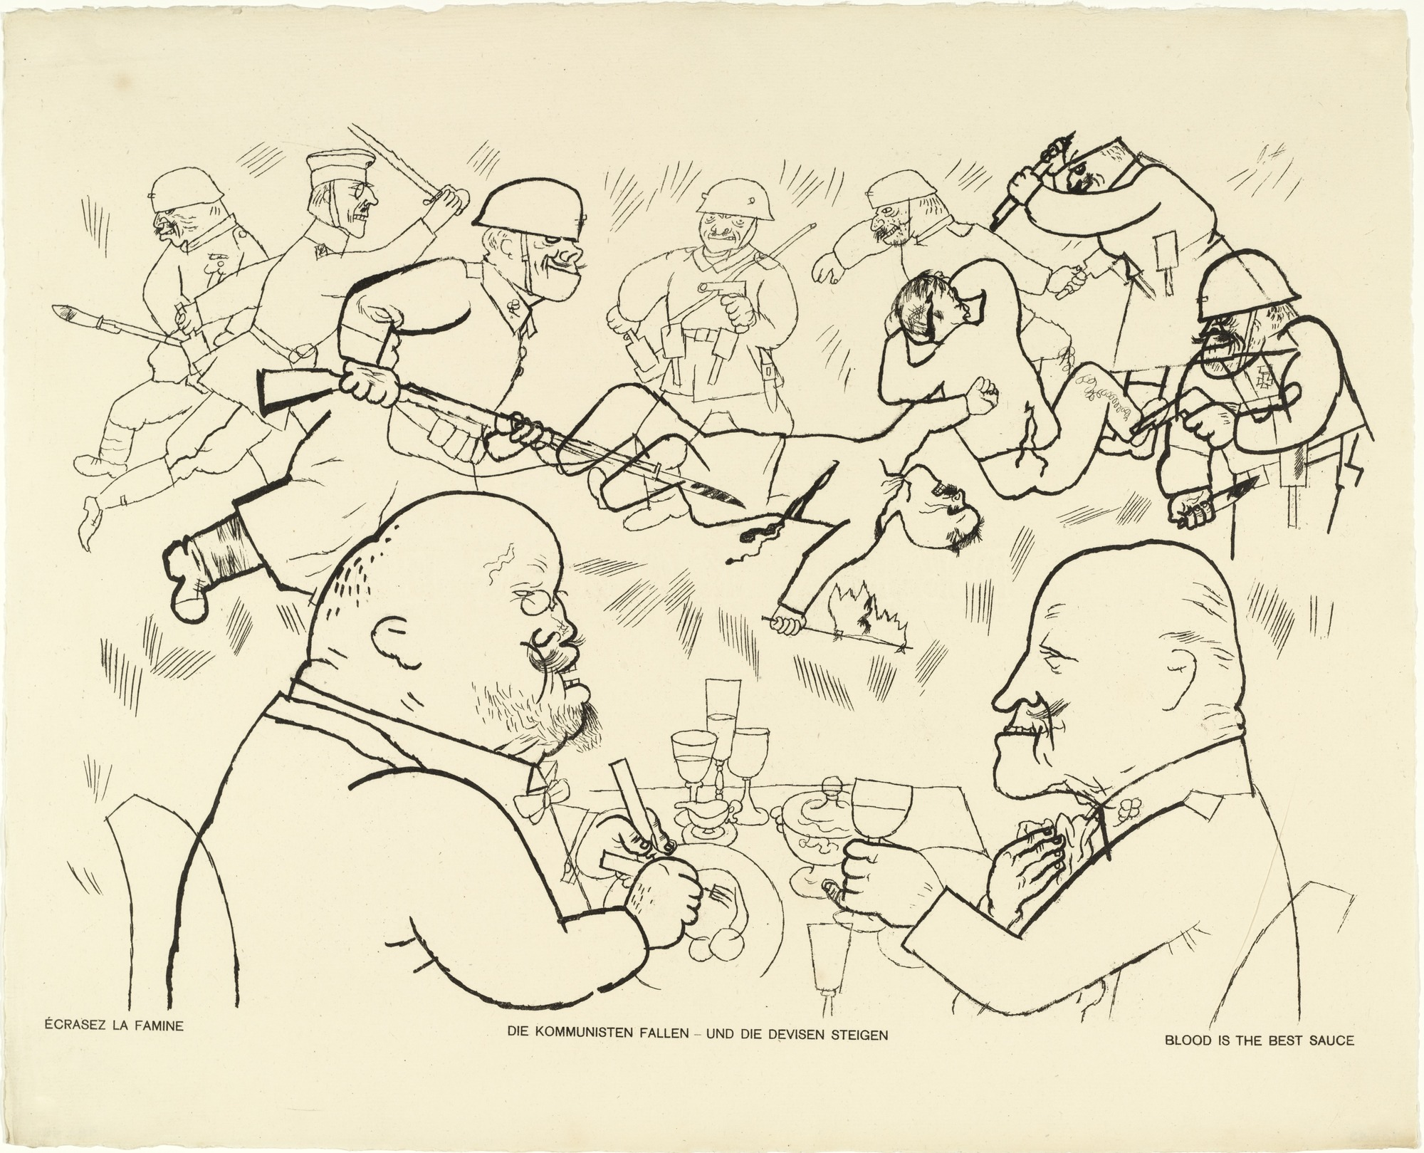
The International Caricature Exhibition
6 April – 6 June 1934
SVU Mánes, Prague
John Heartfield, George Grosz, Adolf Hoffmeister, Antonín Pelc, František Bidlo, Erich Godal, Thomas Theodor Heine, Josef Čapek

Slide 17
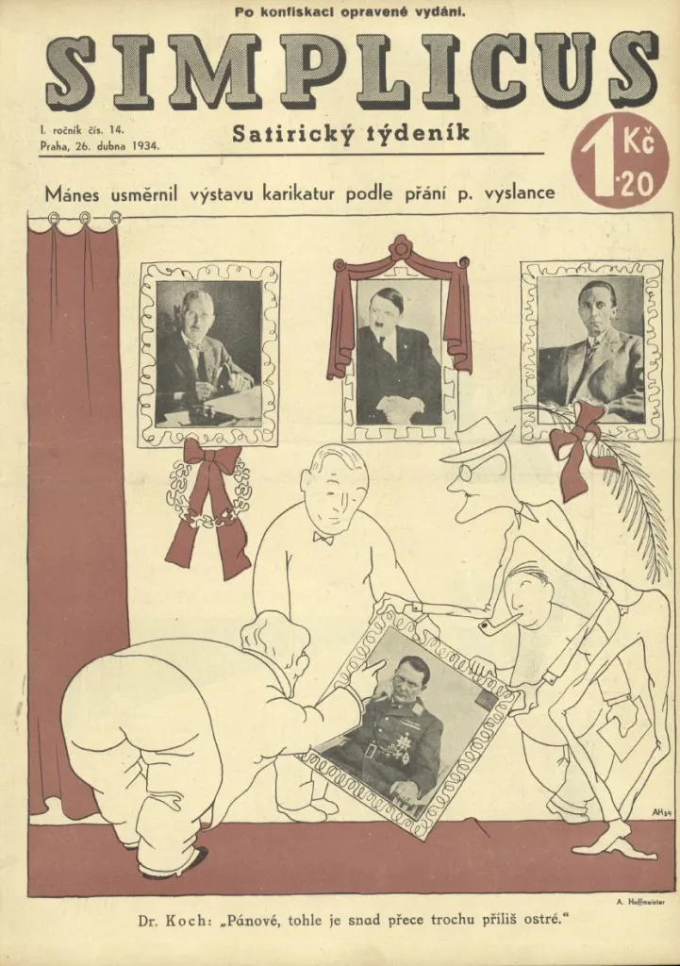
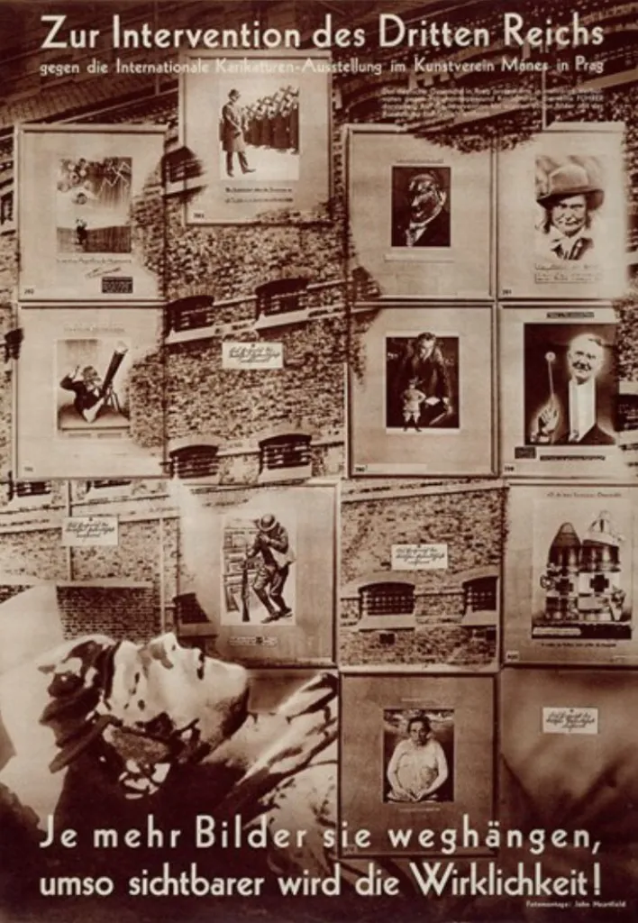
John Heartfield: On the Occasion of the Intervention of the Third Reich,
1934 © David King Collection, Tate Modern
Adolf Hoffmeister: ‘Mánes streamlining the caricature exhibition in accordance with the ambassador’s wishes’, Simplicus, 1:14 (26 April 1934) © Czech National Literature Archives, Prague

Slide 18
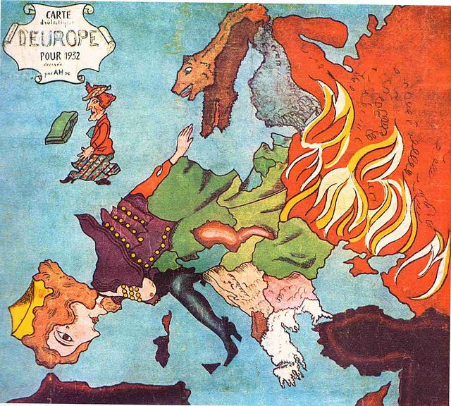
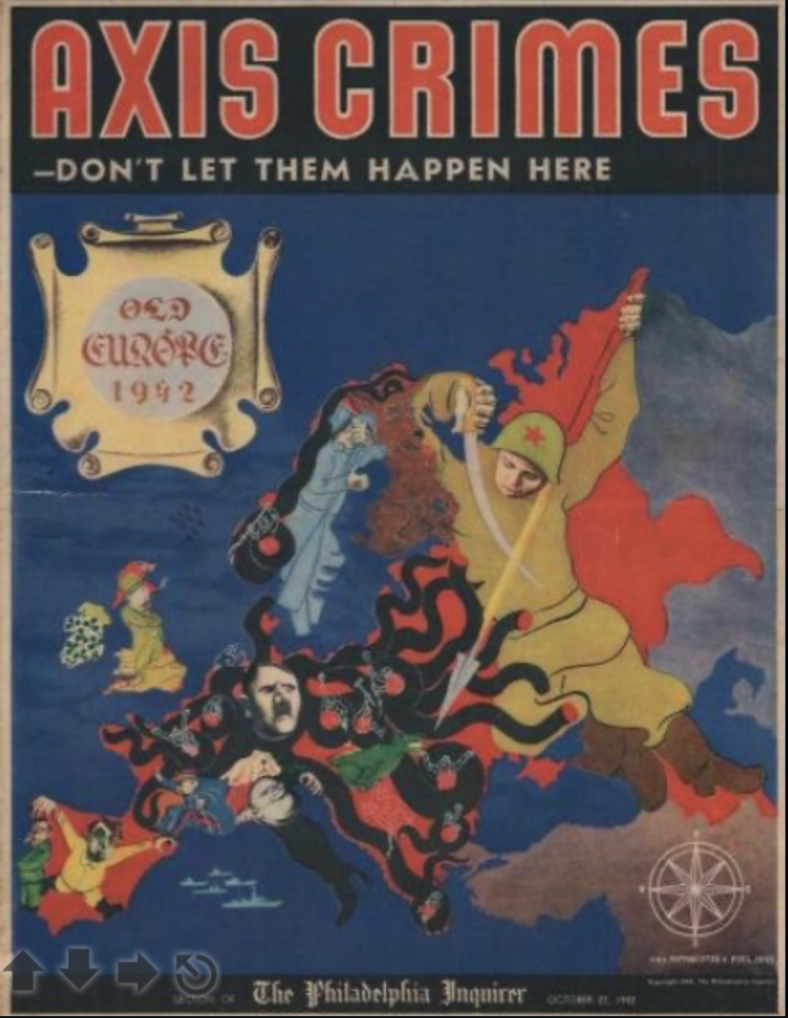
Adolf Hoffmeister -Europa, 1932
Axis Crimes - Don't Let Them Happen Here. Old Europe 1942. 1942 Hoffmeister and Peel (Pelc) Serio-Comic Map of Europe World War II

Slide 19
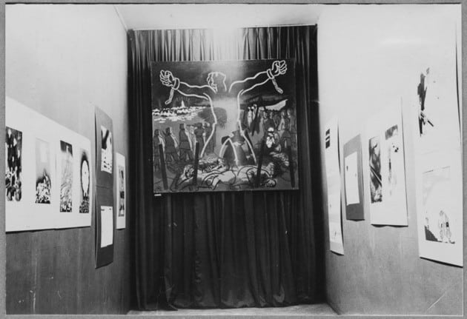
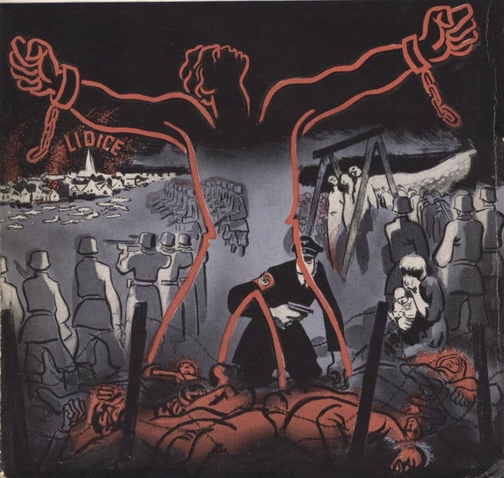
Adolf Hoffmeister and Antonín Pelc at MoMA in 1943
View of the exhibition War Caricatures by Hoffmeister and Peel at The Museum of Modern Art, 1943. The Museum of Modern Art Archives, New York
Antonín Pelc, Lidice, 1943, now missing

Slide 20
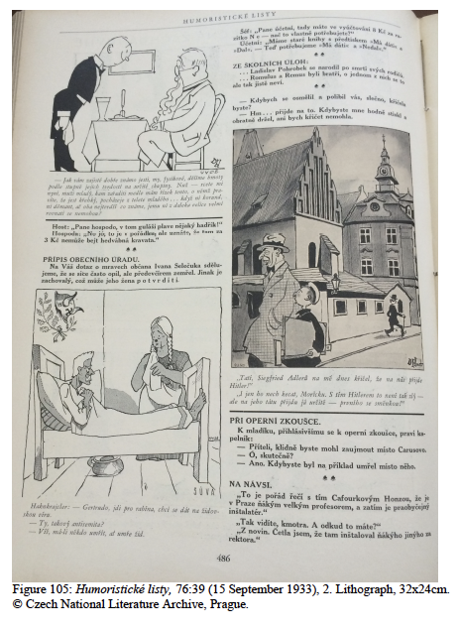
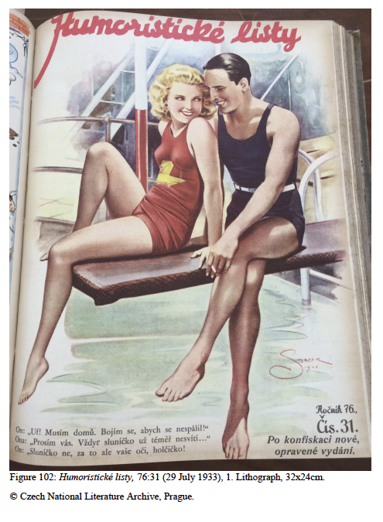
Just “simple entertainment”?

Slide 21
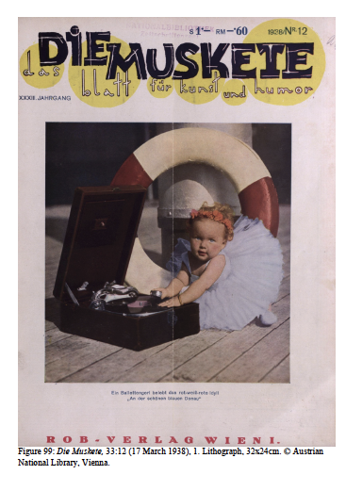
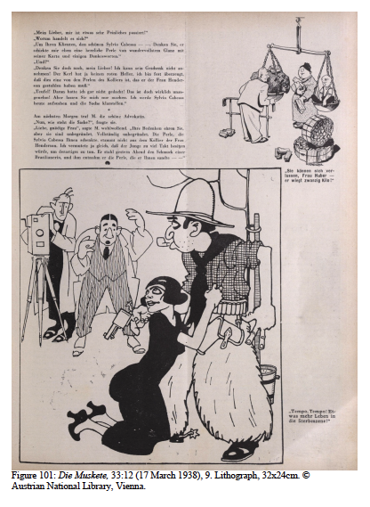
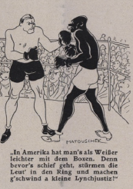

Slide 22
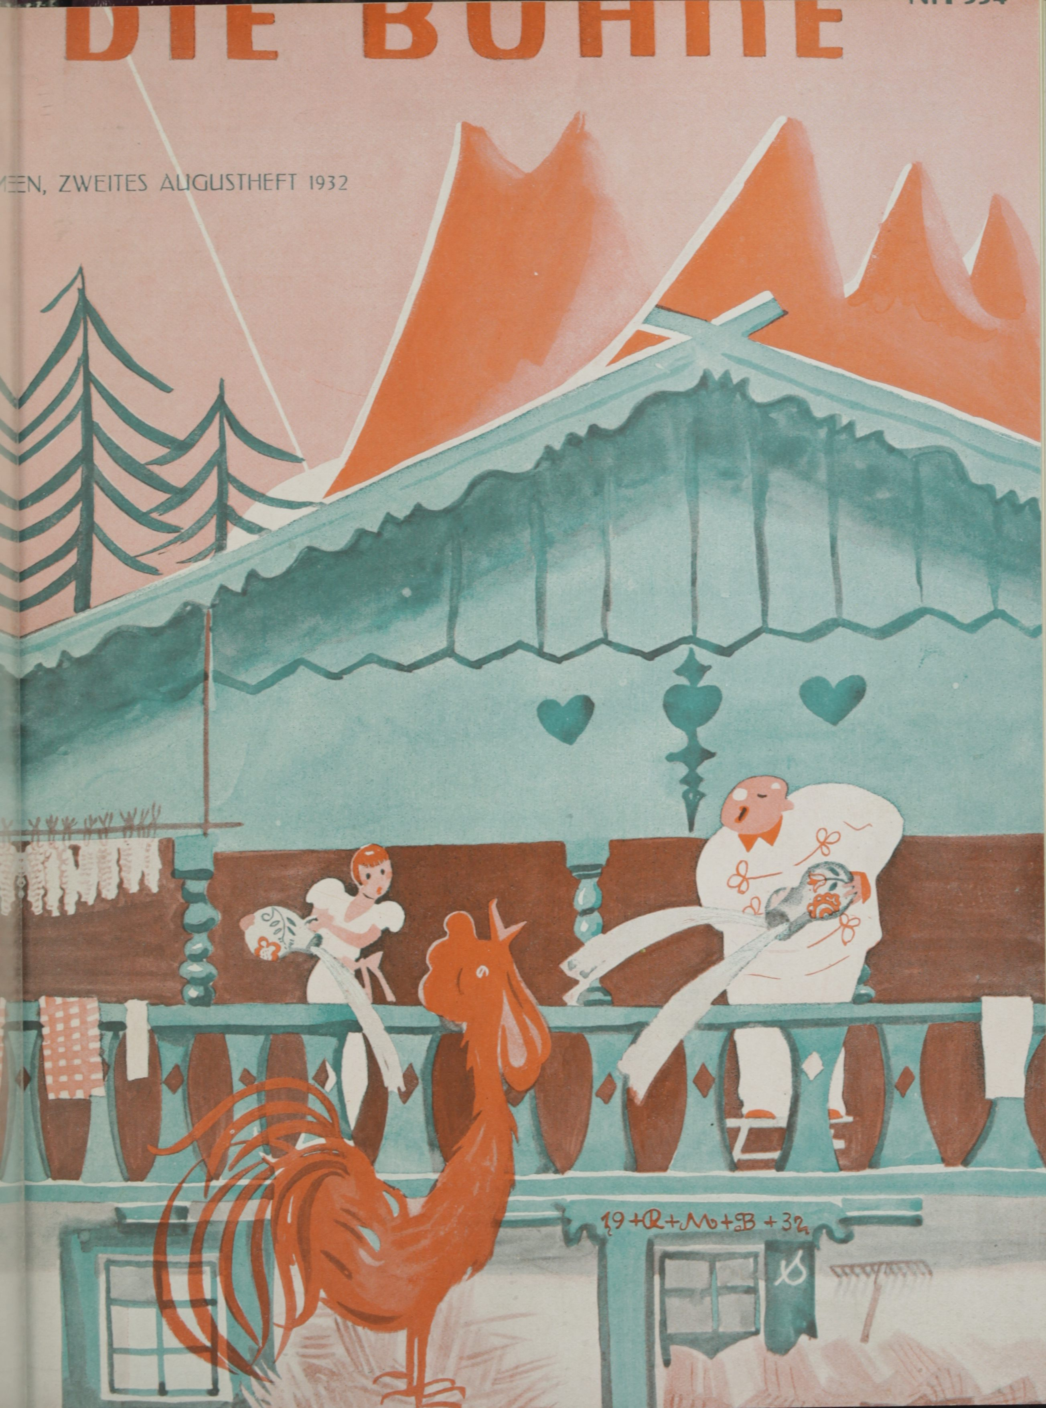
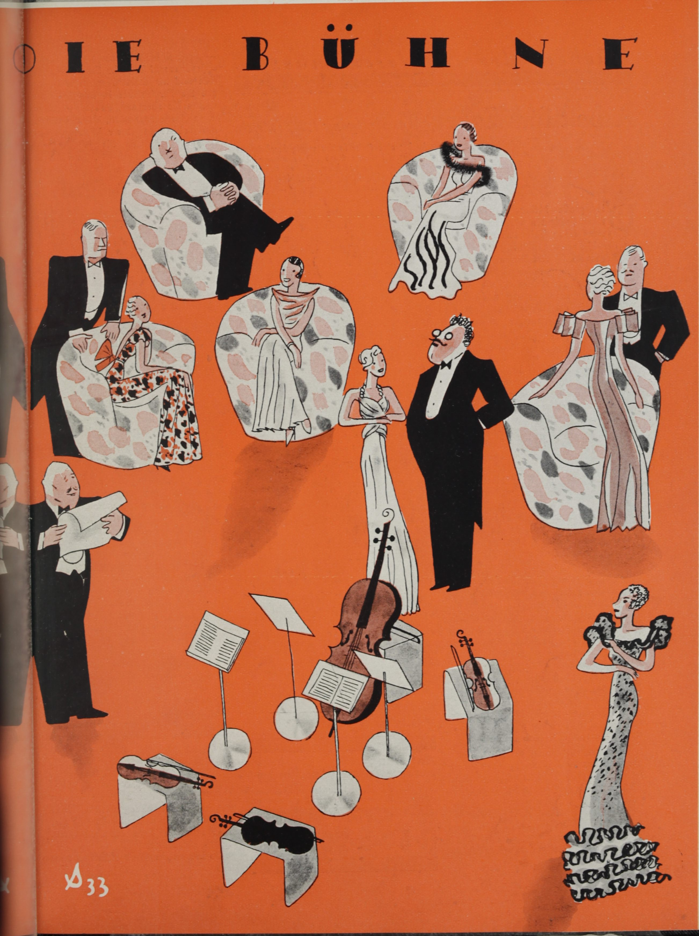
Just “simple entertainment”?
‘…of all kinds of artwork, that which is most familiar to us is the illustrations in our popular magazines. Most people look at the pictures, even if they do not always take time to read the articles.’
Caroline A. Powell, ‘Methods of Magazine Illustration’, The American Woman’s Journal, 7:5
(February 1894), 189.

Slide 23
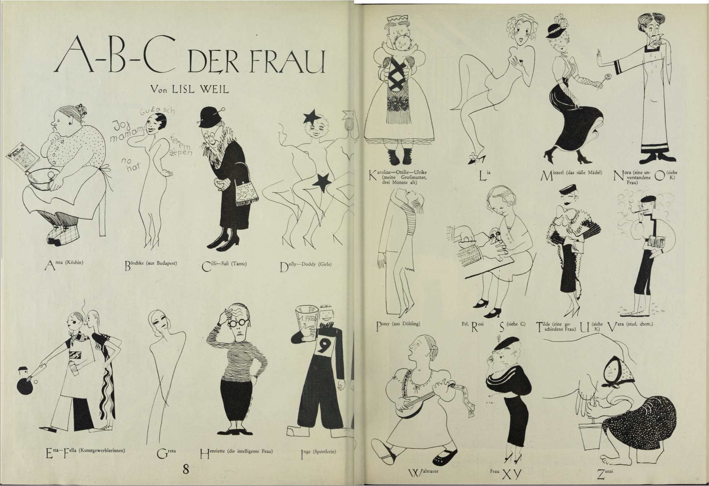
And where are all the women artists?
Lisl Weil, “A-B-C der Frau”, Die Bühne 347 (1933), 10-11

Slide 24
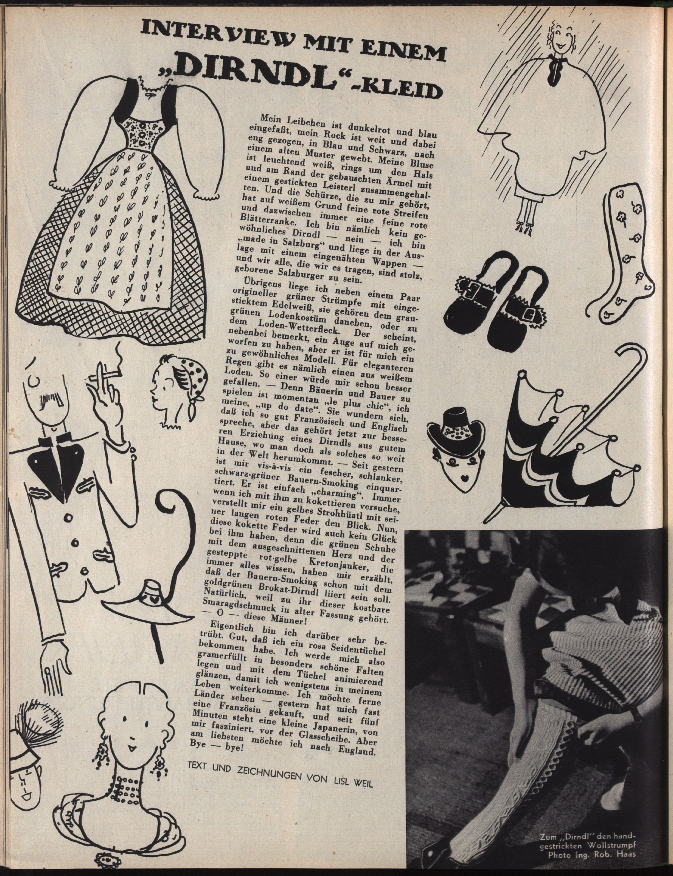
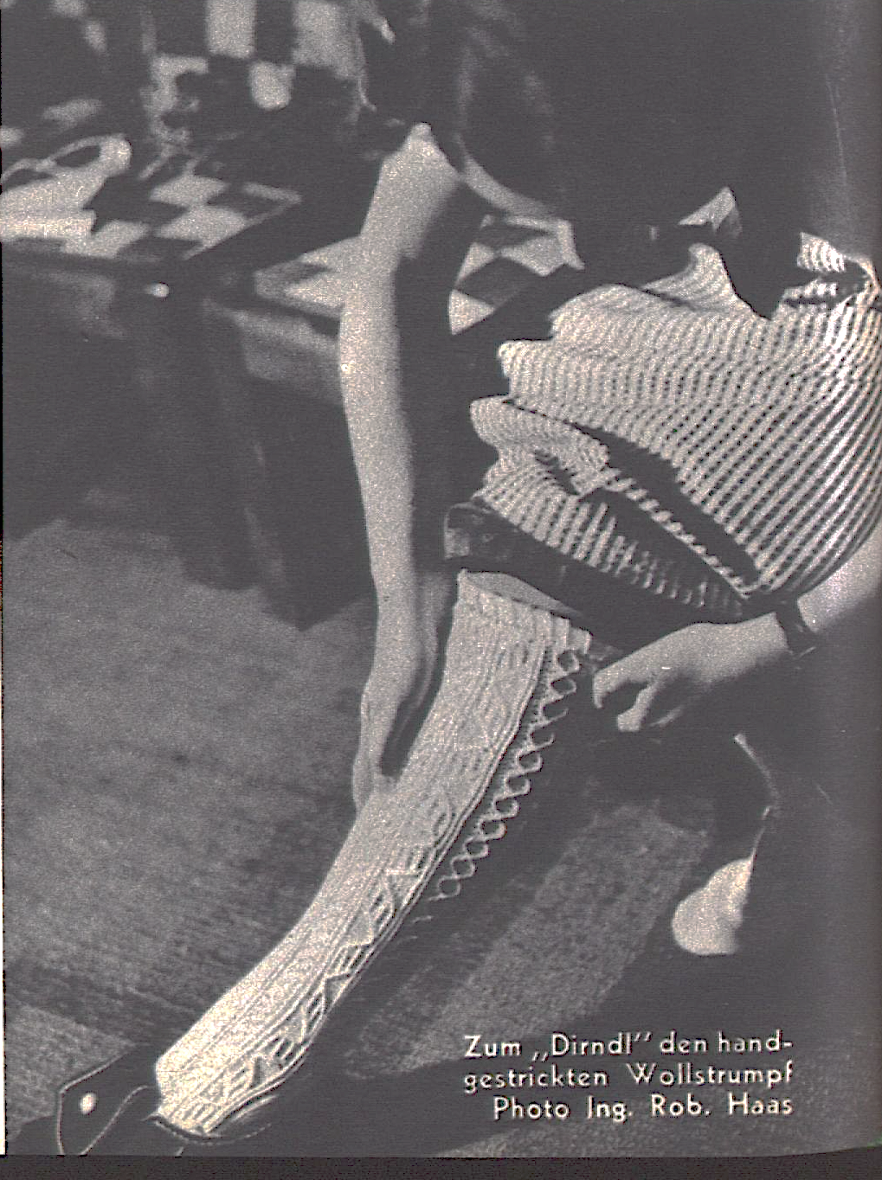
“Interview with a Dirndl dress”
Die Bühne, Heft 453 (1937), 50.

Slide 25
Further reading
Nicholas Sawicki, "The View From Prague: Moderní revue (1894-1925); Volné směry (1896-1949); Umělecký měsíčník (1911-14); Revoluční sborník Devětsil (1922); Život (1922); Disk (1923-5); Pásmo (1924-6); and ReD (1927-31)", in The Oxford Critical and Cultural History of Modernist Magazines, Volume III, Europe 1880-1940, eds. Brooker, Bru, Thacker, and Weikop, Oxford University Press, 2013, pp 1074-1098.
Meghan Forbes, ‘Advertisement as Collaboration in the Central European Avant-Garde Magazines’, post. Notes on art in a global context, https://post.moma.org/advertisement-as-collaboration-in-the-central-european-avant-garde-magazines-2/
Anna Pravdová, ‘Parts 1 and 2: Anti-Fascist Caricatures by Adolf Hoffmeister and Antonín Pelc at MoMA in 1943’, post. Notes on art in a global context, https://post.moma.org/part-1-anti-fascist-caricatures-by-adolf-hoffmeister-and-antonin-pelc-at-moma-in-1943/

