Slide 1
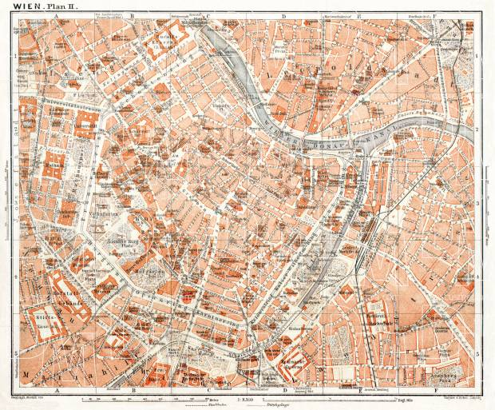
Our Trip to Vienna
Wednesday, 15 November 2023

Slide 2
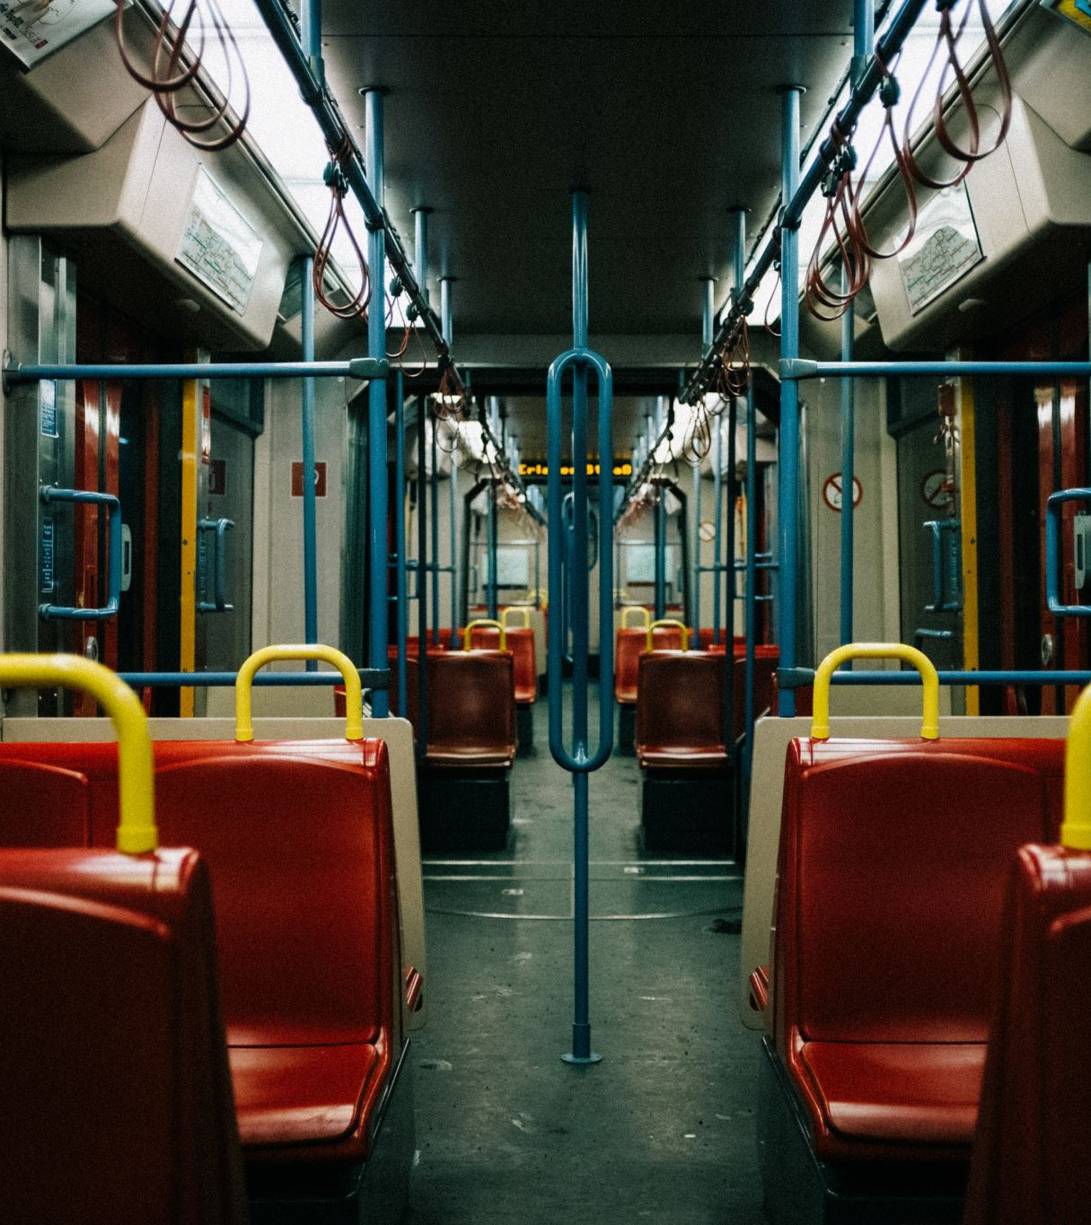
There & back
TO GET THERE: 8.48 from Brno to Wien Hauptbahnhof
TO COME BACK: 17.36 from Wien Hauptbahnhof to Brno (both with RegioHet)
BRING YOUR ISIC Card
We will buy metro/tram tickets once we are in Vienna

Slide 3
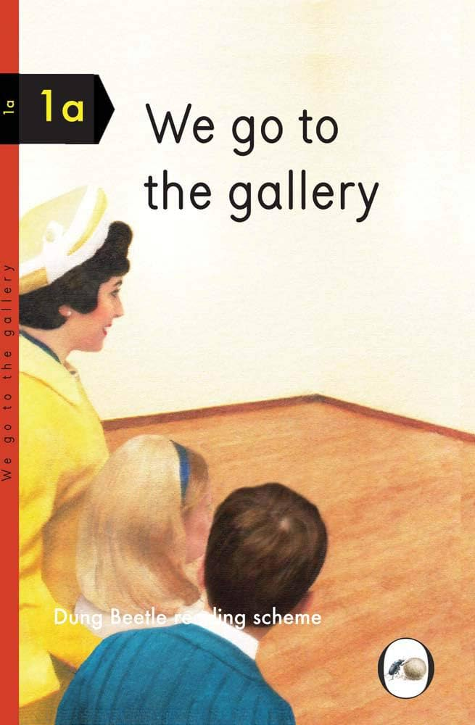
Where will we go? When will we be there?
11.00: The Museum of the Applied Arts – MAK
LUNCH
13.30: Jewish Museum (Dorotheergasse)
COFFEE
16.00: Universitätsgalerie der Angewandten im Heiligenkreuzerhof

Slide 4
MAK – Museum of the Applied Arts
https://www.mak.at/en/program/exhibitions/vienna_1900_1
We will see the permanent collection with a focus on the first half of the twentieth century

Slide 5
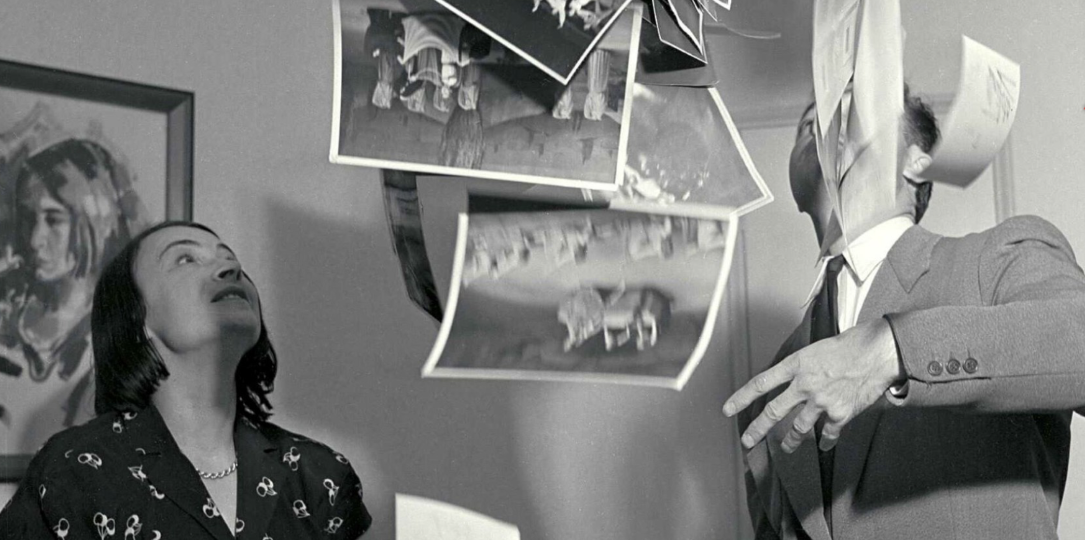
The Jewish Museum
We will see the exhibition Focus! Click! Maria Austria - Photographer in Exile
https://www.jmw.at/en/exhibitions/maria_austria

Slide 6
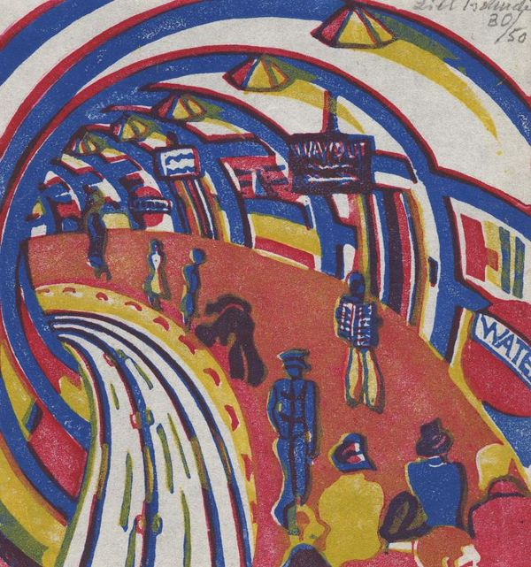
Universitätsgalerie der Angewandten im Heiligenkreuzerhof
We will have a guided tour of the exhibition Lill Tschudi – Franz Čižek. A delightful sort of game with curator Stefanie Kitzberger
https://www.dieangewandte.at/aktuell/ausstellungen/ausstellungen_detail?artikel_id=1689043337156

Slide 7
Contact
Julia: +43 660 759 6700
Marta: +420 608 469 703

