Slide 1

Filmmaking practice and training in the virtual age

Slide 2
Teaching and training approach
“teaching creativity involves teaching and assessing the methods, evaluation expertise and mindset of an artist” Cindy Foley (TEDx Talks, 2014)
Craft skills & transferable skills
Analytical and critical thinking
Team-work and collaborative creative vision
Self-directed learning
Notes:
Ownership of their own learning and to enable them to actively explore and discover workflows and creative approaches.

Slide 3
Teaching and training methodologies
Praxis & WBL (co-constructivism)
Evidence-based learning
Community of practice
Ongoing peer- and tutor- feedback
Assessment-as-learning
Notes:
Ownership of their own learning and to enable them to actively explore and discover workflows and creative approaches.

Slide 4
Film-making practice and training in the virtual age
Established practice: Production and Departments

Slide 5
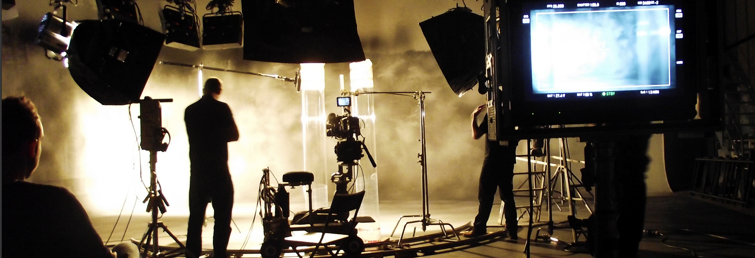
HOW ARE
FILMS MADE?

Slide 6
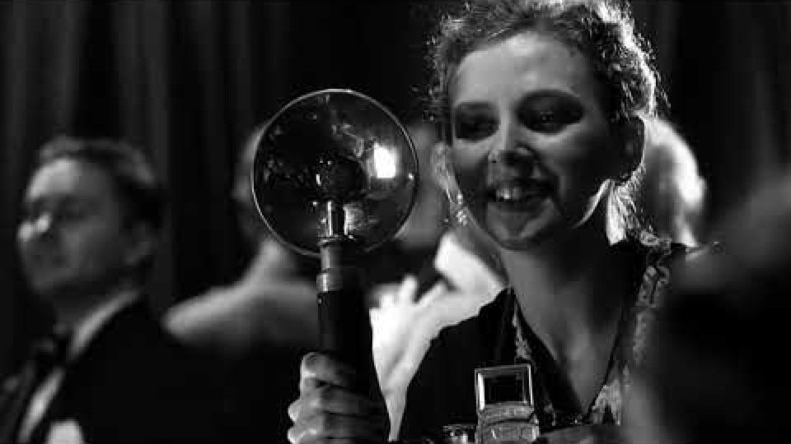

Slide 7
5 ‘STANDARD’ STAGES OF
MAKING A FILM:
DEVELOPMENT
PREPRODUCTION
PRODUCTION
POSTPRODUCTION
DISTRIBUTION

Slide 8

DEVELOPMENT
3 KEY STEPS:
Develop story
Develop script
Secure funding
Aka development hell!

Slide 9
PRE-PRODUCTION
6 KEY STEPS:
Fill key crew positions
Script breakdown
Casting
Secure locations
Production design
Schedule / plan

Slide 10
PRODUCTION
Principle Photography
Second Unit?
(Reshoots?)
Production stills…

Slide 11

POST-PRODUCTION
Editing
VFX
(Pick-ups?)
ADR, Foley, Music
Sound Design/Mix
Colour Grading
Mastering

Slide 12

DISTRIBUTION
Promotion / publicity
Festivals / Film Markets
Sales / Licensing
Distribution (windows)
Localisation

Slide 13
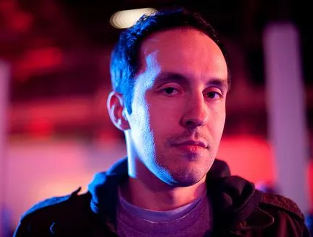
Ben Fritz _
The Big Picture: The fight for the future of movies
https://cheddar.com/media/hollywoods-new-age-of-entertainment-and-the-future-of-movies
Fritz, B (2019) The big picture: the fight for the future of movies. Harper Business
Notes:
BEN FRITZ is an editor for the Wall Street Journal. He previously covered Hollywood for the Journal, the Los Angeles Times and Variety and is coauthor of the best-selling All the President's Spin. A graduate of Swarthmore College, he lives in Los Angeles.
Winner of the Best Non-Fiction Book Prize at the 2018 National Arts & Entertainment Journalism Awards

Slide 14
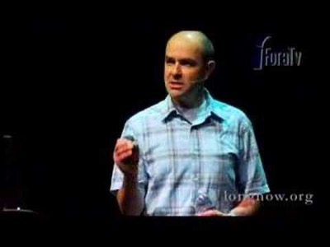
Chris Anderson
“The long tail” (2005)
niche/diverse content not limited by theatrical release scarcity
https://youtu.be/0Yku0GTrcuw?t=153
Anderson, C. (2014) The Long Tail: Why the future of Business is selling less of more. New York: Hachette.
Notes:
‘The Long Tail’ describes the retailing strategy of marketing a large number of different items which each sell in relatively small quantities, usually in addition to selling large quantities of a small number of popular items
Inthemostimportantbusinessbooksince The Tipping Point, Chris Anderson shows how the future of commerce and culture isn’t in hits, the high-volume head of a traditional demand curve, but in what used to be regarded as misses – the endlessly long tail of that same curve. Financial Times

Slide 15
Audience: research and analytics
BFI reports example
Notes:
Money is ready to spend. Key crew positions filled

Slide 16
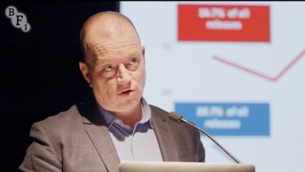
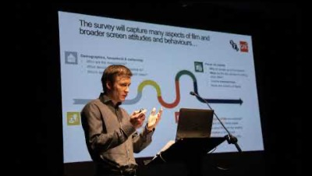
Audience research and analytics
https://www.bfi.org.uk/industry-data-insights/reports
https://www.filmcenter.cz/en/our-activities/projects-presentations
Notes:
Money is ready to spend. Key crew positions filled

Slide 17
Audience research and analytics
https://www.bfi.org.uk/industry-data-insights/reports
https://www.filmcenter.cz/en/our-activities/projects-presentations
Notes:
Money is ready to spend. Key crew positions filled

Slide 18
DEPARTMENTS & ROLES
ON A FILM

Slide 19
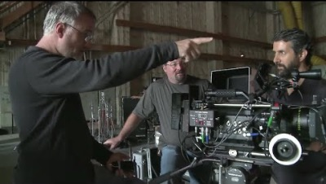
Identify the roles
https://youtu.be/cP9BrtvBIY0?t=2934
Notes:
https://www.youtube.com/watch?v=cP9BrtvBIY0&t=107s
Social network behind the scenes
https://www.youtube.com/watch?v=cP9BrtvBIY0&t=107s
Skillset clip - https://www.youtube.com/watch?v=lsBIR8aN3Ho

Slide 20
ABOVE THE
LINE
BELOW THE
LINE
Executive Producer
Producer
Director
Screenwriter
Principal Cast
Everyone else!
Notes:
Above the line refers to the positions of high importance – those on top of the hierarchy who have a lot of authority on a film set. Historically, this was done to separate the budget for these roles before a film was made from a separate budget that was created for the actual production.
The below the line crew are often viewed as being more expendable to the production and can be replaced more easily,if need be. They’re typically hired only after a film or video has been given the green light. And although they’re responsible for a majority of the day-to-day heavy lifting on a project, they typically only work in one or two phases of a film.

Slide 21
Below the line…(Production)
Production Office/Department
Camera Department
Lighting/Electrical Department
Grip Department
Art department
Makeup Department
Wardrobe Department
Location Department
Notes:
There are others, like script dpt

Slide 22
Production Structure
Transportation, Catering, Medical, Publicity, Accommodation, etc.
SPECIALIST DEPARTMENTS
Stunts, Wranglers, Armourers, Choreograhers, Voice Coaches, etc.
PRODUCTION DEPARTMENT
Line Producer/Production Manager
Production Coordinator
Production Secretary
Location Manager
Accountant
Runner
MAKE UP/HAIR
Make-up Supervisor
Make-up Dailes
Hairdresser
Prosthetics
CAMERA
Director of Photography
Focus Puller
Camera Assistant
DIT / Data Wrangler
DIRECTORS
1st Assistant Director
2nd Assistant Director
3rd Assistant Director
Continuity
Casting
SOUND
Sound Mixer
Boom Operators
ART DEPARTMENT
Production Designer
Art Director
Art Assistants
Draughtsman
GRIPS
Key Grip
Grip Assistants (subdivided)
CONSTRUCTION
Construction Manager
Carpenters, Riggers, Painters, etc
ELECTRICAL
Gaffer
Best Boy
Electricians (sparks)
Rigger
SET DRESSING & PROPS
Set Dressers
Props Master/Props Buyer
Standby Dressers
Standby Props
COSTUMES
Costume Designer
Costume Supervisor
Costume Dailies

Slide 23
Post
POST PRODUCTION SUPERVISOR
SOUND
Sound Editor/Designer
Dialogue Editor
Foley and Effects
Composer/Music Editor
Sound Mixer
PICTURE
Editor
Assistant Editor
VFX Supervisor
VFX Technicians
Colourist
Online Editor

