Slide 1

VISUAL NARRATIVE
SCRIPT BREAKDOWN

Slide 2
Yorke’s 10 questions
Whose story is it?
What does the character need?
(what is their flaw? what do they need to learn?)
What is the inciting incident?
What does the character want?
What obstacles are in the character’s way?
What’s at stake?
Why should we care?
What do they learn?
How and why?
How does it end?
Notes:
Features – any examples of a non 3 act feature that worked well? What memorable shorts have you seen?

Slide 3
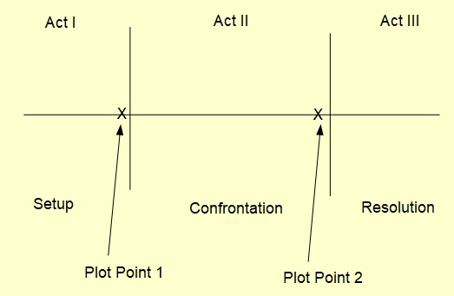
Plot development
(Syd Field)

Slide 4
Notes:
Index cards for film idea

Slide 5
SCRIPT
Narrative structure
Formatting / Tech doc

Slide 6
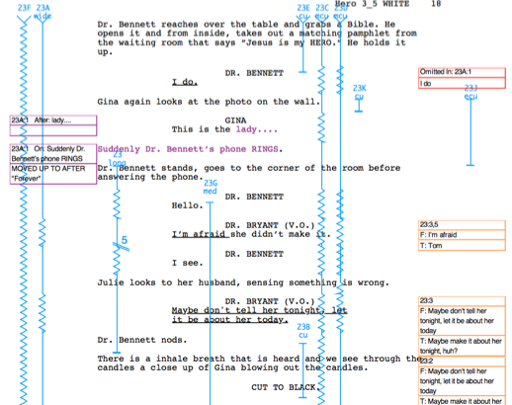
Marked-up Script (lined script)
© 2012 Barbara Abelar

Slide 7
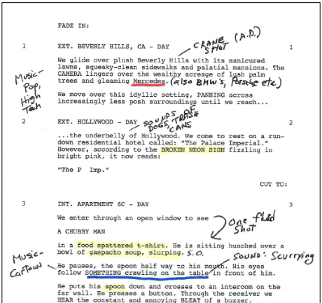
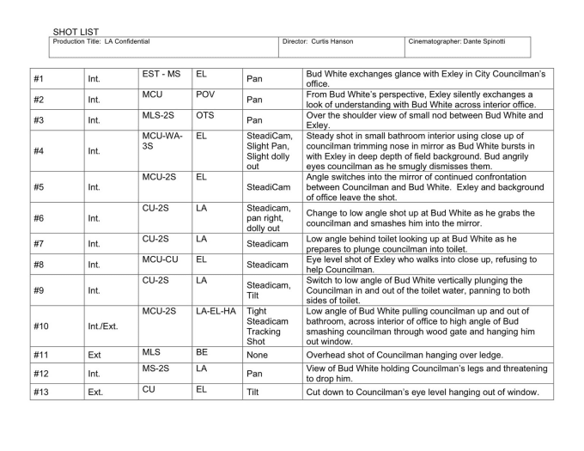
SCRIPT BREAKDOWN / SHOT LIST
Notes:
https://scriptsuper.wordpress.com/2013/04/09/directors-homework/

Slide 8
Shooting Schedule
Usually by 1st AD
Reported to PM

Slide 9
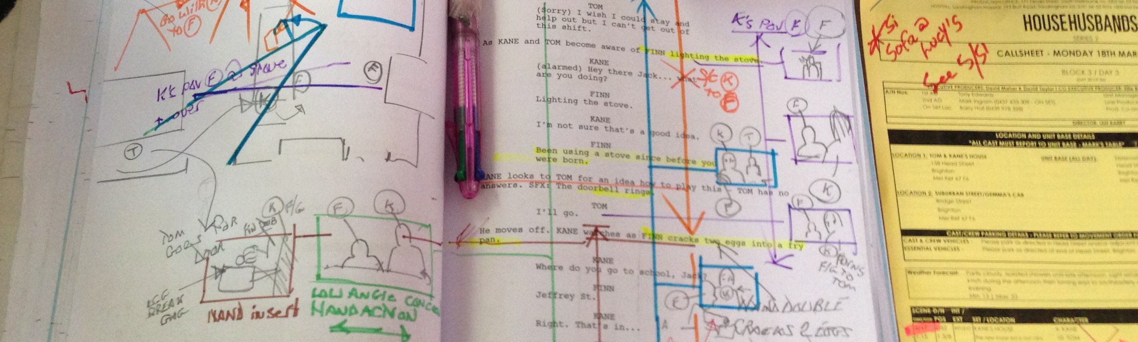
Director’s Homework

Slide 10
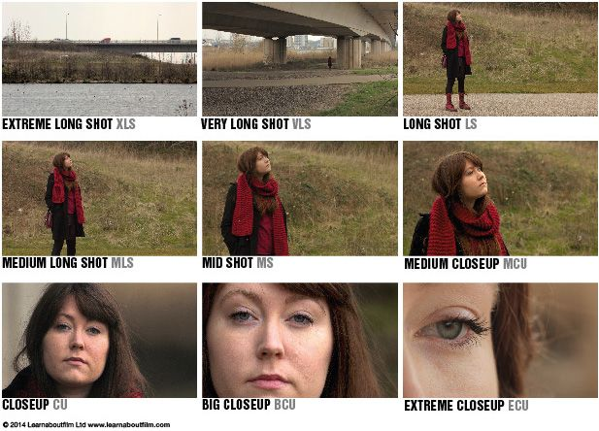
Shots & framing

Slide 11
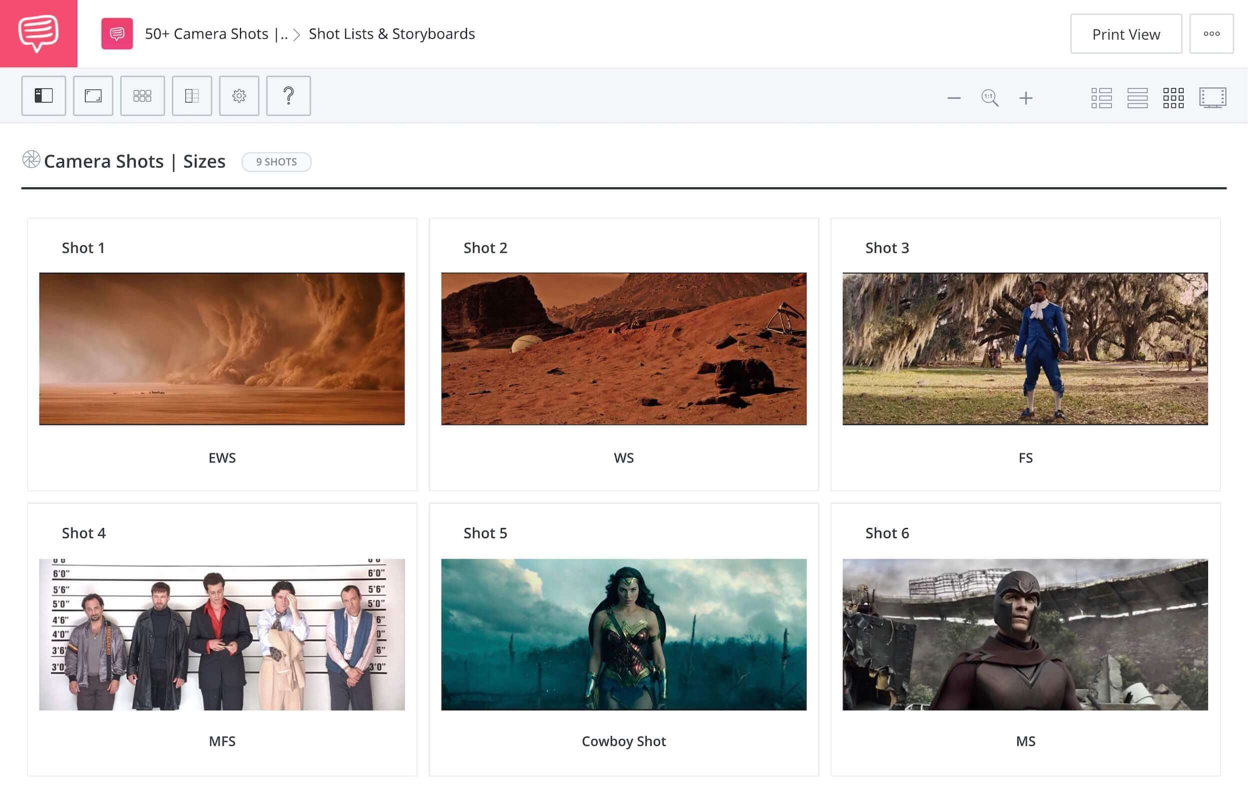
Shots & framing

Slide 12
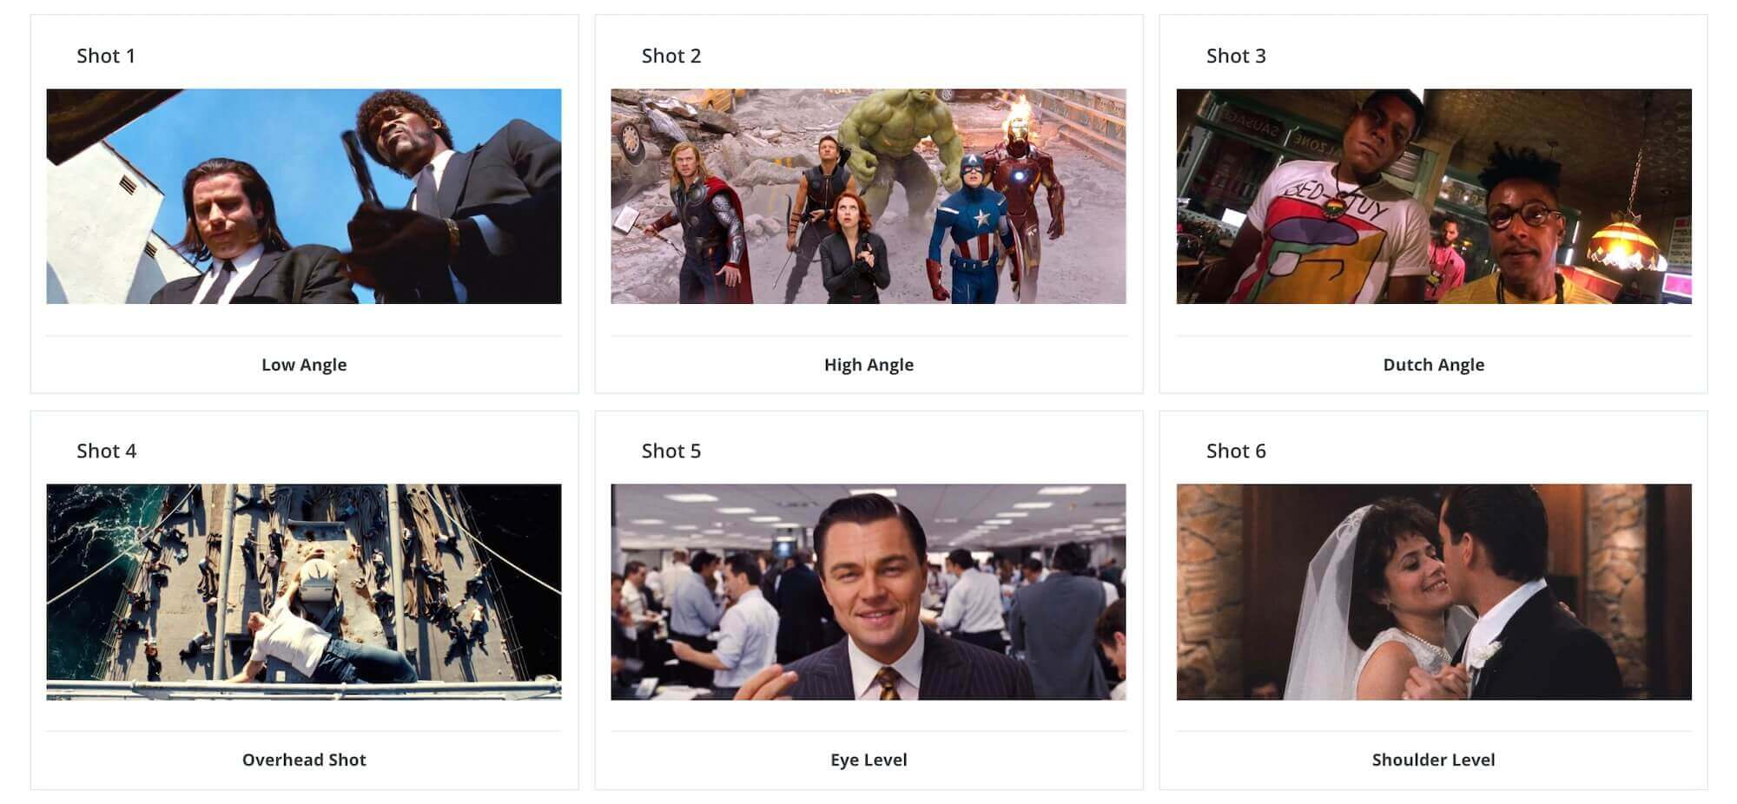
Shots & framing

Slide 13
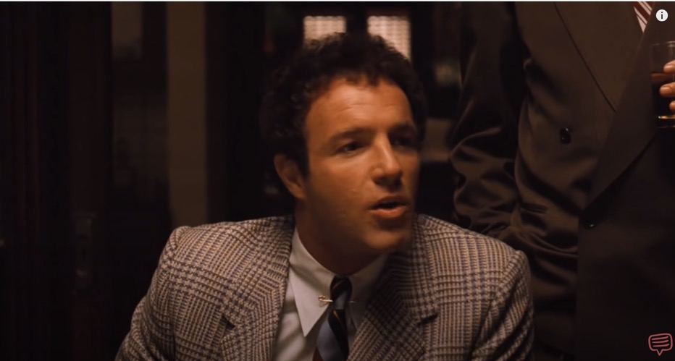
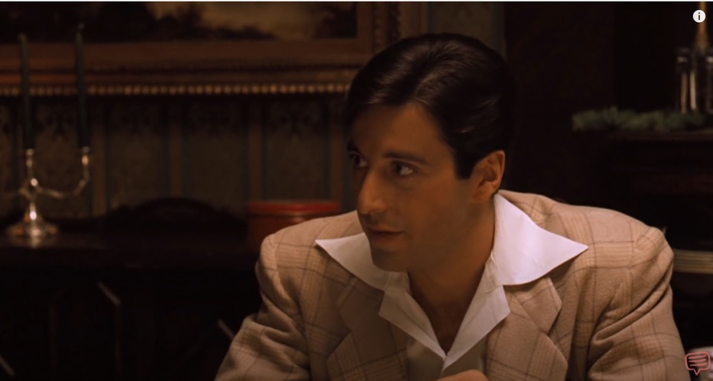
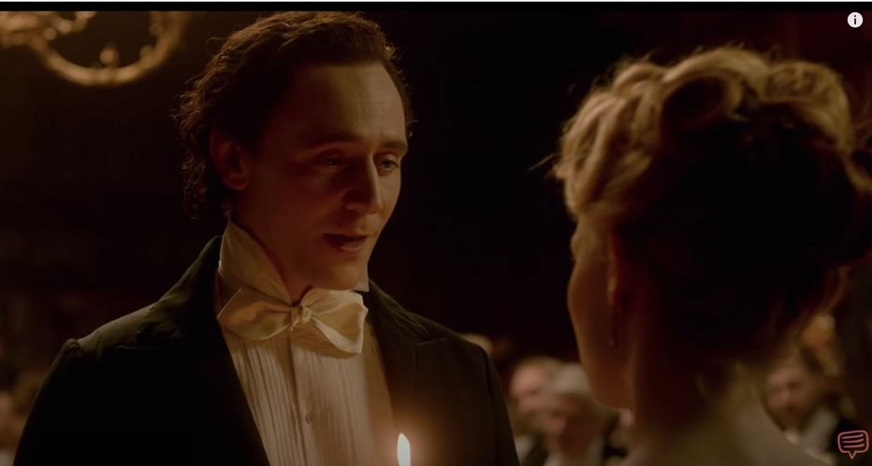
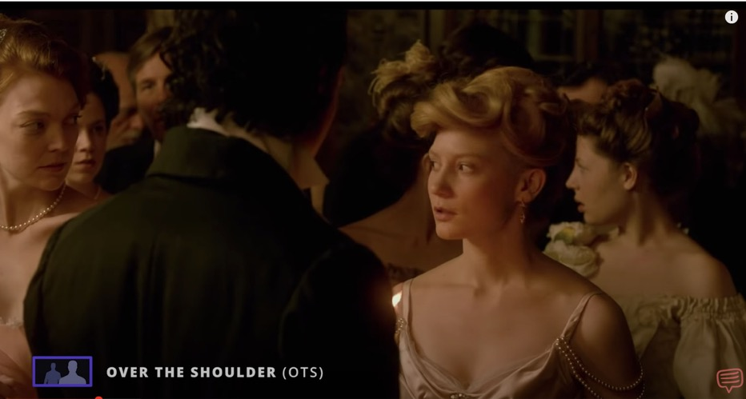
Notes:
Eye lines.
Dirty vs Clean.
Headroom.
Looks space.
These shots would be referred to as singles.

Slide 14
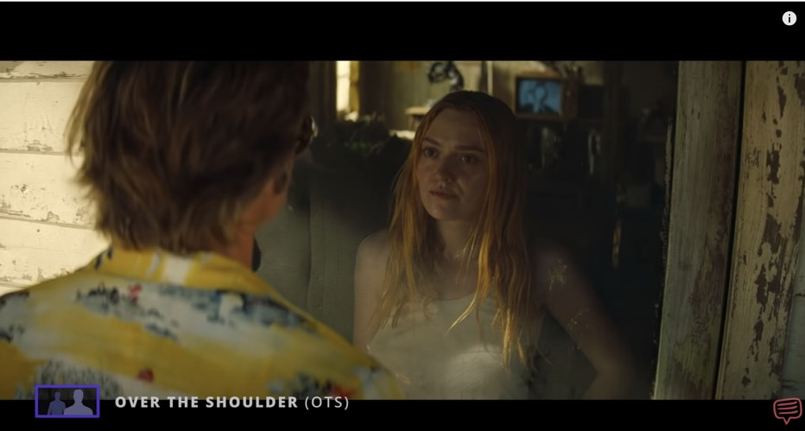
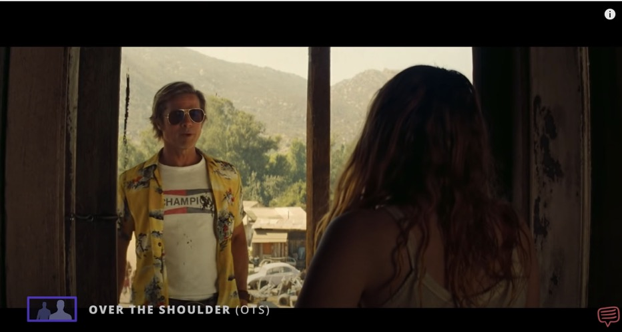
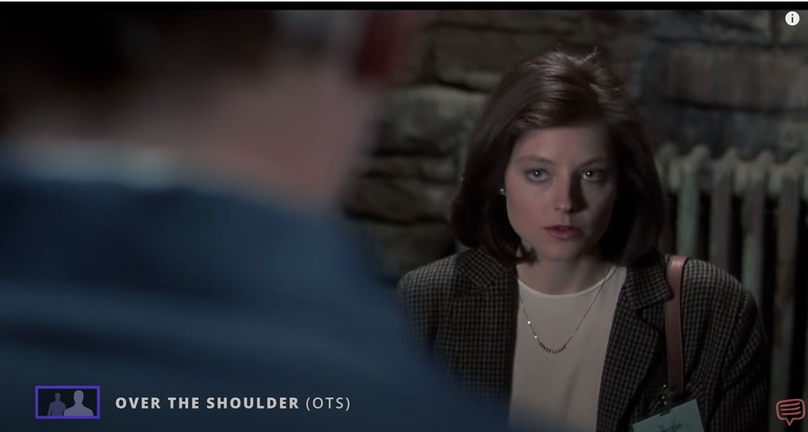
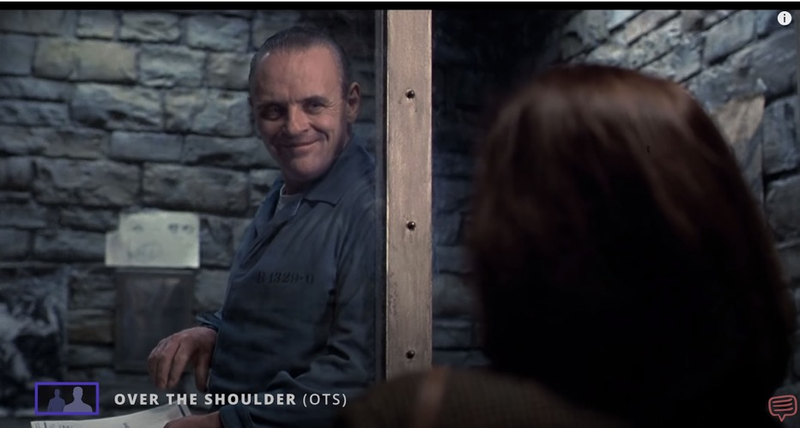
Notes:
Eye lines.
Dirty vs Clean.
Headroom.
Looks space.
These shots would be referred to as singles.

Slide 15
VISUAL NARRATIVE
SCRIPT BREAKDOWN

Slide 16
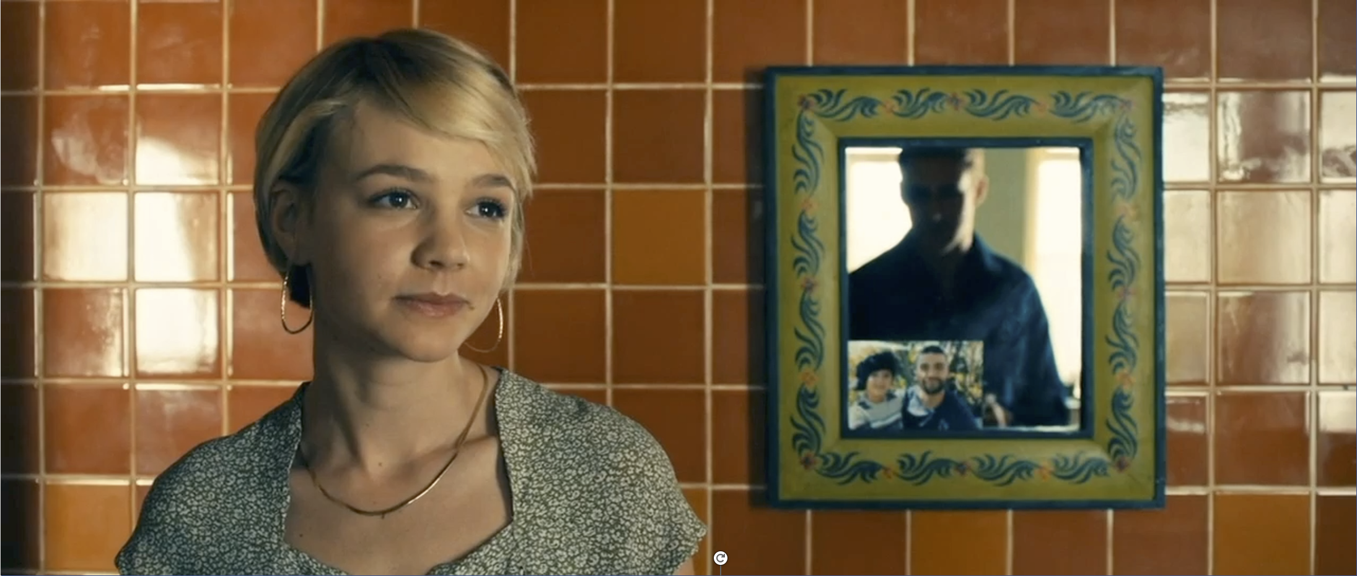
Visual Narrative
Example Scene from Drive:
https://www.youtube.com/watch?v=m8rQimLHnk8

Slide 17
Visual Narrative 1:
Script breakdown

Slide 18
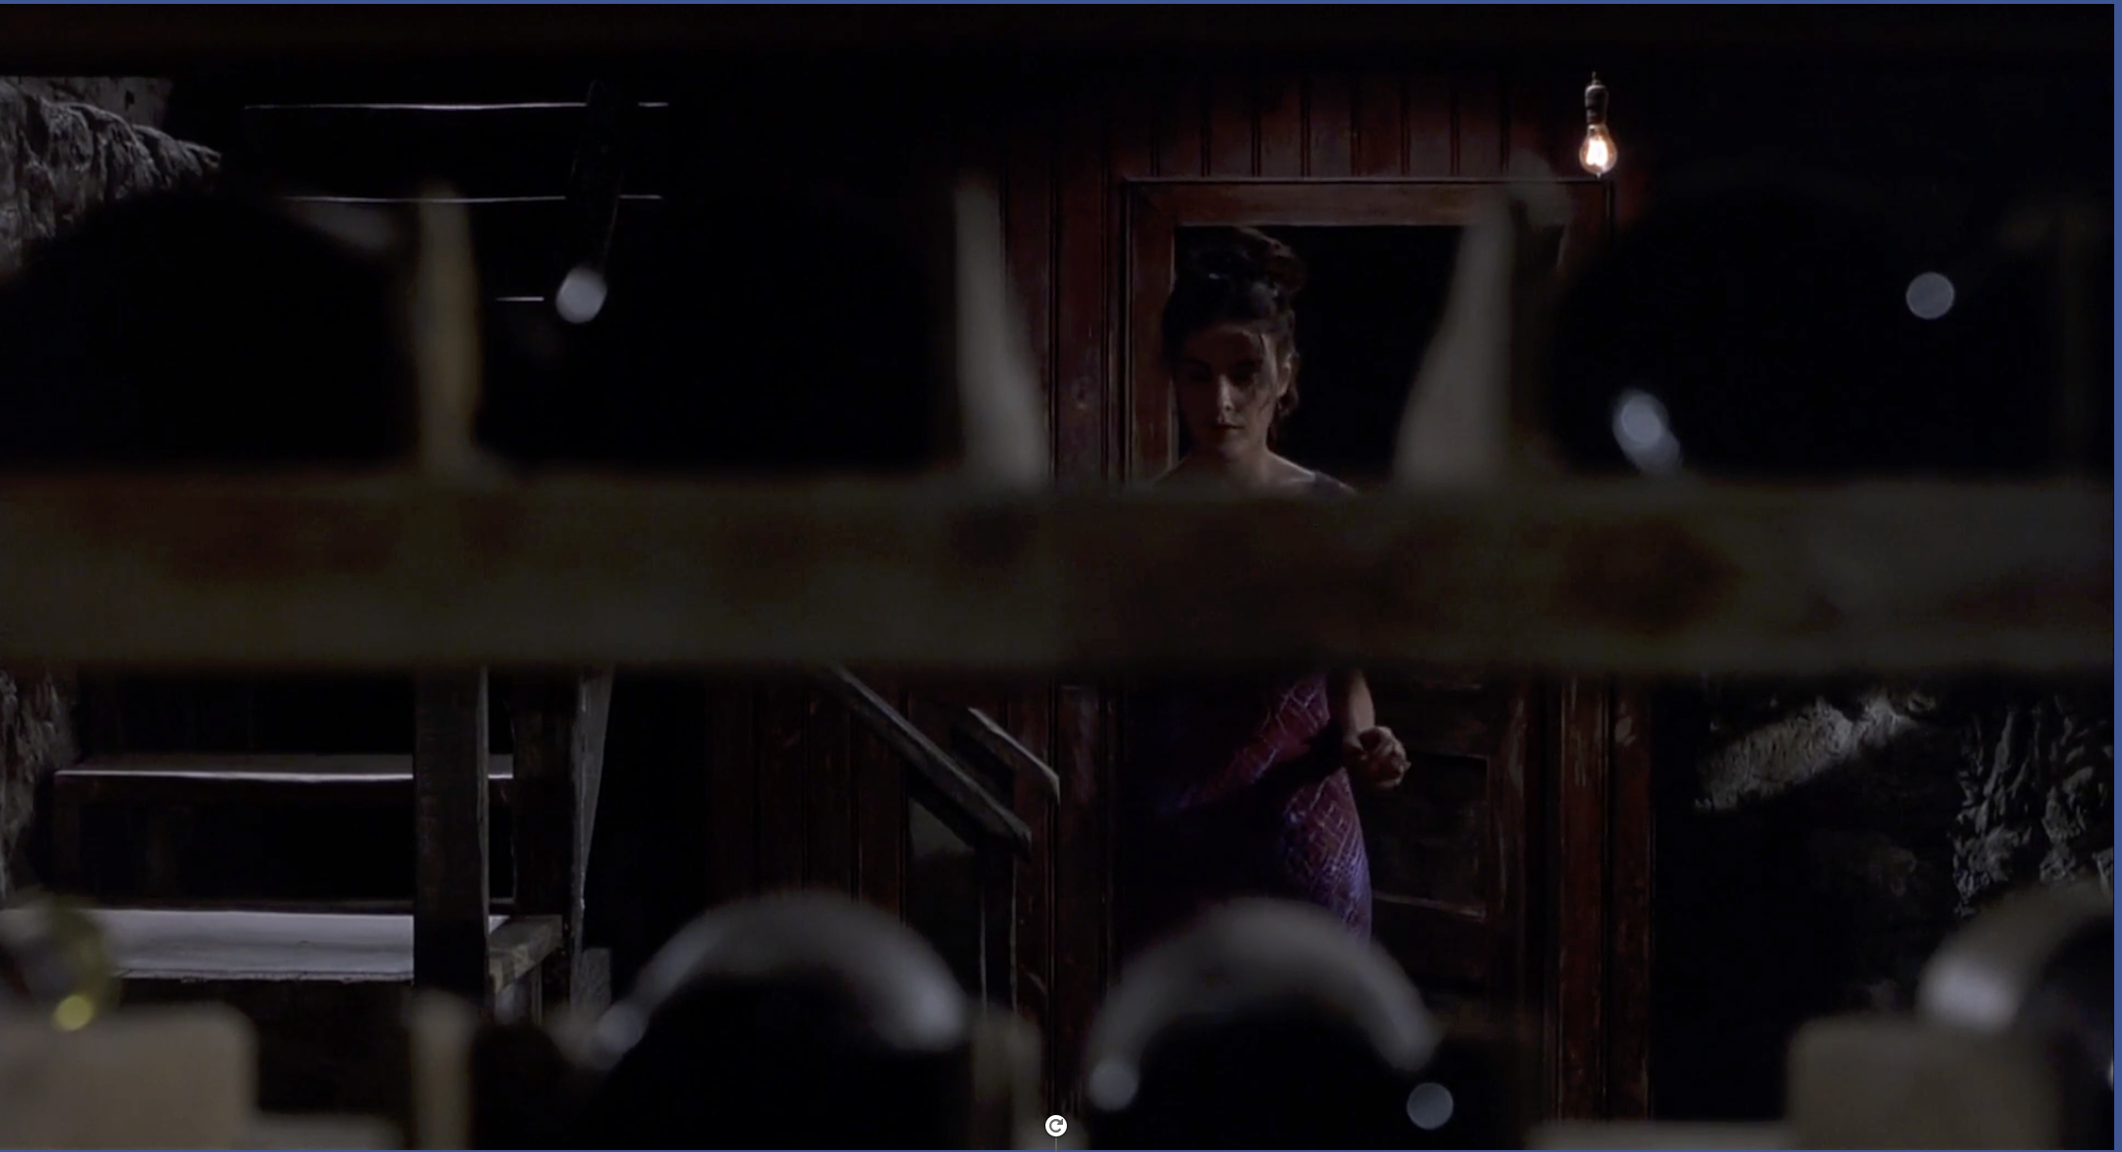
Find and watch the opening of Sixth Sense

Slide 19
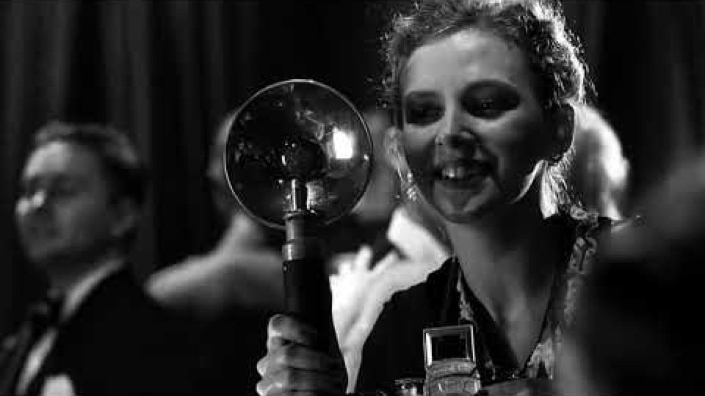
Example from Shindler’s List:
https://www.youtube.com/watch?v=itOBJdtBoKM

Slide 20
Visual Narrative 2:
Storyboard and film scene

