Slide 1

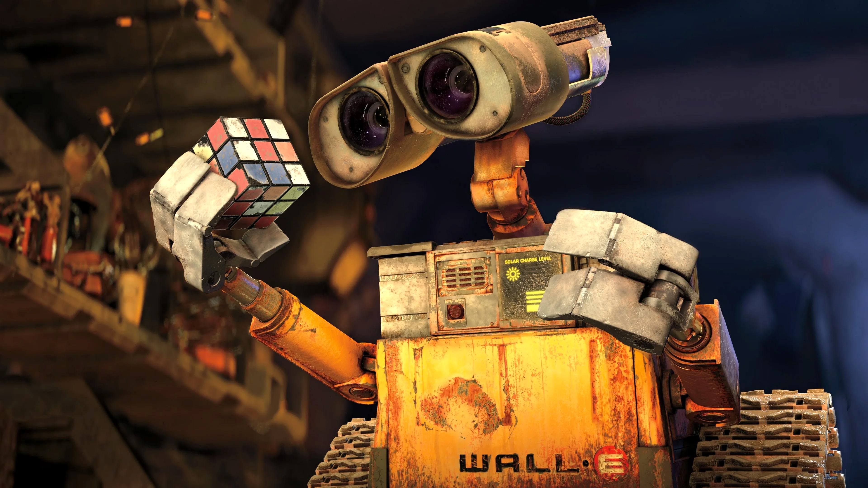
Debate:
Technological innovation and future of film

Slide 2
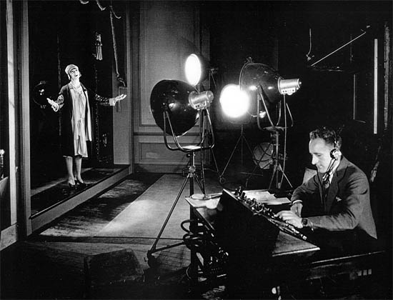
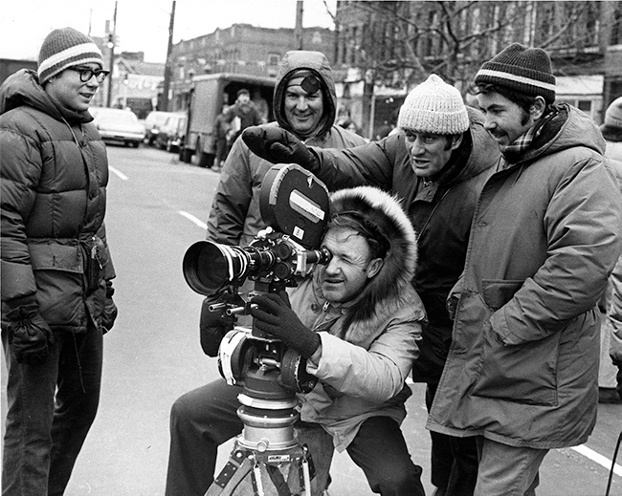
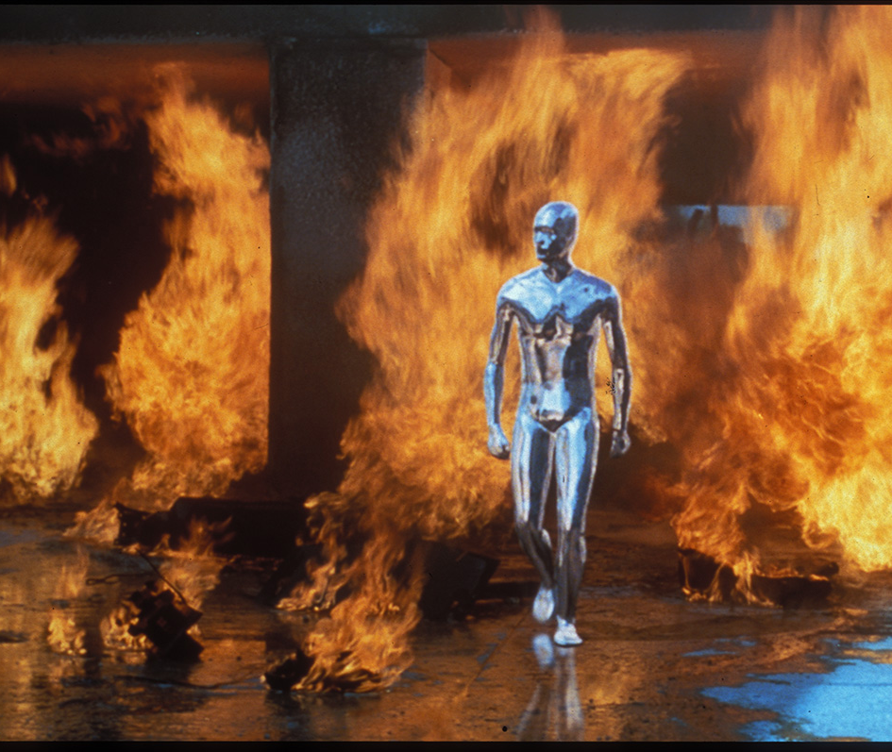
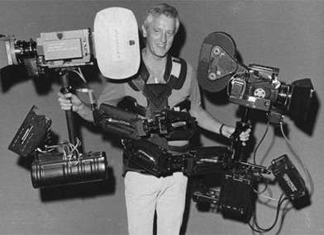
Previous transformative technology in film

Slide 3
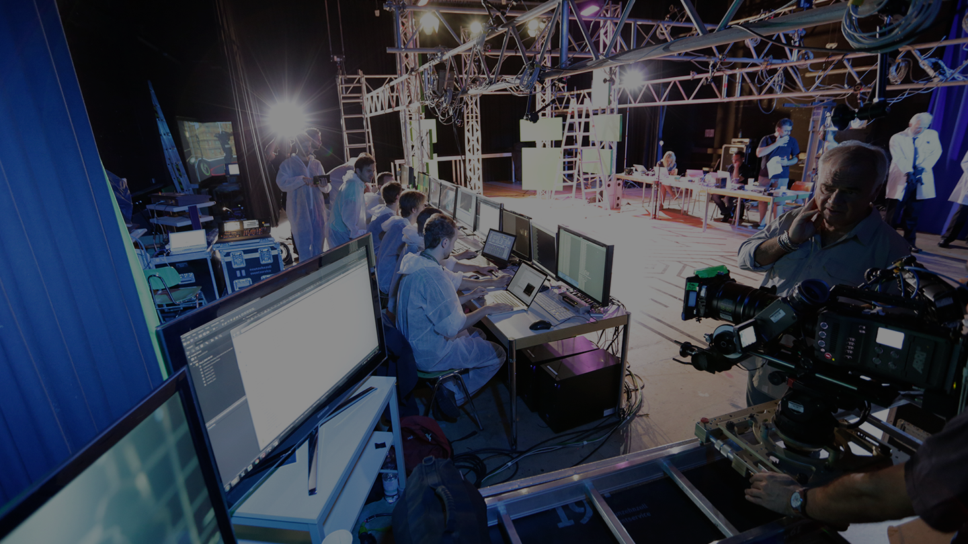
Technology in Film Industry
Casting/recruitment/budget analytics
Audience/engagement data analytics
Generative AI / synthetic media
Previsualisation
Virtual Production / VR scouting
Camera-to-cloud / distributed workflows
Post-prod tools (ML-driven)
Distribution / streaming / funding
Notes:
Addtive manufacturing
Digital design / models
VFX rotoscoping / tracking
Audio processing
Subtitles / transcription

Slide 4
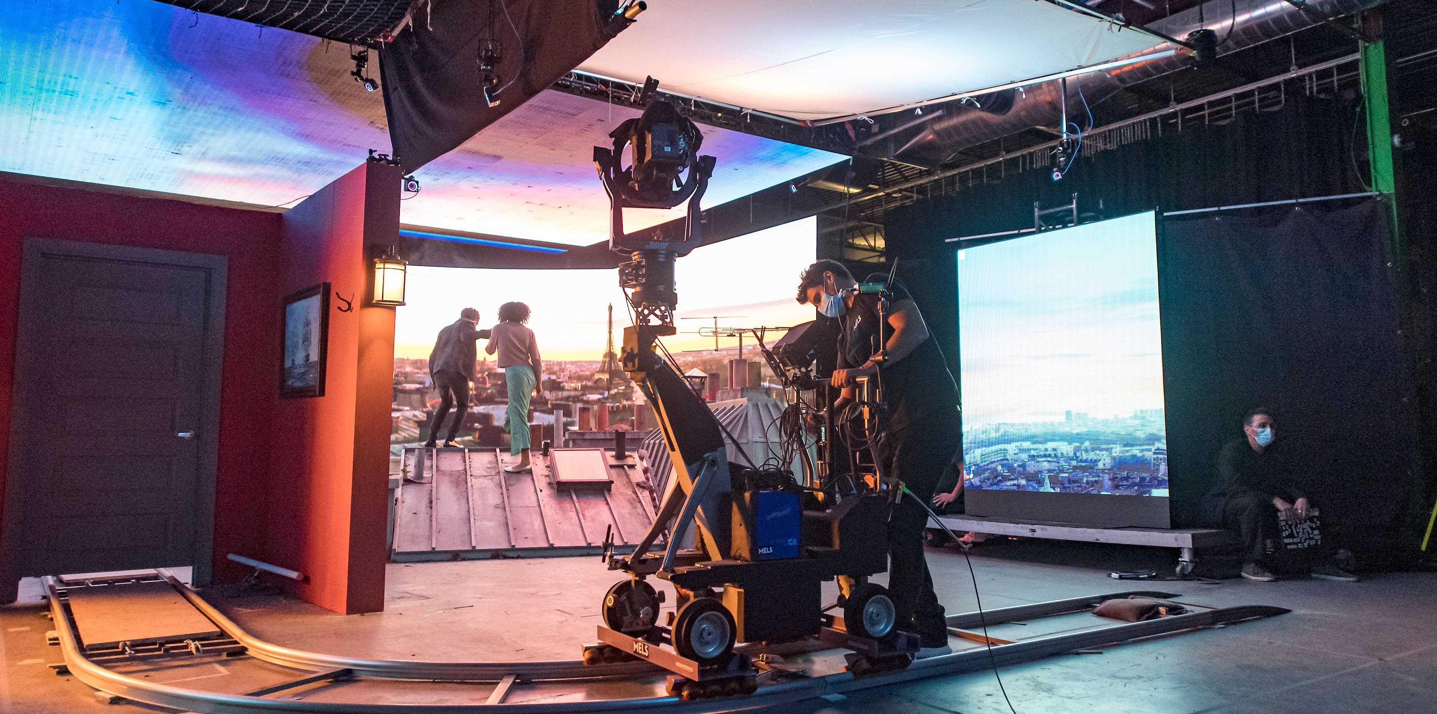
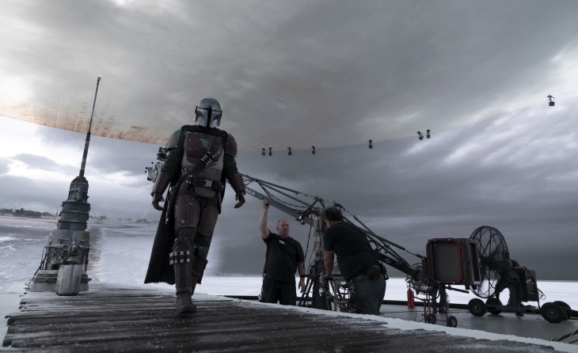
Virtual Production

Slide 5
AI analysis beyond the obvious/genAI
https://www.boldbusiness.com/digital/artificial-intelligence-film-making/
Film-Related Firm | Artificial Intelligence Services | Founding Year and Location | Annual Sales Revenues
Legendary Entertainment | AI used for visual storage, movie trailer design, and audience development | 2005 Burbank, CA | $620,000
Vault ML | AI used to predict opening weekend revenues at the box office | 2015 Israel | Not Available
ScriptBook | AI cloud-based platform allows rapid move script analysis to predict box office success or failure | 2015 Belgium | Not available
Pilot Movies | AI used in a SaaS platform to allow film-makers to predict gross sales revenues long-term | 2016 Boston, MA | Not Available
Qloo | AI database used to create millions of movie viewer profiles to aid in targeting marketing and creation efforts | 2011 New York, NY | $420,000

Slide 6
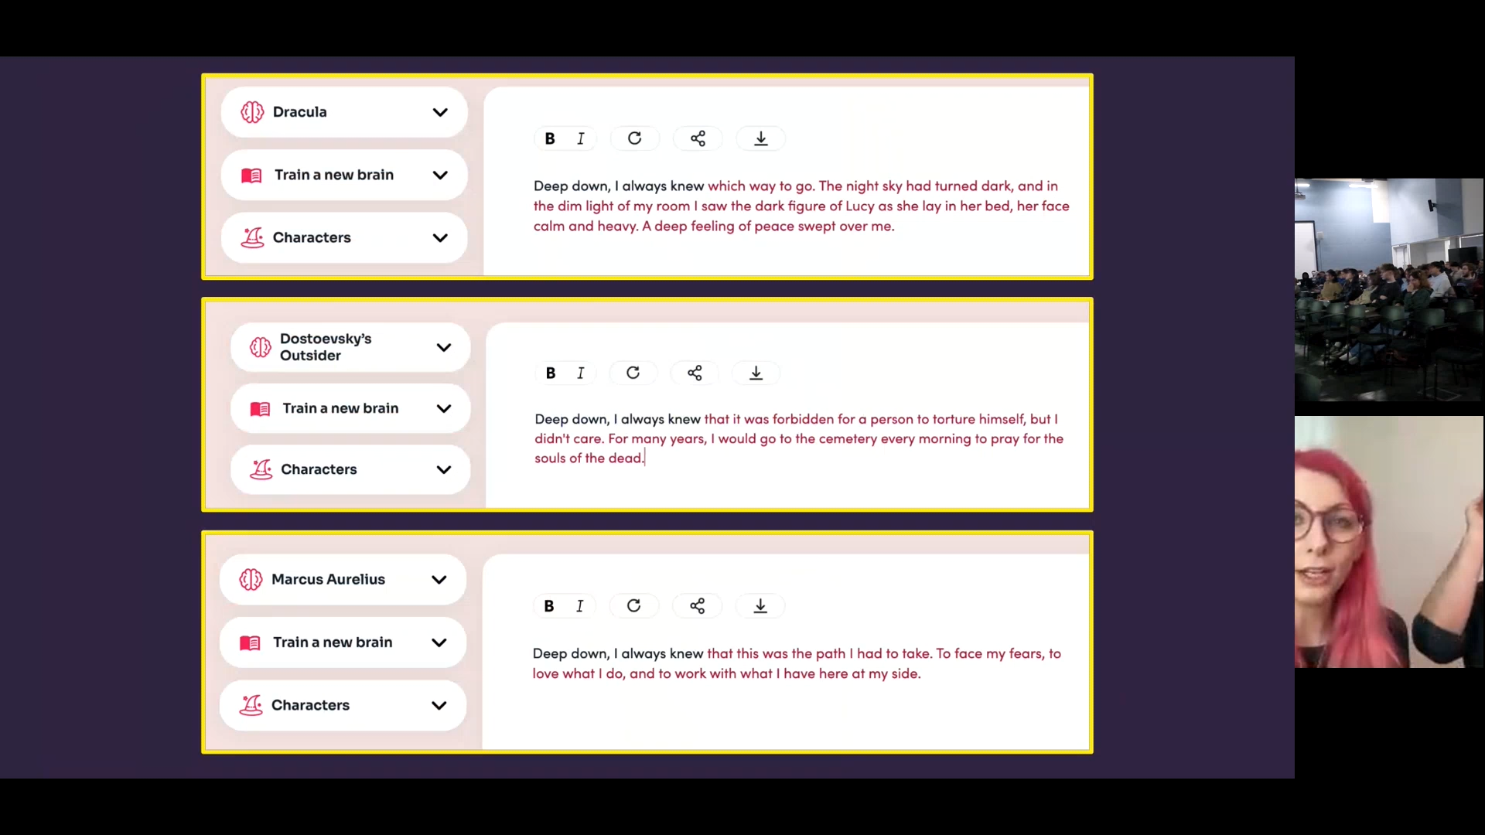
AI-assisted writing example
Notes:
We compiled a summary of the series Friday and asked them to come up with a summary of the final episode in an hour as a part of a writer’s group using input from the AI. Also to create a character and their traits for season 2. We then asked them to present their work, what worked and what didn’t, how much help the AI was and how they used it.

Slide 7
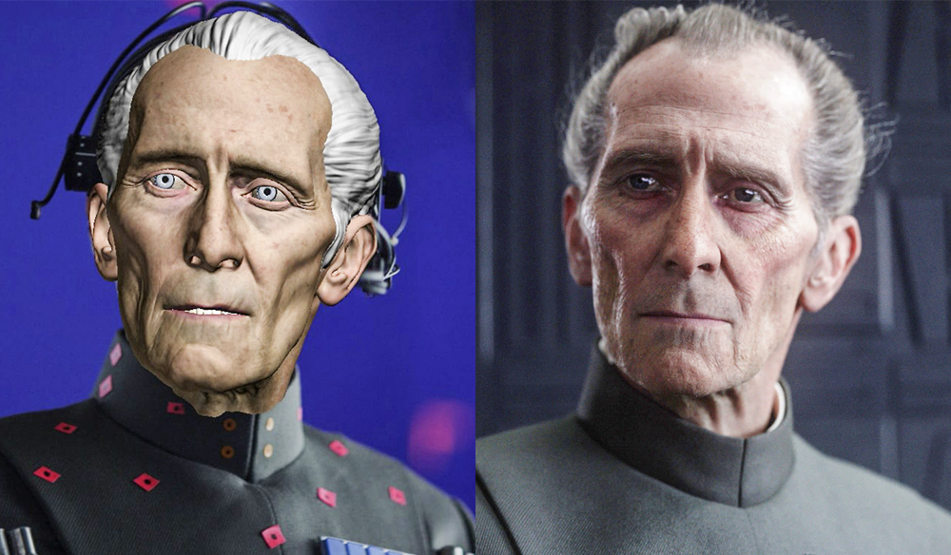
Synthetic Media

Slide 8
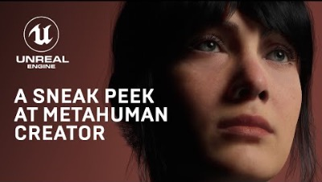
Synthetic Media / Metahumans
https://www.youtube.com/watch?v=S3F1vZYpH8c

Slide 9
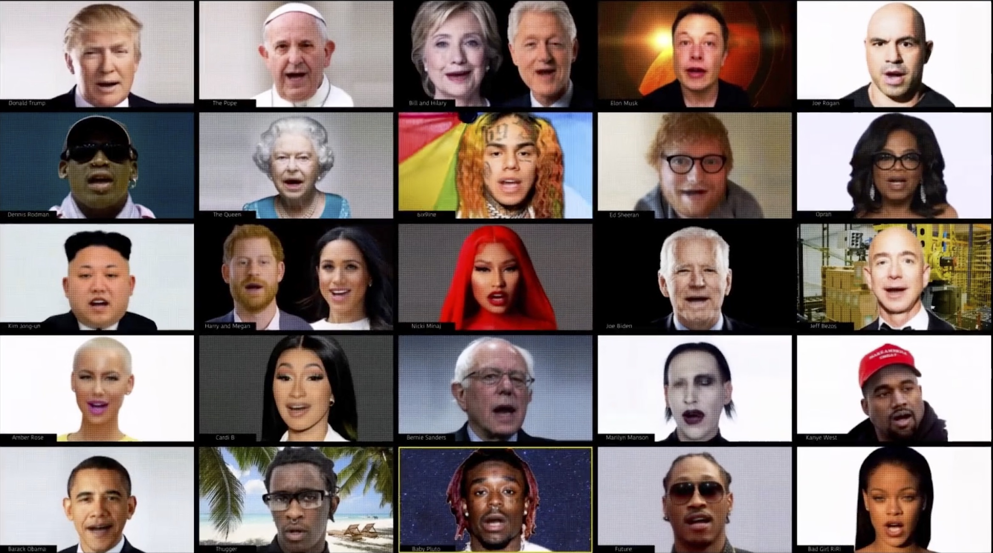
https://studioneural.ai/
Synthetic Media / Deep fakes
Notes:
https://studioneural.ai/

Slide 10
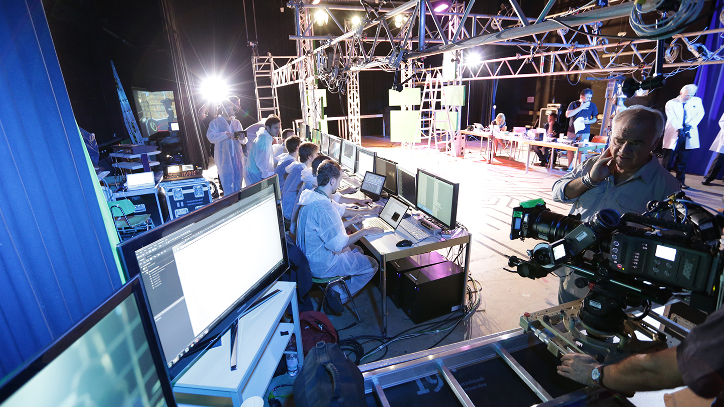
https://www.filmcrux.com/blog/ai-tools

Slide 11
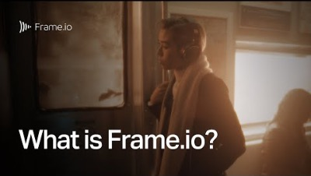
Remote Working
https://frame.io/
https://frame.io/
https://www.youtube.com/watch?v=rapbhpW3jPM
Notes:
https://frame.io/
https://www.youtube.com/watch?v=rapbhpW3jPM

Slide 12
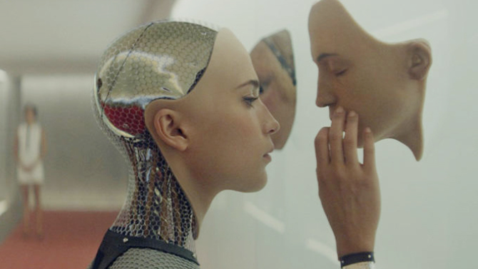
Discussion: Content-related Challenges
Authorship / IP (content & image)
Bias
Artistic & Cultural appropriation
Uncanny valley effect
Audience expectations & aesthetics
Notes:
Sustainability?
Is it art if created by ai? What do we value in creativity?

Slide 13
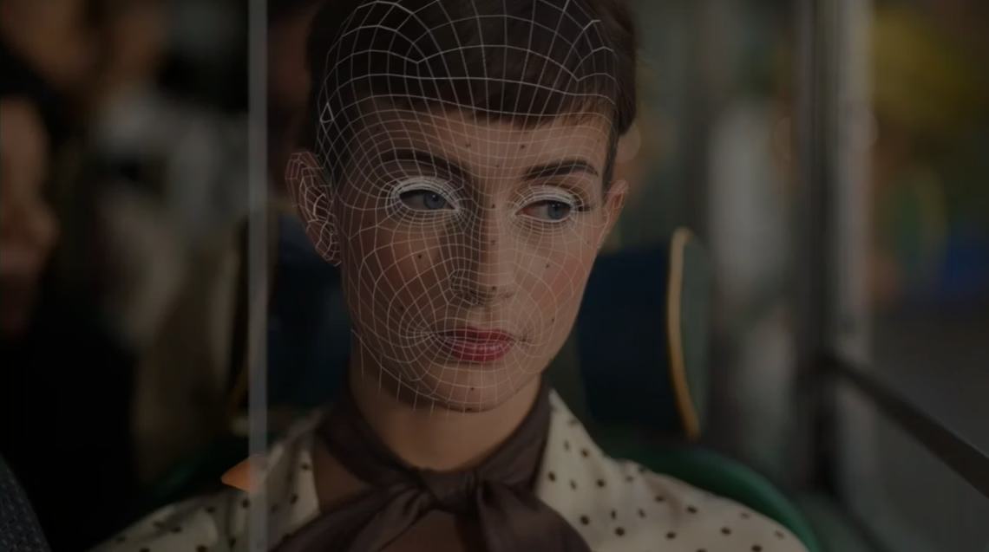
Discussion: Wider challenges
Synthetic media & body image
Rem. working competition / challenges
Sustainability of tech. infrastructure
Data and privacy / analytics
Empathy / communication
Notes:
Bias training sets
Cultural appropriation
Is it art if created by ai?

Slide 14
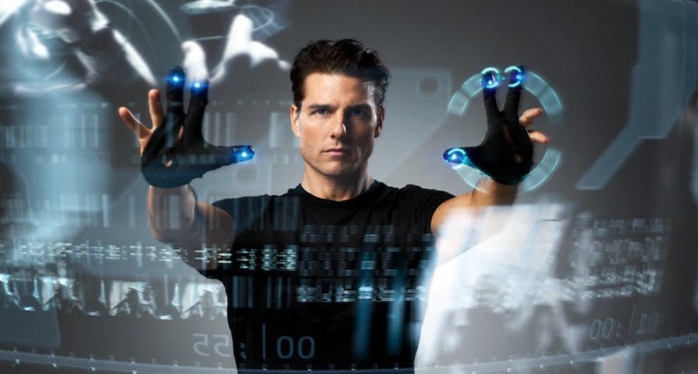
Your place in this landscape?
How do you remain current and relevant?
How do you develop creativity and critical thinking?
How are audiences (expectations / content consumption) shaped / informed?
Notes:
Upskilling / reskilling
Explore industry-entry opportunities/
How are audiences (expectations / content consumption) shaped / informed?
We are unique!
SKILLS AND “UNIQUE SELLING POINT”

Slide 15
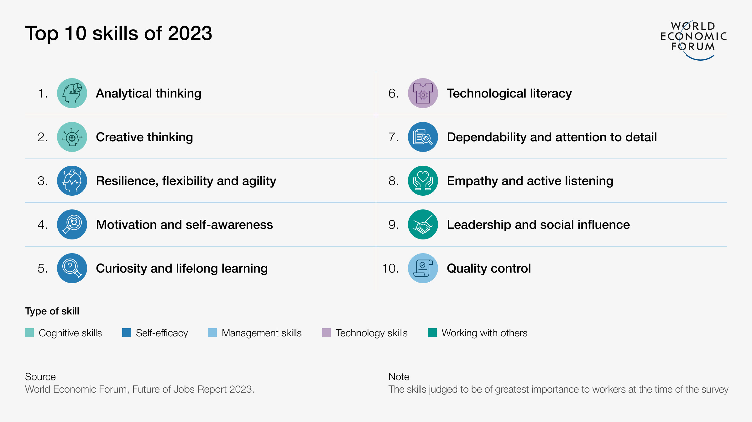
ACTION PLAN
How do you remain current/competitive?
How do you amplify your creativity / output?
Upskilling and reskilling
Explore industry-entry opportunities
Notes:
We are unique!

