Slide 1

Modern Chinese for non-major students I
Week 5
记得点名

Slide 3
第二课–家庭
dìèrkè – jiātíng
Lesson 2 -- family

Slide 4
nà | nǚér | zhè | zhàopiàn | māma | méiyǒu
gè | jiā | nán | gāowénzhōng | bàba | zuò
de | jǐ | huí | dàgē | háizi | mèimei
nǚ | kǒu | érzi | gēge | jiějie | gōngzuò
liǎng | dàjiě | hé | dàxuéshēng | dìdi | yīngwén
lǜshī | èrjiě | dàxué | Báiyīng’ài | dōu | yīshēng
1
2
3
4
5
6
7
8
9
10
11
12
13
14
15
16
17
18
19
20
21
22
23
24
25
26
27
28
29
30
31
32
33
34
35
36
Notes:
宾果

Slide 5

那 nà
这 zhè
That
This

Slide 6

照片 zhàopiàn
Photo; picture

Slide 7

爸爸 bàba
妈妈 māma
Father; dad
Mather; mom

Slide 8


女 nǚ
Female
男 nán
male

Slide 9

孩子 háizi child

Slide 10
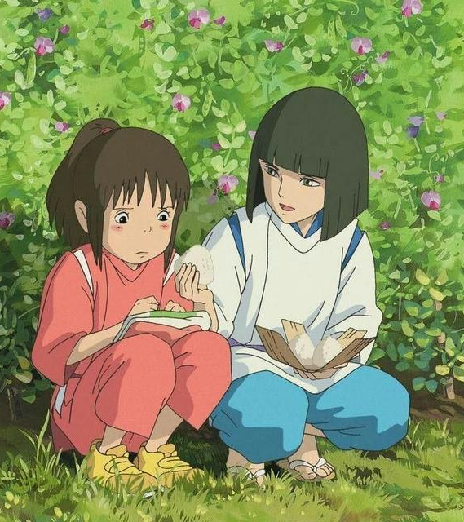
他 tā
He; him
她 tā
She; her
Notes:
你我他

Slide 11

姐姐 jiějie older sister
妹妹 mèimei
Younger sister

Slide 12

哥哥 gēge older brother
弟弟 dìdi
younger brother

Slide 13

大哥 dàgē eldest brother
二哥 èrgē
Secend oldest brother

Slide 14


儿子 érzi son
女儿 nǚér
daughter

Slide 15
的 de
(a possessive or descriptive particle) 【Grammar 1.】
To indicate a possessive relationship, the particle 的 appear between the “possessor” and the “possessed.” To that extent, it is equivalent to the “ ’s ” structure in English.
老师的名字
王朋的妈妈
学生的爸爸
Lǎoshī de míngzi
Wángpéng de māma
xuéshēng de bàba

Slide 16
的 de
(a possessive or descriptive particle) 【Grammar 1.】
To indicate a possessive relationship, the particle 的 appear between the “possessor” and the “possessed.” To that extent, it is equivalent to the “ ’s ” structure in English.
这是什么？
What is this?
那是什么？
What is that?
Zhè shì shénme?
Nà shì shénme?
这是__的__。
This is ______.
那是__的__。
That is ______.
Zhè shì ___de____.
Nà shì ___de____.

Slide 17
个 ge
(meansure word for many common everyday object) 【Grammar 2.】
个 is the single most common measure word in Chinese. It is also sometimes used as a substitute for other measure words.
一个人
一个学生
一个老师
一个爸爸
Yí ge rén
Yí ge xuésheng
Yí ge lǎoshī
Yí ge bàba

Slide 18
Measure Words
In Chinese a numeral is usually not followed immediately by a noun. Rather, a measure word is inserted between the number and a noun, as (1), (2), (3) and (4) below. Similarly, a measure word is often inserted between a demonstrative pronoun and a noun, as in (5) and (6) below. There are over one hundred measure words in Chinese, but you may hear only two or three dozen in everyday speech. Many nouns are associated with special measure words, which often bear a relationship to the meaning of the given noun.
一个人
一个学生
一个老师
Yí ge rén
一个爸爸
这个孩子
那个男学生
Yí ge bàba
Yí ge xuésheng
Zhè ge háizi
Yí ge lǎoshī
Nà ge nán xuésheng

Slide 19
个 ge
(measure word for many common everyday object) 【Grammar 2.】
个 is the single most common measure word in Chinese. It is also sometimes used as a substitute for other measure words.
+叫什么名字？
+ jiào shénme míngzì?
这/那 +个 +who +姓什么？
zhè / nà
+ xìng shénme?
+是…吗？
+ shì ...ma?

Slide 20
谁 shéi who 【Grammar 3.】
Question pronouns include 谁、什么, etc. In a question with a question pronoun, the word order is exactly the same as that in a declarative sentence. Therefore, when leaning to form a question with a question pronoun, we can start with a declarative sentence and then replace the part in question with the appropriate question pronoun.
那个女孩子是李友。
Nà ge nǚháizi shì Lǐyǒu.
谁是李有？
Shéi shì Lǐyǒu?
那个女孩子是谁？
Nà ge nǚháizi shì shéi?

Slide 21

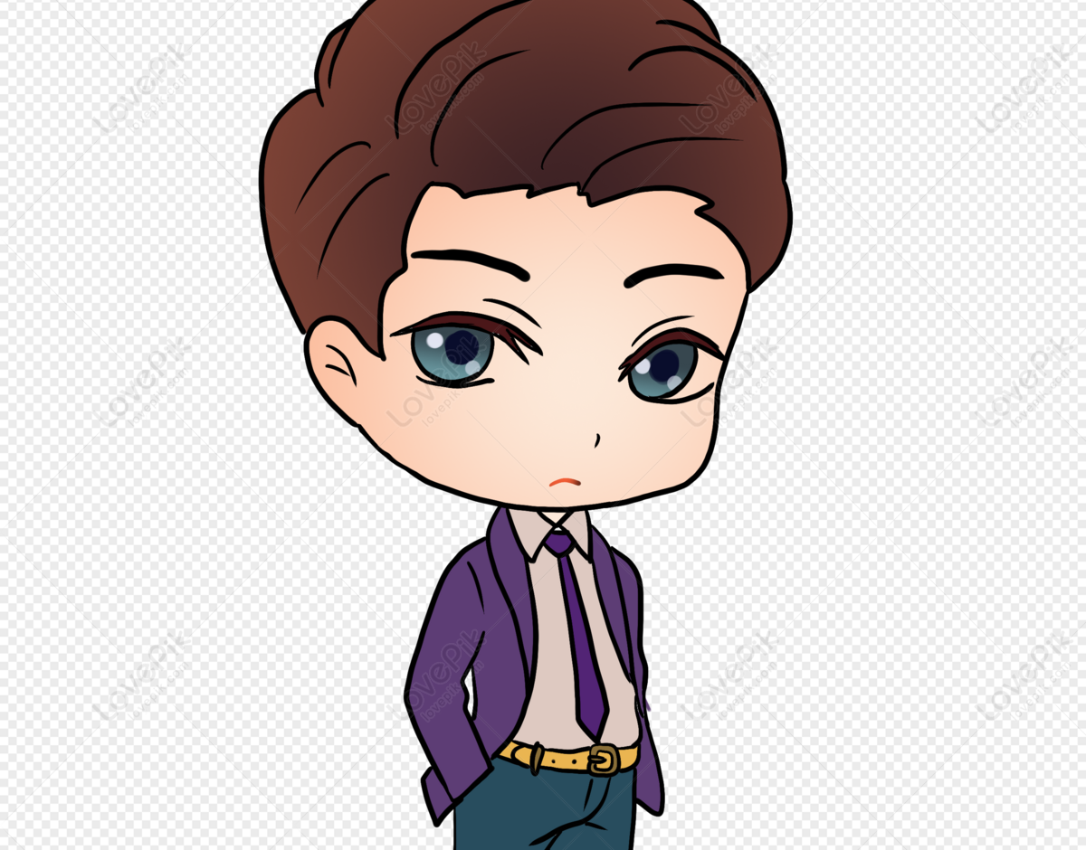
李友
Notes:
李友是美国人吗？

Slide 22
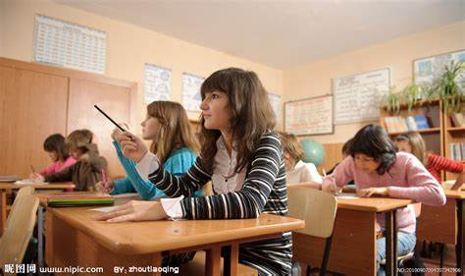

王朋

Slide 23


李生

Slide 24


王生

Slide 25

李生

Slide 26

王生

Slide 27



立陶宛
Lìtáowǎn
王生
李生
Notes:
王生是立陶宛人，李生也是立陶宛人吗？

Slide 28
王生
李生

Slide 29



墨西哥
Mòxīgē
王朋
李友

Slide 30
王朋
李友

Slide 31


越南
Yuènán
印度
Yìndù
李生
王朋

Slide 32


上海
夏威夷
Shànghǎi
Xiàwēiyí
王生
高文中

Slide 33
有 yǒu
To have; to exist 【Grammar 4./5.】
有 in the Sense of “to Have” or “to Possess.”
！！有is always negated with 没 instead of 不！！
没 méi
not
王先生有弟弟吗？
Wáng xiānsheng yǒu dìdi ma?
王先生有弟弟。
Wáng xiānsheng yǒu dìdi.
我有三个姊姊，你呢？
Wǒ yǒu sān ge jiějie, nǐ ne?
我没有三个姐姐。
Wǒ méiyǒu sān ge jiějie.

