Slide 1
Amalie Skram
og Arne Garborg

Slide 2
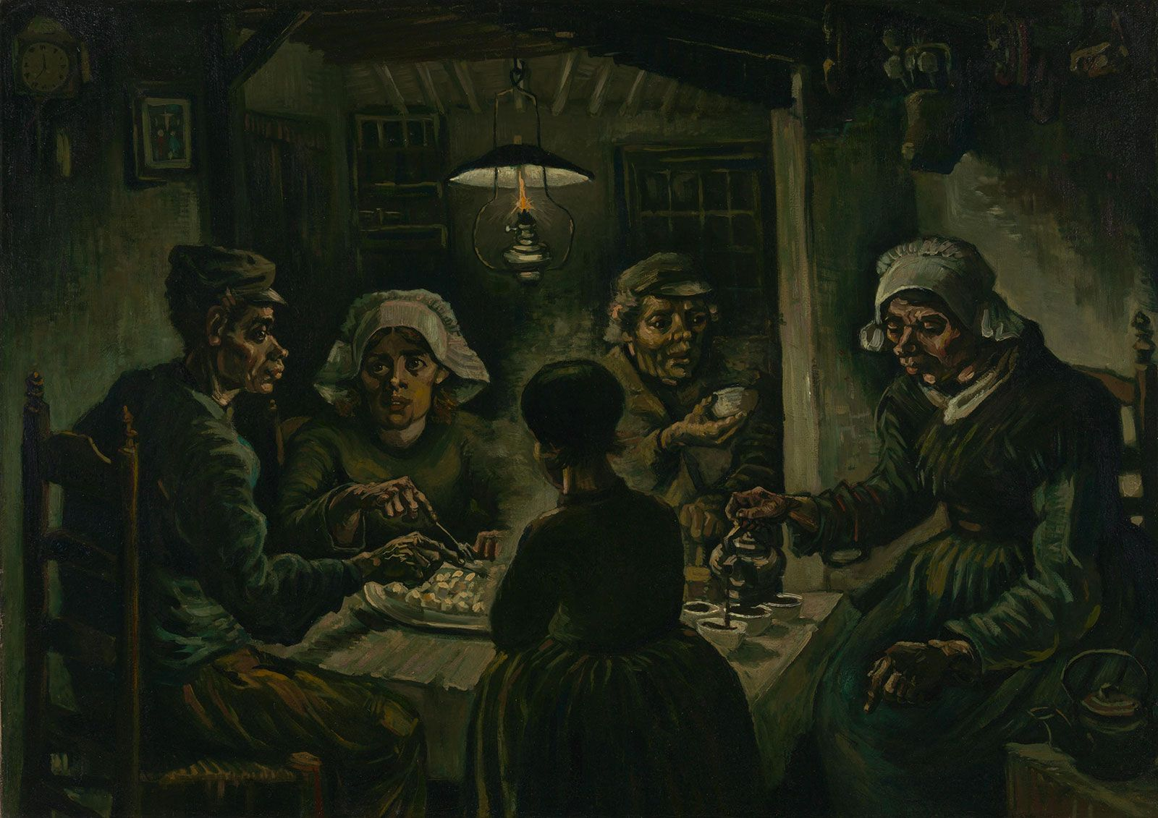

Slide 3
naturalisme
Exponent of naturalism was Émile Zola, whose essay “Le Roman expérimental” (1880; “The Experimental Novel”) became the literary manifesto of the school. According to Zola, the novelist was no longer to be a mere observer, content to record phenomena, but a detached experimenter who subjects his characters and their passions to a series of tests and who works with emotional and social facts as a chemist works with matter.

Slide 4
Kilde: Juleroser 1885
https://www.norgeshistorie.no/kilder/industrialisering-og-demokrati/K1556-Amalie-Skram%E2%80%93Karens-jul.html
kildekritikk

Slide 5
Om forfatteren og verket
https://www.youtube.com/watch?v=HCrFpJCXK38
1:20 – 3.30
13:30 minuta

Slide 6
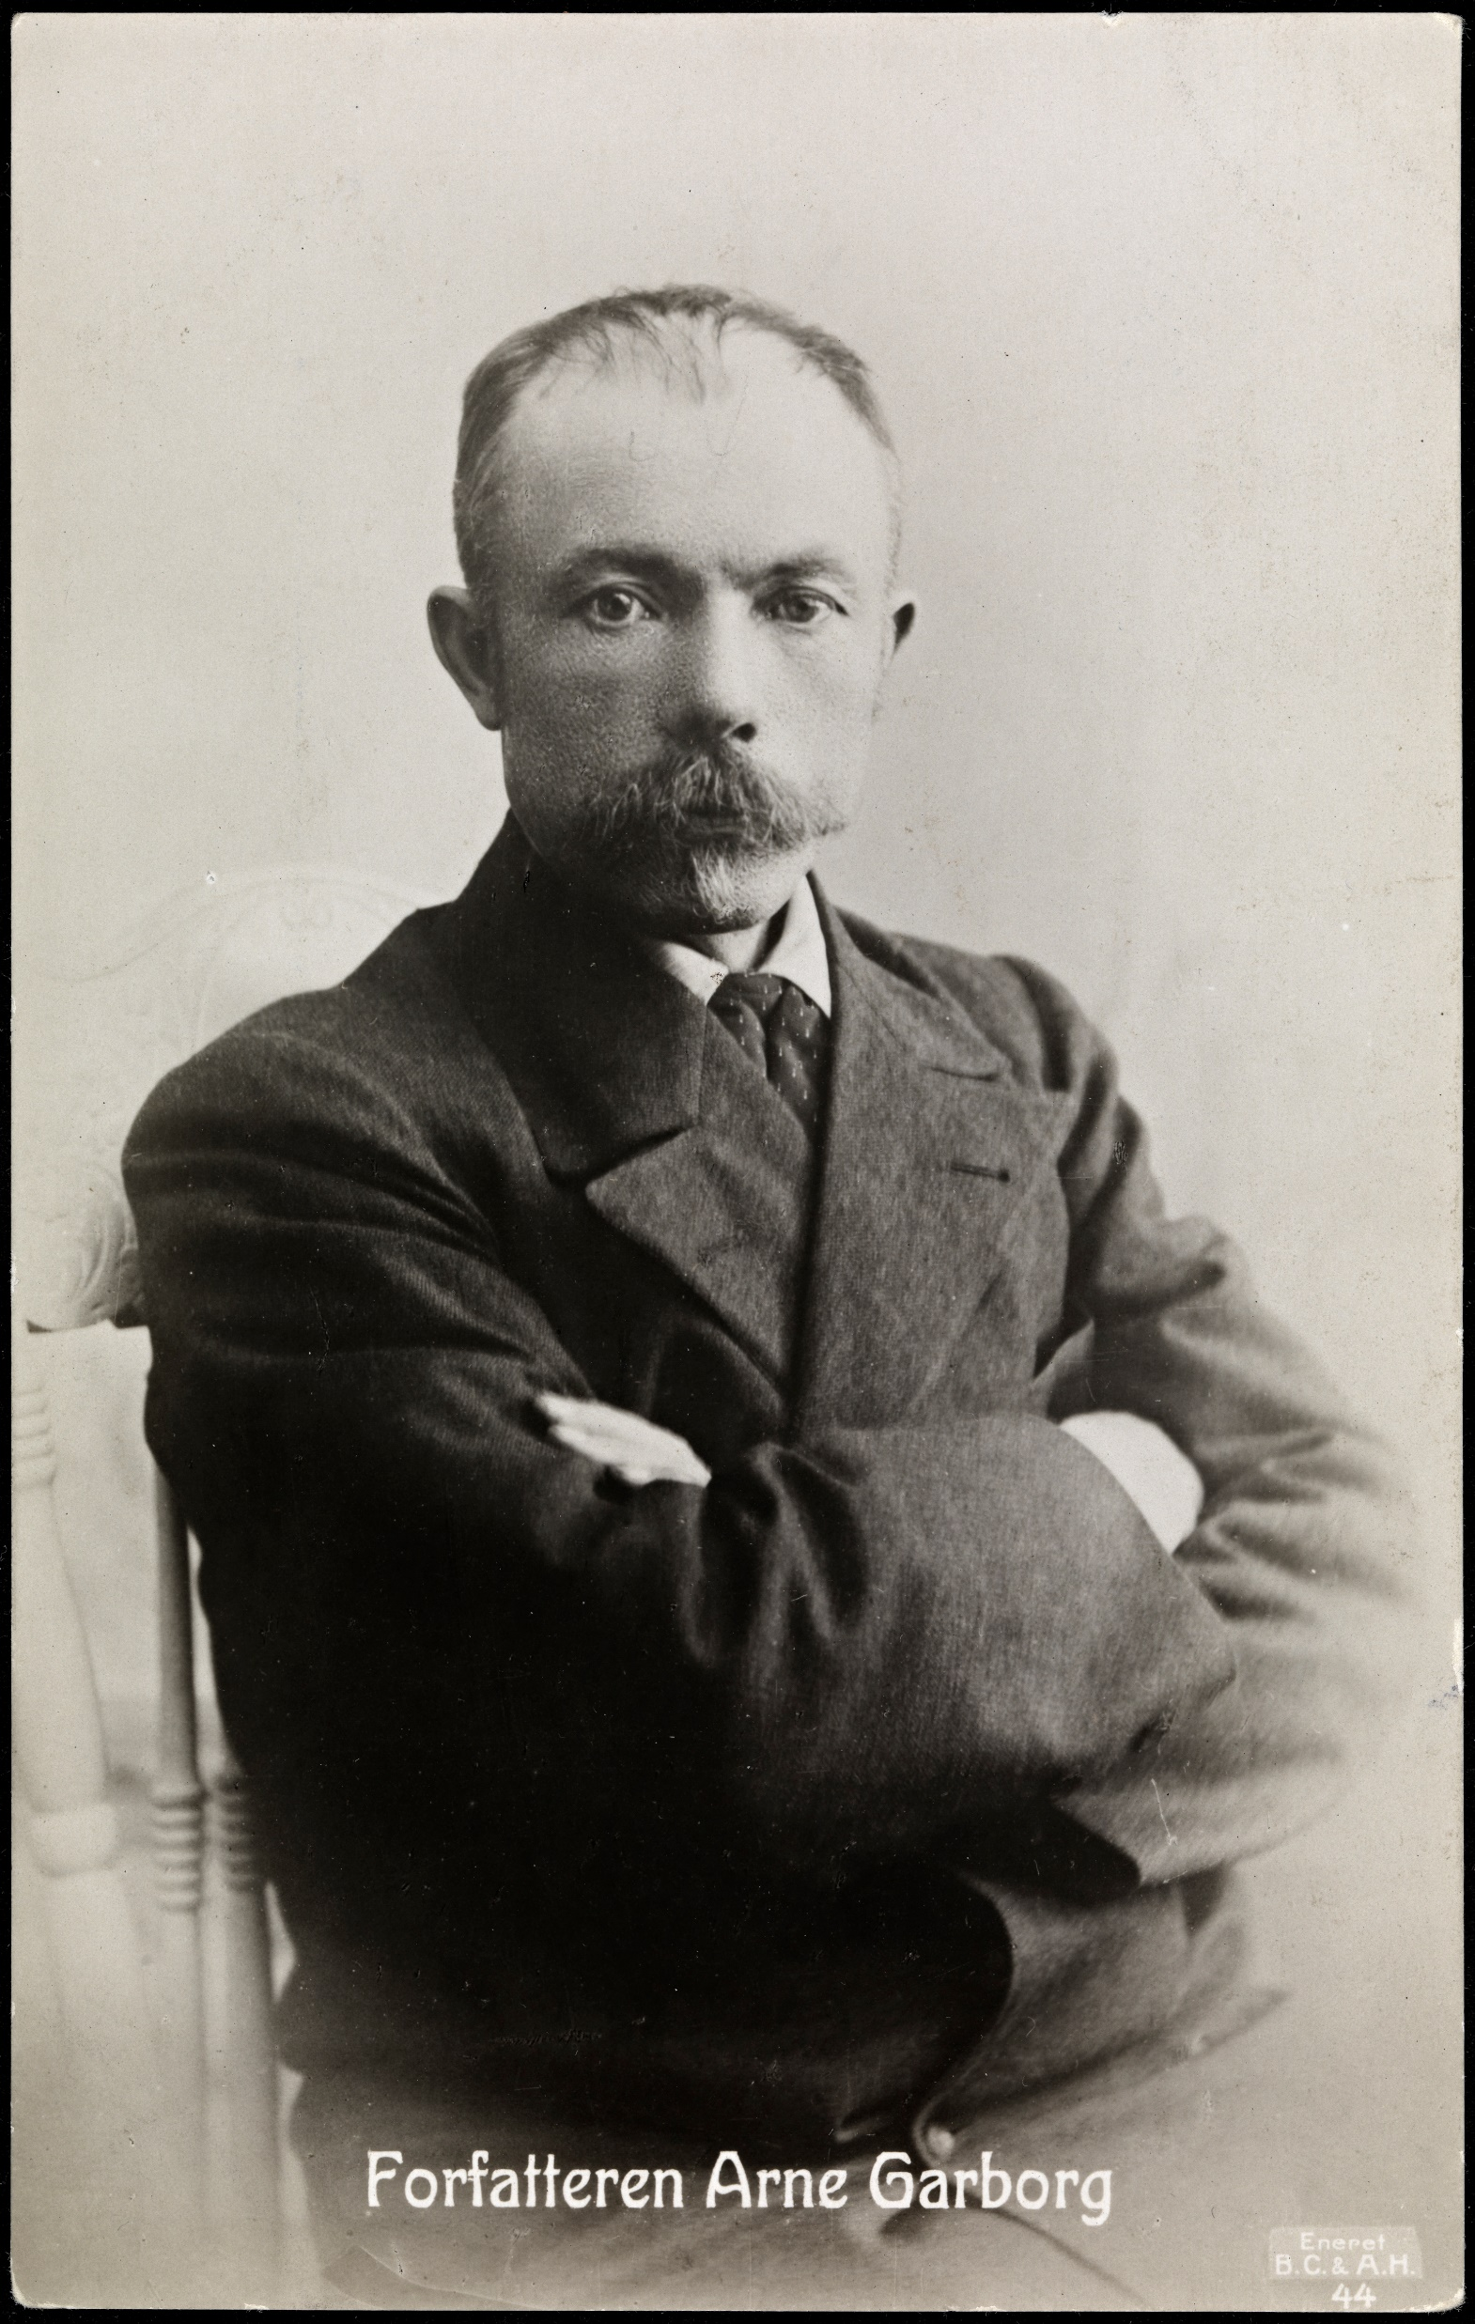
Arne Garborg 1851 - 1924
1883 Bondestudentar
1886 Mannfolk
1891 Trætte Mænd (Umdlené duše)
1891 Fred

Slide 7
Haugtussa

Slide 8
Haugtussa
https://www.youtube.com/watch?v=fw2HLMm5uSk
NRK med Gudleiv Bø
https://www.youtube.com/watch?v=0gHpO6prt-Q
E.Grieg

