Slide 1
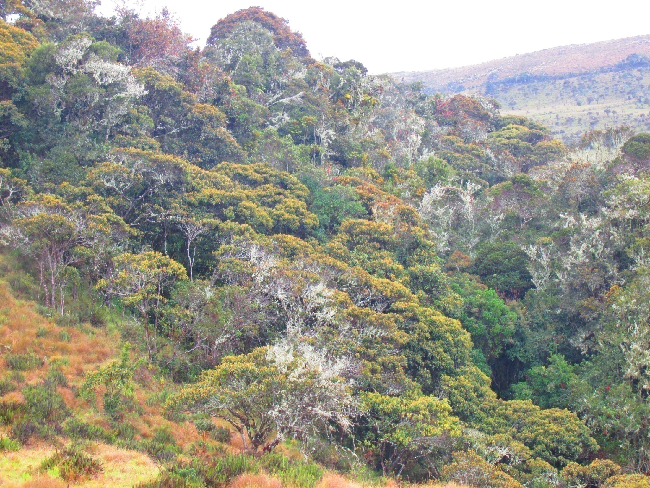
Journey to KansrӨ
(the Underworld of Misak tribe in the south of Colombia)
Lucie Vinsova
Masaryk University Brno

Slide 2
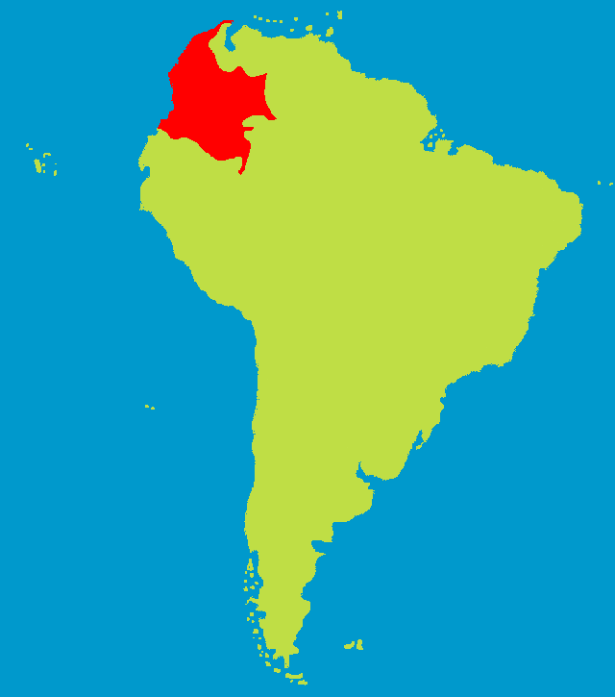
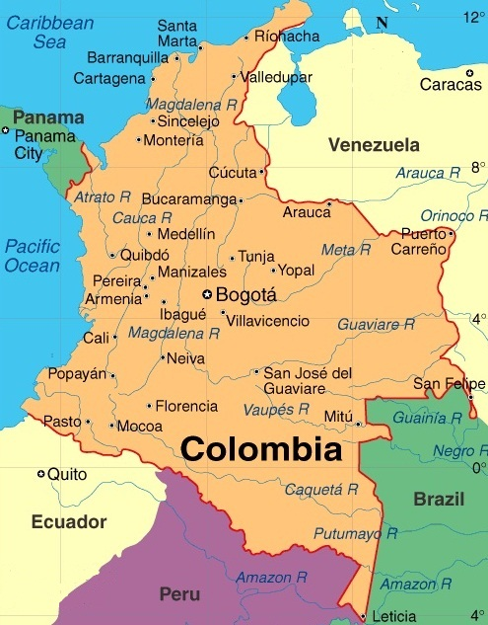
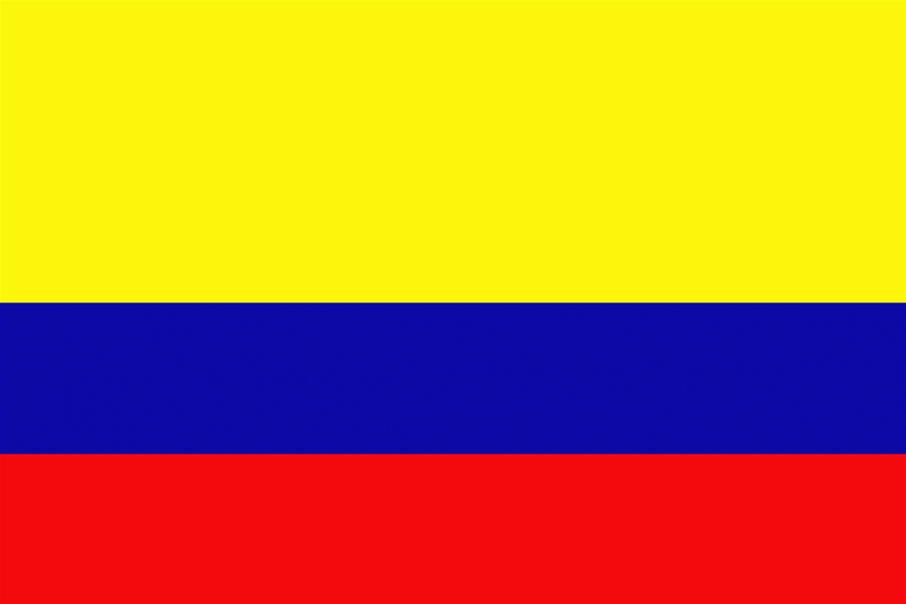
Colombia
Capital: Bogotá
Population: nearly 50 million
Languages: Spanish and at least
68 other recognized ethnic languages

Slide 3
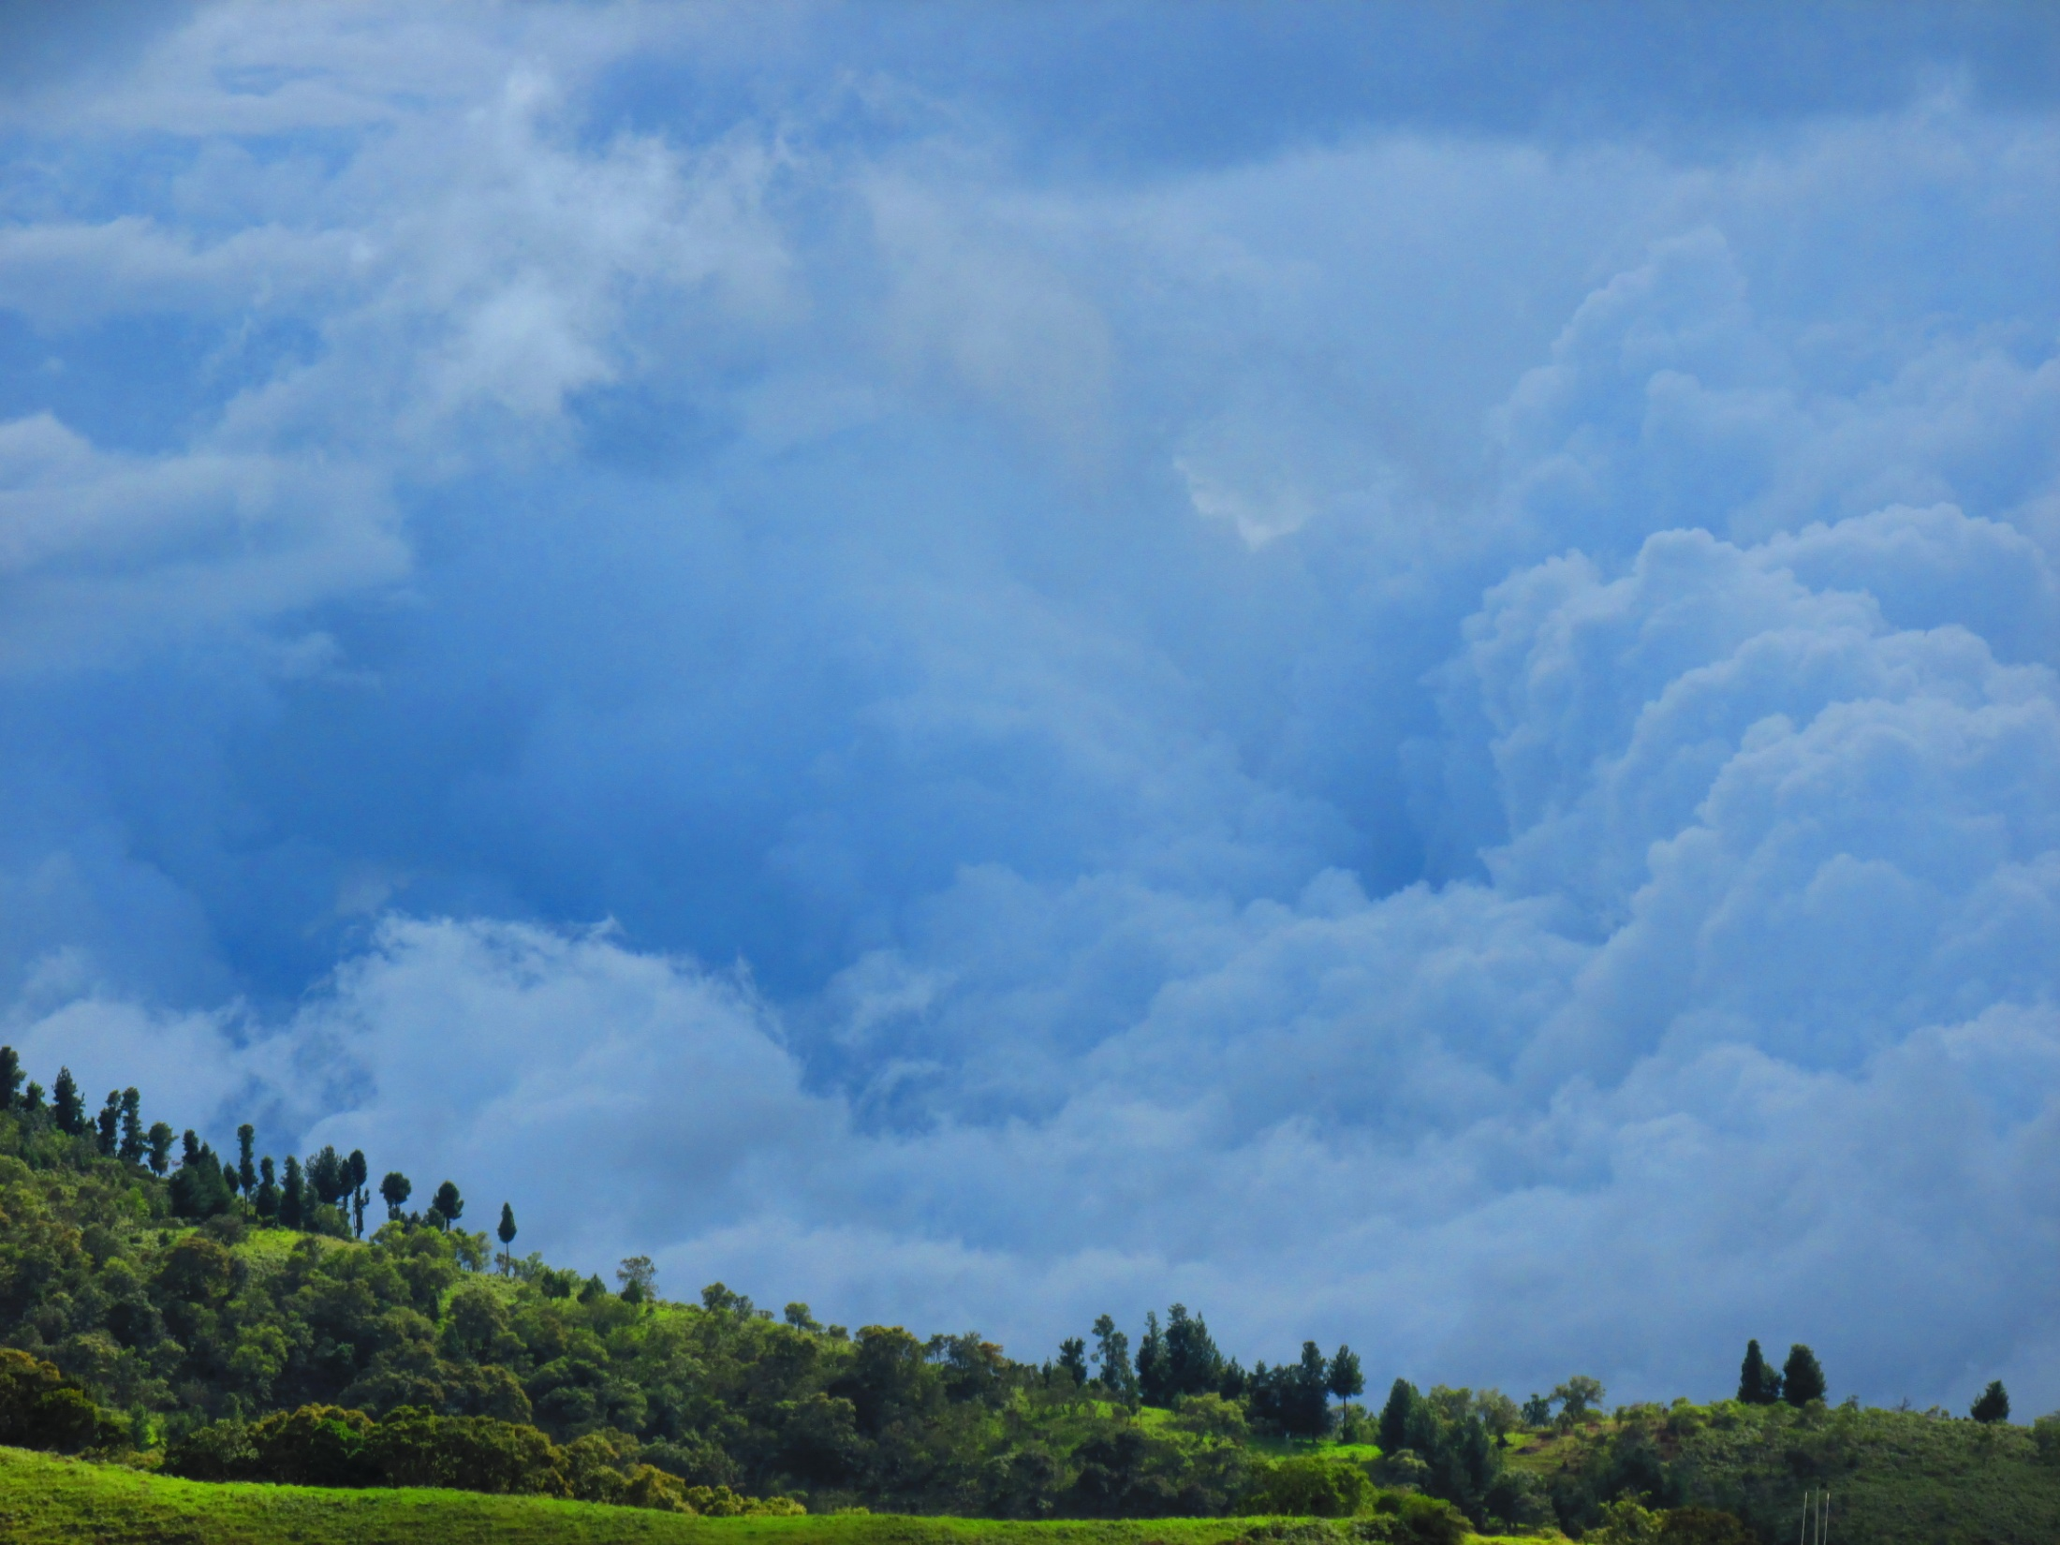
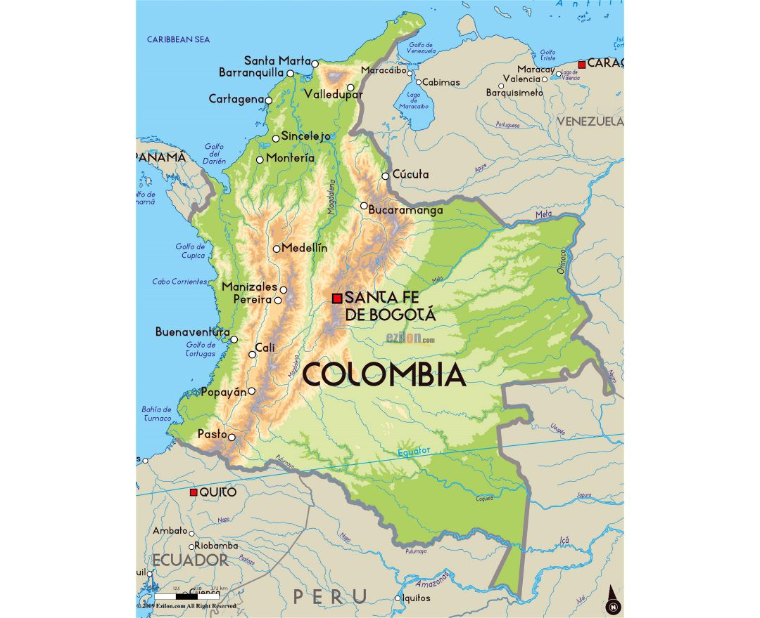
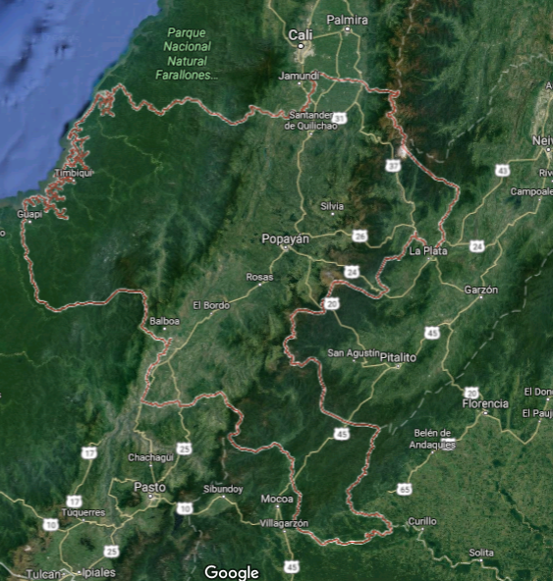
Departamento: Cauca
Capital: Popayán
High percentage of indigenous population (about 20%)

Slide 4
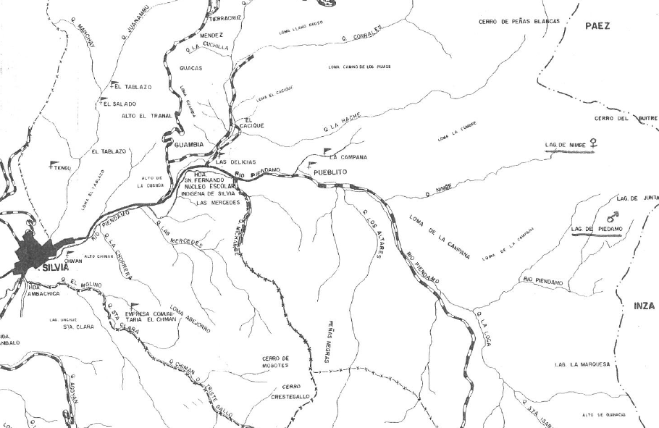
Municipio Silvia:
Population about 32 000 people
Average altitude: 2 800 m.

Slide 5
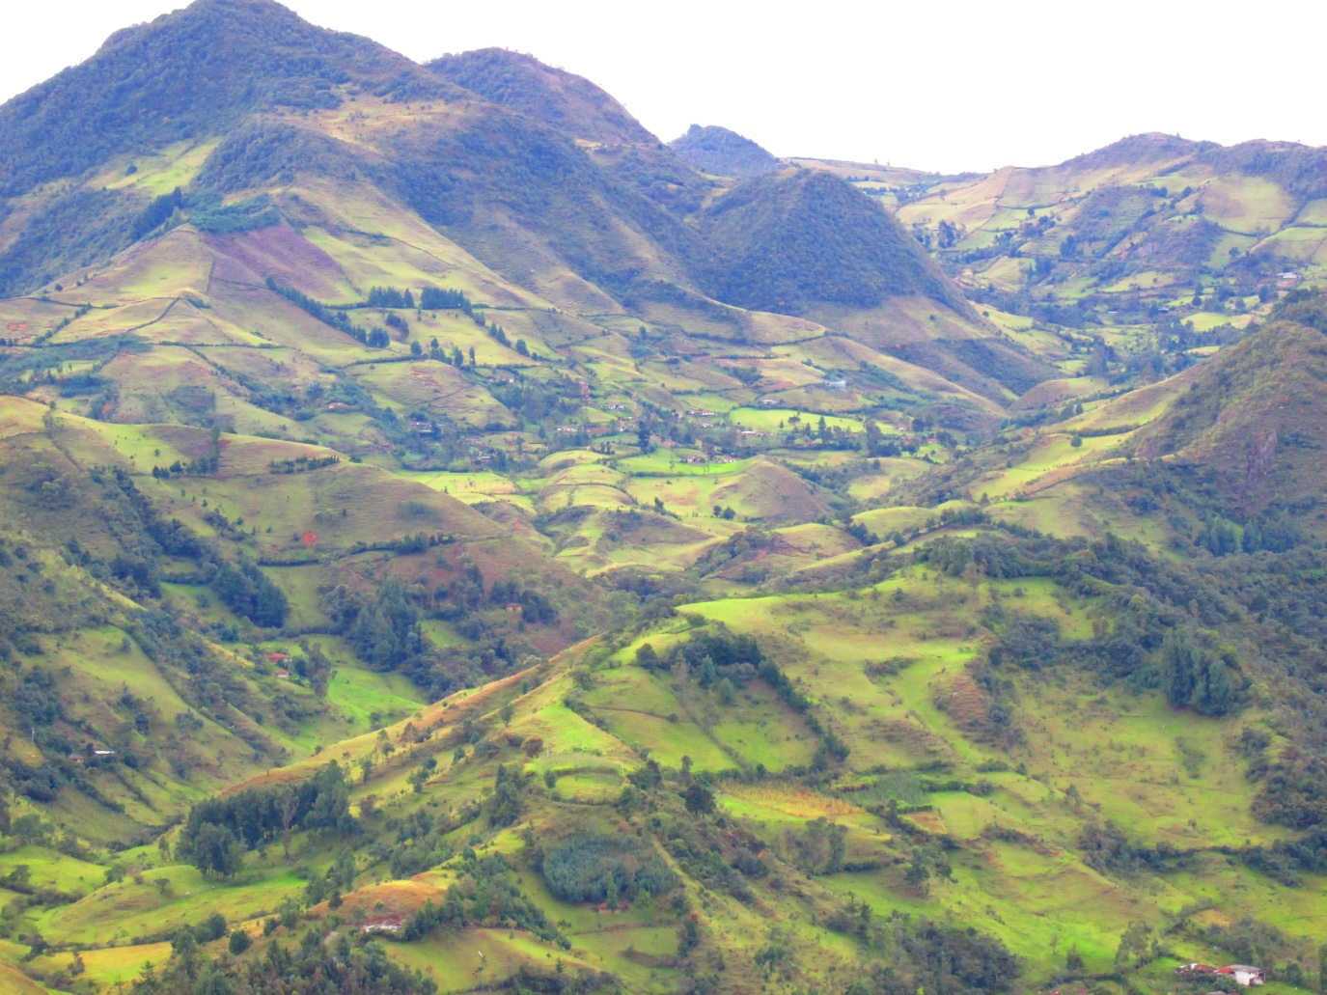
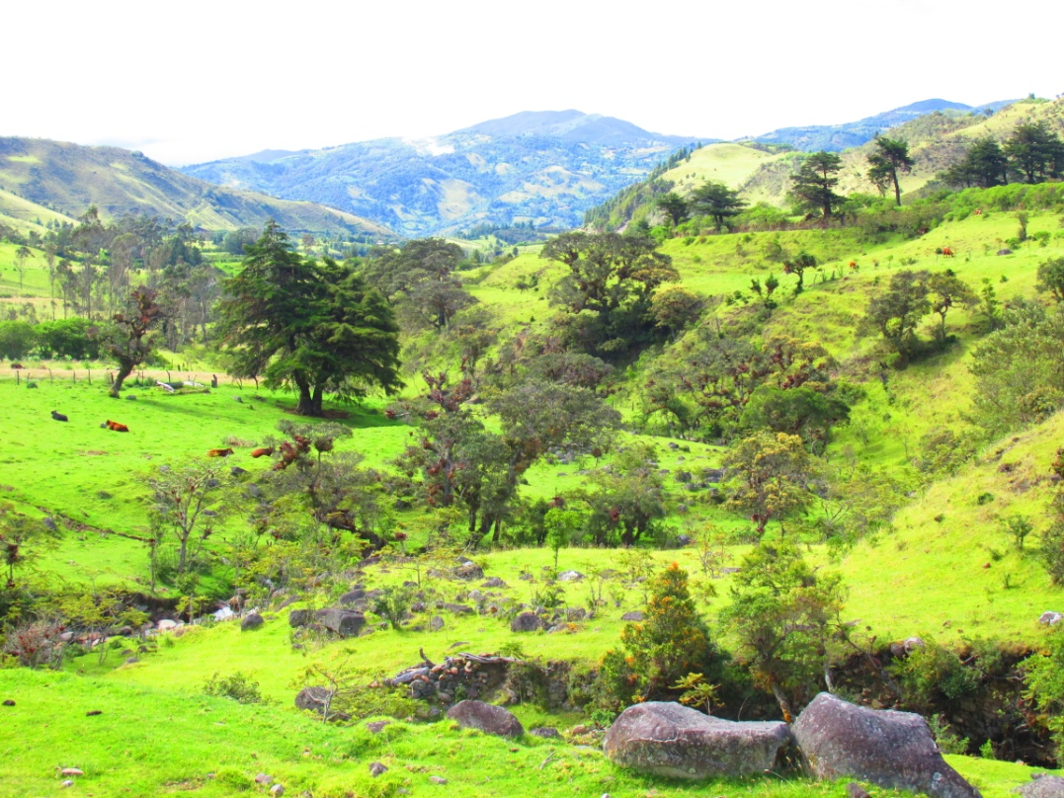
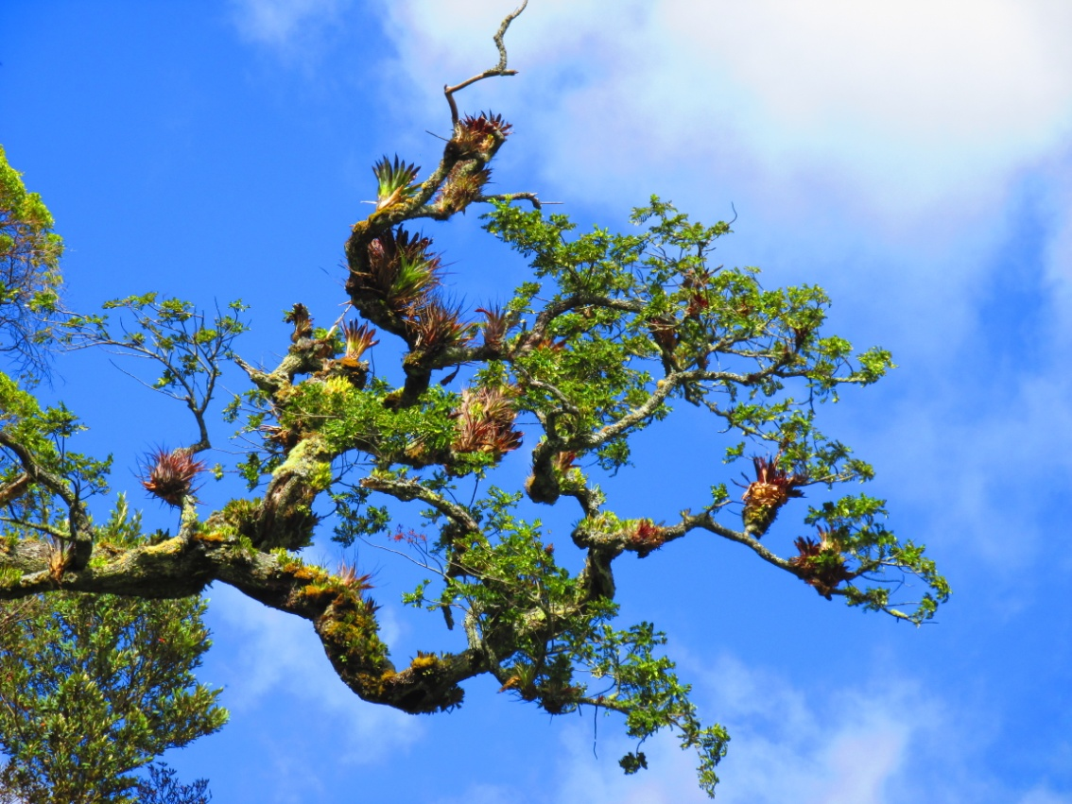
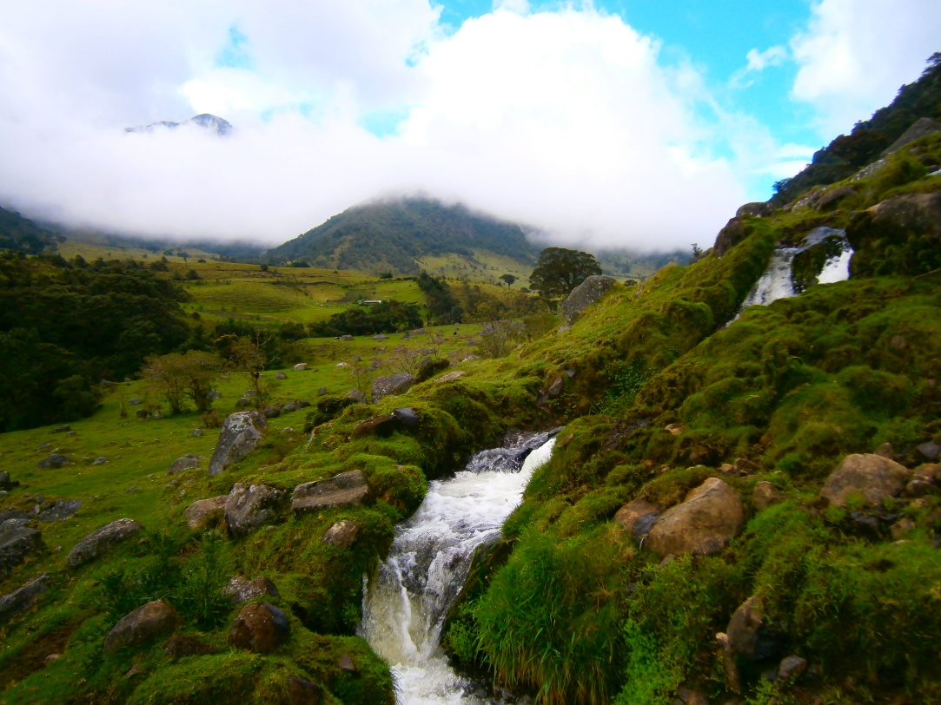
Typical countryside

Slide 6

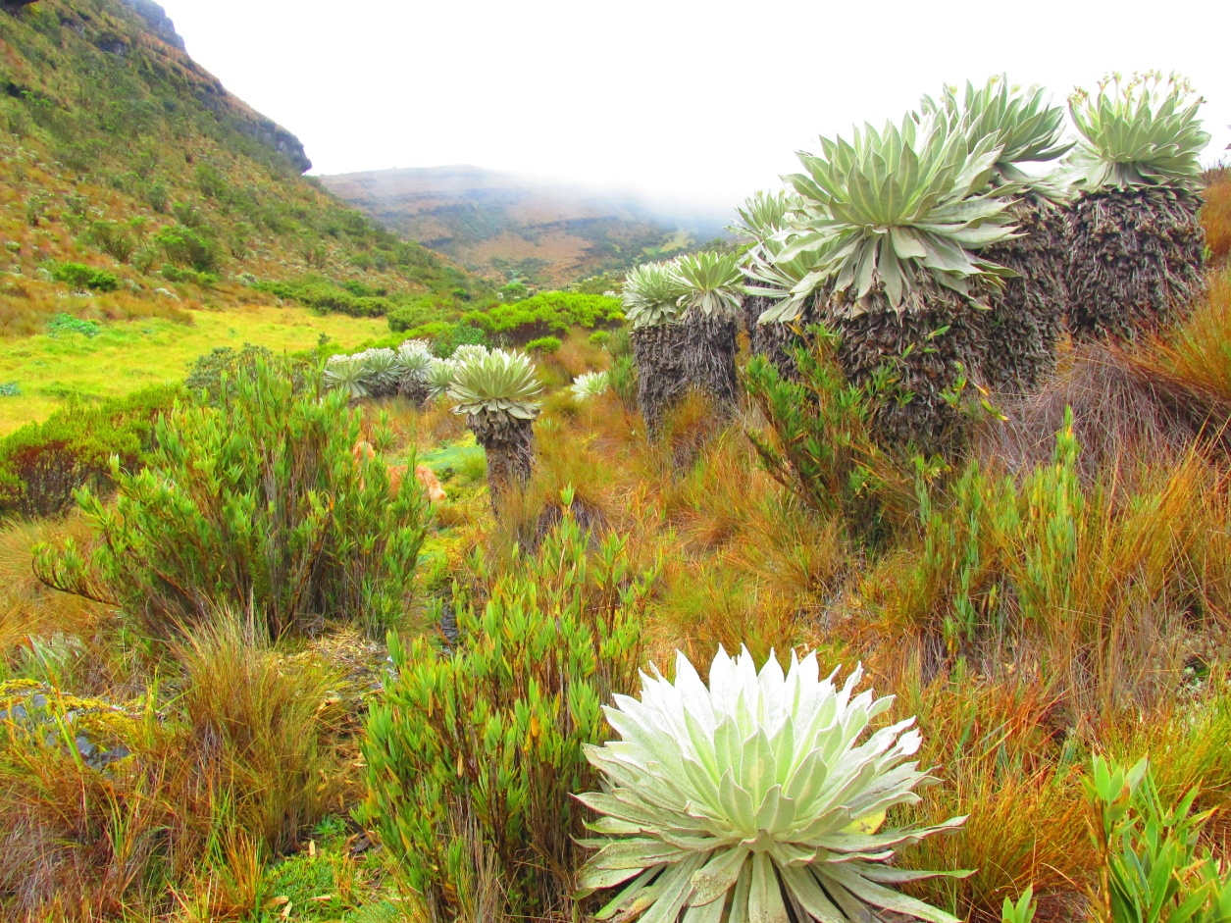
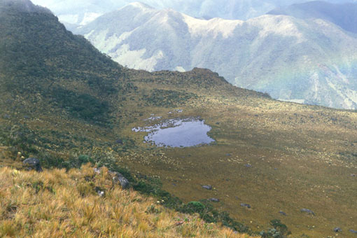
Páramos:
alpine tundra ecosystems.
Altitudes vary from 3000–4800 m. Areas of marshes, high-mountain plains and lakes.
High rainfall and big temperature differences.
Local tribes connect the area of páramos with KansrӨ, the realm of the dead.

Slide 7
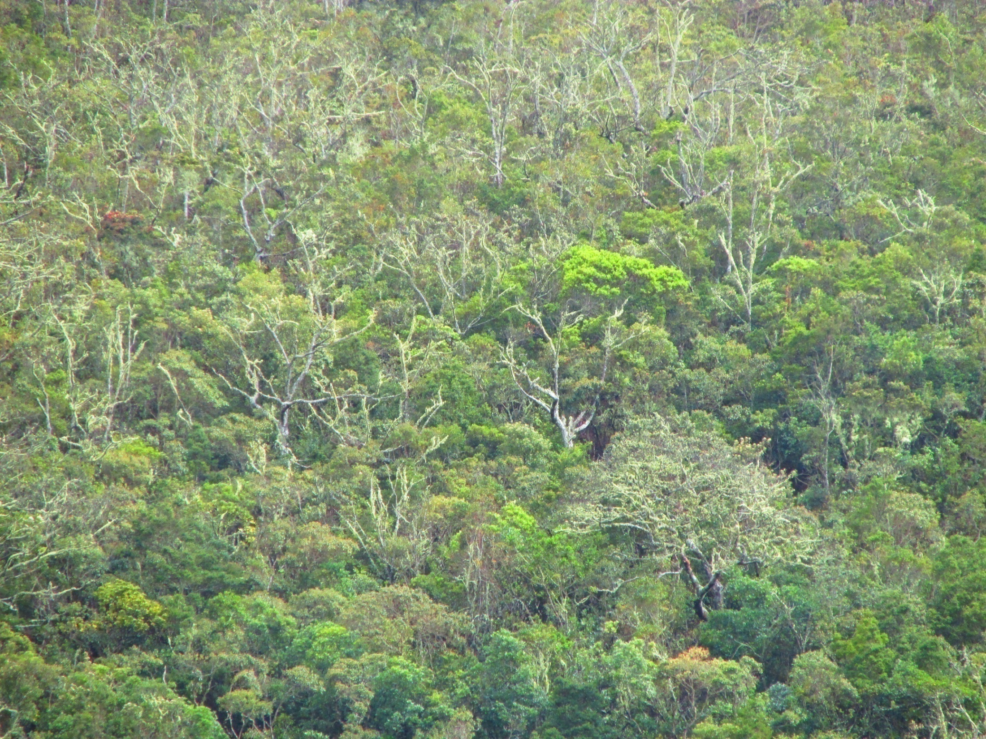
Tribes in North East Cauca (“Mother of forests”):
Misak (Guambianos)- language namuy wam (“our language”) or namtrik, population about 20 000 people. They call themselves piurek “children of water”.
Nasa (Paeces)- language nasa yuwe, population about 180 000 people.
Coconuco – about 6000 people living in the National Natural Park Puracé .
The languages are of so called Barbacoan family spoken in Colombia and Ecuador.
Probably related to Chibcha languages.

Slide 8
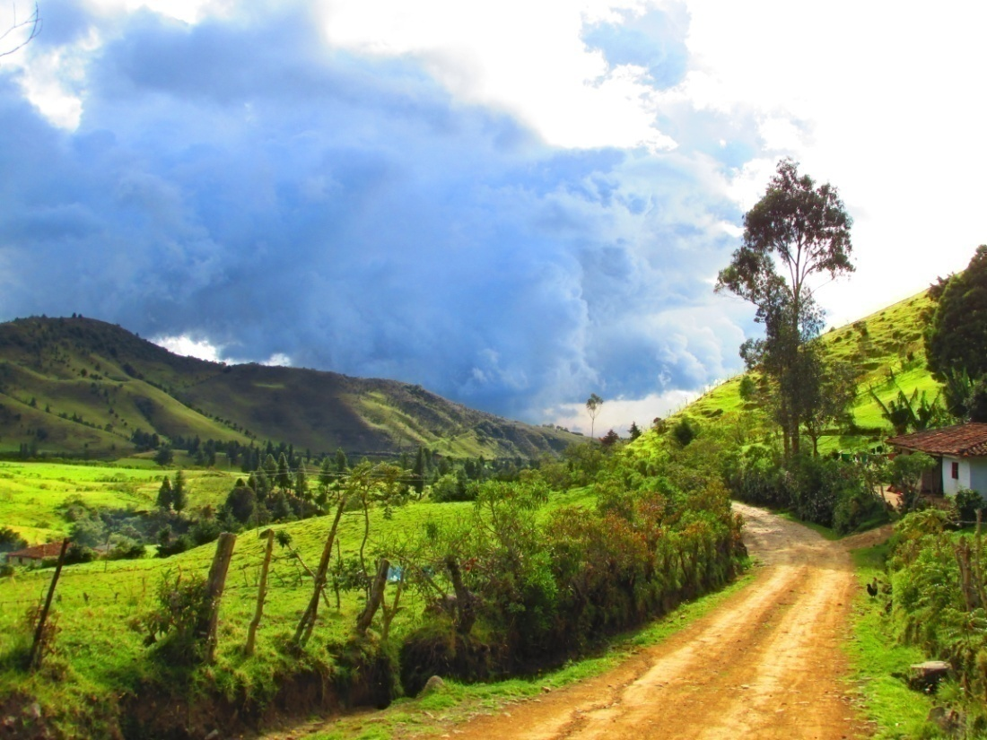
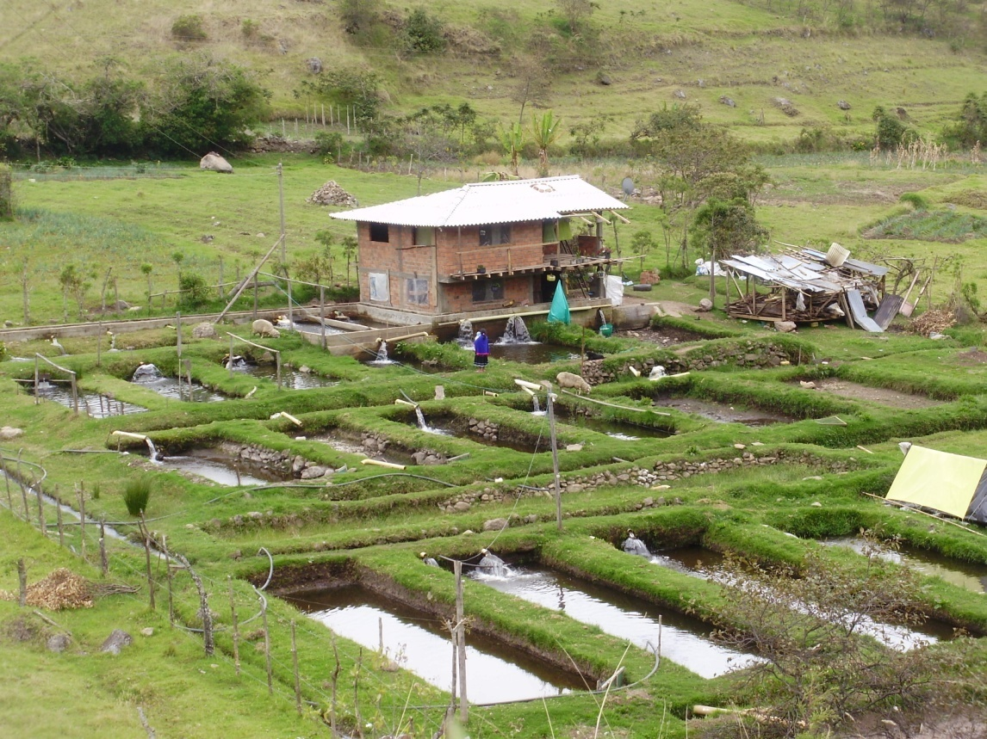
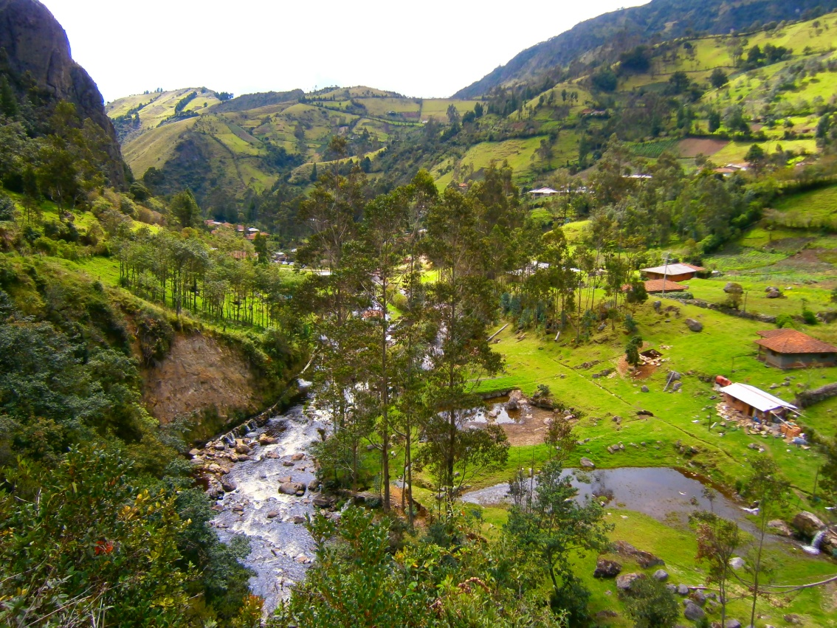
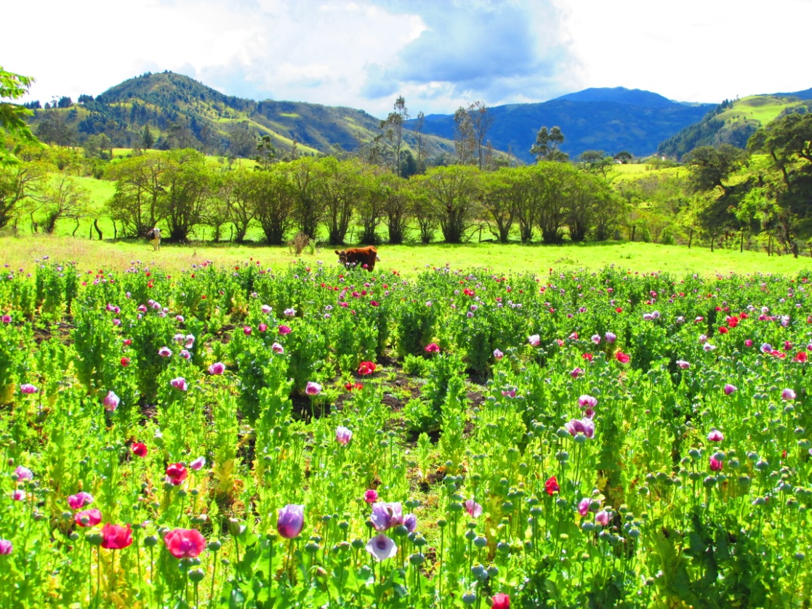

Slide 9
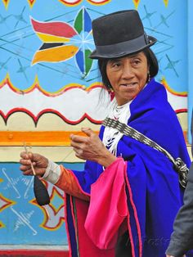
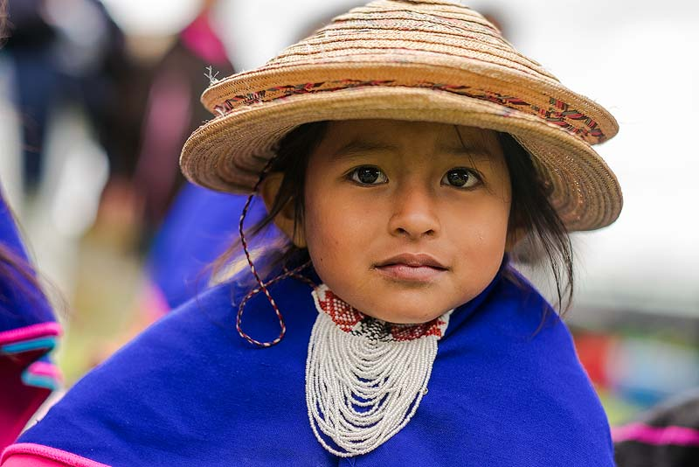
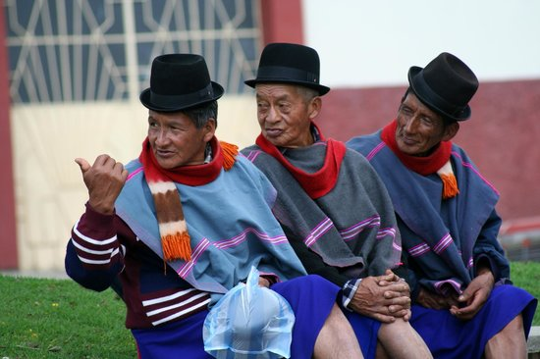
People of the Misak tribe

Slide 10
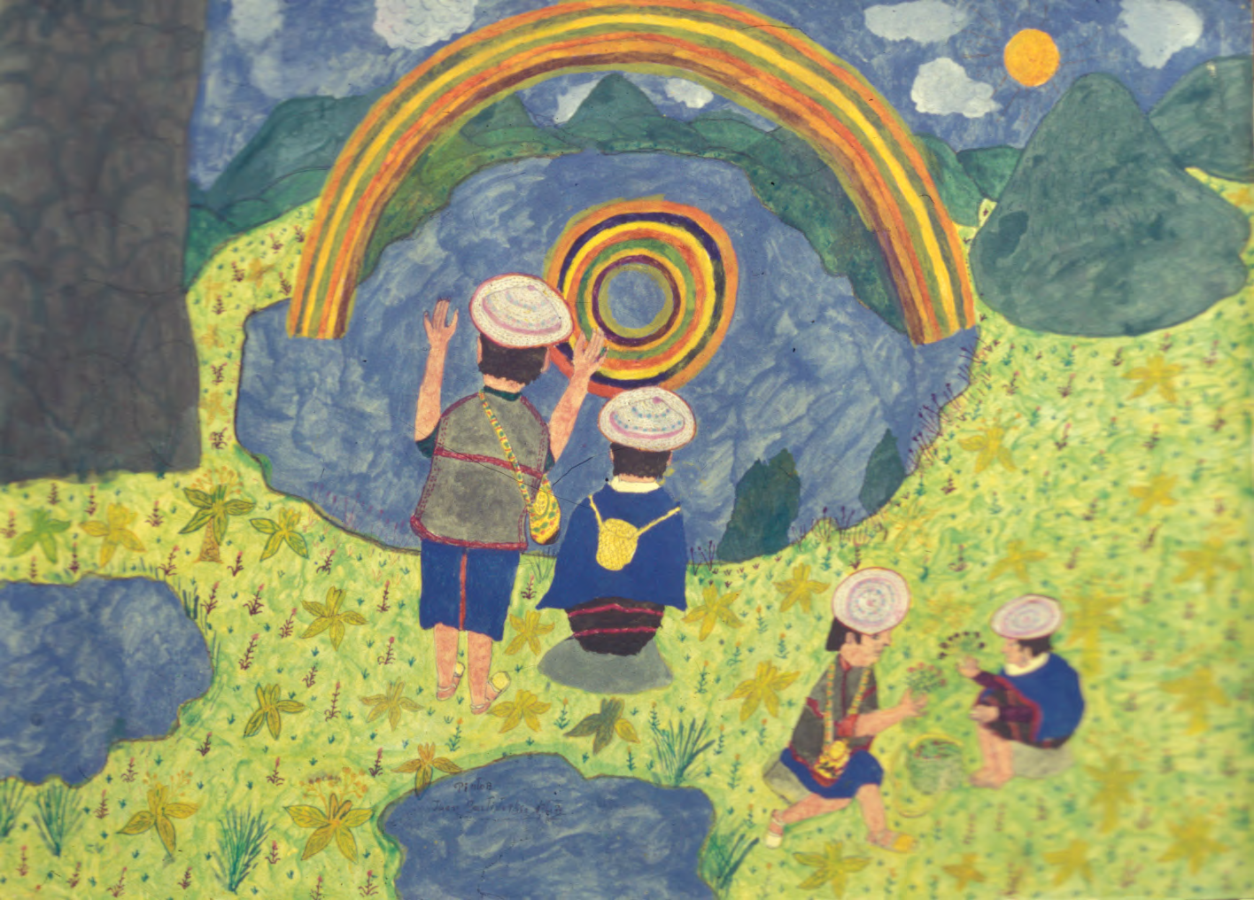
Picture by taita Juan Bautista Ussa Ulluné
Let`s start our journey into their spiritual world…

Slide 11

Time unfolds in a spiral. Misaks say that Time is actually a snail shell, srurrapu, which is constantly on the move. Only from our perspective, it moves backwards, so the past is in front of us and the future behind.

Slide 12
This important concept of Misak cosmology is reflected in their language, namtrik.
The tenses in namtrik are not expressed grammatically, but lexically.
To say that something happened in the past, we use the word metrap, which also means ahead, in front of.
To say that something is going to happen in the future, we use the word wente, which also means behind and symbolizes everything that is unknown and uncertain, for we can`t see it. It is placed behind us not only in time, but also in place.
Surprisingly, we can find similar time and space orientation in the religious literature of ancient Ugarit (today`s Syria), where the past was all that is found before us and the future all that is behind us. In the Ugaritic language, these expressions also corresponded with the west and east direction, where the east was in the front and the west behind.

Slide 13
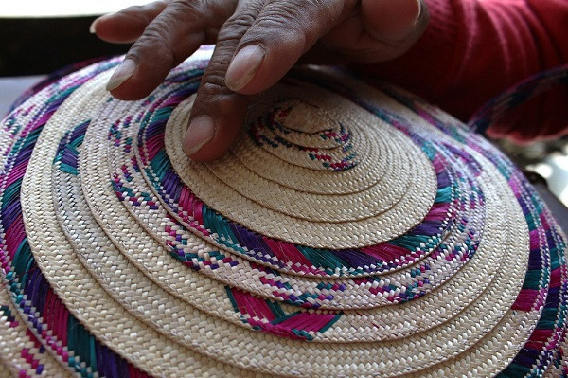
The traditional tampal kuari hat symbolizes the spiral of life with its most important stages, the Misak territory and the unfolding space-time of our whole universe.

Slide 14
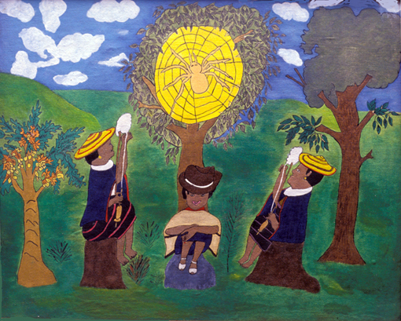
Picture by taita Juan Bautista Ussa Ulluné.
In everyday life, weaving on a loom represents the life cycle and the way the life of every individual is intertwined with the whole community, its history and all the land around. Thus everybody is attached to the central point of the Beginning. The spider`s web should remind us of this fact.

Slide 15

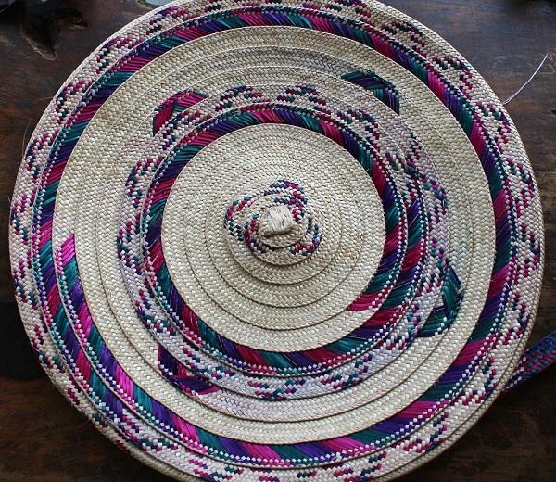

The spiral is a symbol of Time, Life and the known World.
When one life finishes or when one world finishes, there is a time period called spiritual return (mӨsik), then after some time the spirit is reborn once again.

Slide 16
Misak`s cosmology is principally based on dualities, which in their co-existence maintain the equilibrium of the World.
For example, all the plants, minerals, places, animals and even situations are of cold (pishi) or hot (pachi) essence. Misbalance of hot and cold causes illnesses (and medicine plants are used accordingly).
Even the greetings people use on everyday bases are chosen according to the fact if the moment is more of a cold or more of a hot nature. Thus when the Sun shines, hello is pachiteken, and when it is cold, it is pishiteken.
Similarly, when a Misak shaman (mӨrӨbik: the one who works with water) performs rituals of divination, he pays attention to the side from which specific sensations are coming. The left side represents all that is “positive” and the right side all that is “negative”. This is closely connected to the river Piendamó, which flows from the male lake Piendamó from the right side towards the left (From the east to the west, this basic rule of orientation was set according to the easterly winds, which prevail over the westerly winds in this part of the world, the direction of wind thus determines the fundamental direction of all movement).

Slide 17
On the left side, there are entities which represent well-being and “positive” energy like: the Sun, páramos, ancestors, wilderness, thunder, wild plants, warm-blooded animals, shamans and healers.
On the right side are entities which represent “negative” energy. Amongst them are: the Moon, plants of cold essence (mostly the plants of lower regions), cold-blooded animals, ice, death, rainbow etc.
This division of the world into two opposite principles can be easily compared to certain Asian philosophies (Chinese yin and yang).
This viewpoint corresponds even with the fact that in both cases the principles manifest themselves as contrary forces only in our material world (for they can`t exist one without the other, and each of them originated from the opposite principle- in order to balance the whole existence).
Thus for example “in the cold parts of the land, there are “warm” plants, while in the warm parts of the land are those of “cold” essence… it is the same with people, those with cold blood live in the valleys, and those with warm blood high in the mountains…” (Hugo Portela Guarín, El pensamiento de las aguas de las montañas, p. 37)

Slide 18
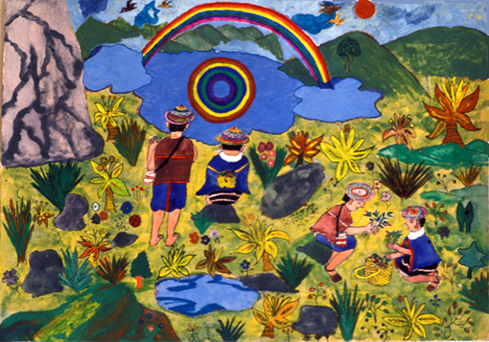
Picture by taita Juan Bautista Ussa Ulluné

Slide 19
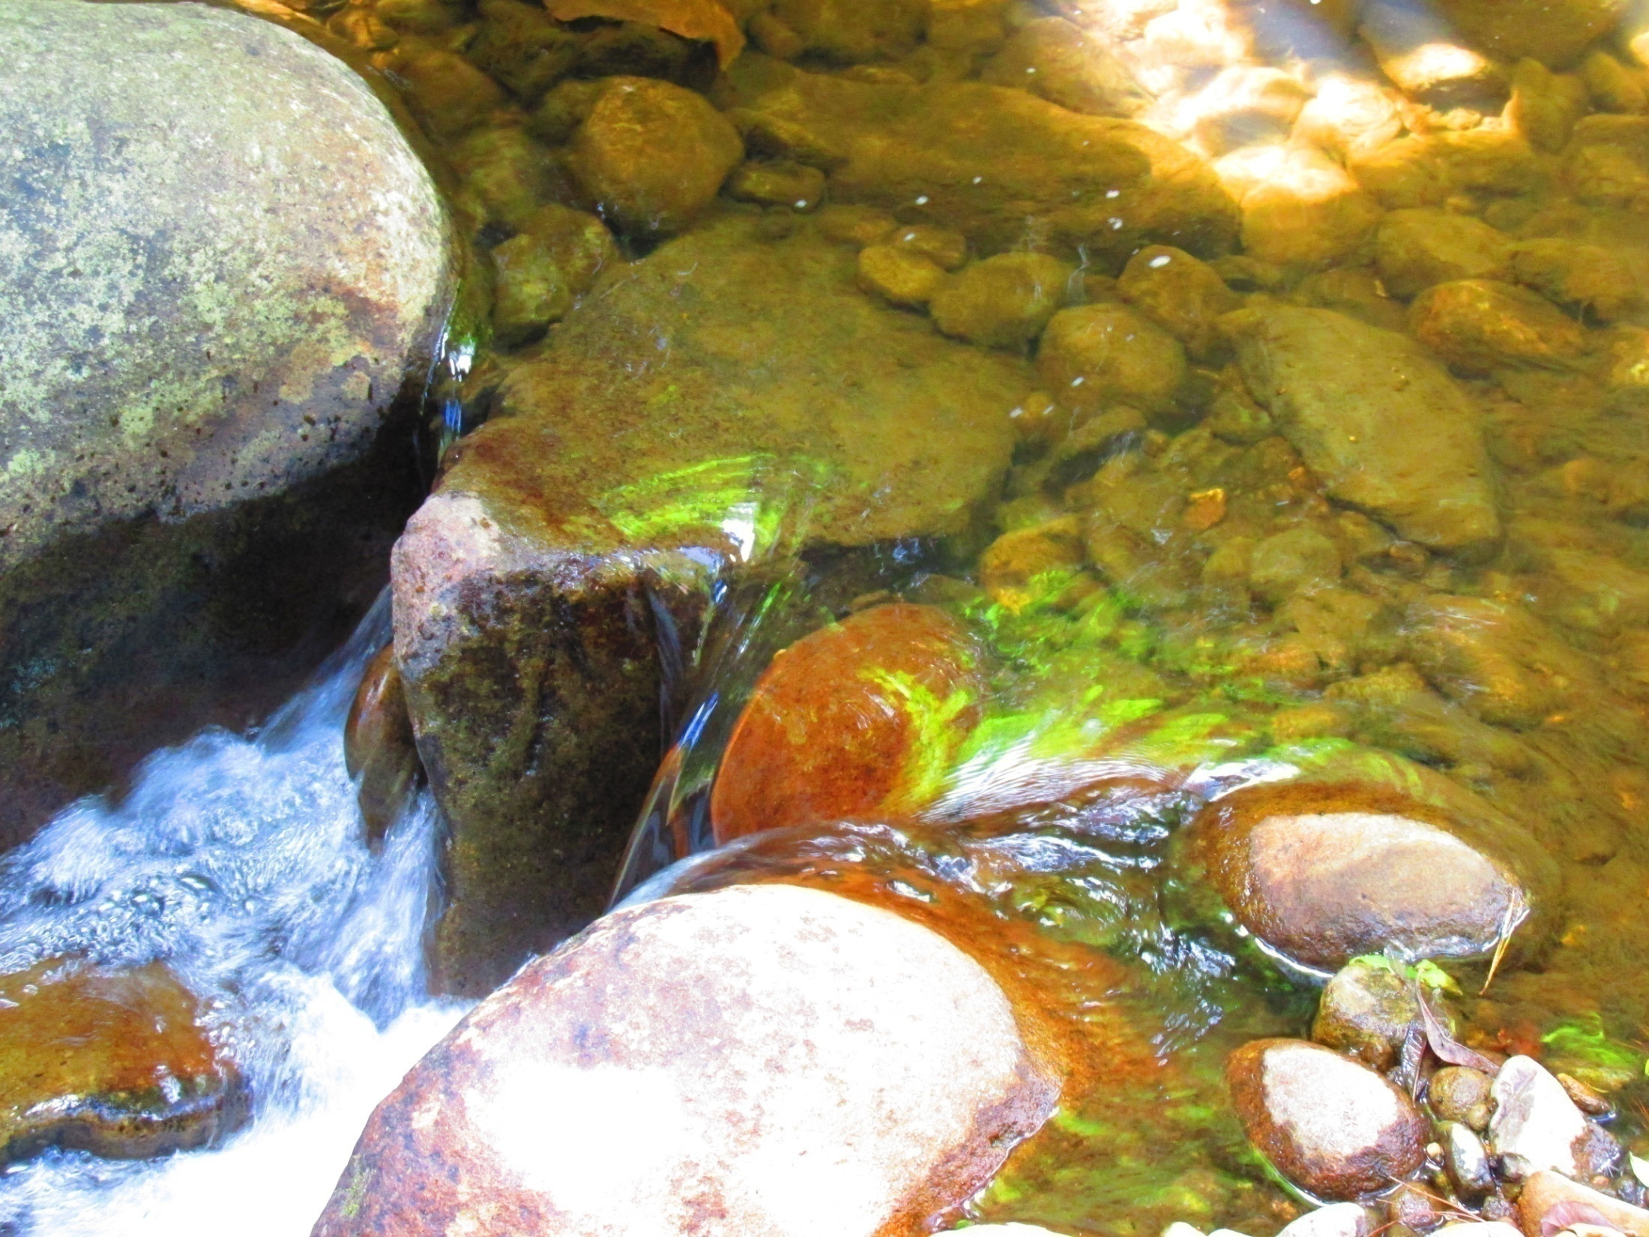
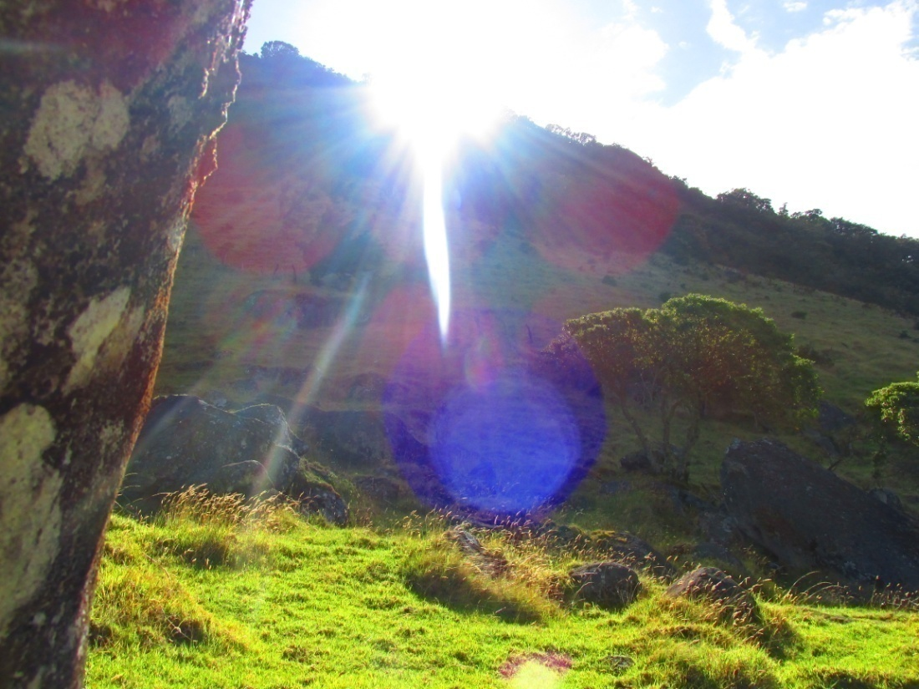
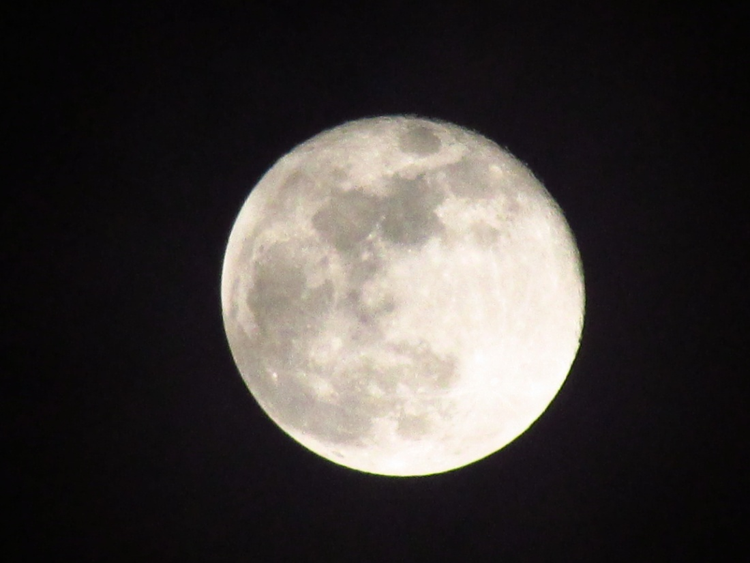
Similarly, when one`s life spiral comes to the end, the soul of the deceased splits into two. One part is the Moon, dark spirit, yem mӨsik, which wants to stay where it used to live…
…While the other one is the Sun, light spirit, pӨsr mӨsik, which departs for kansrӨ, dissolves in the basic elements of the Great Spirit (the wind, water and earth) and is eventually reborn.

Slide 20
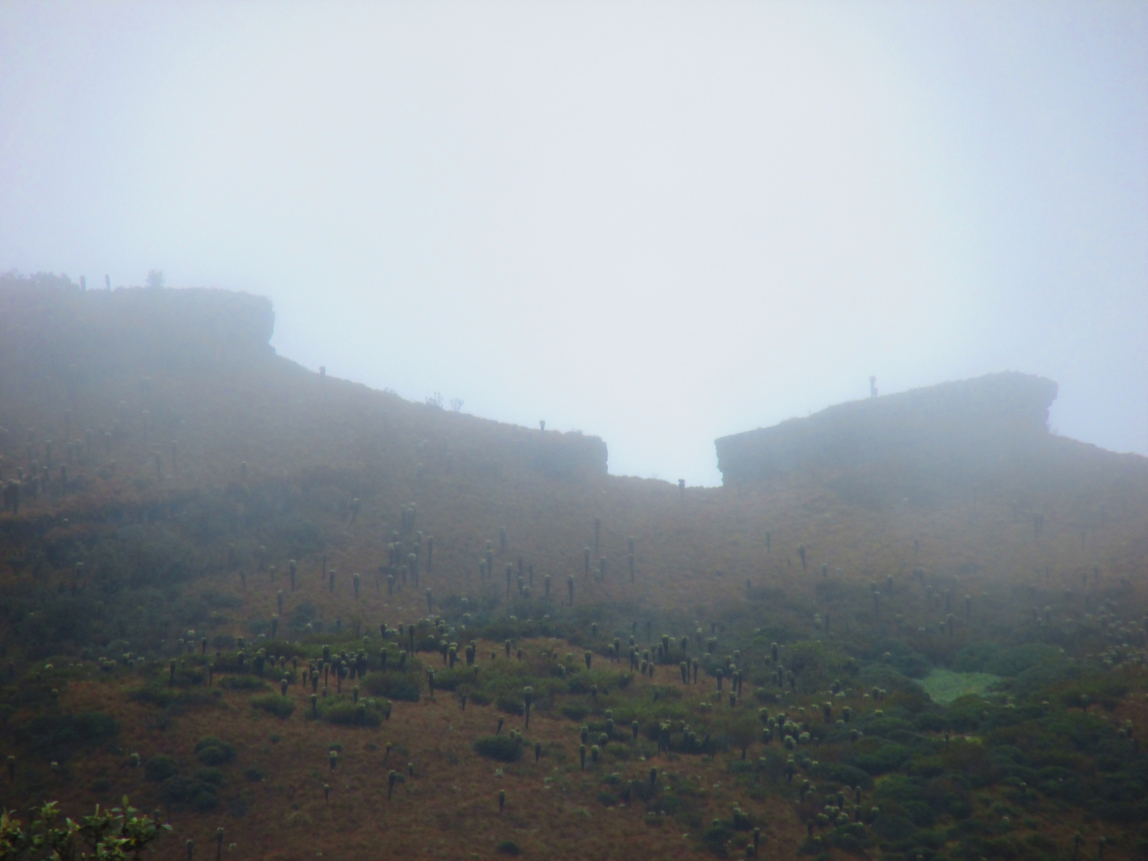
KansrӨ, the Realm of the Dead, is said to be located in páramos, the Andean mountain highland plains. It is believed that the spirits actually reside there and that is why páramos are considered sacred places. This together with the arrow of time means that the Misaks can “see” their ancestors, those who “walk before them”.
“... Thus those who have already passed through this world, opened the path and showed us which way to walk. And so the Misaks of today walk in the footprints of their great tatas, whose work thus hasn`t yet been completed... “
(Luis Guillermo Vasco Uribe, Hijos del Aroiris y del Agua)
In the same manner, when one`s life spiral comes to the end, the soul of the deceased splits into two. One part is the Moon, dark spirit, yon musik, which wants to stay where it used to live…
…While the other one is the Sun, light spirit, posr musik, which departs for Kanre, eventually dissolves in the Great Spirit (which is divided into three great spirits of three basic elements: air, water and earth) and is eventually reborn.

Slide 21
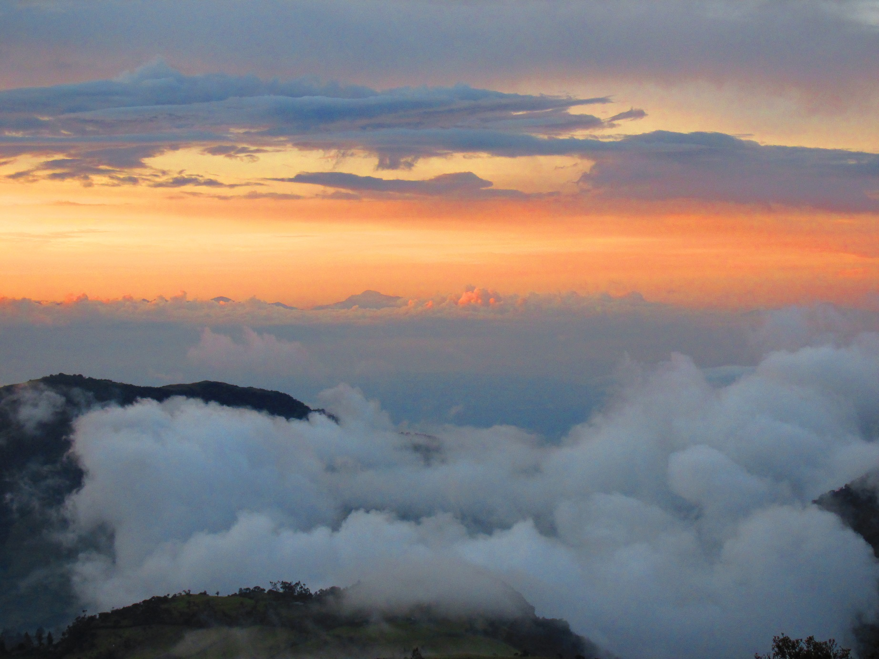
There are three underworld beasts and one demonic spirit that come when somebody is dying. These four make sure that the spirit of the deceased leaves the dead body…

Slide 22
They are:
Yemwasre(an eagle), Kuawera (a demonic dog) and Kuskunku (an owl). The fourth is Kuanmusik (a spirit of a dead person).
Kuanmusik persuades the spirit (the dark part of the spirit) of the newly deceased person to leave the body and then whistles to the demonic beasts to pursue the escaping spirit to the páramos. There they attack the spirit and start biting off its flesh and pecking at its bones.
This was connected to the practice of burying the dead after the bruises caused by these demonic animals have appeared on their skin. This custom has now been replaced and the deceased is buried as soon as possible).

Slide 23
Nowadays, Christian funeral customs have merged with the original tribal ones.
Funeral now includes a mass held in Silvia or Las Delicias (towns in Cauca), a funeral procession, the burial itself and cleansing ceremonies.
The deceased is dressed in western clothes , for there is a common belief that western clothes don`t burn in Hell. The Misak clothes is burnt with other things of personal possession.
The mourning period of nine days is followed by cleansing ceremonies performed by the local mӨrӨbik, shaman.
During those nine days, neighbours and family relatives help the family of the deceased. They bring them food and drink, for the household of the dead person is contaminated by pape
(strong contamination of cold essence which attracts illnesses, evil and malicious spirits), and so cooking is prohibited until the arrival of the shaman who performs the purification rituals.

Slide 24
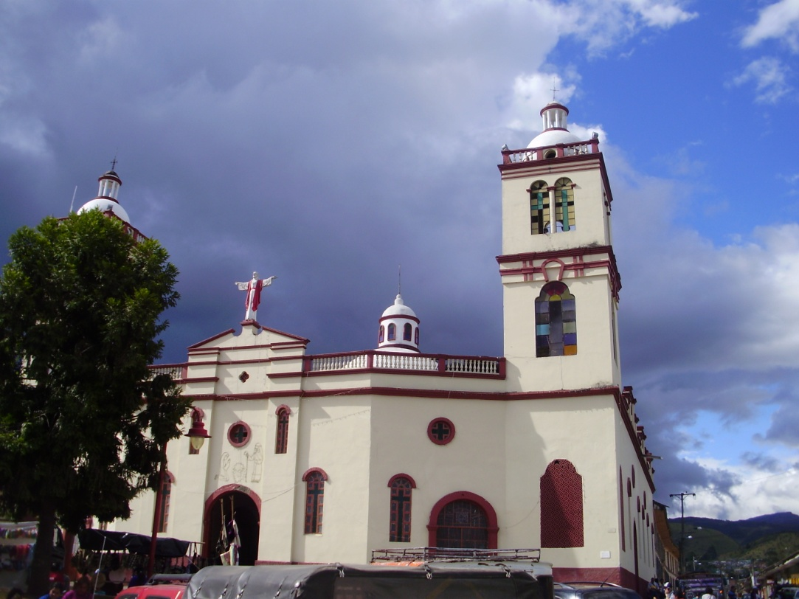
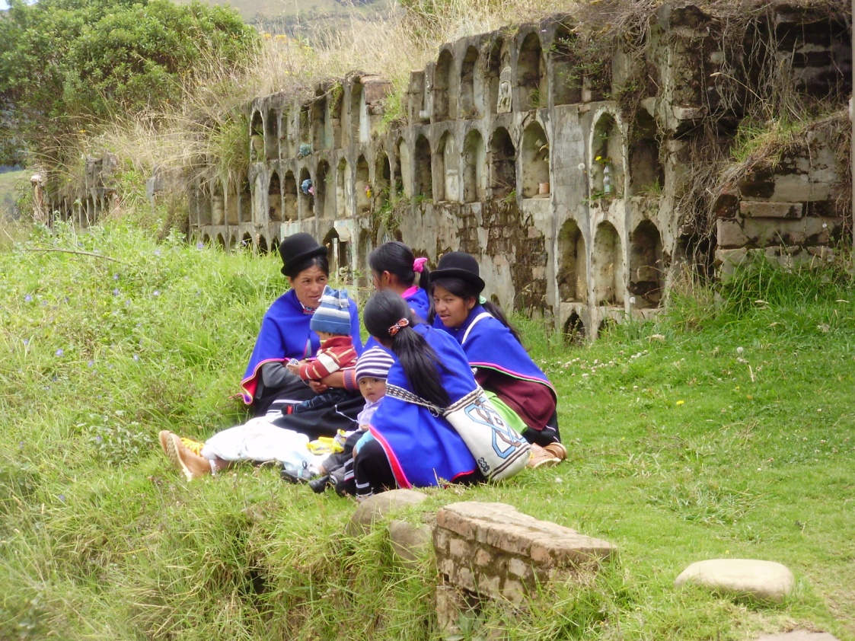
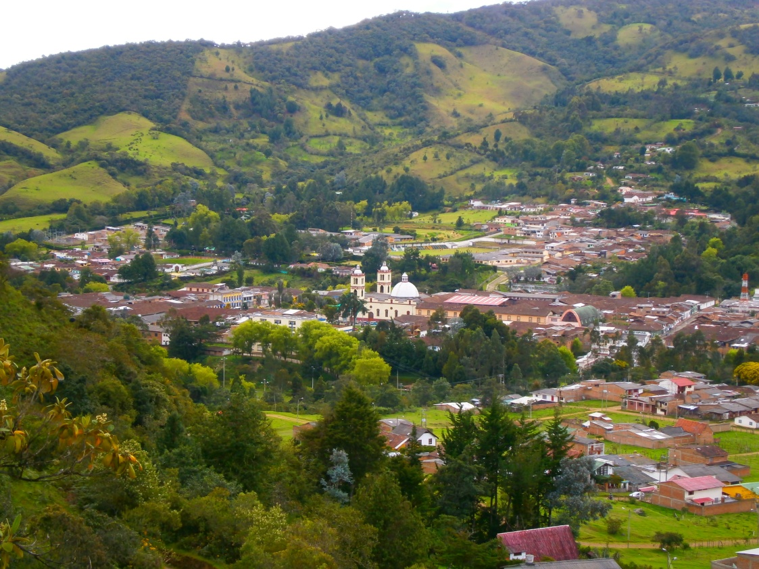
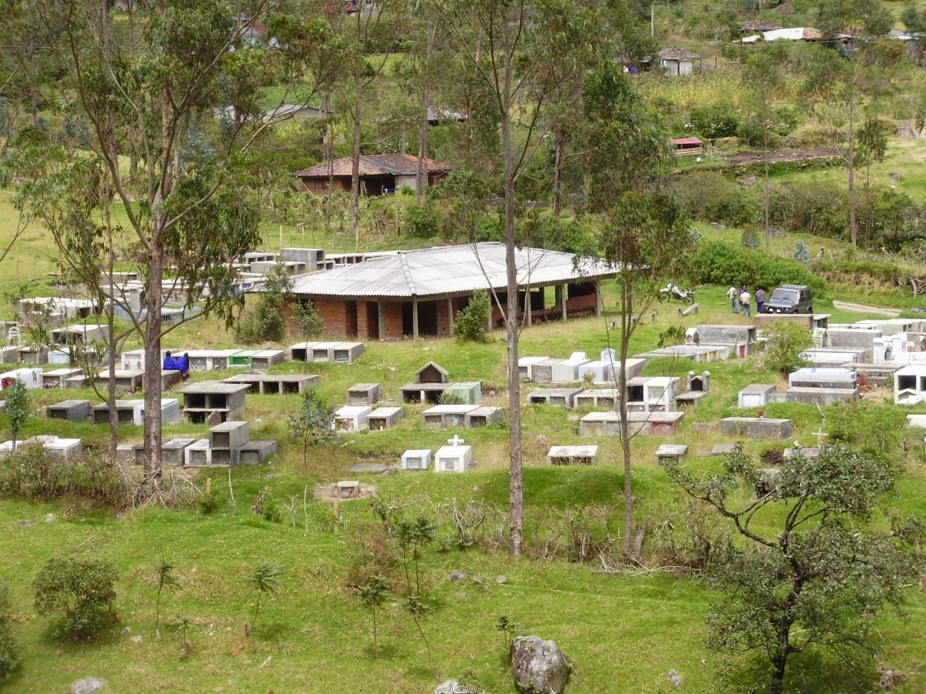

Slide 25
Shaman, merebik, arrives 9 days after the death to perform the purification ceremonies.
The yem mesik, “dark spirit” doesn`t want to leave its home and clutches to its formal material possessions. That is why most of the personal possessions, and especially the Misak clothes of the deceased are instantaneously taken outside the house to be burnt.

Slide 26
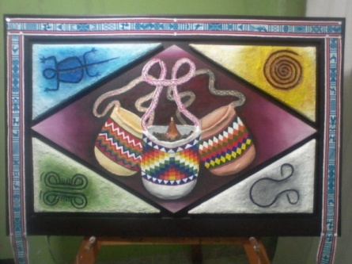
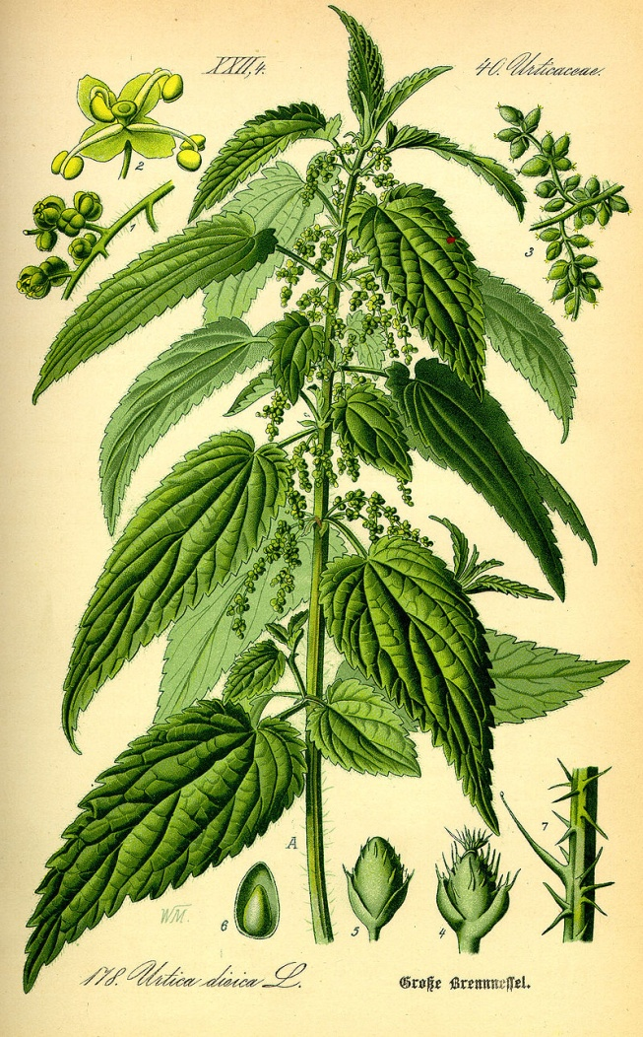
For the cleansing ceremony, shaman is generously paid. The rituals themselves involve using a lot of various herbs, tobacco and homemade liquor.
The shaman works at night and his work consists of sensing the spirit on his left or right side, smoking tobacco, burning herbs, libations and alcohol spitting. At the very end of the ceremony, the spirit is chased around the house three times and whipped with stinging nettles.
Shaman`s provisions are placed in a jigra, (a ceremonial woven bag) and include herbs, alcohol and tobacco needed for the rituals and some money.

Slide 27
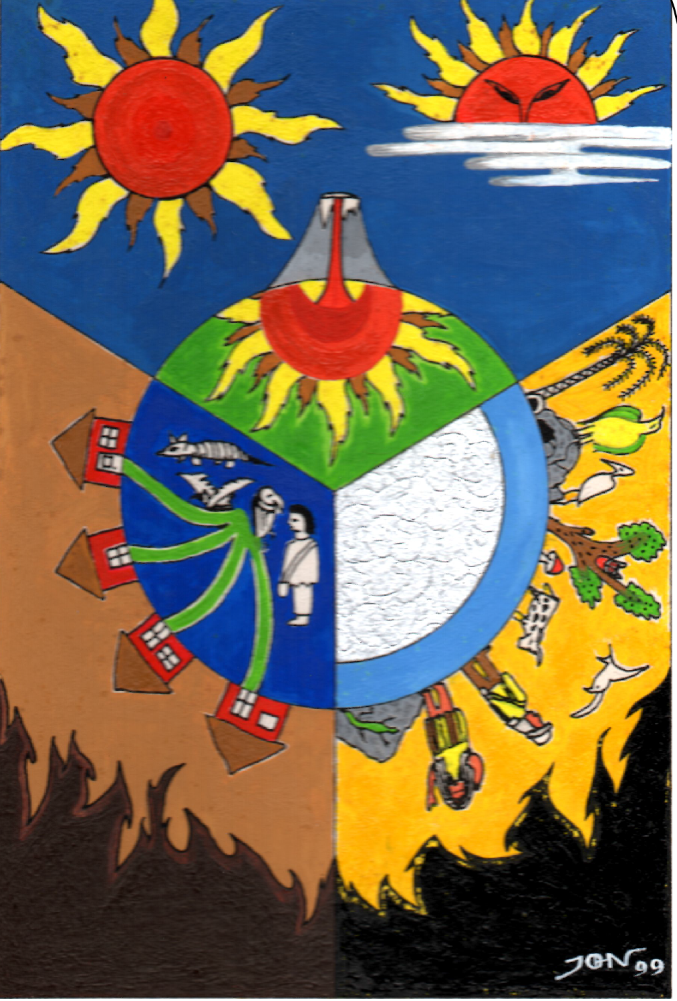
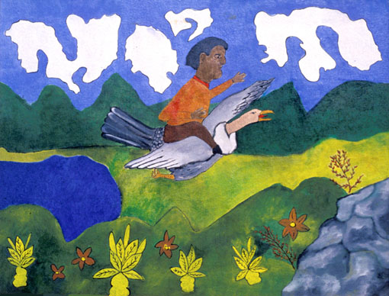
Picture by taita Juan Bautista Ussa Ulluné.
The importance of a shaman: his access to the four spheres of existence and his connection to certain powerful animals.
Picture by Jhon Ferney López Muñoz

Slide 28
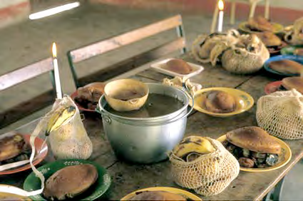
Festival of Offerings
Originally, this festival was celebrated with the first rainfall after the dry season and thus marked the beginning of the new agricultural year, which used to be usually at the end of September or throughout the first half of October.
Today, this festival has merged with the All Saints Day, on the first of November. On this day, people prepare food and drink for the spirits of their deceased (in here they specify that it is the Sun spirit, pesr mesik, which returns).
Offerings consists of prepared and raw food placed in ceremonial jigras (woven bags). For drink, spirits can choose from coffee, hot chocolate, hot sugar cane water or specially made chicha (fermented corn drink). The offerings differ in case the deceased was a child. (Compare Andean cultures, esp. Cochabamba, Bolivia)
Today, the offerings are usually performed in community centres and at schools.

Slide 29
In the cosmology of the south-west Cauca tribes, spirits of the deceased ancestors are believed to stay with their descendants and influence the life of the present community forever. This is explained in several ways:
When the spirits come for the offering ceremony each year, they cry. Their tears are the raindrops of the first rain in the farming season. And so the tears of the ancestors themselves water the seeds of the coming crop providing food for their descendants.
Kansre is a real place in our very world. It is situated in the sacred places of the páramos, high in the mountains. Moreover, people can`t really cease to exist, they just leave for Kansre, from where they return every year.
The time current moves in a spiral, and from our point of view backwards, that is why we can always see our ancestors, follow their example and ask them for advice. Moreover, their work is not yet completed for they are attached to the filament of life to the centre of the origin, they are just moving in time, but are still present in this world.

Slide 30
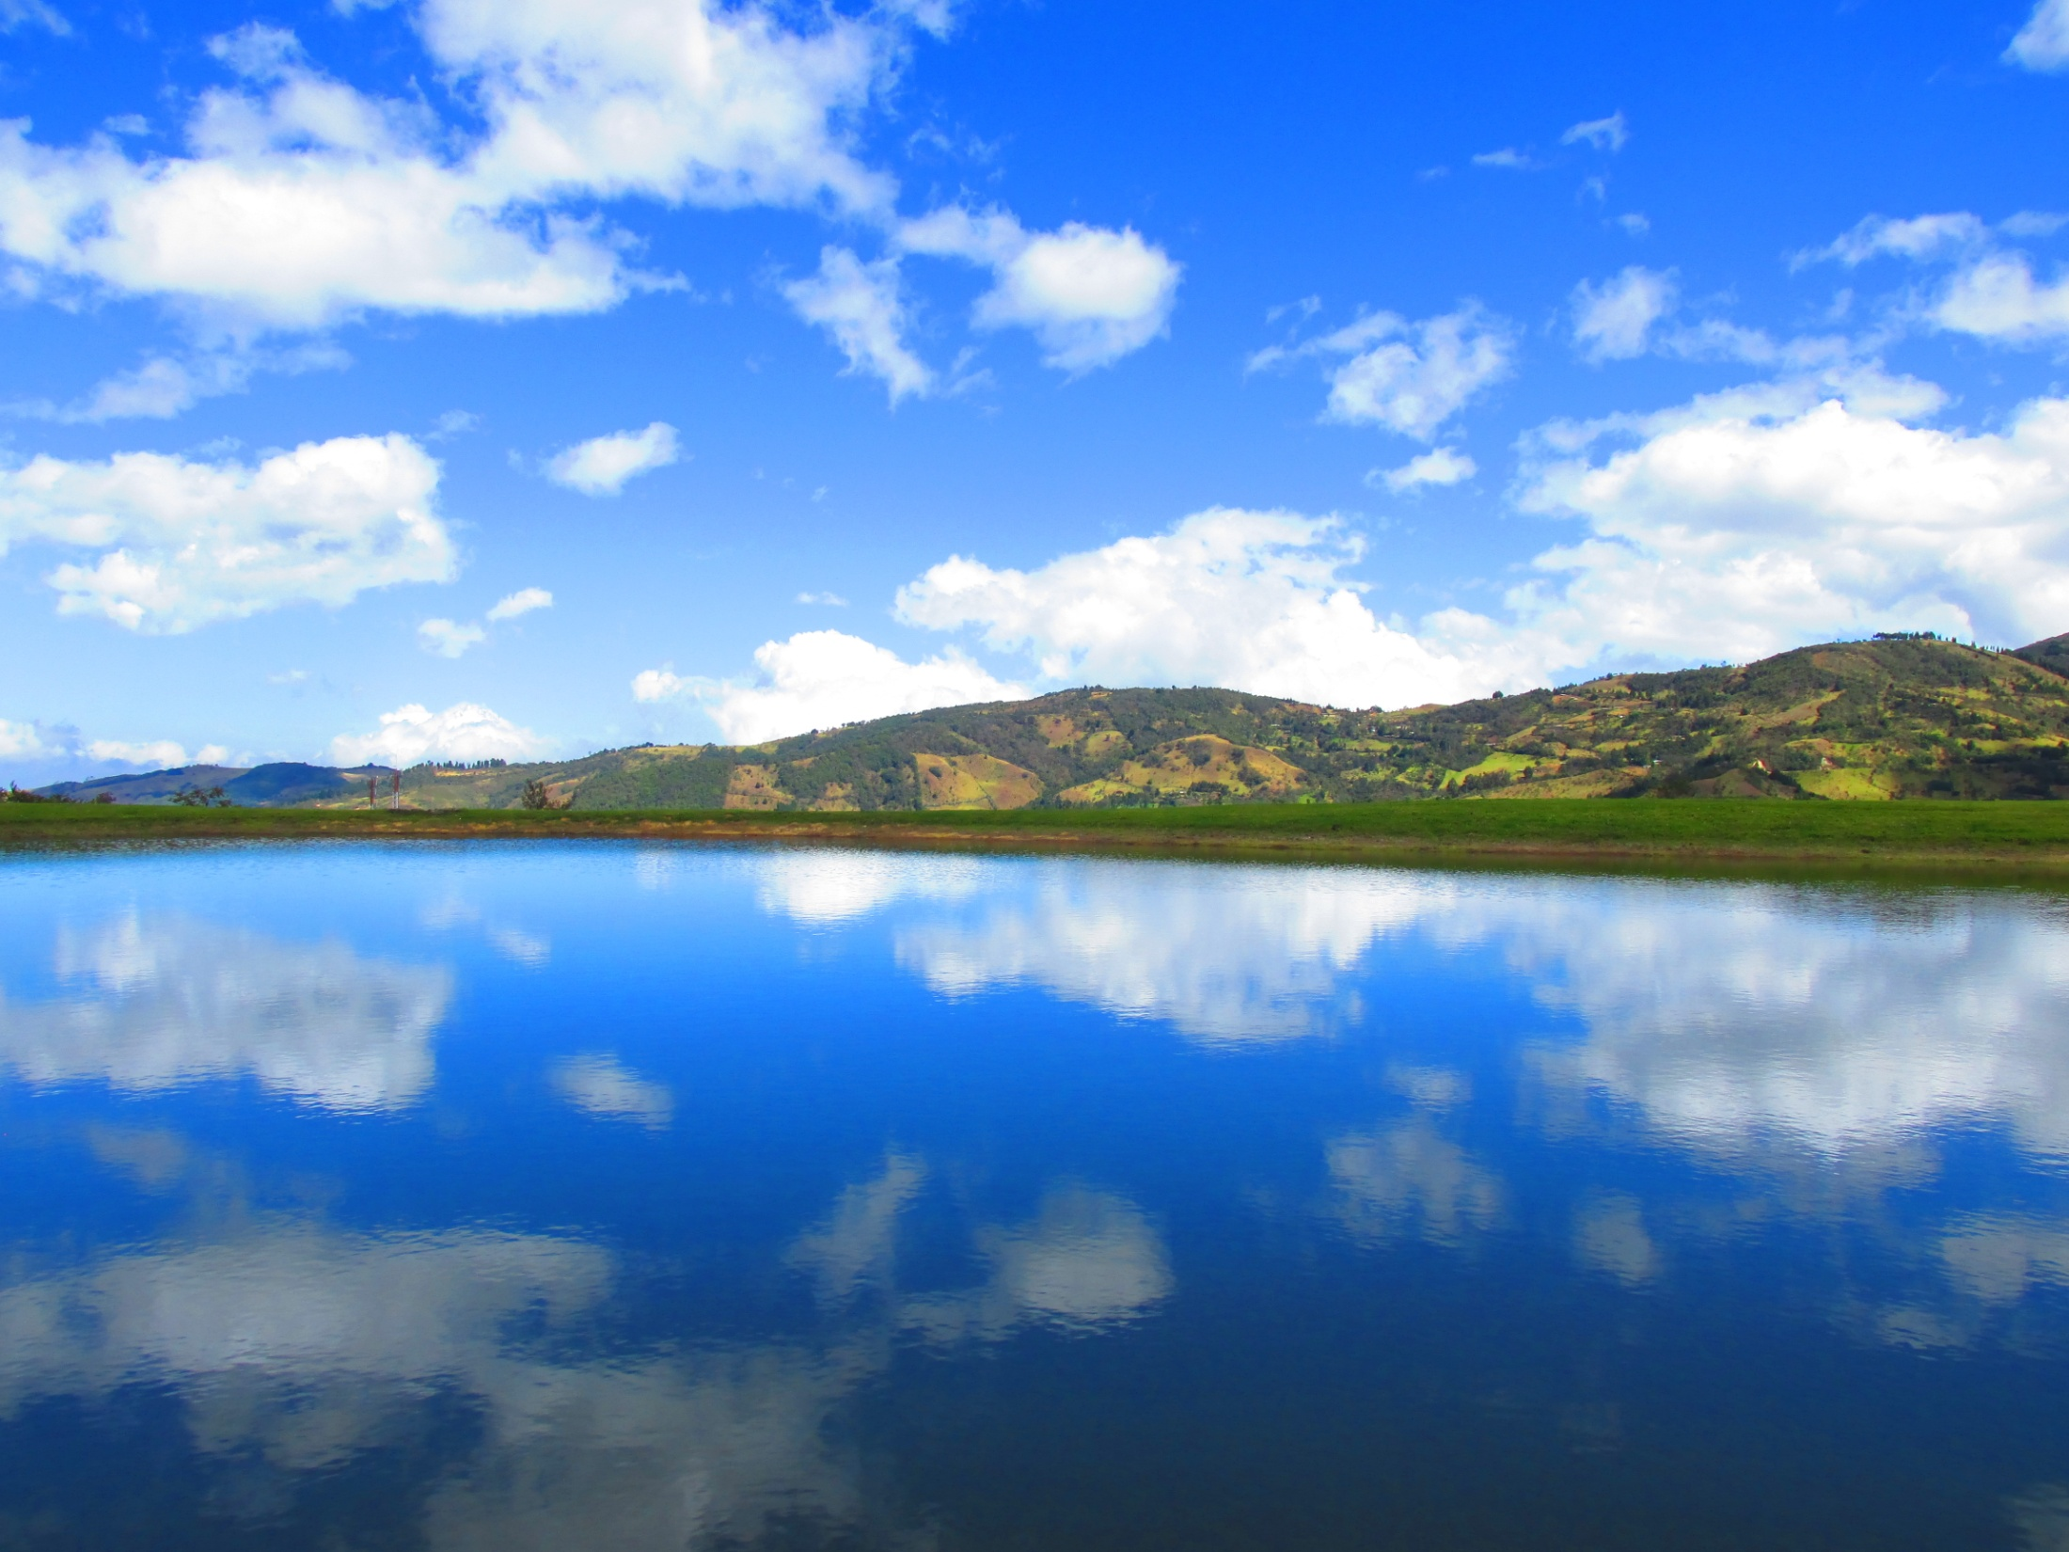
Thank you

Slide 31
Materials:
Abelino Aranda, Luis Guillermo Vasco Uribe, Hijos del Aroiris y del Agua, 2015,
Universidad Nacional de Colombia, Colombia.
Hugo Portela Guarín, El Pensamiento de las Aguas de las Montañas (Coconucos, Guambianos, Paeces, Yanaconas), 2000, Universidad del Cauca, Popayán, Colombia.
Judy Branks and Juan Bautista Sánchez, The Drama of Life (A Study of Life Cycle Customs Among the Guambiano Colombia, South America), 1978, 2011, SIL International, USA.
Walter Krickeberg, Mitos y Leyendas de los Aztecas, Incas, Mayas y Muiscas, 1971, México.
Tulio Rojas Curieux, Adonías Perdomo Dizú, Martha Helena Corrales Carvajal, Una Mirada al Habla Nasa Yuwe de Novirao, 2009, Universidad del Cauca, Colombia.
Mario García Isaza, Gramática Páez, 1996, Prefectura Apostólica de Tierradentro, Belalcázar, Cauca, Colombia.
Lilia Triviño, Bárbara Muelas y equipo colaborador, Gramática Pedagógica de la Lengua Namtrik para Maestros Misak, 2011, Universidad del Cauca, Cali, Colombia.

Slide 32
Gregorio Alberto Yalanda Muelas, Relación entre la Música Tradicional y el Ciclo de Vida de los Misak, 2013, Observatorio del Patrimonio Cultural y Arqueológico OPCA.
Grupo Linguistico de Guambía, Wabia MisaabirӨ, 1986, Popayán, Colombia.
Beatriz Vasquez de Ruiz, Lenguas Aborigenes de Colombia, Descripciones 2, La predicacion en Guambiano, 1988, Universidad de los Andes, Bogotá.
David Lorente Fernández, El «frío» y el «calor» en el sistema médico nahua de la Sierra de Texcoco. Una aproximación. Revista Española de Antropología Americana. 2012, vol. 42, núm. 1, 243-266.
Víctor Bascopé Caero, El Sentido de la Muerte em la Cosmovisión Andina: El Caso de los Valles Andinos de Cochabamba, 2000, Cochabamba, Bolivia.
Léxico de la Lengua Namtrik de Totoró, Comunidad del Resguardo Indígena de Totoró.
Primera edición. 2009. Totoró. Colombia. Lilia Triviño Garzón, Algunas particularidades de los verbos de posición en la lengua guambiana, 2004-2005, Universidad del Cauca.

Slide 33
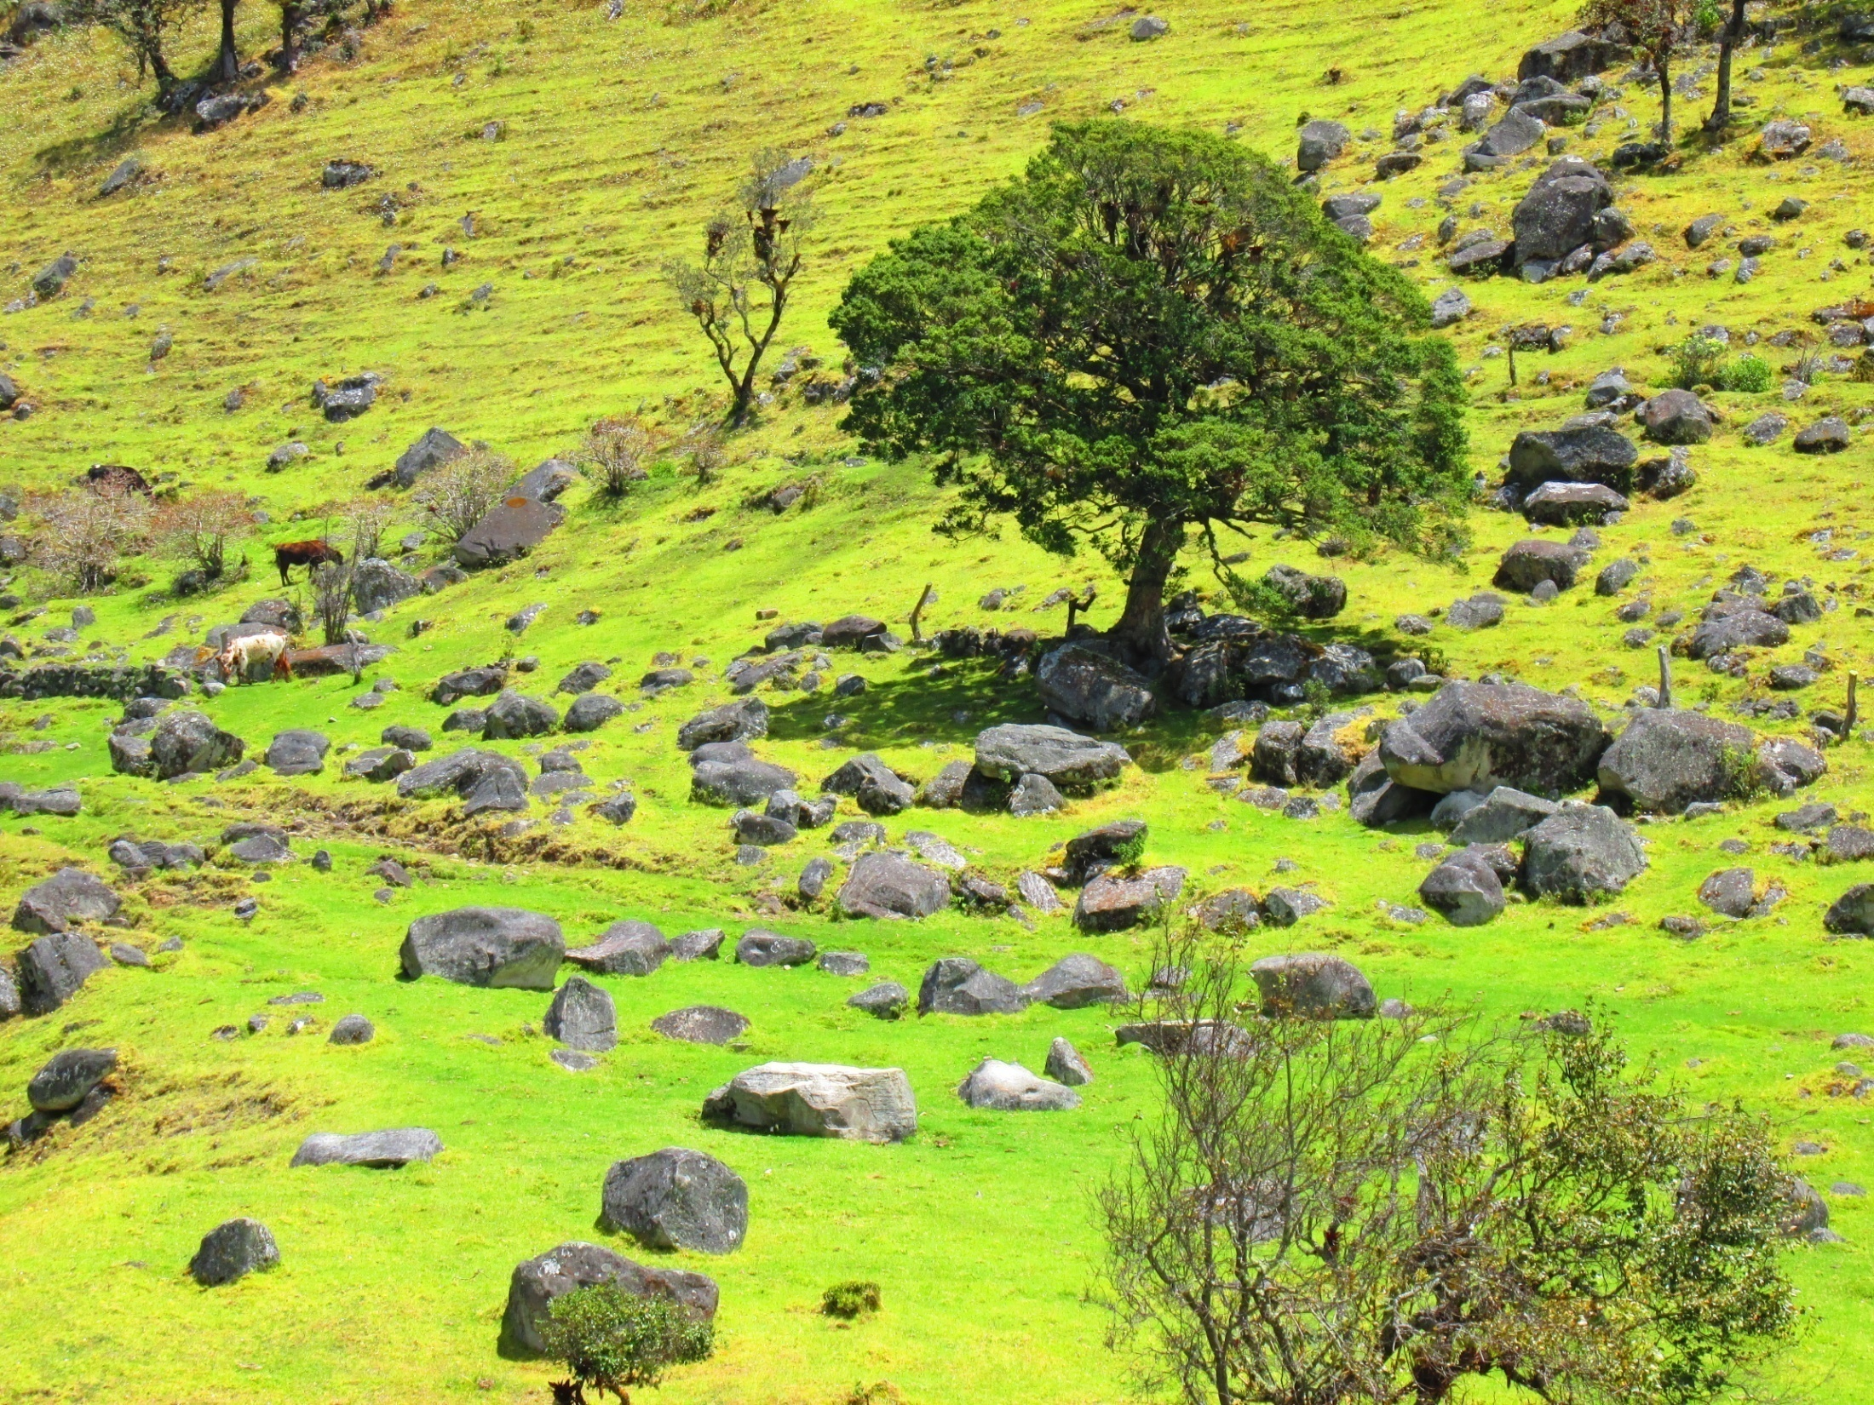
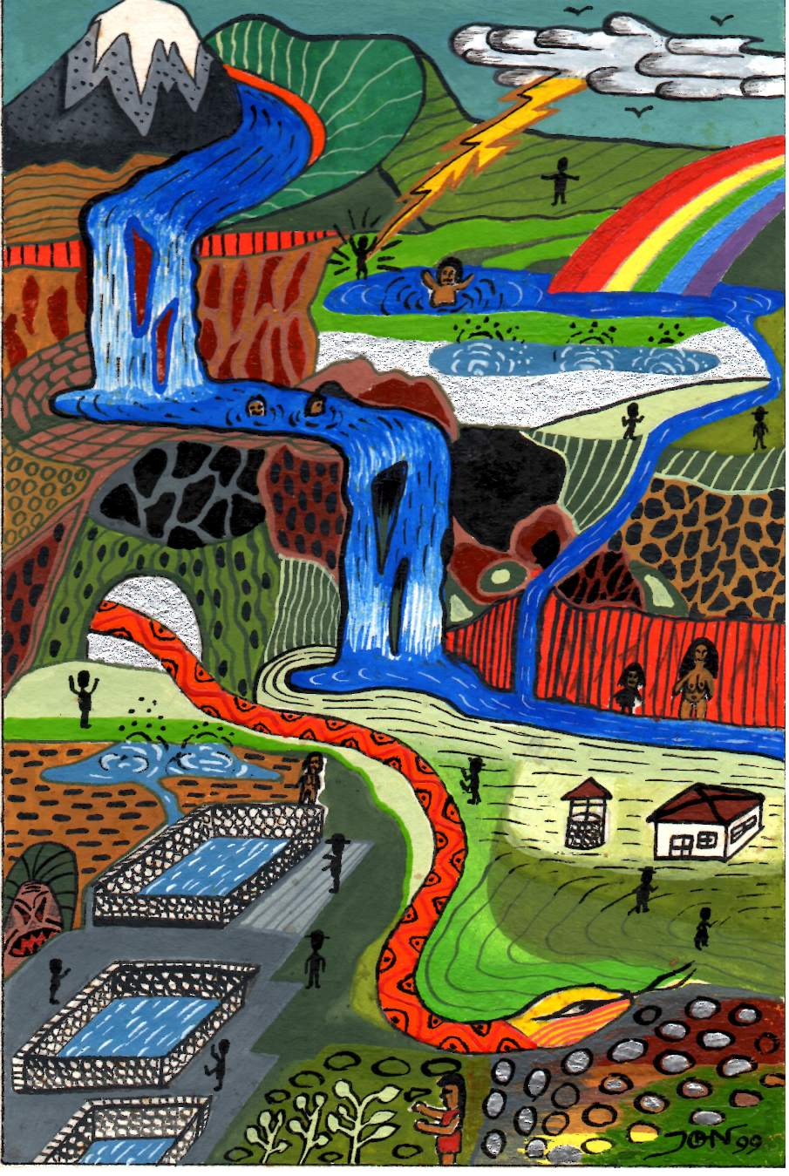
In case you want more…

