Slide 1
The Rainbow snake myths

Slide 2
Misak, Páez- The story of the rainbow- origin, the manifestations of the rainbow, the way it is linked with diseases…
Origin of diseases- Bororo (Strauss)- p. 59-60
The motifs comparison
What is up is down- Milky way and the Rainbow
The poisoning, fish, epidemics and tapirs (Strauss- p. 261)
Tapir`s secret words- the magic of words (followed up lesson)

Slide 3
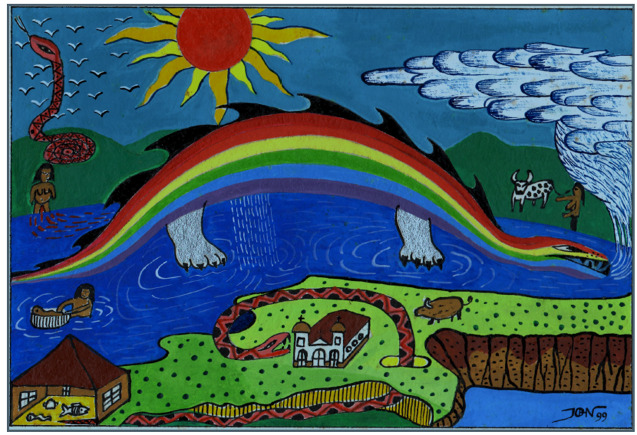

Slide 4
The origin of diseases (some South American myths)- Claude Lévy-Strauss: The Raw and the Cooked
The origin of diseases (Bororo, Paraguay) (p. 59-60)
Diseases coming from a woman`s body- she ate the fish which had been collectively poisoned (for the purpose of catching them) instead of taking them back to the village. Her body bloated and she released the illnesses. She was then killed and cut into pieces, her body parts thrown to the both sides of the river.
(motif of rainbow, snake, snake as the master of fish, anthill- dryness, pottery clay, taboo violation)

Slide 5
The poisoning motif appears three times- the son and his grandmother poisoning him, then fish, then diseases.
Connection between “poisoning and rainbow”- Also Misaks and Paéz- the little “darts” which rain down when the rainbow is in the sky and cause illnesses. (Modern biology?)
Desana- the quality of the food depends on its clean origin- the fish up the stream are better for eating because of what they eat (only blossoms and insect) while the fish down the river eat other fish and people`s food.
Rainbow (p. 60)
People hide from a rainbow…
Gran Chaco- a solitary boy who hunted birds (bird plumage is also often linked to the rainbow) changed into a multicoloured deadly serpent- the rainbow.
Parallel to Paez- the boy who became the snake and devoured the people in the “church”… also the boy was eating raw fish (just like the “mother of illnesses”- Bororo.

Slide 6
What is up is down:
Sky (p. 246)
Food bearing tree- Milky Way (Desana- the creative force of life- sperm)
Rainbow- its counterpart- death (linked to the absence of the Milky Way- the blackness between)
The mother of illnesses- transformable into a rainbow (two snakes coming from the two sides of the river- like the re-assembling of her body.
Rainbows- masters of potter clay (linked with diseases, taboo for women, especially pregnant) and of fish (Desana- anaconda)
Rainbows are linked to diseases, especially epidemics (p. 278)- create big gaps in population (just as the poisoning of the fish upsets the master of the fish)
Food bearing tree vs. Diseases
Milky Way vs. Rainbow
Life vs. Death

Slide 7
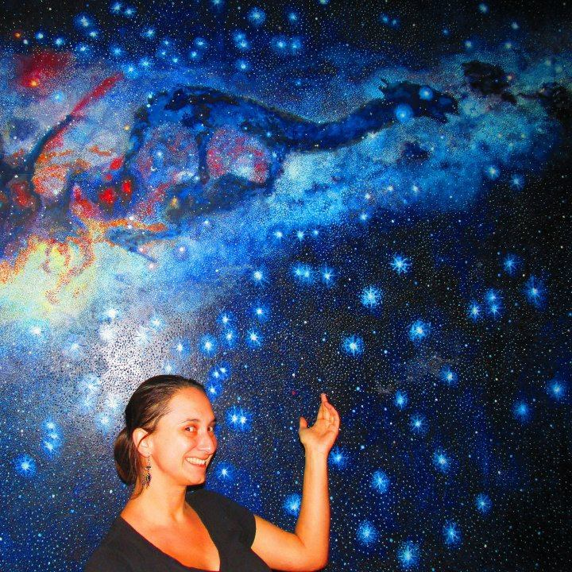

Slide 8
