Slide 1
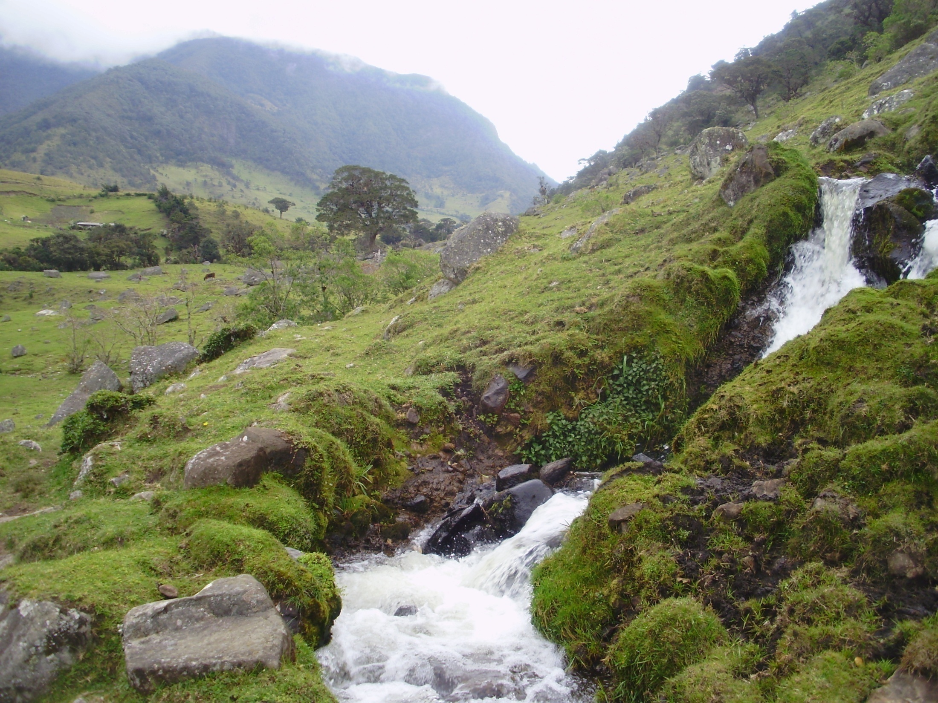
Humans as Keepers of the Universe: Water Cycle and its symbolism in Native Colombian Cosmology
Learning to appreciate Water: the voice of Misak, Nasa and Kogi in Edinburgh…
Lucie Vinsova, Masaryk University Brno, Bangor University, 2019

Slide 2
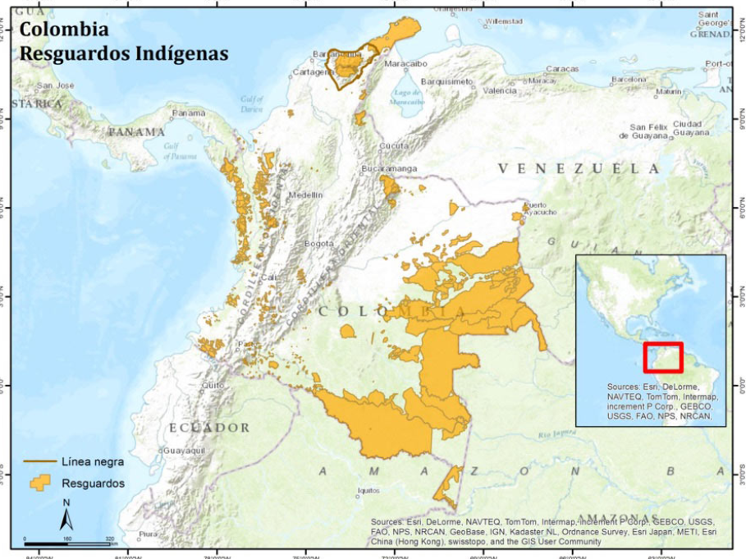
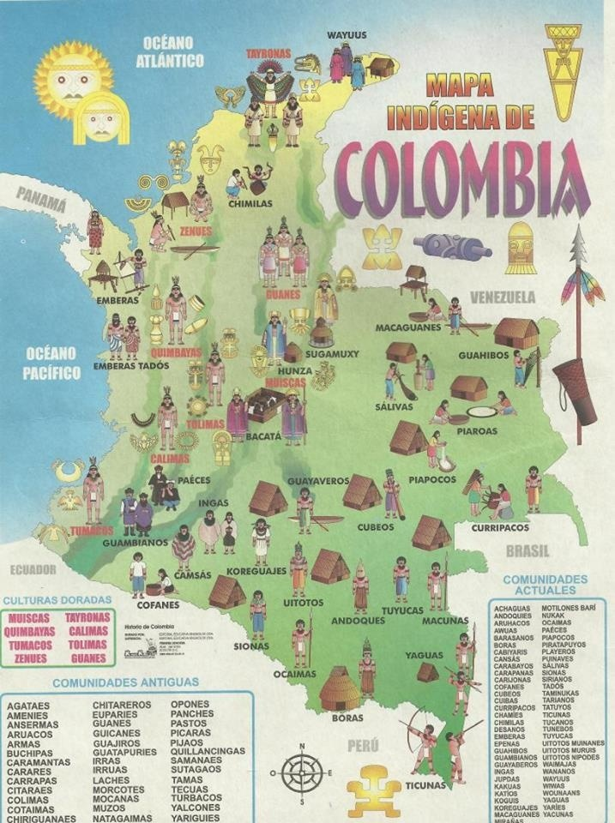
About 3.4% of the 50 million Colombian population accounts for native American (indigenous) tribes (about 1.4 million people). (2005)
There are about 87 “pueblos indígenas”, main indigenous groups whose languages we could divide into at least 13 language families.

Slide 3
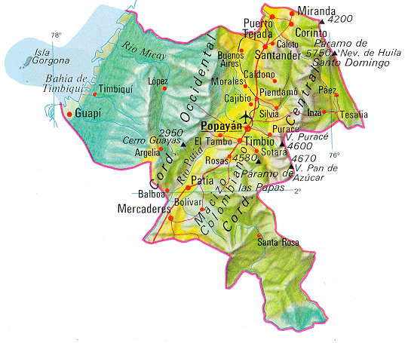
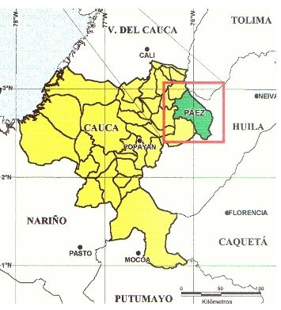
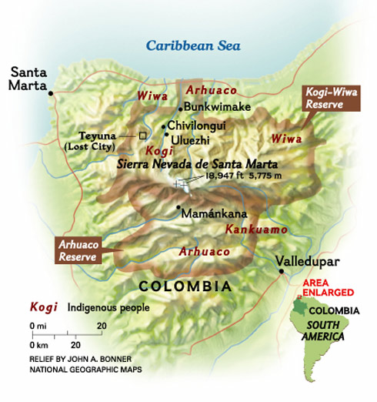
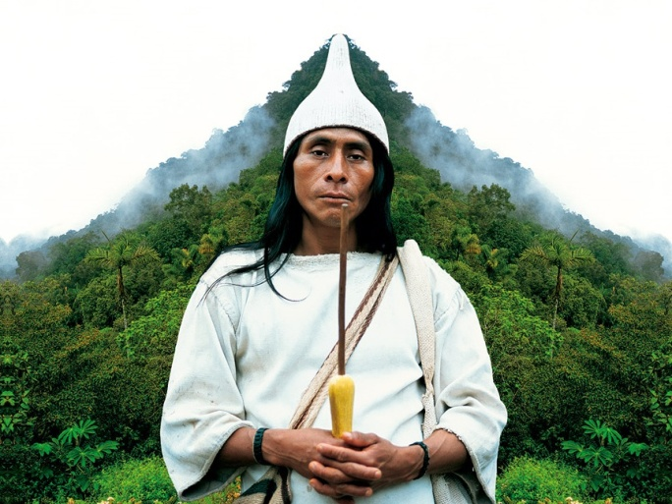
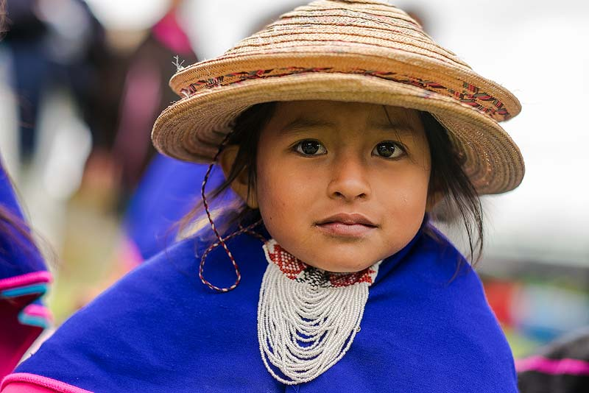
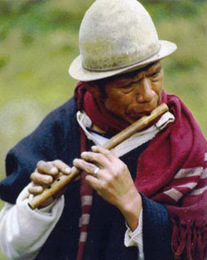
Misak (Guambianos)
Nasa (Paéz)
Kogi (Kággaba) (“jaguar”)
Regions: Cauca
Population: cca. 20 000 Language: namuy wam (“our language”) or Namtrik (Barbacoan family)
Regions: Cauca, Valle del Cauca, Putumayo, Tolima, Huila, Meta…
Population: cca. 186 000
Language Nasa Yuwe (isolated language)
Regions: Magdalena, Cesar, La Guajira
Population: cca. 10 000
Language Kogian (Chibcha family)

Slide 4
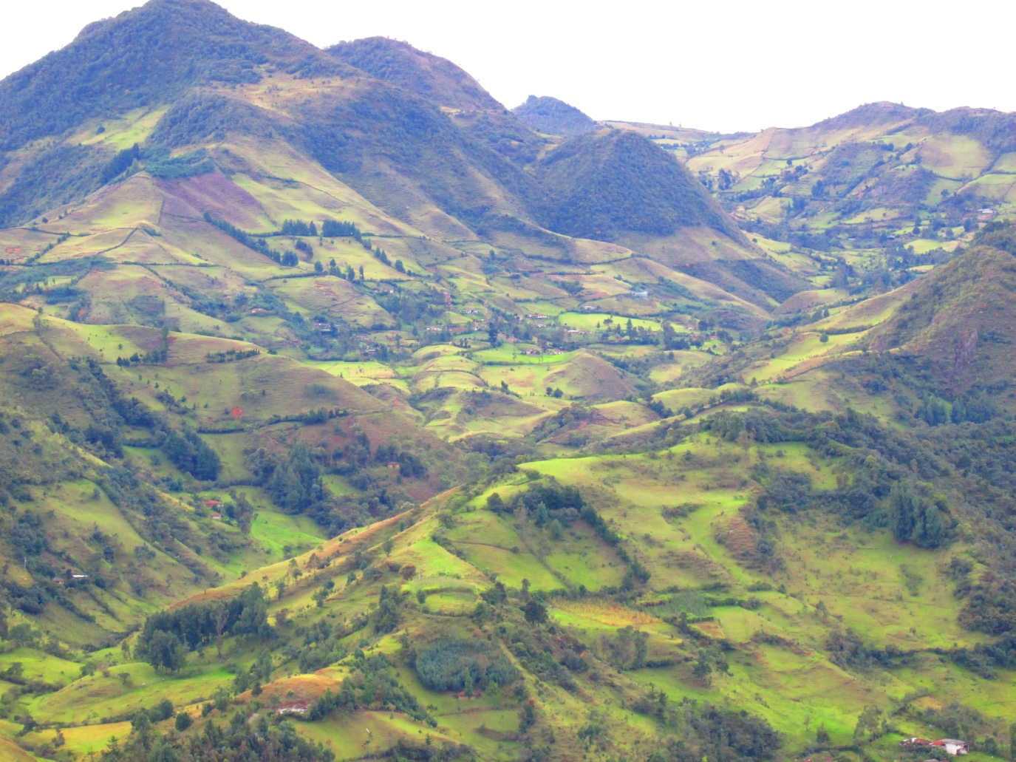
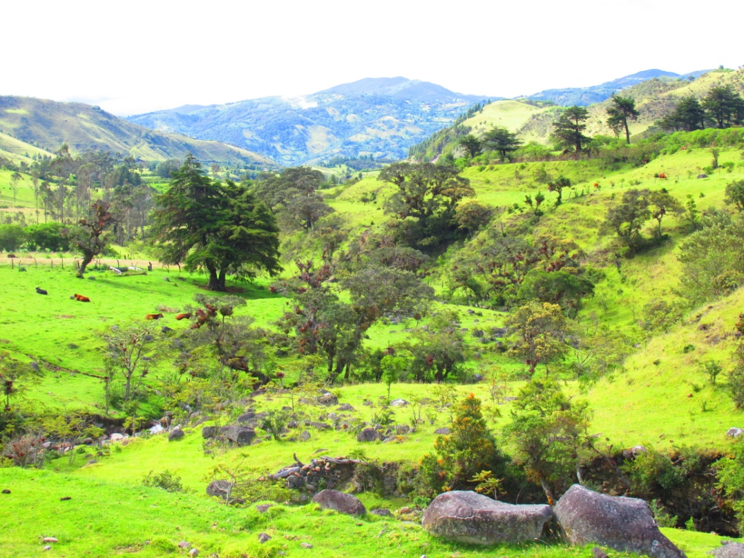
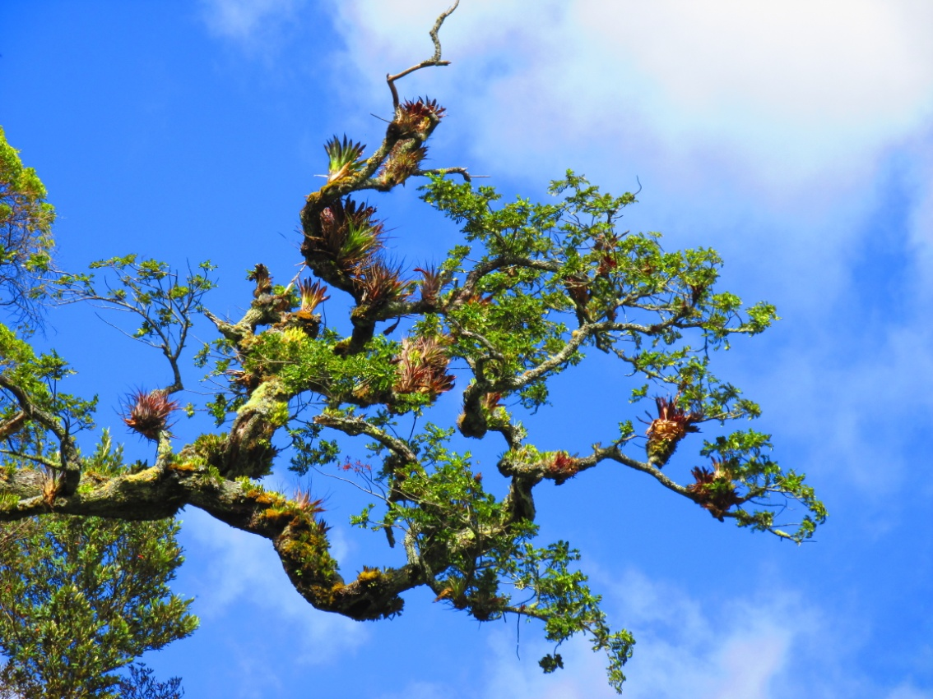
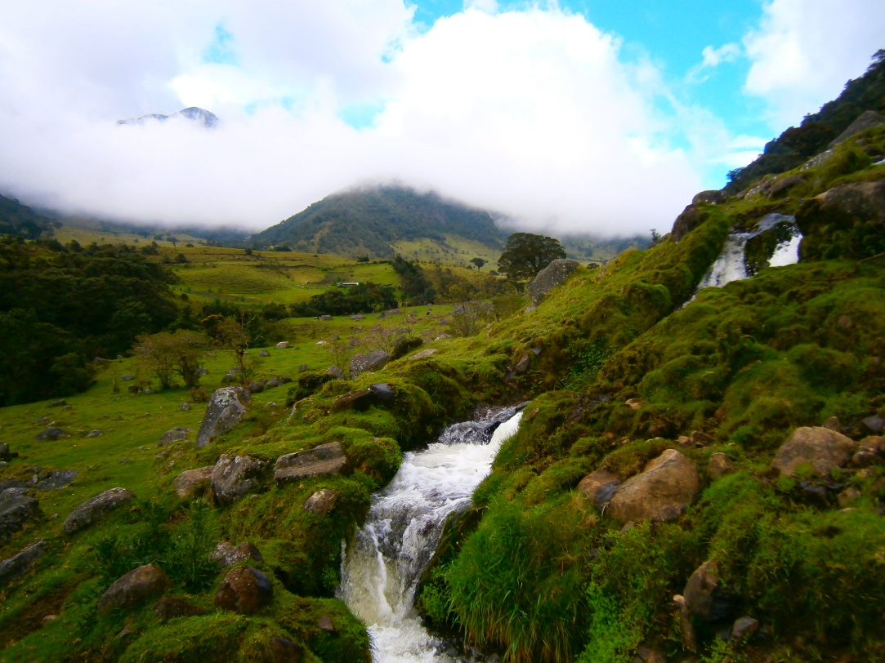
Typical countryside

Slide 5
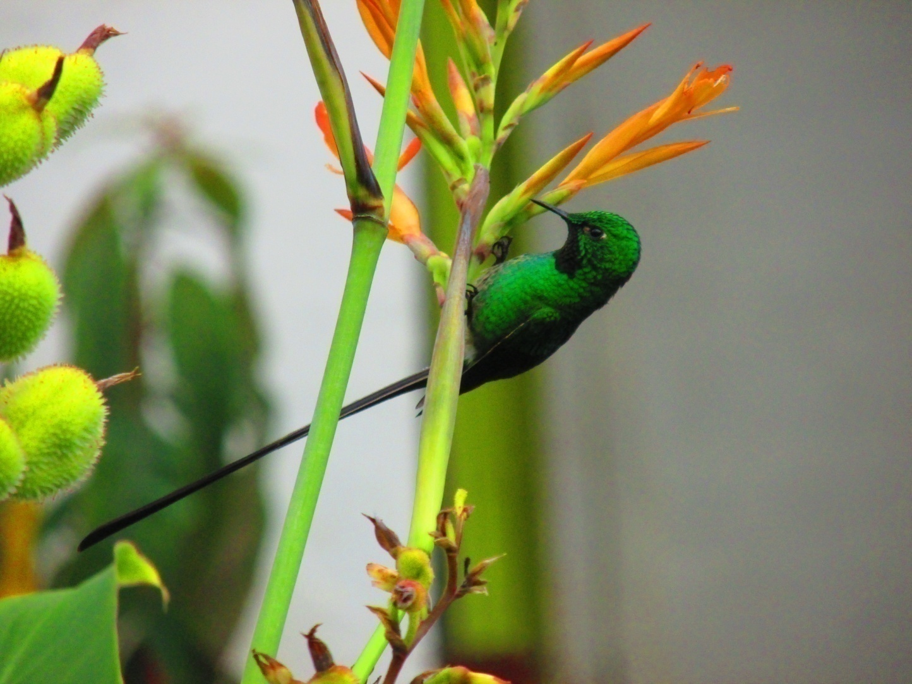
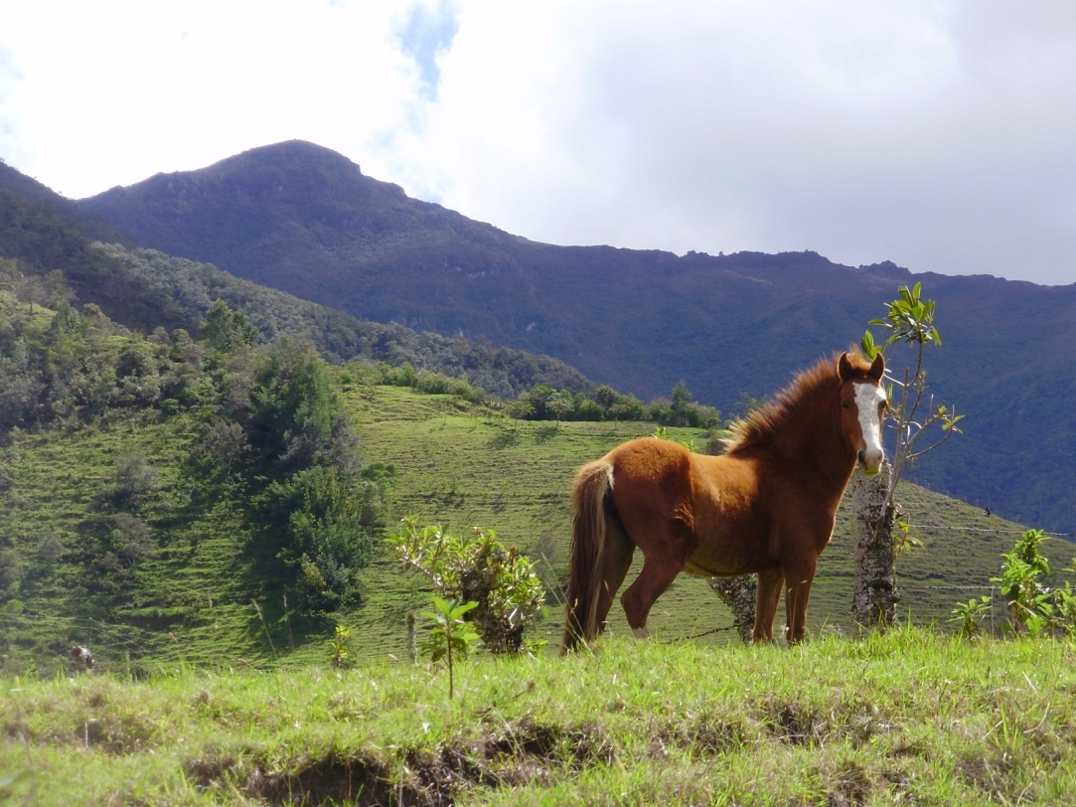
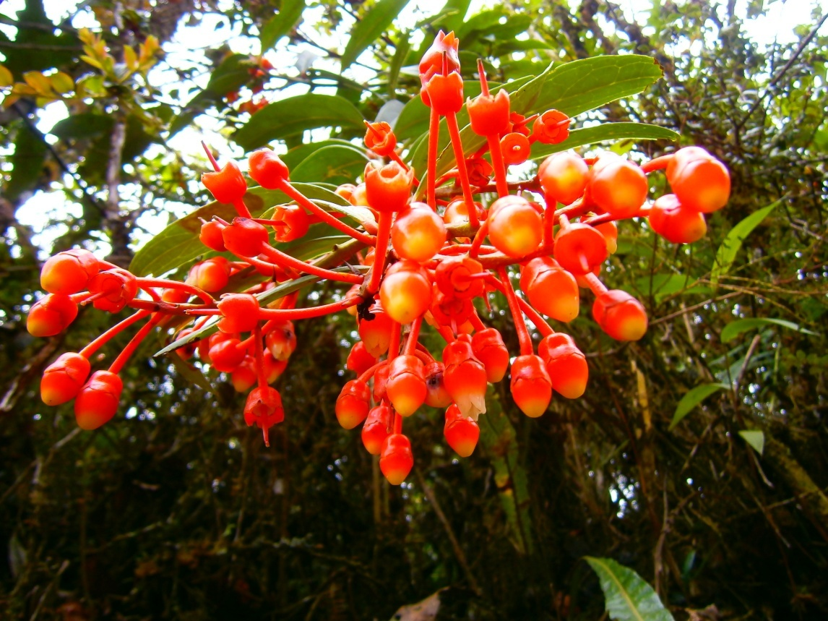
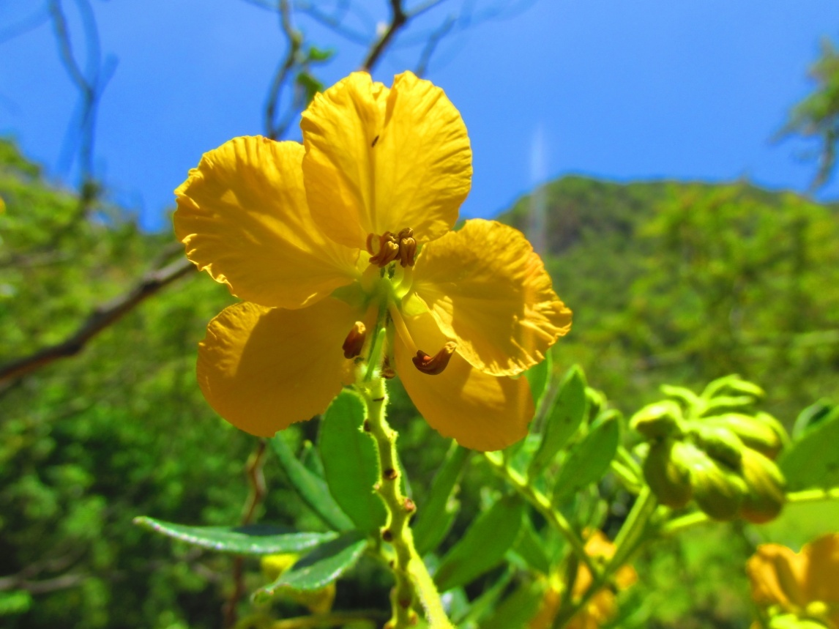
…its animals and plants

Slide 6
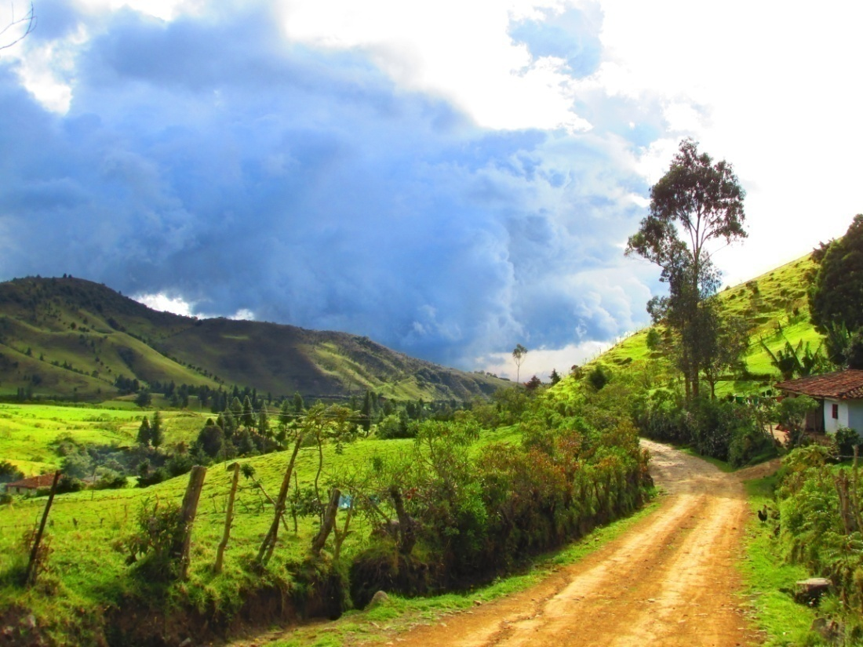
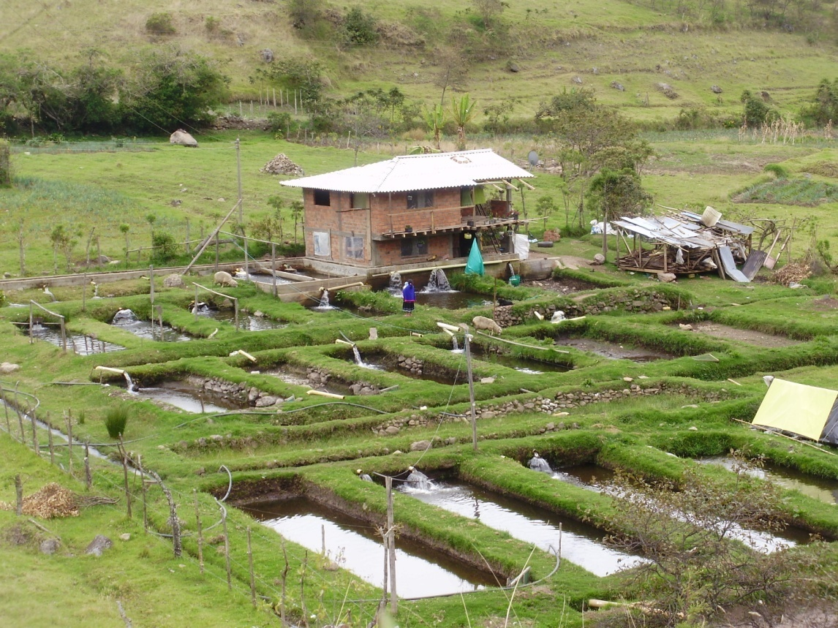
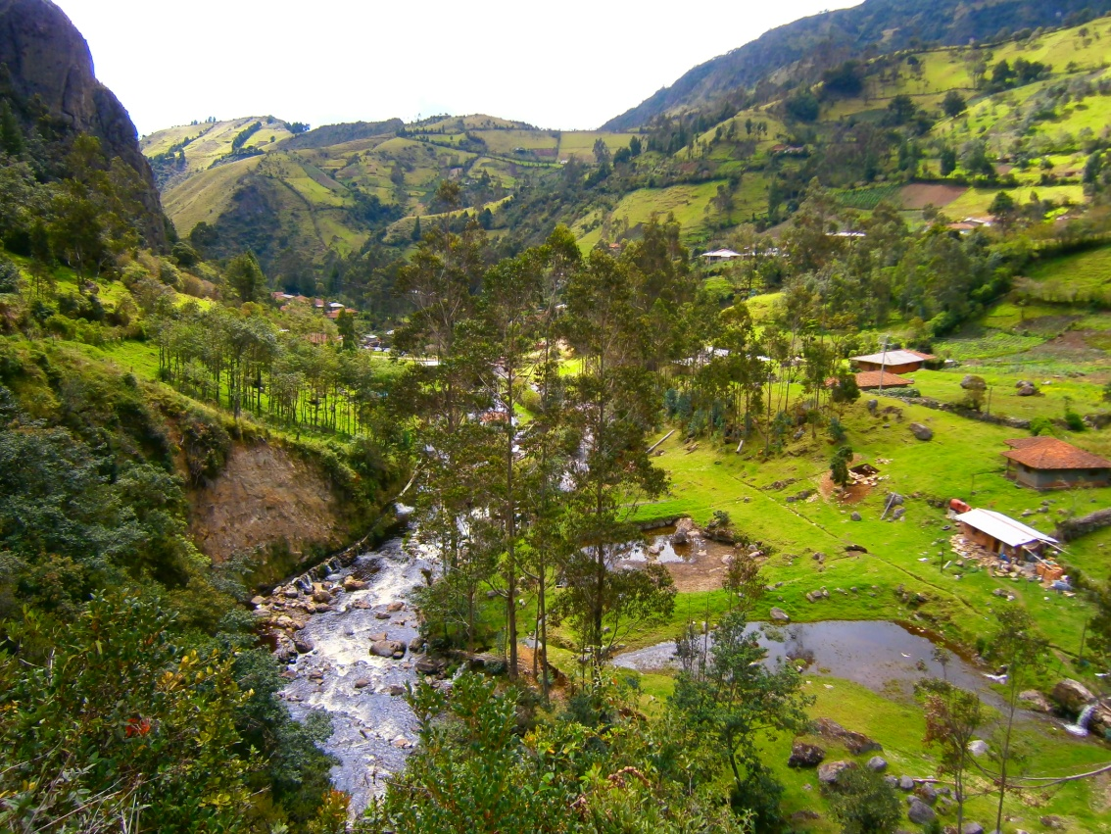
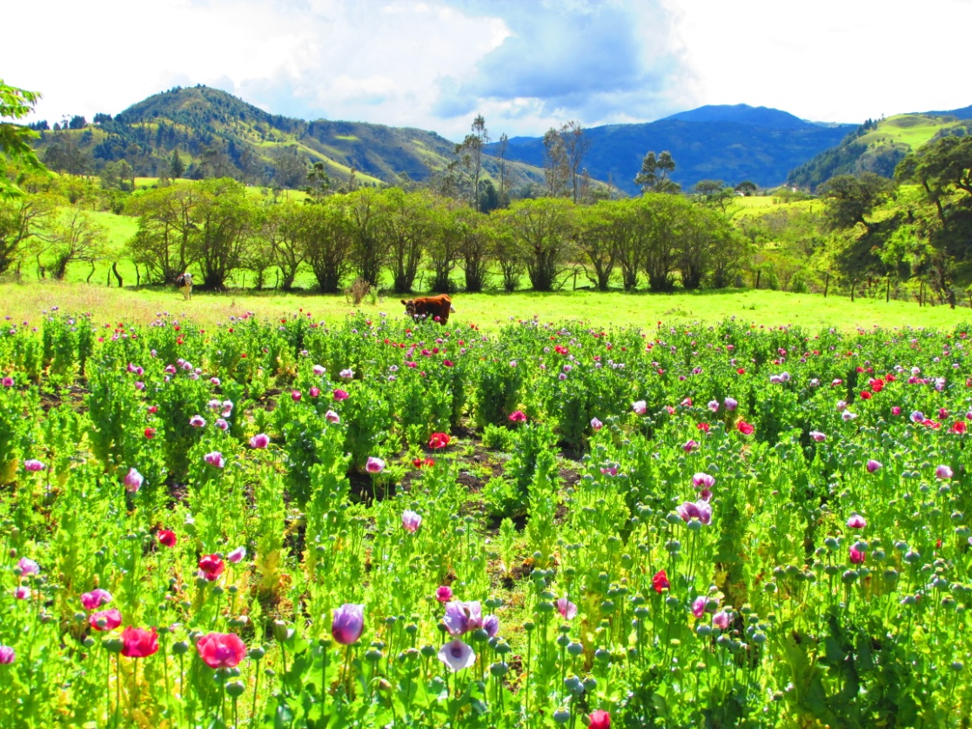

Slide 7
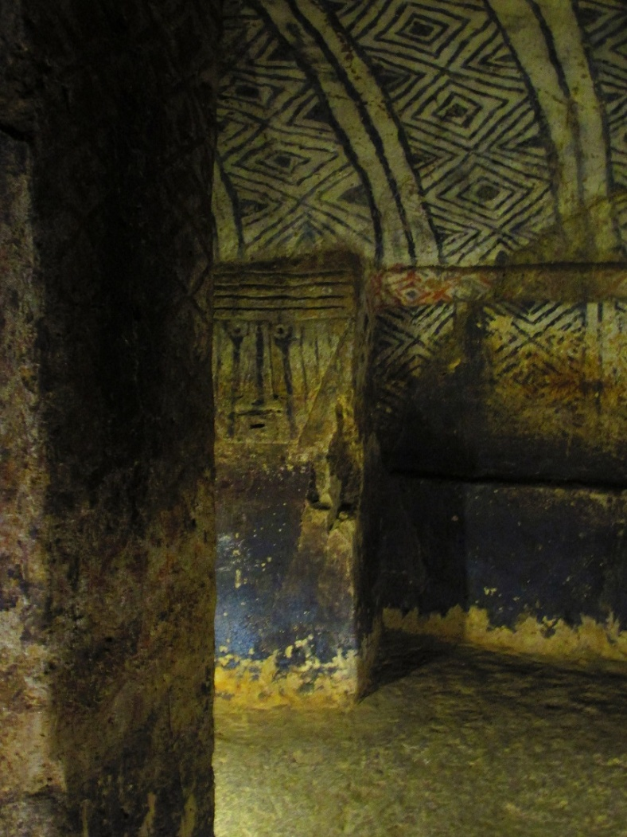
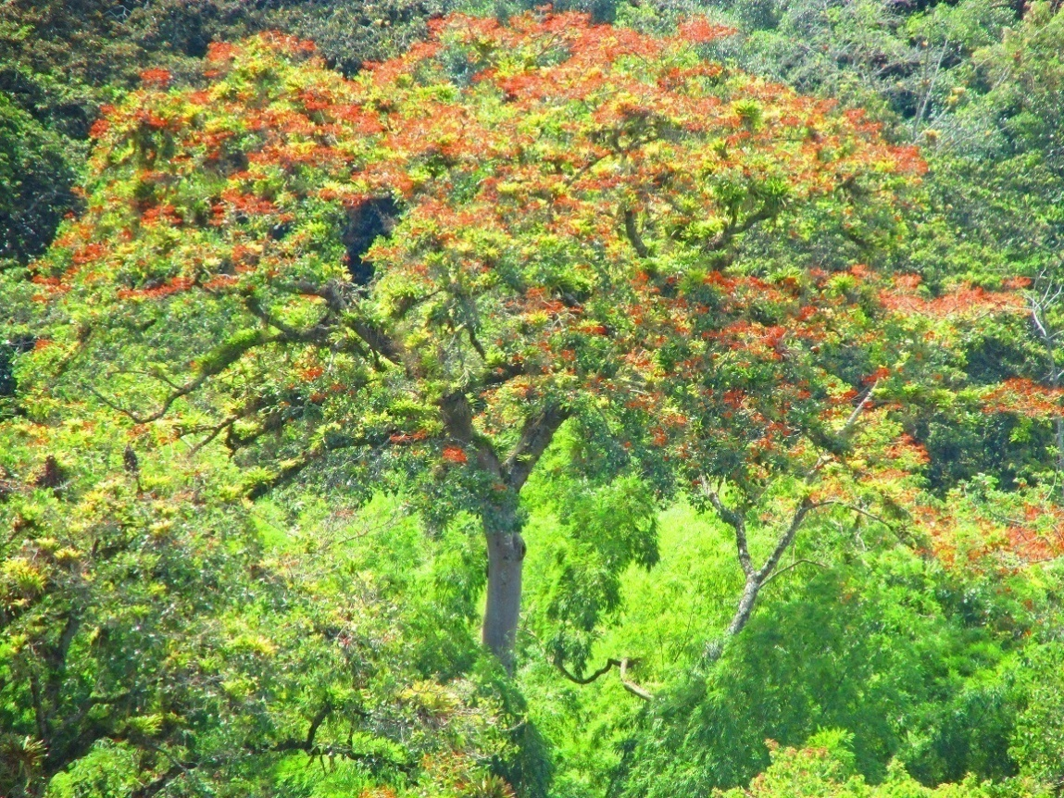
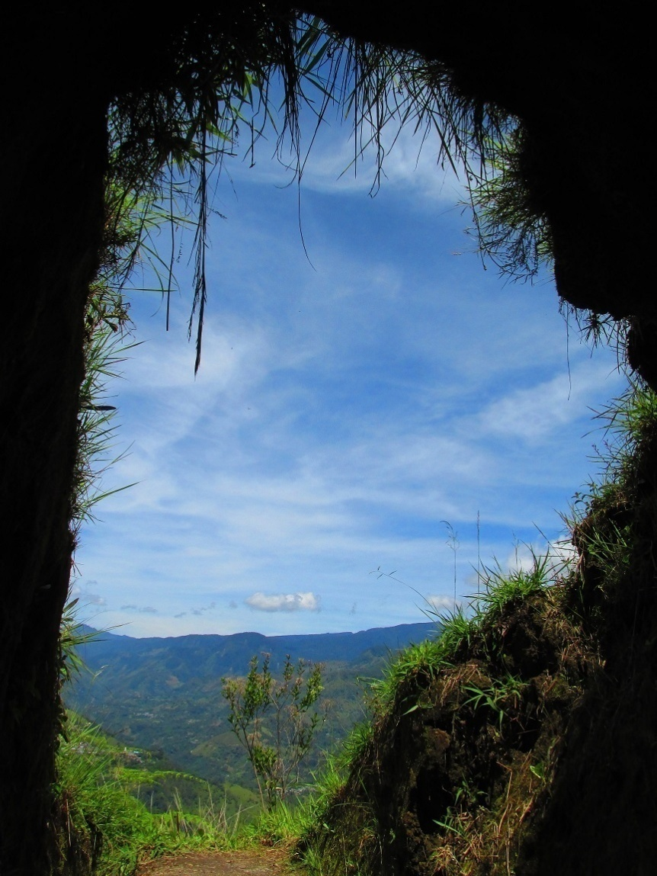
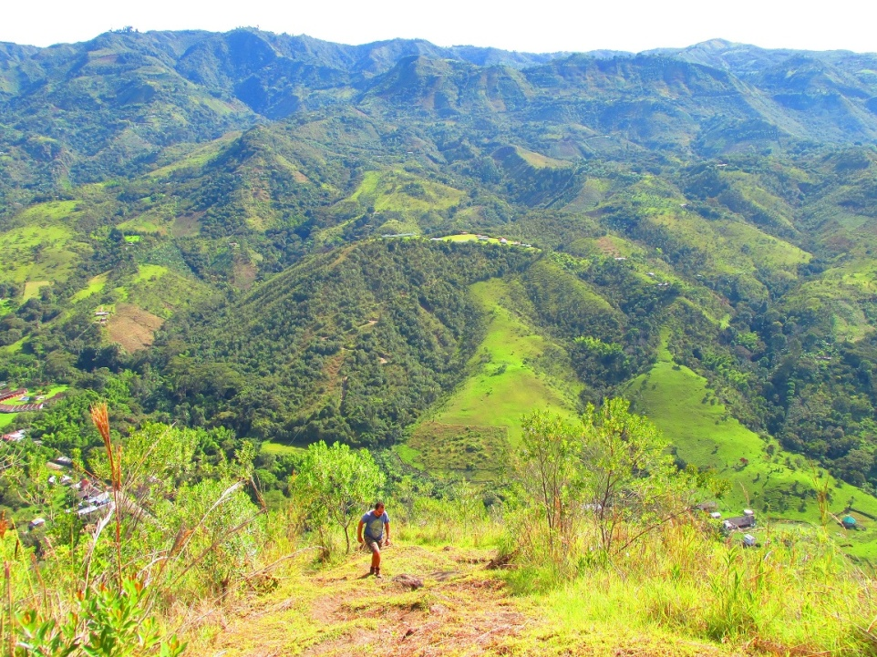

Slide 8
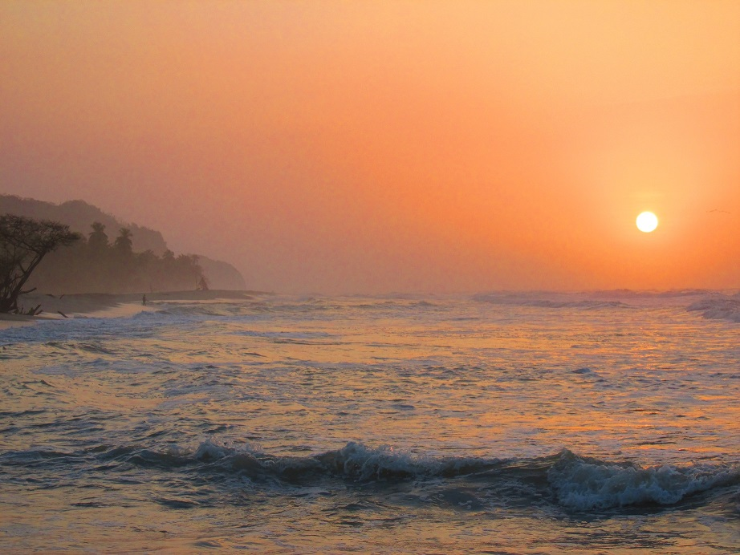
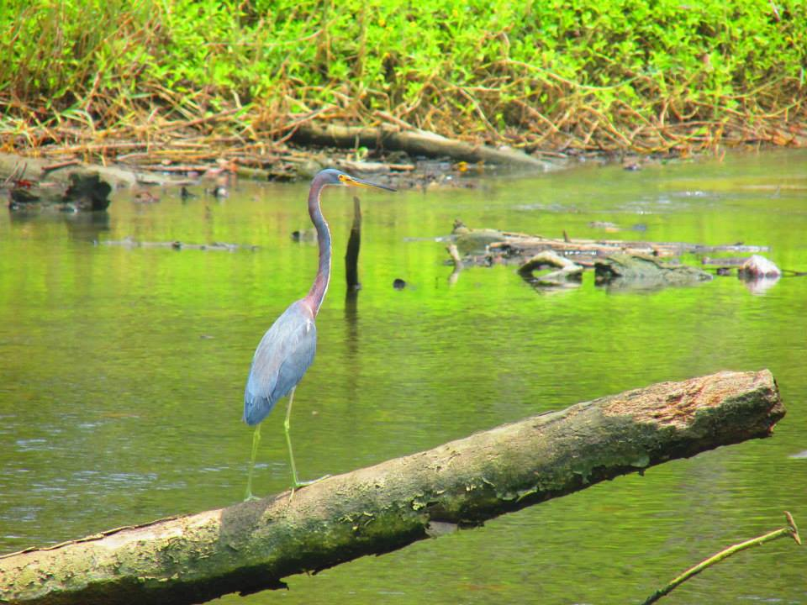
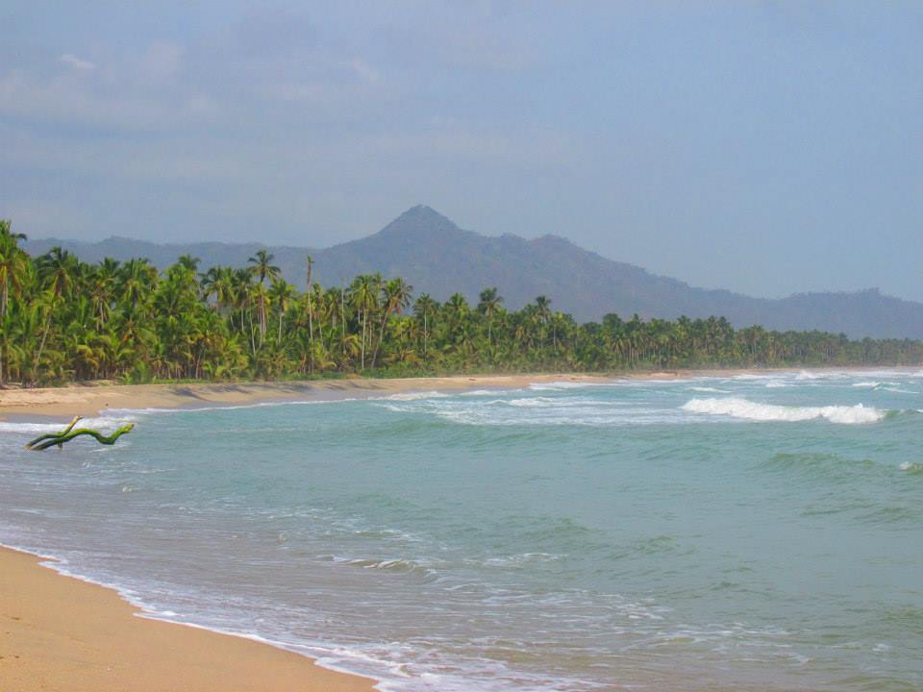
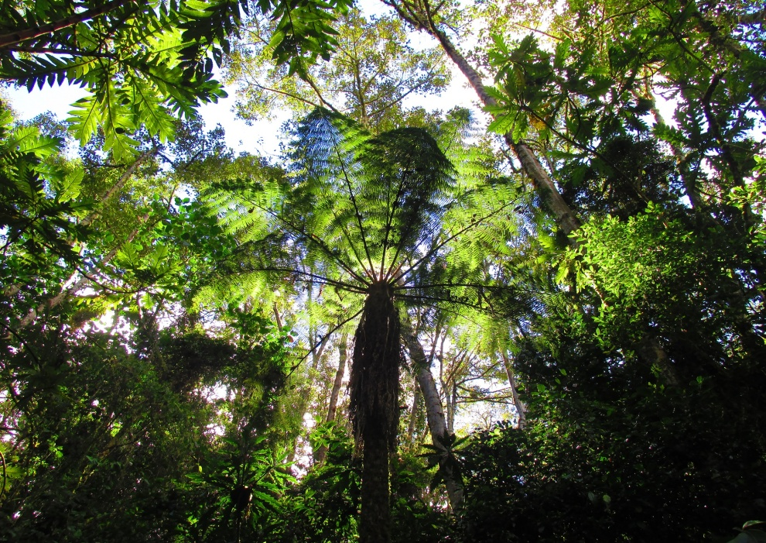

Slide 9
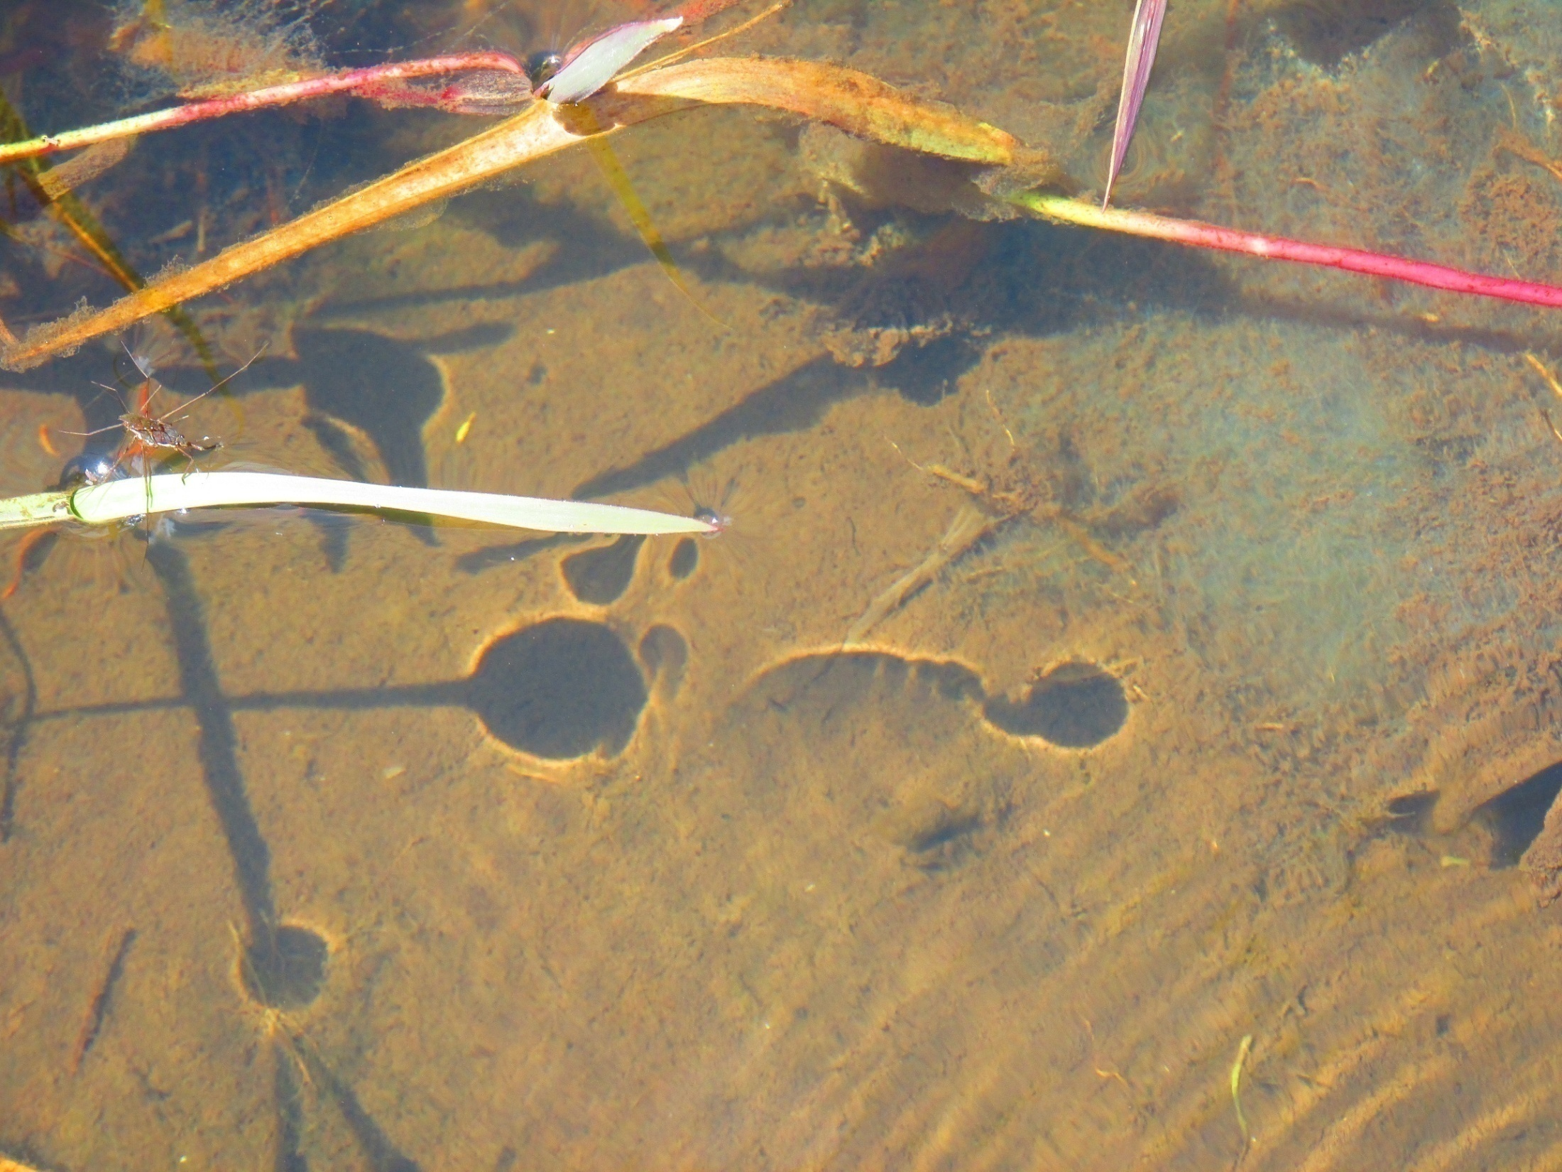
Water
What do these tribes have in common?
páramos (high mountain ecosystem- the main water sources, sacred lakes and rivers, the birthplace of water and the habitat of the mythical beings connected to water)
include sea into their water cycle (geographic position)
water is at the beginning of the creation myths (creation of the world, living beings, people)
water is considered mainly a female principle and its cycle reflects the cycles in a woman`s body (giving birth, menstruation). Its nature is beyond “good” and “bad”
regular water cycles are encouraged by religious rituals (connected to agriculture, healing) and misbalances are said to cause catastrophes and illnesses on a small and large scale
people are the keepers of the universal balance (through rituals and everyday chores they help preserve the cosmic equilibrium)

Slide 10

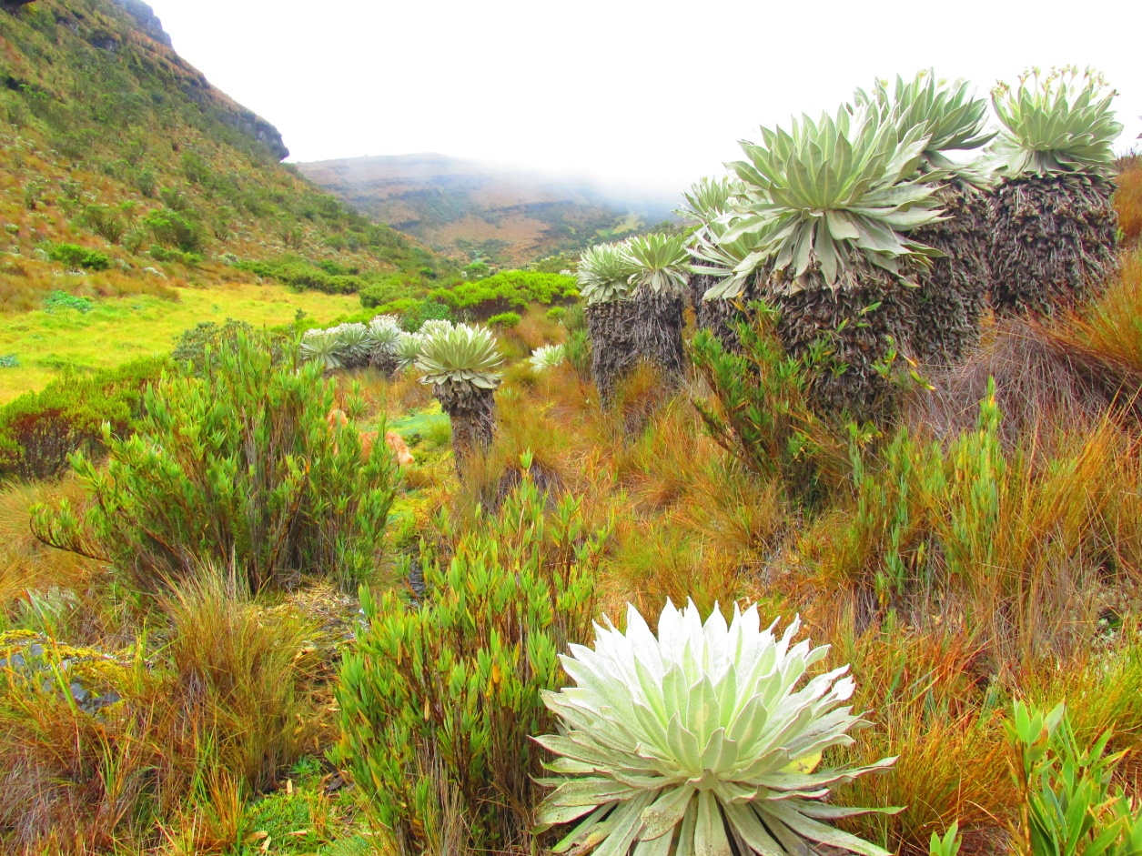
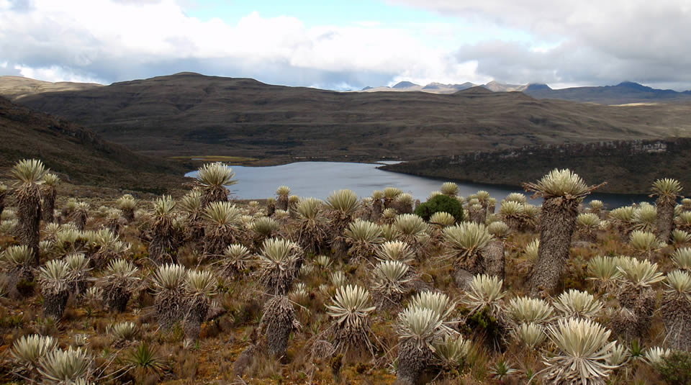
Páramos:
Alpine tundra ecosystems.
Altitudes vary from 3000–4800 m. Areas of marshes, high-mountain plains and lakes.
High rainfall and big temperature differences.
Colombia has the highest number of páramos globally.
These areas provide drinking water to 70% of the population.
About 70% of the water from the Andes makes its way through the páramos.

Slide 11
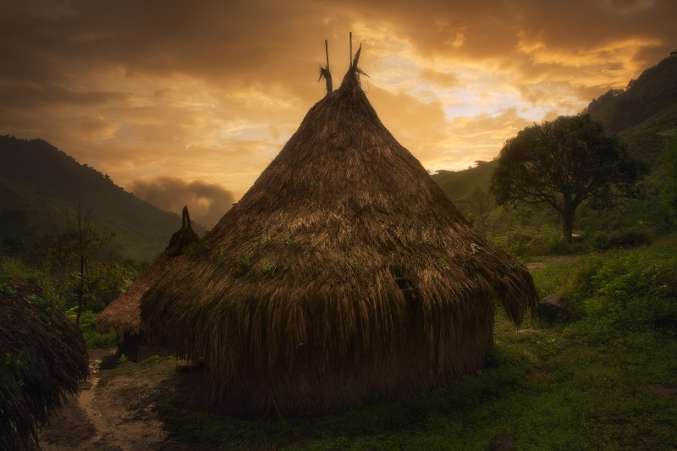
THE KOGI MYTH OF CREATION:
“At the beginning there was nothing but darkness.
Nothing but the sea.
There was no Sun, Moon, people, animals or plants.
Only the Sea was everywhere.
The sea was the Mother.
She was Water- the river, the lake, the stream and the sea.
At the beginning, there was only the Mother.
The Mother was not people, she was not anything.
She was Alúna.
She was the spirit of what was yet going to come
And she was thoughts and memory.
Thus the Mother existed only in Alúna…”
Water symbolizes the source of all Life, it`s the original Mother.
Its nature is feminine and brings Life as well as Death (it stands outside the people`s differentiation of good or bad).
The first man Sintána was born in “the House of the Sea Foam, in the darkness, in water…” before anything else was created.
Water is blood (at times connected to the sacred menstrual blood of the Mother). Rivers and streams are the veins of the land.

Slide 12
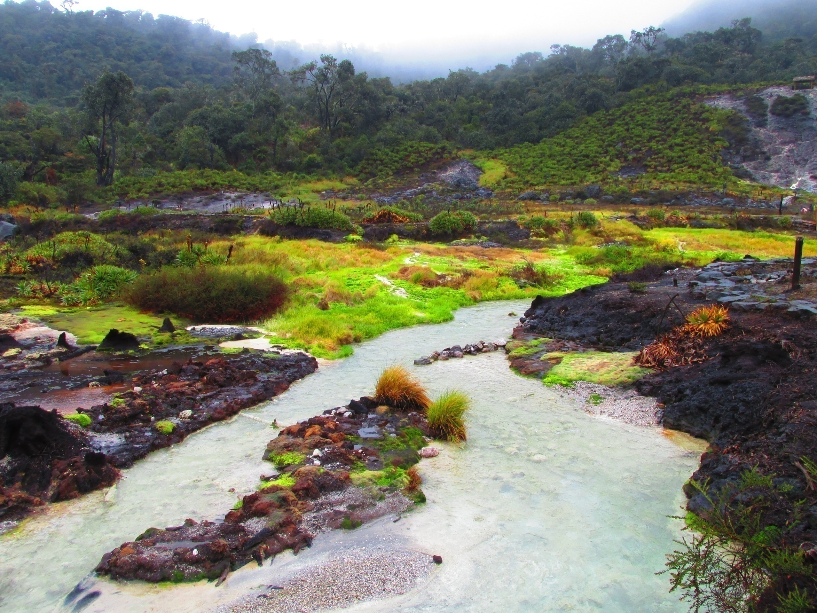
NASA (Páez)
“…Nosotros existimos por el agua… que ella, si se va, vuelve a estar con nosotros… ella es eterna y quiere que existamos.”
“…We exist because of water… because if She goes, She returns again to be with us… She is eternal and wants us to exist.”
According to the creation myth, all animals, people, plants and minerals came from water.
The first child of the sacred union between señor estrella “Star” and agua “Water” was Nasa “the human being”.
Lakes in the páramos are the sources of Life, from them comes knowledge, magical powers and the universal rules all communities should respect.
The lakes are home to powerful ancestors and spirits, from them, these communicate with people (through shamans- the‘ walas).

Slide 13
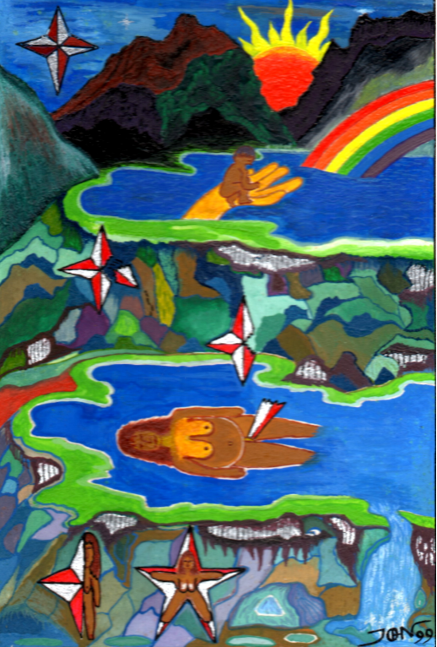
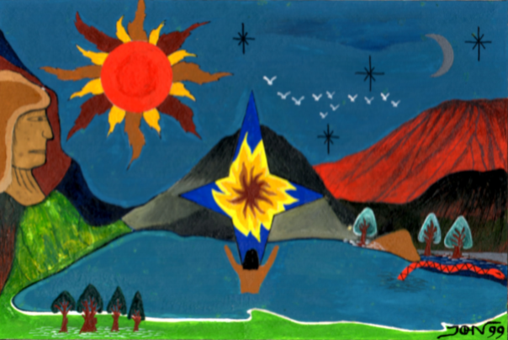
Nasas - the children of the Star
Author: Jhon Ferney López Muñoz

Slide 14
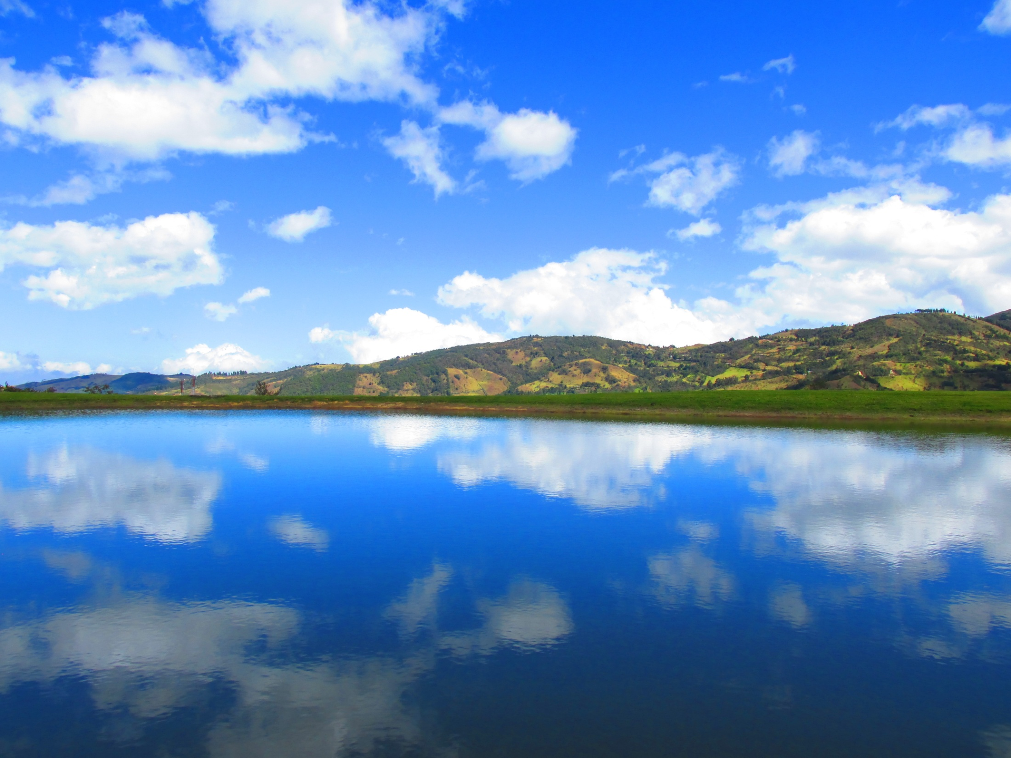
MISAK (Guambianos)
“La historia guambiana es una historia de agua. Nace muy alto de los páramos y de Pishimisak y baja hasta llegar al valle.”
“History of Misaks is a story of water. It is born of páramos and Pishimisak and descends until it arrives in the valley”.
Misaks call themselves Pi Urek “Children of water” to emphasize the fact that they originated in their land.
At the beginning, there was land and two lakes- the female lake Nupisu “sea” or Piendamó and the male lake Nupitrapuik. These gave birth, first to the spirit of páramos and then to other beings.
In Misak cosmology, water is connected to the flow of time and to the life cycles (human life, community, agriculture).
There is also a mythological story describing a great flood.

Slide 15

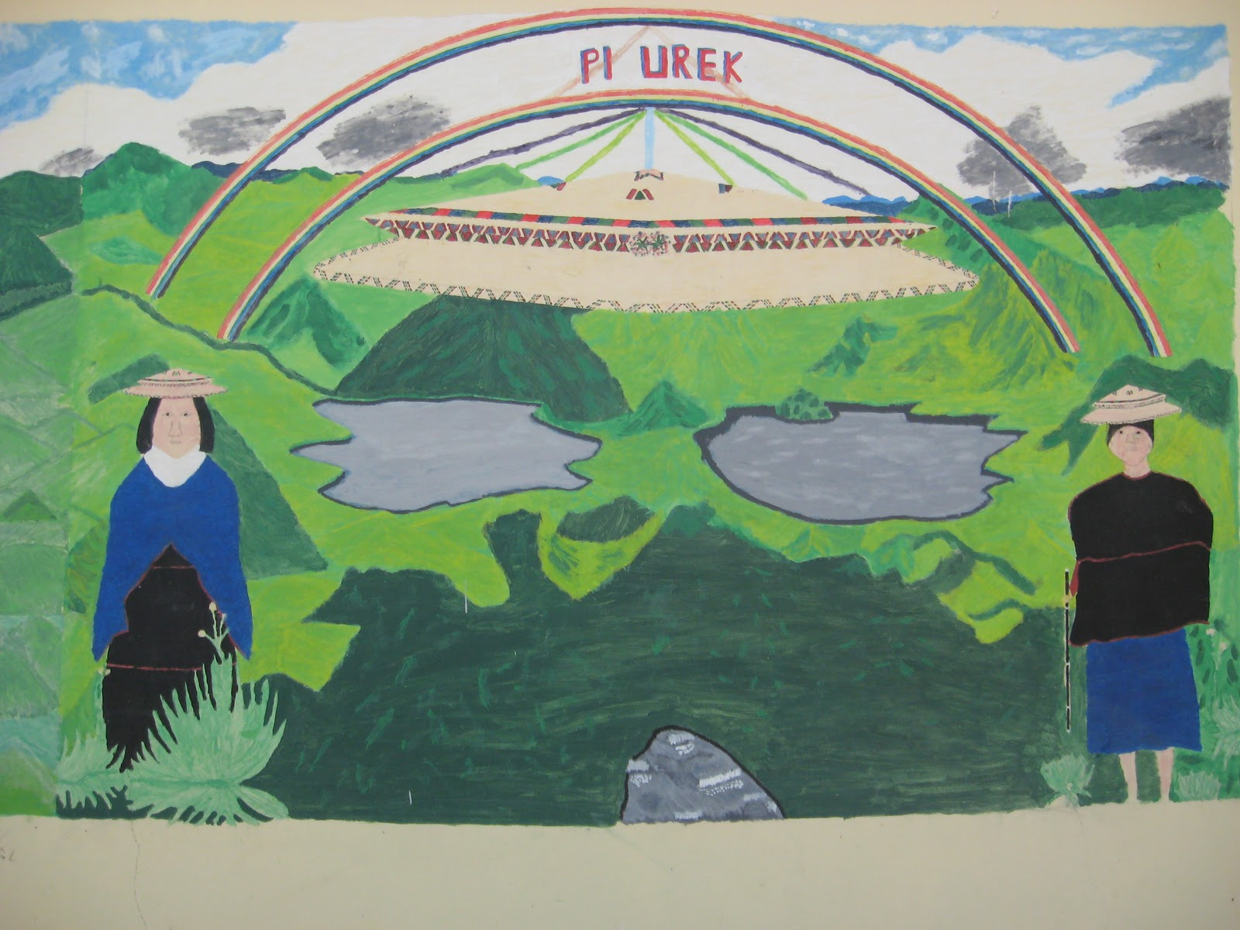
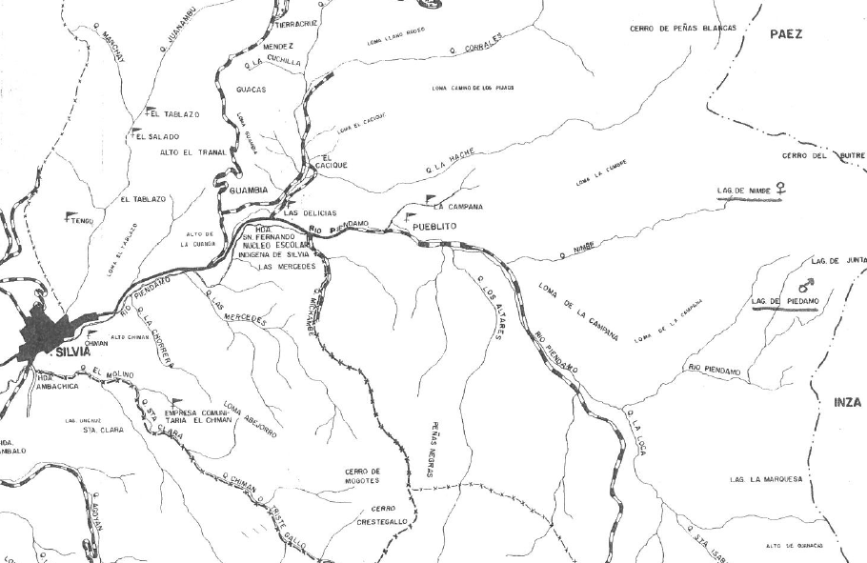

Slide 16
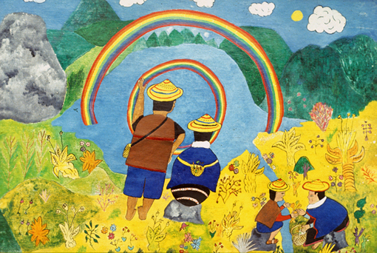
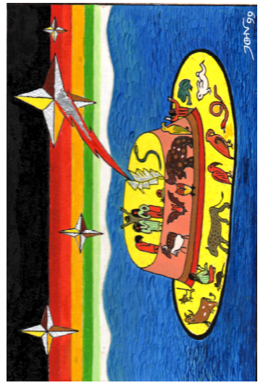
The world (Cauca) as the hat floating on the sea at the time of the great flood.
Author: Jhon Ferney López Muñoz
Misaks call themselves
Pi Urek:
“Children of water”
Picture by taita Juan Bautista Ussa Ulluné.

Slide 17
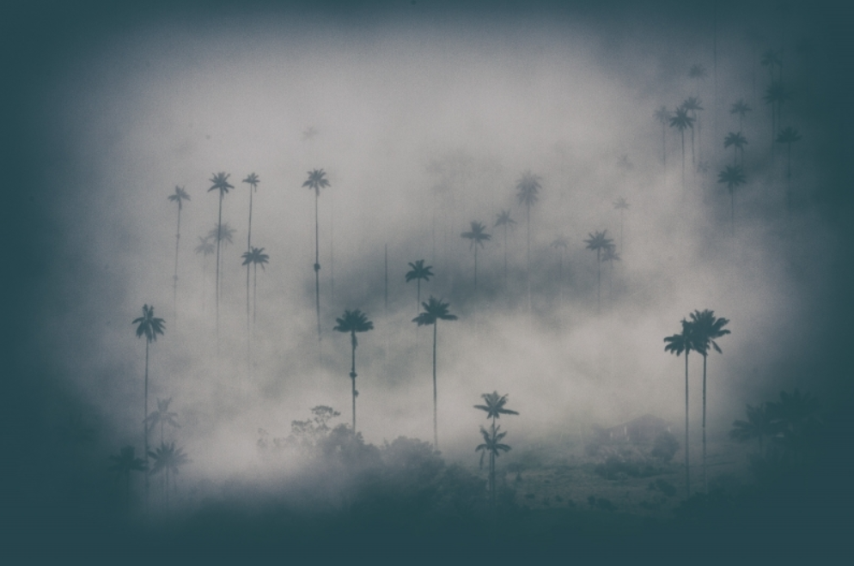
MYTHICAL WATER CREATURES (MISAK)
PISHIMISAK: the great original spirit which inhabits the area of the páramos and sacred lakes (pi “water”, pishi “cold”, misak “person”). Its nature is both- male and female. At the beginning, Pishimisak had all the sources of food in the páramos.
“… he has always been in existence (and is) all white and good, all fresh.”
Pishimisak appears in many manifestations: as an old man collecting herbs (initiation of new shamans), a guardian of sacred sites and healing plants, lightning and thunder. One of its manifestations is duende (mainly mischievous, but sometimes dangerous spirit). Duende is always connected to the element of water (water bodies, rainbow).
ARCOIRIS KƏSRƏMPƏTƏ (Nam. “aroiris”) (Nam. Kəsrəm “páramo”, pətə “circle”)
Rainbow forms a whole circle with its other half underneath the ground. It was born of water and is one of the original páramo spirits. It can be dangerous to people, cause illnesses and miscarriages. There is a male and a female rainbow.
SIERPI, UL (Nam. “snake”)
Water snake which lives in marshes and swamps. It can take upon itself a form of a young woman or a young man (depends who it wants to seduce). It impregnates women with its children and causes illnesses to men. Sierpi is also a guardian of some medicinal and poisonous plants.

Slide 18
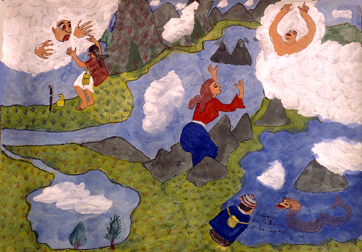
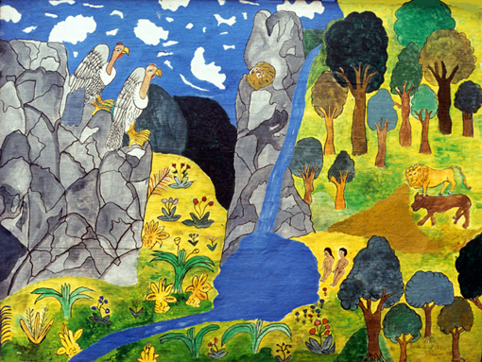
The mythical water creatures
and the original páramo paradise.
Pictures by taita Juan Bautista Ussa Ulluné.

Slide 19
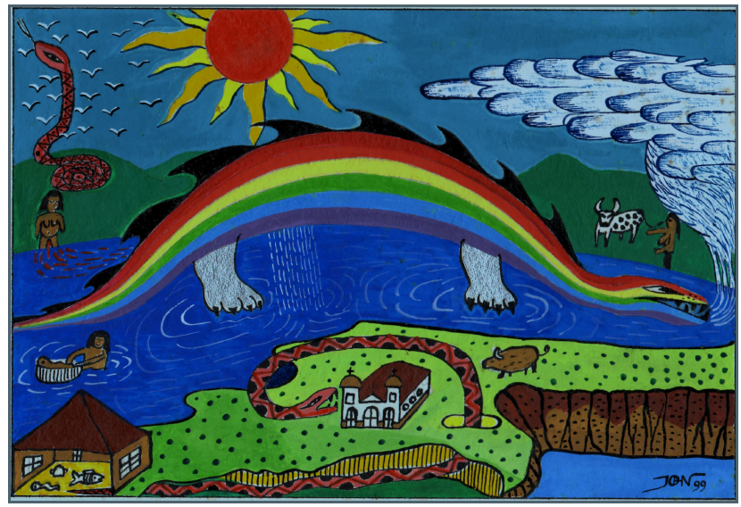
The rainbow
Author: Jhon Ferney López Muñoz

Slide 20
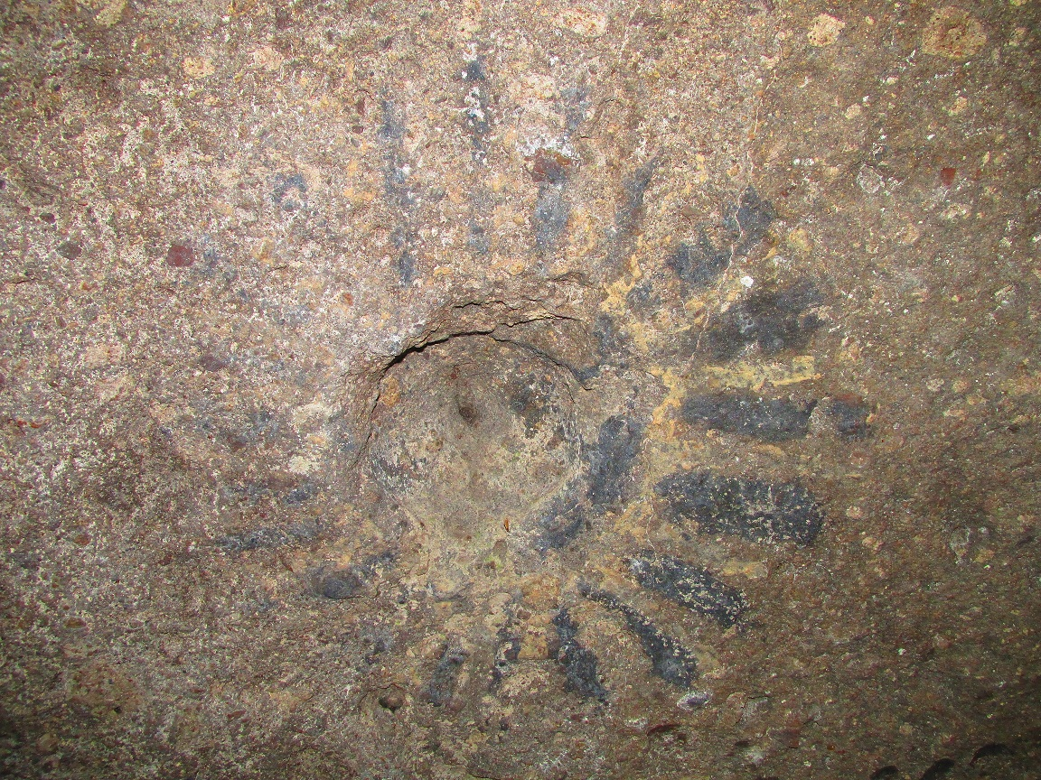
THE BIRTH OF LEGENDARY CHIEFTAINS (NASA and MISAK)
Juan Tama de la estrella (Nasa)
Teresita de la estrella (Misak)
The birth of legendary chieftains and teachers (Sat for Nasas and Piuno or Pishau for Misaks - connection to mythological ancestors Pishau).
Their birth comes from the union of water and a celestial body (star). They are said to gestate inside mountains, being fed by a giant puma.
They usually come from the inside of a mountain (underground lakes) after a landslide or a tremor, in a stream of water and mud (or they come floating on another water body- lake, river etc.). They are swaddled in the most beautiful chumbes or are even decorated with gold.
Strange events (falling stars) accompany their arrival and they have strange dietary habits.
They devote their life to the community (important warriors, teachers etc.) and end their lives reentering the water body.
Communities await these prodigies in certain time periods (40 or 60 years). If they don`t appear, they take it as a warning or punishment (earthquake and mud avalanche in northeast Cauca in 1994).

Slide 21
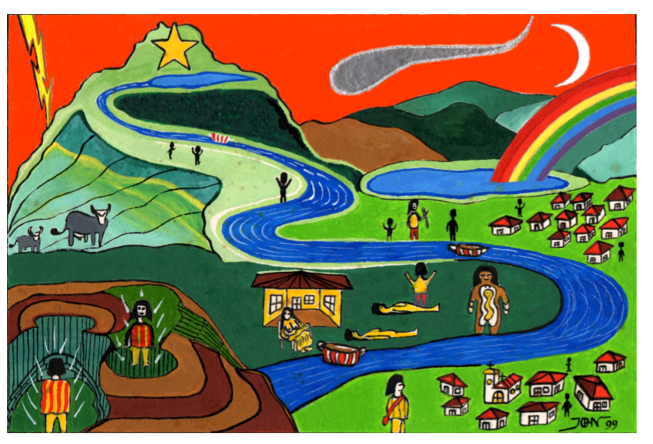
The birth of Juan Tama
Author: Jhon Ferney López Muñoz

Slide 22
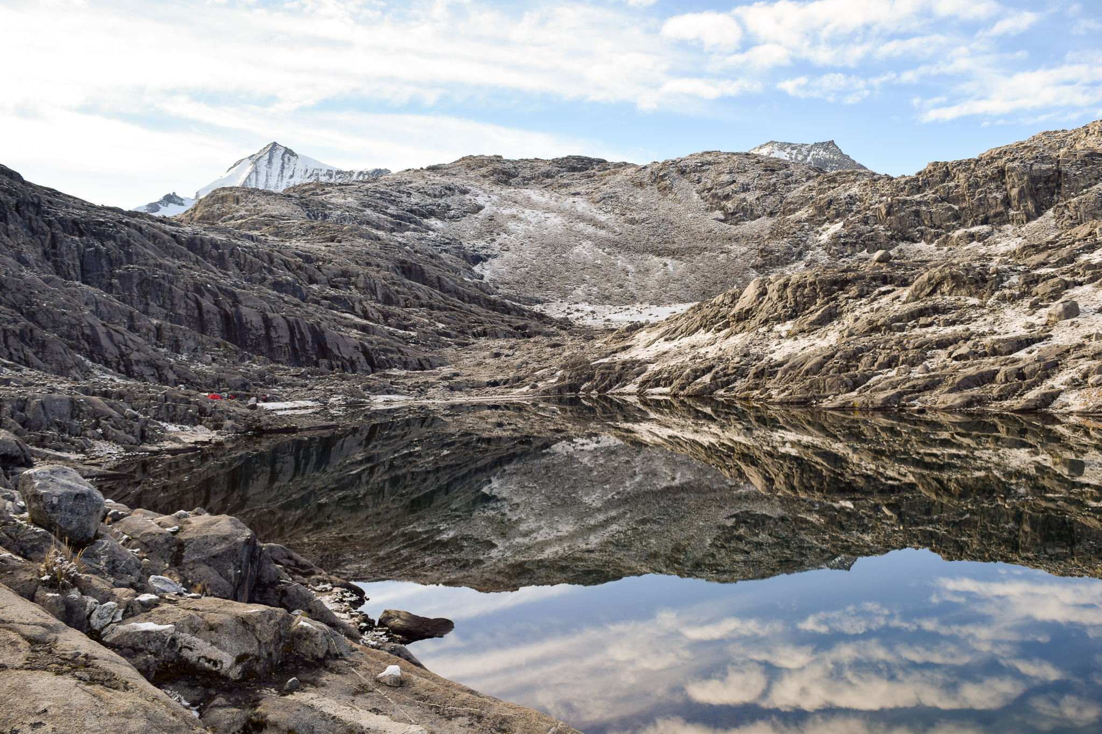
WATER CYCLE AND CONNECTED RITUALS
“… Water is life. It is born in the springs and flows down in rivers towards the sea. And it comes back, only not in the same rivers, but in the air, in clouds… then it falls again as rain. The water which is good and bad falls down again…”
Sources of water (springs and lakes)- páramos where water comes from is a “sacred land” and only shamans have access to certain sites (Kogi, Misak). Lakes and springs are linked to the birth of all living beings and special prodigies. There are many rituals connected to sacred lakes- cleansing rituals, summoning the rain, initiation of shamans, etc.
Rivers and streams (Kogi) rivers and streams are veins of the world. The water currents running down the rivers are seen as a baby which is being carried by the river down into the valley and it`s laughing.
The river Piendamó represents the axis of the world (territory). In the same way, in each person, the axis goes through the centre of the body. This is used in healing rituals (Nasa and Misak). Rivers are of an unpredictable nature (it is important to observe their colours and sounds).

Slide 23
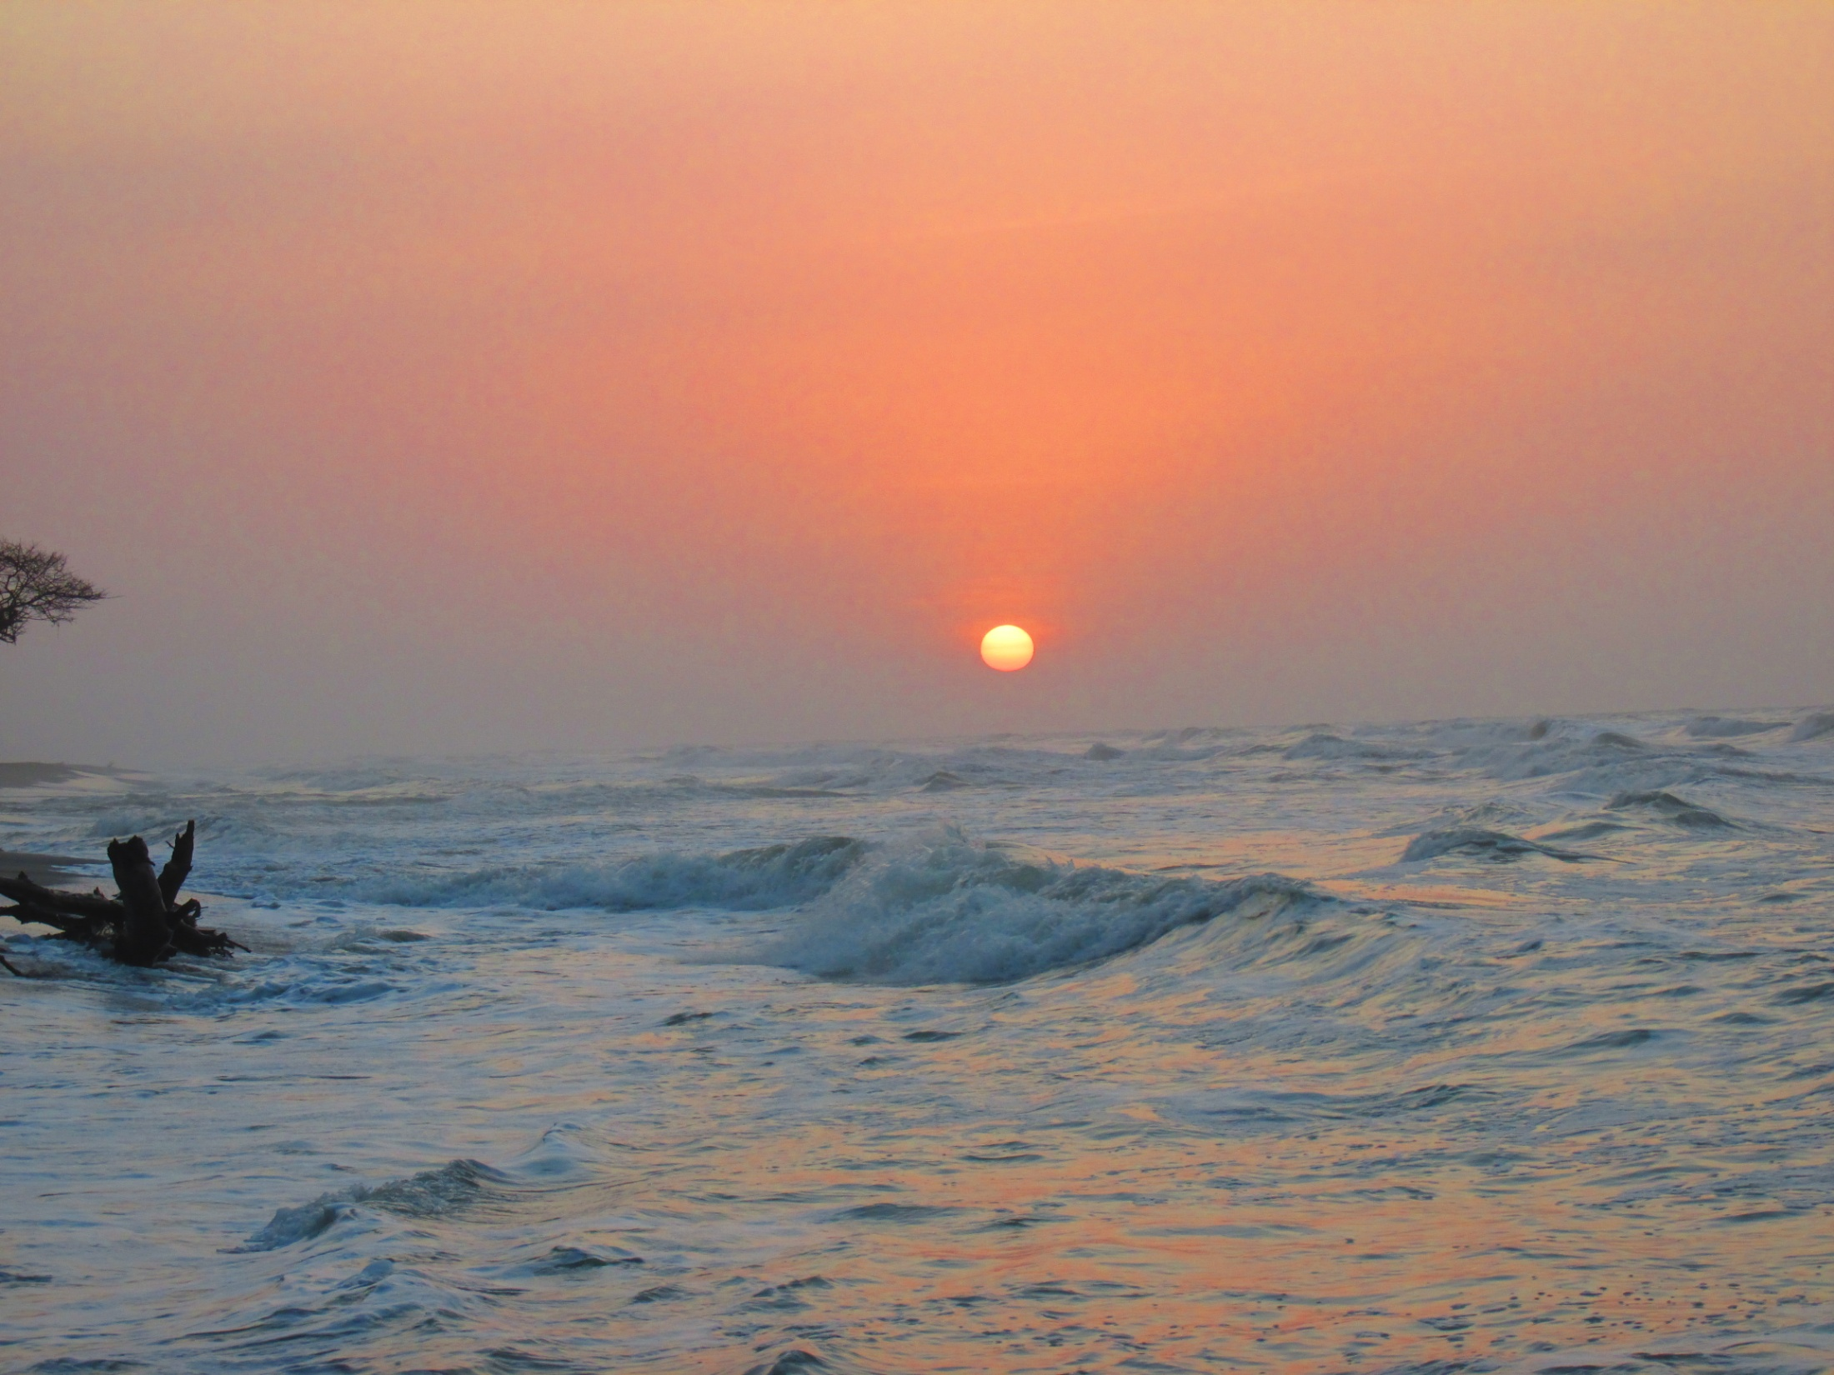
Sea is seem as a crucial stage in the water cycle. (Kogi) the Mother was at the beginning identified with the ocean. The salty sea water is the amniotic fluid of the Earth.
Sea shells play an important role in Misak and Kogi rituals (Misak and Nasa) - ritual of connecting the waters of the female Lake with the sea water brought in a seashell to summon seasonal rains- we can observe a similar ritual in the Kogi communities for keeping the world in balance).
Coming back of the same water in forms of clouds and rain- important are colours and the types of rain as well as the direction it is coming from (signs for events connected to agriculture and to the general well-being of the community).

Slide 24
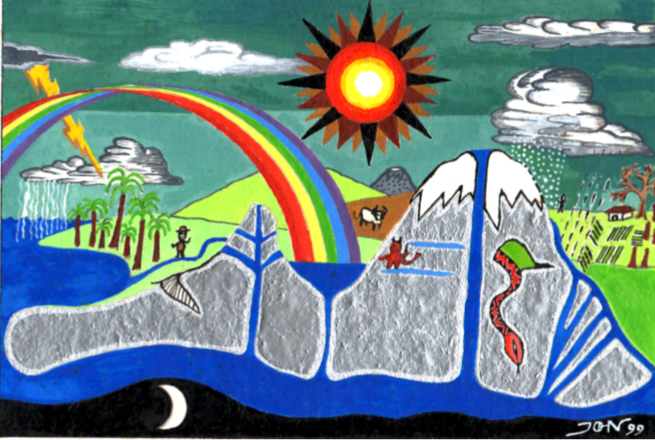
Water in all parts
Author: Jhon Ferney López Muñoz

Slide 25

PEOPLE AS KEEPERS OF THE UNIVERSE
People were created as keepers (guardians) of the Universe. By the right way of performing daily chores and rituals (seasonal and life cycle related), they ensure equilibrium in their bodies (health), community, territory and consequently in the whole Universe.
Kogi: Strict division of chores between men and women (each chore- weaving, spinning, clothes making, pottery making etc. corresponds with the most profound process that stood behind the creation of the Universe). Connecting sites of spiritual importance (to ensure the right cycles) with ceremonial objects, planting “mothers” (figures of spirits and elements or figures representing particular animal or plant species). Performing the right offerings and rituals (looking after the Sun, the Moon, the Earth, water etc.).
Nasa, Misak: Importance of keeping the main universal forces in balance (hot, cold; left, right; up, down). Any imbalance projects itself from the smallest scale (human body) to the largest (Universe). The balance is kept by daily actions and rituals (cleansing ceremonies, summoning the rain, offerings to dead ancestors etc.).

Slide 26




Slide 27

The Creation Myths
Kogi: Alúna (Mother Ocean); Misak, Nasa: sacred lakes+ celestial bodies
CONNECTIONS
“When the land heals, we also heal” (Nasa)
People created as the guardians of natural resources, keepers of the balance in the Universe (right rituals and rightly performed chores)
Failing the role of the guardians and balance keepers- breaking taboos, exploiting the land and redirecting water bodies)
BALANCE
WATER
outside “good” and “bad”
DISBALANCE
Re-living the creation myth in the daily life as an individual and community (Kogi: male and female principles; Misak, Nasa: balance between cold and warmth, balance between the three spheres of the world etc.)
Manifests in communities and individuals in forms of wars, epidemics, illnesses. Natural forces (linked to particular supernatural beings are trying to regain the disturbed balance)
ABUNDANCE
COLLAPSE
The land
(territory in which the history unfolds-its well-being or ill-being is immediately mirrored in the communities and individuals)
Community- Nature connection
Regular water cycles= healthy community and healthy individuals (following the traditional way of living consulting ancestors)
Disasters and irregularities in water cycles and the changing of seasons

Slide 28


CHANGES
2015 Constitutional Court of Colombia defined a number of páramo ecosystems on which mining (gold, silver, coal) and oil and gas extraction was prohibited.
2013 Kogis regained ownership of some sacred sites on the Caribbean coast.
Nasa and Misak – continuous organized recuperation and protection of water sources, springs, rivers and lakes; reforestations with native plant species; protection and conservation of “sacred sites” (area of páramos and forests).

Slide 29


BEHIND THE SCENE
Only a fraction of the overall páramo areas has been officially recognized (in most areas the mining continues, and the negotiations have been suspended).
Mercury usage in gold and silver mining causes serious water contamination (south east of Cauca is referred to as “la estrella fluvial”- vast areas and many indigenous communities are directly supplied with water coming from the contaminated areas).
Sulphur mining continues in the Puracé National Park (dangerous seasonal rains).
High landslide risk- deforestation and climatic changes (Misak - “modern” mythological story about how Srekollimisak`s (Spirit of Rain) house was burnt and how he left páramos) - explanation of the fact that dry seasons are getting longer and the water supplies are decreasing.
Sulphur mines in the Puracé National Park

Slide 30

THE END OF THE UNIVERSE
According to the mythologies of the selected indigenous tribes in Colombia, people are responsible for keeping the Universe in balance.
The end of the world, according to U’Was (tribe living in Sierra Nevada del Cocuy), will be caused by a severe imbalance between the “world above” (associated with white colour) and the “world below” (red colour). The colours are now mixed gently in living beings (blue and yellow) who have to strive for equilibrium. Severe disturbances can cause that the red colour of the “world below” mixes with the white colour of the “world above”. This will ultimately lead to the end of our Universe.
Kogi: “… Our father Serankua created the world, so there is peace. When will the world finish? If we act and think correctly, if we continue bringing the offerings, the world won`t come to an end… That is why we are still taking care of the Sun, the Moon and the Earth… That is why we live. If we continue doing it, nothing will happen…” (excerpts translated from Ereira 2004)

Slide 31
 | The Land/The World (Territory, resguardos - reservations) | People- communities (agriculture and well-being) | People- individuals (body and well-being)
Creation myths, cosmology | The creation myths are being continuously re-lived in specific places within the territory. The myths are directly linked to the real places within the community surroundings. Kogi- Sierra Navada- “The Heart of the Earth”. Misak- páramo - “ the Realm of Dead Ancestors”; lakes from which the Life and people were created, etc. | The activities of the community are linked to the specific processes described by the creation myths. Kogi- temples and houses built to represent the universe; making pottery, clothes, spinning replays the processes of the creation on a smaller scale. Misak- the traditional hat represents the universe and the territory. | People have come from nature and live within a community. Misak- people are born from water, water and its cycles represent each person`s life cycle. Nasa- human body mirrors the territory and natural beings (used in traditional medicine, reflected in language- names of body parts, human body = tree). Naturalization of a human being vs. antropomorphization of nature.
Seasons and regular cycles in nature | Regular changes of the weather conditions. Linked to water cycles and the movements of celestial bodies. Kogi, Misak- houses and esp. temples serve as calendars and are designed to trace the movements of important celestial bodies and constellations). | Agriculture Rituals- summoning the rain. Kogi, Misak, Nasa- cleansing rituals which keep the water cycle flowing (connecting lakes and the sea). Misak- the festival of offering to dead ancestors- their souls come flying bringing the seasonal rains needed for the crop. Misak, Nasa- mingas “the organized, collective work events”. Misak- shamans` participation (soil preparation, sowing, harvest). | Supplies of food, water; seasonal work and festivals Misak, Nasa- participation in mingas “the organized, collective work events”. Kogi, Misak, Nasa- sowing and harvesting plants according to seasons and the Moon phases.

Slide 32
Keeping the equilibrium | The land is in harmony (seasons, water, plants, animals, minerals, people and spirits). Misak, Nasa- there is equilibrium between the main forces (cold and warm) and between the main directions (left and right; above and under). Point of reference might be an important river. Kogi- the land is kept in balance with the help of so called “mothers”- golden and clay figures that represent natural forces or specific species of animals and plants. Misak, Nasa- mythical guardians of plants and animals (Sierpi, Pishimisak, duendes)- importance of taking care of the biodiversity. | Community lives in harmony following ancestors. Kogi- people keep the equilibrium by performing the right rituals and keeping to the traditional division of chores (male, female). Misak, Nasa- the cleansing rituals, offerings to the dead ancestors (the importance of shamans). | Personal health and fertility Each individual restrains from violating taboos. Misak, Nasa- balance of the cold and warm principles in one`s body (follow the restrictions advised by shamans). Kogi- approach carefully to one`s responsibilities in the community (everything is an intention first created in alúna “the spiritual world”).
Disbalance | Sudden, destructive changes to the natural environment. Draughts, floods, eruptions, avalanches appear as the Earth is trying to regain balance. Kogi- the changes on a small scale (microregions) mirror the destructive changes in the whole created world. Misak, Nasa- cleansing rituals (summoning the rain), trying to “rebuild” the house of Pishimisak (Srekollimisak), saving water sources campaigns. Progress in banning mining in some páramo areas. | The community is stricken by wars, skirmishes and epidemics. Misak, Nasa- special prodigies come from the underground (sacred) lands to help re-establish balance in their community. Misak, Nasa, Kogi- cleansing rituals (refrescos) performed by shamans for the community. | The imbalance in one`s body causes an illness or miscarriage. Misak, Nasa- it is important to observe traditional regulations (esp. pregnant women) eg. going to páramo, washing in streams, be exposed to the rainbow etc. to maintain balance between the two main principle (hot and cold).

Slide 33

For stories, suggestions, further questions:
lucie.vinsova@gmail.com
Thank you

Slide 34

Main Sources:
Abelino Aranda, Luis Guillermo Vasco Uribe. 2015. Hijos del Aroiris y del Agua. Universidad Nacional de Colombia, Colombia.
Hugo Portela Guarín. 2000. El Pensamiento de las Aguas de las Montañas (Coconucos, Guambianos, Paeces, Yanaconas). Universidad del Cauca, Popayán, Colombia.
Judy Branks and Juan Bautista Sánchez. 1978, 2011. The Drama of Life (A Study of Life Cycle Customs Among the Guambiano Colombia, South America). SIL International, USA.
Joana Alexandra Peña Bautista. 2009. En las Voces del Pishimisak: Apuentes Etnográficos sobre el Tiempo Misak. Universidad Nacional de Colombia. Bogotá.
Alan Ereira. 2004. Poselství ze srdce světa. Praha.
Alain Fabre. 2005 Diccionario etnolingüístico y guía bibliográfica de los pueblos indígenas sudamericanos.
Jose R. Navia. 1992. Los Mamos y sus Aguas Mitológicas.
Valencia, José Herinaldy Gómez. 2000. Lugares y Sentidos de la Memoria Indígena Paez. Universidad Autónoma del Estado de México, México.
Orozco M, Paredes M, Tocancipá-Falla J. 2013. La Nasa Yat: Territorio y cosmovisión. Una aproxinación interdisciplinaria al problema del cambio y la adaptación en los nasa. En: Boletín de Atropología. Universidad de Antioquia. Medellín.

Slide 35
Hugo Portela Guarín. La Cultura Medica en la Cosmovision Paez. Cultura y Salud en la Construccion de las Americas.
Guarín Hugo Portela. Cuerpo y Cosmos en el rito Paez. Visión Problématica.
Tamara Felipe Cardenas. 2003. El Paisaje Adivinatorio de los Kogi: elementos del nanejo ambiental indígena (Sierra Nevada de Santa Marta – Colombia). Pontificia Universidad Javeriana.
Vargas Héctor Llanos. 2011. La Percepción del Tiempo-Espacio en Sociedades Aborígenes. Universidad Nacional de Colombia.
Gerson Javier Pérez-Valbuena , Iván Higuera-Mendieta, Leonardo Bonilla-Mejía. 2017. La Linea Negra y otras áreas de protección de la Sierra Nevada de Santa Marta: ¿han funcionado? Banco de la Republica - Sucursal Cartagena.
Cárdenas Támara, Cleef Antoine M. 1996. El páramo: un ecosistema de alta montaña. Fundación Ecosistemas Andinos, Bogotá.

