Slide 1
EDITACE FOTOGRAFIÍ
Fidlerová Adéla

Slide 2
Adobe Photoshop
Adobe Lightroom
Gimp
Pixlr
Fotor
https://cdn.mos.cms.futurecdn.net/gyNFkPcDEEGVPTALdDaPbC-1200-80.jpg.webp

Slide 3
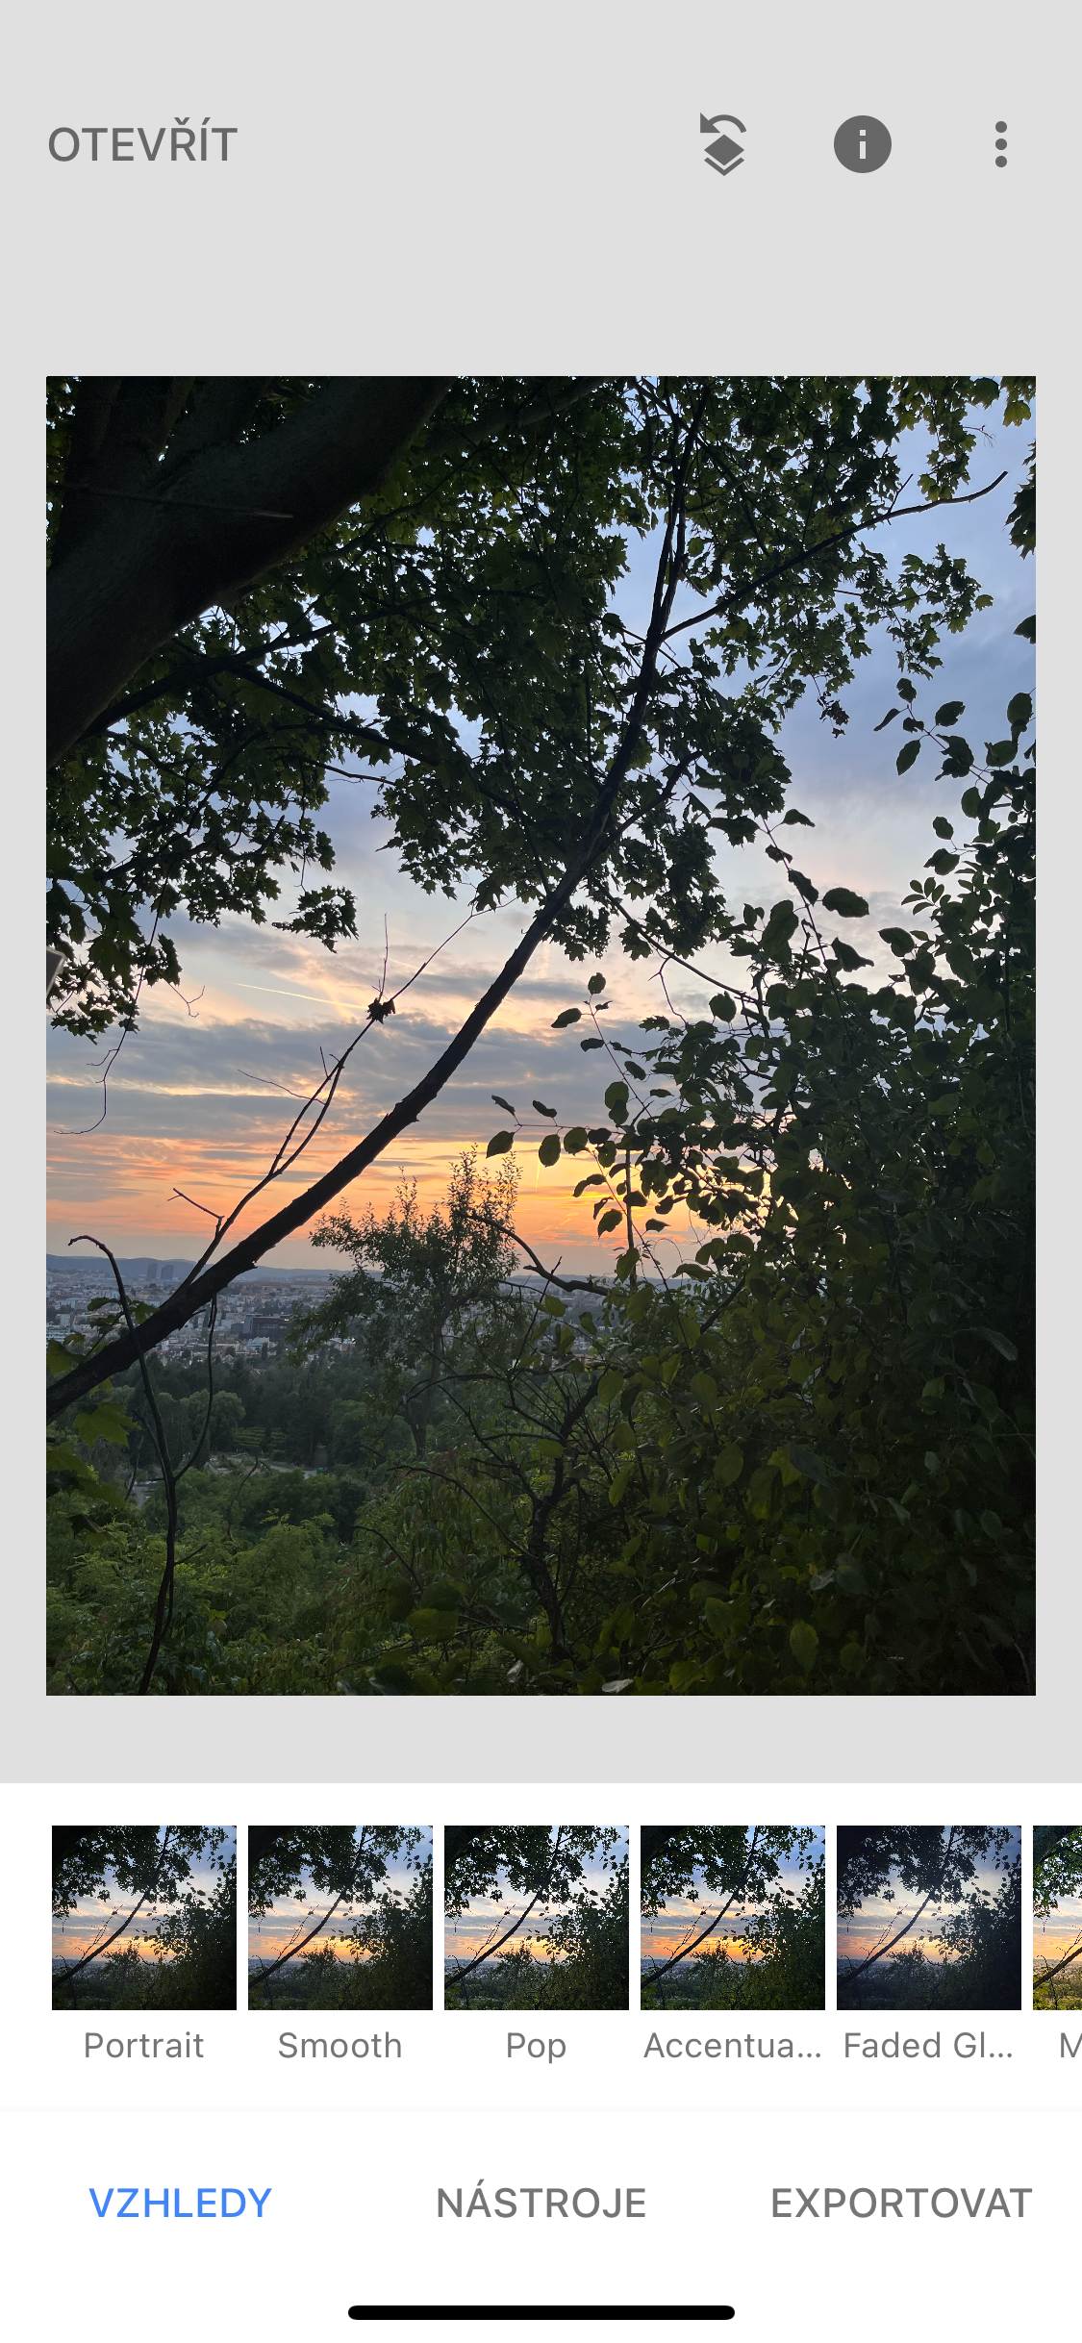
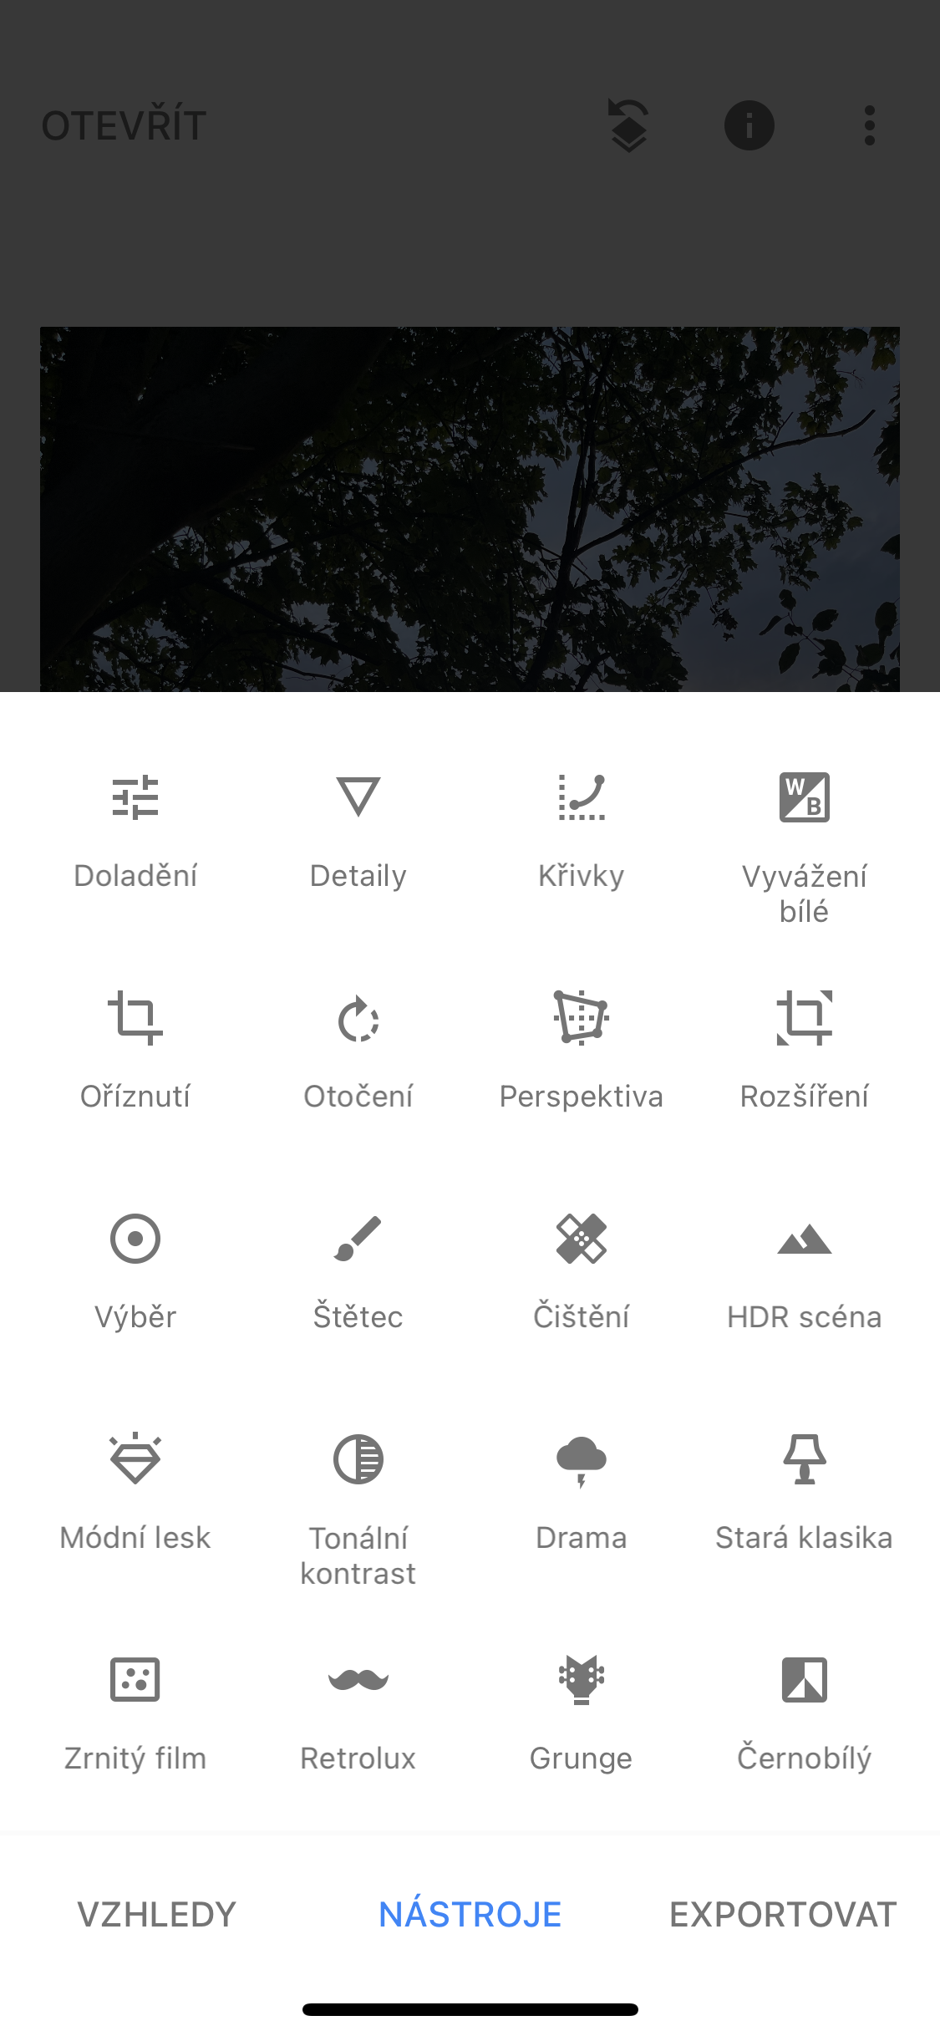
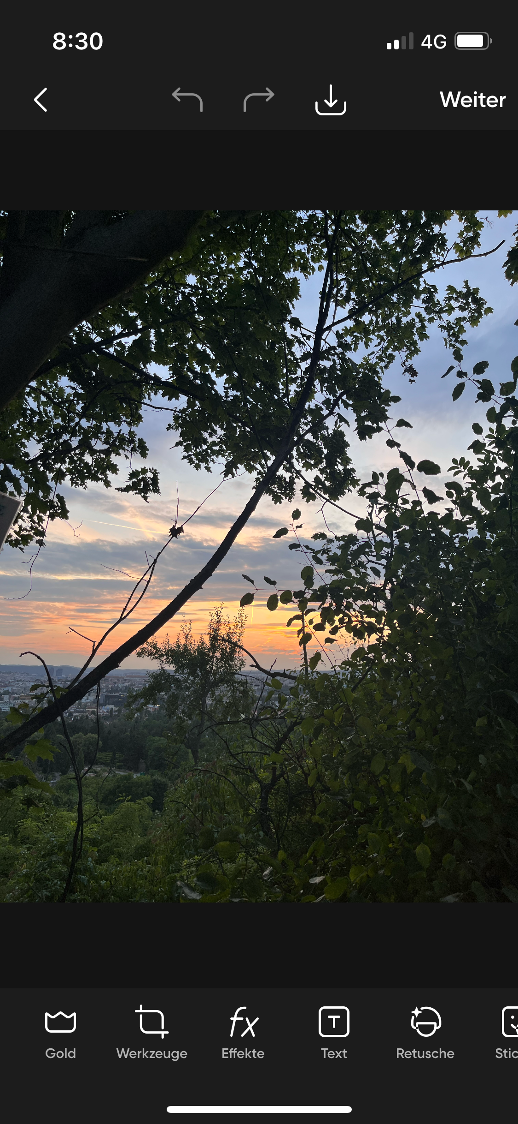
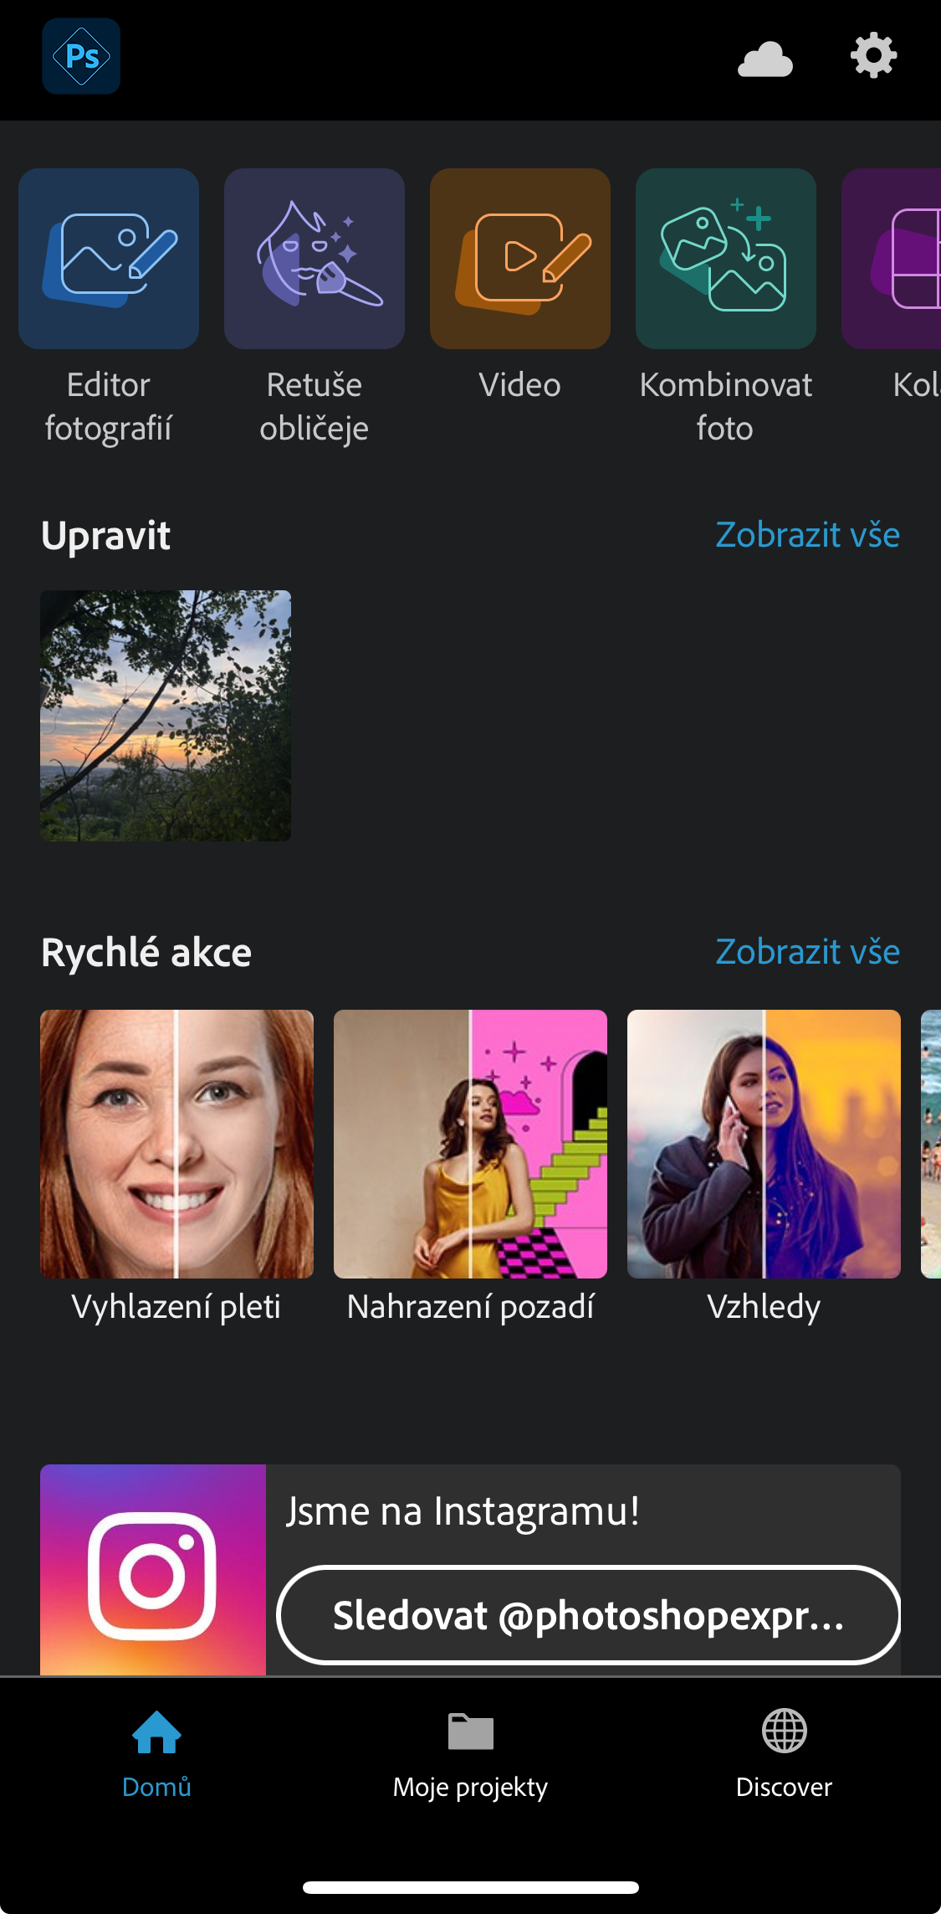
Snapseed
PicsArt
Pocked studio
Photoshop Express

Slide 4
https://m-cdn.phonearena.com/images/articles/399329-image/samsung-fake-moon-photos2.jpg

Slide 5
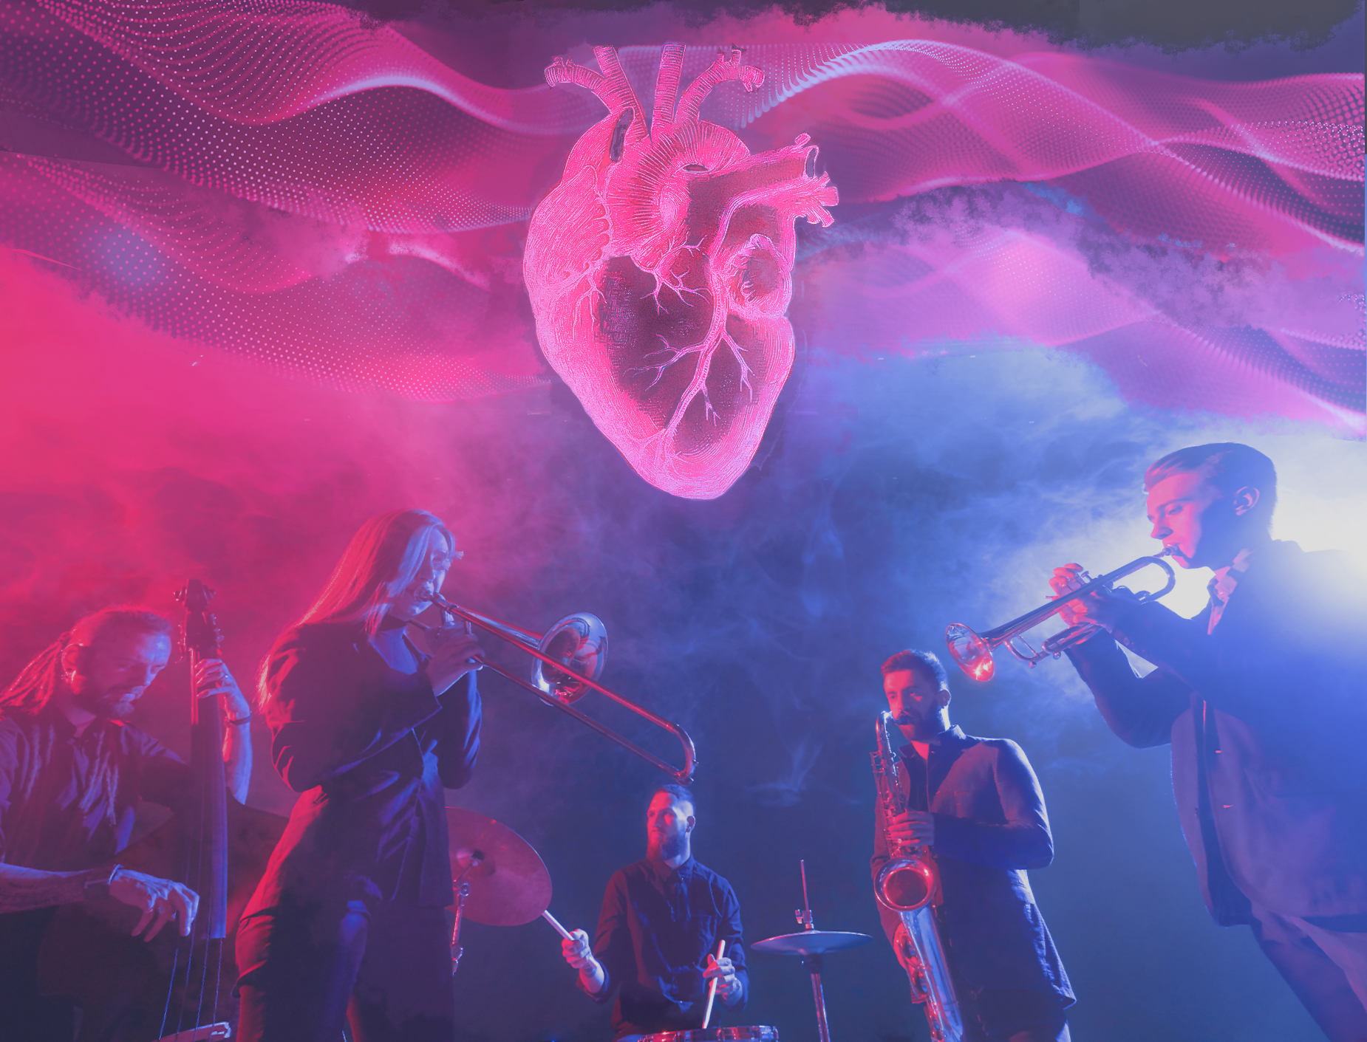

Slide 7
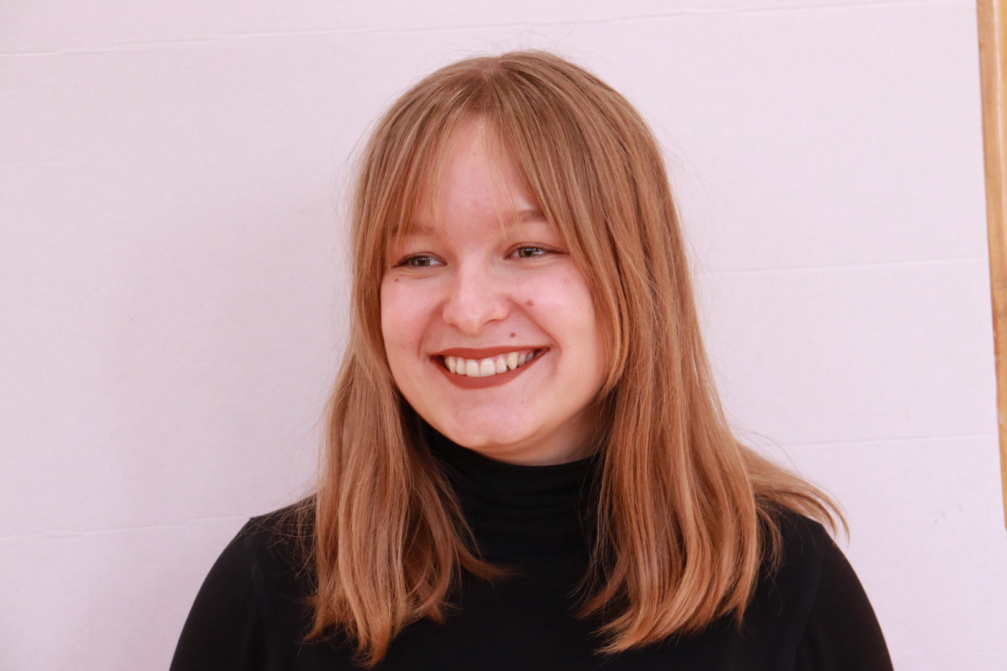
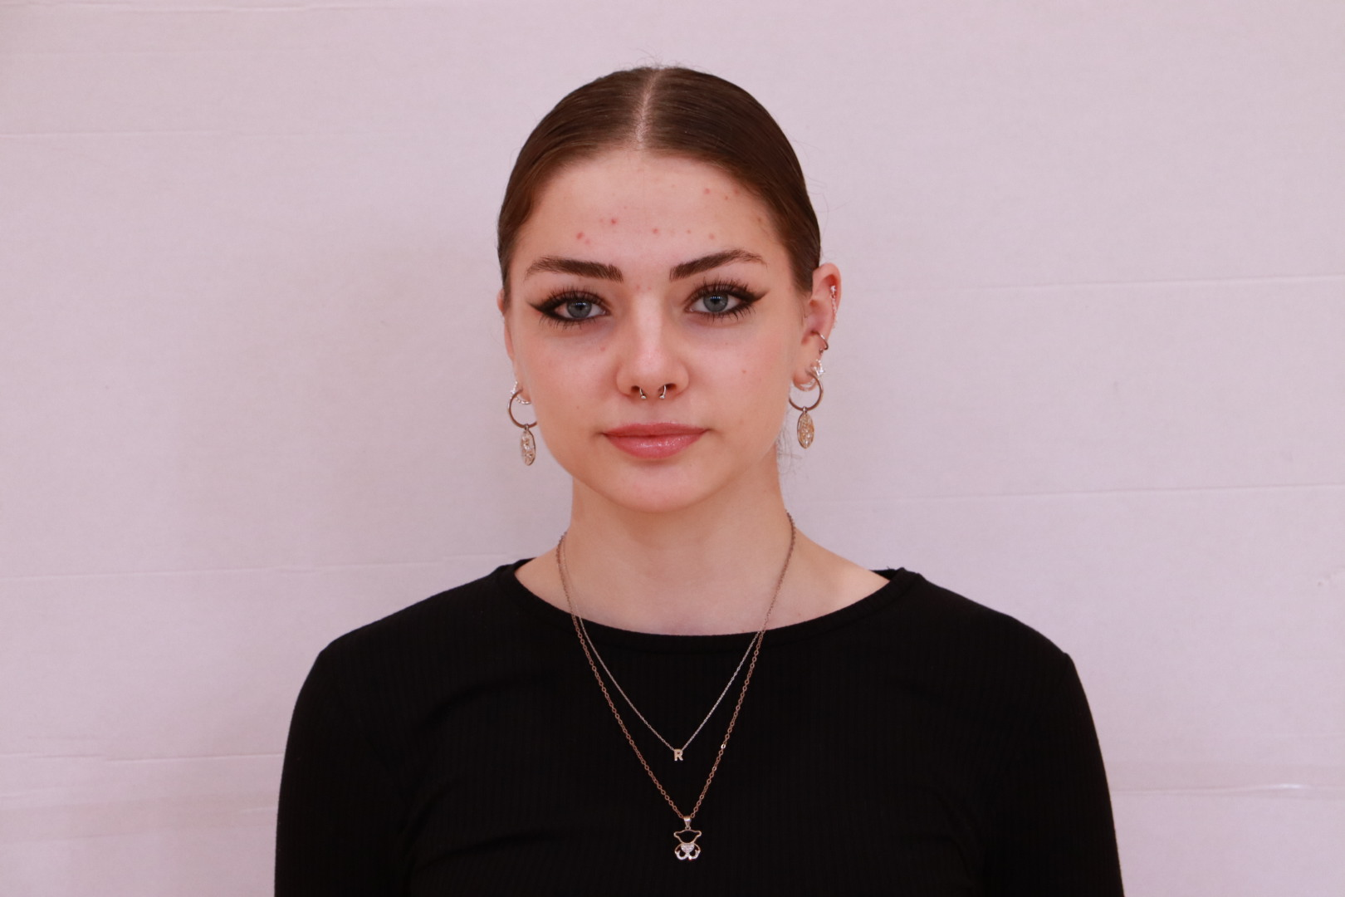
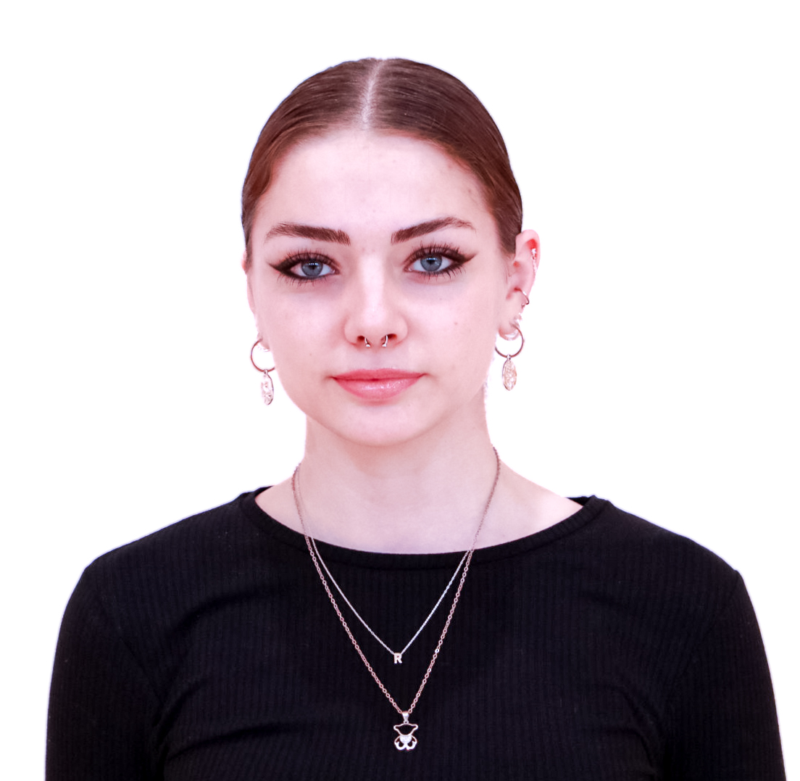

Slide 8
