Slide 1
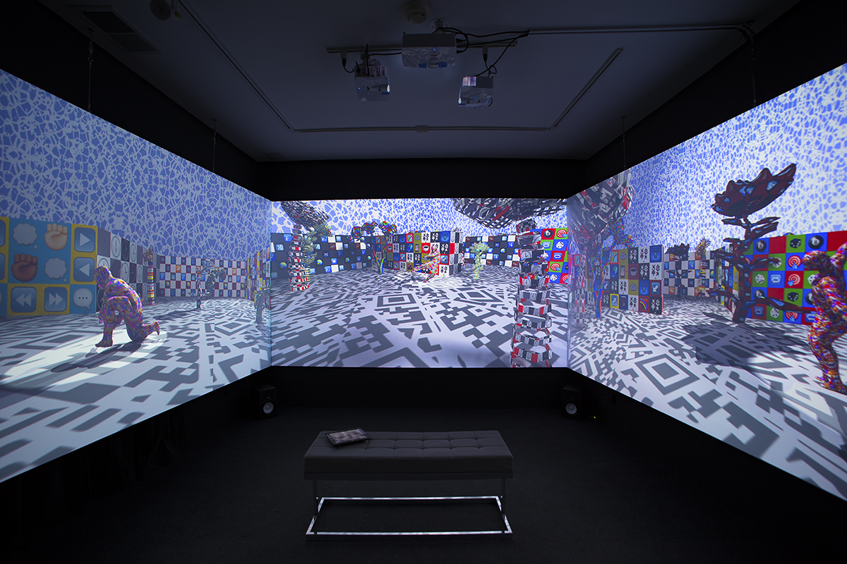
Performance, happening, sociální skulptura

Slide 2
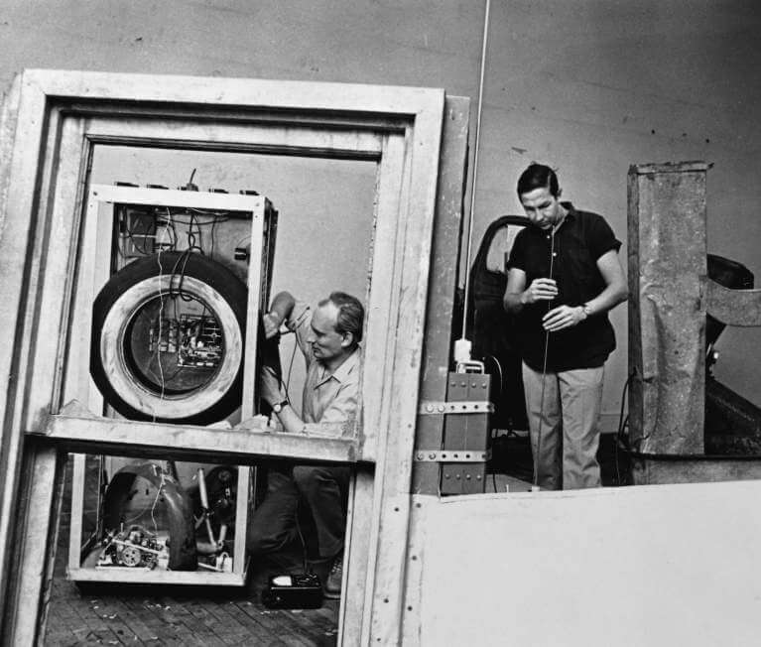
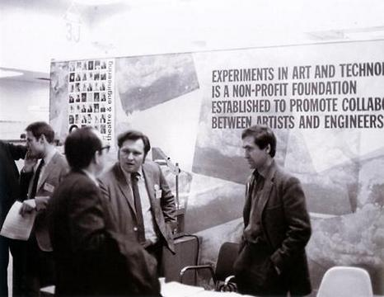
EAT - Nine Evenings: Theater and Engineering (1966)

Slide 3
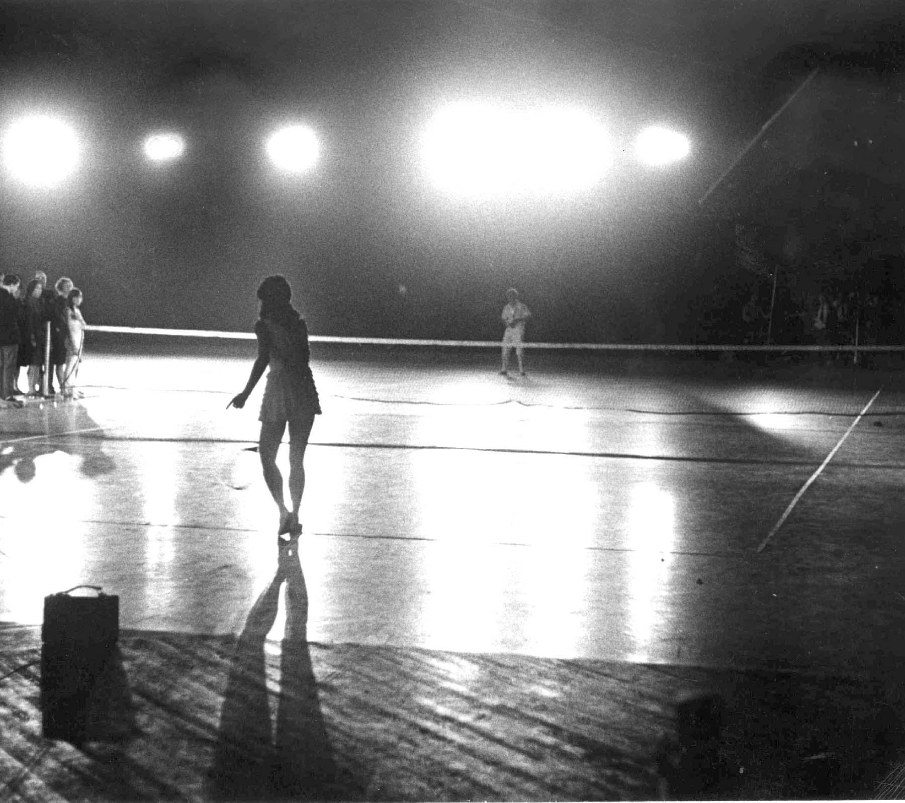
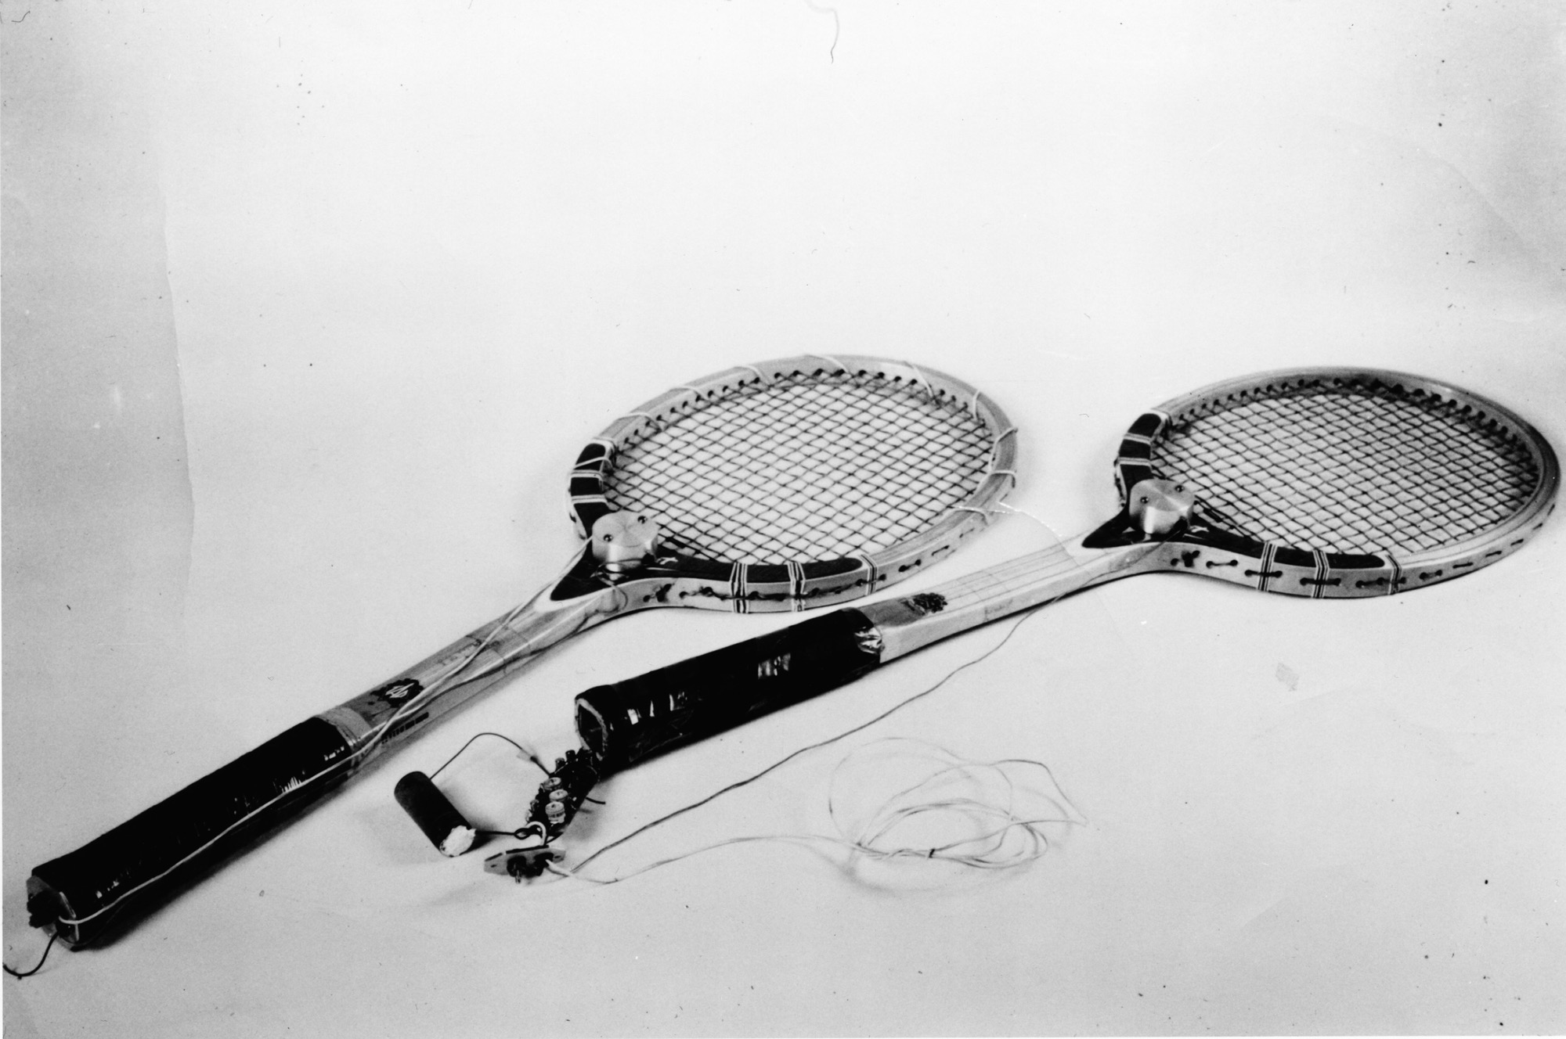
EAT - Nine Evenings: Theater and Engineering (1966)
Robert Rauschenberg – Open Score

Slide 4
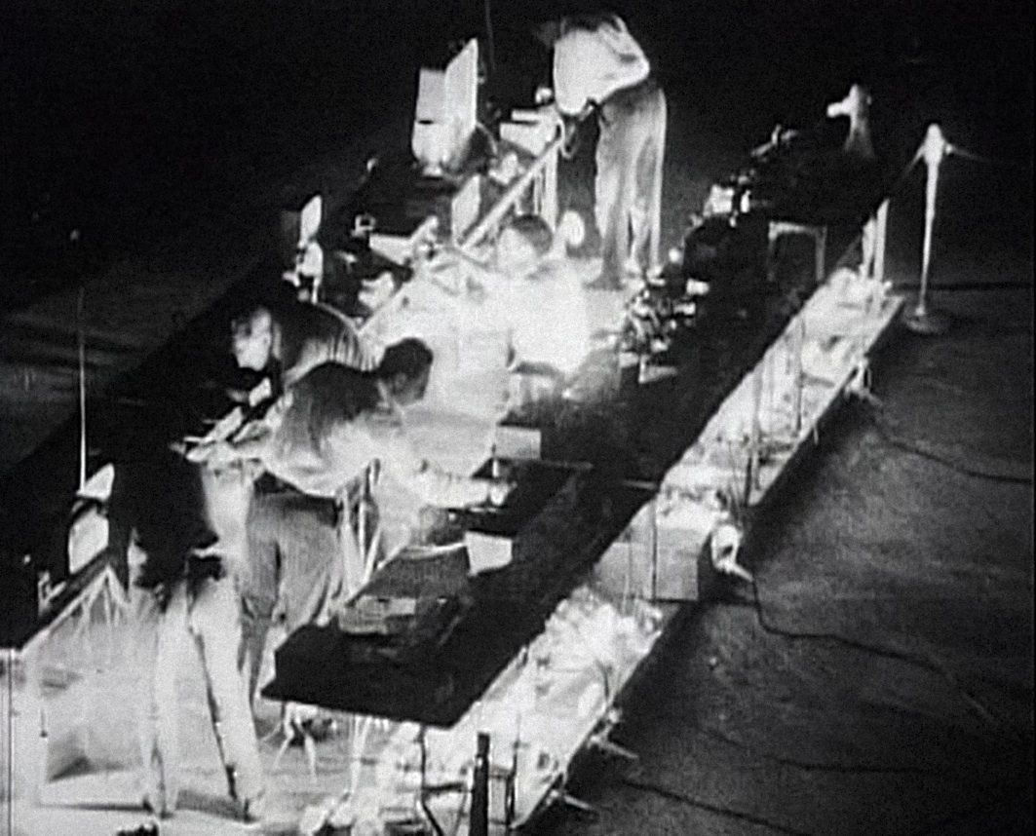
EAT - Nine Evenings: Theater and Engineering (1966)
John Cage – Variations VII

Slide 5
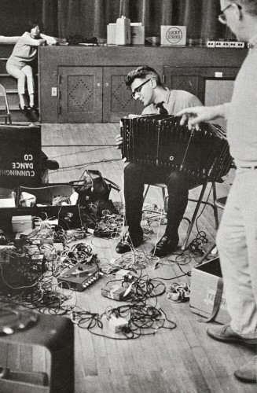
EAT - Nine Evenings: Theater and Engineering (1966)
David Tudor – Bandoneon!

Slide 6
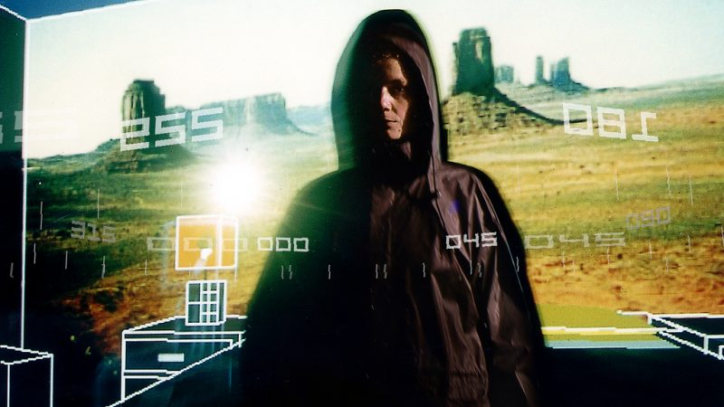
Blast Theory – Desert Rain (2000)

Slide 7
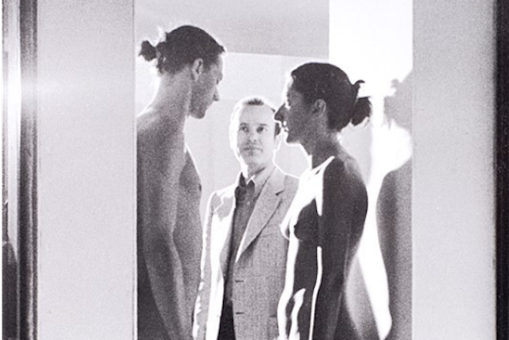
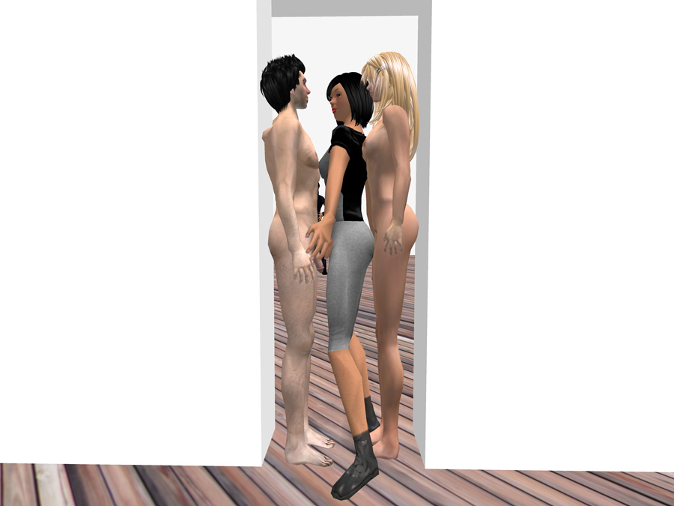
Eva a Franco Mattes – Synthetic Performances (2007)

Slide 8
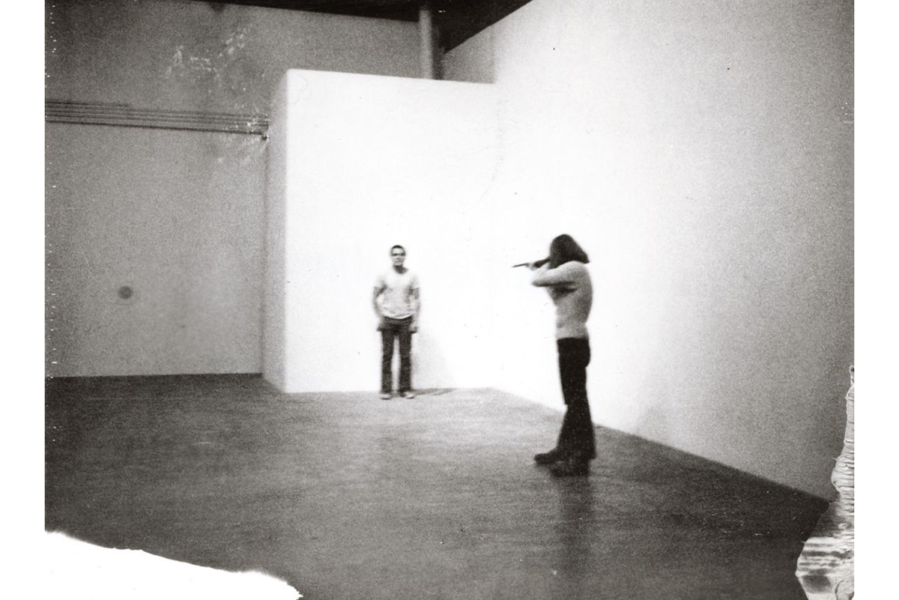
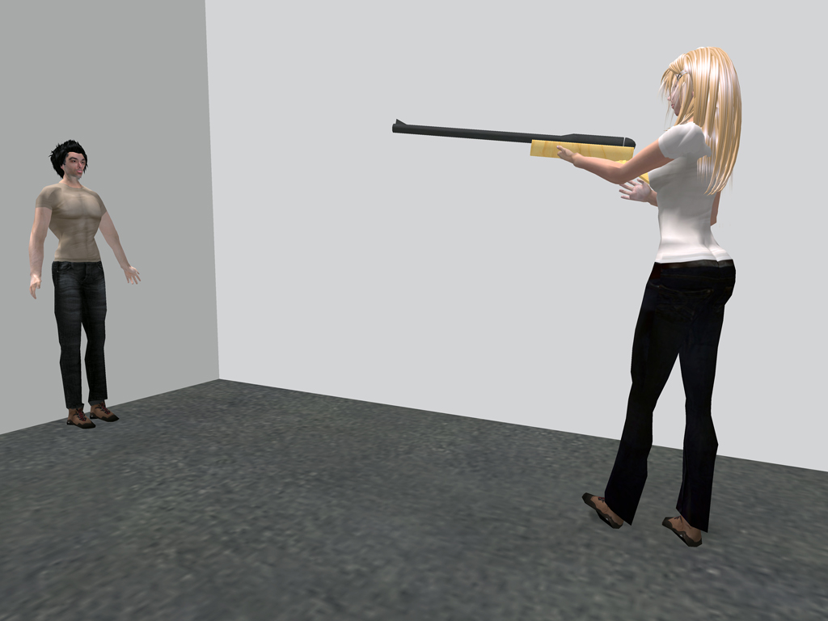
Eva a Franco Mattes – Synthetic Performances (2007)
https://0100101110101101.org/readme-code-of-chris-burdens-shoot/

Slide 9
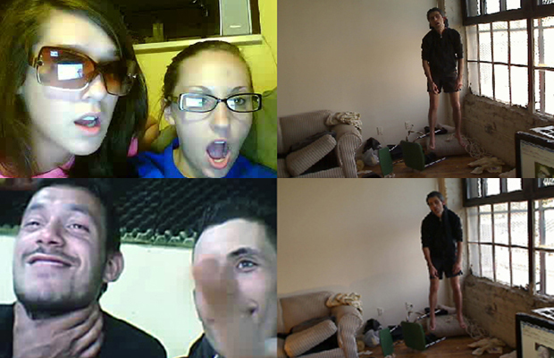
Eva a Franco Mattes – No Fun (2010)

Slide 10
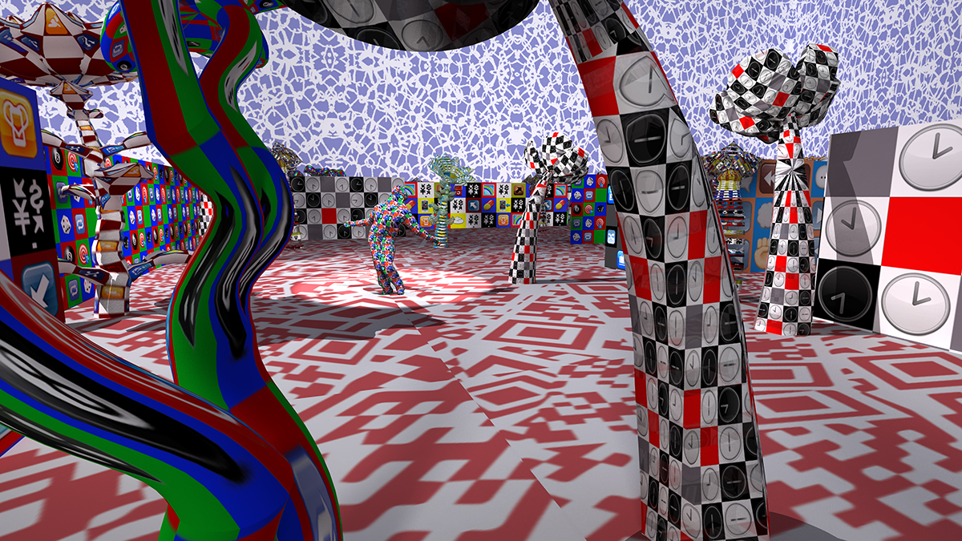
Claudia Hart - Alice Unchained XR: 3 Channel Video Installation + Vive VR (2018)

Slide 11
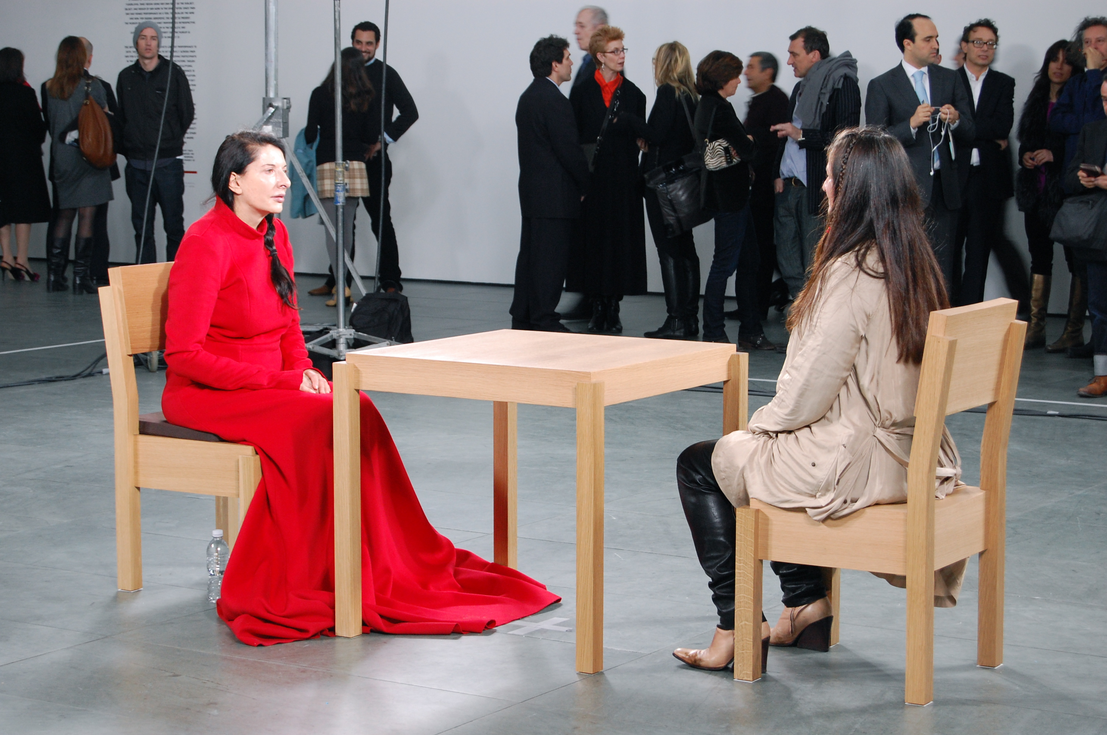
Marina Abramović - The Artist Is Present (2010)

