Slide 1
Korean class
WEEK 8

Slide 2
Index
Adverb
Key Sentences
Grammer
Korea’s Culture

Slide 3
Key sentences
- time & date
When is your ~ ?
~ 이 언제입(십)니까?
~ will be on (N: date).
~ 은 N월 N일 N요일입니다.
What date does (schedule) (end/start)?
(schedule)이 언제 (끝나지/시작하지)?
What date does mid-term test start?
중간고사가 언제 시작하지?
[junggangosa-ga eonje- sijakaji?]
What date does this trip end?
이 여행이 언제 끝나지?
[i yeohaeng-i eonje- kkeunnaji?]
When is the vacation?
휴가가 언제십니까?
[hyuga-ga eonje-simnikka?]
When is your Final test?
기말고사가 언제입니까?
[gimalgosa-ga eonje-imnikka?]
Next concert will be on Wednesday, November 16th.
다음 콘서트는 11월 16일 수요일입니다.
[daeum (concert) neun 11wol 16il suyoirimnida]
Mid-term test will be December 25th.
중간고사는 12월 25일입니다.
[junggangosa-neun 12wol 25irimnida.]
*휴가 – vacation / 기말고사 – final test / 중간고사 – midterm test / 여행 – trip

Slide 4
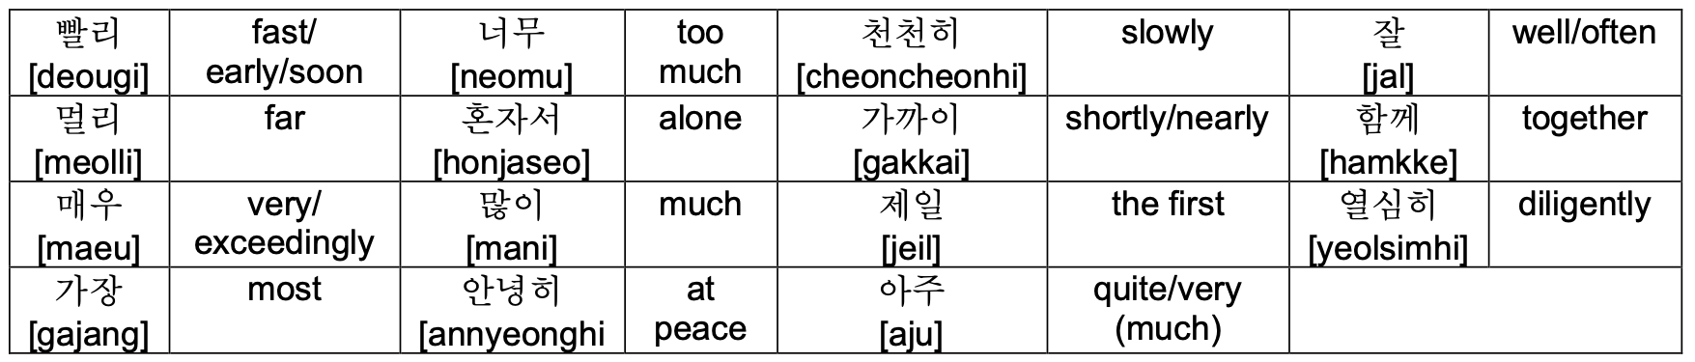
Adverb
[bballi]
Notes:
읽기
매우, 너무, 아주 all have similar meanings. If you're trying to say “it is very delicious“(맛있다), you can say 매우 맛,아주 맛, 너무 맛 all.

Slide 5
Key sentences
- in café & restaurant
오늘/ 카페에서/ 숙제를/ 했어요. “I did my homework at the café today”
[o neul ka pe e seo sug je leul hae sseo yo]
:→(when), (where)에서 (what)을/를 (action/verb)어요.
Ex) 어제 식당에서 라면을 먹었어요 I ate ramen at a restaurant yesterday
[eoje sikdangeseo ramyeoneul meogeosseoyo]
Ex) 오늘 학교에서 숙제를 했어요 I did my homework at school today
[oneul hakgyoeseo sukjereul haesseoyo ]
하다(do)= 하+다
[ha da]
했어요(did)
[hae sseo yo]
먹다(eat)= 먹+다
[meokda]
먹었어요(ate)
[meogeosseoyo]
Notes:
영어-한국어
오늘 corresponds to When.
카페에서 corresponds to where
숙제 corresponds to what
Then you can put action or verb stem here.
In this sentence, verb ‘하다’ is put here.
The form of the word 하다 has changed to the past tense 했어요.
예시
읽기
--------------

Slide 6
Key sentences
- in café & restaurant
주문(noun: order)= 주문+하다 (verb: order)
[ju mun ha da]
너는 /뭐 /주문/ 할래? “What do you want to order?”
[neo neun /mwo/ ju mun/ hal lae?]
:→(who)은/는 뭐 (action/verb) 할래?
Ex) 아빠는 뭐 주문 할래? Dad, what do you want to order?
[appaneun mwo jumun hallae?]
Notes:
영어-한국어
너 corresponds to Who.
주문 is order.
You can add action noun 주문 in here.
예시
읽기

Slide 7
Key sentences
- in café & restaurant
남은 음식 포장해주세요. “Please wrap up the leftovers.”
[nam eun eum sig po jang hae ju se yo]
:→(what) (action/verb)세요
어떤 메뉴가 제일 인기 많나요? “Which menu is the most popular?”
[eo tteon me nyu ga je il in gi manh na yo?]
:→ 어떤 (what)이/가 제일 인기 (action/verb)나요?
포장해주다(wrap up)= 포장해주+다
[po jang hae ju da]
많다 [adjective](a lot, most, much)= 많+다
[manh da]
Notes:
영어-한국어
남은 음식 corresponds to What.
Then put action or verb stem 포장해주 here.
읽기
-------
영어-한국어
메뉴 corresponds to What.
많다 is adjective in Korean and mean a lot many, much, most. So you can put 많 the adjective stem in here.
읽기

Slide 8
Key sentences
- in café & restaurant
피클이랑 김치 더 주시겠어요?
“Would you please give more pickle and kimchi?”
[pi keul I lang gim chi deo ju si ge sseo yo?]
:→(what)(이)랑 (what) 더 (action/verb) 시겠어요?
Notes:
영어-한국어
You can put in the target you want this blank.
Also you can say 이랑 or 랑. It depends on the presence of a 받침.
If previous word have 받침, you should say 이랑. But there is no 받침, you should add just ‘랑’
읽기

Slide 9
Key sentences
- private question
나이를 여쭤봐도 될까요?
May I ask your age?
[naireul yeojjwobwado doelkkayo]
→(noun)을 여쭤봐도 될까요?
Notes:
시작!!
나이 is noun and means age.
May I ask = 여쭤봐도 될까요? Is polite expression.

Slide 10
Key sentences
- private question
당신의 종교는 뭡니까? What’s your religion?
[dangsinui jonggyoneun mwomnikka]
→당신의 (noun)은 뭡니까?
저는 기독교 신자입니다. I’m a Christian.
[jeoneun gidokgyo sinjaimnida]
→저는 (religion) 신자입니다.
Notes:
종교 = religion. 당신의 = your, what is = 뭡니까?
So you can create many sentence chaging this noun black.
For example, What’s your religion? = 당신의 이름(name)은 뭡니까?
Next,
You can answer by putting the religion corresponding to the blank.
Christian is 기독교 in Korean.

Slide 11
Key sentences
- private question
태어나다(be born)= 태어나+다 [tae eo na da]
자라다(Grow up, raise)= 자라+다[jarada]
나오다(Graduate)= 나오+다[na o da]
전공하다(Major in)=전공하다 [jeon gong ha da]
전주에서 태어나 서울에서 자랐습니다.
I was born in Jeonju and raised in Seoul.
[Jeonjueseo taeeona seoureseo jaratseumnida]
→(place)에서 (verb) (place)에서 (verb).
어느 학교 나오셨나요? Which school did you graduate from?
[eoneu hakgyo naosyeonnayo]
→ 어느 (noun) (verb)?
교육학을 전공하고 있습니다. I’m majoring in education.
[gyoyukageul jeongonghago itseumnida]
Notes:
Be born = 태어나다. 자라다
You can add appropriate place and verb here.
For example, Germany 독일.
학교 = noun
나오셨나요? =is a pollite questionable form of 나오다.
You can change this word to give various answers.
예를 들어 Economics

Slide 12
Key sentences
- private question
과제 제출일이 언제까지야?
“When is the dead-line of assignment?”
[gwaje jechuriri eonjekkajiya]
:→(what)이 언제까지야?
장학금을 받으려면 어떤
기준을 충족해야 하나요?
“Which criteria should be met to get a scholarship?”
[janghakgeumeul badeuryeomyeon eotteon gijuneul
chungjokaeyahanayo]
:→(what)을 받으려면 어떤 기준을 충족해야 하나요?
오늘 팀플하러 가야 해.
“I have to go to the team
meeting today.”
[oneul timpeulhareo gayahae]
:→(when) (what)하러 가야 해

Slide 13
Key sentences
- time & date
Which criteria should be met to get ~ ?
~ 을/를 받으려면 어떤 기준을 충족해야 하나요?
I have to go to (schedule) (time).
(time) (schedule)러 가야 해.
Which criteria should be met to get credits?
학점을 받으려면 어떤 기준을 충족해야 하나요? [hakjeomeul badeuryeomyeon eotteon gijuneul chungjokaeya hanayo?]
Which criteria should be met to get bonus point?
추가 점수를 받으려면 어떤 기준을 충족해야 하나요?
[chuga jeomsu-reul badeuryeomyeon eotteon gijuneul chungjokaeya hanayo?]
I have to go to eat dinner now.
지금 저녁먹으러 가야 해
[jigeum jeonyeongmeogeuro gaya hae]
I have to go to take a quiz tomorrow.
내일 퀴즈 보러 가야 해
[naeil (Quiz) boreo gaya hae]
*추가 점수 – bonus point / 지금 – now / 퀴즈 - quiz

Slide 14
Key sentences
- private question
오늘 같이 과제 할래?
“Do you want to work
together today?”
[oneul gachi gwaje hallae]
:→(when) 같이 (what)할래?
수업 끝나고 아르바이트
가야해.
“I have to go for part time job after class.”
[sueop kkeunnago
areubaiteu gayahae]
:→(what) 끝나고
(where)가야해.
시험 끝나고 술 마시러
가자.
“Let’s go drink after
the exam.”
[siheom kkeunnago
sulmasireo gaja]
:→(what) 끝나고
술 마시러 가자.

Slide 15
Key sentences
- time & date
I have to go for (schedule) after ~.
~ 끝나고 (schedule) 가야 해.
Do you want to ~ together (time)?
(time) 같이 ~ 할래?
Do you want to drink alcohol together now?
지금 같이 술 마시러 갈래?
[jigeum gachi sul masireo gallae?]
Do you want to see a movie together next Monday?
다음 월요일에 같이 영화 볼래?
[daeum woryoire gachi yeonghwa bollae?]
I have to go for doing assignment after lunch.
저녁식사 끝나고 과제 하러 가야 해.
[jeonyeo-ksiksa kkeunnago gwaje hareo gaya hae]
I have to go for having lunch after this class.
이 수업 끝나고 점심 먹으러 가야 해.
[i sueop kkeunnago jeomsim meogeuro gaya hae]
*영화 – movie / 과제 – assignment / lunch – 점심(식사) / 수업 - class

Slide 16
Grammar - palatalization
A phenomenon in which ㄷ, ㅌ meets 'ㅣ‘ [i] vowels and turns into‘ㅈ, ㅊ’.
ㄷ+ㅣ= 지
ㅌ+ㅣ= 치
Example) 같이 /ga-ti/: together – 가치[gachi]
해돋이 /hae-do-di/ : sunrise – 해도지[hae-do-ji]

Slide 17
Grammar - liquidization
'ㄴ' is pronounced as [ㄹ] in front or behind＇ㄹ’
ㄹ + ㄴ + ㄹ =ㄹ
Example ) 논리 /non-li/ : logic – 놀리[nol-li]
온라인 :On-line – 올라인[Ol-line]
난로 /nan-lo/: Stove – 날로[nal-lo]

Slide 18
Batchim pronounce
Consonant base | Pronunciation | Example
ㄱ,ㅋ,ㄲ | [ㄱ] | 책[책]:Book-{Caeck}, 부엌[부억]:Kitchen-{Bueok}, 약[약]:Medicine-{Yak},
ㄴ | [ㄴ] | 산[산]:Mountain-{San}
ㄷ,ㅅ,ㅆ,ㅈ,ㅊ,ㅌ,ㅎ | [ㄷ] | 낮[낟]:Daytime-{Not}, 꽃[꼳]:Flower-{ggoat}
ㄹ | [ㄹ] | 길[길]:Road-{Gil}
ㅁ | [ㅁ] | 몸[몸]:Body-{Moam}
ㅂ,ㅍ | [ㅂ] | 밥[밥]:Rice-{Bap}, 숲[숩]:Forest-{Soop}
ㅇ | [ㅇ] | 강[강]:River-{Gang}
Notes:
There may be more than one consonant for ‘batchim’, but today we will only lean cases which only one consonant comes.
And before we start, we should know that ‘ㄸ’, ‘ㅉ‘ and ‘ㅃ’ do not come as a ‘Batchim’.
The remaining consonants can be divided into seven types according to the pronounced consonants.
First, ㄱ, ㅋ and ㄲ are all prodounced as ‘ㄱ’. They have k sound. [책] Chae / k. [부엌] Boo-Eo / k. [닦다] Da / k – Da]
And we can pronounce ㄴ 받침, with the alphabet ‘n’. [산] sa / n. [간] Ga / n.
Next is quite challenging. ㄷ, ㅅ, ㅆ, ㅈ, ㅊ, ㅌ and ㅎ are pronounced as ‘ㄷ’. They all have ‘t’ sound 받침.
[받침] Ba / t – chim. [씻다] Ssi / t – da. [낮] Na – t. (➔Not). [꽃] Ggo – t. (➔Ggoat).
Consonant ㄹ also sounds same even it is in the batchim position. You can add ‘l’ at the end.
[길] Gi / l. [말] Ma / l.
Consonant ㅁ sounds same even it is in the batchim position. You can add ‘m’ at the end.
[몸] mo / m (➔ moam). [감] Ga / m.
ㅂ and ㅍ all sound ㅂ, which sounds ‘p’, when they are batchim.
[밥] Ba / p. [숲] Soo / p
Finally, it’s “o”. ‘o' has no pronunciation when it first came to syllable. It only makes an ng sound when it uses as 받침.
[아이브] ah – i – beu. [강] Ga / ng.

Slide 19
Grammar - nasalization
A phenomenon in which consonants other than the original nasal sounds are changed to nasal sounds (ㄴ, ㅁ, ㅇ) under the influence of neighboring nasal sounds.
Example)
국물 : soup – 궁물[goong-mool]
대통령 : president – 대통녕[dae-tong-nyung]
국립 : national – 국닙 – 궁닙[goong-nip]
'ㅂ, ㄷ, ㄱ’ + ‘ㄴ, ㅁ’ → ［ㅁ, ㄴ, ㅇ］
'ㅁ, ㅇ’ + ‘ㄹ’ → ［ㅁ, ㅇ］ + ［ㄴ］
‘ㅂ, ㄷ, ㄱ’ + ‘ㄹ’ → ‘ㅂ, ㄷ, ㄱ’ + ［ㄴ］ → ［ㅁ, ㄴ, ㅇ］ + ［ㄴ］
Notes:
When a ㄴ, ㄹ, or ㅁ interacts with other consonants, sometimes it undergoes nasalization. Nasalization basically means it forces another consonant to become a nasal sound ㄴ, ㅇ or ㅁ.

Slide 20
Grammar – nasalization Example
First Syllable Consonant | Second Syllable Consonant | Becomes… |  | Examples
ㅂ/ㄷ/ㄱ | ㄴ/ㅁ | ㅂ→ㅁ ㄷ→ㄴ ㄱ→ㅇ | No change | 밥맛[밤맏] 악마[앙마] 거짓말[거진말] | [Bammat] [Angma] [Geojinmal]
ㅁ/ㅇ | ㄹ | No change | ㄹ→ㄴ | 심리[심니] 승리[승니] | [Simni] [Seungni]
ㅂ/ㄷ/ㄱ | ㄹ | ㅂ→ㅁ ㄷ→ㄴ ㄱ→ㅇ | ㄹ→ㄴ | 왕십리[왕심니] 덧니[던니] 폭력[퐁녁] | [wangsimni] [deonni] [pongnyeok]
With batchim pronounciation…
거짓말 → [거짇말] → [거진말]
덧니→[덛니]→[던니]
Notes:
When a ㄴ, ㄹ, or ㅁ interacts with other consonants, sometimes it undergoes nasalization. Nasalization basically means it forces another consonant to become a nasal sound ㄴ, ㅇ or ㅁ.

Slide 21
Important !!
When you write, you must use original word !
These grammatical rules are only used when you speak.
같이 ( ㅇ )
가치 ( x )
대통령 ( ㅇ )
대통녕 ( x )

Slide 22
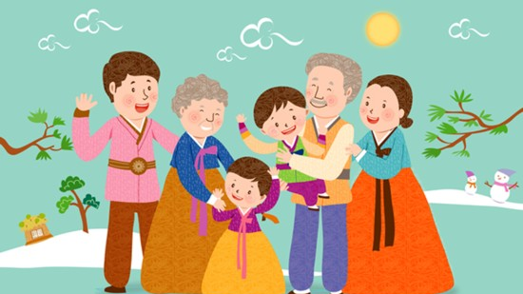
Korea’s culture - holiday

Slide 23
설 [sul]
It is the first day of the New Year, and there is a custom of greeting and saying words of blessing as the first holiday of the year.(January 1st, in the lunar calendar)
윷놀이[Yutnoli]
떡국[ddeokguk]
Korea’s Culture

Slide 24
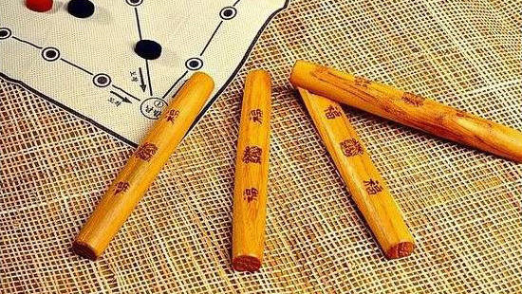

Slide 25
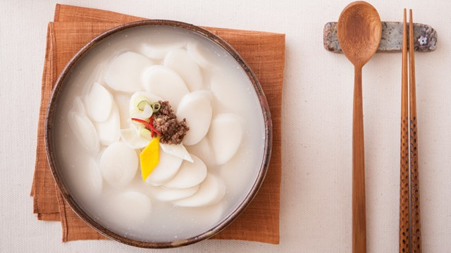

Slide 26
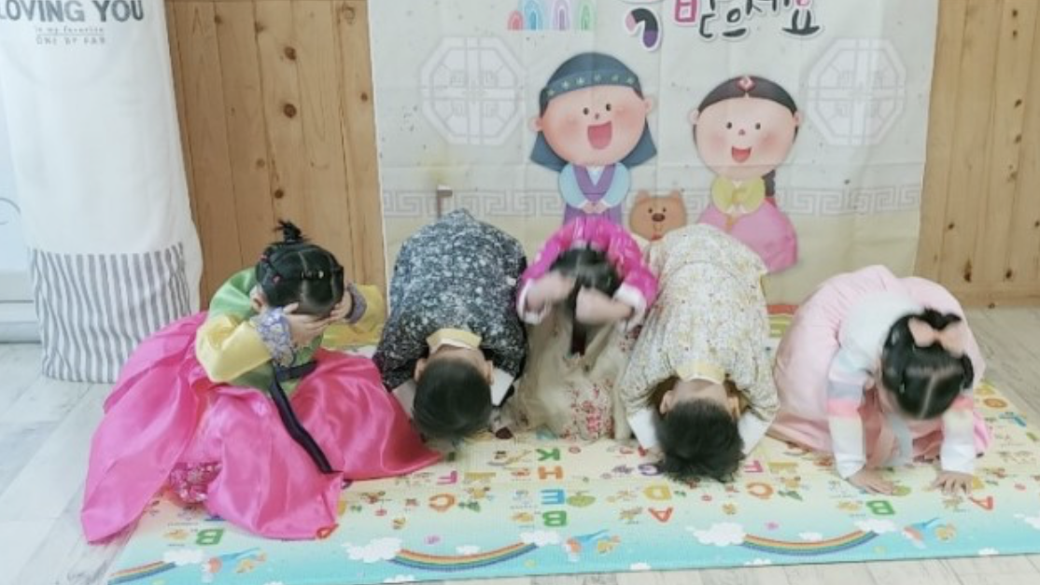

Slide 27
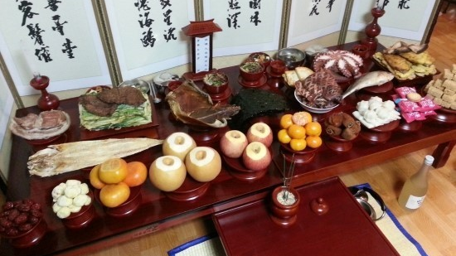

Slide 28
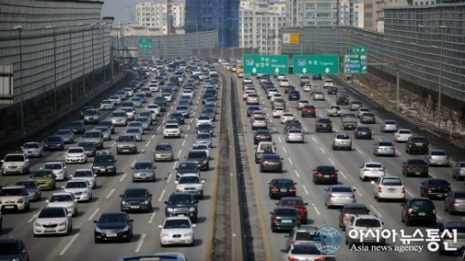

Slide 29
Useful websites
King Sejong Institute
http://www.sejonghakdang.org/sjcu/home/main.do
Talk to me in Korean
https://talktomeinkorean.com/

Slide 30

Thank you

