Slide 1
Roles of ESP practitioners

Slide 2
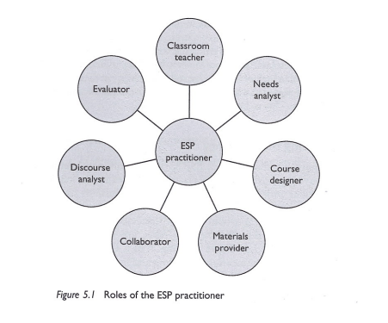
Woodrow, L. (2018). Course Design in ESP. Routledge.

