Slide 2
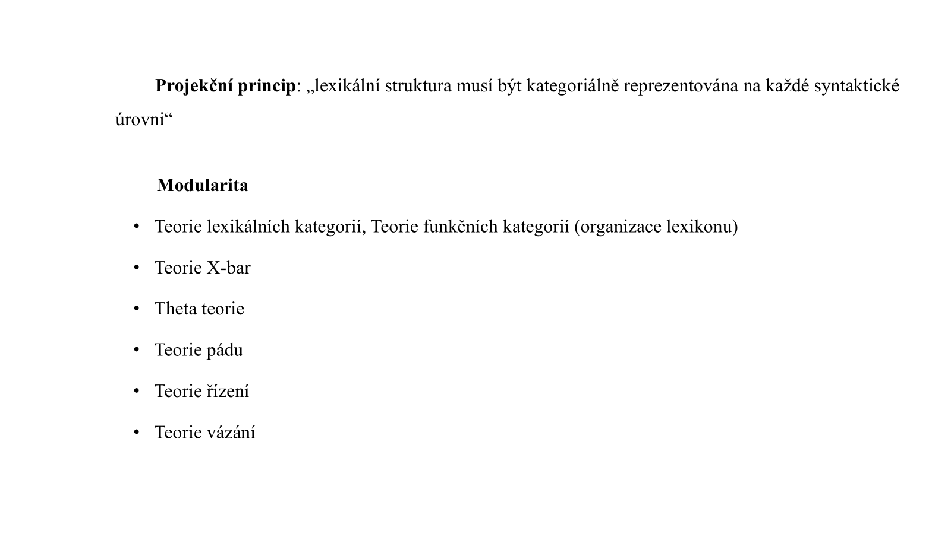

Slide 3
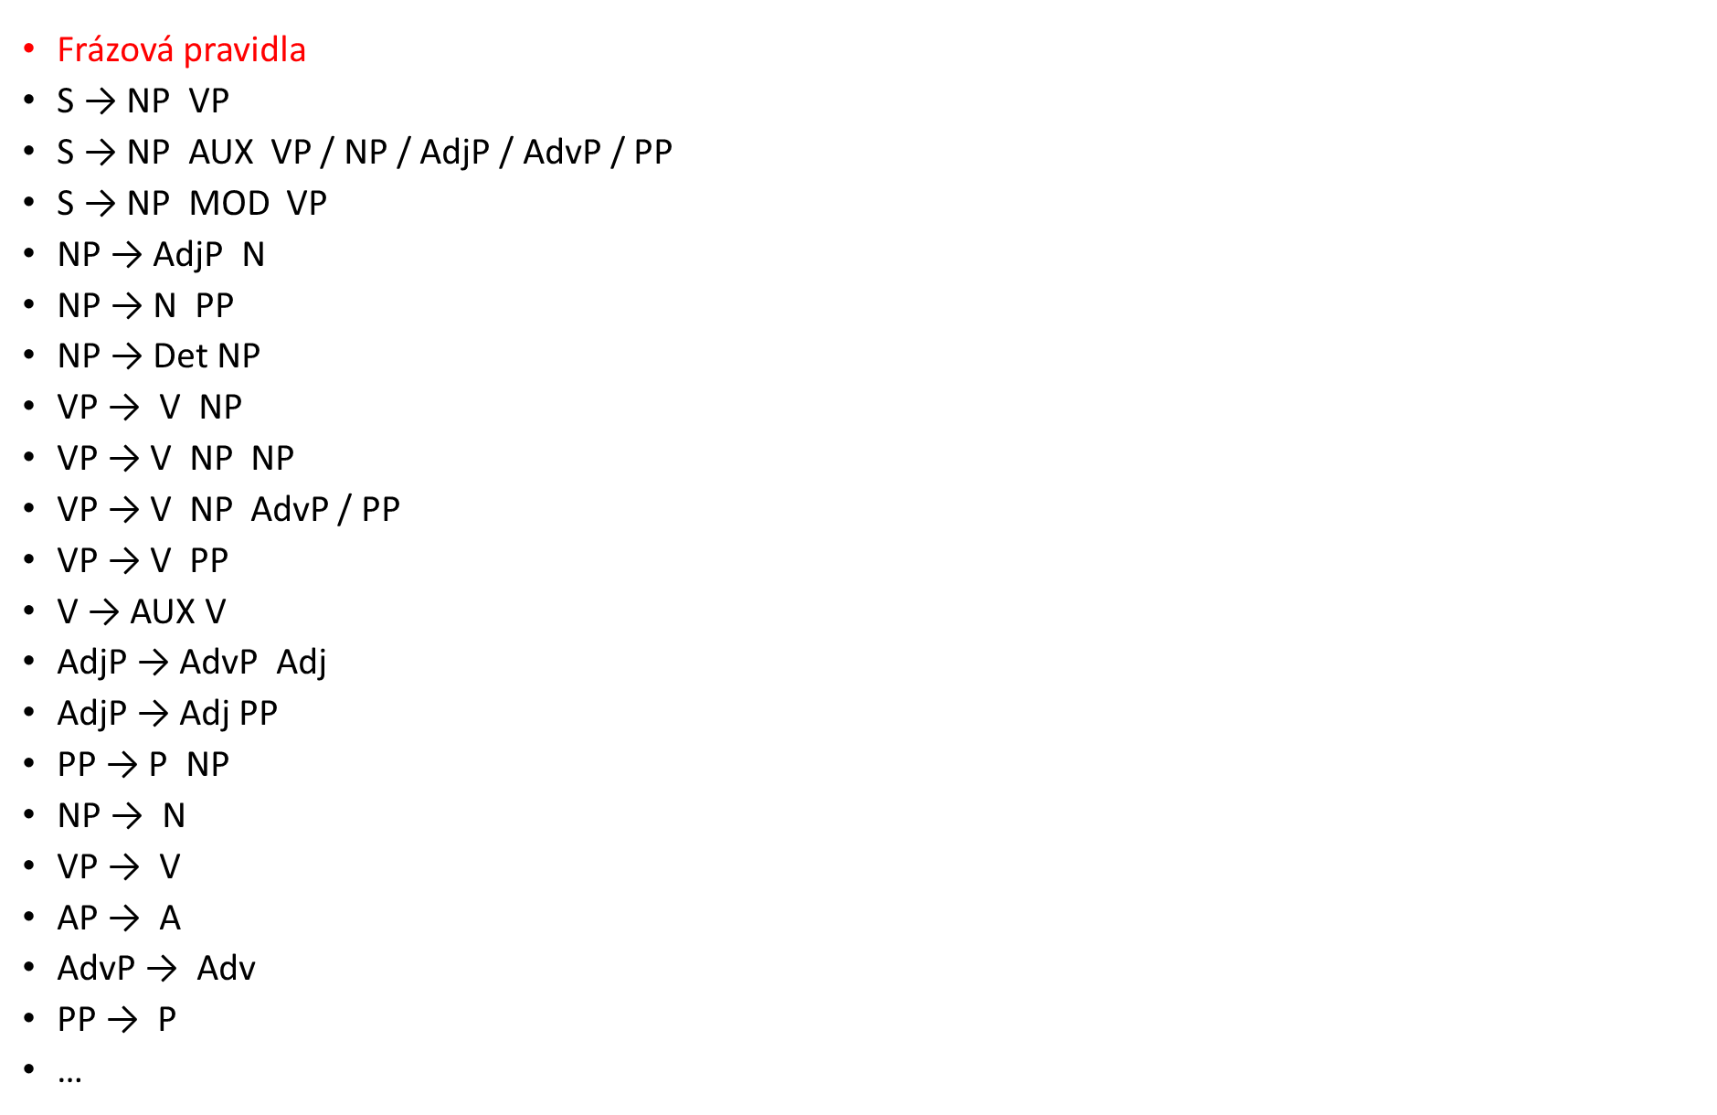

Slide 8
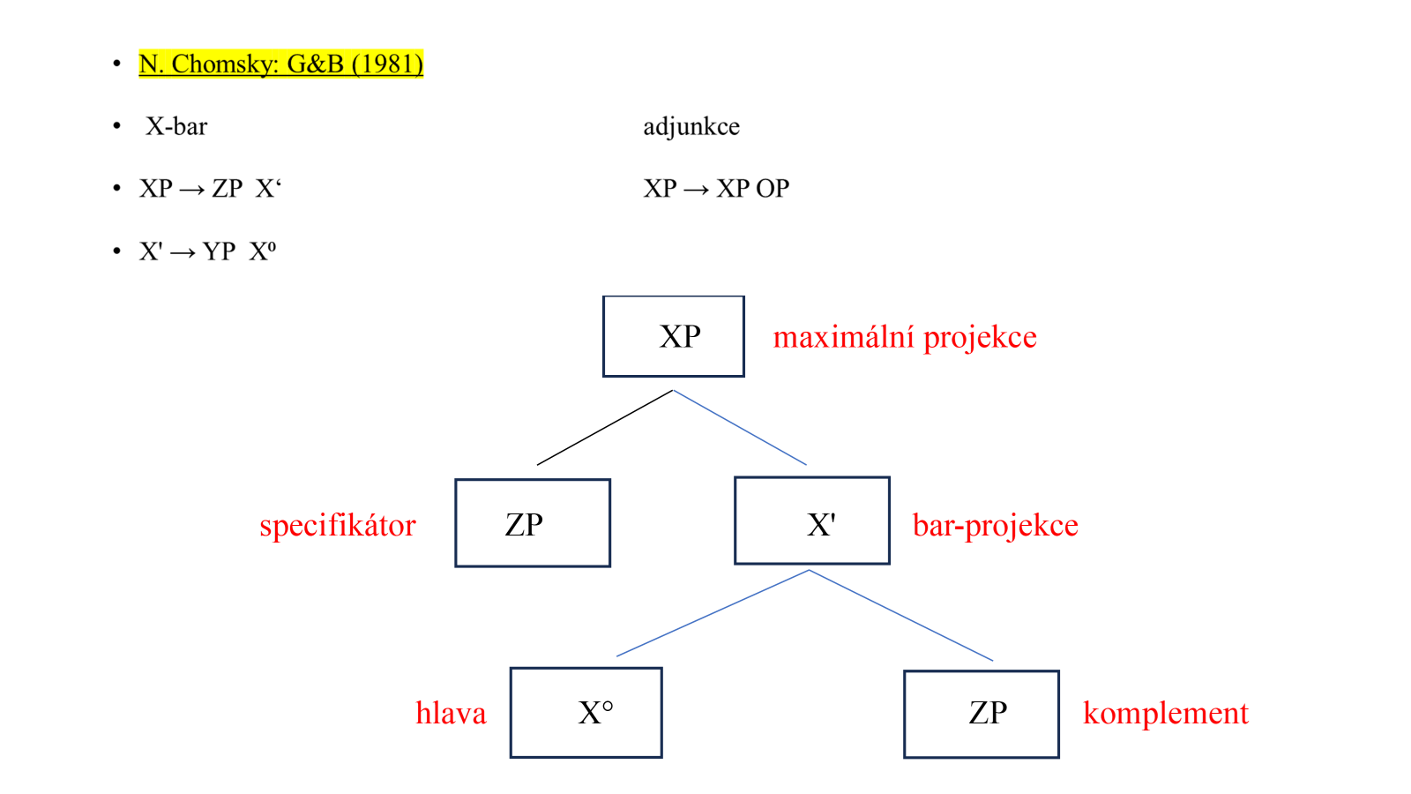

Slide 9
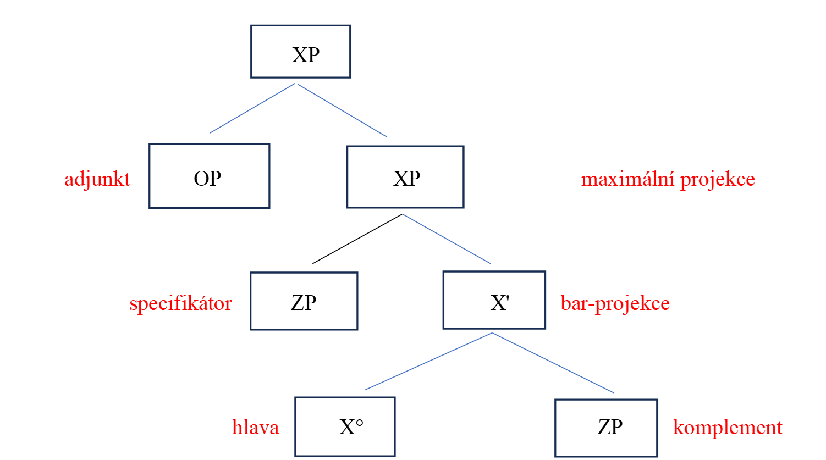

Slide 17
readjustment

Slide 19
Paul wonders [whether the man will ask Jane]

Slide 22
Will the man ask Jane?

Slide 25
Who will ask Jane?

Slide 27
Who will the man ask?

Slide 29
The man is asking Jane

