Slide 1
Outline the history of Czechoslovakia "From National Cleansing to Communist Dictatorship" using the relevant chapter from Mary Heimann
Kira Quinley

Slide 2
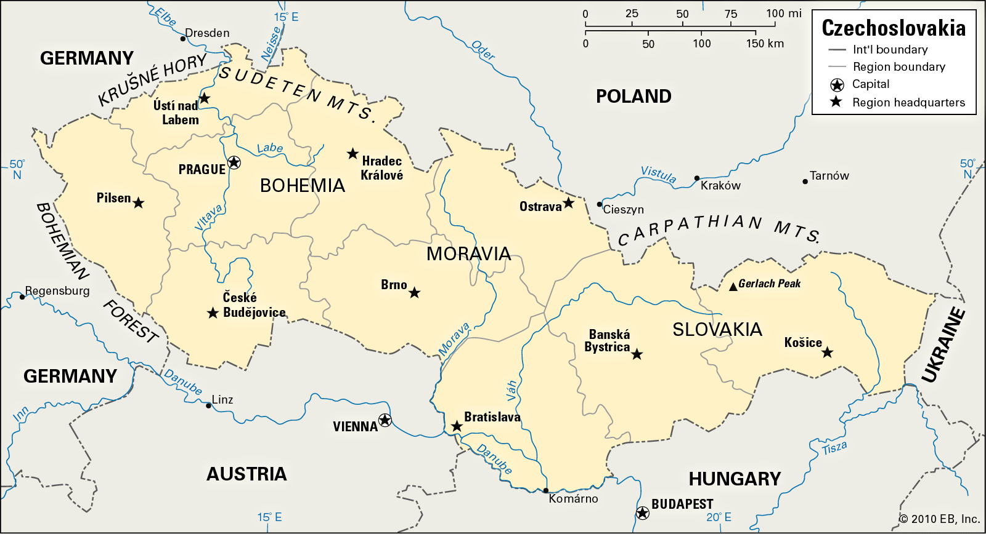
Czechoslovakia: Before 1938
Formed of 5 territories from the former Austro-Hungarian empire
Multinational state: Czech, German and Slovak are the main 3 ethnic groups
Ongoing tensions between Czech, Slovak and German populations - increased dissatisfaction from the Germans
Pre-war Communist Party membership around 100,000

Slide 3
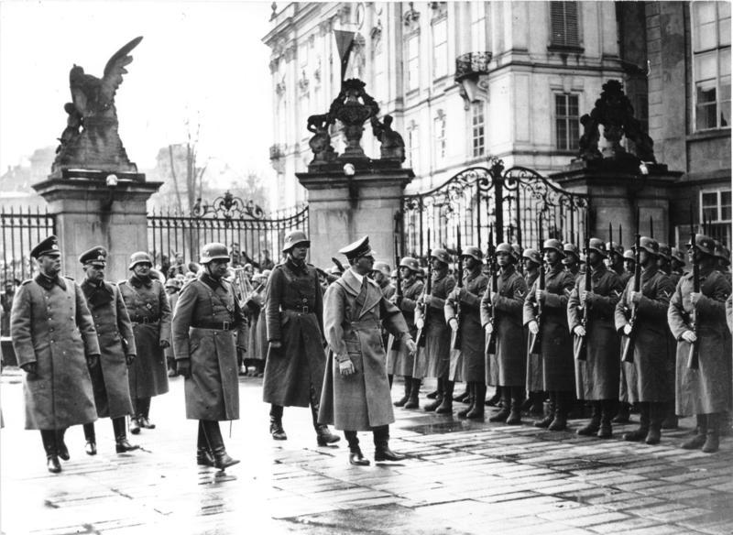
1938: A major turning point
1938 was a major socio-political turning point for the country
Growing tensions between Czechoslovakia & German populations getting worse, especially with growing influence and threats from the Nazis
Munich Betrayal = Czechoslovakia doesn’t have a say in the annex of the Sudetenlands and are left vulnerable to Nazi Germany.
Beneš’s exile to London in October. He doesn’t return until after the war.

Slide 4
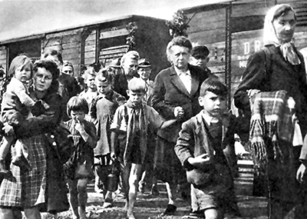
Expulsion of Germans
Over 2.5 million Sudeten Germans expelled
Germans, Hungarians, Traitors and Collaborators all named as targets during the ‘Wild Transfer’ (May - Aug 1945). Incredibly violent.
Largest forced migration of group of European people at the time in history.
Germans that remained in Czechoslovakia have to wear white armbands to identify themselves and under rigid restrictions. Heimann parallels these times to expulsion techniques to rid themselves of Jewish populations in years prior.

Slide 5
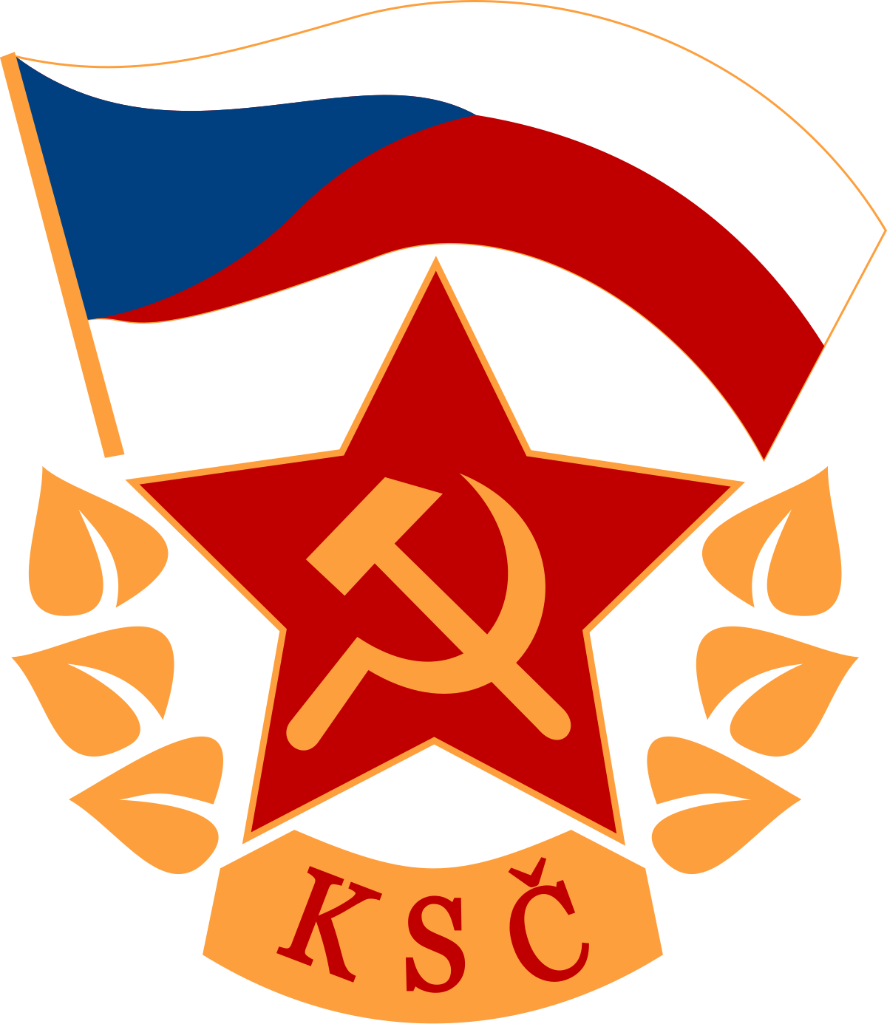
Communist Dictatorship
Communism growing increasingly popular after the war despite large losses during WW2
Core support from the working class. Provides further advantages for these groups while silencing the middle class.
Increasing number of Communist influence in positions of power from 1945 as well as becoming the largest Communist party later on.
Tensions between leaders of the National Front, until many of the leaders resign in 1947. Many Communists put into power.
Coup d’etat in 1948 consolidates unchallenged power for the KSC for 40 years until the Prague Spring briefly lifts restrictions.

Slide 6
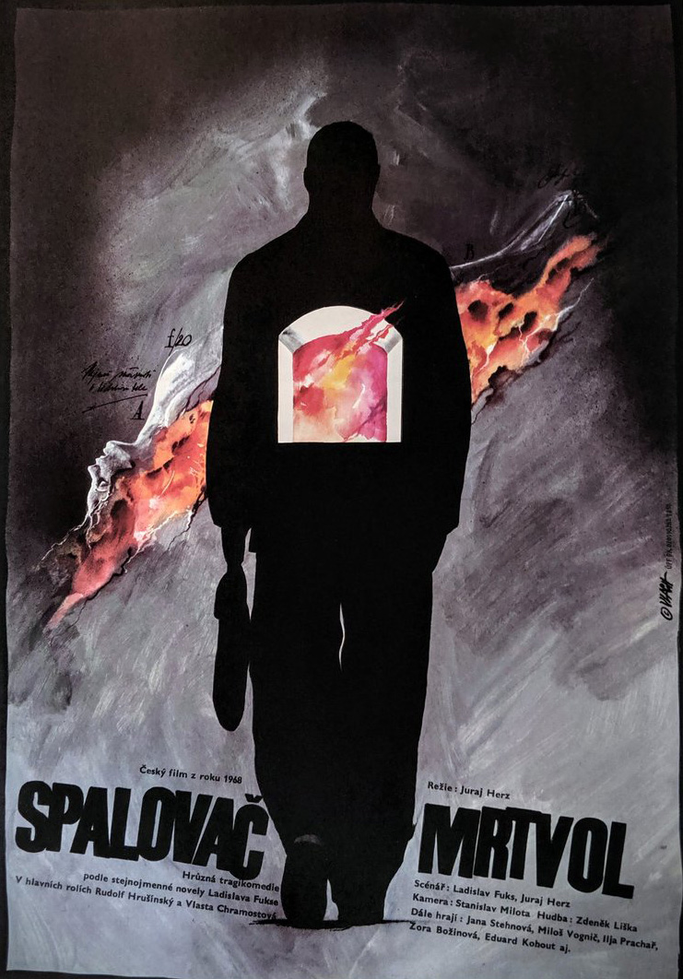
QUESTIONS TO CONSIDER
What the characters in ‘The Cremator’ reflect with this history in mind?
What is the significance of ‘fifth pillar’ figures and this relevance to Kopfrkingl?
Could ‘The Cremator’ be considered timeless and applicable to other oppressive regimes?

Slide 7
READING LIST
Cashman, Laura, "Remembering 1948 And 1968: Reflections On Two Pivotal Years In Czech And Slovak History", Europe-Asia Studies, 60 (2008), 1645-1658 <https://doi.org/10.1080/09668130802434281>
Glassheim, Eagle, "National Mythologies And Ethnic Cleansing: The Expulsion Of Czechoslovak Germans In 1945", Central European History, 33 (2000), 463-486 <https://doi.org/10.1163/156916100746428>
Hames, Peter, Czech And Slovak Cinema (Edinburgh: Edinburgh University Press, 2010)
Heimann, Mary, Czechoslovakia: The State That Failed (New Haven ; London: Yale University Press, 2011)
Herz, Juraj, The Cremator (Barrandov Studios, 1969)
Kacowicz, Arie Marcelo, and Pawel Lutomski. 2007. Population resettlement in international conflicts (Lanham, MD: Lexington Books)

