Slide 1
The Owners (2019) Directed by Jiří Havelka
Insights into contemporary Czech society
Presentation by Leah Reilly

Slide 2
The Owners 2019
> Directed by Jiří Havelka
> Released 19 November 2019
> Advertised as a comedy/drama
> Depicts a meeting between owners of units within an apartment building
> simple concept, bigger meaning

Slide 3
Wider Context out with Owners (2019)
Czechoslovakia under Communist regime until November 1989
Czech Republic and Slovakia from 1993
Communism as a beneficial means of governance?

Slide 4
Reflection of Czech Society
Metaphor based
Democracy – each person/couple represents a factor within the Czech democracy today
Legislative nonsense = failing to make important changes

Slide 5
Mr & Mrs. Zahrádková > Chair of the committee > Secretary > Activists > Bribery?

Slide 6
Society representations
Ms. Horváthová = Idiocy
Mr. Kubát = Nostalgic communist
Mrs. Procházková = selfishness
Mr. Nitranský and New tenants = Xenophobia
Mr. Svec = Pensioners
Mr. Sokol = Intellectuals

Slide 7
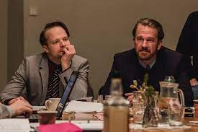
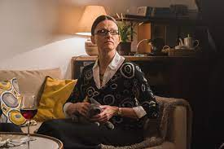
> Sons of deceased tenant > Opportunists > Focuses on legislative issues and following the rules > Debilitates real change?

Slide 8
Conclusions - Failings of a modern day democracy?

Slide 9
References -
Jiří Havelka, Vlastníci (Owners), (2019).
Czech Film Review, Owners (Vlastníci) – Jiří Havelka (2019).
Avaliable at - https://czechfilmreview.com/2020/07/24/owners-vlastnici-jiri-havelka-2019/
Dominika Švecová and Jan Čulík, (2019). Owners: Horror about what the Czech Republic is like today.
Jan Čulík, Current Czech Opinion of the pre-1989 and post 1989 Regimes: Disillusionment with Politics, Regardless of Party Political Allegiances.
Former Czech PM Petr Pithart: 1968 was the only time when I believed that the world might be better.
Avaliable at - https://youtu.be/eP7b0Jhzlnk

