Slide 1
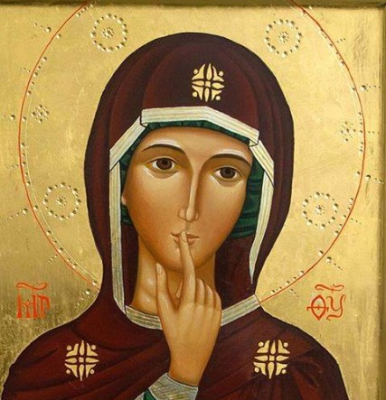
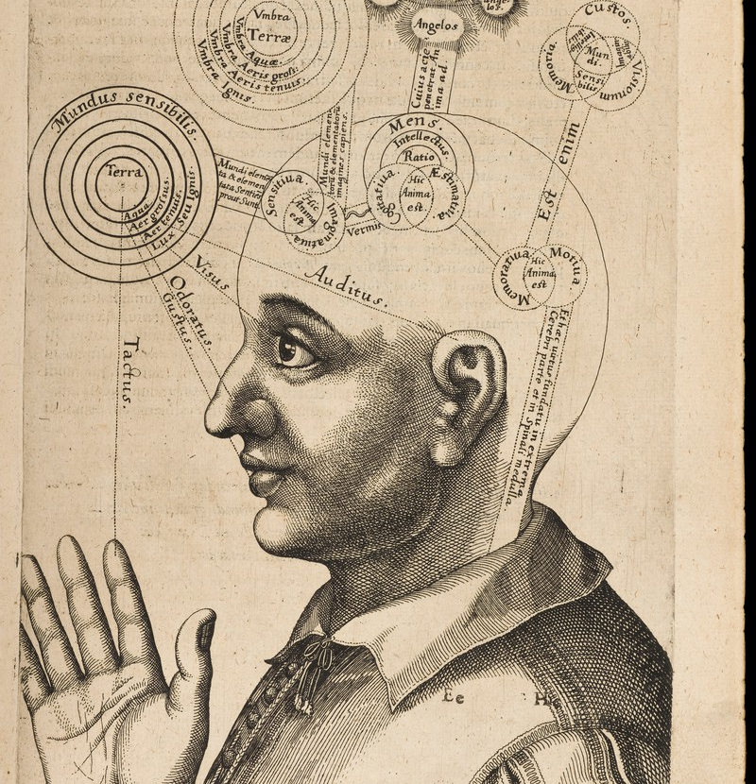
Náboženství a smysly CORE098

Slide 2
Antropologie smyslů
Kultura
Biologie

Slide 3
habitus & smyslové vnímání
Habitus (Pierre Bourdieu): „schémata vnímání, myšlení a jednání“, která vytvářejí kolektivní i individuální praktiky -> tímto jednáním se tato schémata znovu vytváří a udržují
Vysoká míra internalizace
Viditelnost během krize/změny
Percepce jako dovednost (someliér, absolutní sluch, ornotologie)

Slide 5
“When we examine the meanings associated with various sensory faculties and sensations in different cultures we find a cornucopia of potent sensory symbolism. Sight may be linked to reason or to witchcraft, taste may be used as a metaphor for aesthetic discrimination or for sexual experience, an odour may signify sanctity or sin, political power or social exclusion. Together, these sensory meanings and values form the sensory model espoused by a society, according to which the members of that society 'make sense' of the world, or translate sensory perceptions and concepts into a particular 'worldview.' There will likely be challenges to this model from within the society, persons and groups who differ on certain sensory values, yet this model will provide the basic perceptual paradigm to be followed or resisted.“ (Classen 1997: 402, Foundations for an Anthropology of the Senses)

Slide 6
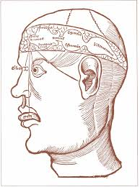
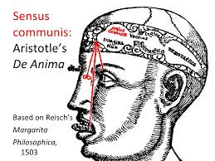
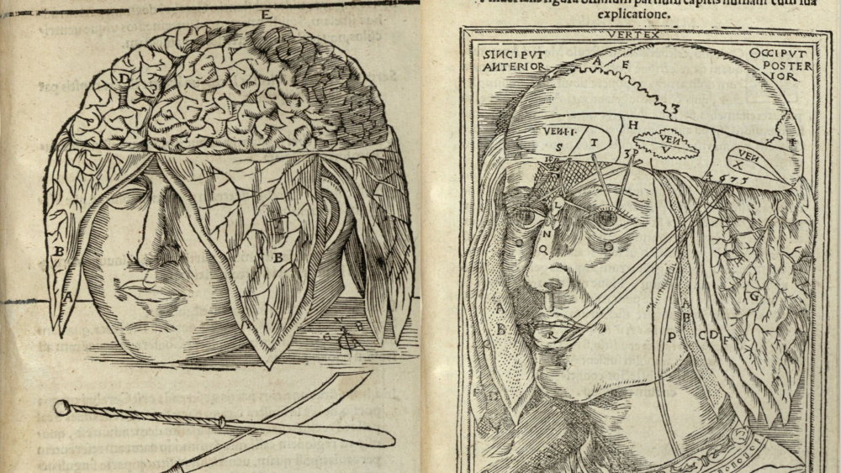

Slide 7
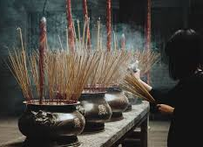
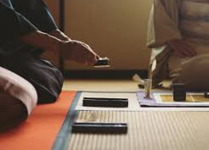

Slide 8
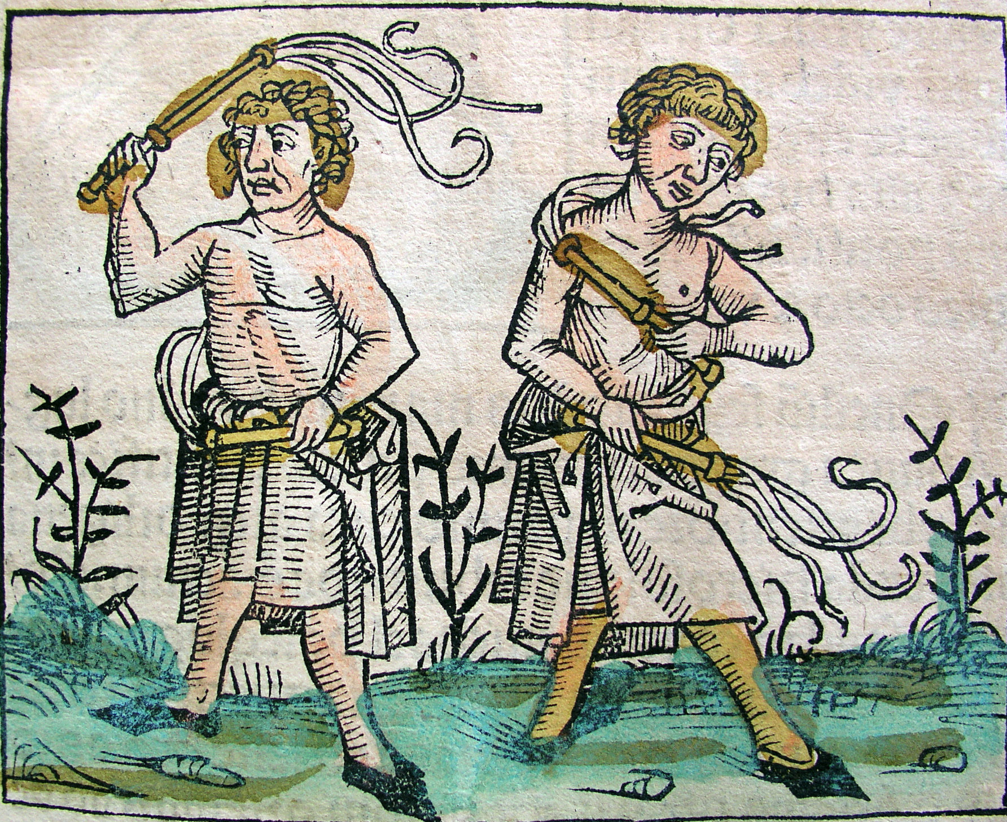
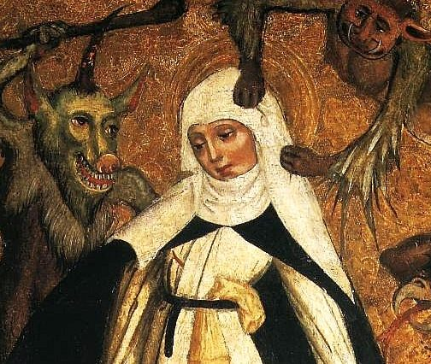
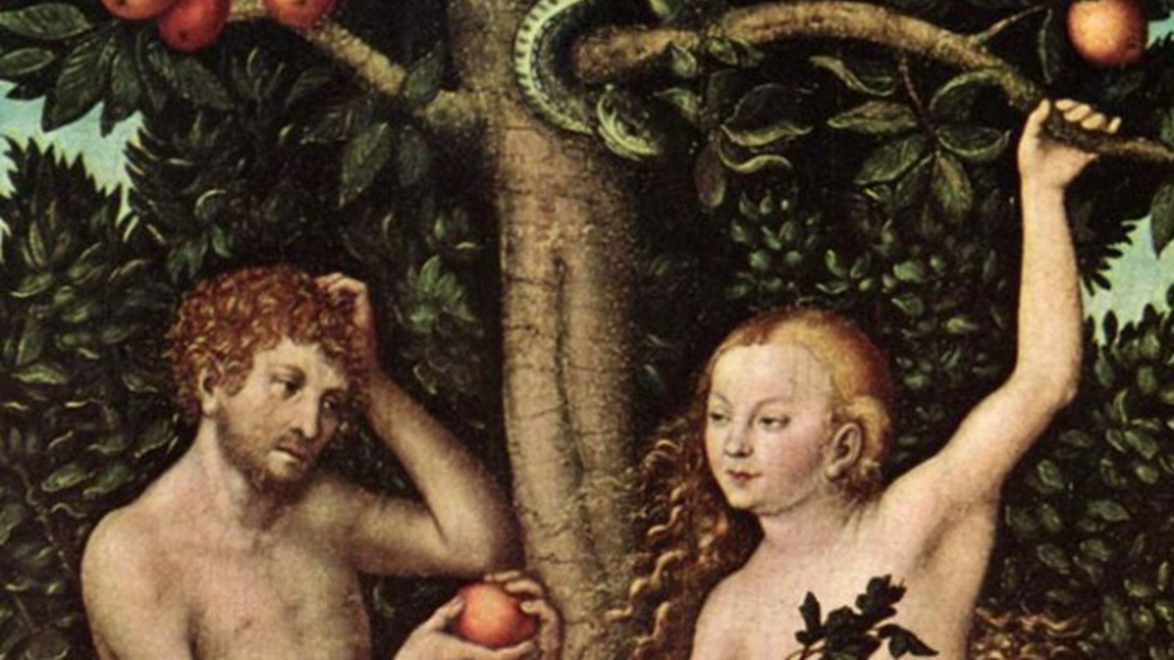

Slide 9
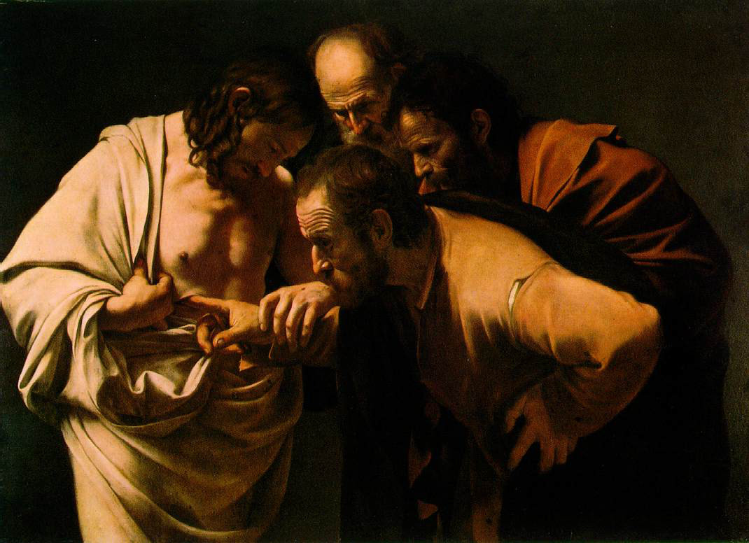
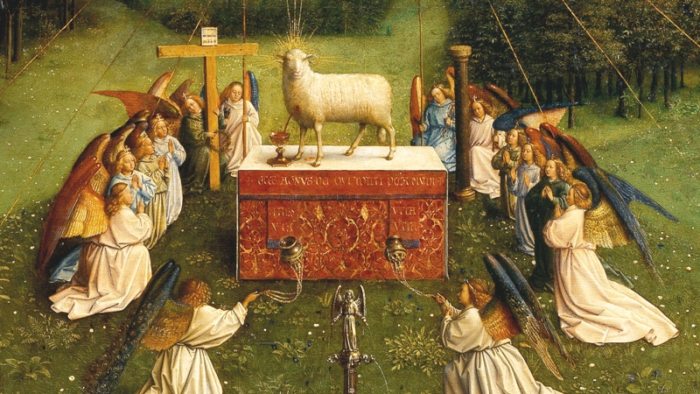

Slide 10
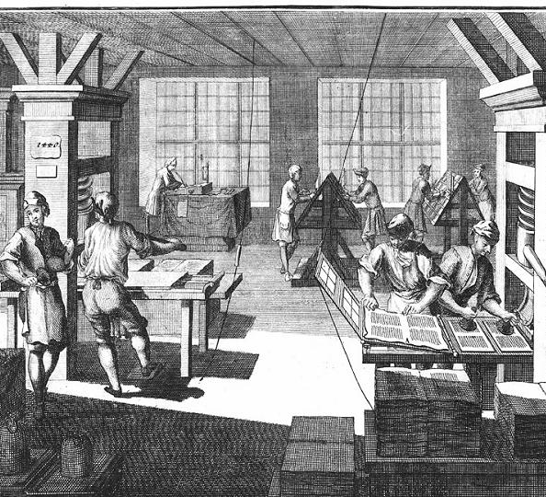
M. MCLuhan
The Gutenbert Galaxy
oral
chirographic
typographic
electronic

Slide 11
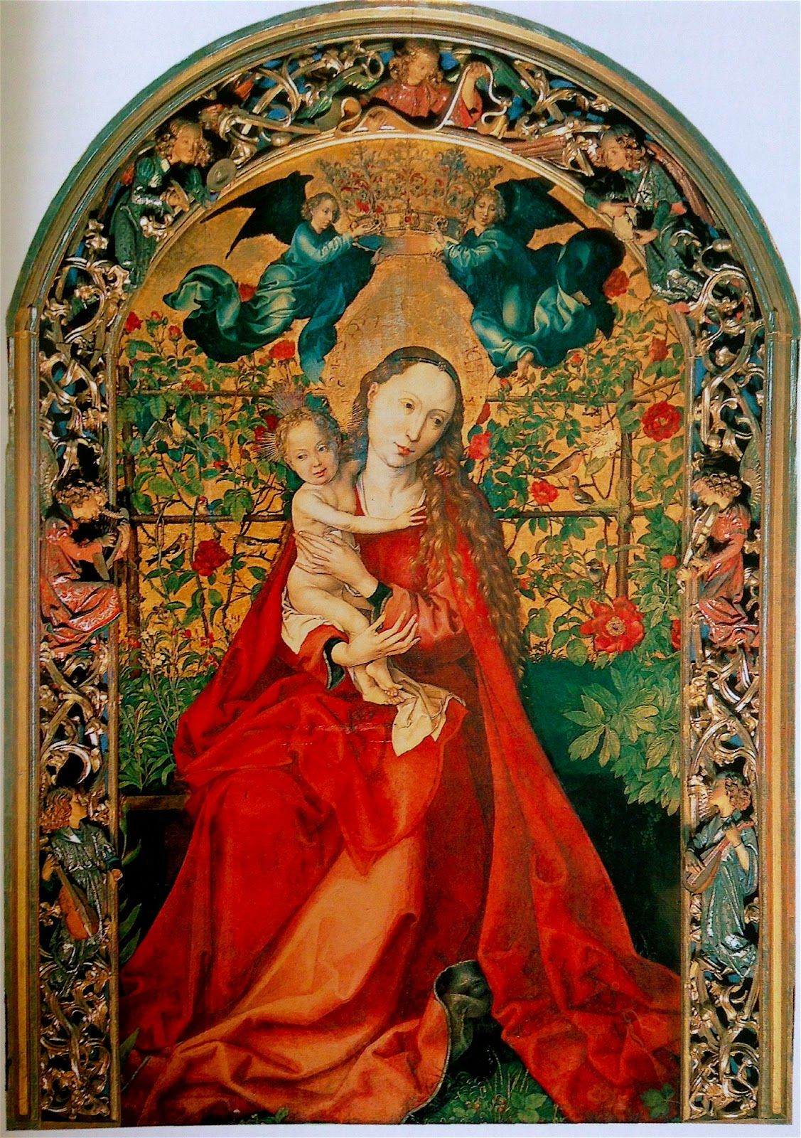
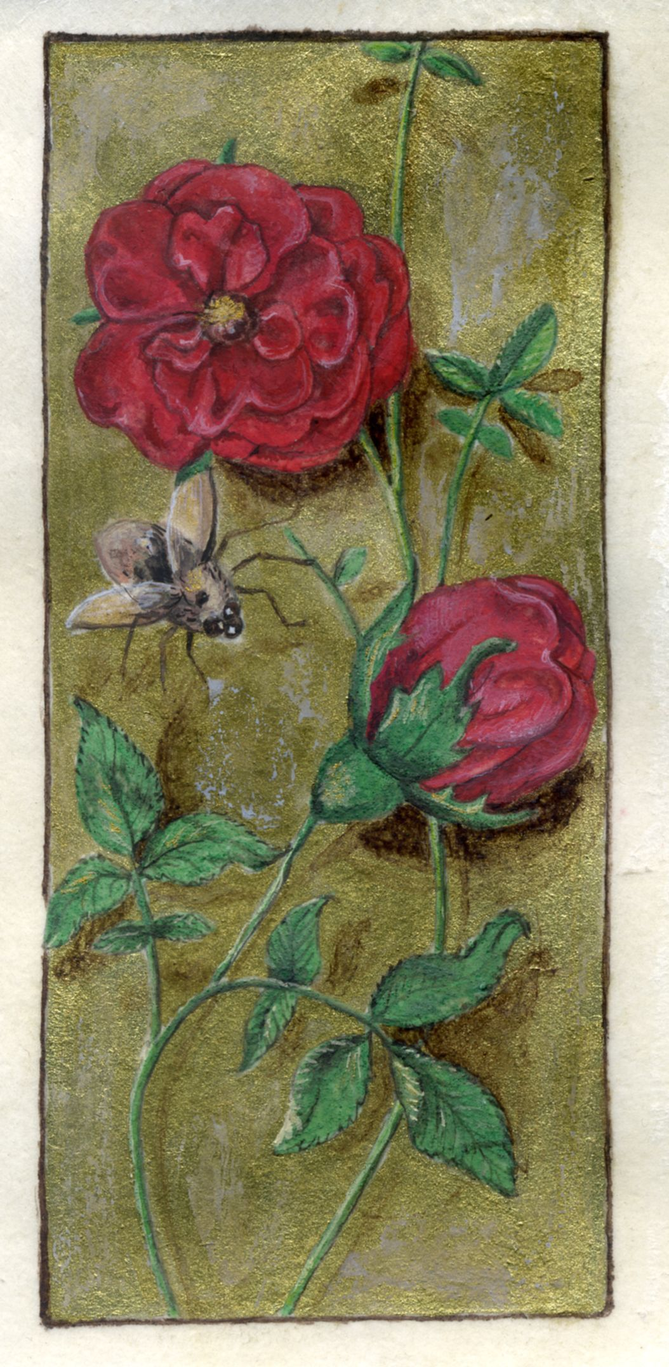
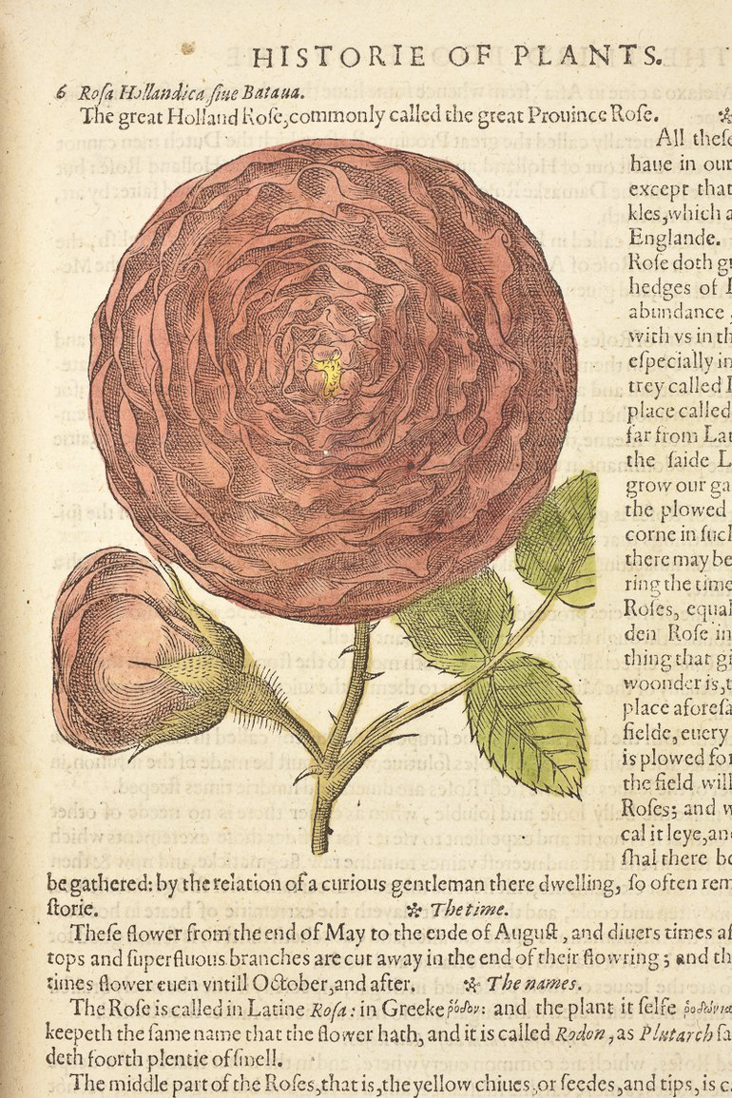

Slide 12
„in the historical writing of the nineteenth century when the notion that "high" culture requires the suppression of the "lower" senses was formalized. Touch was typed by the scholars of the day as a crude and uncivilized mode of perception. In the sensory scale of "races" created by the natural historian Lorenz Oken, the "civilized" European "eye-man," who focussed on the visual world, was positioned at the top and the African "skin-man," who used touch as his primary sensory modality, at the bottom. Societies which touched much, it was said, did not think much and did not bear thinking much about - except perhaps by anthropologists. To achieve respectability, societies needed to be seen to have risen above the "animal" life of the body. To achieve respectability, historians had to show that in their work they had done the same (Classen 2012: 3, The Book of Touch).“

Slide 14
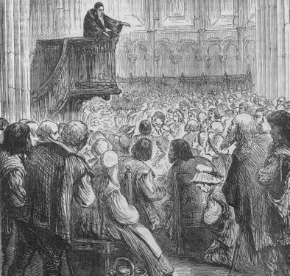
Reformace jako kultura těla
Opakování, přezkušování
Pozorné naslouchání
Poznámky
Zasedací pořádek
Výuka
Akustika (prostor, kázání)
Manipulace pozorností, „čištění prostoru“
Tištěné knihy v liturgii

Slide 15
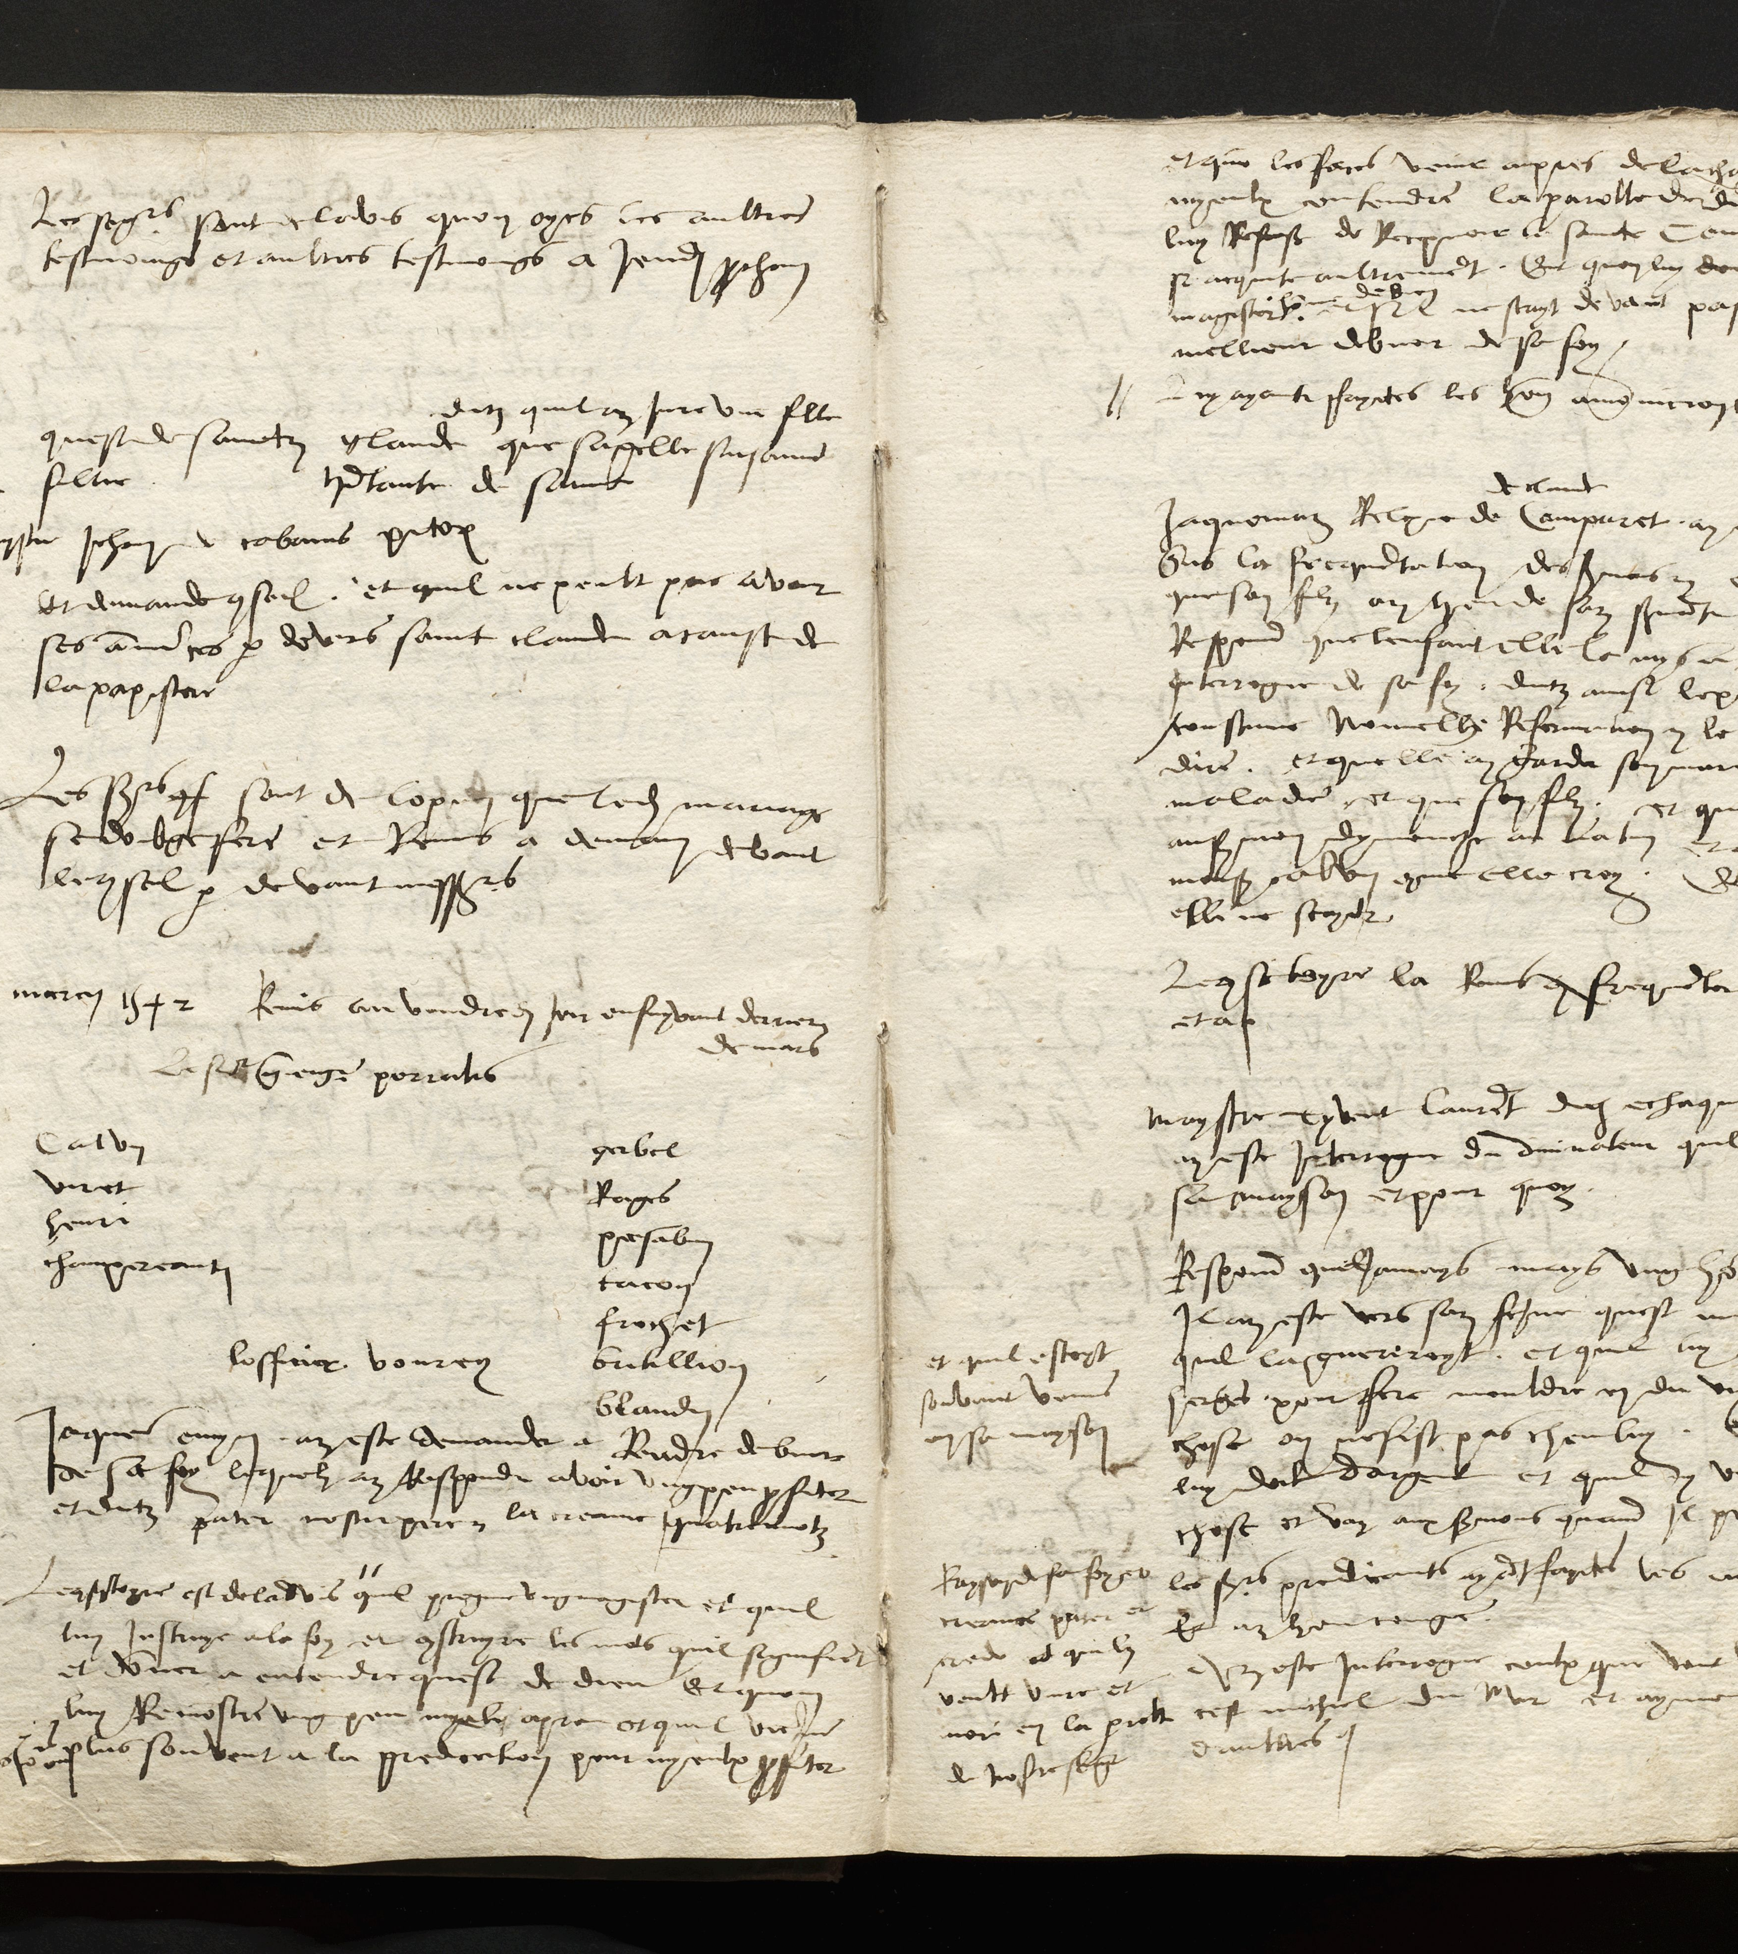
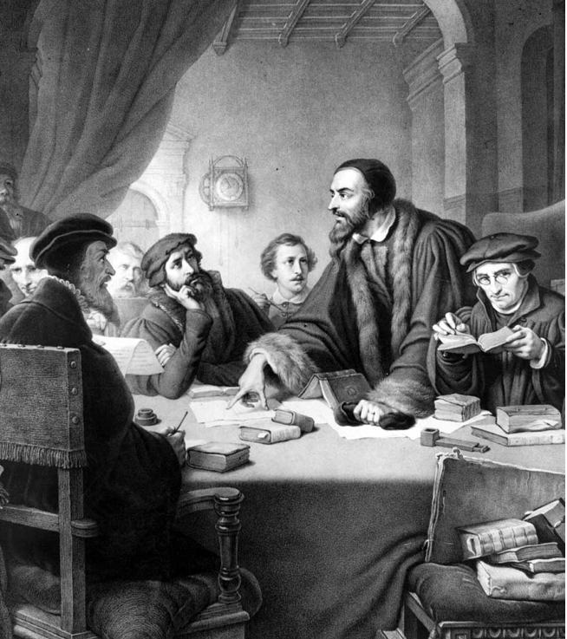

Slide 16
Fyziolgická vada
Společenská diagnóza

Slide 17
Dobrý vs. špatný sluch
medicína
filozofie
náboženství
Společnost

Slide 18
Fyzické tělo
Společenské/kult prostředí

Slide 19
hluchota
nedoslýchovost
nepozornost
nepochopení
špatná paměť
nízká inteligence
zatvrzelost

