Slide 1
DSBcB49 Starověká ekumena - antické zprávy o Asii a Africe
Egypt #2
καὶ τὸ μέγιστον γυναικὶ ἀντ᾽ ἀνδρὸς δουλεύοντες

Slide 2
Lidé a zvyky
Extrémně zbožní
Úcta ke zvířatům
Mnoho věcí (bohové, zákony, …) pochází z Egypta
Starodávný původ, dlouhé dějiny

Slide 3
Lidé
V jiném „pásu“ než Řekové
Protiklad – Skythové
Airs 12 – podnebí Evropy a Asie – dostatek všeho, ideální střed – osídlený Řeky

Slide 4
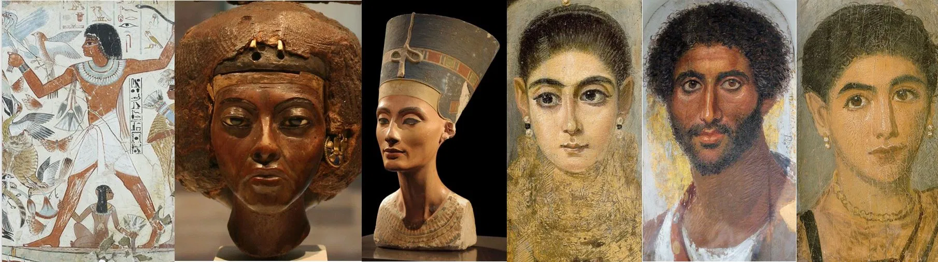
Lidé
Airs, 18
ωὑτὸς λόγος καὶ περὶ τῶν Αἰγυπτίων, πλὴν ὅτι οἱ μὲν ὑπὸ τοῦ θερμοῦ εἰσι βεβιασμένοι, οἱ δὲ ὑπὸ τοῦ ψυχροῦ.
and do not resemble any other, the same observation applies to the Egyptians, only that the latter are oppressed by heat and the former by cold.

Slide 5
Lidé
Hdt. 2.104
αὐτὸς δὲ εἴκασα τῇδε, καὶ ὅτι μελάγχροες εἰσὶ καὶ οὐλότριχες· … ἀλλὰ τοῖσιδε καὶ μᾶλλον, ὅτι μοῦνοι πάντων ἀνθρώπων Κόλχοι καὶ Αἰγύπτιοι καὶ Αἰθίοπες περιτάμνονται ἀπ’ ἀρχῆς τὰ αἰδοῖα.
I myself guessed it to be so, partly because they are dark-skinned and woolly-haired; though that indeed goes for nothing, seeing that other peoples, too, are such; but my better proof was that the Colchians and Egyptians and Ethiopians are the only nations that have from the first practised circumcision.

Slide 6
Lidé
Aristot. De Physiog.
Οἱ ἄγαν μέλανες δειλοί. ἀναφέρεται ἐπὶ τοὺς Αἰγυπτίους, Αἰθίοπας.
Those who are too swarthy are cowardly, this applies to Egyptians and Ethiopians.

Slide 7
Egypt a barbaři
Hdt. 2.79 Πατρίοισι δὲ χρεώμενοι νόμοισι ἄλλον οὐδένα ἐπικτῶνται·
2.41 ῶν εἵνεκα οὔτε ἀνὴρ Αἰγύπτιος οὔτε γυνὴ ἄνδρα Ἕλληνα φιλήσειε ἂν τῷ στόματι, οὐδὲ μαχαίρῃ ἀνδρὸς Ἕλληνος χρήσεται οὐδὲ ὀβελοῖσι οὐδὲ λέβητι, οὐδὲ κρέως καθαροῦ βοὸς διατετμημένου Ἑλληνικῇ μαχαίρῃ γεύσεται.
They keep the oracles of their fathers, and add none others to them.
For this reason no Egyptian man or woman will kiss a Greek man, or use a knife, or a spit, or a caldron belonging to a Greek, or taste the flesh of an unblemished ox that has been cut up with a Greek knife.

Slide 8
Egypt a barbaři
Hdt. 2.91 Ἑλληνικοῖσι δὲ νομαίοισι φεύγουσι χρᾶσθαι, τὸ δὲ σύμπαν εἰπεῖν, μηδ’ ἄλλων μηδαμὰ μηδαμῶν ἀνθρώπων νομαίοισι.
Hdt. 2.158 Νεκῶς μέν νυν μεταξὺ ὀρύσσων ἐπαύσατο μαντηίου ἐμποδίου γενομένου τοιοῦδε, τῷ βαρβάρῳ αὐτὸν προεργάζεσθαι. βαρβάρους δὲ πάντας οἱ Αἰγύπτιοι καλέουσι τοὺς μὴ σφίσι ὁμογλώσσους.
The Egyptians shun the use of Greek customs, and (to speak generally) the customs of any other men whatever.
During the course of excavations, Necos ceased from the work, being stayed by a prophetic utterance that he was toiling beforehand for the barbarian. The Egyptians call all men of other languages barbarian.

Slide 9
Egypt a barbaři
Gen. 43.32 Egypťané totiž nemohou jíst s Hebreji – je to pro ně ohavnost.
Oracle of the Lamb
Oracle of the Potter
Demotic Chronicle

Slide 10
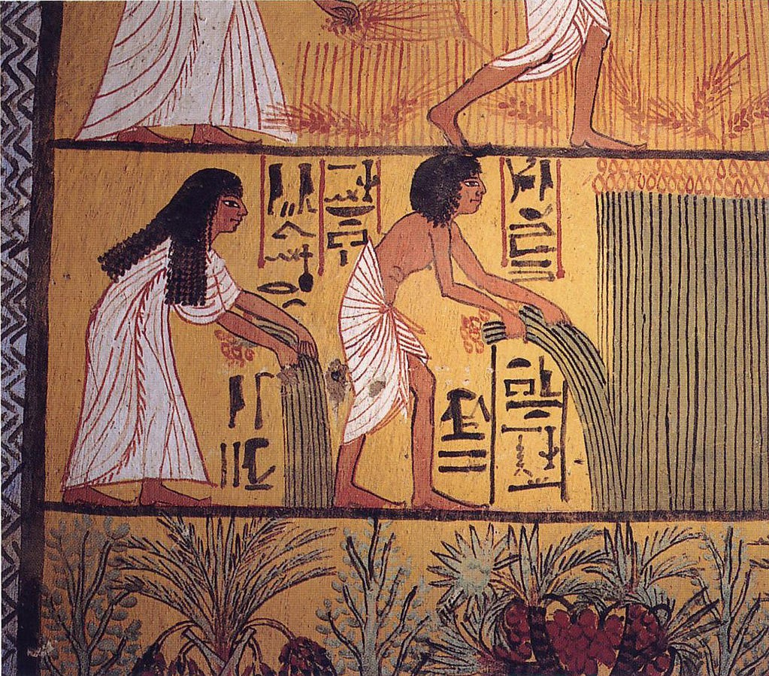
Zvyky – vše naopak
As the Egyptians have a climate peculiar to themselves, and their river is different in its nature from all other rivers, so have they made all their customs and laws of a kind contrary for the most part to those of all other men. Among them, the women buy and sell, the men abide at home and weave; and whereas in weaving all others push the woof upwards, the Egyptians push it downwards. Men carry burdens on their heads, women on their shoulders. Women make water standing, men sitting. They relieve nature indoors, and eat out of doors in the streets, giving the reason, that things unseemly but necessary should be done in secret, things not unseemly should be done openly. No woman is dedicated to the service of any god or goddess; men are dedicated to all deities male or female. Sons are not compelled against their will to support their parents, but daughters must do so though they be unwilling.
Hdt. 2.35–37
Αἰγύπτιοι ἅμα τῷ οὐρανῷ τῷ κατὰ σφέας ἐόντι ἑτεροίῳ καὶ τῷ ποταμῷ φύσιν ἀλλοίην παρεχομένῳ ἢ οἱ ἄλλοι ποταμοί, τὰ πολλὰ πάντα ἔμπαλιν τοῖσι ἄλλοισι ἀνθρώποισι ἐστήσαντο ἤθεά τε καὶ νόμους· ἐν τοῖσι αἱ μὲν γυναῖκες ἀγοράζουσι καὶ καπηλεύουσι, οἱ δὲ ἄνδρες κατ’ οἴκους ἐόντες ὑφαίνουσι· ὑφαίνουσι δὲ οἱ μὲν ἄλλοι ἄνω τὴν κρόκην ὠθέοντες, Αἰγύπτιοι δὲ κάτω. τὰ ἄχθεα οἱ μὲν ἄνδρες ἐπὶ τῶν κεφαλέων φορέουσι, αἱ δὲ γυναῖκες ἐπὶ τῶν ὤμων. οὐρέουσι αἱ μὲν γυναῖκες ὀρθαί, οἱ δὲ ἄνδρες κατήμενοι. εὐμαρείῃ χρέωνται ἐν τοῖσι οἴκοισι, ἐσθίουσι δὲ ἔξω ἐν τῇσι ὁδοῖσι ἐπιλέγοντες ὡς τὰ μὲν αἰσχρὰ ἀναγκαῖα δὲ ἐν ἀποκρύφῳ ἐστὶ ποιέειν χρεόν, τὰ δὲ μὴ αἰσχρὰ ἀναφανδόν. ἱρᾶται γυνὴ μὲν οὐδεμία οὔτε ἔρσενος θεοῦ οὔτε θηλέης, ἄνδρες δὲ πάντων τε καὶ πασέων. τρέφειν τοὺς τοκέας τοῖσι μὲν παισὶ οὐδεμία ἀνάγκη μὴ βουλομένοισι, τῇσι δὲ θυγατράσι πᾶσα ἀνάγκη καὶ μὴ βουλομένῃσι.

Slide 11
zvyky
Οἱ ἱρέες τῶν θεῶν τῇ μὲν ἄλλῃ κομέουσι, ἐν Αἰγύπτῳ δὲ ξυρῶνται. τοῖσι ἄλλοισι ἀνθρώποισι νόμος ἅμα κήδεϊ κεκάρθαι τὰς κεφαλὰς τοὺς ἱκνέεται, Αἰγύπτιοι δὲ ὑπὸ τοὺς θανάτους ἀνιεῖσι τὰς τρίχας αὔξεσθαι τάς τε ἐν τῇ κεφαλῇ καὶ τῷ γενείῳ, τέως ἐξυρημένοι. τοῖσι μὲν ἄλλοισι ἀνθρώποισι χωρὶς θηρίων ἡ δίαιτα ἀποκέκριται, Αἰγυπτίοισι δὲ ὁμοῦ θηρίοισι ἡ δίαιτα ἐστί. ἀπὸ πυρῶν καὶ κριθέων ὧλλοι ζώουσι, Αἰγυπτίων δὲ τῷ ποιευμένῳ ἀπὸ τούτων τὴν ζόην ὄνειδος μέγιστον ἐστί, ἀλλὰ ἀπὸ ὀλυρέων ποιεῦνται σιτία, τὰς ζειὰς μετεξέτεροι καλέουσι. φυρῶσι τὸ μὲν σταῖς τοῖσι ποσί, τὸν δὲ πηλὸν τῇσι χερσί, καὶ τὴν κόπρον ἀναιρέονται.
Everywhere else, priests of the gods wear their hair long; in Egypt they are shaven. With all other men, in mourning for the dead those most nearly concerned have their heads shaven; Egyptians are shaven at other times, but after a death they let their hair and beard grow. The Egyptians are the only people who keep their animals with them in the house. Whereas all others live on wheat and barley, it is the greatest disgrace for an Egyptian so to live; they make food from a coarse grain which some call spelt. They knead dough with their feet, and gather mud and dung with their hands.

Slide 12
zvyky
τὰ αἰδοῖα ὧλλοι μὲν ἔωσι ὡς ἐγένοντο, πλὴν ὅσοι ἀπὸ τούτων ἔμαθον, Αἰγύπτιοι δὲ περιτάμνονται. εἵματα τῶν μὲν ἀνδρῶν ἕκαστος ἔχει δύο, τῷ δὲ γυναικῶν ἓν ἑκάστη. τῶν ἱστίων τοὺς κρίκους καὶ τοὺς κάλους οἱ μὲν ἄλλοι ἔξωθεν προσδέουσι, Αἰγύπτιοι δὲ ἔσωθεν. γράμματα γράφουσι καὶ λογίζονται ψήφοισι Ἕλληνες μὲν ἀπὸ τῶν ἀριστερῶν ἐπὶ τὰ δεξιὰ φέροντες τὴν χεῖρα, Αἰγύπτιοι δὲ ἀπὸ τῶν δεξιῶν ἐπὶ τὰ ἀριστερά· καὶ ποιεῦντες ταῦτα αὐτοὶ μὲν φασὶ ἐπὶ δεξιὰ ποιέειν, Ἕλληνας δὲ ἐπ’ ἀριστερά. διφασίοισι δὲ γράμμασι χρέωνται, καὶ τὰ μὲν αὐτῶν ἱρὰ τὰ δὲ δημοτικὰ καλέεται.
The Egyptians​ and those who have learnt it from them are the only people who practise circumcision. Every man has two garments, every woman only one. The rings and sheets of sails are made fast elsewhere outside the boat, but inside it in Egypt. The Greeks write and calculate by moving the hand from left to right; the Egyptians do contrariwise;​ yet they say that their way of writing is towards the right, and the Greek way towards the left. They use two kinds of writing; one is called sacred, the other common.

Slide 13
zvyky
Θεοσεβέες δὲ περισσῶς ἐόντες μάλιστα πάντων ἀνθρώπων νόμοισι τοιοῖσιδε χρέωνται. … ἄλλας τε θρησκηίας ἐπιτελέουσι μυρίας ὡς εἰπεῖν λόγῳ. … ἰχθύων δὲ οὔ σφι ἔξεστι πάσασθαι. κυάμους δὲ οὔτε τι μάλα σπείρουσι Αἰγύπτιοι ἐν τῇ χώρῃ, τούς τε γινομένους οὔτε τρώγουσι οὔτε ἕψοντες πατέονται, οἱ δὲ δὴ ἱρέες οὐδὲ ὁρέοντες ἀνέχονται, νομίζοντες οὐ καθαρὸν εἶναί μιν ὄσπριον.
They are beyond measure religious, more than any other nation; and these are among their customs: … Their religious observances are, one may say, innumerable. … They may not eat fish. The Egyptians sow no beans in their country; if any grow, they will not eat them either raw or cooked; the priests cannot endure even to see them, considering beans an unclean kind of pulse.

Slide 14
společnost
Sedm skupin obyvatel – Hdt. 2.164
Ἔστι δὲ Αἰγυπτίων ἑπτὰ γένεα, καὶ τούτων οἳ μὲν ἱρέες οἳ δὲ μάχιμοι κεκλέαται, οἳ δὲ βουκόλοι οἳ δὲ συβῶται, οἵ δὲ κάπηλοι, οἳ δὲ ἑρμηνέες, οἳ δὲ κυβερνῆται.
The Egyptians are divided into seven classes, severally entitled priests, warriors, cowherds, swineherds, hucksters, interpreters, and pilots.

Slide 15
společnost
D.S. 1.73 Τῆς Αἰγύπτου δὲ πάσης εἰς πλείω μέρη διῃρημένης, ὧν ἕκαστον κατὰ τὴν Ἑλληνικὴν διάλεκτον ὀνομάζεται νομός, ἐφ´ ἑκάστῳ τέτακται νομάρχης ὁ τὴν ἁπάντων ἔχων ἐπιμέλειάν τε καὶ φροντίδα.
And since Egypt as a whole is divided into several parts which in Greek are called nomes, over each of these a nomarch is appointed who is charged with both the oversight and care of all its affairs.

Slide 16
společnost
Hdt. 2.147 Ἐλευθερωθέντες Αἰγύπτιοι μετὰ τὸν ἱρέα τοῦ Ἡφαίστου βασιλεύσαντα, οὐδένα γὰρ χρόνον οἷοί τε ἦσαν ἄνευ βασιλέος διαιτᾶσθαι, ἐστήσαντο δυώδεκα βασιλέας, δυώδεκα μοίρας δασάμενοι Αἴγυπτον πᾶσαν.
After the reign of the priest of Hephaestus the Egyptians were made free. But they could never live without a king, so they divided Egypt into twelve portions and set up twelve kings.

Slide 17
Společnost
Aristot. Pol. 1313b
καὶ τὸ πένητας ποιεῖν τοὺς ἀρχομένους τυραννικόν, ὅπως μήτε φυλακὴ [20] τρέφηται καὶ πρὸς τῷ καθ᾽ ἡμέραν ὄντες ἄσχολοι ὦσιν ἐπιβουλεύειν. παράδειγμα δὲ τούτου αἵ τε πυραμίδες αἱ περὶ Αἴγυπτον
And it is a device of tyranny to make the subjects poor, so that a guard [20] may not be kept, and also that the people being busy with their daily affairs may not have leisure to plot against their ruler. Instances of this are the pyramids in Egypt

Slide 18
Zvyky - negativní
D.S. 1.90 Διὰ δὲ τὰς αὐτὰς αἰτίας δοκοῦσιν Αἰγύπτιοι τοὺς ἑαυτῶν βασιλεῖς προσκυνεῖν τε καὶ τιμᾶν ὡς πρὸς ἀλήθειαν ὄντας θεούς, ἅμα μὲν οὐκ ἄνευ δαιμονίου τινὸς προνοίας νομίζοντες αὐτοὺς τετευχέναι τῆς τῶν ὅλων ἐξουσίας, ἅμα δὲ τοὺς βουλομένους τε καὶ δυναμένους τὰ μέγιστ´ εὐεργετεῖν ἡγούμενοι θείας μετέχειν φύσεως.
And it is apparently on these grounds that the Egyptians prostrate themselves before their kings and honour them as being in truth very gods, holding, on the one hand, that it was not without the influence of some divine providence that these men have attained to the supreme power, and feeling, also, that such as have the will and the strength to confer the greatest benefactions share in the divine nature.

Slide 19
Historie - negativní
D.S. 1.67 Οἱ μὲν γὰρ πρὸ τούτου δυναστεύσαντες ἄβατον ἐποίουν τοῖς ξένοις τὴν Αἴγυπτον, τοὺς μὲν φονεύοντες, τοὺς δὲ καταδουλούμενοι τῶν καταπλεόντων. Καὶ γὰρ ἡ περὶ τὸν Βούσιριν ἀσέβεια διὰ τὴν τῶν ἐγχωρίων ἀξενίαν διεβοήθη παρὰ τοῖς Ἕλλησιν, οὐκ οὖσα μὲν πρὸς ἀλήθειαν, διὰ δὲ τὴν ὑπερβολὴν τῆς ἀνομίας εἰς μύθου πλάσμα καταχωρισθεῖσα.
For his predecessors in power had consistently closed Egypt to strangers, either killing or enslaving any who touched its shores. 11 Indeed, it was because of the objection to strangers on the part of the people that the impiety of Busiris became a byword among the Greeks, although this impiety was not actually such as it was described, but was made into a fictitious myth because of the exceptional disrespect of the Egyptians for ordinary customs.

Slide 20
Historie - búsíris
D.S. 1.45 Μετὰ δὲ ταῦτα κατασταθέντος βασιλέως Βουσίριδος καὶ τῶν τούτου πάλιν ἐκγόνων ὀκτώ, τὸν τελευταῖον ὁμώνυμον ὄντα τῷ πρώτῳ φασὶ κτίσαι τὴν ὑπὸ μὲν τῶν Αἰγυπτίων καλουμένην Διὸς πόλιν τὴν μεγάλην, ὑπὸ δὲ τῶν Ἑλλήνων Θήβας.
Subsequently, when Busiris became king and his descendants in turn, eight in name, the last of the line, who bore the same name as the first, founded, they say, the city which the Egyptians call Diospolis​ the Great, though the Greeks call it Thebes.

Slide 21
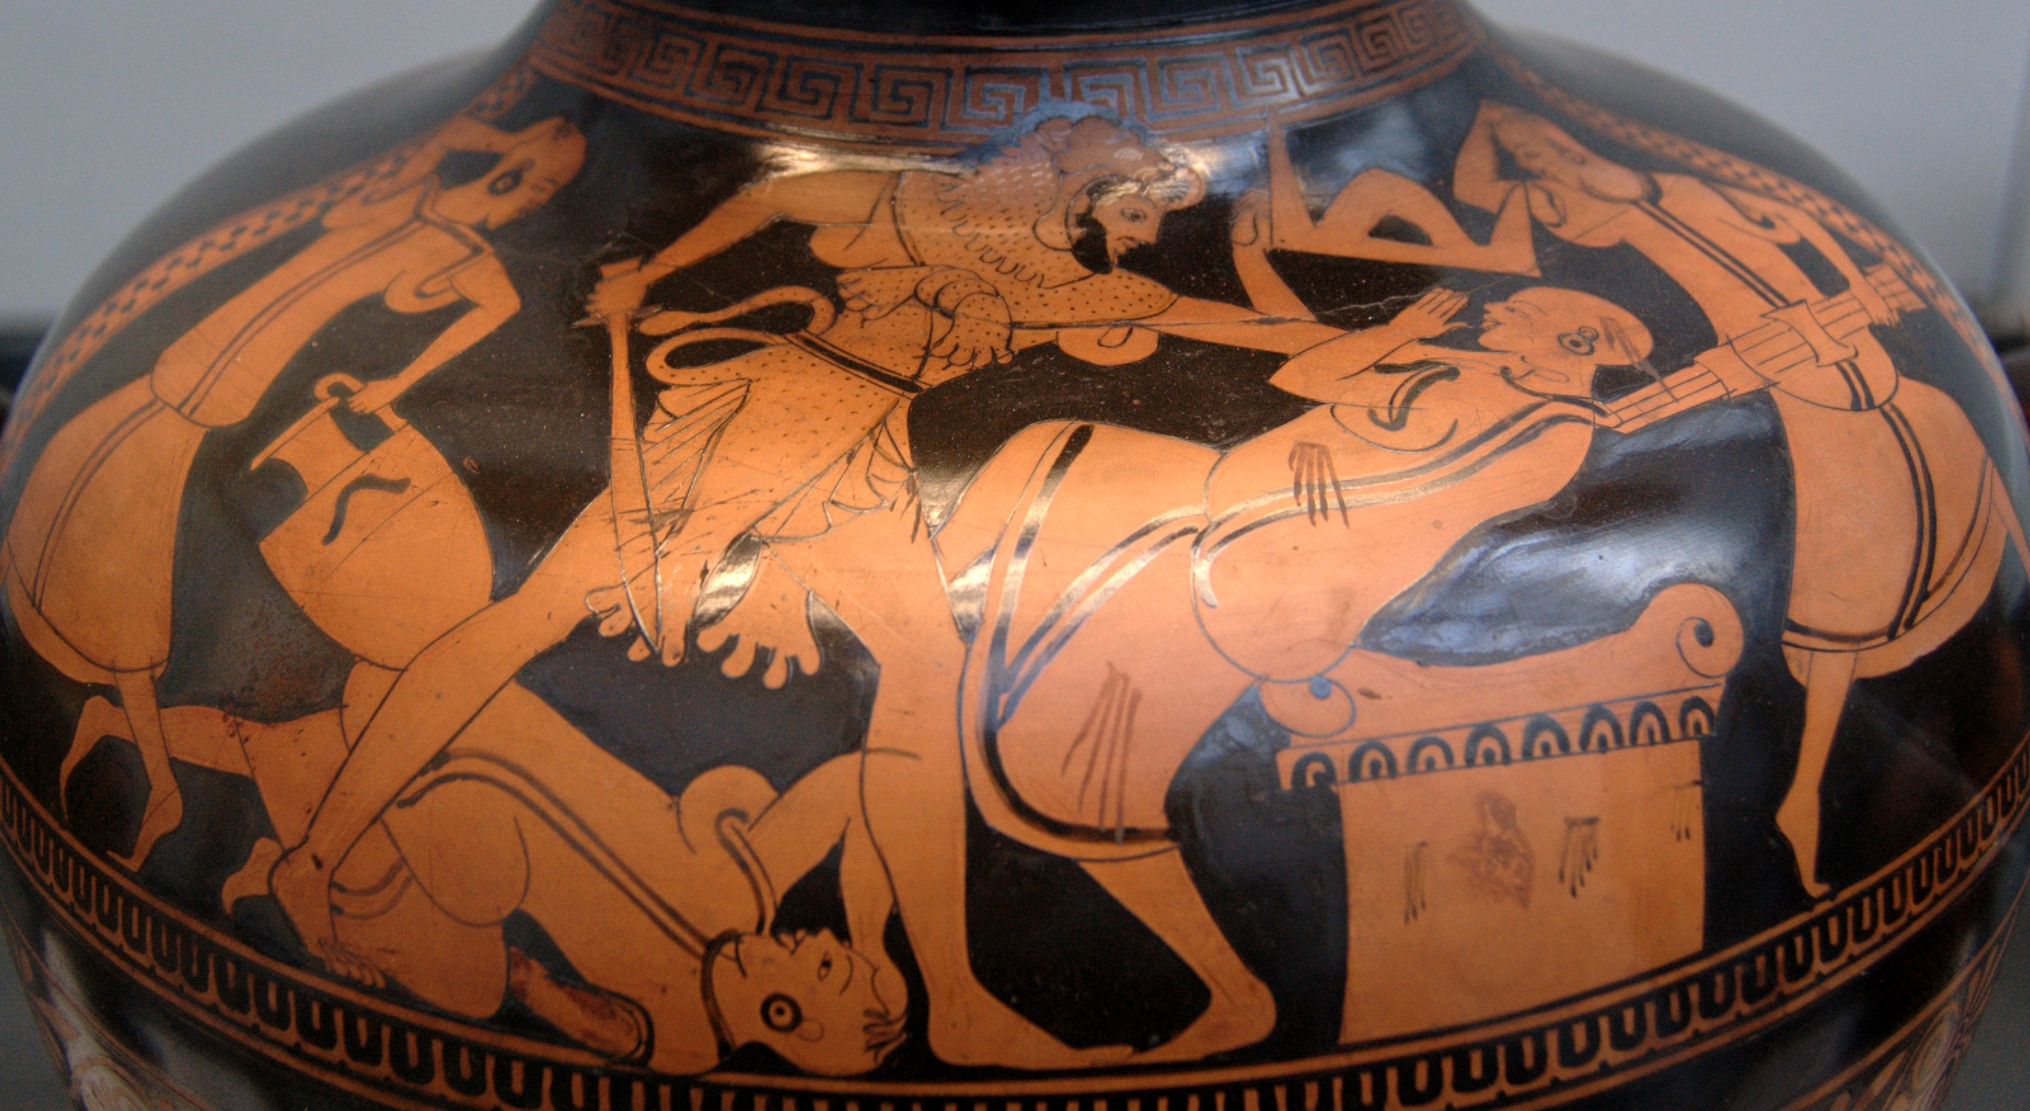
búsíris
Hdt. 2.45 λέγουσι δὲ πολλὰ καὶ ἄλλα ἀνεπισκέπτως οἱ Ἕλληνες, εὐήθης δὲ αὐτῶν καὶ ὅδε ὁ μῦθος ἐστὶ τὸν περὶ τοῦ Ἡρακλέος λέγουσι, ὡς αὐτὸν ἀπικόμενον ἐς Αἴγυπτον στέψαντες οἱ Αἰγύπτιοι ὑπὸ πομπῆς ἐξῆγον ὡς θύσοντες τῷ Διί: τὸν δὲ τέως μὲν ἡσυχίην ἔχειν, ἐπεὶ δὲ αὐτοῦ πρὸς τῷ βωμῷ κατάρχοντο, ἐς ἀλκὴν τραπόμενον πάντας σφέας καταφονεῦσαι.
And the Greeks say many other ill-considered things, too; among them, this is a silly story which they tell about Heracles: that when he came to Egypt, the Egyptians crowned him and led him out in a procession to sacrifice him to Zeus; and for a while (they say) he followed quietly, but when they started in on him at the altar, he resisted and killed them all.

Slide 22
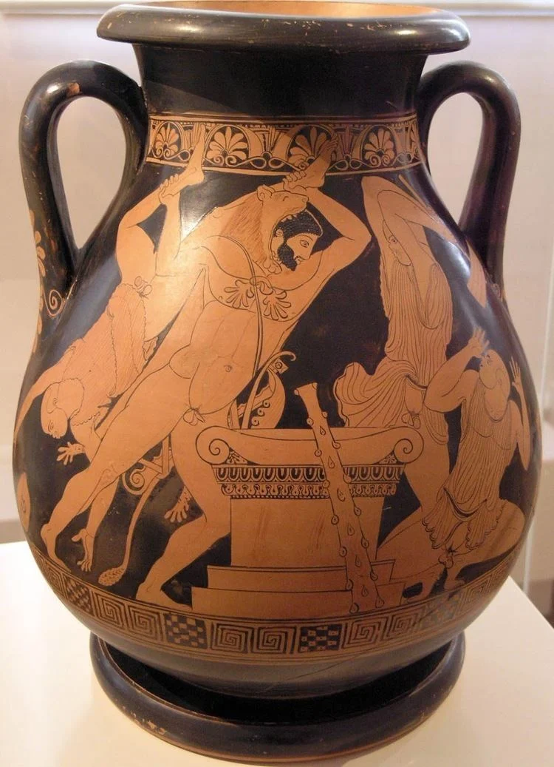
Búsíris (také ísokratés – búrísis)
Apollod. 2.5.11 μετὰ Λιβύην δὲ Αἴγυπτον διεξῄει. ταύτης ἐβασίλευε Βούσιρις Ποσειδῶνος παῖς καὶ Λυσιανάσσης τῆς Ἐπάφου. οὗτος τοὺς ξένους ἔθυεν ἐπὶ βωμῷ Διὸς κατά τι λόγιον: ἐννέα γὰρ ἔτη ἀφορία τὴν Αἴγυπτον κατέλαβε, Φρασίος δὲ ἐλθὼν ἐκ Κύπρου, μάντις τὴν ἐπιστήμην, ἔφη τὴν ἀφορίαν παύσασθαι ἐὰν ξένον ἄνδρα τῷ Διὶ σφάξωσι κατ᾽ ἔτος. Βούσιρις δὲ ἐκεῖνον πρῶτον σφάξας τὸν μάντιν τοὺς κατιόντας ξένους ἔσφαζε. συλληφθεὶς οὖν καὶ Ἡρακλῆς τοῖς βωμοῖς προσεφέρετο τὰ δὲ δεσμὰ διαρρήξας τόν τε Βούσιριν καὶ τὸν ἐκείνου παῖδα Ἀμφιδάμαντα ἀπέκτεινε.
After Libya he traversed Egypt. That country was then ruled by Busiris,⁸ a son of Poseidon by Lysianassa, daughter of Epaphus. This Busiris used to sacrifice strangers on an altar of Zeus in accordance with a certain oracle. For Egypt was visited with dearth for nine years, and Phrasius, a learned seer who had come from Cyprus, said that the dearth would cease if they slaughtered a stranger man in honor of Zeus every year. Busiris began by slaughtering the seer himself and continued to slaughter the strangers who landed. So Hercules also was seized and haled to the altars, but he burst his bonds and slew both Busiris and his son Amphidamas.

Slide 23
Kult zvířat
Ath. 7.55
οὐκ ἂν δυναίμην συμμαχεῖν ὑμῖν ἐγώ:
οὔθ᾽ οἱ τρόποι γὰρ ὁμονοοῦσ᾽ οὔθ᾽ οἱ νόμοι
ἡμῶν, ἀπ᾽ ἀλλήλων δὲ διέχουσιν πολύ.
βοῦν προσκυνεῖς, ἐγὼ δὲ θύω τοῖς θεοῖς:
τὴν ἔγχελυν μέγιστον ἡγεῖ δαίμονα,
ἡμεῖς δὲ τῶν ὄψων μέγιστον παρὰ πολύ:
οὐκ ἐσθίεις ὕει᾽, ἐγὼ δέ γ᾽ ἥδομαι
μάλιστα τούτοις: κύνα σέβεις, τύπτω δ᾽ ἐγώ,
τοὔψον κατεσθίουσαν ἡνίκ᾽ ἂν λάβω.
τοὺς ἱερέας ἐνθάδε μὲν ὁλοκλήρους νόμος
εἶναι, παρ᾽ ὑμῖν δ᾽, ὡς ἔοικ᾽, ἀπηργμένους.
τὸν αἰέλουρον κακὸν ἔχοντ᾽ ἐὰν ἴδῃς
κλαίεις, ἐγὼ δ᾽ ἥδιστ᾽ ἀποκτείνας δέρω.
δύναται παρ᾽ ὑμῖν μυγαλῆ, παρ᾽ ἐμοὶ δέ γ᾽ οὔ.
I never could myself your comrade be,
For neither do'our manners nor our laws
Agree with yours, but they are wholly different.
You do adore an ox; I sacrifice him
To the great Gods of heaven. You do think
An eel the mightiest of deities;
But we do eat him as the best of fish.
You eat no pork; I like it above all things.
You do adore a dog; but I do beat him
If e'er I catch him stealing any meat.
Then our laws enjoin the priests to be
Most perfect men; but yours are mutilated.
If you do see a cat in any grief
You weep; but I first kill him and then skin him.
You have a great opinion of the shrew-mouse;
But I have none at all.

Slide 24
zbožnost
D.C. 42.34.2 καὶ δεινῶς φέροντες ὅτι μηδὲ τῶν ιερῶν τις ἀπείχετο ῾θρησκεύουσί τε γὰρ πολλὰ περισσότατα ἀνθρώπων, καὶ πολέμους ὑπὲρ αὐτῶν καὶ πρὸς ἀλλήλους, ἅτε μὴ καθ᾽ ἓν ἀλλὰ καὶ ἐκ τοῦ ἐναντιωτάτου καὶ αὑτοῖς τιμῶντές τινα,
For they are the most religious people on earth in many respects and wage wars even against one another on account of their beliefs, since they are not all agreed in their worship, but are diametrically opposed to each other in some matters.

Slide 25
zbožnost
Philostr. VA. 3.32 ‘κἀγώ,’ ἔφη ‘ὦ βασιλεῦ, ἐγίγνωσκον, ὅτι σοι τὰ ὦτα διέφθορεν ὑπὸ τῶν Αἰγυπτίων τούτων,
I too, O king, was aware that your mind had been poisoned by these Egyptians;

Slide 26
Zrádní, podvodníci
Aristoph. Thes. 920–922
οἴμ᾽ ὡς πανοῦργος καὐτὸς εἶναί μοι δοκεῖς
καὶ τοῦδέ τις ξύμβουλος. οὐκ ἐτὸς πάλαι
ᾐγυπτιάζετ᾽. ἀλλ᾽ ὅδε μὲν δώσει δίκην.
You seem to me to be a cunning rascal too; you are in collusion with this man, and it wasn't for nothing that you kept babbling about Egypt.

Slide 27
Zrádní, podvodníci
Propert. 3.11.33–37
noxia Alexandria, dolis aptissima tellus,
et totiens nostro Memphi cruenta malo,
tris ubi Pompeio detraxit harena triumphos--
tollet nulla dies hanc tibi, Roma, notam
Noxious Alexandria place so skilled in deceit and Memphis so often bloody with our grief where the sand robbed Pompey of his three triumphs? Rome, no day will ever wipe away the stain.

Slide 28
zrádní
Caes. Civ. 7.2
at mihi si defendendi essent Alexandrini neque fallaces esse neque temerarii, multa oratio frustra absumeretur; cum vero uno tempore et natio eorum et natura cognoscatur, aptissimum esse hoc genus ad proditionem dubitare nemo potest.
But to offer here a defense either of the sincerity or conduct of these Alexandrians, would be only labor in vain, since all who know the genius and temper of the people must be satisfied that they are the fittest instruments in the world for treason.

Slide 29
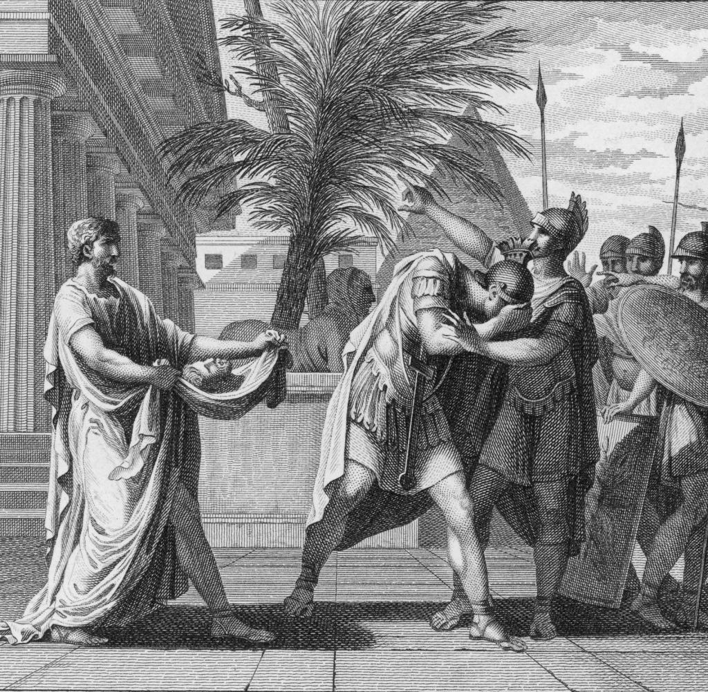
zrádní
Caes. Civ. 24
Caesar etsi fallacem gentem semperque alia cogitantem, alia simulantem bene cognitam habebat, tamen petentibus dare veniam utile esse statuit
Though Caesar knew the nation to be false and perfidious, seldom speaking as they really thought, yet he judged it best to comply with their desire.

Slide 30
Alexandrie
Plb. 15.24–33
παραδοθέντων δὲ πάντων ὁμοῦ τοῖς ὄχλοις, οἱ μὲν ἔδακνον, οἱ δ᾽ ἐκέντουν, οἱ δὲ τοὺς ὀφθαλμοὺς ἐξέκοπτον: ἀεὶ δὲ τοῦ πεσόντος τὰ μέλη διέσπων, ἕως ὅτου κατελώβησαν πάντας αὐτούς: [10] δεινὴ γάρ τις ἡ περὶ τοὺς θυμοὺς ὠμότης γίνεται τῶν κατὰ τὴν Αἴγυπτον ἀνθρώπων.
They were all given up to the populace, who bit, and stabbed them, and knocked out their eyes, and, as soon as any one of them fell, tore him limb from limb, until they had utterly annihilated them all: for the savagery of the Egyptians when their passions are roused is indeed terrible.

Slide 31
Kleopatra
Verg. A. 8.685–688
hinc ope barbarica variisque Antonius armis,
victor ab Aurorae populis et litore rubro,
Aegyptum virisque Orientis et ultima secum
Bactra vehit, sequiturque (nefas) Aegyptia coniunx.
Opposing, in barbaric splendor shine
the arms of Antony: in victor's garb
from nations in the land of morn he rides,
and from the Red Sea, bringing in his train
Egypt and Syria, utmost Bactria's horde,
and last—O shameless!—his Egyptian spouse.

Slide 32
Kleopatra
Propert. 3.11.26–35
nam quid ego heroas, quid raptem in crimina divos?
Iuppiter infamat seque suamque domum.
quid, modo quae nostris opprobria nexerit armis,
et, famulos inter femina trita suos,
coniugii obsceni pretium Romana poposcit
moenia et addictos in sua regna Patres?
noxia Alexandria, dolis aptissima tellus,
et totiens nostro Memphi cruenta malo,
tris ubi Pompeio detraxit harena triumphos--
tollet nulla dies hanc tibi, Roma, notam.
Why should I seize on heroes, why gods, who stand accused? Jupiter shames himself and his house. Why Cleopatra, who heaped insults on our army, a woman worn out by her own attendants, who demanded the walls of Rome and the Senate bound to her rule, as a reward from her obscene husband? Noxious Alexandria place so skilled in deceit and Memphis so often bloody with our grief where the sand robbed Pompey of his three triumphs? Rome, no day will ever wipe away the stain.

Slide 33
Kleopatra
Propertius 3.11.38–46
scilicet incesti meretrix regina Canopi,
una Philippeo sanguine adusta nota,
ausa Iovi nostro latrantem opponere Anubim,
et Tiberim Nili cogere ferre minas,
Romanamque tubam crepitanti pellere sistro,
baridos et contis rostra Liburna sequi,
foedaque Tarpeio conopia tendere saxo,
iura dare et statuas inter et arma Mari!
Truly that whore, queen of incestuous Canopus, a fiery brand burned by the blood of Philip, dared to oppose our Jupiter with yapping Anubis, and forced Tiber to suffer the threats of Nile, banished the Roman trumpet with the rattle of the sistrum, chased the Liburnian prow with a poled barge, spread her foul mosquito nets over the Tarpeian Rock, and gave judgements among Marius’ weapons and statues.

Slide 34
Kleopatra
Horatius, Od. 1.37.5–8
antehac nefas depromere Caecubum
cellis avitis, dum Capitolio
regina dementis ruinas,
funus et imperio parabat
Twas shame to broach, before today,
The Caecuban, while Egypt's dame
Threaten'd our power in dust to lay
And wrap the Capitol in flame,

Slide 35
Kleopatra
Horatius, Epod. 9.11–16
Romanus eheu---posteri negabitis---
emancipatus feminae
fert vallum et arma miles et spadonibus
servire rugosis potest
interque signa turpe militaria
sol adspicit conopium.
A Roman, – you’ll not credit it, posterity –
Sadly, ups sticks and arms himself,
For a woman’s sake, and though a soldier, deigns
To serve the withered eunuchs,
While the sun looks down on her shameful pavilion,
Among the warlike standards.

Slide 36
Kleopatra
Luc. 8.543–547 (10.55–106)
Instruit. O superi, Nilusne et barbara Memphis,
Et Pelusiaci tam mollis turba Canopi
Hos animos? Sic fata premunt civilia mundum?
Sic Romana iacent? Ullusue in cladibus istis
Est locus Aegypto, Phariusque admittitur ensis?
With swords embark. Ye gods! and shall the Nile
And barbarous Memphis and th' effeminate crew
That throngs Pelusian Canopus raise
Its thoughts to such an enterprise? Do thus
Our fates press on the world? Is Rome thus fallen
That in our civil frays the Pharian sword
Finds place, or Egypt?

Slide 37
Kleopatra
C.D. 50.24.3,5
τὸ γάρ τοι Ῥωμαίους τε ὄντας καὶ τῆς πλείστης καὶ ἀρίστης οἰκουμένης ἄρχοντας καταφρονεῖσθαι καὶ καταπατεῖσθαι πρὸς γυναικὸς Αἰγυπτίας ἀνάξιον …
πῶς μὲν γὰρ οὐ μέγα ἂν ἀλγήσειαν πάντες ἐκεῖνοι οἱ τὰ προειρημένα κατειργασμένοι, εἰ αἴσθοιντο ἡμᾶς ὀλέθρῳ γυναικὶ ὑποπεπτωκότας;
…
For that we who are Romans and lords of the greatest and best portion of the world should be despised and trodden under foot by an Egyptian woman is unworthy of our fathers, …Would not all those who have performed the exploits I have named grieve mightily if they should learn that we had succumbed to an accursed woman?

Slide 38
Kleopatra, Egypt, Alexandrie
C.D. 50.24.6–7 , ὦ Ἡράκλεις, Ἀλεξανδρεῖς τε καὶ Αἰγύπτιοι ὄντες ῾τί γὰρ ἂν ἄλλο τις αὐτοὺς χεῖρον ἢ ἀληθέστερον εἰπεῖν ἔχοι;᾿ καὶ τὰ μὲν ἑρπετὰ καὶ τἆλλα θηρία ὥσπερ τινὰς θεοὺς θεραπεύοντες, τὰ δὲ σώματα τὰ σφέτερα ἐς δόξαν ἀθανασίας ταριχεύοντες, καὶ θρασύνασθαι μὲν προπετέστατοι ἀνδρίσασθαι δὲ ἀσθενέστατοι ὄντες, καὶ τὸ μέγιστον γυναικὶ ἀντ᾽ ἀνδρὸς δουλεύοντες,
are Alexandrians and Egyptians (what worse or what truer name could one apply to them?), who worship reptiles and beasts as gods, who embalm their own bodies to give them the semblance of immortality, 7 who are most reckless in effrontery but most feeble in courage, and who, worst of all, are slaves to a woman and not to a man,

Slide 39
Alexandrie
C.D. 39.58.1–2. πρὸς δὲ δὴ πόλεμον τά τε δεινὰ αὐτοῦ φλαυρότατοί εἰσι, καίπερ ἐν ταῖς στάσεσι, πλείσταις δὴ καὶ μεγίσταις παρ᾽ αὐτοῖς γιγνομέναις, διὰ φόνων τε ἀεὶ χωροῦντες καὶ τὸ ζῆν παρ᾽ οὐδὲν πρὸς τὴν αὐτίκα φιλονεικίαν τιθέμενοι, ἀλλὰ καὶ ὥσπερ τι τῶν ἀρίστων ἢ ἀναγκαιοτάτων τὸν ἐν αὐταῖς ὄλεθρον διώκοντες.
For the Alexandrines are most ready to assume a bold front everywhere and to speak out whatever may occur to them, 2 but for war and its terrors they are utterly useless. This is true in spite of the fact that in seditions, which with them are very numerous and very serious, they always become involved in slaughter, setting no value upon life as compared with the rivalry of the moment, but pursuing destruction in such quarrels as if it were one of the best and dearest prizes.

Slide 40
Egypt
Tac. Hist. 4.81
e plebe Alexandrina quidam oculorum tabe notus genua eius advolvitur, remedium caecitatis exposcens gemitu, monitu Serapidis dei, quem dedita superstitionibus gens ante alios colit; precabaturque principem ut genas et oculorum orbis dignaretur respergere oris excremento.
One of the common people of Alexandria, well known for his loss of sight, threw himself before Vespasian's knees, praying him with groans to cure his blindness, being so directed by the god Serapis, whom this most superstitious of nations worships before all others; and he besought the emperor to deign to moisten his cheeks and eyes with his spittle.

Slide 41
Zvířecí kult
Cic. N.D. 1.16.43 Cum poetarum autem errore coniungere licet portenta magorum Aegyptiorumque in eodem genere dementiam, tum etiam vulgi opiniones, quae in maxima inconstantia veritatis ignoratione versantur.
With the errors of the poets may be classed the monstrous doctrines of the magi and the insane mythology of Egypt, and also the popular beliefs, which are a mere mass of inconsistencies sprung from ignorance.

Slide 42
Zvířecí kult
Cic. N.D. 1.29.81 at non Aegyptii nec Syri nec fere cuncta barbaria; firmiores enim videas apud eos opiniones esse de bestiis quibusdam quam apud nos de sanctissimis templis et simulacris deorum.
But they are not so known to the Egyptians or Syrians, or any almost of the uncivilized races. Among these you will find a belief in certain animals more firmly established than is reverence for the holiest sanctuaries and images of the gods with us.

Slide 43
Zvířecí kult
Cic. N.D. 1.36.10. ipsi qui inridentur Aegyptii nullam beluam nisi ob aliquam utilitatem quam ex ea caperent consecraverunt; velut ibes maximam vim serpentium conficiunt.
Even the Egyptians, whom we laugh at, deified animals solely on the score of some utility which they derived from them; for instance, the ibis, being a tall bird with stiff legs and a long horny beak, destroys a great quantity of snakes:

Slide 44
Zvířecí kult
Cic. Tusc. 27.78 Aegyptiorum morem quis ignorat? quorum inbutae mentes pravitatis erroribus quamvis carnificinam prius subierint quam ibim aut aspidem aut faelem aut canem aut corcodillum violent, quorum etiamsi inprudentes quippiam fecerint, poenam nullam recusent.
Who is there who is unacquainted with the customs of the Egyptians? Their minds being tainted by pernicious opinions, they are ready to bear any torture, rather than hurt an ibis, a snake, a cat, a dog, or a crocodile: and should anyone inadvertently have hurt any of these animals, he will submit to any punishment.

Slide 45
Zvířecí kult
Luc. J. Tr. 42 καὶ τοῦτο μὲν ἅπασι κοινὸν τοῖς Αἰγυπτίοις τὸ ὕδωρ, ἰδίᾳ δὲ Μεμφίταις μὲν ὁ βοῦς θεός, Πηλουσιώταις δὲ κρόμμυον, καὶ ἄλλοις ἶβις ἢ κροκόδειλος καὶ ἄλλοις κυνοκέφαλος ἢ αἴλουρος ἢ πίθηκος: καὶ ἔτι κατὰ κώμας τοῖς μὲν ὁ δεξιὸς ὦμος θεός, τοῖς δὲ κατ᾽ ἀντιπέρας οἰκοῦσιν ἅτερος: καὶ ἄλλοις κεφαλῆς ἡμίτομον, καὶ ἄλλοις ποτήριον κεραμεοῦν ἢ τρύβλιον. ταῦτα πῶς οὐ γέλως ἐστίν, ὦ καλὲ Τιμόκλεις;
In Egypt, though, besides the universal worship of water, Memphis has a private cult of the ox, Pelusium of the onion, other cities of the ibis or the crocodile, others again of baboon, cat, or monkey. Nay, the very villages have their specialities: one deifies the right shoulder, and another across the river the left; one a half skull, another an earthenware bowl or platter. Come, my fine fellow, is it not all ridiculous?

Slide 46
Mix
Juv. 15 Quis nescit, Volusi Bithynice, qualia demens
Aegyptos portenta colat? crocodilon adorat
pars haec, illa pauet saturam serpentibus ibin.
effigies sacri nitet aurea cercopitheci,
dimidio magicae resonant ubi Memnone chordae 5
atque uetus Thebe centum iacet obruta portis.
illic aeluros, hic piscem fluminis, illic
oppida tota canem uenerantur, nemo Dianam.
Who knows not, O Bithynian Volusius, what monsters demented Egypt worships? One district adores the crocodile, another venerates the Ibis that gorges itself with snakes. In the place where magic chords are sounded by the truncated Memnon, and ancient hundred-gated Thebes lies in ruins, men worship the glittering golden image of the long-tailed ape. In one part cats are worshipped, in another a river fish, in another whole townships venerate a dog; none adore Diana,

Slide 47
mix
Juv. 15 porrum et caepe nefas uiolare et frangere morsu
(o sanctas gentes, quibus haec nascuntur in hortis
numina!), lanatis animalibus abstinet omnis
mensa, nefas illic fetum iugulare capellae:
carnibus humanis uesci licet.
but it is an impious outrage to crunch leeks and onions with the teeth. What a holy race to have such divinities springing up in their gardens! No animal that grows wool may appear upon the dinner-table; it is forbidden there to slay the young of the goat; but it is lawful to feed on the flesh of man!

Slide 48
mix
Juv 15 labitur hic quidam nimia formidine cursum
praecipitans capiturque. ast illum in plurima sectum
frusta et particulas, ut multis mortuus unus
sufficeret, totum corrosis ossibus edit
uictrix turba, nec ardenti decoxit aeno
aut ueribus, longum usque adeo tardumque putauit
expectare focos, contenta cadauere crudo.
Hereupon one of them, over-afraid and hurrying, tripped and was caught; the conquering host cut up his body into a multitude of scraps and morsels, that one dead man might suffice for everyone, and devoured it bones and all. There was no stewing of it in boiling pots, no roasting upon spits; so slow and tedious they thought it to wait for a fire, that they contented themselves with the corpse uncooked!

Slide 49
Juv 15 Maeotide saeuior ara
Aegyptos.
qua nec terribiles Cimbri nec Brittones umquam
Sauromataeque truces aut inmanes Agathyrsi,
hac saeuit rabie inbelle et inutile uolgus
paruula fictilibus solitum dare uela phaselis
et breuibus pictae remis incumbere testae.
But Egypt is more savage than the Maeotid altar;
No dread Cimbrians or Britons, no savage Scythians or monstrous Agathyrsians ever raged so furiously as this unwarlike and worthless rabble that hoists tiny sails on crockery ships, and plies puny oars on boats of painted earthenware!

Slide 50
Literatura
Matthews, R. (Ed.). (2003). Ancient Perspectives on Egypt. London: Oxbow.
Lloyd, A. (1975). Herodotus: Book II: Introduction. Leiden: Brill.
Burkert, W. & Nenci, G. (1990). Hérodote et les peuples non grecs. Genève: Fondation Hardt.
Vasunia, P. (2001). The Gift of Nile: Hellenizing Egypt from Aeschylus to Alexander. Berkeley: University of California Press.
Chamoux, F. (1995). L'Égypte d'après Diodore de Sicile. In H. Leclant (Ed.). Entre Égypte et Grèce. Paris: Les Belles Lettres.

