Slide 1
DSBcB49 Starověká ekumena - antické zprávy o Asii a Africe
Afrika, Kartágo
ceterum autem censeo Carthaginem esse delendam

Slide 2
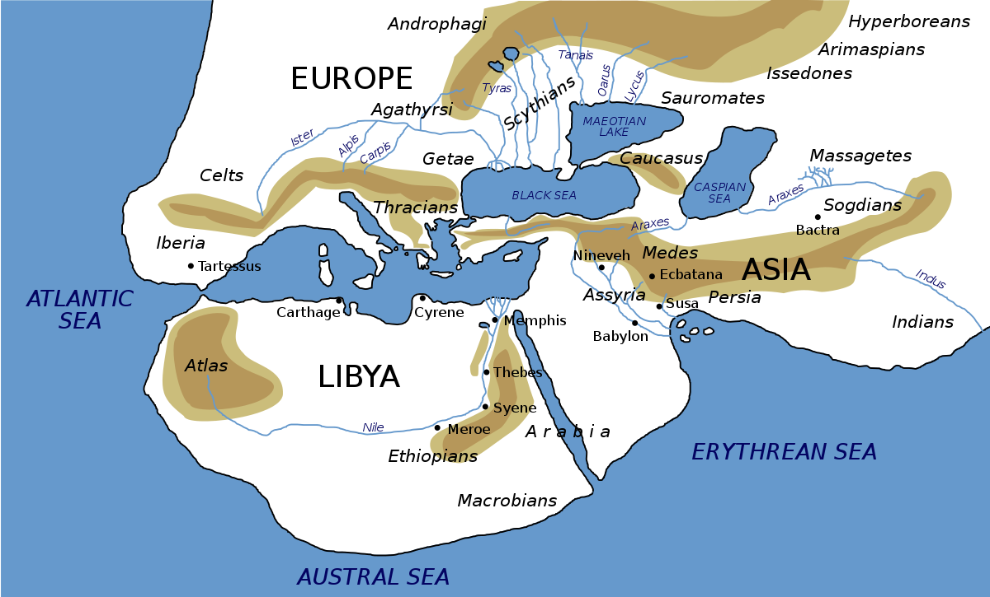
Afrika
Libye – Libyé (Λιβύη) – řecké pojmenování pro celý (!) kontinent
Afrika – od Africa
Podle kmenů v severní Africe
Libu, Afri
Libyé – dcera Epafa, vnučka Dia a Íó

Slide 3
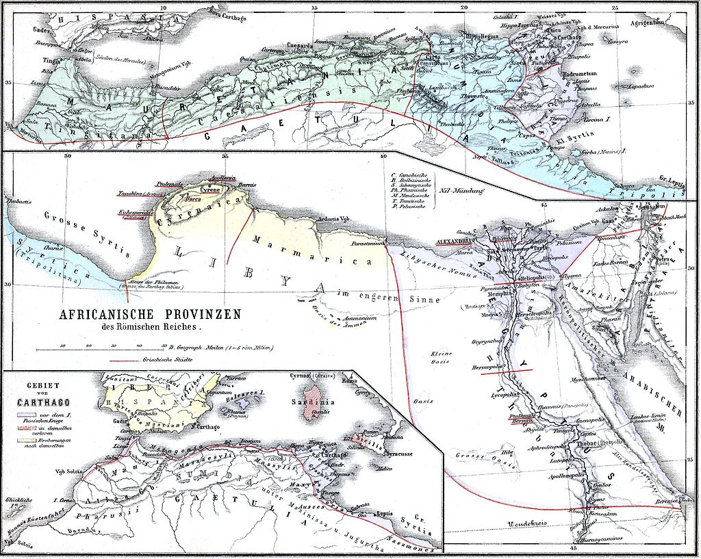
Afrika
Dobře známé severní pobřeží
Na jih od Sahary prakticky neznámé
Aithiopie
Neznámý pramen Nilu
Nejasné hranice, pobřeží, konec světa na jihu

Slide 4
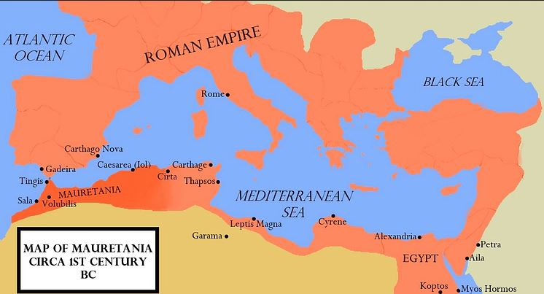
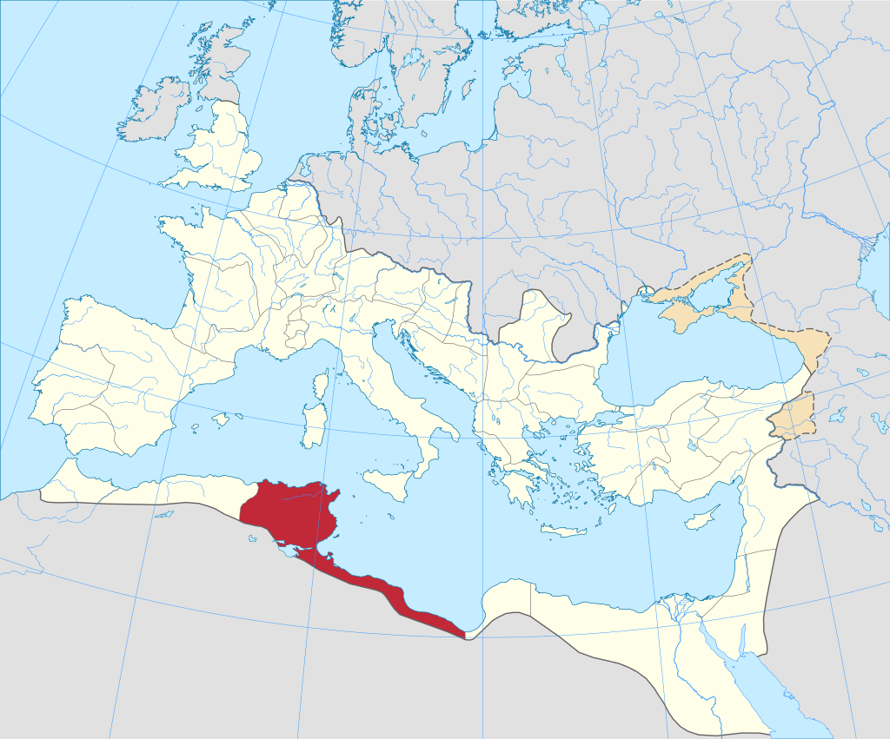
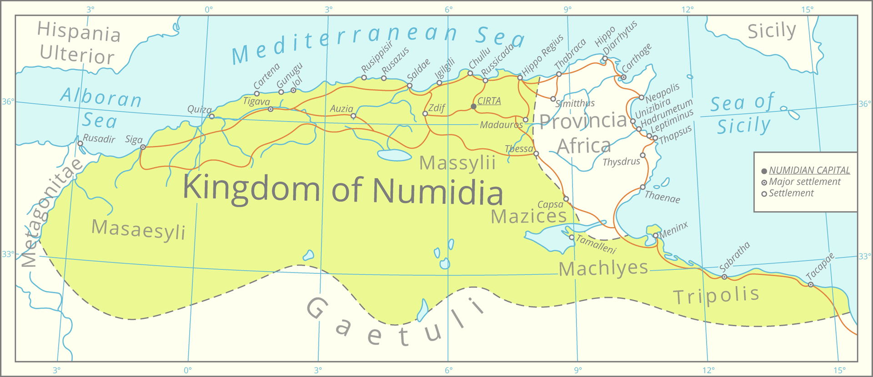
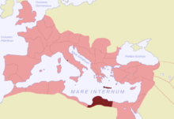
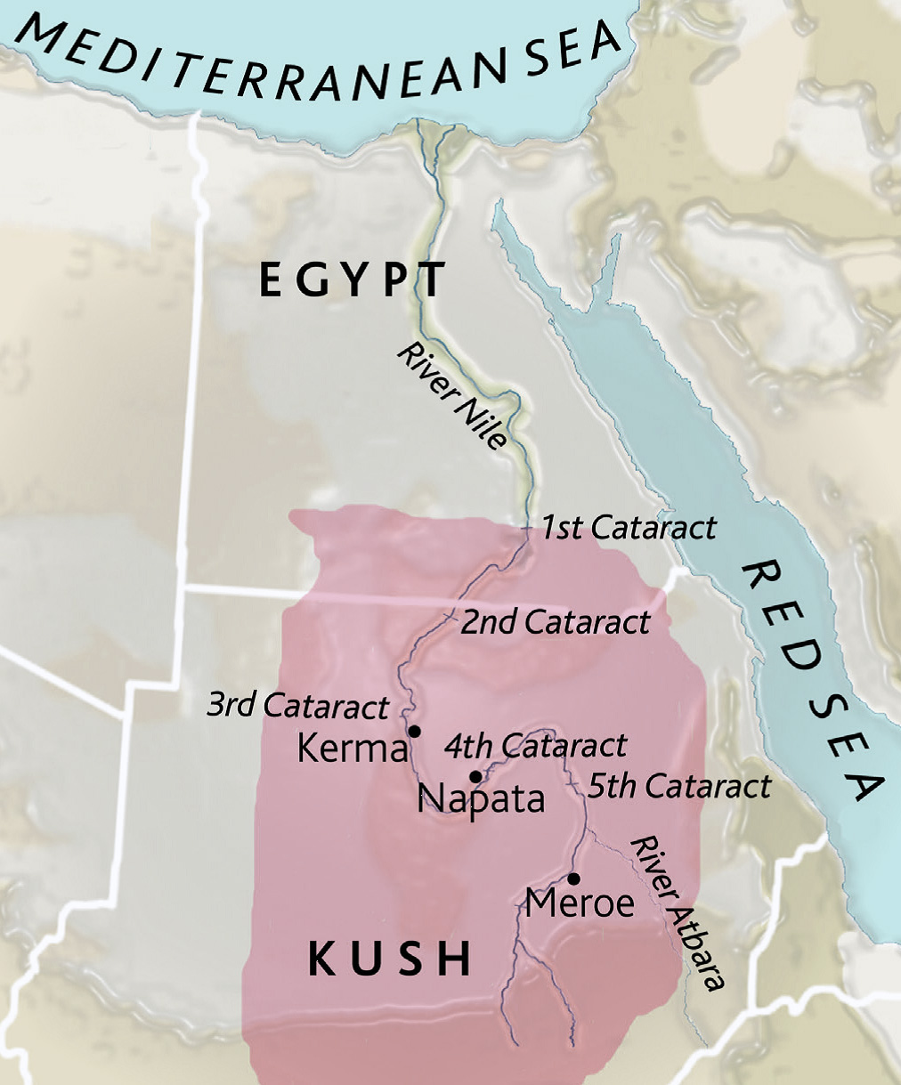
Afrika
Části
Egypt
Afrika
Núbie
Kyrenaika
Mauretánie
Numidie
Aithiopie

Slide 5
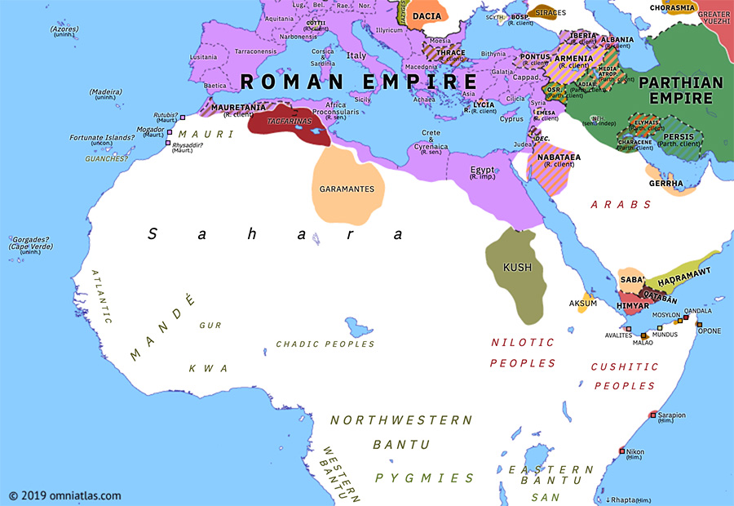
Afrika
Kmeny
Libyjci
Punové*
Aithiopové
Numiďané
Maurové
Garamantové
Gaetulové

Slide 6
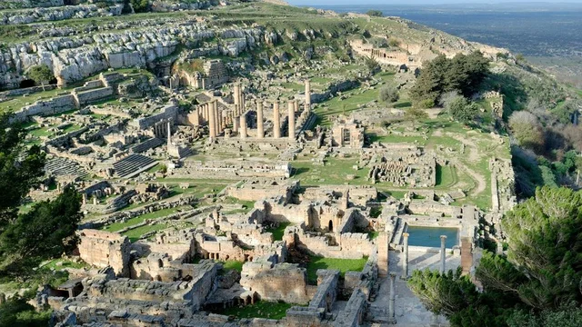
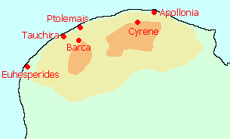
Kontakty
Libye/Kyrenaika
Od 7. stol. pnl – řecké kolonie
Dórští osadníci
Pentapolis
Kyréné, Taucheira, Euesperides, Balagrai, Barké, Ptolemais
Nezávislé království, řečtí králové
Obilí, víno, silfium
Obsazení Achaimenovci, Alexandrem, Ptolemaiovci
Ptolemaios Magás – nezávislost
Ptolemaios VIII.
Ptolemaios Apión – odkázání území Římu
Provincie Kréta a Kyrenaika od 67 pnl

Slide 7
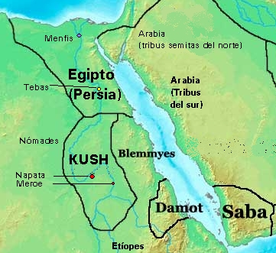
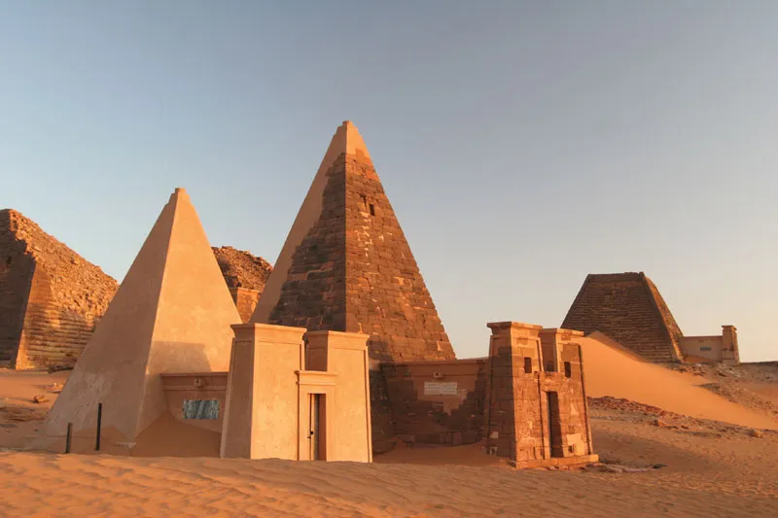
Kontakty
Núbie (Kúš) (Aithiopie)
25. dynastie Egypta (Šebitku, Šabaka, Tahirka)
Od 1. kataraktu na jih
2 fáze – hl. města Napata a Meroé
X Assyřané, Saitská dynastie
Většinou mírové vztahy s Ptolemaiovci a Římem
Hranice 1. katarakt (dnes Asuán)
X Axum
Zlato, slonovina, měď

Slide 8
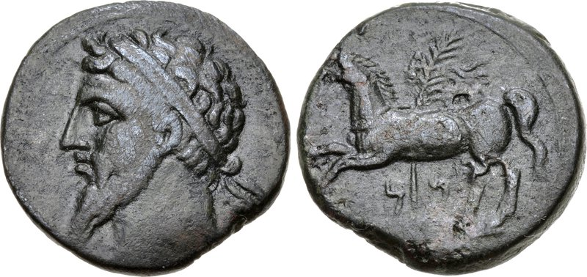
Kontakty
Numidie
Nomades; Numidae/ původní název
2 hlavní kmeny (Massyliové, Massaisylové)
2. punská válka – Syfax (Řím→Kartágo) a Masinissa (Kartágo → Řím)
Sjednocení - Masinissa králem (i ve 3. punské válce)
Hl. město Kirta
Jugurtha – válka s Jugurthou (112–106 pnl), nelegitimní vnuk Masinissy
Úplatky, Gaius Marius, Sulla, zajetí Jugurthy a poprava v Římě
Provincie 46 pnl, klientské království – Juba II.

Slide 9
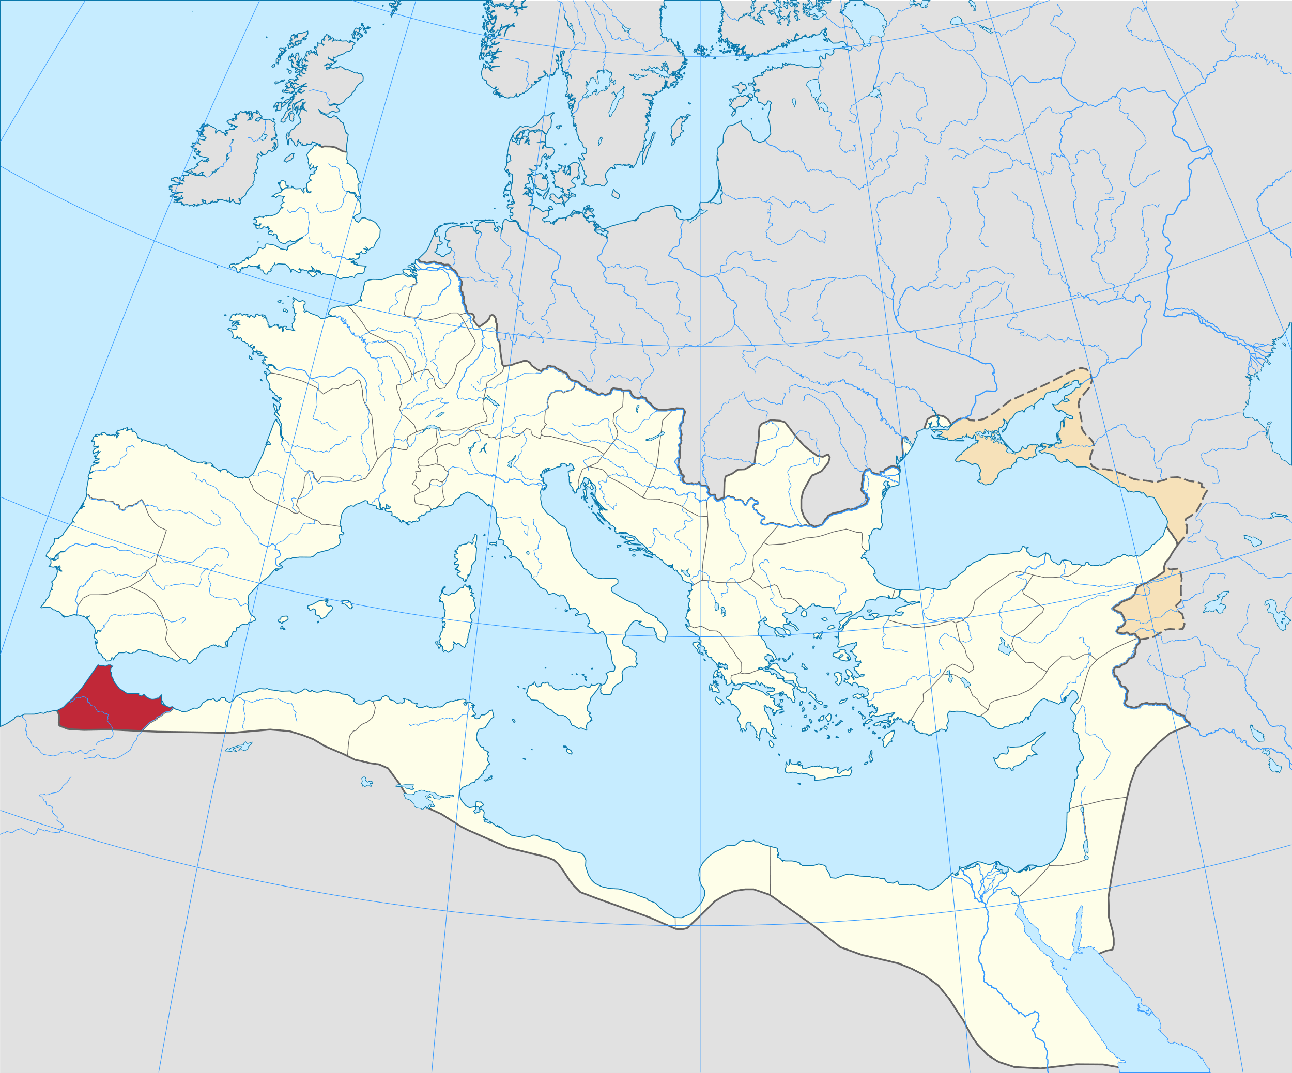
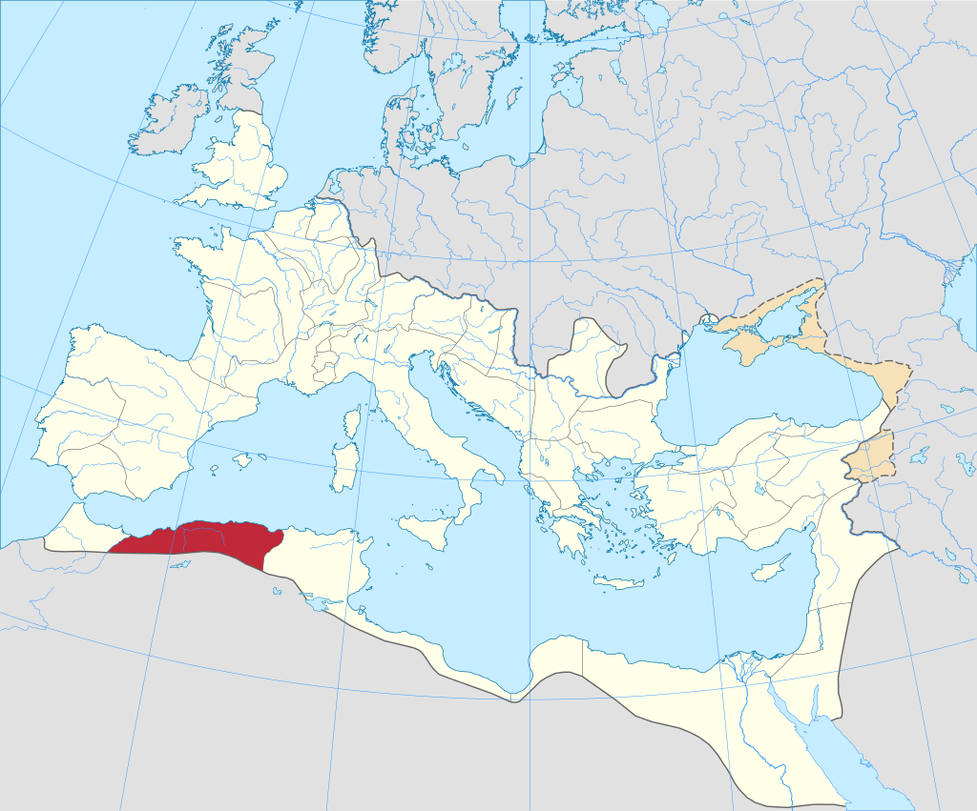
Kontakty
Mauretánie
Mauri
Bocchus I. – Jugurtha
Juba II. – klientské království
Tingis, Caesarea – 2 provincie
Ptolemaios z Mauretánie
Anektování Římem 44 nl

Slide 10
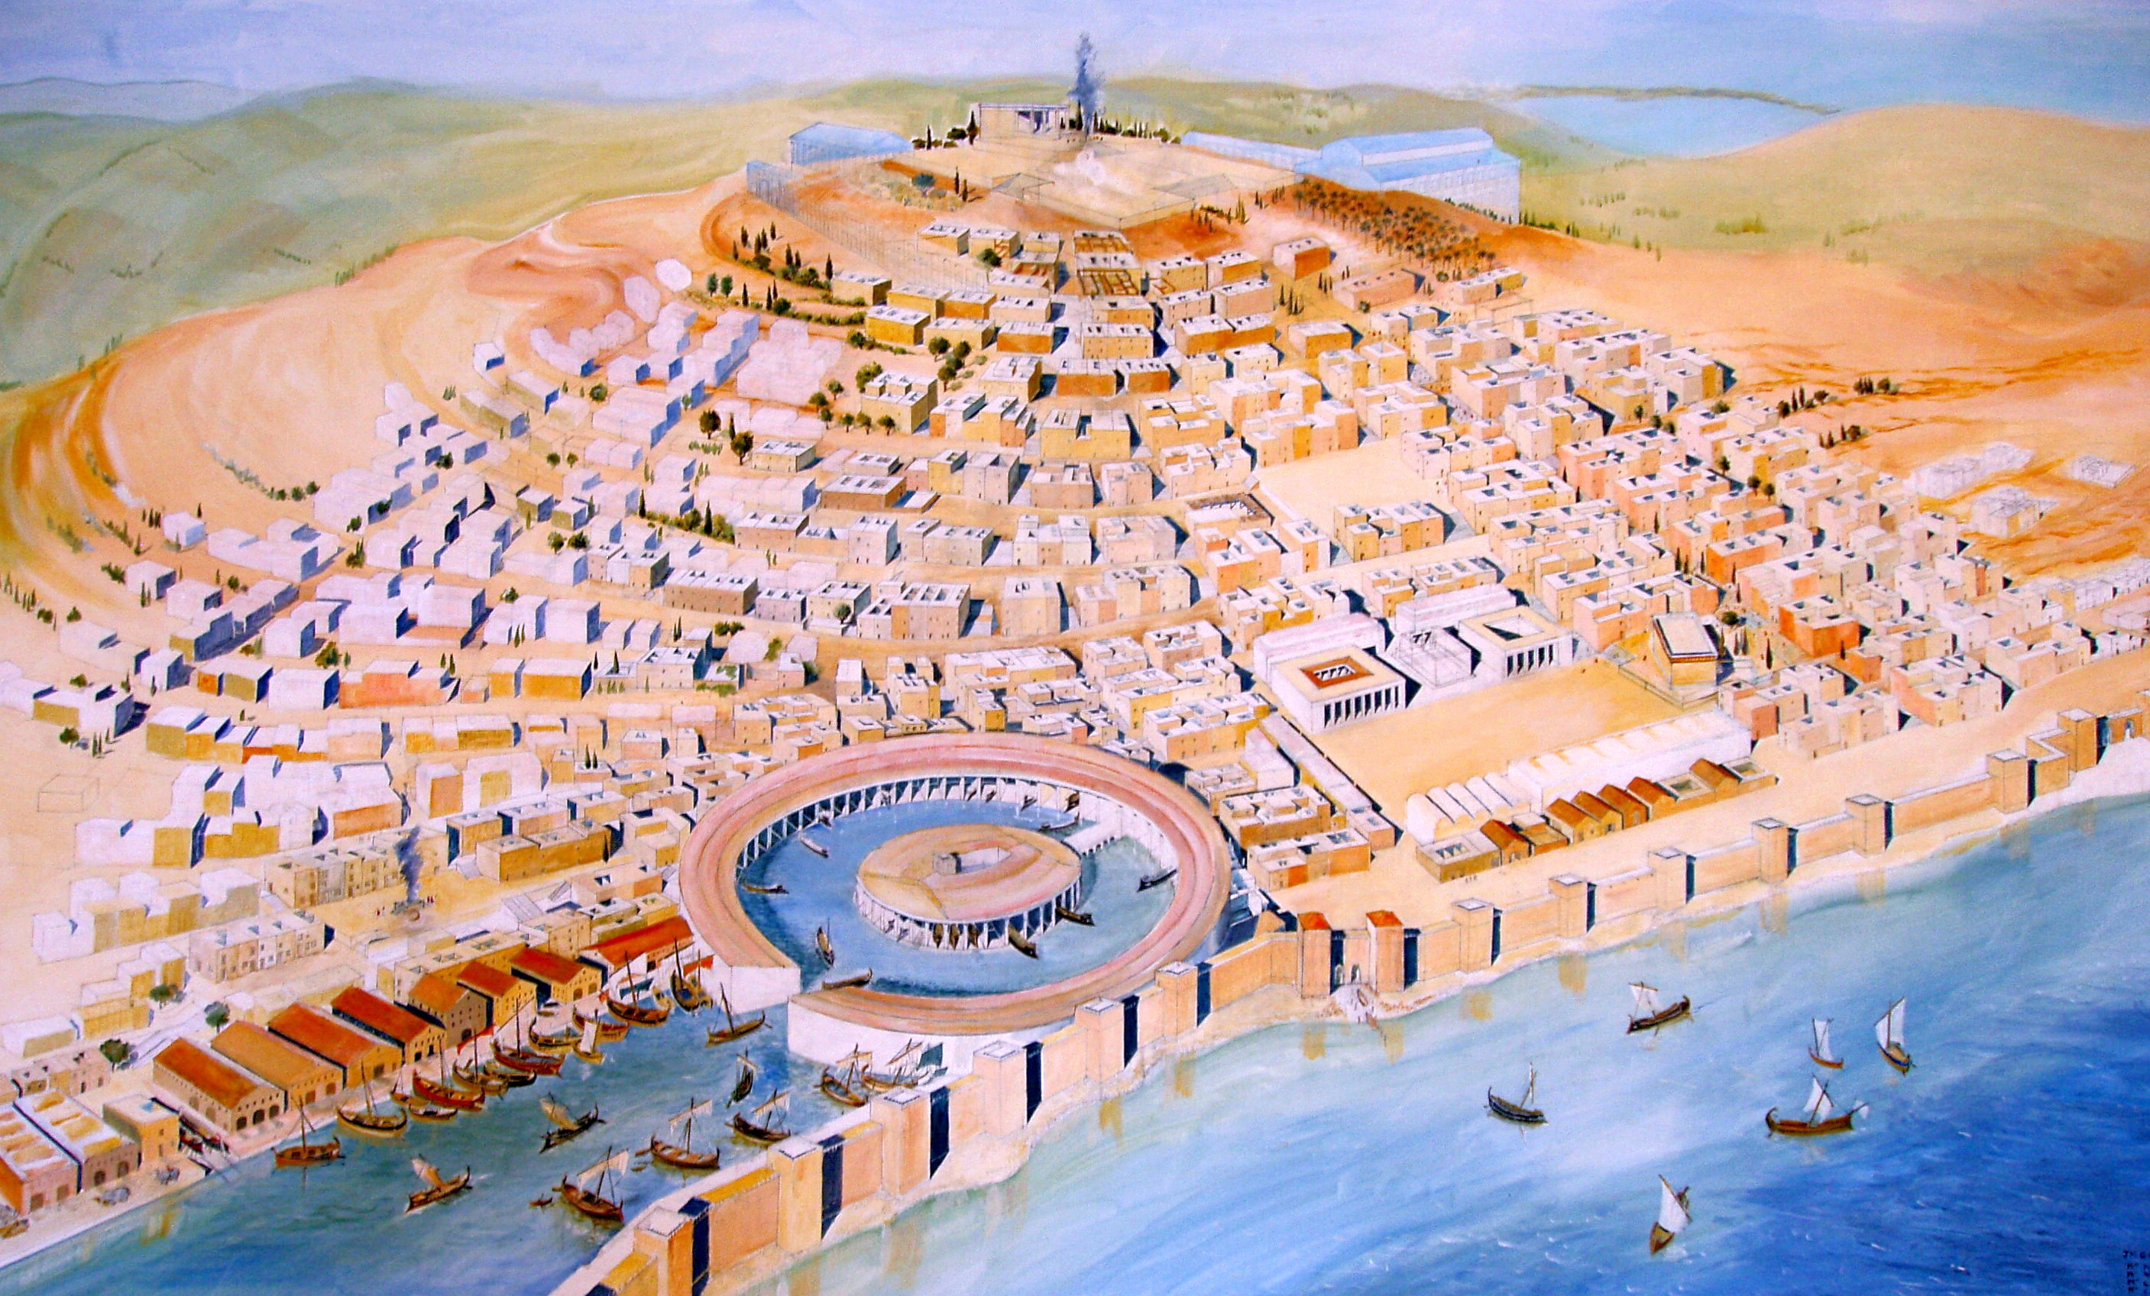
Kontakty
Kartágo
Karthadašt (Qārtḥadāšt)
Karchédón (Καρχηδών), Carthago
Punové, Punicus/Poenicus
Obchodní centrum
2 přístavy, pevnost Byrsa
Bohové – Tanit, Baal Hammon, Melkart
Ústava – smíšená moc, 2 sufeti (voleni na rok, výkonná, soudní moc, z nejvlivnějších rodin), vojevůdci (po dobu války, voleni), rada starších (Adirim, pokladna, zahraniční politika), rada 104 (dohled nad ostatními úředníky), lidová shromáždění
Chváleno Aristotelem a Ísokratem – nejlepší státní zřízení

Slide 11
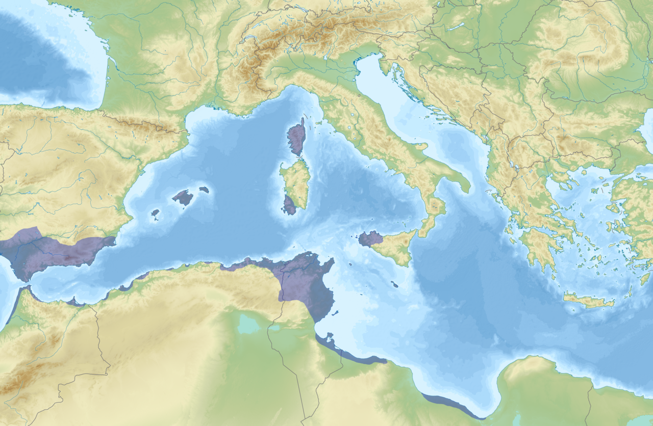
Kartágo
Založení z města Tyru (814 pnl)
Dido (Elissa), kopec Byrsa, emblém kůň, kolonie Utica
Sebevražda Dido
Výhodná pozice, rozmach města
Králové (do 308 pnl, méně moci od 480 pnl)
Obsazení dalších foinických kolonií, pobřeží severní Afriky, část Sicílie, Sardinie, Korsika, později i jižní Španělsko
Smlouvy s Římem – vymezení moci (od 509 pnl)

Slide 12
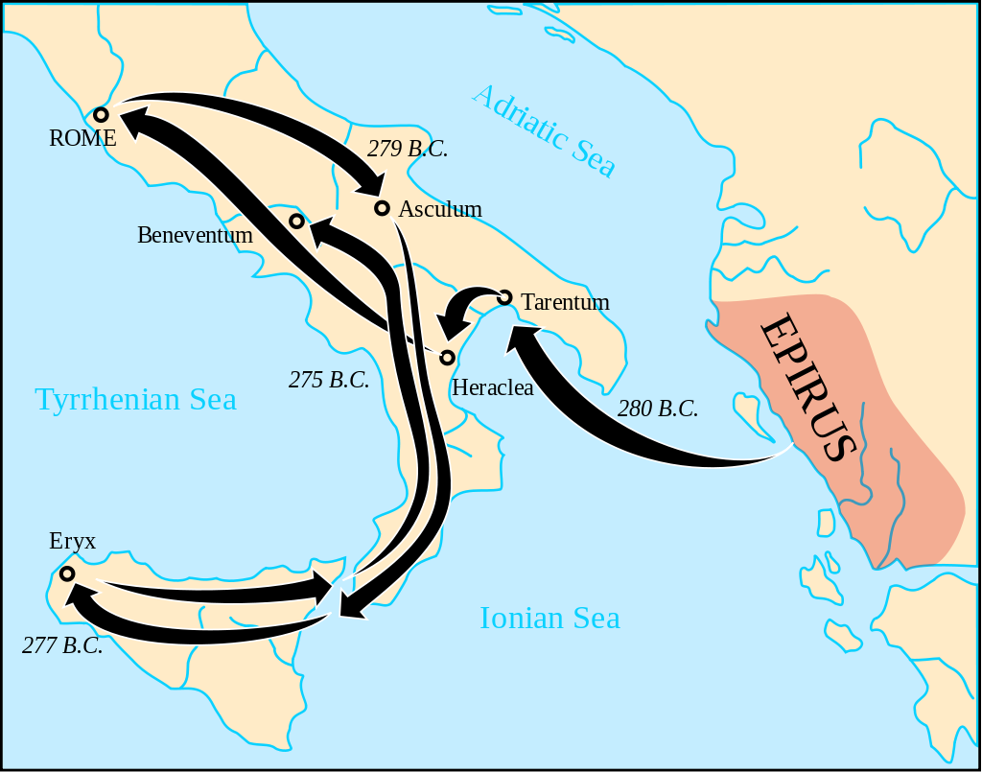
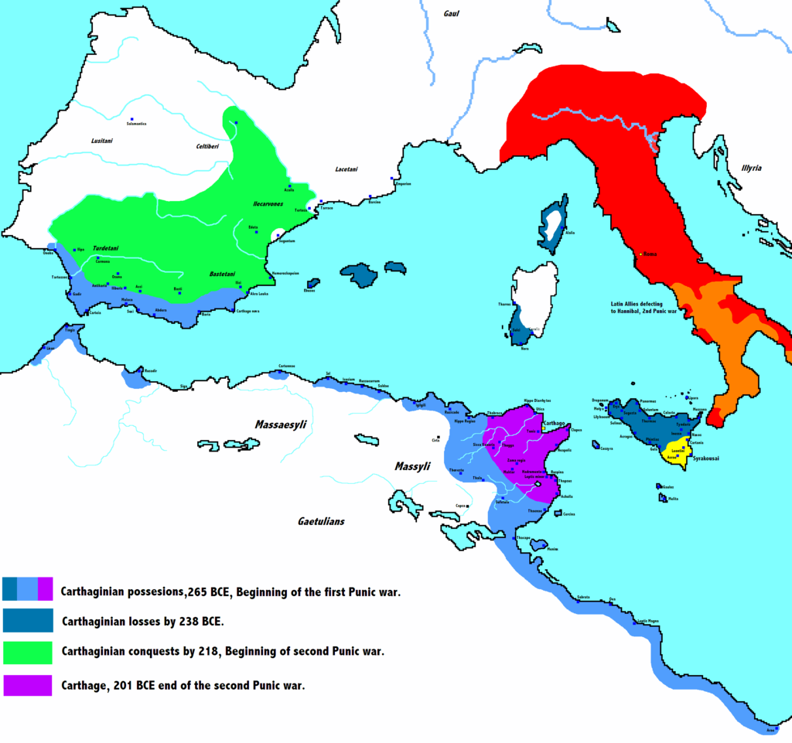
Kartágo
Války s Řeky/Římem
Boje na Sicílii od 5. stol. pnl, zejm. proti Syrákúsám
546 pnl – bitva u Alalie, Korsika
480 pnl – Hamilkar x Gelón, bitva u Hímery
398 pnl – obléhání Syrákús, mor (Himilco)
311 pnl – Agathoklés – výprava do Afriky
280–275 pnl – Pyrrhos

Slide 13
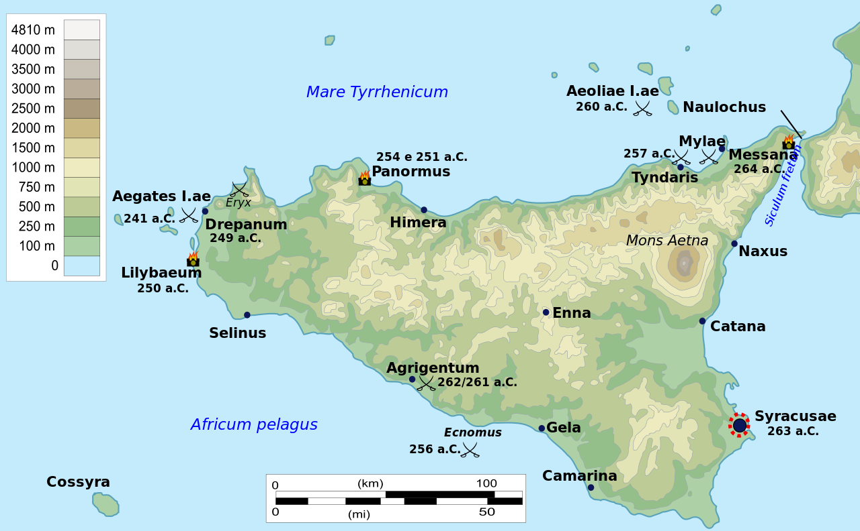
Kartágo
Války s Řeckem/Římem
264–241 pnl – 1. punská válka
Sicílie (Akragás, Mylae, Eknomos, Liparské ovy, Drepana, Aegatské ovy), výprava do Afriky (M. Atilius Regulus)
241–238 pnl - Žoldnéřská válka – Spendius, Matho x Hamilkar Barkas
218–201 pnl – 2. punská válka
Hispánie, Itálie, Afrika (Trebie, Trasimenské jezero, Cannae, Metaurus, Zama; Capua, Syrákúsy, Horní Baetis, Ilipa)
149–146 pnl – 3. punská válka – zničení města
C. Julius Caesar – obnova města

Slide 14
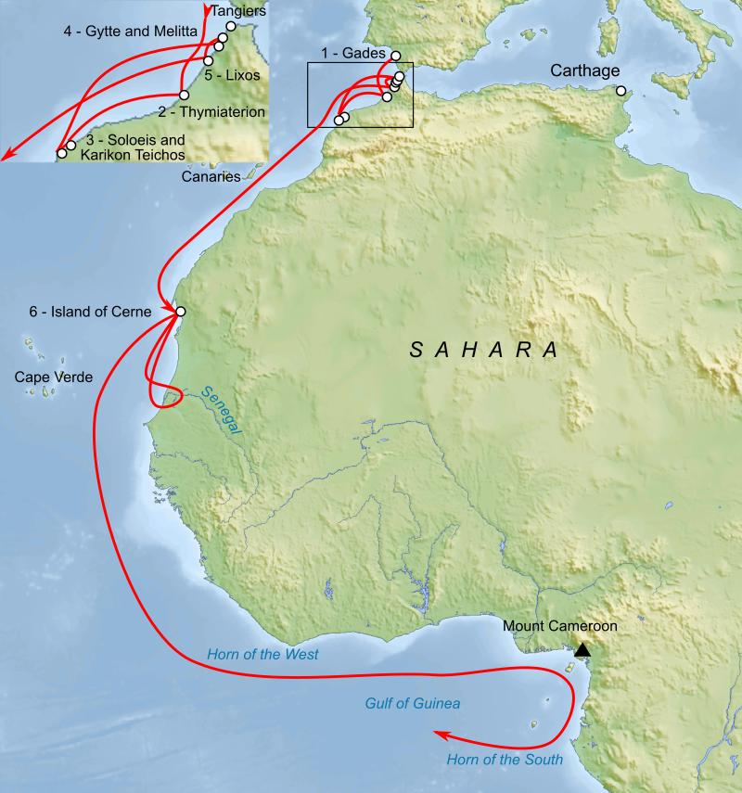
Kartágo
Prameny
Hanno mořeplavec – západní Afrika
Himilco – SZ Evropa
Punský jazyk – ještě v době Augustina
Překlady punských děl do řečtiny a latiny
Mago – O Zemědělství
Plautus – Poenulus
Juba II. – Libyka, O Arábii, Podobnosti
Hiempsal II. – dějiny
Tímaios – Dějiny (do první punské války)

Slide 15
Kartágo
Přenesení topoi od Foiníčanů
Mořeplavci, obchodníci, vynalézaví, nelze jim věřit

Slide 16
Vznik města
The Phoenicians settled Carthage, in Africa, fifty years before the capture of Troy. Its founders were either Zorus and Carchedon, or, as the Romans and the Carthaginians themselves think, Dido, a Tyrian woman, whose husband had been slain clandestinely by Pygmalion, the ruler of Tyre. The murder being revealed to her in a dream, she embarked for Africa with her property and a number of men who desired to escape from the tyranny of Pygmalion, and arrived at that part of Africa where Carthage now stands. Being repelled by the inhabitants, they asked for as much land for a dwelling place as they could encompass with an ox-hide. The Africans laughed at this frivolity of the Phoenicians and were ashamed to deny so small a request. Besides, they could not imagine how a town could be built in so narrow a space, and wishing to unravel the mystery they agreed to give it, and confirmed the promise by an oath. The Phoenicians, cutting the hide round and round in one very narrow strip, enclosed the place where the citadel of Carthage now stands, which from this affair was called Byrsa (a hide).
App. Pun. 1
Καρχηδόνα τὴν ἐν Λιβύῃ Φοίνικες ᾤκισαν ἔτεσι πεντήκοντα πρὸ ἁλώσεως Ἰλίου, οἰκισταὶ δ᾽ αὐτῆς ἐγένοντο Ζῶρός τε καὶ Καρχηδών, ὡς δὲ Ῥωμαῖοι καὶ αὐτοὶ Καρχηδόνιοι νομίζουσι, Διδὼ γυνὴ Τυρία, ἧς τὸν ἄνδρα κατακαίνει Πυγμαλίων Τύρου τυραννεύων, καὶ τὸ ἔργον ἐπέκρυπτεν. ἡ δὲ ἐξ ἐνυπνίου τὸν φόνον ἐπέγνω, καὶ μετὰ χρημάτων πολλῶν καὶ ἀνδρῶν, ὅσοι Πυγμαλίωνος τυραννίδα ἔφευγον, ἀφικνεῖται πλέουσα Λιβύης ἔνθα νῦν ἔστι Καρχηδών. ἐξωθούμενοι δ᾽ ὑπὸ τῶν Λιβύων ἐδέοντο χωρίον ἐς συνοικισμὸν λαβεῖν, ὅσον ἂν βύρσα ταύρου περιλάβοι. τοῖς δὲ ἐνέπιπτε μέν τι καὶ γέλωτος ἐπὶ τῇ τῶν Φοινίκων μικρολογίᾳ, καὶ ᾐδοῦντο ἀντειπεῖν περὶ οὕτω βραχυτάτου: μάλιστα δ᾽ ἠπόρουν ὅπως ἂν πόλις ἐν τηλικούτῳ διαστήματι γένοιτο, καὶ ποθοῦντες ἰδεῖν ὅ τι ἔστιν αὐτοῖς τοῦτο τὸ σοφόν, συνέθεντο δώσειν καὶ ἐπώμοσαν. οἱ δὲ τὸ δέρμα περιτεμόντες ἐς ἱμάντα ἕνα στενώτατον, περιέθηκαν ἔνθα νῦν ἔστιν ἡ Καρχηδονίων ἀκρόπολις: καὶ ἀπὸ τοῦδε Βύρσα ὀνομάζεται.

Slide 17
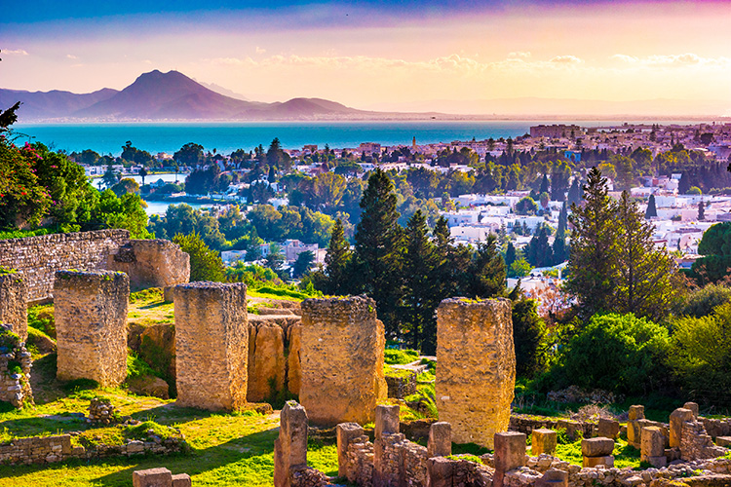
Vznik města
Just. 18.4–6
Cum interim rex Tyro decedit filio Pygmalione et Elissa filia, insignis formae uirgine, heredibus institutis. 4 Sed populus Pygmalioni, admodum puero, regnum tradidit. 5 Elissa quoque Acherbae.auunculo suo, sacerdoti Herculis, qui honos secundus a rege erat, nubit.
dein empto loco, qui corio bouis tegi posset, in quo fessos longa nauigatione socios, quoad proficisceretur, reficere posset, corium in tenuissimas partes secari iubet atque ita maius loci spatium quam petierat, occupat, unde postea ei loco Byrsae nomen fuit.
Condita est haec urbs LXXII annis ante quam Roma.
Meanwhile their king Mutto died at Tyre, appointing his son Pygmalion and his daughter Elissa, a maiden of extraordinary beauty, his heirs. 4 But the people gave the throne to Pygmalion, who was quite a boy. 5 Elissa married Acerbas, her uncle, who was priest of Hercules, a dignity next to that of the king.
Having then bargained for a piece of ground, as much as could be covered with an ox-hide, where she might refresh her companions, wearied with their long voyage, until she could conveniently resume her progress, she directed the hide to be cut into the thinnest possible strips, and thus acquired a greater portion of ground than she had apparently demanded; whence the place had afterwards the name of Byrsa.
This city was founded seventy-two years before Rome

Slide 18
Dido
Verg. A. 12–14
Urbs antiqua fuit, Tyrii tenuere coloni, Karthago, Italiam contra Tiberinaque longe ostia, dives opum studiisque asperrima belli;
Dido a Aeneas 1.657→
4.450→
Tum vero infelix fatis exterrita Dido mortem orat; taedet caeli convexa tueri. Quo magis inceptum peragat lucemque relinquat, vidit, turicremis cum dona imponeret aris,
In ages gone an ancient city stood— Carthage, a Tyrian seat, which from afar made front on Italy and on the mouths of Tiber's stream; its wealth and revenues were vast, and ruthless was its quest of war.
Then wretched Dido, by her doom appalled, asks only death. It wearies her to see the sun in heaven. Yet that she might hold fast her dread resolve to quit the light of day,

Slide 19
This dying word is flowing from my heart with my spilt blood. And—O ye Tyrians! I sting with your hatred all his seed and tribe forevermore. This is the offering my ashes ask. Betwixt our nations twain, No love! No truce or amity! Arise, Out of my dust, unknown Avenger, rise! To harry and lay waste with sword and flame those Dardan settlers, and to vex them sore, to-day, to-morrow, and as long as power is thine to use! My dying curse arrays shore against shore and the opposing seas in shock of arms with arms. May living foes pass down from sire to son insatiate war!”
4.621–629
Tum vos, o Tyrii, stirpem et genus omne futurum exercete odiis, cinerique haec mittite nostro munera. Nullus amor populis, nec foedera sunto. Exoriare aliquis nostris ex ossibus ultor, qui face Dardanios ferroque sequare colonos, nunc, olim, quocumque dabunt se tempore vires. Litora litoribus contraria, fluctibus undas imprecor, arma armis; pugnent ipsique nepotesque.”

Slide 20
Kartágo - ústava
Arist. Pol. 2. 1272b
πολιτεύεσθαι δὲ δοκοῦσι καὶ Καρχηδόνιοι καλῶς καὶ [25] πολλὰ περιττῶς πρὸς τοὺς ἄλλους, μάλιστα δ᾽ ἔνια παραπλησίως τοῖς Λάκωσιν. αὗται γὰρ αἱ τρεῖς πολιτεῖαι ἀλλήλαις τε σύνεγγύς πώς εἰσι καὶ τῶν ἄλλων πολὺ διαφέρουσιν, ἥ τε Κρητικὴ καὶ ἡ Λακωνικὴ καὶ τρίτη τούτων ἡ τῶν Καρχηδονίων. καὶ πολλὰ τῶν τεταγμένων ἔχει παρ᾽ [30] αὐτοῖς καλῶς: σημεῖον δὲ πολιτείας συντεταγμένης τὸ τὸν δῆμον ἑκουσίον διαμένειν ἐν τῇ τάξει τῆς πολιτείας, καὶ μήτε στάσιν, ὅ τι καὶ ἄξιον εἰπεῖν, γεγενῆσθαι μήτε τύραννον.
Carthage also appears to have a good constitution, with many outstanding features as compared with those of other nations, but most nearly resembling the Spartan in some points. For these three constitutions are in a way near to one another and are widely different from the others—the Cretan, the Spartan and, thirdly, that of Carthage. Many regulations at Carthage are good; and a proof of a well-regulated constitution is that the populace willingly remain faithful to the constitutional system, and that neither civil strife has arisen in any degree worth mentioning, nor yet a tyrant.

Slide 21
Ústava
ἔχει δὲ παραπλήσια τῇ Λακωνικῇ πολιτείᾳ τὰ μὲν συσσίτια τῶν ἑταιριῶν τοῖς φιδιτίοις, τὴν δὲ τῶν ἑκατὸν [35] καὶ τεττάρων ἀρχὴν τοῖς ἐφόροις （πλὴν ὃ οὐ χεῖρον: οἱ μὲν ἐκ τῶν τυχόντων εἰσί, ταύτην δ᾽ αἱροῦνται τὴν ἀρχὴν ἀριστίνδην）, τοὺς δὲ βασιλεῖς καὶ τὴν γερουσίαν ἀνάλογον τοῖς ἐκεῖ βασιλεῦσι καὶ γέρουσιν: καὶ βέλτιον δὲ τοὺς βασιλεῖς μήτε καθ᾽ αὑτὸ εἶναι γένος μήτε τοῦτο τὸ τυχόν, [40] εἴτε διαφέρον ...
Points in which the Carthaginian constitution resembles the Spartan are the common mess-tables of its Comradeships corresponding to the Phiditia, and the magistracy of the Hundred and Four corresponding to the Ephors （except one point of superiority—the Ephors are drawn from any class, but the Carthaginians elect this magistracy by merit）; the kings and the council of Elders correspond to the kings and Elders at Sparta, and it is another superior feature that the Carthaginian kings are not confined to the same family and that one of no particular distinction, and also that if any family distinguishes itself . . .

Slide 22
Ústava
Arist. Pol. 2. 1273a
εἴπερ οὖν τὸ μὲν αἱρεῖσθαι πλουτίνδην ὀλιγαρχικὸν τὸ δὲ κατ᾽ ἀρετὴν ἀριστοκρατικόν, αὕτη τις ἂν εἴη τάξις τρίτη, καθ᾽ ἥνπερ συντέτακται καὶ τοῖς Καρχηδονίοις τὰ περὶ τὴν πολιτείαν: αἱροῦνται γὰρ εἰς δύο ταῦτα βλέποντες, καὶ μάλιστα [30] τὰς μεγίστας, τούς τε βασιλεῖς καὶ τοὺς στρατηγούς.
If therefore election by wealth is oligarchical and election by merit aristocratic, this will be a third system exhibited in the organization of the constitution of Carthage, for there elections are made with an eye to these two qualifications, and especially elections to the most important offices, those of the kings and of the generals.

Slide 23
Státní zřízení
Str. 1.4.9
ἔτι δὲ Ῥωμαίους καὶ Καρχηδονίους οὕτω θαυμαστῶς πολιτευομένους.
Plb. 6.43.
σχεδὸν δὴ πάντες οἱ συγγραφεῖς περὶ τούτων ἡμῖν τῶν πολιτευμάτων παραδεδώκασι τὴν ἐπ᾽ ἀρετῇ φήμην, περί τε τοῦ Λακεδαιμονίων καὶ Κρητῶν καὶ Μαντινέων, ἔτι δὲ Καρχηδονίων:
or still better the Romans and Carthaginians, whose political system is so beautifully perfect.
Nearly all historians have recorded as constitutions of eminent excellence those of Lacedaemonia, Crete, Mantinea, and Carthage.

Slide 24
Státní zřízení
Plb. 6.51
τὸ δὲ Καρχηδονίων πολίτευμα τὸ μὲν ἀνέκαθέν μοι δοκεῖ καλῶς κατά γε τὰς ὁλοσχερεῖς διαφορὰς συνεστάσθαι. [2] καὶ γὰρ βασιλεῖς ἦσαν παρ᾽ αὐτοῖς, καὶ τὸ γερόντιον εἶχε τὴν ἀριστοκρατικὴν ἐξουσίαν, καὶ τὸ πλῆθος ἦν κύριον τῶν καθηκόντων αὐτῷ: καθόλου δὲ τὴν τῶν ὅλων ἁρμογὴν εἶχε παραπλησίαν τῇ Ῥωμαίων καὶ Λακεδαιμονίων.
Již v úpadku v době válek
παρὰ μὲν Καρχηδονίοις δῶρα φανερῶς διδόντες λαμβάνουσι τὰς ἀρχάς, παρὰ δὲ Ῥωμαίοις θάνατός ἐστι περὶ τοῦτο πρόστιμον.
Now the Carthaginian constitution seems to me originally have been well contrived in these most distinctively important particulars. For they had kings, and the Gerusia had the powers of an aristocracy, and the multitude were supreme in such things as affected them; and on the whole the adjustment of its several parts was very like that of Rome and Sparta.
The Carthaginians obtain office by open bribery, but among the Romans the penalty for it is death.

Slide 25
Sláva města
Pomp. 1.29
Utica et Carthago ambae inclutae ambae a Phoenicibus conditae, illa fato Catonis insignis, haec suo, nunc populi Romani colonia, olim imperii eius pertinax aemula, iam quidem iterum opulenta, etiam nunc tamen priorum excidio rerum quam ope praesentium clarior.
Both Utica and Carthage are famous, and both were founded by Phoenicians. The former is marked by the death of Cato. The latter is marked by its own fate: now it is a colony of the Roman people, but it was once their determined rival for imperial power. In fact, Carthage is now wealthy again, but it remains more famous for the destruction of its ancestors' claims than for the wealth of its present inhabitants.

Slide 26
Zničení města
Plb. 38.2
App. Pun. 67–135
ὁ δὲ Σκιπίων πόλιν ὁρῶν ἑπτακοσίοις ἔτεσιν ἀνθήσασαν ἀπὸ τοῦ συνοικισμοῦ, καὶ γῆς τοσῆσδε καὶ νήσων καὶ θαλάσσης ἐπάρξασαν, ὅπλων τε καὶ νεῶν καὶ ἐλεφάντων καὶ χρημάτων εὐπορήσασαν ἴσα ταῖς ἀρχαῖς ταῖς μεγίσταις, τόλμῃ δὲ καὶ προθυμίᾳ πολὺ διασχοῦσαν, ἥ γε καὶ ναῦς καὶ ὅπλα πάντα περιῃρημένη τρισὶν ὅμως ἔτεσιν ἀντέσχε πολέμῳ τοσῷδε καὶ λιμῷ, τότε ἄρδην τελευτῶσαν ἐς πανωλεθρίαν ἐσχάτην, λέγεται μὲν δακρῦσαι καὶ φανερὸς γενέσθαι κλαίων ὑπὲρ πολεμίων, …
Scipio, beholding this city, which had flourished 700 years from its foundation and had ruled over so many lands, islands, and seas, rich with arms and fleets, elephants and money, equal to the mightiest monarchies but far surpassing them in bravery and high spirit (since without ships or arms, and in the face of famine, it had sustained continuous war for three years), now come to its end in total destruction - Scipio, beholding this spectacle, is said to have shed tears and publicly lamented the fortune of the enemy.

Slide 27
Zničení města
Plut. Cat. Ma. 27
‘δοκεῖ δέ μοι καὶ Καρχηδόνα μὴ εἶναι.’
In my opinion, Carthage must be destroyed.

Slide 28
Punica fides, krutost, úskočnost
Liv. 21.4.5–9
Hanno - odvaha, uměřenost, dobrý příklad vojákům avšak –
has tantas uiri uirtutes ingentia uitia aequabant, inhumana crudelitas, perfidia plus quam Punica, nihil ueri, nihil sancti, nullus deum metus, nullum ius iurandum, nulla religio.
Sal. Jug. 108.3
Sed ego comperior Bocchum magis Punica fide quam ob ea,
These admirable qualities of the man were equalled by his monstrous vices: his cruelty was inhuman, his perfidy worse than Punic; he had no regard for truth, and none for sanctity, no fear of the gods, no reverence for an oath, no religious scruple.
I find, however, that it was rather from African duplicity than from the motives which he professed,

Slide 29
Punica fides, krutost, úskočnost
Liv. 42.47.8
religionis haec Romanae esse, non versutiarum Punicarum neque calliditatis Graecae, apud quos fallere hostem quam vi superare gloriosius fuerit.
Liv. 23.5.12–13
hunc natura et moribus immitem ferumque insuper dux ipse efferauit, pontibus ac molibus ex humanorum corporum strue faciendis et, quod proloqui etiam piget, uesci corporibus humanis docendo. [13] his infandis pastos epulis, quos contingere etiam nefas sit, uidere atque habere dominos et ex Africa et a Carthagine iura petere et Italiam Numidarum ac Maurorum pati prouinciam esse, cui non, genito modo in Italia, detestabile sit?
This is the true Roman spirit, there is nothing here of the cunning of the Carthaginians or the cleverness of the Greeks, who pride themselves more in deceiving an enemy than in overcoming him in fair fight.
Savage and barbarous by nature and habit, their general has made them still more brutal by building up bridges and barriers with human bodies and-I shudder to say it-teaching them to feed on human flesh. [13] What man, if he were merely a native of Italy, would not be horrified at the thought of looking upon men who feast upon what it is impious even to touch as his lords and masters, looking to Africa and above all to Carthage for his laws, and having to submit to Italy becoming a dependency of the Numidians and the Moors?

Slide 30
Punica fides, krutost, úskočnost
Liv. 22.48.1
iam et sinistro cornu Romano, ubi sociorum equites adversus Numidas steterant, consertum proelium erat, segne primo et a Punica coeptum fraude.
Liv. 30.30.27
… aut exspectatam nuper pacem suspectam esse uobis Punicam fidem.
By this time the Roman left, where the cavalry of the allies had taken position facing the Numidians, was also engaged, though the fighting was at first but sluggish. It began with a Punic ruse.
Punic honour for you Romans is now tainted with suspicion.

Slide 31
Záludnost, prohnanost
V.Max. 7.4.4 (bitva u Metauru)
quo evenit ne Hasdrubal cum duobus se consulibus proeliaturum prius sciret quam utriusque virtute prosterneretur. ita illa toto terrarum orbe infamis Punica calliditas Romana elusa prudentia
Therefore it happened that Hasdrubal was not aware that he was fighting with two consuls, before he had been defeated by the virtue of them both. And thus Punic trickery, so infamous over all the world, was itself outwitted:

Slide 32
Záludní, úskoční
Verg. A. 1.661
quippe domum timet ambiguam Tyriosque bilinguis;
Pl. Poen. 1031–1034
At hercle te hominem et sycophantam et subdolum, qui huc advenisti nos captatum, migdilix, bisulci lingua quasi proserpens bestia.
Sooth, Venus feared the many-languaged guile which Tyrians use
But, i' faith, at yourself a person that's both a swindler and a cheat, who have come here to take us in, you half-and-half Lybian, you double-tongue, just like a crawling reptile.

Slide 33
Ukázky punských slov
Pl. Poen. 5.2
Mehar bocca
Rufen nuco istam
Moin lechianna
Lalech lachananim liminichot
Is amar binam
Palum erga dectha
Oh! what a son of tears!
We are no doctors
I beg an entrance for Saturn
The messenger who asks a safe abode and kind endurance here
Us unarmed
Naked men

Slide 34
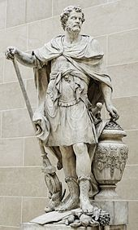
Punica fides, záludnost
Pl. Poen. 112–113
et is omnis linguas scit, sed dissimulat sciens se scire: Poenus plane est. quid verbis opust?
Plb. 3.78.1
ἐχρήσατο δέ τινι καὶ Φοινικικῷ στρατηγήματι τοιούτῳ κατὰ τὴν παραχειμασίαν. [2] ἀγωνιῶν γὰρ τὴν ἀθεσίαν …
Plb. 9.11.2 διὰ τὴν ἔμφυτον Φοίνιξι πλεονεξίαν καὶ φιλαρχίαν
Str. 3.5.5
πολλοὺς ἀποστόλους ψεῦσμα Φοινικικόν
Hor. Od. 4.4.49
dixitque tandem perfidus Hannibal
He knows all languages, too; but, though he knows them, he pretends not to know them: what need is there of talking? He is a Carthaginian all over.
While he was in these winter quarters also he practised a ruse truly Punic. Being apprehensive that from the fickleness of their character,
through the innate covetousness and ambition of the Phoenician character
the several expeditions as a Phoenician invention
Then the false Libyan own'd his doom

Slide 35
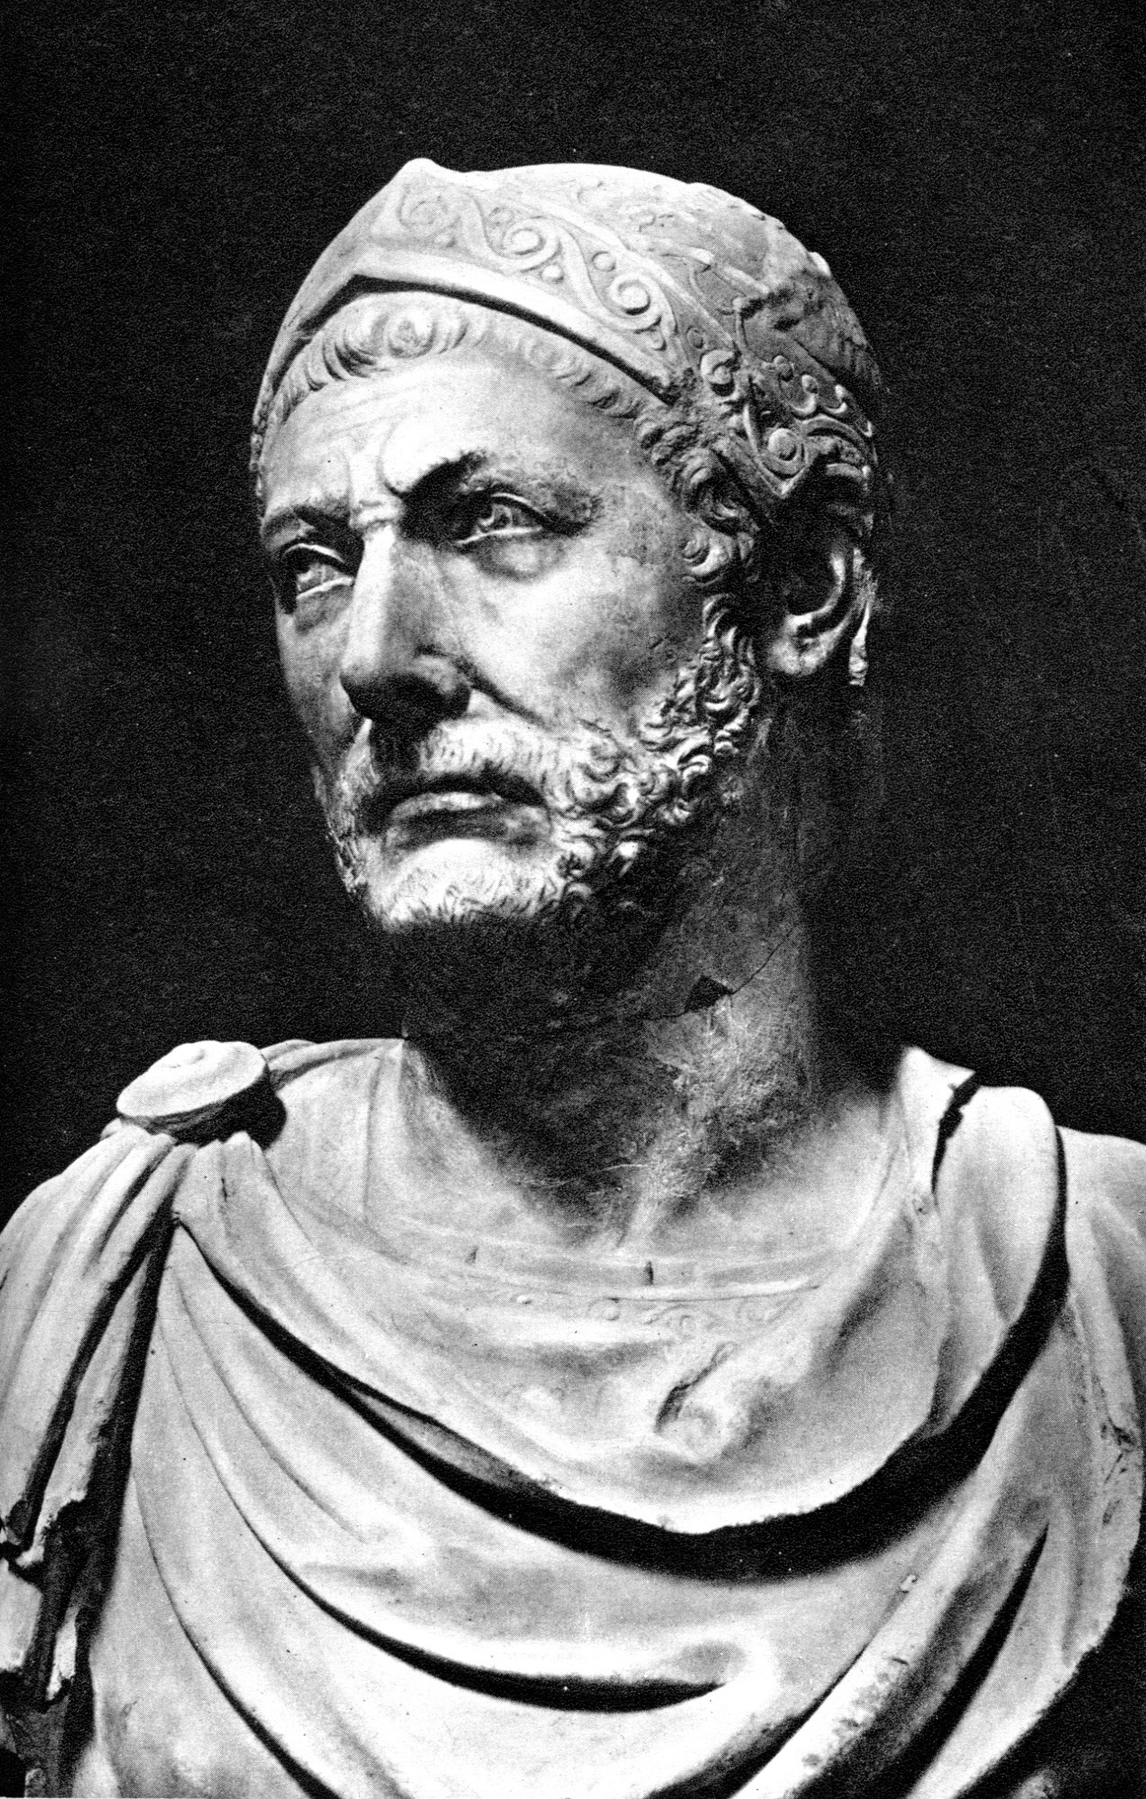
Krutost, Hannibal
Plb. 9.24.6
τοῦ δ᾽ Ἀννίβου λέγειν κελεύσαντος, διδάξαι δεῖν ἔφη τὰς δυνάμεις ἀνθρωποφαγεῖν καὶ τούτῳ ποιῆσαι συνήθεις. …
τούτου δὲ τἀνδρὸς εἶναί φασιν ἔργα καὶ τὰ κατὰ τὴν Ἰταλίαν εἰς Ἀννίβαν ἀναφερόμενα περὶ τῆς ὠμότητος, οὐχ ἧττον δὲ καὶ τῶν περιστάσεων.
Upon Hannibal bidding him speak out, he said that they must teach the army to eat human flesh, and make them accustomed to it. …
It is this man's acts in Italy that they say were attributed to Hannibal, to maintain the accusation of cruelty, as well as such as were the result of circumstances.

Slide 36
Krutost, Hannibal
Plb. 9.22.8
τινὲς μὲν γὰρ ὠμὸν αὐτὸν οἴονται γεγονέναι καθ᾽ ὑπερβολήν, τινὲς δὲ φιλάργυρον.
Nep. Han. 2.3
'Pater meus' inquit 'Hamilcar puerulo me, utpote non amplius VIIII annos nato, in Hispaniam imperator proficiscens Carthagine, Iovi optimo maximo hostias immolavit. … Id cum libenter accepissem atque ab eo petere coepissem, ne dubitaret ducere, tum ille 'Faciam', inquit 'si mihi fidem, quam postulo, dederis.' Simul me ad aram adduxit, apud quam sacrificare instituerat, eamque ceteris remotis tenentem iurare iussit numquam me in amicitia cum Romanis fore.
Some regard him as having been extraordinarily cruel, some exceedingly grasping of money.
My father Hamilcar, when I was a small boy not more than nine years old, just as he was setting out from Carthage to Spain as commander-in-chief, … Thereupon he said: 'I will do it, provided you will give me the pledge that I ask.' With that he led me to the altar on which he had begun his sacrifice, and having dismissed all the others, he bade me lay hold of the altar and swear that I would never be a friend to the Romans.
O zločinech Kartaginců také Appián – App. Pun. 9.62–64

Slide 37
Krutost
App. Pun. 9.64
φίλους οὖν καὶ συμμάχους ποιησόμεθα τοὺς ὠμοτάτους;
App. Pun. 9.63
ὅσα δ᾽ Ἀννίβας ἢ πολεμῶν ἢ ἐνεδρεύων ἢ παρορκῶν ἔς τε πόλεις καὶ στρατόπεδα ἡμῶν καὶ λήγων ἐς τοὺς συμμάχους ἔδρασε τοὺς αὑτοῦ, τάς τε πόλεις πορθῶν καὶ τοὺς αὐτῷ συστρατευσαμένους κατακαίνων, μακρὸν ἂν εἴη καταλέγειν.
App. Pun. 8.53 – zrádci, nedodržují přísahy
Ought we to make the most cruel people in the world our friends and allies?
The acts perpetrated by Hannibal himself in war, stratagem and perjury, against our cities and armies, and at last against his own allies, destroying their cities and slaughtering their soldiers serving with him, it would take too long to enumerate.

Slide 38
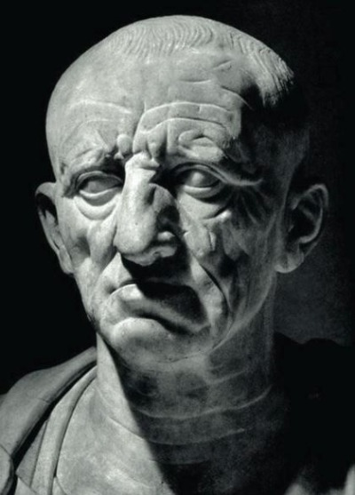
Krutost, zrádnost
Gel. 3.14.19
"Homines defoderunt in terram dimidiatos ignemque circumposuerunt, ita interfecerunt.“
10.1.10
Carthaginienses sextum de foedere decessere.
"They buried the men half-way down in the ground and built a fire around them; thus they destroyed them.„
The Carthaginians broke the treaty for the sixth time
Slova Catona

Slide 39
Další poznámky ke Kartágu
Cic. Agr. 2.87
Výhodná pozice a velká populace – proto zničeno, ohrožení Říma
Cic. Rep. 2.4(9) – piráti
Cic. Inv. 1.71
Mnohokrát zradili
Cic. Off. 1.38
Zrádci, Hannibal krutý
Cic. Scaur. 42
Nedodržují přísahy, zrádci

Slide 40
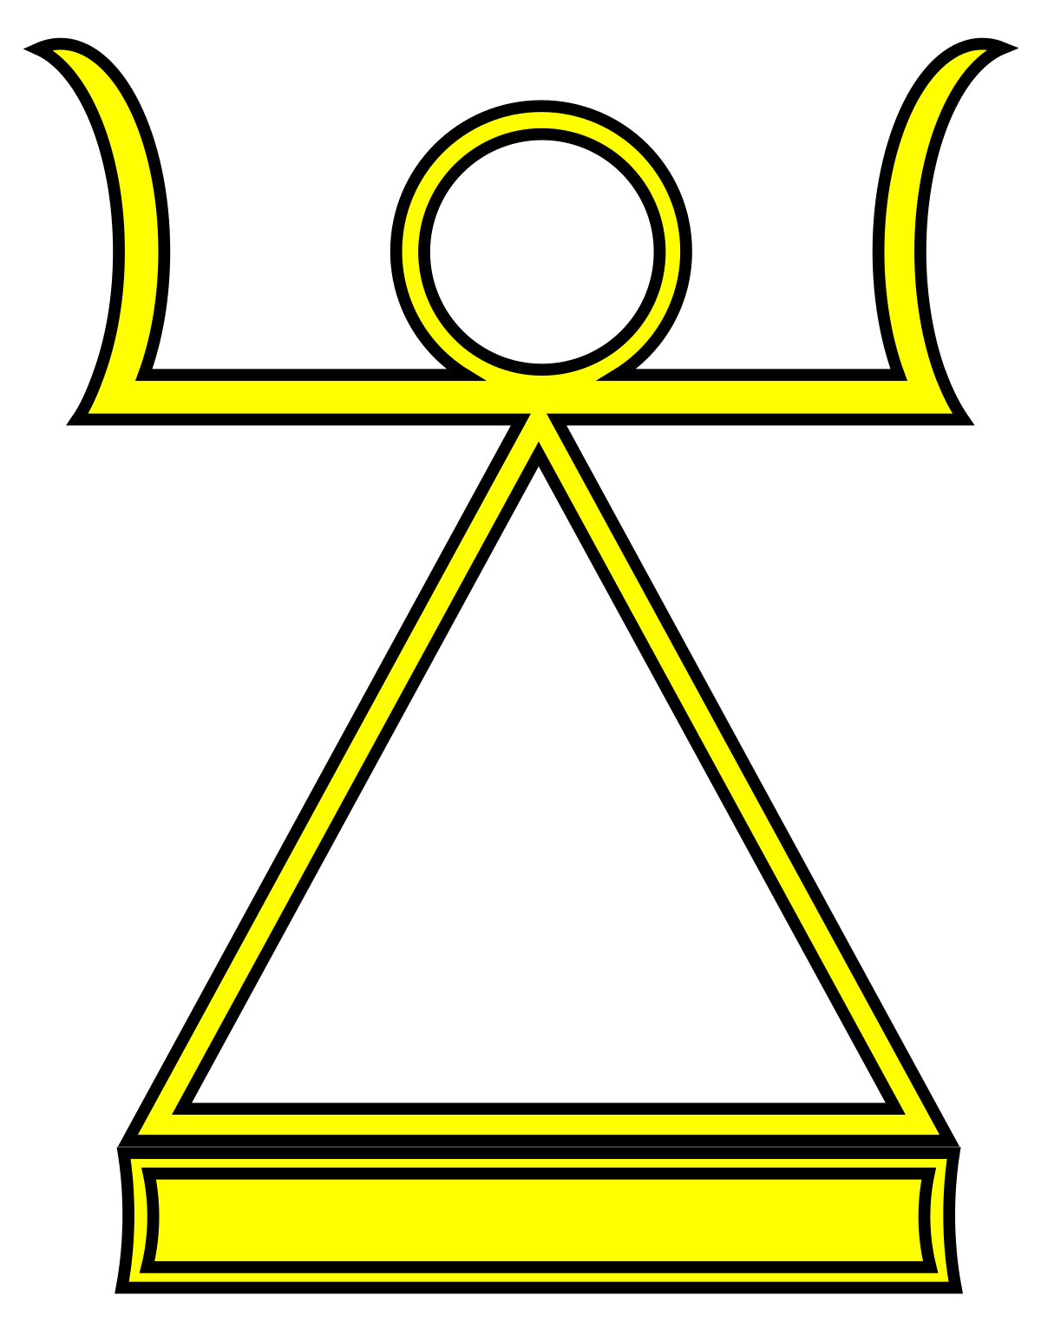
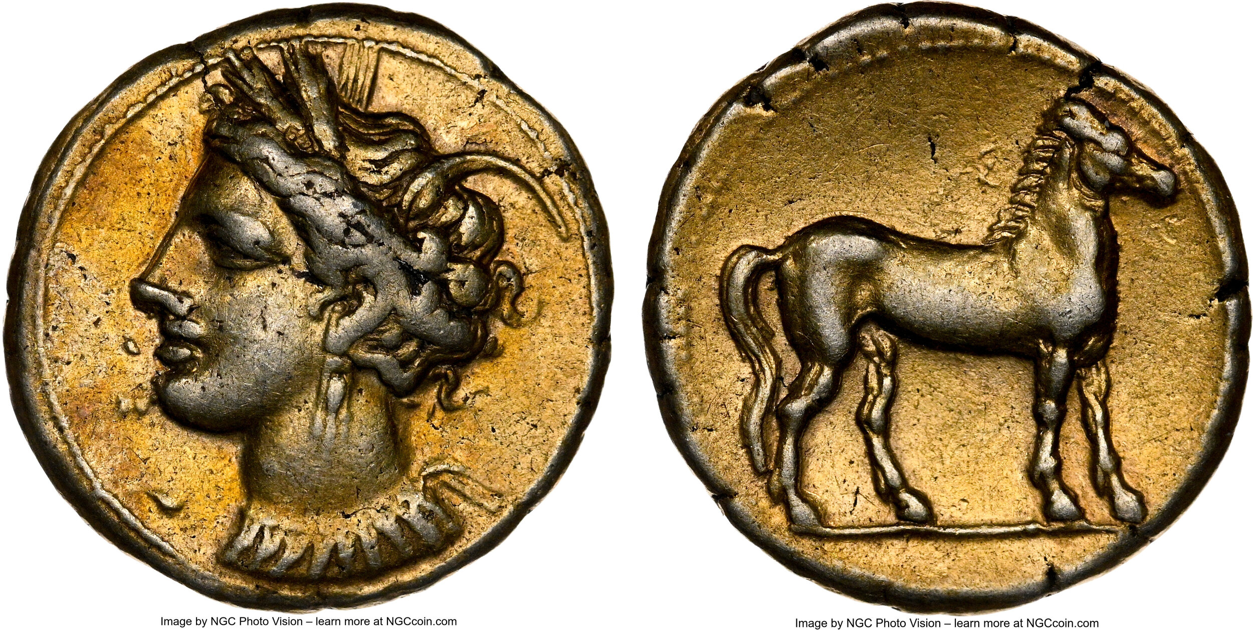
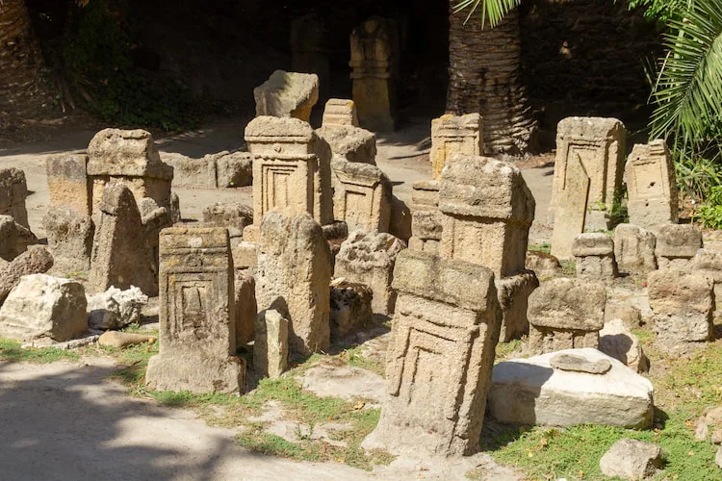
Krutost - oběti
Hlavní božstva
Baal Hammon
Tanit
Melkart
Tofet

Slide 41
Krutost - oběti
Plut. Regum
Γέλων ὁ τύραννος, ὅτε Καρχηδονίους πρὸς Ἱμέρᾳ, κατεπολέμησεν, εἰρήνην ποιούμενος πρὸς αὐτοὺς ἠνάγκασεν ἐγγράψαι ταῖς ὁμολογίαις ὅτι καὶ τὰ τέκνα παύσονται τῷ Κρόνῳ καταθύοντες.
De Super. 13
Καρχηδονίοις οὐκ ἐλυσιτέλει Κριτίαν λαβοῦσιν ἢ Διαγόραν νομοθέτην ἀπ᾽ ἀρχῆς μήτε τινὰ δαιμόνων μήτε θεῶν νομίζειν ἢ τοιαῦτα θύειν οἷα τῷ Κρόνῳ ἔθυον;
Gelon the tyrant, after he had overcome the Carthaginians at Himera, made peace with them, and among other articles compelled them to subscribe this, - that they should no more sacrifice their children to Cronus.
Again, would it not have been far better for the Carthaginians to have taken Critias or Diagoras to draw up their law-code at the very beginning, and so not to believe in any divine power or god, rather than to offer such sacrifices as they used to offer to Cronos?

Slide 42
ἀλλ᾽ εἰδότες καὶ γιγνώσκοντες αὐτοὶ τὰ αὑτῶν τέκνα καθιέρευον, οἱ δ᾽ ἄτεκνοι παρὰ τῶν πενήτων ὠνούμενοι παιδία κατέσφαζον καθάπερ ἄρνας ἢ νεοσσούς, παρειστήκει δ᾽ ἡ μήτηρ ἄτεγκτος καὶ ἀστένακτος. εἰ δὲ στενάξειεν ἢ δακρύσειεν, ἔδει τῆς τιμῆς στέρεσθαι, τὸ δὲ παιδίον οὐδὲν ἧττον ἐθύετο, κρότου τε κατεπίμπλατο πάντα πρὸ τοῦ ἀγάλματος ἐπαυλούντων καὶ τυμπανιζόντων ἕνεκα τοῦ μὴ γίγνεσθαι τὴν βοὴν τῶν θρήνων ἐξάκουστον.
No, but with full knowledge and understanding they themselves offered up their own children, and those who had no children would buy little ones from poor people and cut their throats as if they were so many lambs or young birds ; meanwhile the mother stood by without a tear or moan ; but should she utter a single moan or let fall a single tear, she had to forfeit the money, and her child was sacrificed nevertheless ; and the whole area before the statue was filled with a loud noise of flutes and drums so that the cries of wailing should not reach the ears of the people.

Slide 43
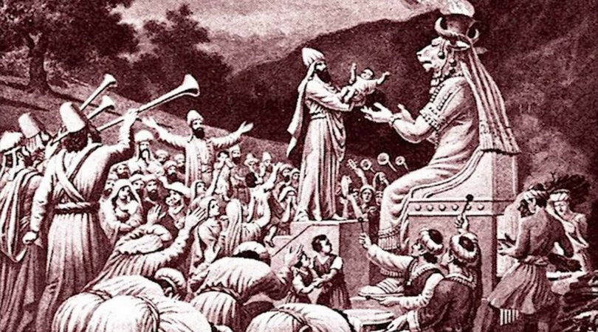
Krutost - oběti
Diod. 20.14
ᾐτιῶντο δὲ καὶ τὸν Κρόνον αὑτοῖς ἐναντιοῦσθαι, καθ᾽ ὅσον ἐν τοῖς ἔμπροσθεν χρόνοις θύοντες τούτῳ τῷ θεῷ τῶν υἱῶν τοὺς κρατίστους ὕστερον ὠνούμενοι λάθρᾳ παῖδας καὶ θρέψαντες ἔπεμπον ἐπὶ τὴν θυσίαν: … διορθώσασθαι δὲ τὰς ἀγνοίας σπεύδοντες διακοσίους μὲν τῶν ἐπιφανεστάτων παίδων προκρίναντες ἔθυσαν δημοσίᾳ: ἄλλοι δ᾽ ἐν διαβολαῖς ὄντες ἑκουσίως ἑαυτοὺς ἔδοσαν, οὐκ ἐλάττους ὄντες τριακοσίων. [6] ἦν δὲ παρ᾽ αὐτοῖς ἀνδριὰς Κρόνου χαλκοῦς, ἐκτετακὼς τὰς χεῖρας ὑπτίας ἐγκεκλιμένας ἐπὶ τὴν γῆν, ὥστε τὸν ἐπιτεθέντα τῶν παίδων ἀποκυλίεσθαι καὶ πίπτειν εἴς τι χάσμα πλῆρες πυρός.
They also alleged that Cronus​ had turned against them inasmuch as in former times they had been accustomed to sacrifice to this god the noblest of their sons, but more recently, secretly buying and nurturing children, they had sent these to the sacrifice; … In their zeal to make amends for their omission, they selected two hundred of the noblest children and sacrificed them publicly; and others who were under suspicion sacrificed themselves voluntarily, in number not less than three hundred. 6 There was in their city a bronze image of Cronus, extending its hands, palms up and sloping toward the ground, so that each of the children when placed thereon rolled down and fell into a sort of gaping pit filled with fire.

Slide 44
Krutost - oběti
Tert. Apol. 9.2–3
Infantes penes Africam Saturno immolabantur palam usque ad proconsulatum Tiberii, qui eosdem sacerdotes in eisdem arboribus templi sui obumbratricibus scelerum votivis crucibus exposuit, teste militia patriae nostrae, quae id ipsum munus illi proconsuli functa est. [3] Sed et nunc in occulto perseveratur hoc sacrum facinus.
Children were openly sacrificed in Africa to Saturn as lately as the proconsulship of Tiberius, who exposed to public gaze the priests suspended on the sacred trees overshadowing their temple — so many crosses on which the punishment which justice craved overtook their crimes, as the soldiers of our country still can testify who did that very work for that proconsul. And even now that sacred crime still continues to be done in secret.

Slide 45
Krutost - oběti
Scholion Plat. Rep. I, 337
Κλείταρχος δέ φησι τοὺς Φοίνικας, καὶ μάλιστα Καρχηδονίους, τὸν Κρόνον τιμῶντας, ἐπάν τινος μεγάλου κατατυχεῖν σπεύδωσιν, εὔχεσθαι καθ᾽ ἑνὸς τῶν παίδων, εἰ περιγένοιντο τῶν ἐπιθυμηθέντων, καθαγιεῖν αὐτὸν τῷ θεῷ. τοῦ δὲ Κρόνου χαλκοῦ παρ᾽ αὐτοῖς ἑστῶτος, τὰς χεῖρας ὑπτίας ἐκτετακότος ὑπὲρ κριβάνου χαλκοῦ, τοῦτον ἐκκαίειν τὸ παιδίον. τῆς δὲ φλογὸς τοῦ ἐκκαιομένου πρὸς τὸ σῶμα ἐμπιπτούσης, συνέλκεσθαί τε τὰ μέλη, καὶ τὸ στόμα σεσηρὸς φαίνεσθαι τοῖς γελῶσι παραπλησίως, ἕως ἂν συσπασθὲν εἰς τὸν κρίβανον παρολίσθῃ.
And Kleitarchos says the Phoenicians, and above all the Carthaginians, venerating Kronos, whenever they were eager for a great thing to succeed, made a vow by one of their children. If they would receive the desired things, they would sacrifice it to the god. A bronze Kronos, having been erected by them, stretched out upturned hands over a bronze oven to burn the child. The flame of the burning child reached its body until, the limbs having shriveled up and the smiling mouth appearing to be almost laughing, it would slip into the oven. Therefore the grin is called “sardonic laughter,” since they die laughing.

Slide 46
Literatura
Barceló, P. (1994). The Perception of Carthage in Classical Greek Historiography. Acta Classica, 37, 1–14.
Rives, J. B. (1994). Tertullian on Child Sacrifice. Museum Helveticum, 51(1), 54–63.

