Slide 1
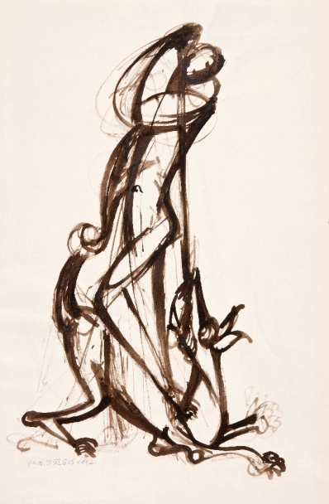
Affect and pathos formulae in art and visual culture of XX. and XXI. century

Slide 2
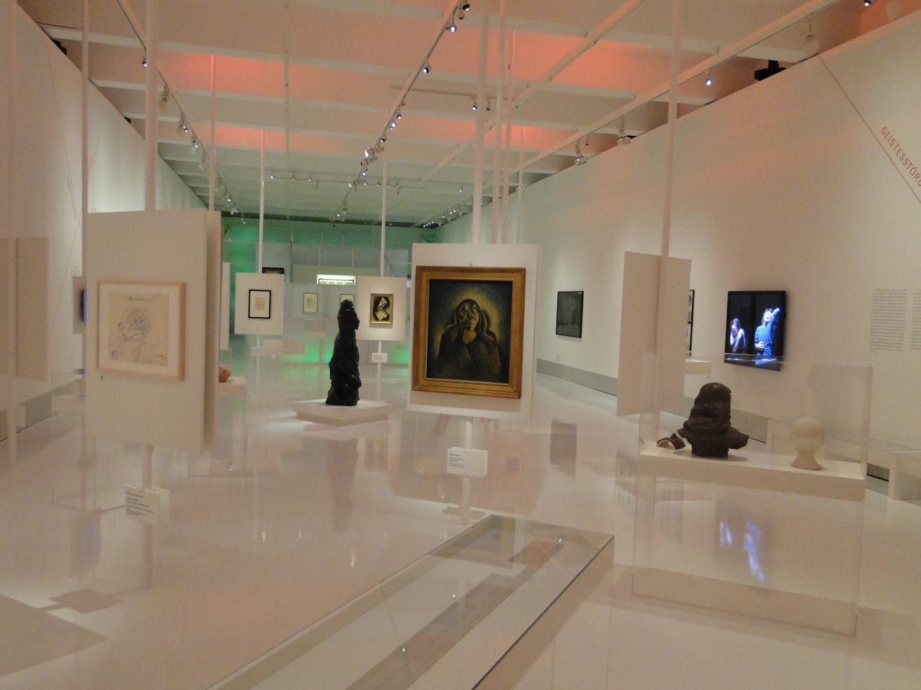
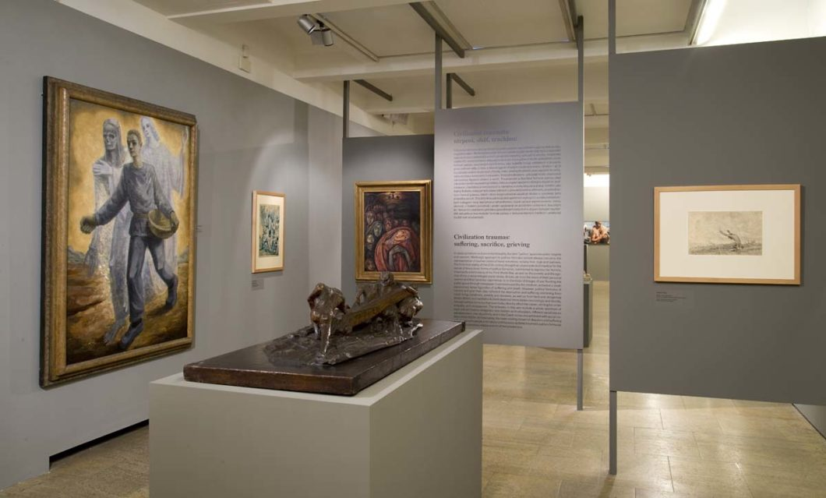
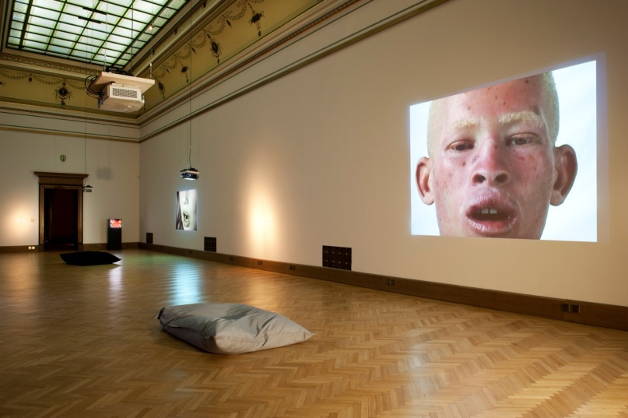
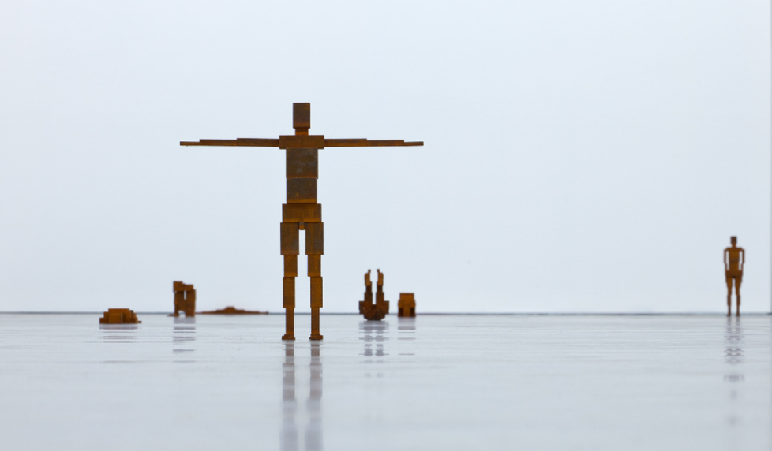
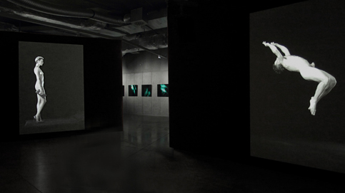

Slide 3
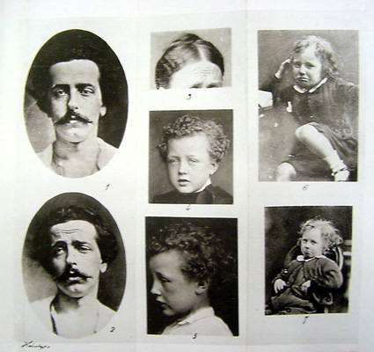
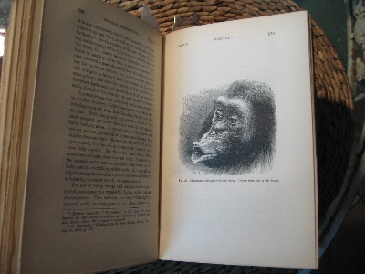
Charles Darwin on emotional expressions
The Expression of the Emotions In Man and Animals, 1872
universal repertoire of emotional expressions
..“the young and the old of widely different races, both with men and animals, express the same state of mind by the same movements…“

Slide 4
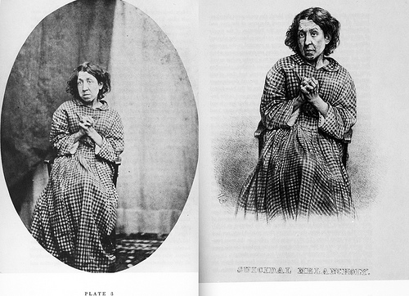
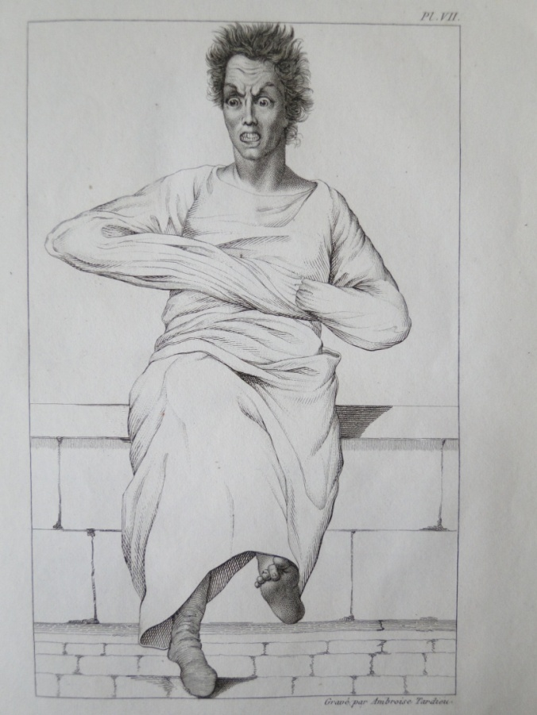
Psychiatry as visual symptomatology
Hugh Welch Diamond, ca. 1850

Slide 5
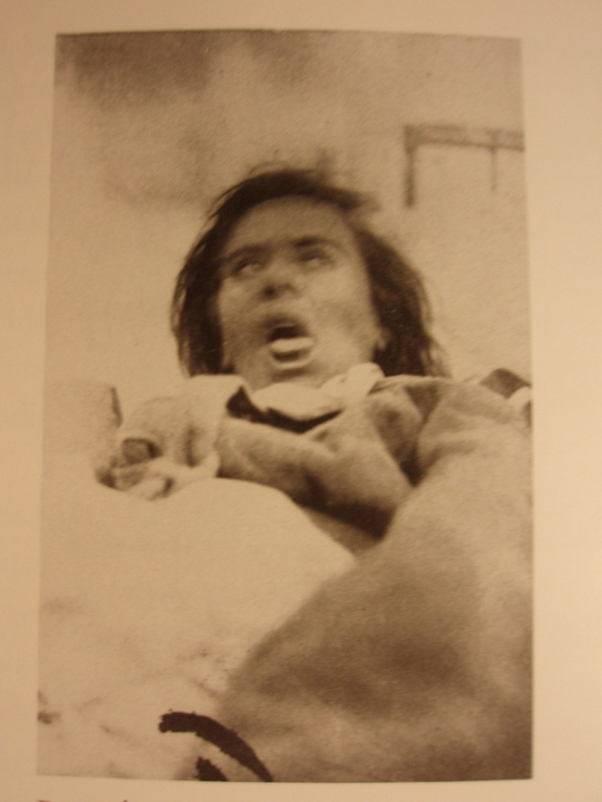
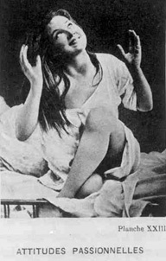
Iconography of hysteria
Iconographie photographique de la Salpêtrière (1877-)
Jean-Martin Charcot (1825—1893)
Photographs: Desiré Magloire Bourneville )
Paul Régnard

Slide 6
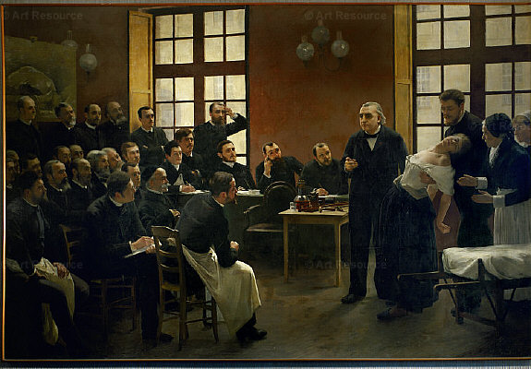
André Brouillet, Clinical lecture at Salpêtrière (1887)
(J.-M. Charcot, Blanche Wittman)

Slide 7
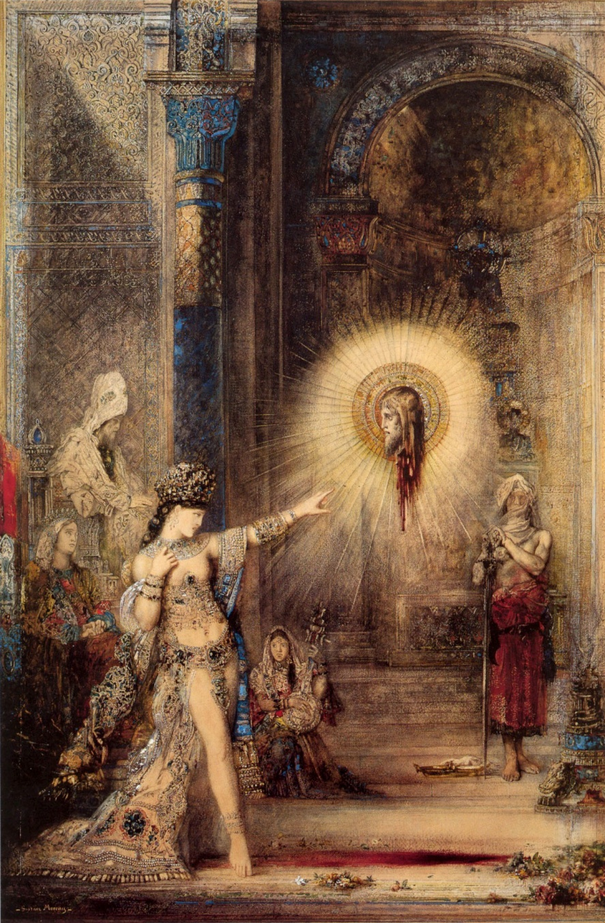
Symbolism and new expressionissm of body
Salomé…the symbolic incarnation of undying Lust, the goddess of immortal Hysteria, accursed Beauty exalted above all other beauties by the catalepsy that hardens her flesh and steels her muscles…“
Joris-Karl Huysmans
Gustave Moreau, Apparition, 1876

Slide 8
Superlative der Gebärdensprache
Aby M. Warburg´s pathos formulae

Slide 9
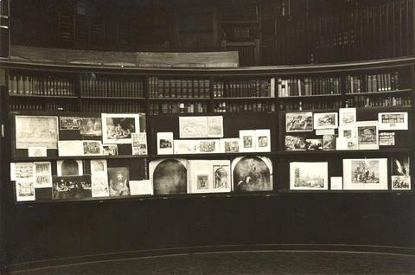
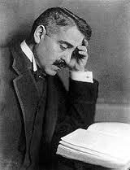
Aby Warburg 1866-1929

Slide 10
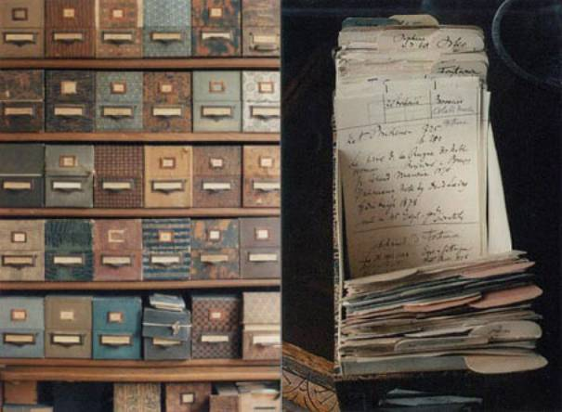
Warburg´s archive

Slide 11
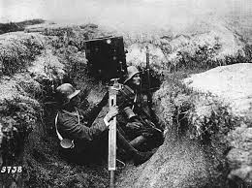
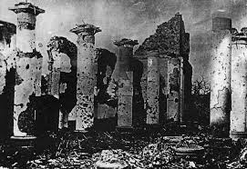
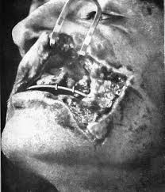
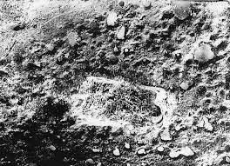
Warburg´s Kriegskartotheke

Slide 12
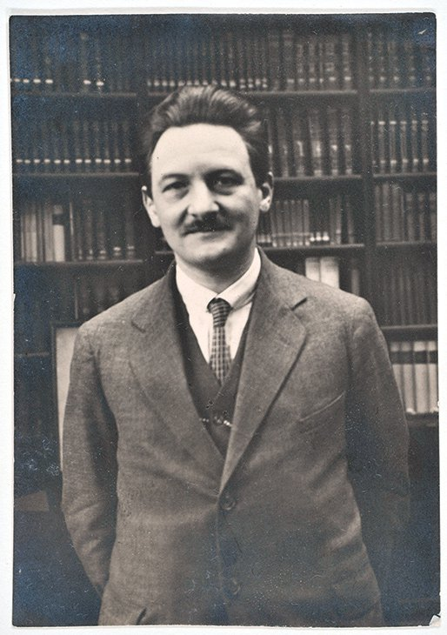
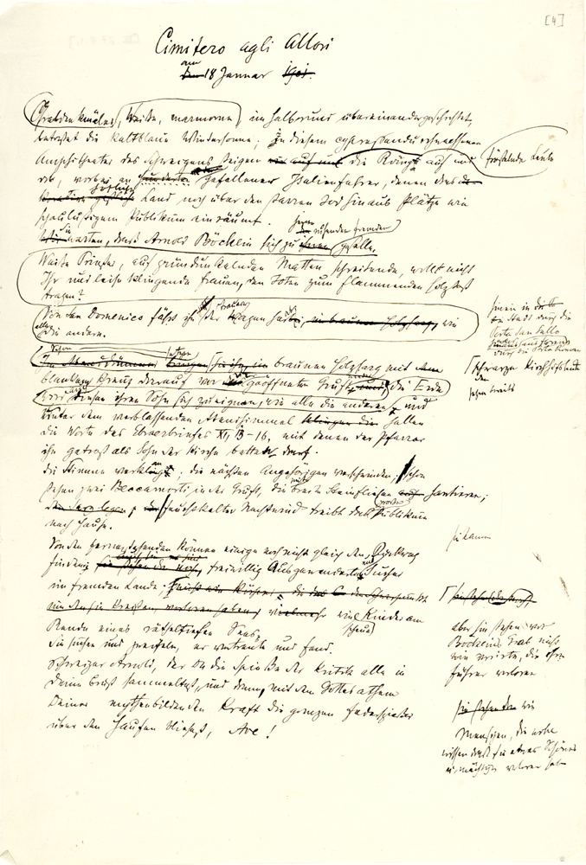

Slide 13
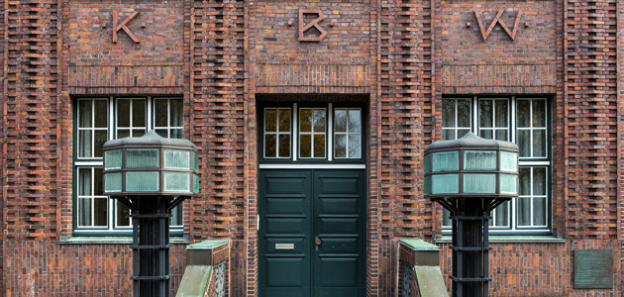
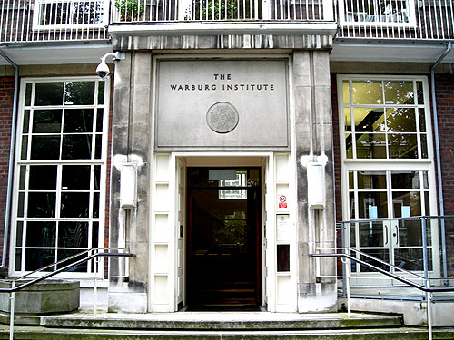
. Wang etal. , Neurons
Warburg Haus in Hamburgu
After 1933:
Warburg Institute, London

Slide 14
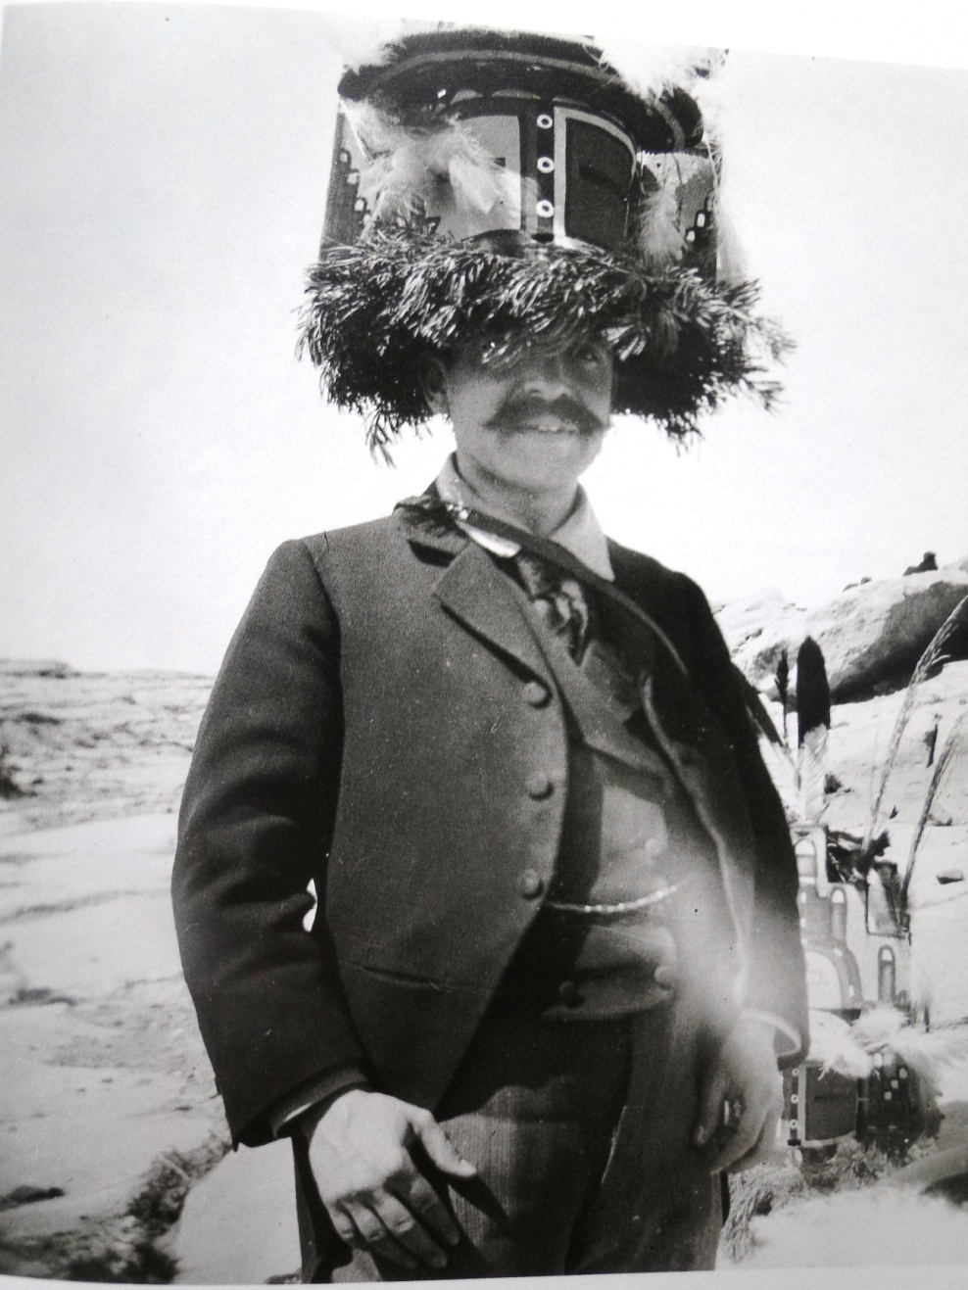
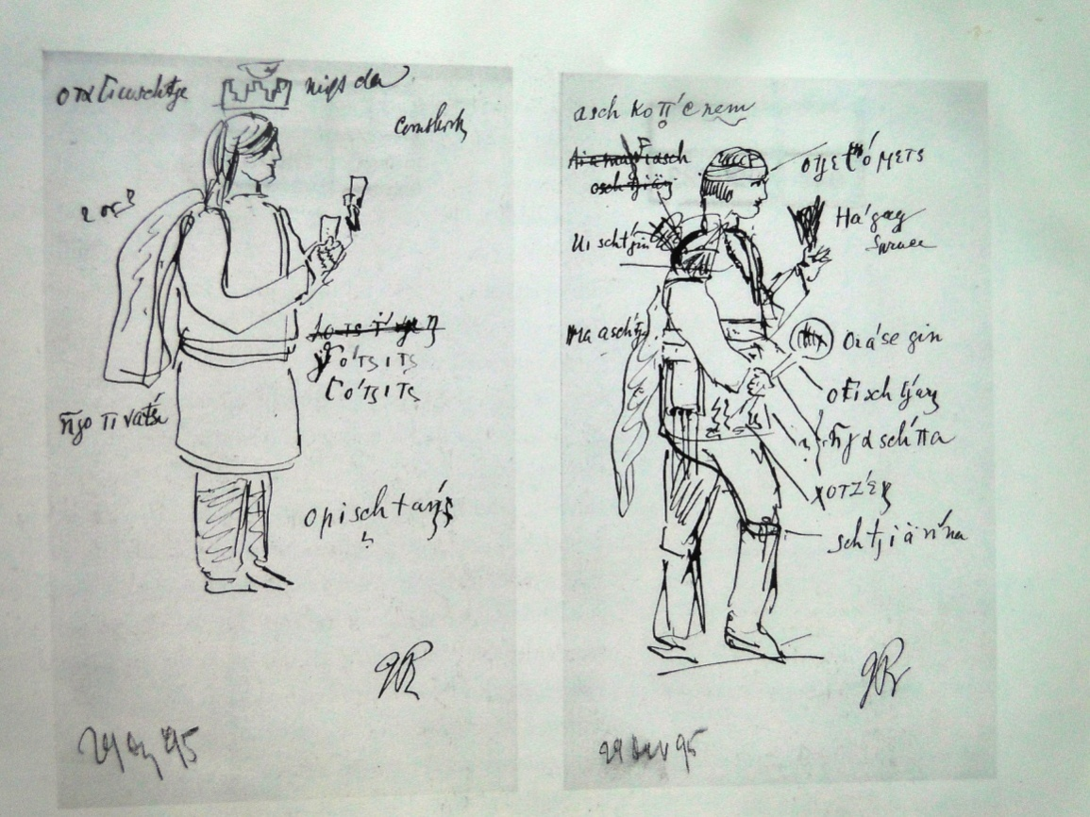
Kreuzlingen lecture
Bilder aus dem Gebiet der Pueblo-Indianer in Nord-Amerika

Slide 15
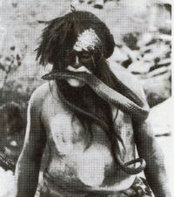
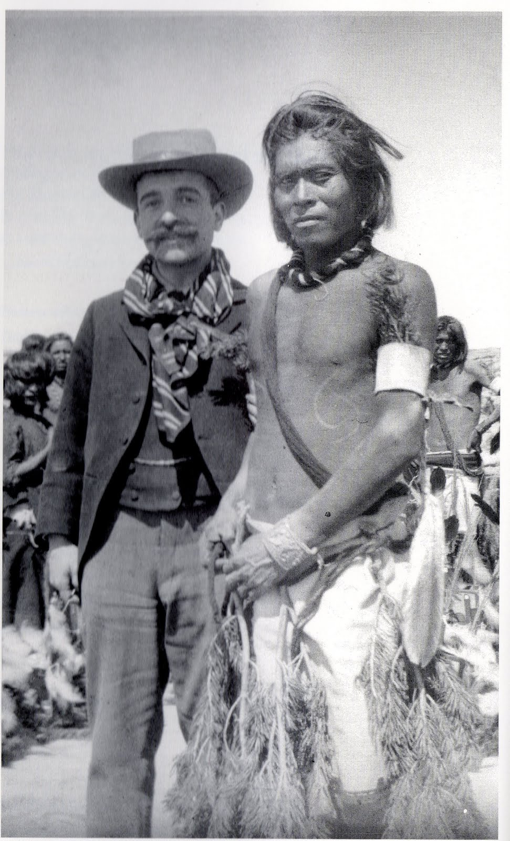

Slide 16
Denkraum and Distanzierung
Liberation from irationality and fear
The acqusition of the feeling of distance betwen subject and object /is/ the task of so-called cultivation and the criterion of progress of the human race.
/Grundlegende Bruchstücke zu einer pragmatischen Ausdruckskunde (monistischen Kunstpsychologie)
1890-1903/
The conscious creation of distance between oneself and the external world can probably be designated as the founding act of human civilization.
/Mnémosyné, Introduction/
Civilization is thus founded on the creation of a psychic space /Denkraum/
Sublimation of primitive, phobic reactions

Slide 17
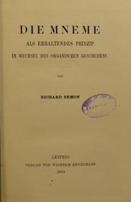
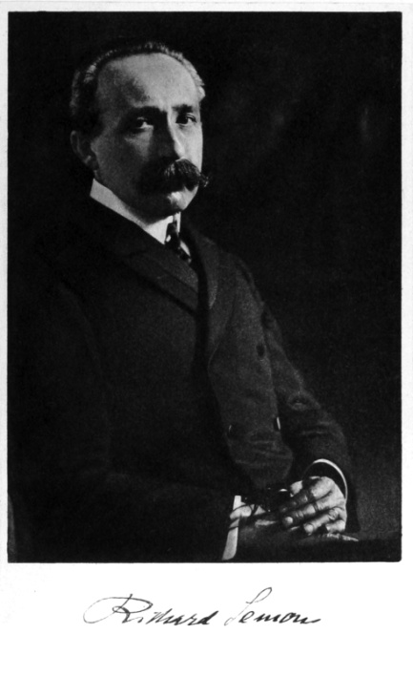
Theory of social memory
Nachleben ( afterlife)
Continuity and metamorphosis of images and motifs
Mimetic and gestural language is an inherent medium of historical memory a
Social mediation of human expressive communication and the transformation of its ´language´
„..diese Engramme leidenschaftlicher Erfahrung, als gedächtnisbewahrtes Erbgut überleben und vorbildlich….“
Engrams of emotional experience, surviving as heritage in memory

Slide 18
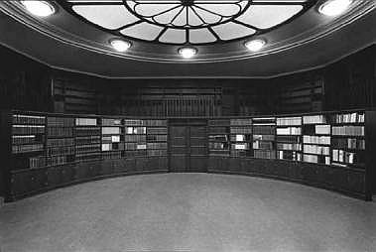
Warburg´s library and Mnémosyné
Warburg´s central topic: social mediation of human expressive communication and its transformations
Description of the goals of my library can be formulated as follows: the collection of documents related to the psychology of human expression. The question is:
How did human and pictorial expression originate; what are the feelings or points of view, conscious or unconscious, under which they are stored in the archives of memory? Are there laws to govern their formation or re-emergence?

Slide 19
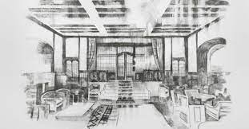
From Kreuzlingen notes:
The question is: how are verbal or visual expressions generated, according to which aspect or sensation, consciously or unconsciously, are they stored in
the archive of memory and do laws exist according to which they are inscribed and re-activated?

Slide 20
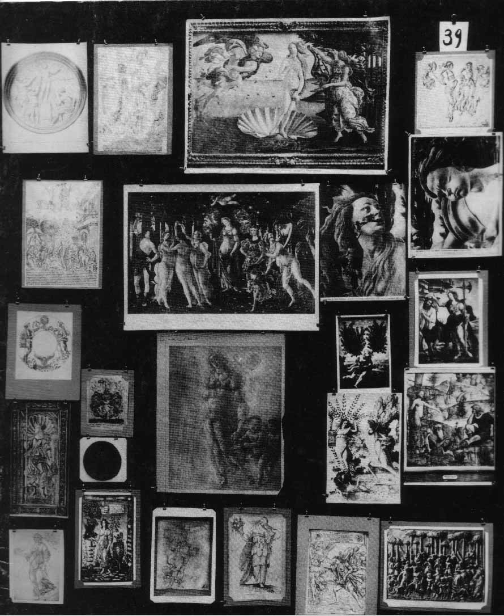
BilderAtlas Mnemosyne 1924-29
Bildtafeln zur „historischen Psychologie des Ausdrucks“
http://warburg.library.cornell.edu/

Slide 21
Mnemosyne
“Mnemosyne: the awakening of the pagan gods in the age of the European Renaissance as the transformation of energy into expressive values
“The creation of the “space for reflection” as a function of culture. An essay in the Psychology of Human Orientation based on the universal history of images.”

Slide 22
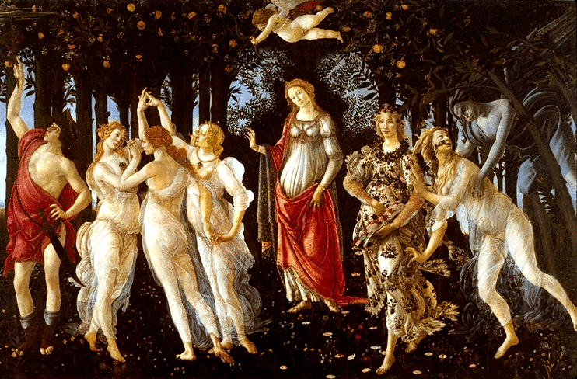
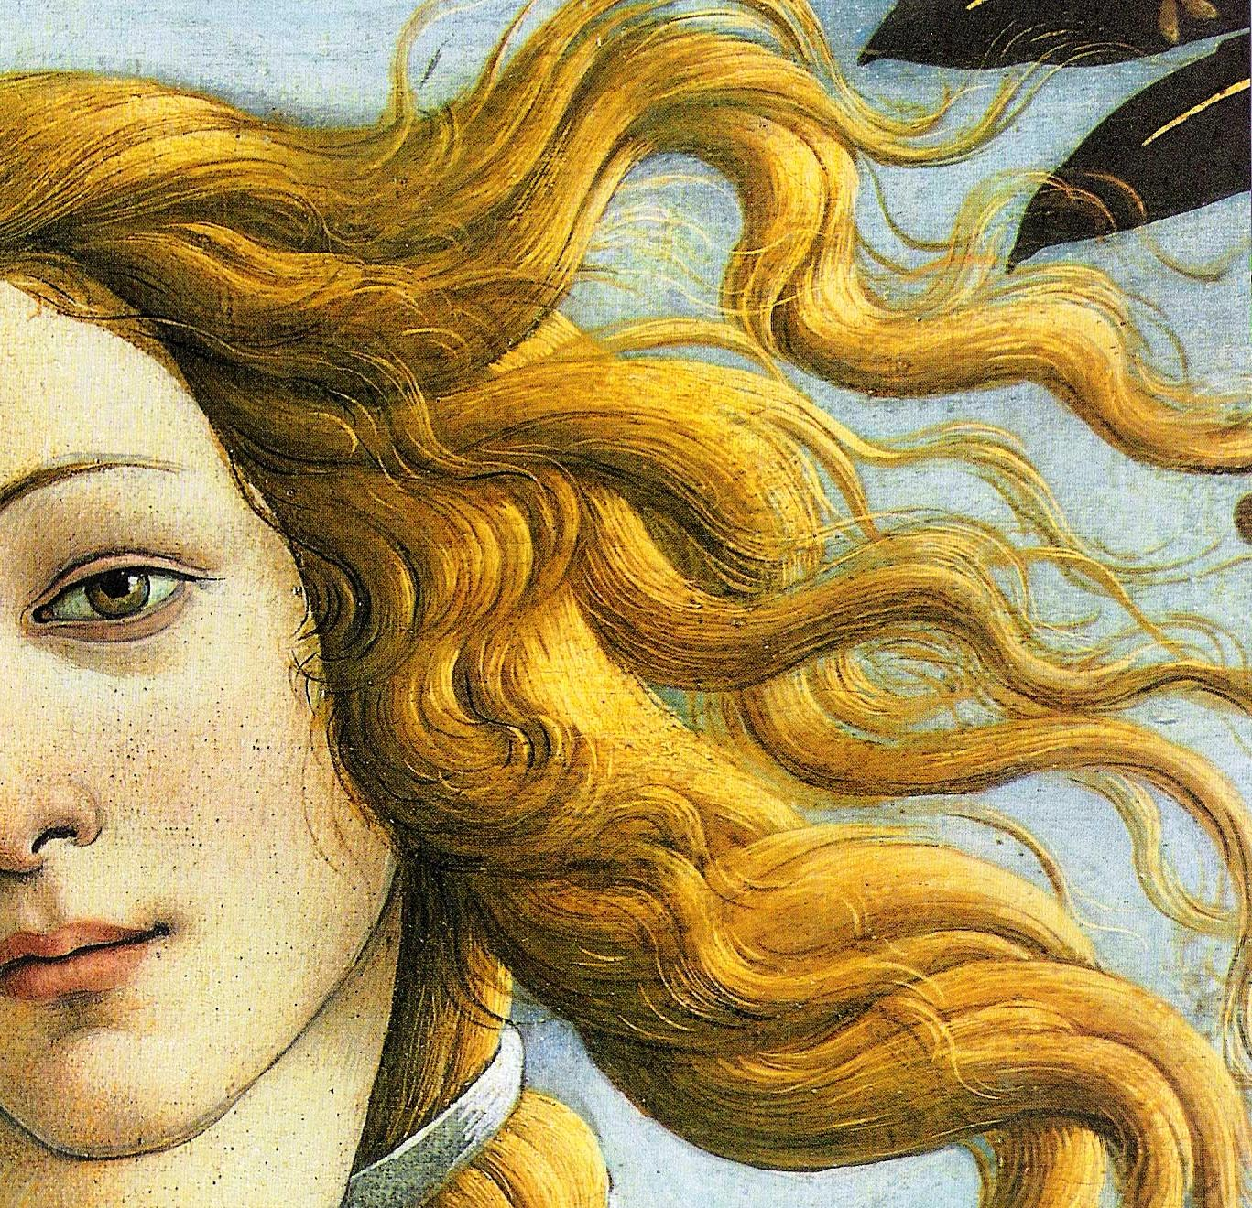
Movements of soul
Moving accessories
(äusserlich bewegtes Beiwerk)
As an expression of affective (passionate)
movements of soul
(leidenschaftlicher Seelenbewegung)
Dissertation on o Botticeli
1893

Slide 23
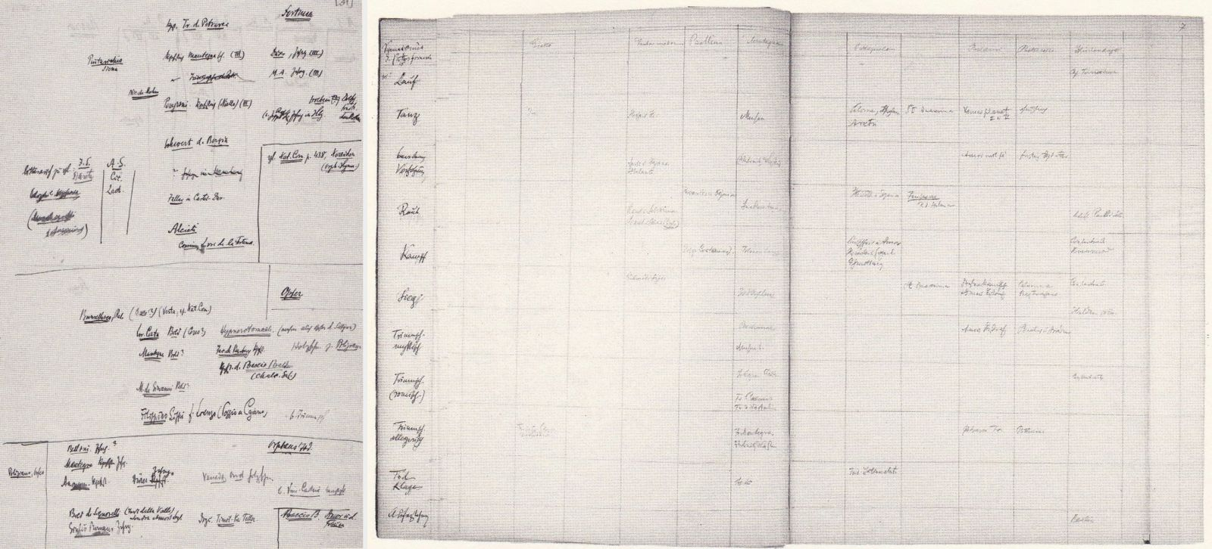
Pathosformel
Schema Pathosformeln, WIA, III.71, f. 7,
asi 1905
Notes:
corsa”, “danza”, “corteggiamento, inseguimento”, “ratto”, “conquista”, “trionfo mitico”, “trionfo romano”, “trionfo allegorico”, “morte, lamento e resurrezione”

Slide 24
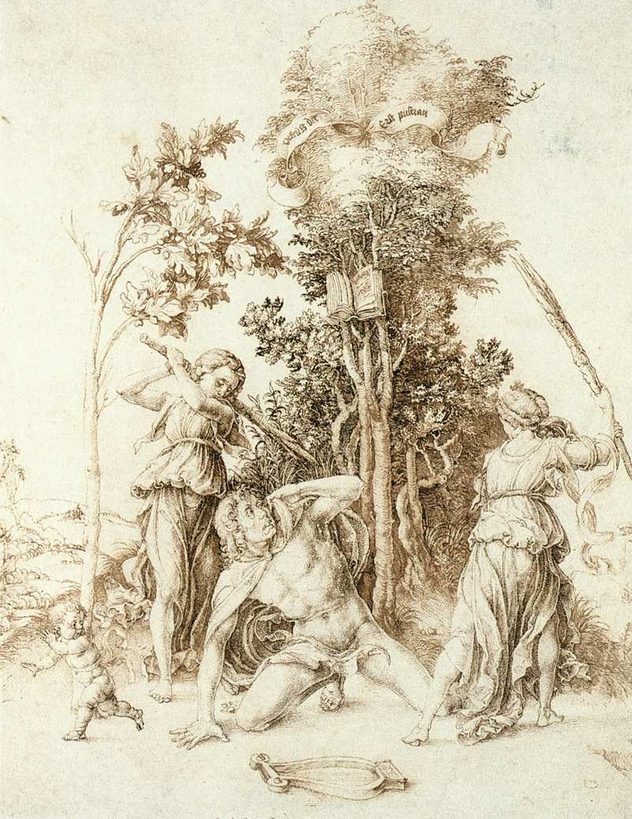
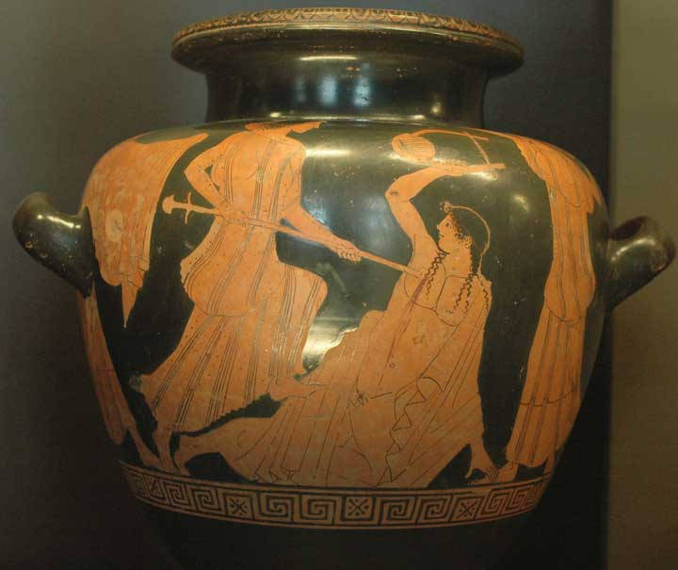
“..die echt antiken Formlen geisteigerten körperlichen oder seelsichen Ausdrucks in den Renaissancestil bewegter Lebensschilderung einzugliedern” genuinely ancient formulae of an intensified physical or psychic expression in the Renaissance style, which strives to portray life in motion evidence of mental states transformed into images”…in which “later generations …sought out the permanent traces of the most profound emotions in human existence.
Dürer und die italienische Antike, 1905
Dürer, Smrt Orfeova, 1494

Slide 25
….and Warburg´s subsequent redefinitions
„..diese Engramme leidenschaftlicher Erfahrung, als gedächtnisbewahrtes Erbgut überleben und vorbildlich….“
….Echt antike Superlative der Gebärdensprache (1912)
Urworte der leidenschaftliche Gebärdensprache (1927)
dynamisierende Zusatzformen”
(dynamic forms)
hochstgespannter energetischer Ausdruckswerte (energetic expressive values in the highest tension

Slide 26
Origins….
It is in the zone of orgiastic mass-seizures that we must look for the mint which stamps upon the memory the expressive movements of the extreme transports of emotion, as far as they can be translated into gesture language, with such intensity that these engrams of the experience of suffering passion survive as a heritage stored in the memory….

Slide 27
Inversion (re- polarization) of affective formulae
While the energy of past experience remains enshrined in the engrams or symbols, this energy may be canalized into different themes of expression
The dynamograms of ancient art are handed down in a state of maximal tension but unpolarized with regard to the passive or active energy….It is only the contact with the new age that results in polarization.This polarization can lead to a radical reversal (inversion) of the meaning they held for classical tradition

Slide 28
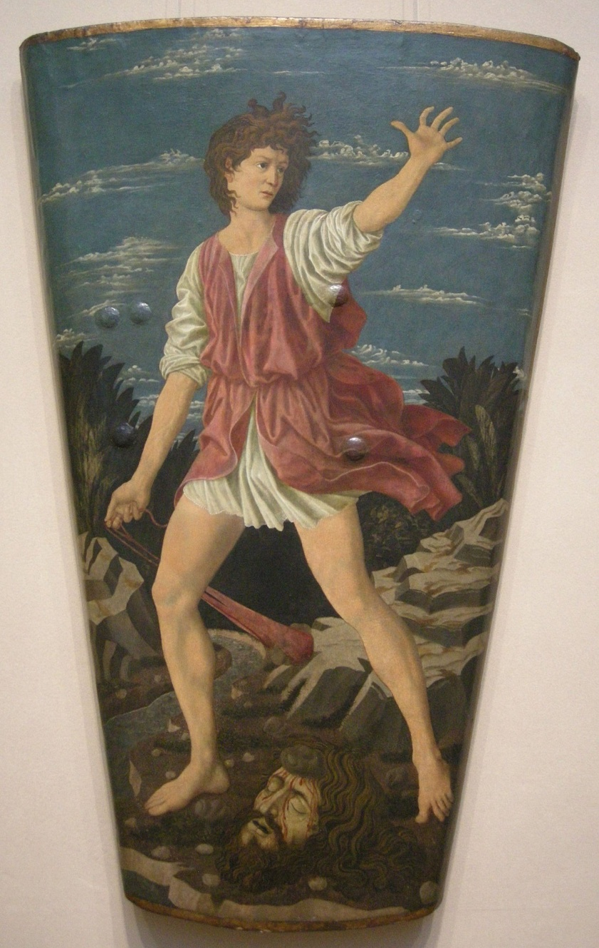
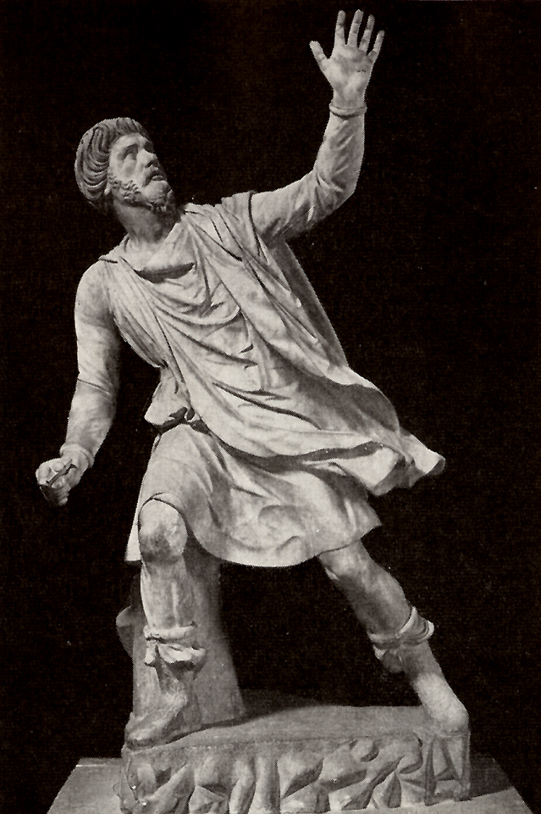
simple inversion….
Andrea del Castagno, David, ca 1455 Pedagog, římský sochař, 5.stol. př.n.l.

Slide 29
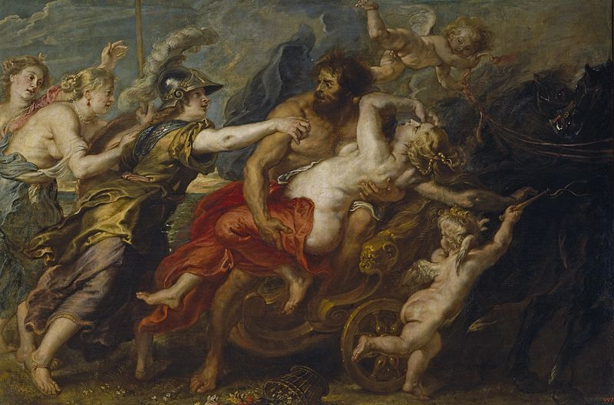
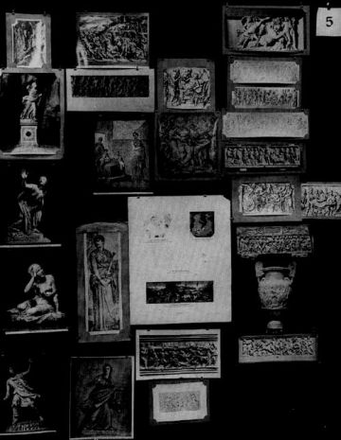
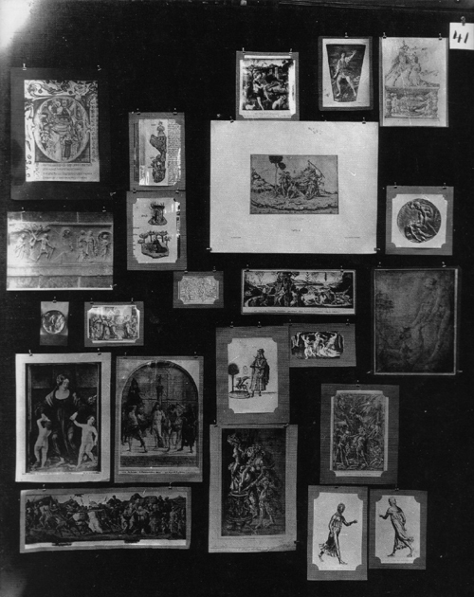
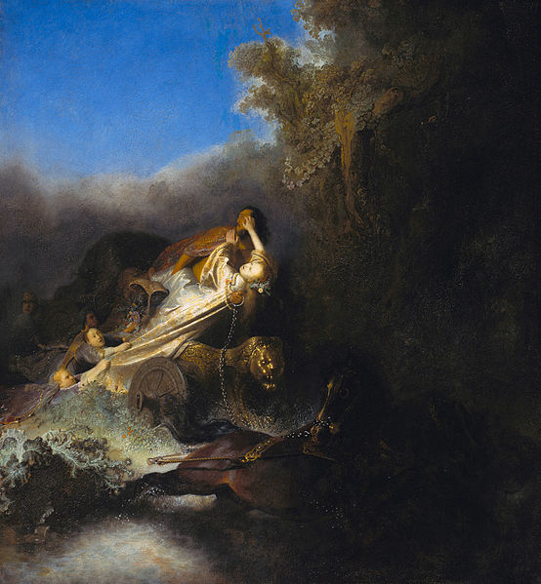
( often rather unclear) juxtapositions, oscilations, inversions
within single panel
(kupř. 70, Rape, of Proserpin)
Between panels (kupř. 5 a 41)
Vernichtungpathos

Slide 30
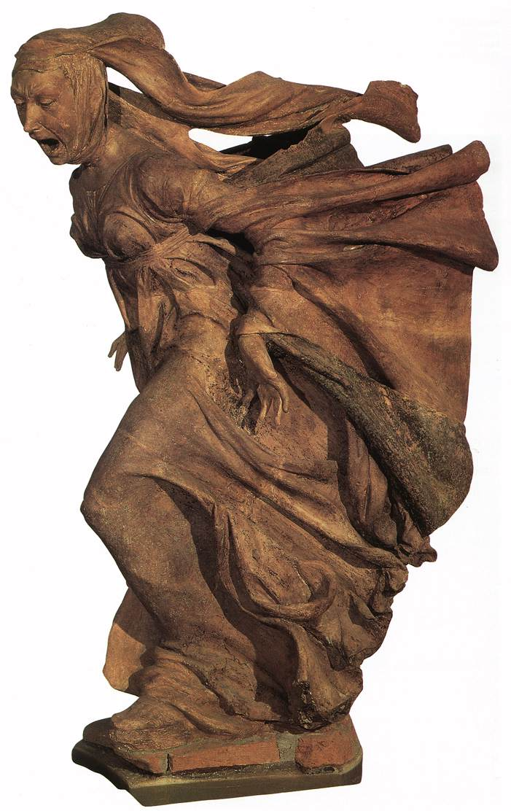
Summary: Dual nature of pathos formula
Affective condensator
emotional charge
index of the mind (Ausdruckswerte seelischer Dynamik)
Formulaic expression
iconographic formula, in which it is impossible to distinguish between form and content ,
Stylistic device

Slide 31
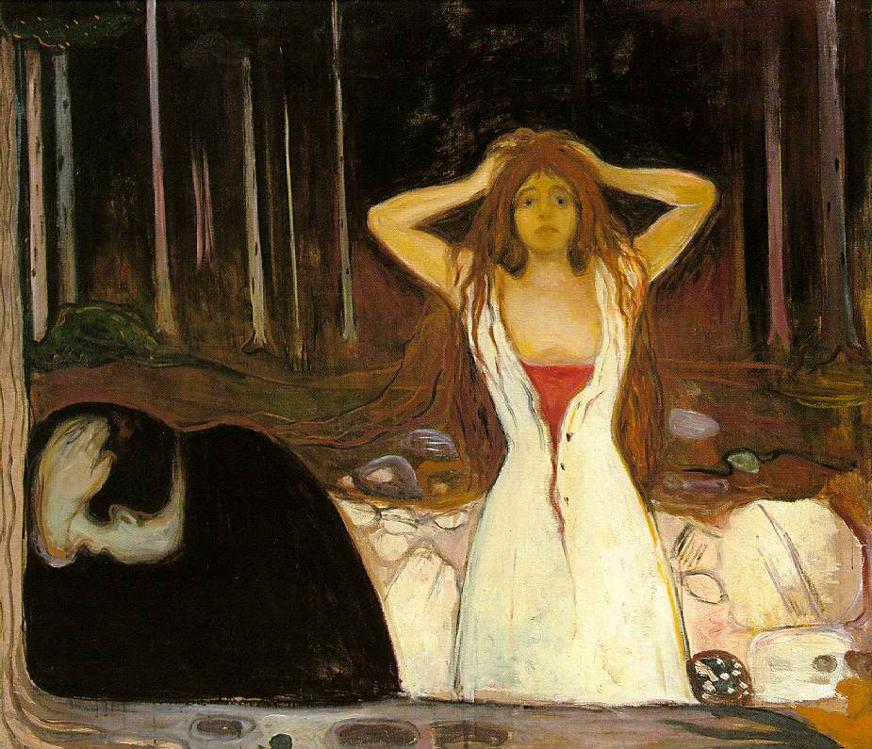
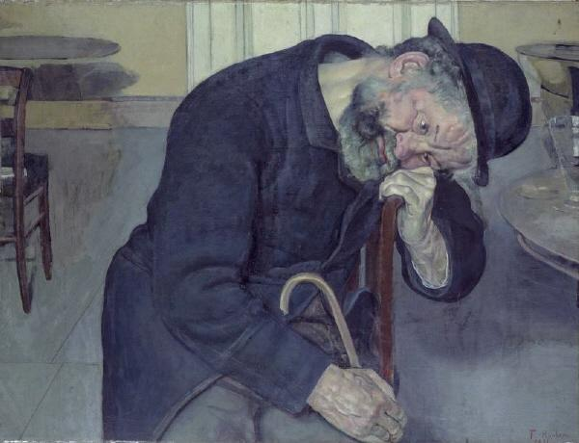
Reconsidering Warburg´ s legacy
Pathos formula as a gestalt: Binding of affective affordances
Facial expression
Gaze direction
Body posture
Gestures
Affordances are relations between dispositions of the perceiver and some feature of the picture
Affective affordance
Has the capacity to activate the affective response of the viewer

Slide 32
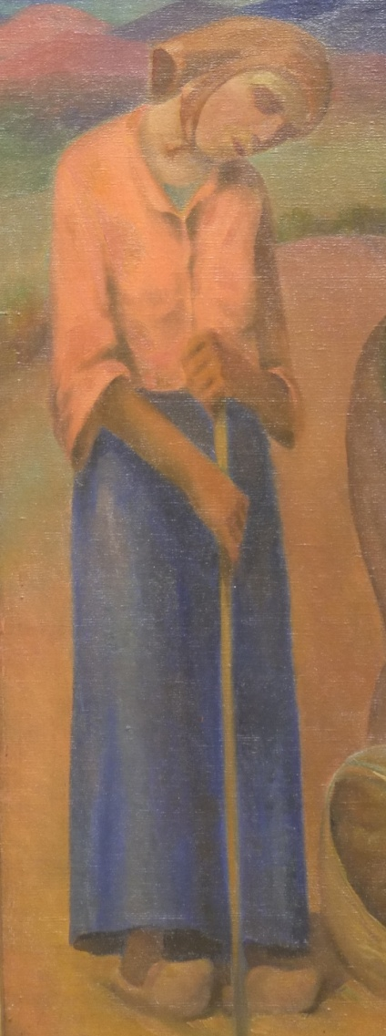
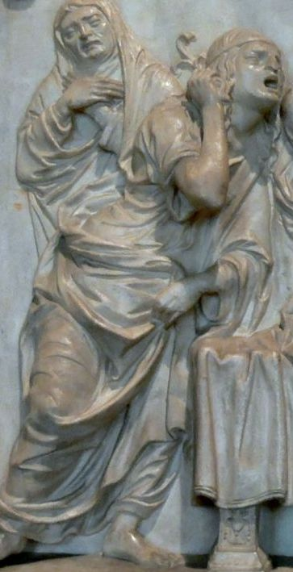


Affect formula = holistic percept (Gestalt) a complex of affcetive affordances

Slide 33




Affective affordances in the image
faces and bodies:
Gaze, expression, gestures

Slide 34
Pathos formulae
Warburg´s concept
Pathos formula is a mimetic reproduction of traumatic event
gesture and movement
PF record and make manifest the pitch rather than the content of passions and events……..
        but: body language includes also non-dynamic
        posture and stance
        Pathos formula is expressive even when it does embody a violent reaction

Slide 35

Hans Balluschek, Summer Night 1928

Slide 36

Affective
Affordances
Faces, bodies
Other Objects
Color
line
composition

Slide 37



Formulaic nature and iconography
General subject of formula is presented through an iconographic subject, which provides pictorial and semantic context

Slide 38


Pictorial and semantic context of emotional formula

Slide 39



Slide 40
Pathos formulae of modern times
Or: Nachleben of old and origins of new pathos formulae in modern times

Slide 41
Some questions
Does bodily expressivity – as a representational medium – functions historically?
Can it be used as a means of understanding of logic of psycho-historical development of different periods?
What is the fate of Warburg´s historical psychology of human expression vis- a- vis current understanding of mind and brain sciences?

Slide 42
Affective /Pathos/ formulae in modern times
What is the fate of Warburg´s historical psychology of human expression vis- a- vis current understanding of mind and brain sciences?
What are the mechanisms of through which affect formula affects the viewer?
What mental and cultural contents modern pathos formulae conserve and transmit?
Can they be used to analyze the dynamics of cultural and artistic development of modern
times?

Slide 43


Trauma, anguish, extasy, emptiness….

Slide 44




Framework of references in modern times: beyond mythology and religion

Slide 45
Context for pathos formulae in 20th century
Work
Heroism of propaganda
Intersubject relationships
Religious and metaophysical inspiration
Trauma of wars, social upheavals
Social difficulties
Individual emotional states and existential dillemas of modern subject

Slide 46

Pathos formulae and variability of mental states
Dimensional model of affect
Pathos formulae can embody emotions in the entire field of affective experiences

Slide 47


Labyrinth of pathos formulae in 20th century- Warburg in extenso
George Didi-Huberman
Nouvelles Histoires de fantômes
Panel 42

Slide 48


Ressurection of religious pathos formulae
August Brömse
Messiah and stigmatized Christ

Slide 49




Jantsch
Edgar Jantsch, Pieta 1927
Maxim Kopf, Crucifixion 1920

Slide 50

Jakob Steinhardt, Flooding, 1912

Slide 51

Albert Weisgerber, Jeremiah weeping over ruins 1912

Slide 52



Mystical and metaphysical a metaphysical pathos formulae
Petr Wittlich:
“enigmatická dialektika afektu
“vzrušený a mesianistický psychismus
Bílek, Hands 1903

Slide 53

„..monster in desperate theatrical pose …..inexplicable experimenting ….deepest degeneration
„chaos of communication “
František Bílek, Grief, 1909

Slide 54

Who are we?What we seek here?Where are we going?
We are blind. Only by the voice of heart we sing songs about goodness, strength and beauty.

Slide 55




Slide 56

Traumatic emotional formulae

Slide 57




Visualisation of suffering and death around WW I

Slide 58


Karel Rélink, Soldier burnt by flamethrower Albin Egger-Lienz, Finale

Slide 59

Albin Egger-Lienz, Die Namenlosen 1916

Slide 60




…and crisis of modern monument

Slide 61

1930´s and WW II

Slide 62


Socially determined pain and trauma

Slide 63

Käthe Kollwitz 1867-1945

Slide 64


Slide 65

Tina Bauer-Pezzelen, Golgota 1917

Slide 66

Vratislav Nechleba, Hunger
before 1915

Slide 67


Karel Myslbek 1874-1915

Slide 68

Albin Egger-Lienz Kriegsfrauen 1918-22

Slide 69

Albin Egger- Lienz, Das Tischgebet 1923

Slide 70


Moving image and the new visibility of mind in early 20th century
“Today, all of humanity is on the verge of relearning this utterly neglected language of expression and gestures.It is not a substitute for words, like the language of deaf-mutes, but rather the visual correspondences of the immediately embodied soul. Man will again become visible.“

Slide 71



Pathos of ecstasy,uplifting and heroism

Slide 72

..in social art and visual propaganda of 1920´s and 1930´s
Mexičtí muralisté: José Clemente Orozco 1926

Slide 73

Mexican muralists: Diego Rivera

Slide 74


Slide 75

David Siqueiros

Slide 76



Slide 77

…in totalitarian art and propaganda
Hubert Lanzinger,
Der Bannerträger 1935

Slide 78



Slide 79



Slide 80

Hubert Lanzinger,
Der Bannerträger 1935
Hubert Lanzinger,
Der Bannerträger 1935

Slide 81


Slide 82



Slide 83


Slide 84


Slide 85



Slide 86


Slide 87




Slide 88


Slide 89
„Anti pathos formulae“
EXPRESSION - INEXPRESSION
Anxiety
Apathy
Emptiness
Resignation
-------------
Melancholy - Depression
----------------
Mind-wandering

Slide 90
Pathos formulae and variability of mental states
Dimensional model of affect
Pathos formulae can embody emotions in the entire field of affective experiences

Slide 91

Melancholy
Albrecht Dürer, Melancholie I 1514

Slide 92


Domenico Fetti, Melancholie, ca 1620 Camille Corot 1826-7

Slide 93



M Melancholie

Slide 94

Mental states of 20. century, connected with
Fatigue
Alienation
Loneliness
Daydreaming
Apathy
Vladimír Silovský, Tramvay 1926

Slide 95

Ferdinand Hodler, Tired of life, 1892

Slide 96


Anxiety
Ernst Barlach, Horror, 1923 Otto Gutfreund, Anxiety, 1911

Slide 97



Egon Schiele
Posing, self-identity, alienation
Selfportrait 1910 Standing nude, 1910

Slide 98



Nouvelle Iconographie de la Salpetriere, 1904
Sitting nude, 1910

Slide 99

Portrait of dr. Erwin Graaf, 1910

Slide 100




Slide 101



Slide 102

Agony 1912

Slide 103


Václav Hejna
Left-overs, 1938

Slide 104



Václav Hejna

Slide 105


Edward Hopper
Sunday, 1926 Excursion into Philosophy, 1959

Slide 106


Pathos and poses of ordinary existence
Vladimír Držkovic, Cleaner, 1920´s

Slide 107

Eduard
Demartini

Slide 108

Ubbaldo Oppi, Surgeons 1926

Slide 109

Ubbaldo Oppi
1889-1942

Slide 110




Slide 111


Charley Toorop 1891-1955

Slide 112

Affect/pathos formula in contemporary art and visual culture

Slide 113


George Segal (1924-2000)

Slide 114

George Segal 1924-2000

Slide 115

Diner 1964-66

Slide 116

I note [my subjects] gestures. I depend on my language [plaster] to communicate anguish. I really am interested in provoking a state of compassion."

Slide 117

Restaurant 1975

Slide 118

Couple Against A Grey Brick Wall 1986

Slide 119

Edward Kienholz, Sollie 17,
1979

Slide 120


Philip Pearlstein (1924 -

Slide 121

Duane Hanson (1925-1996)

Slide 122

Young Shopper
I like the physical burdens this woman carries. She is weighted down by all of her shopping bags and purchases, and she has become almost a bag herself. She carries physical burdens – the burdens of life, of everyday living. But initially, it’s quite a funny sculpture’.

Slide 123

Magdalena Abakamowicz 1930-2017
Crowd 1988

Slide 124

Backs 1967-80

Slide 125


Slide 126


Kiki Smith 1954-
Untitled, 1990
Blood pool, 1992

Slide 127

Berlinde De Bruyckere 1964-
Into One-Another III, 2010

Slide 128


Slide 129



Slide 130

Antony Gormley 1954 -

Slide 131

Antony Gormley

Slide 132


Slide 133



Slide 134


Slide 135


Slide 136



Slide 137

Markus Muntean and Adi Rosenblum 1962-

Slide 138



Slide 139


Slide 140


Slide 141

Volker Stelzmann (1940)

Slide 142


Slide 143



Slide 144



Slide 145


Pathos and ethos in iconic photography in 20th-21st century
Dmitrij Baltermanc, Grief (Kerč) 1942
Nick Ut, Napalm Girl 1972

Slide 146


Josef Koudelka, 1968 Jeff Widener, Tank man, 1989

Slide 147



Allusions on emotional language of Christian imagery
Georges Merillon, Kosovo pieta 1990
Hocine Zaourar, Madona from Bentalha, 1997

Slide 148

Alex Majoli, Lesbos 2015

Slide 149


Filip Singer, from Lesbos cycle, 2015

Slide 150


