Slide 1
Art of XX-XXI century
What is the difference between modern and contemporary?
When does contemporary begin?
Does ´contemporary ´art belong to history of art?
Can we tell good from bad
in contemporary art?
These questions are not value-neutral!

Slide 2
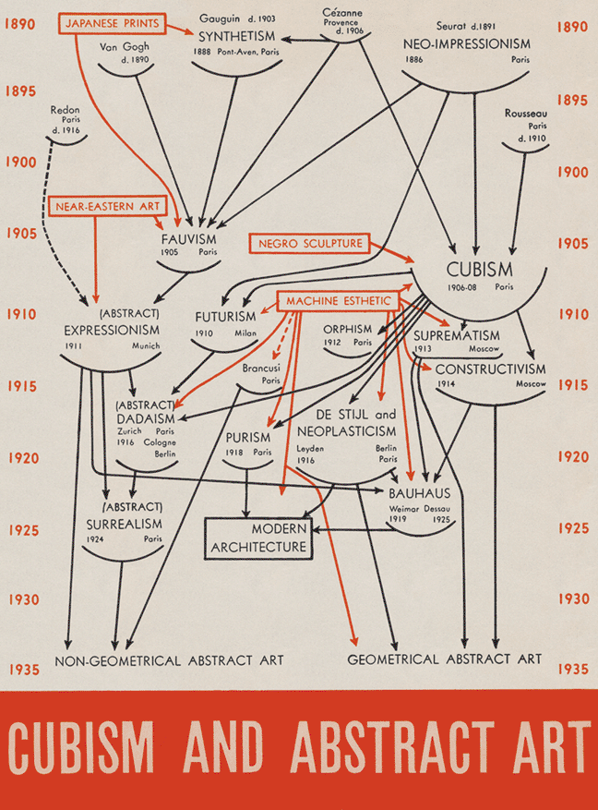
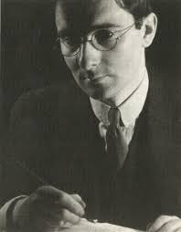
When modern was ´contemporary´
Alfred Barr Jr.

Slide 3
….after that?

Slide 4
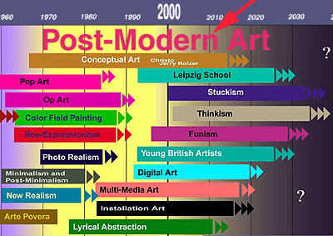

Slide 5
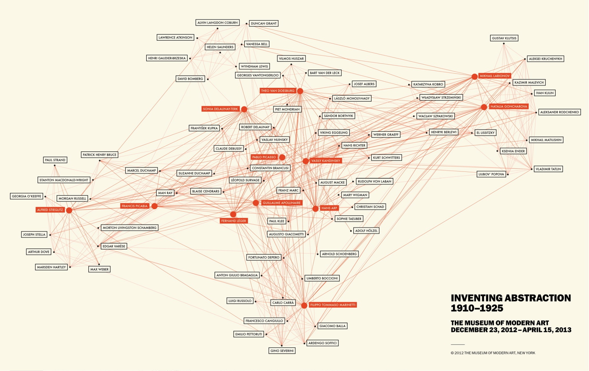

Slide 6
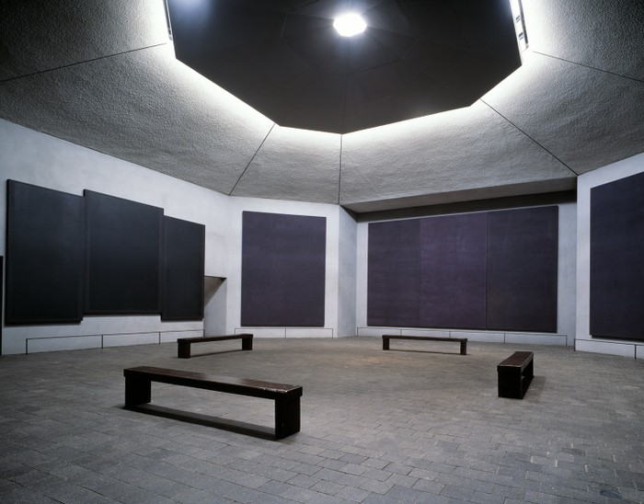
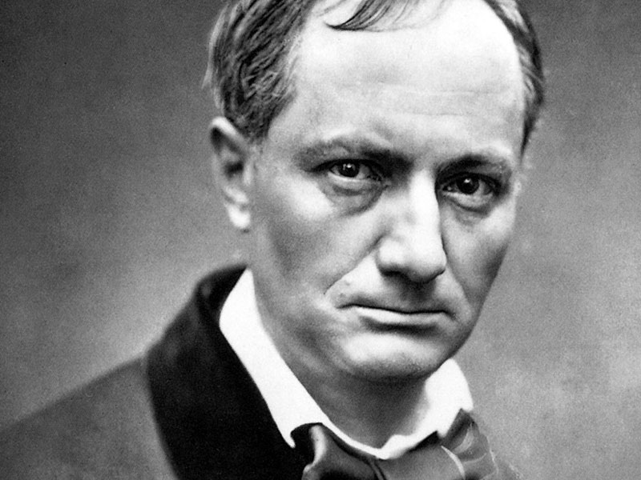
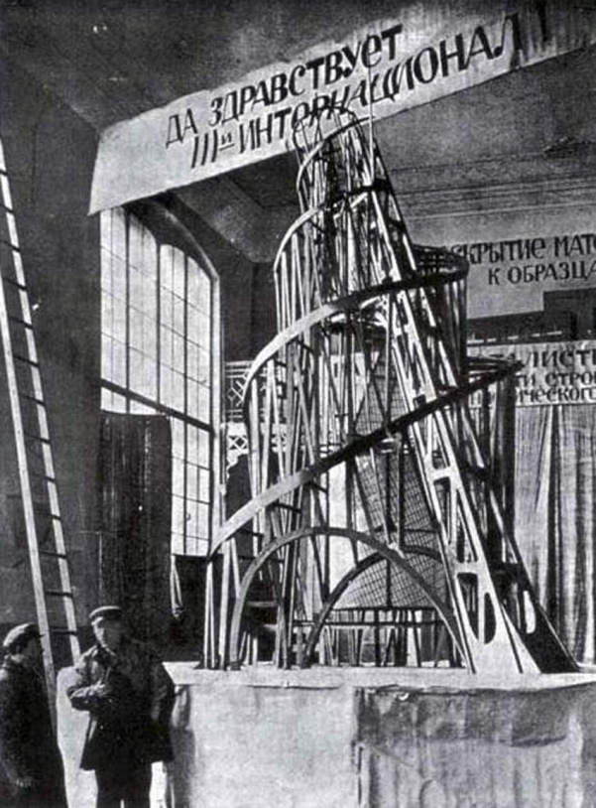
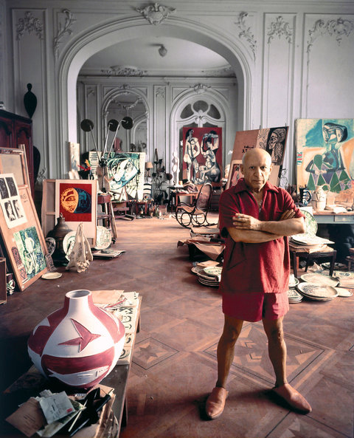
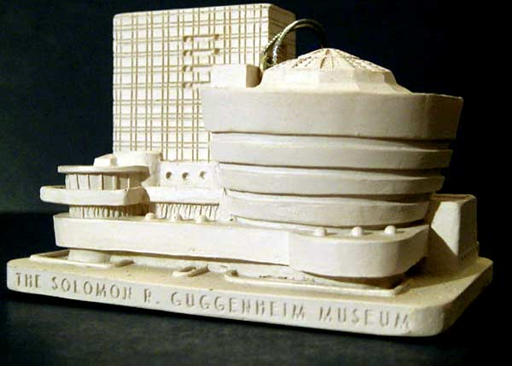
What is modern art?

Slide 7
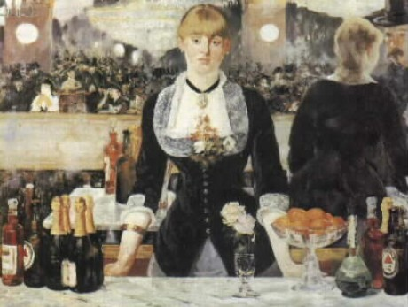
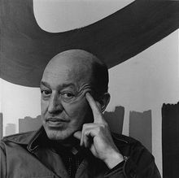
Modernism
Art becomes its own subject
Shift from mimetic to non-mimetic features
Clement Greenberg in Modernist painting
´Manet´s became the first modernist pictures by virtue of the frankness with which they declared the flat surfaces on which they were painted.´

Slide 8
Modernism as a profound shift…
modernism is marked by an ascent to a new level of consciousness, which is reflected in painting as a kind of discontinuity, almost as if to emphasize that mimetic representation had become less important than some kind of reflection on the means and methods of representation
Arthur Danto
We will return to this later on!
Is there a similar break between modern and contemporary?

Slide 9
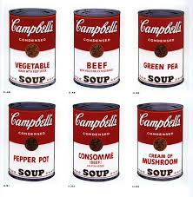
Modern vs Postmodern
Formal purity
Medium specificity
Authenticity
Originality
Utopic ideals
Linear concept of
History
Progress in art
Appropriation -borrowing
Copying
Irony, parody
Pastiche
No master narratives

Slide 10
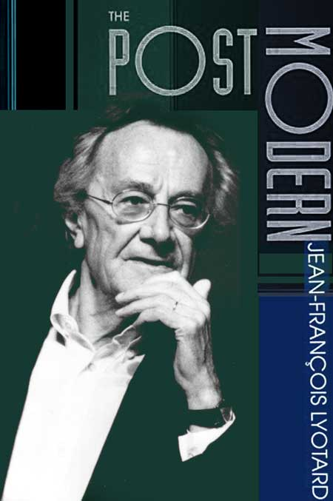
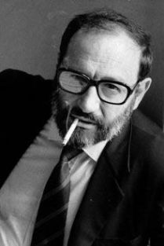
´Tyranny´ of theory…
Michel Foucault
Jacques Derrida
Gilles Deleuze
Felix Guattari
Umberto Eco

Slide 11
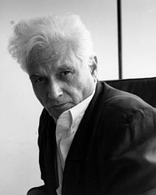
Deconstruction
Art works considered as text
Texts have multiple meanings

Slide 12
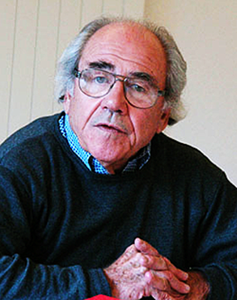
Jean Baudrillard (1929- 2006)
when it comes to postmodern simulation and simulacra, “It is no longer a question of imitation, nor duplication, nor even parody. It is a question of substituting the signs of the real for the real”
first order of simulacra = the pre-modern period, the image is a clear counterfeit of the real; the image is recognized as just an illusion, a place marker for the real
the second order of simulacra = the industrial revolution, the distinctions between the image and the representation begin to break down because of mass production and the proliferation of copies
the third order of simulacra = the postmodern age,
we are confronted with a precession of simulacra; that is, the representation precedes and determines the real. There is no longer any distinction between reality and its representation; there is only the simulacrum.
Simulacres et Simulation, 1981

Slide 13
Jean-François Lyotard:
"Simplifying to the extreme, I define the postmodern as incredulity toward metanarratives."
The postmodern as a historical/cultural "condition" based on a dissolution of master narratives or metanarratives (totalizing narrative paradigms like progress and national histories), a crisis in ideology when ideology no longer seems transparent but contingent and constructed
(The Post-Modern Condition: A Report on Knowledge).

Slide 14
Fredric Jameson
Postmodernism is an intensification and latest phase of global capitalism
Reality is evaporating into mere images
We’re fixated on commodities and products
There is no linguistic normality, only pastiche
Postmodernism as a movement in arts and culture corresponding to a new configuration of politics and economics, "late capitalism"

Slide 15
Postmodernism? Postmodern condition
after modernism subsumes, assumes, extends the modern or tendencies already present in modernism, not necessarily in strict chronological succession, or working out questions and problems implicit in modernism without a break from core assumptions
contra modernism subverting, resisting, opposing, or countering features of modernism
equivalent to "late capitalism" culture dominated by post-industrial, consumerist, multi- and trans-national capitalism, beginnings of globalization
the historical era following the modern an historical time-period marker, recognizing cultural, ideological, and economic shifts without a new trajectory (triumphalism) or privileging of values
artistic and stylistic eclecticism (aesthetic postmodernism) hybridization of forms and genres, combining "high" and "low" cultural forms and sources, mixing styles of different cultures or time periods, dehistoricizing and re-contextualizing styles in architecture, visual arts, literature, film, photography
"global village" phenomena: globalization of cultures, races, images, capital, products"information age" redefinition of nation-state identities, which were the foundation of the modern era; dissemination of images and information across national boundaries, a sense of erosion or breakdown of national, linguistic, ethnic, and cultural identities;

Slide 16
Key features of postmodern styles
Nostalgia, reto styles, rycycling of genre and styles in new contexts
"History" represented through nostalgic images of pop culture, fantasies of the past. History has become one of the styles; historical representations blend with nostalgia.
"the disappearance of a sense of history, the way in which our entire contemporary social system has little by little begun to lose its capacity to retain its own past, has begun to live in a perpetual present and in a perpetual change that obliterates traditions of the kind which all earlier social formations have had in one way or another to preserve...
Culture on Fast Forward: Time and history replaced by speed, futureness, accelerated obsolescence.
Critique: note the image of the past and origins presupposed in the view of history and the postmodern, the sense of Hegelian trajectories with no possible future in view to be argued for.
Irony, parody
Sampling
Mixing of „high“ and „low“
Approprition and
Copying
Pastiche

Slide 17
Postmodernism as (dominantly) architectural style

Slide 18
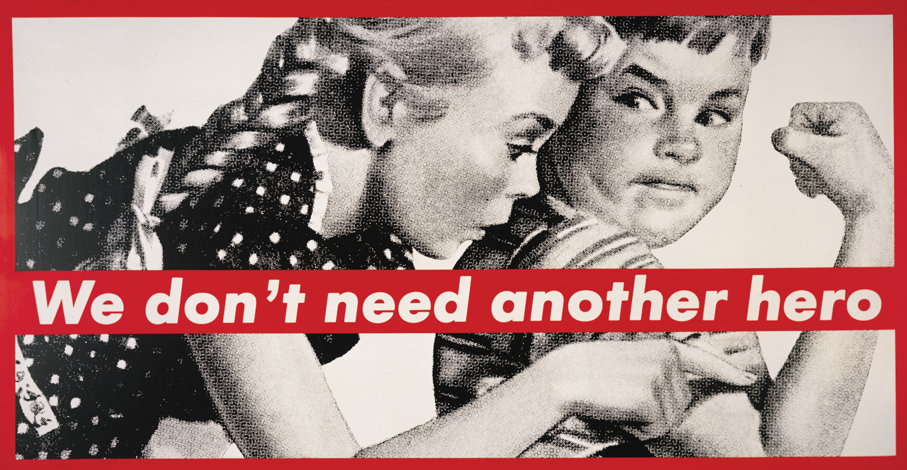
Retro-sensationalist (postmodern) art

Slide 19
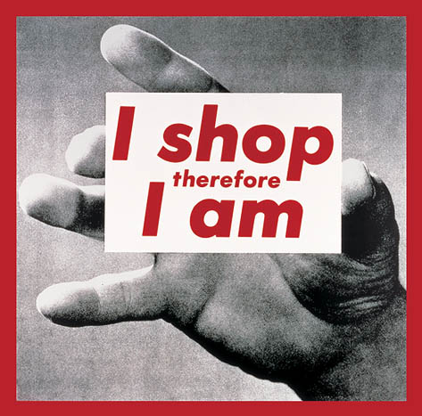
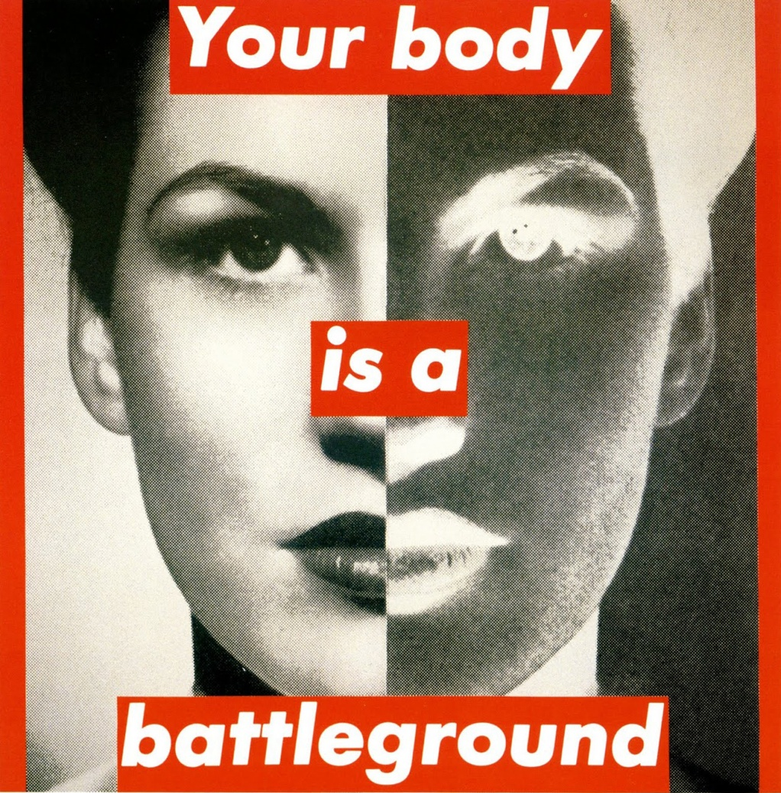
Barbara Kruger (1945)

Slide 20
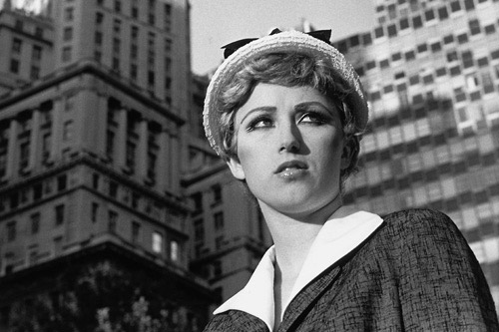
Cindy Sherman (1954)
http://www.moma.org/interactives/exhibitions/2012/cindysherman/#/0/

Slide 21
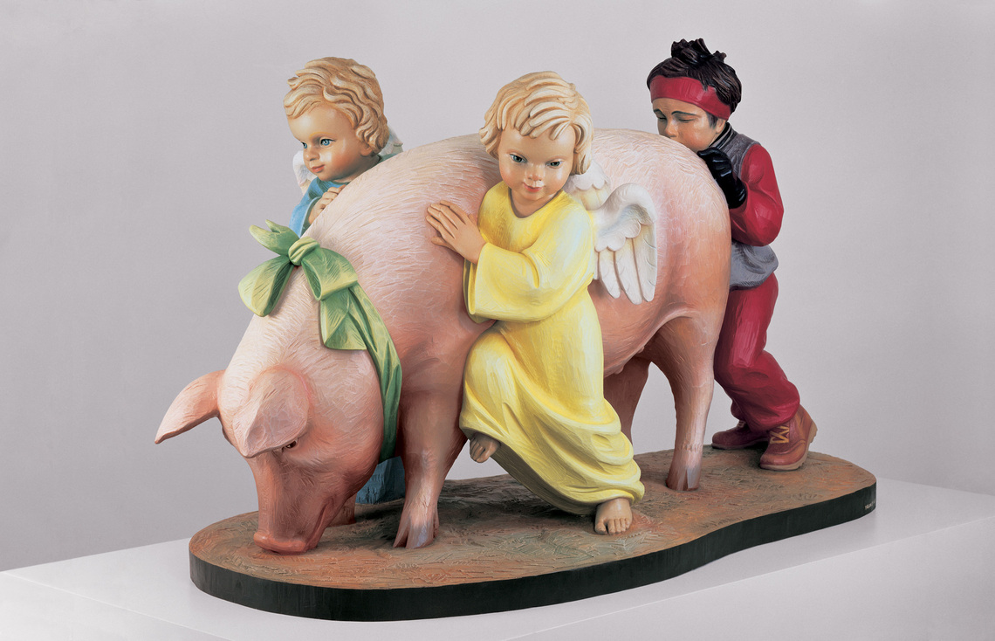
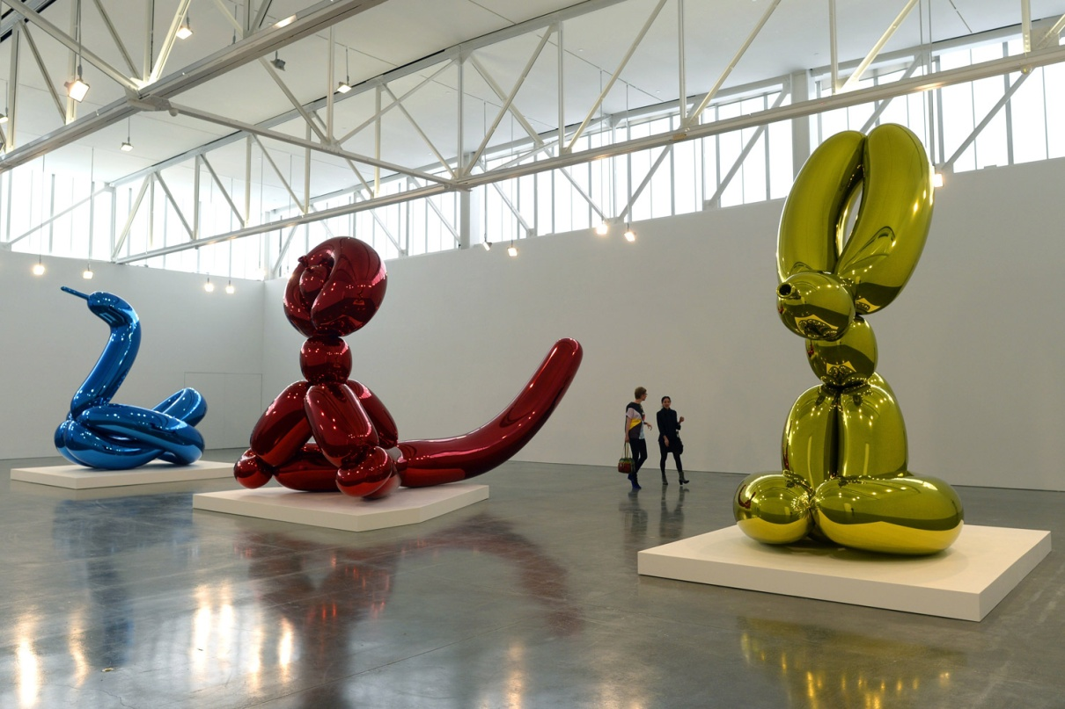
Jeff Koons (1955)
Ushering in Banality 1988
neo-pop, post-pop

Slide 22
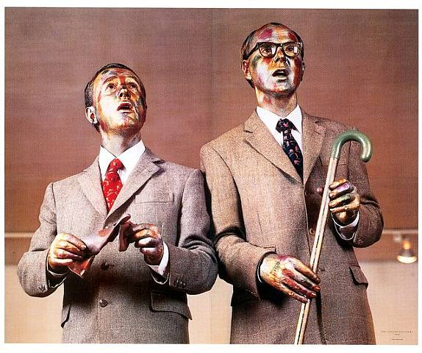
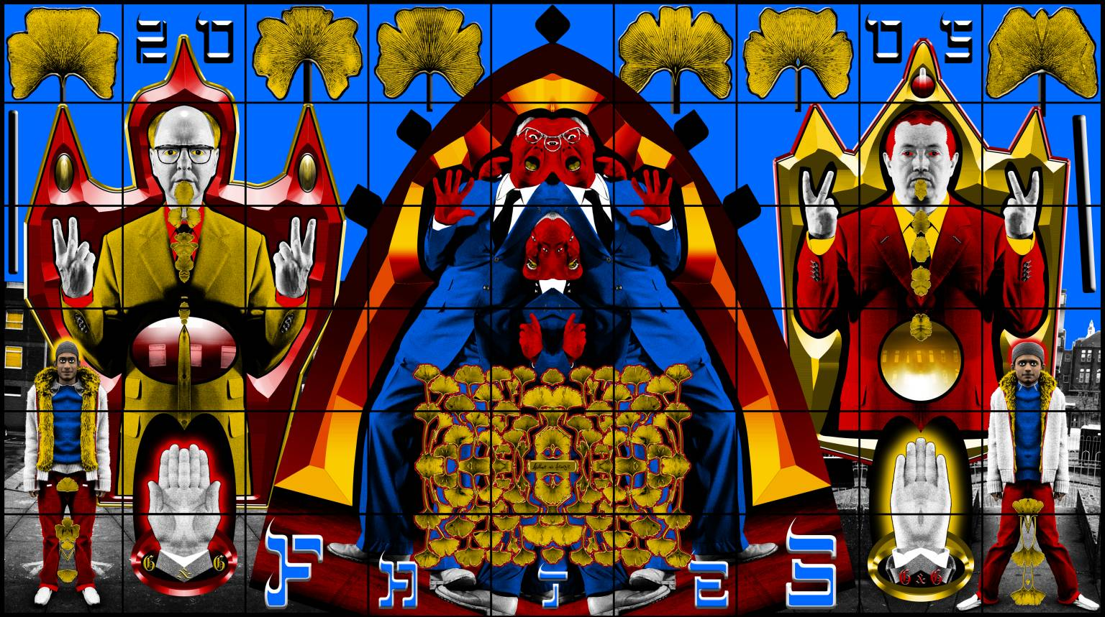
Gilbert and George

Slide 23
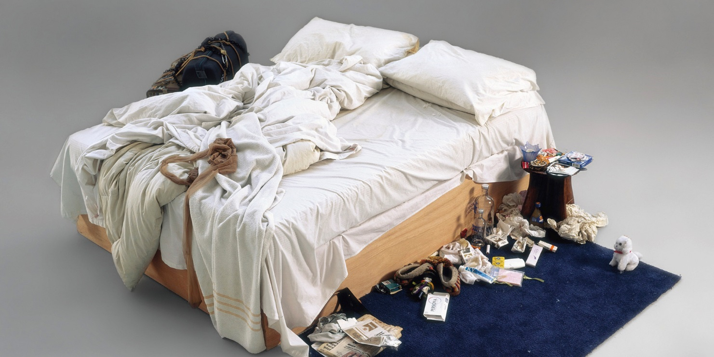
Young British Artists
https://www.youtube.com/watch?v=sRdpV7GqtrA
Tracey Emin (1963), My Bed

Slide 24
Damien Hirst (1965)

Slide 25
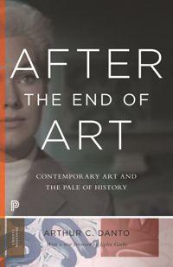
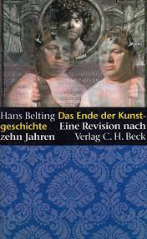
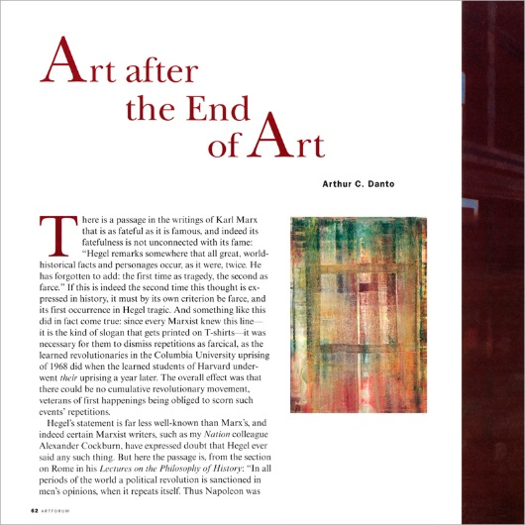
Modern / Contemporary

Slide 26
Contemporary
It designates less a period than what happens after there are no more period in master narrative of art and less a style of making than a style of using styles…
post-historical art
A state of being permanently out of time, suspended in a state after or beyond history
contemporary has come to designate something more than simply the art of the present…
art produced within certain structure of production never seen before
Contemporary art is different in kind from modern art?

Slide 27
Modern // contemporary
Or ?:
Artistic production which is different in kind from
historical (including modernist) art
Common-sense:
What is happening now
Belonging to our times
Art produced by our contemporaries
(is it so simple?)

Slide 28
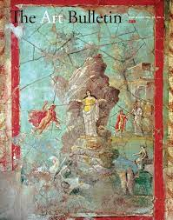
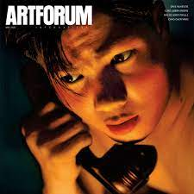
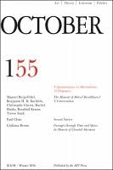
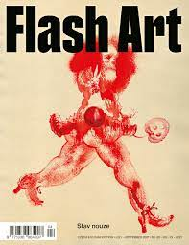
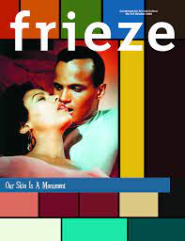
Is contemnporary a part of history? In what sense?

Slide 29
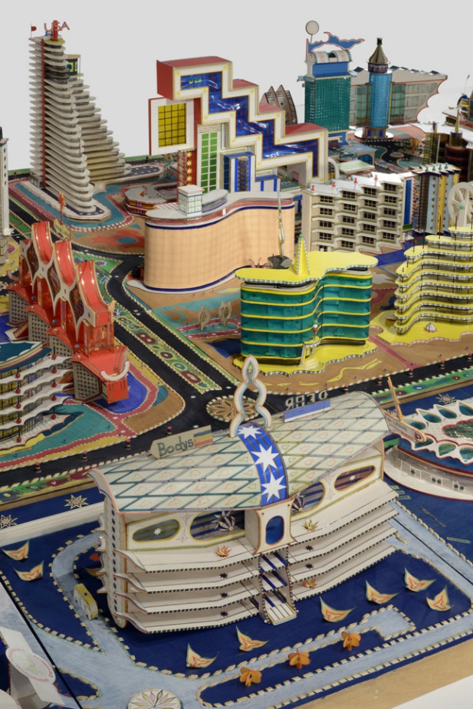
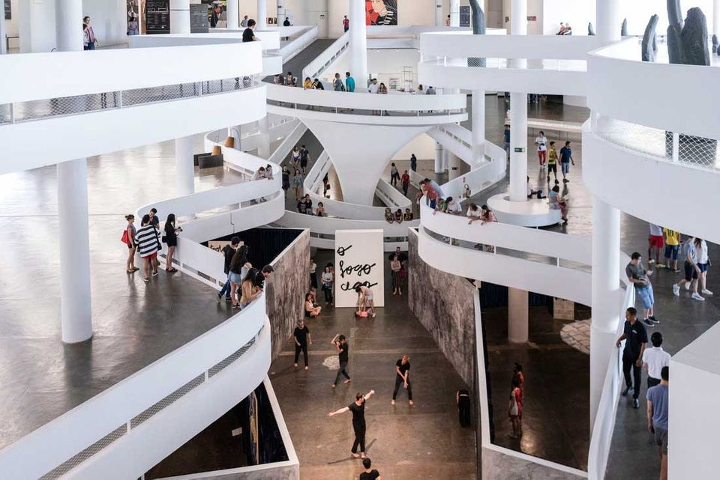
Key to definition of contemporary art
globalization
Decentering
(Art is where money is)

Slide 30
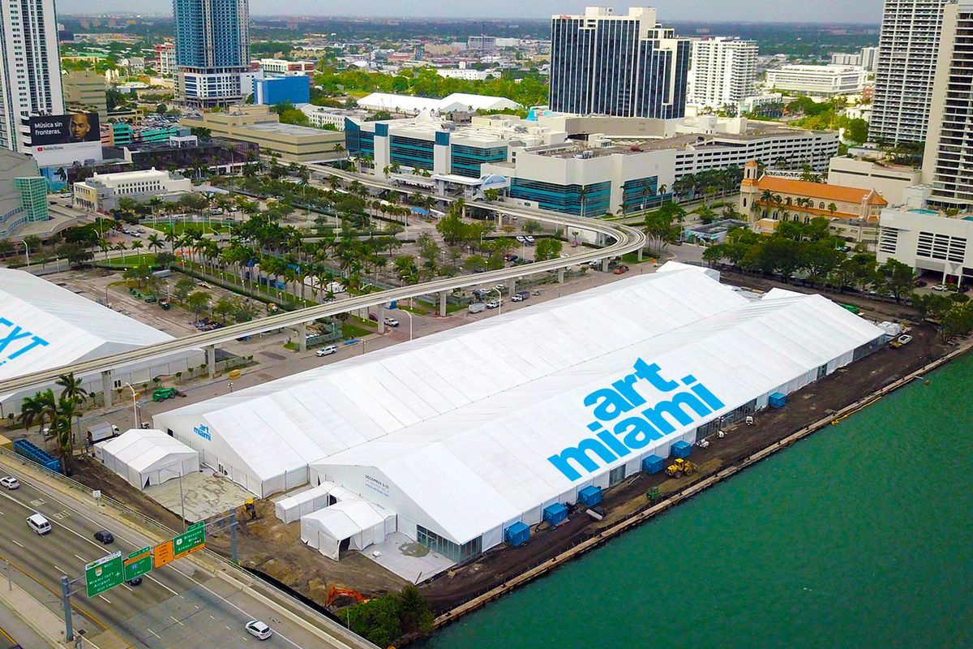
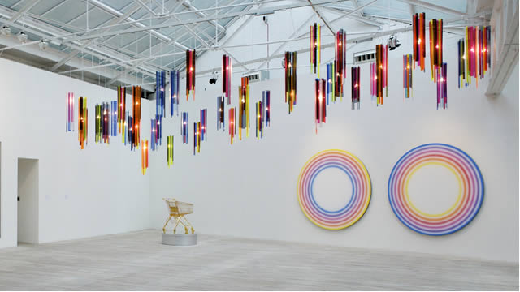
Art market forces
Commercial galleries
Collectors
Art fairs

Slide 31
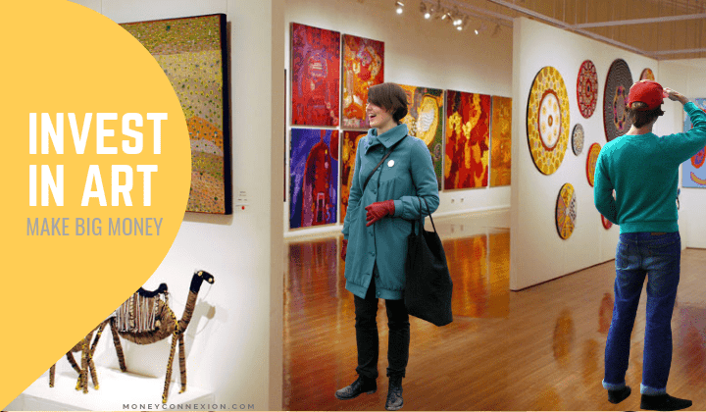
Intense commodification Art as investment
Damien Hirst, For the Love of God, 2007

Slide 32
Who is contemporary? Who is part of history of art?
Antony Gormley 1954
Anish Kapoor 1954
Rachel Whiteread 1963
Thomas Schutte 1954
Vincent Desiderio 1955
Jaroslav Róna 1957
Marlene Dumas 1953
Anselm Kiefer 1945
Berlinde de Bruyckere 1964
Callum Innes 1962

Slide 33
Anselm Kiefer 2021

Slide 34
Documenta 15
Ruangruppa

Slide 35
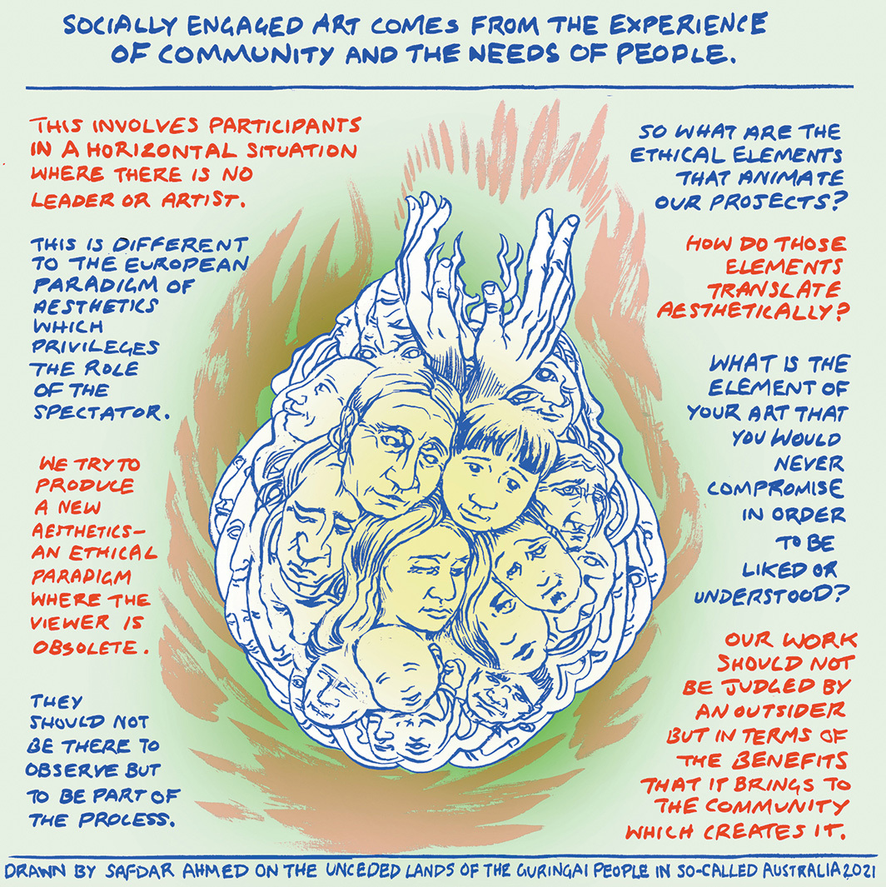

Slide 36
Taring Padi, People´s Justice, detail

Slide 37
1860 1900 1940 1975 2000 2020
MODERN CONTEMPORARY
Classical (high) modernism
Late modernism
Extended contemporary
Present

Slide 38
Art // World Framework
1989-2010
End of Cold War
Economic globalization
Dominance of economic neolioberalism
Spread of integrated electronic culture
2010 –
Return of cold war
Raise of authoritarian regimes and tendencies
Contuing crisis of neoliberal model
Climate change
COVID
Spread of social platforms
Spread of AI
Does a match between world historical epoch and universal art historical period remain viable in contemporary conditions?

Slide 39
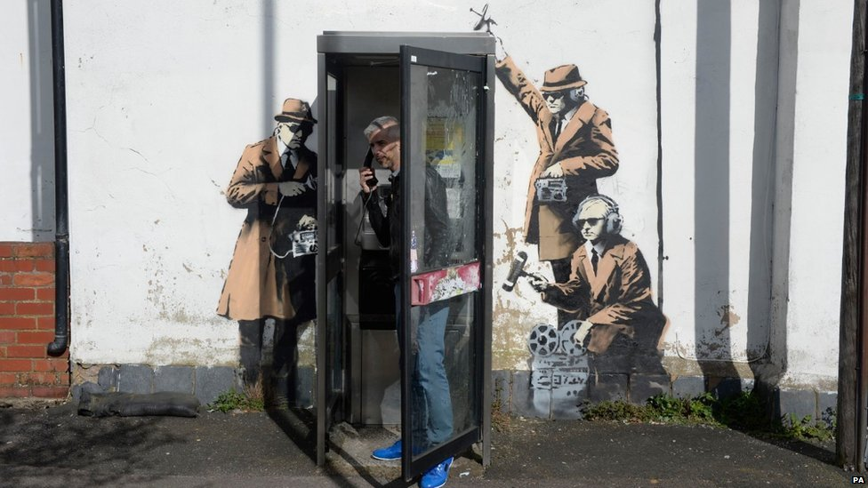
Closed world of contemporary art
“In the 1970s, there were hundreds of people in the art world. Now there are hundreds of thousands. The art world is so big that even people who’ve been collecting for thirty-five years are seeking help to navigate it.”
Massive overproduction
Loss of quality and banality
Populist, yet at the same time inacessible
Competing fiercely for attention (attention economy)
Pervasive influence of fashionable theories and discourses
Dictate of art market forces
Deskilling
https://magazin.aktualne.cz/umelec-odevzdal-galerii-za-dva-miliony-jen-prazdne-ramy-jde/r~89957c24210411ec94d2ac1f6b220ee8/

