Slide 1
Outline
Before Beading
-Shellwork
-Quillwork
The Indigenization of Beading
-bead trade; “object itinerary”
-the global made local, and often back again
-Lakota beaded containers
-a few examples of Lakota belongings that are now in French collections
-Blackfeet dress
Living Beaders
Key Definitions
Expressive culture
Belonging > artifact / object
Co-eval artistry
Survivance = survival and resistance

Slide 2
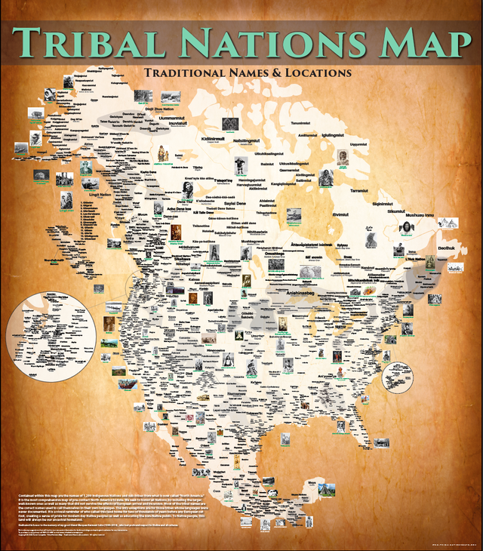
Powhatan’s Mantle,

Slide 3
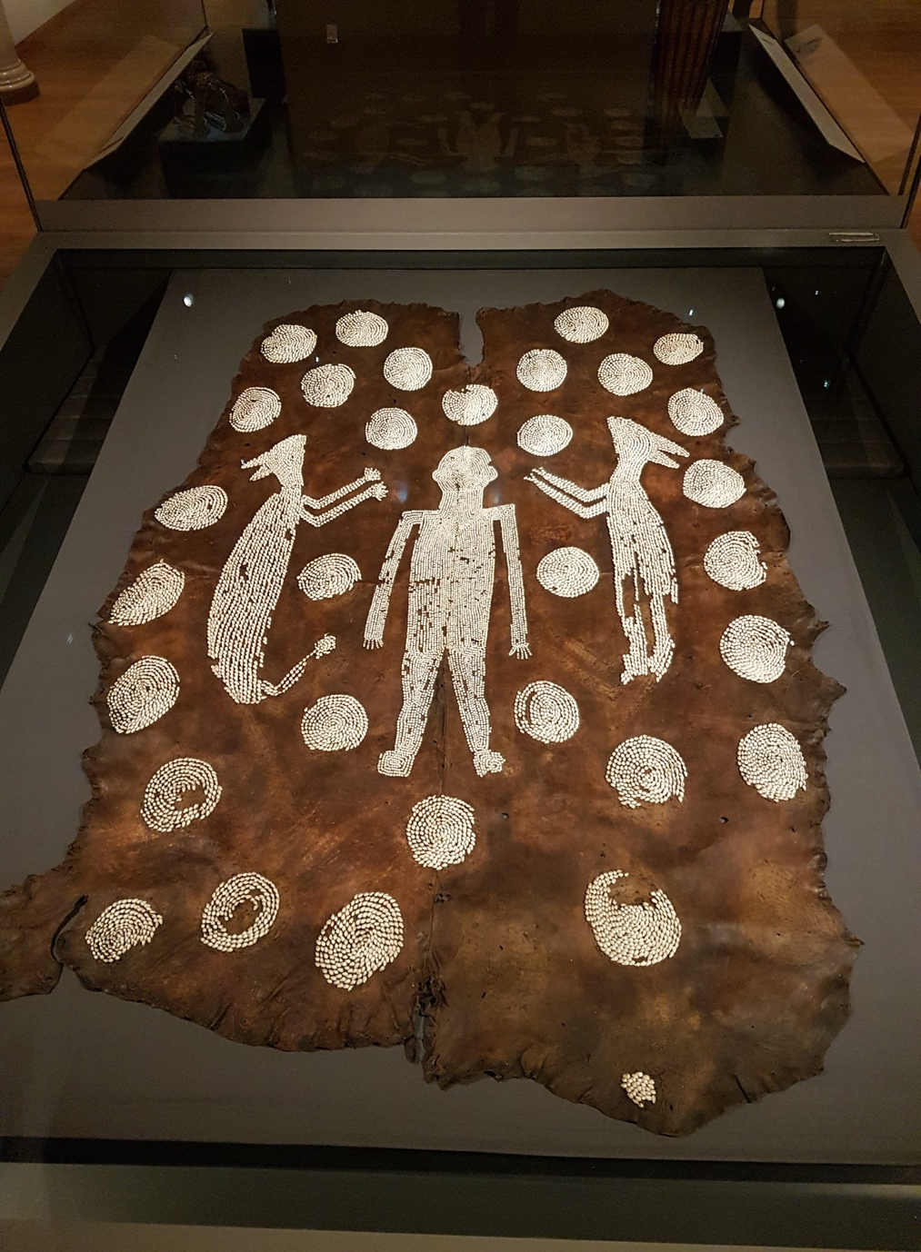
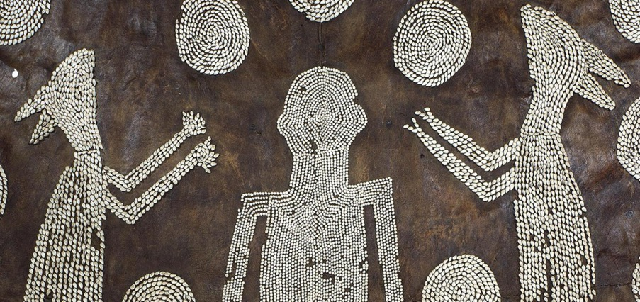
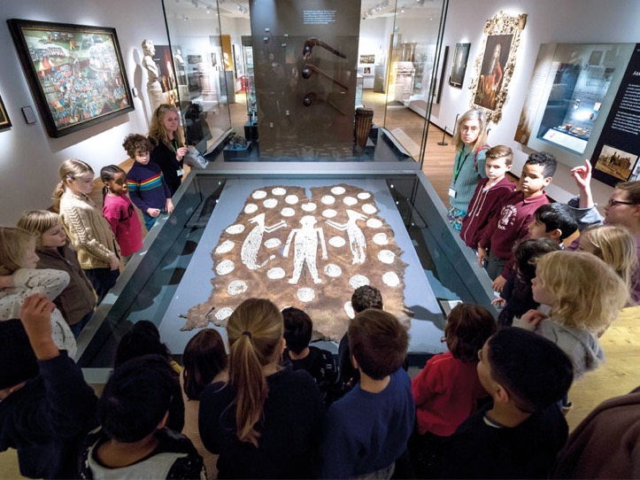
Powhatan’s Mantle,

Slide 4
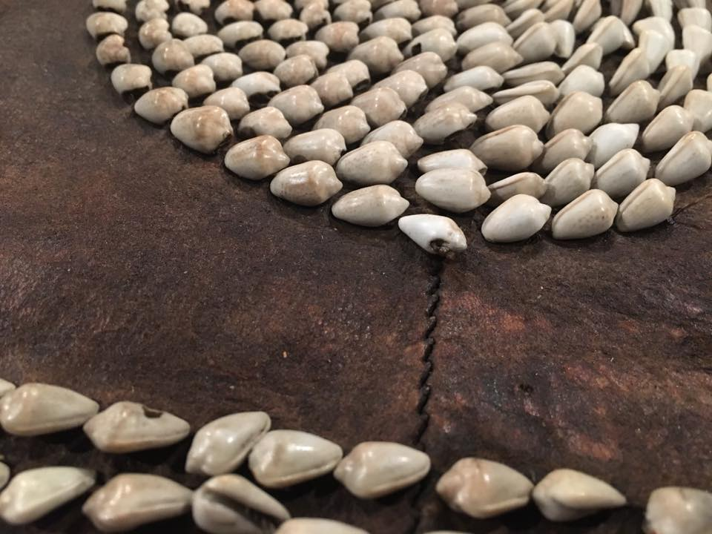
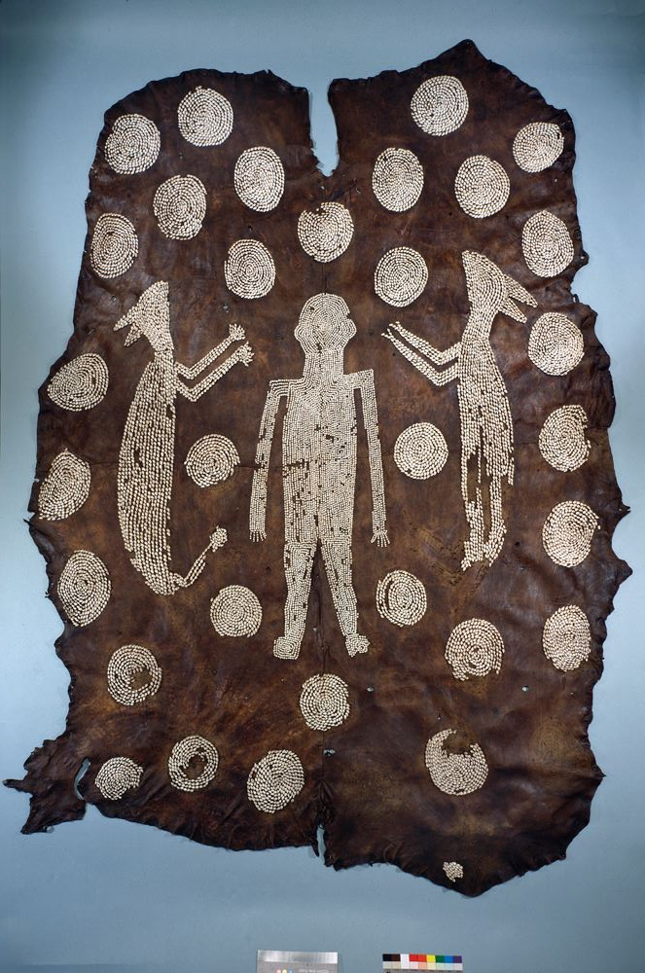
Powhatan’s Mantle,

Slide 5
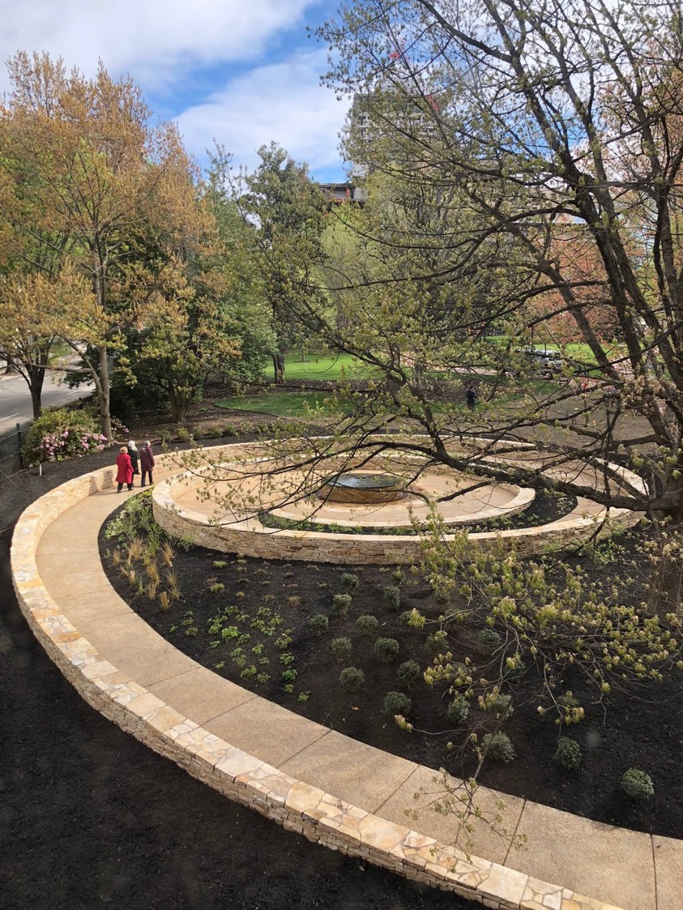
Alan Michelson (Mohawk), Mantle, 2018

Slide 6
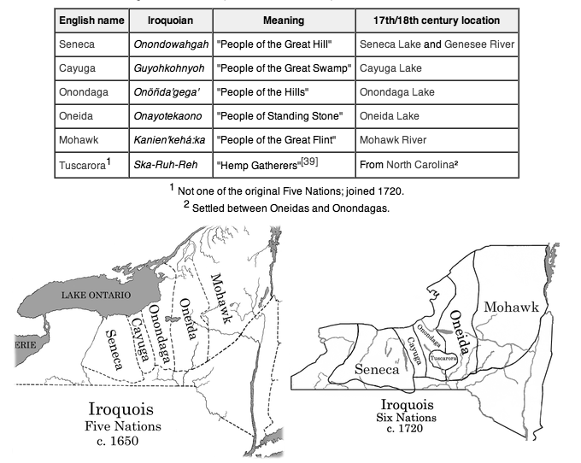
Haudenosaunee

Slide 7
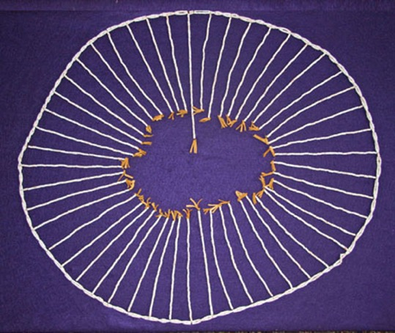
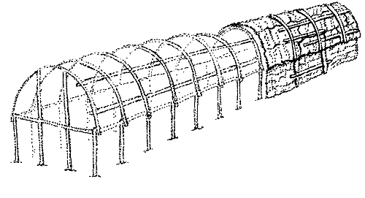
Haudenosaunee
Circle Wampum
6 after Tuscarora join in 1722-3
Longhouse

Slide 8
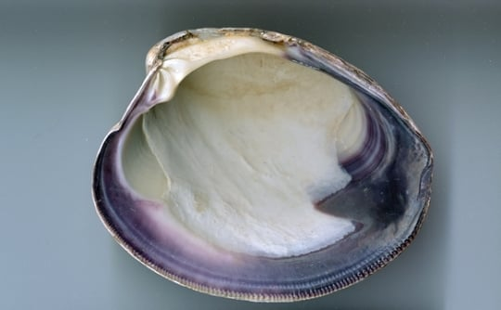
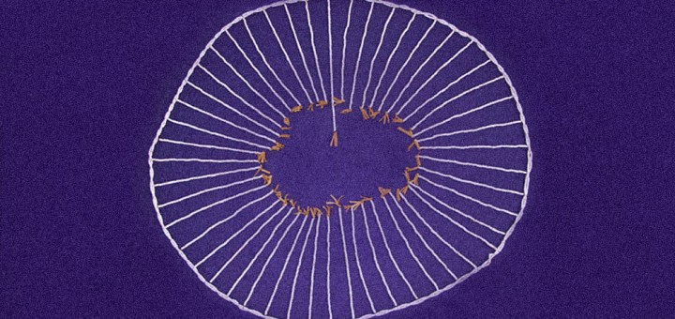
Co-eval artistry
Right to opacity or readings beyond our access
Wampum; quahog shells
Unknown Iroquois Maker, Belt, 1750-70, skin, birchbark, quillwork, British Museum, objects from Benjamin West’s Studio

Slide 9
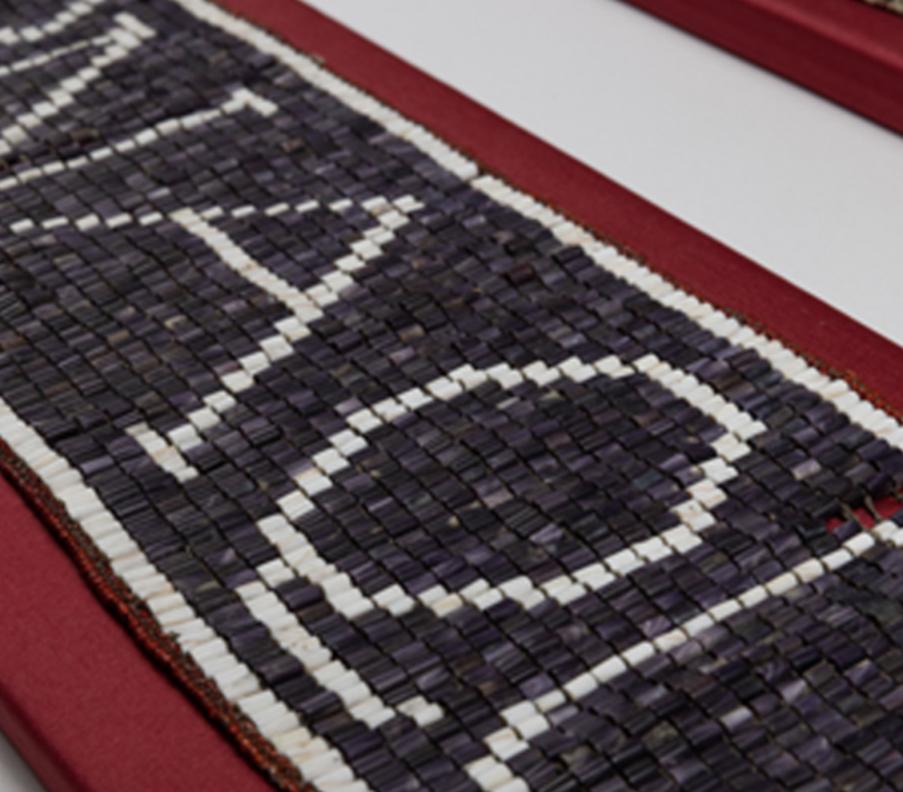
Co-eval artistry
Right to opacity or readings beyond our access
Wampum; quahog shells
Unknown Iroquois Maker, Belt, 1750-70, skin, birchbark, quillwork, British Museum, objects from Benjamin West’s Studio

Slide 10
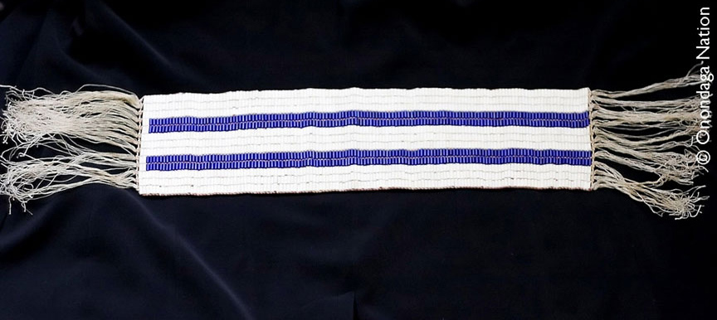
Wampum; quahog shells
Two Row Wampum – Gaswéñdah
17th century

Slide 11
Guswenta or Two-Row Wampum, 1613 – Dutch and Haudenosaunee

Slide 12
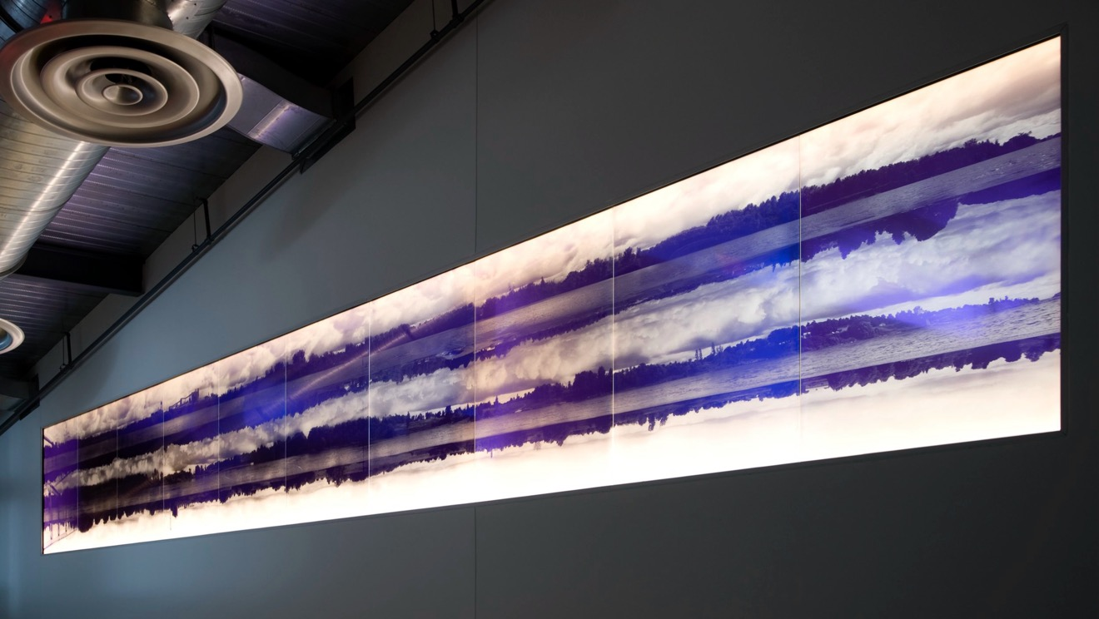
Alan Michelson, Third Bank of the River, etched glass, 2009.
Two Row Wampum – Gaswéñdah
17th century

Slide 13
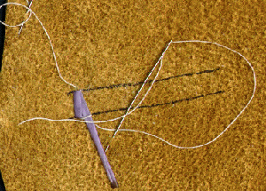
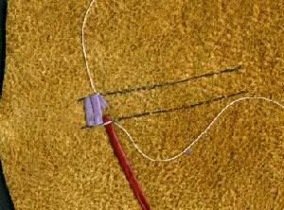
Quillwork

Slide 14
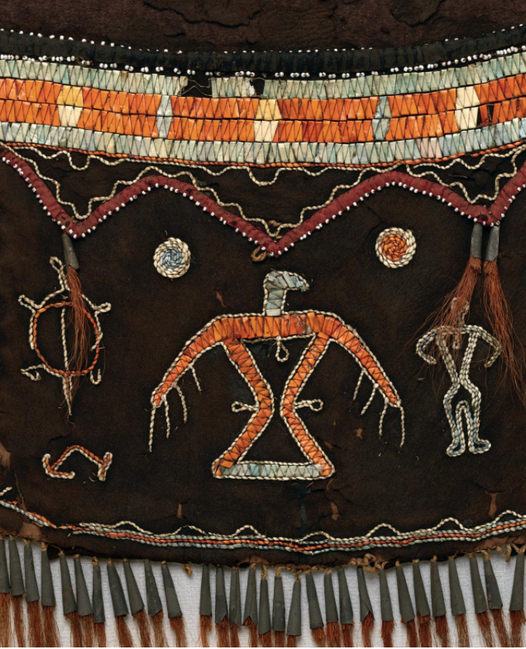
Shoulder bag, Anishinaabe, possibly Mississauga Ojibwa, c. 1800, tanned leather, porcupine quills, dye, glass beads, silk ribbon, metal cones, and deer hair, Metropolitan Museum of Art, 2019.456.3

Slide 15
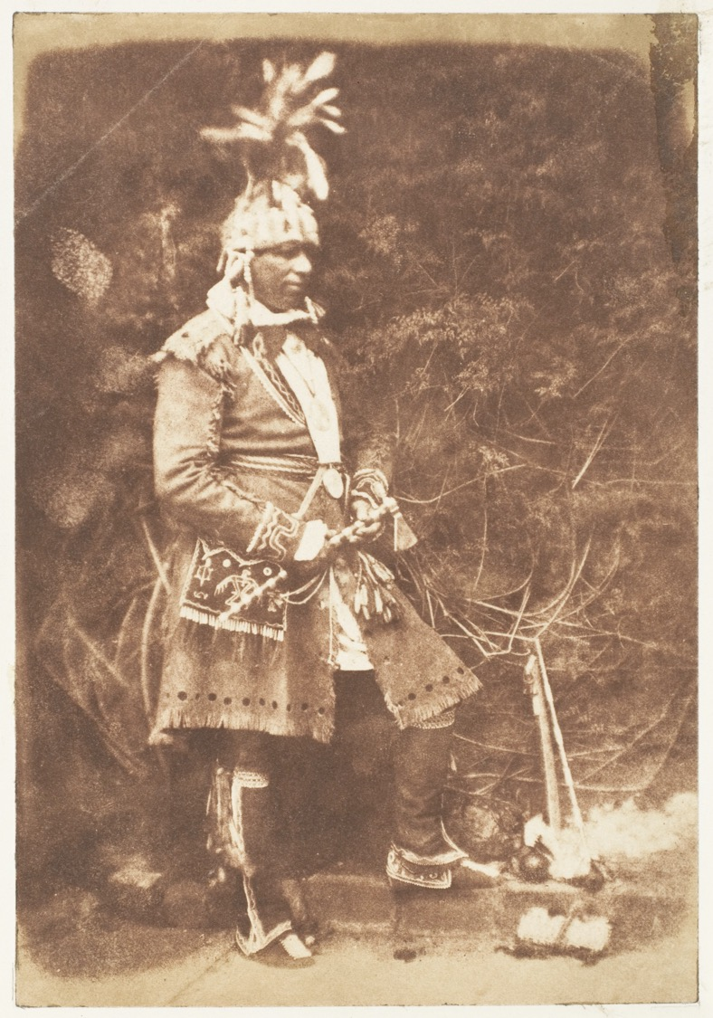
Hill and Adamson, Kahkewāquonāby or Reverend Peter Jones, 1845, salted paper print from paper negative, Metropolitan Museum of Art
Mississauga chief in 1829, taken on Edinburgh trip in 1845

Slide 16
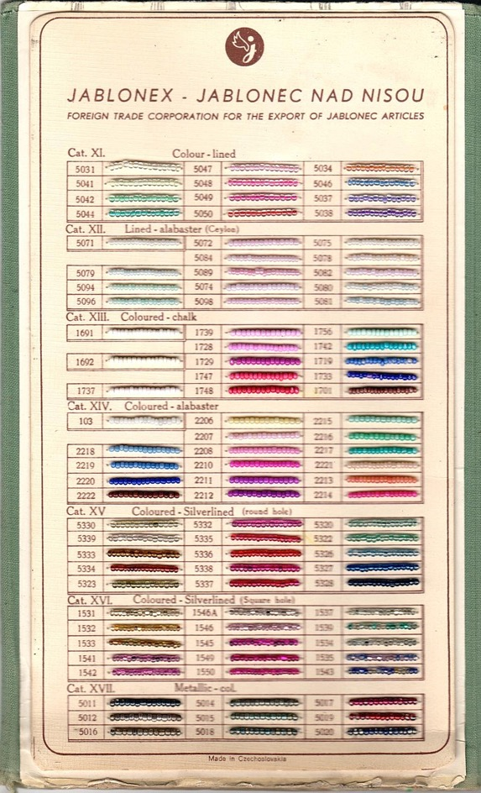
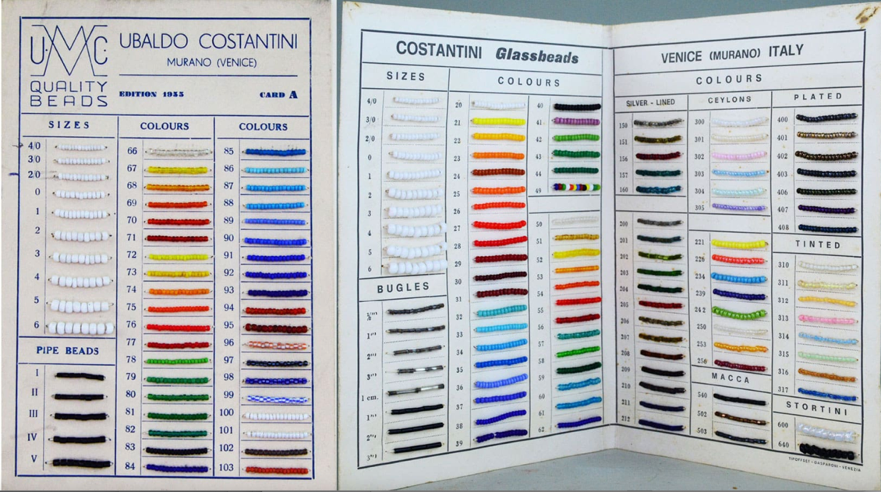
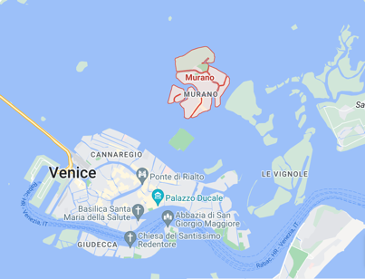
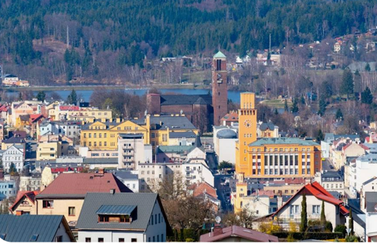
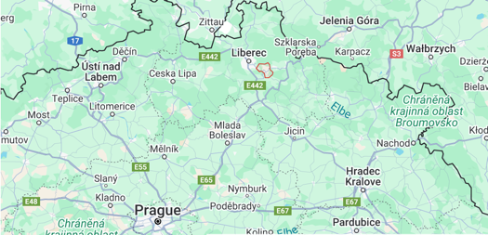
Jablonec nad Nisou (Gablonz an der Neiße) in Bohemia
Murano in Venice

Slide 17
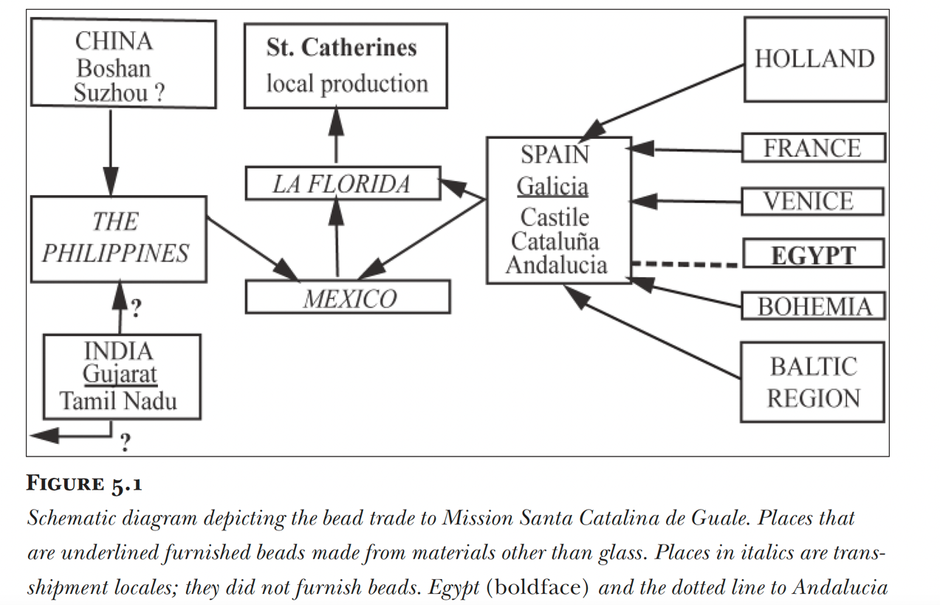
“multiple overlapping communities of practice”
Notes:
As layered with stories and meanings as the paintings we have been looking at
Use of beads showing already a transnational dialogue with Italy; women makers on both sides
Think about exporting beads to the borderlands of Turtle Islands and then those beads migrating back to Italy
Blair, object itineraries/ingold’s meshwork
“community of practice”
17th century, oer 70,000 beads excavated

Slide 18
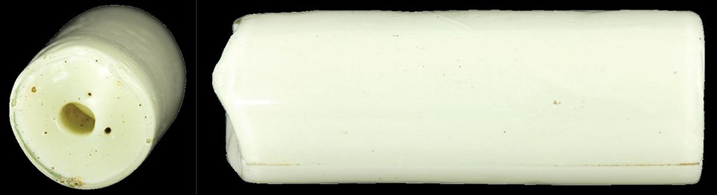
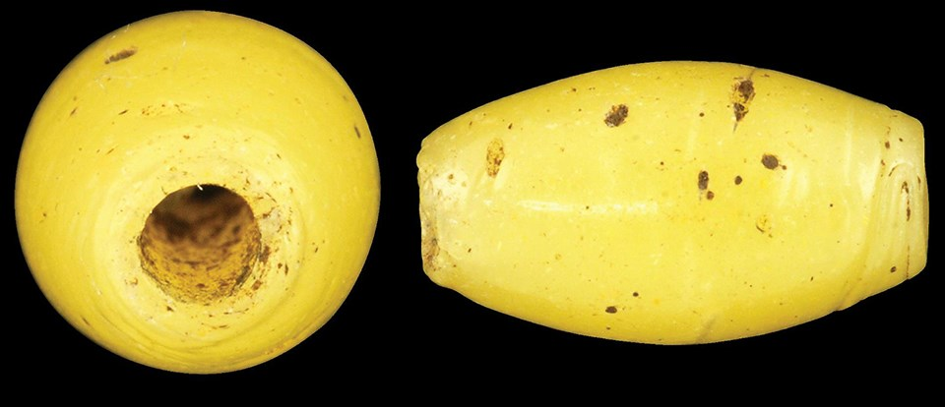
“multiple overlapping communities of practice”
Drawn
Wound
Notes:
As layered with stories and meanings as the paintings we have been looking at
Use of beads showing already a transnational dialogue with Italy; women makers on both sides
Think about exporting beads to the borderlands of Turtle Islands and then those beads migrating back to Italy
Blair, object itineraries/ingold’s meshwork
“community of practice”
17th century, oer 70,000 beads excavated

Slide 19
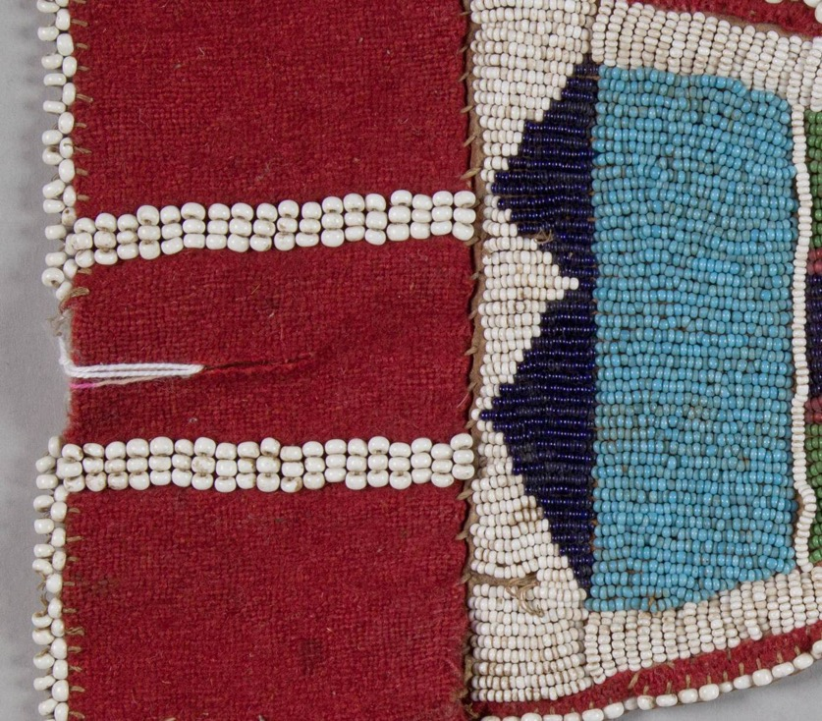
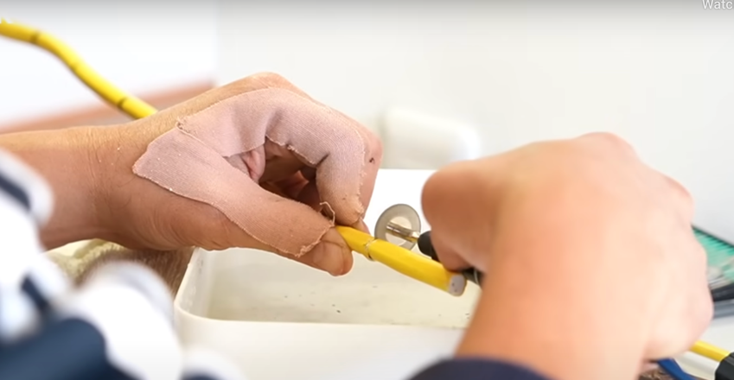
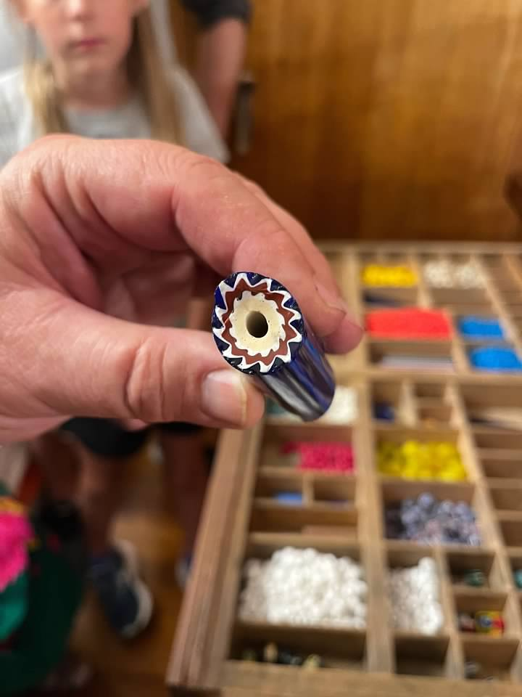
https://matotope.com/period-embroidery-beads-old-color-beads/
Pony beads – seed beeds

Slide 20
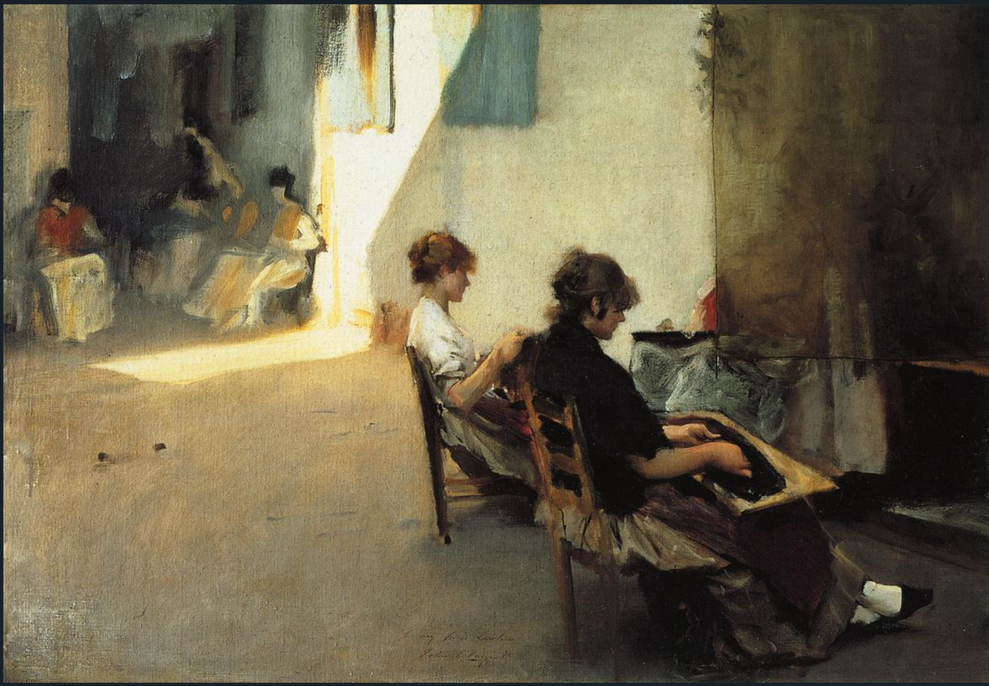
John Singer Sargent, Bead Stringers, 1880-82

Slide 21
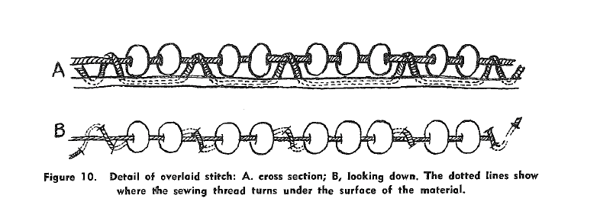
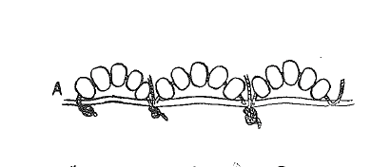
Overlaid stitch
Sinew – animal membrane/tendon
Lane Stitch

Slide 22
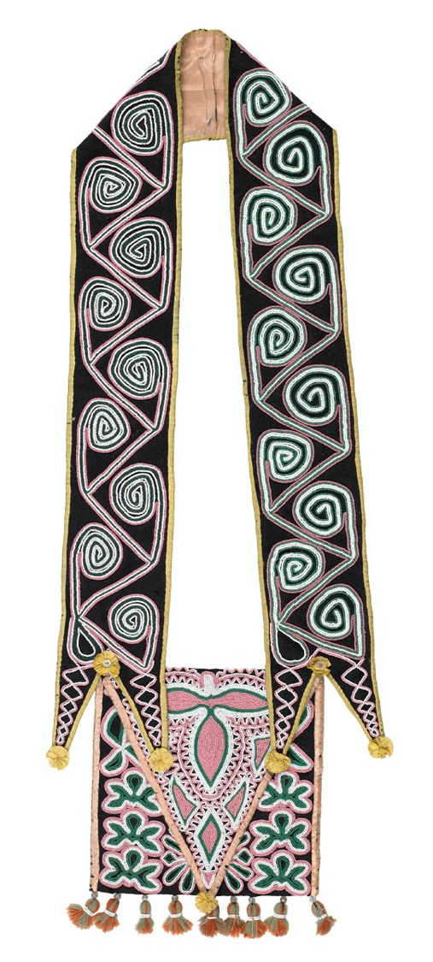
Lana Ray
“Beading Becomes a Part of your Life” International Review of Qualitative Research 9, no. 3 (Fall 2016): 363-78
-Beading as an Indigenous mode of teaching and an academic mode of inquiry
-storytelling – “even when patterns are nameless they are not without story”
-relationality – from sinew (connective tissue) and from the parts and whole in beading itself – interdependence / intergenerationality
-respect – details work within the whole
-harmony – promoting spiritual and community consciousness (teaching-making-gifting)
-balance
-repetition – promoting meditation and mindfulness
From Carmen Robertson
-land-based epistemology
Muscogee Creek Maker, Bandolier Bag, 1820
Notes:
As layered with stories and meanings as the paintings we have been looking at
Use of beads showing already a transnational dialogue with Italy; women makers on both sides
Think about exporting beads to the borderlands of Turtle Islands and then those beads migrating back to Italy
Blair, object itineraries/ingold’s meshwork
“community of practice”
17th century, oer 70,000 beads excavated

Slide 23
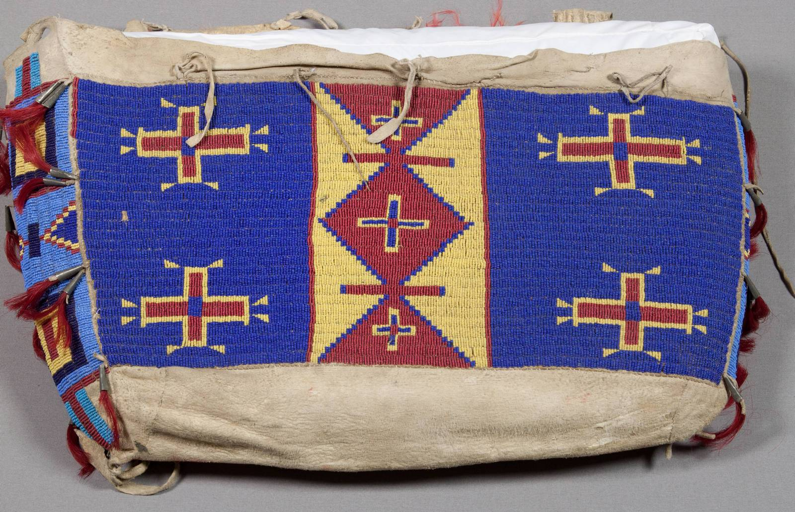
Abstraction
Oglala Lakota Sun Dance leader Loretta Afraid of Bear Cook explains the significance of the Wokphun (whoa kphan), a Possible Bag, such as those made by Little Thunder: “Wo is the word description used for all living things or everything that is alive. Ph’an is a description for creating something smooth and malleable from something rough using your creativity. It is the word used for describing a special container, a sacred container.”
Lakota Maker, Possible Bag/ Wokphan, c. 1880s
Notes:
As layered with stories and meanings as the paintings we have been looking at
Use of beads showing already a transnational dialogue with Italy; women makers on both sides
Think about exporting beads to the borderlands of Turtle Islands and then those beads migrating back to Italy
Blair, object itineraries/ingold’s meshwork

Slide 24
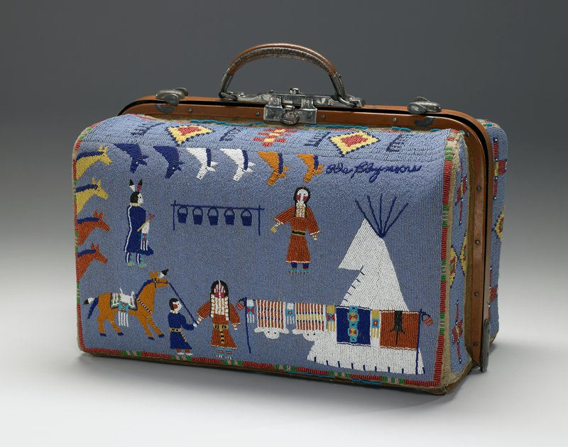
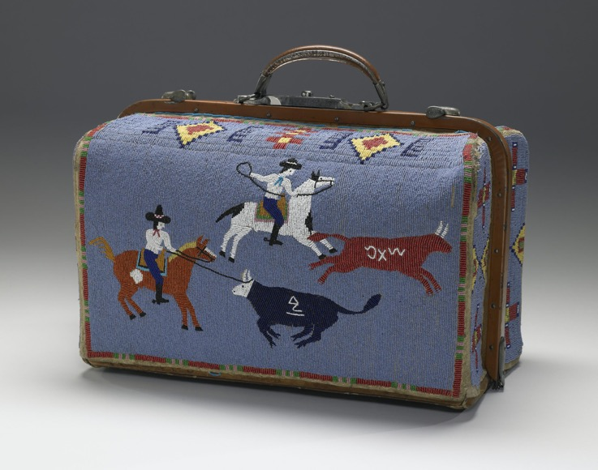
Nellie Two Bears Gates (Yanktonai Dakota), Suitcase for Ida Claymore, 1880-1910, beads, hide, oilcloth, thread
Notes:
As layered with stories and meanings as the paintings we have been looking at
Use of beads showing already a transnational dialogue with Italy; women makers on both sides
Think about exporting beads to the borderlands of Turtle Islands and then those beads migrating back to Italy
Blair, object itineraries/ingold’s meshwork

Slide 25
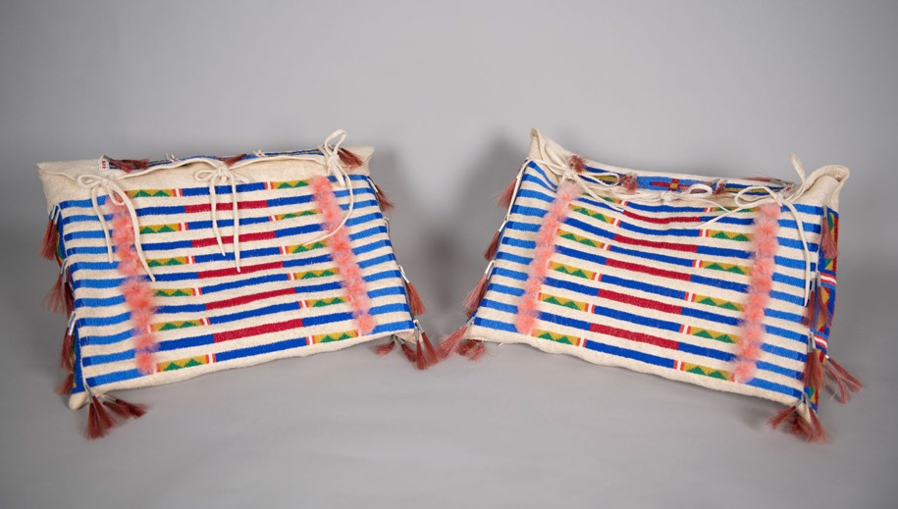
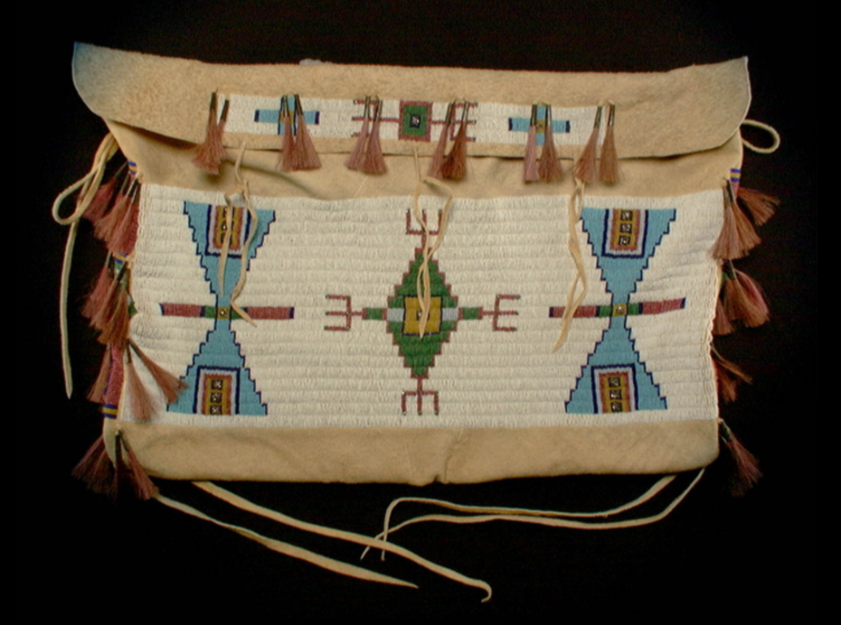
Rosalie Little Thunder (Sičhą́ǧu Lakȟóta, 1949-2014), Possible Bags, 1995, tanned hide, beads, feathers, and horsehair, 13 ½ x 18 in. ea.; Joslyn Art Museum, Museum purchase and partial gift of Putt Thompson, 1995.14.1
Rosalie Little Thunder (Sičhą́ǧu Lakȟóta, 1949-2014), Possible Bag, 1985, hide, glass beads/ horsehair, hide, sinew, National Museum of the American Indian, donated to NMAI by Pam King in 1998, 25/4717.
“old patterns are peaceful and natural to me – so peaceful and powerful that when I start doing them, it’s almost as though I can recover that piece; I can achieve a kind of meditation. I can relate today and tomorrow with yesterday.”
“’look at this design, see the color combination.’ I’m taking them back to that earlier preservation period. The more I do this work, the more I see its relevance to my role from my grandfather’s generation to my children’s."

Slide 26
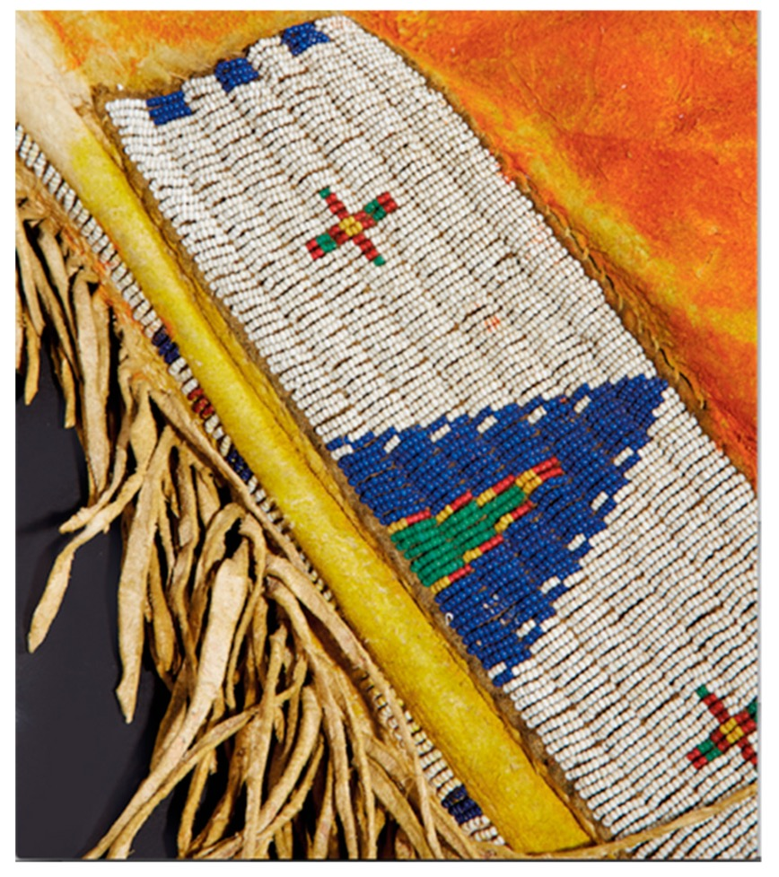
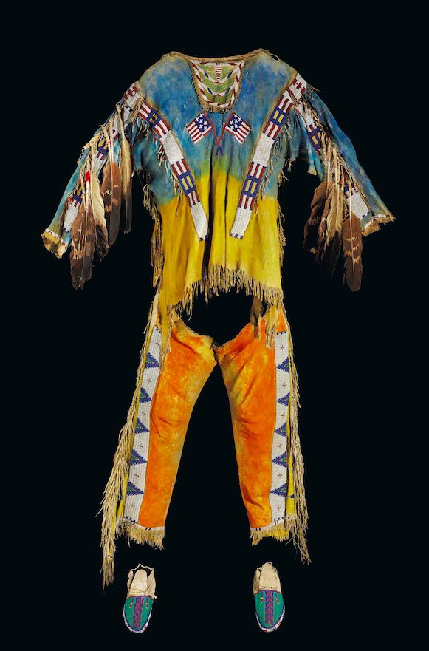
Plains Indian buckskin tunic and
leggings given or sold to Rosa Bonheur
in 1889. Beadwork, eagle feathers,
paint, and quillwork on deerskin.
Musée de l’Atelier Rosa-Bonheur,
Ch.teau de By, Thomery, France.
Photograph courtesy of Christie’s
Paris.
Oglala Lakota Maker, Warrior Shirt and pants, before 1887

Slide 27
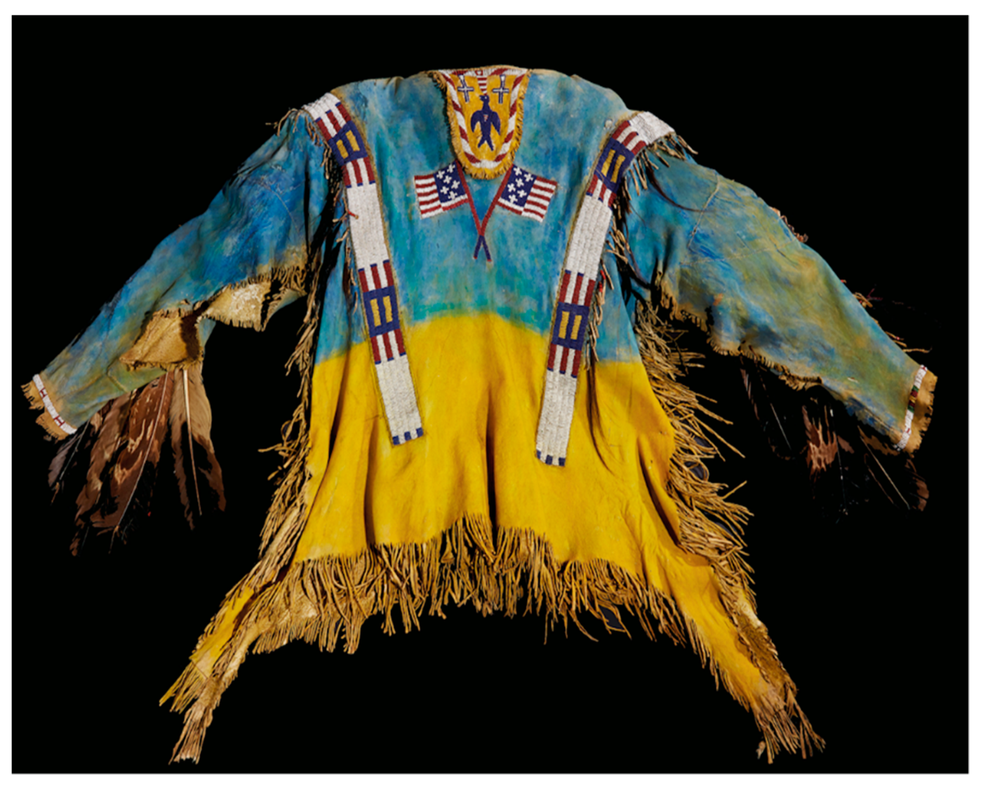

Slide 28
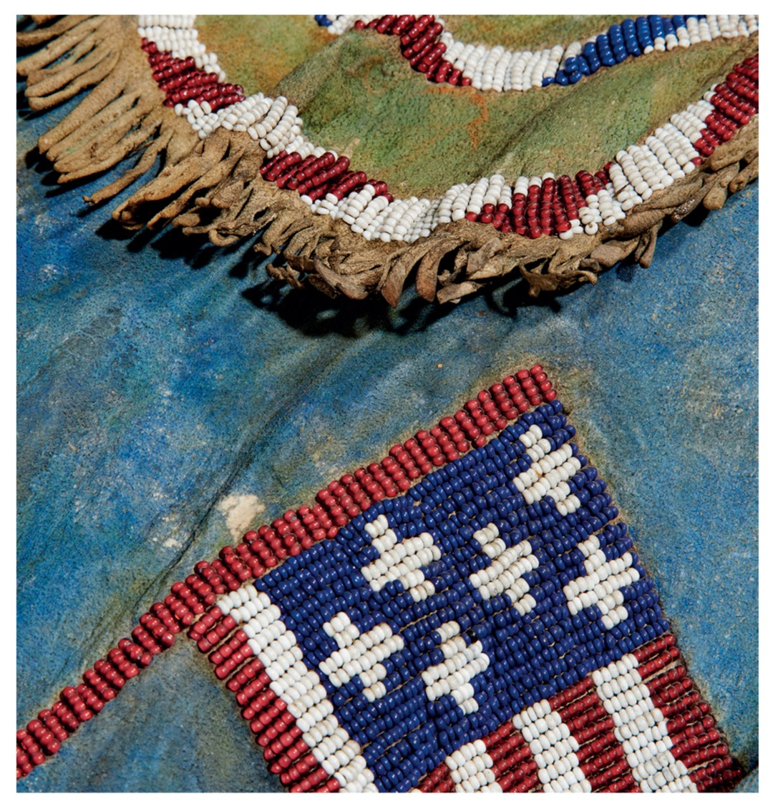

Slide 29
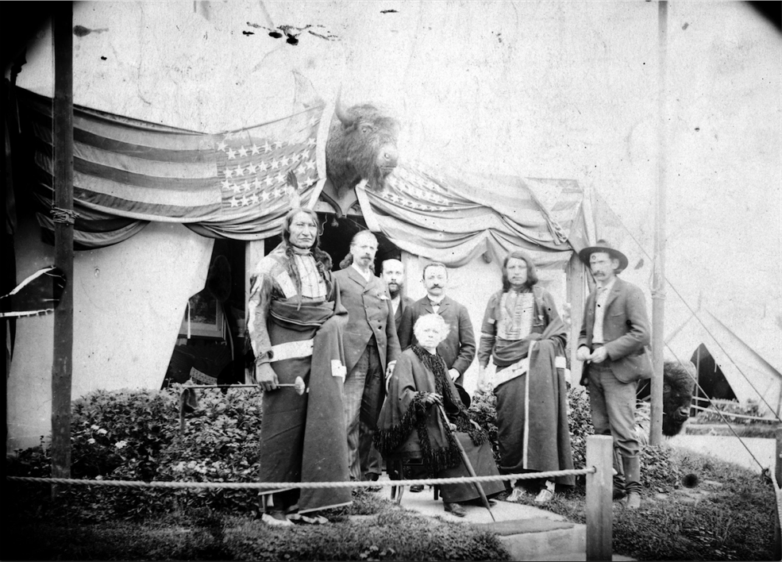
I. Composite Characters
Sam Mathó̌ Išnála
Sam Lone Bear
Íŋyaŋ Mathó̌
Rocky Bear
Itĥúŋkasan Gleŝká
Spotted Weasel

Slide 30
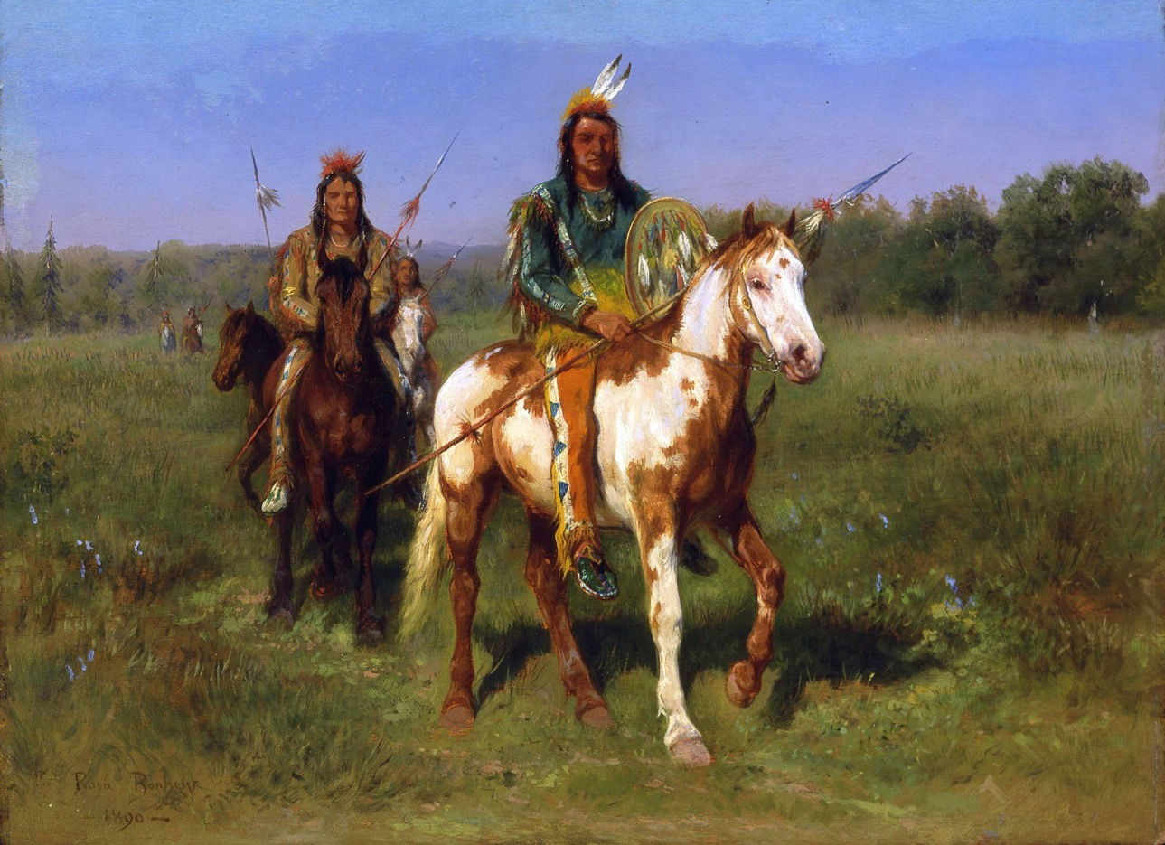
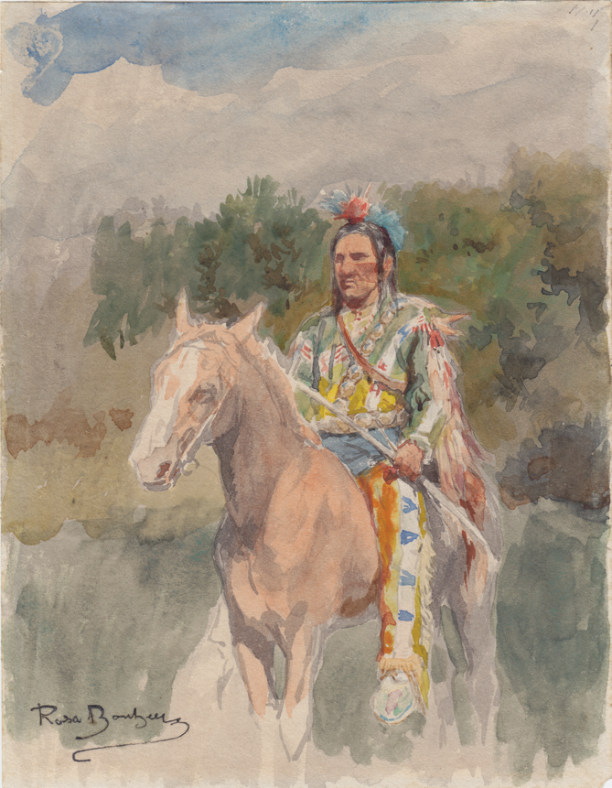
Rosa Bonheur, Mounted Indians Carrying Spears, 1890, oil on board, Whitney Gallery of Western Art, Buffalo Bill Center of the West
.

Slide 31
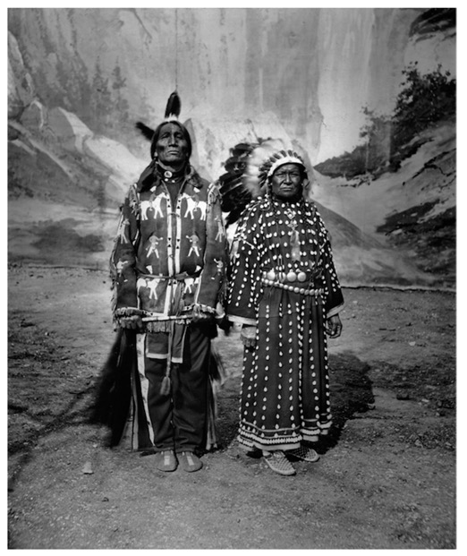
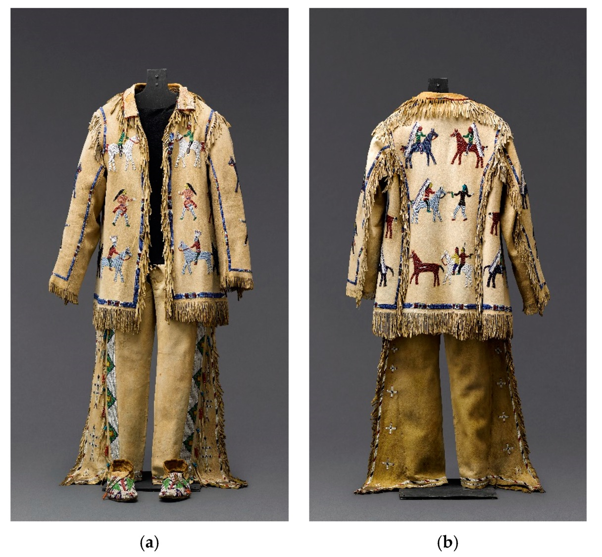
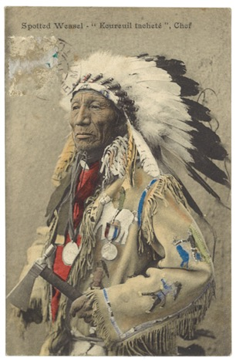

Slide 32
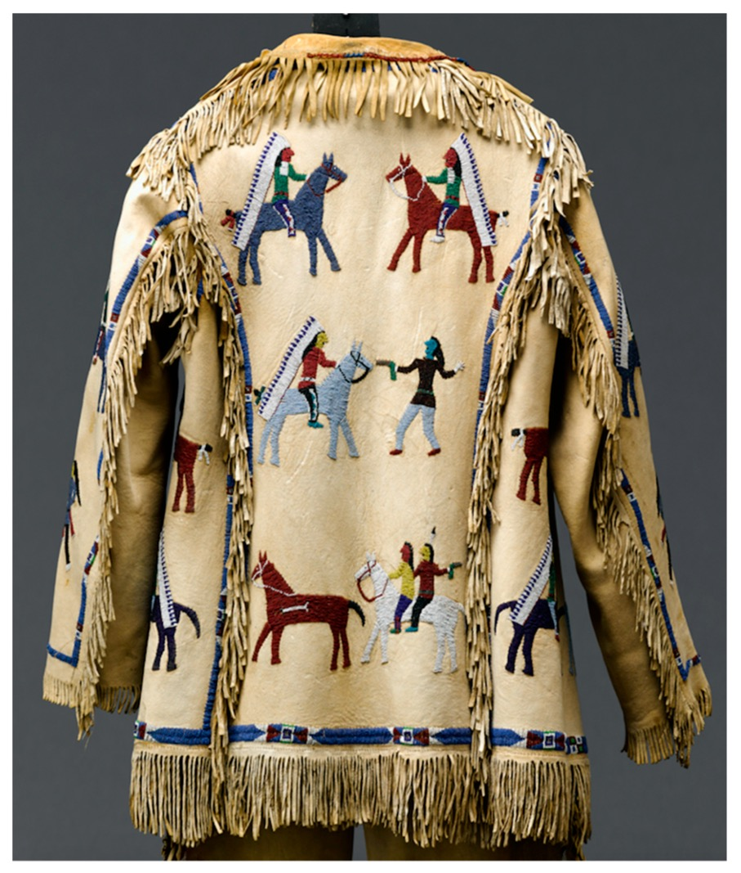


Slide 33


Slide 34


Blackfeet Maker, Dress, c. 1900

Slide 35


Blackfeet Maker, Dress, c. 1900

Slide 36




Slide 37


Slide 38



Nancy Josephine Clark, Blackfeet Dress, 2023
Mokakssini – Blackfoot Knoweledge

Slide 39

Thomas Jefferson
Indian peace medal
owned by Powder Face
(Northern Inunaina/
Arapaho), Oklahoma,
1801. Artist unknown.
Bronze copper alloy,
hide, porcupine quills,
feathers, dye, metal
cones, 14 x 17 . in.
National Museum of
the American Indian,
Smithsonian Institution
(24/1965)

Slide 40


Ruth Cuthand (Plains Cree and Scots), Trading: Smallpox, 2009, beads and acrylic on suede board, 24 x 18”, MacKenzie Art Gallery
Notes:
As layered with stories and meanings as the paintings we have been looking at
Use of beads showing already a transnational dialogue with Italy; women makers on both sides
Think about exporting beads to the borderlands of Turtle Islands and then those beads migrating back to Italy
Blair, object itineraries/ingold’s meshwork
“community of practice”
17th century, oer 70,000 beads excavated

Slide 41

Catherine Blackburn (Dëne ), But There’s No Scar
Ruth Cuthand, Trading: Smallpox, 2009, beads and acrylic on suede board, 24 x 18”, MacKenzie Art Gallery
Notes:
As layered with stories and meanings as the paintings we have been looking at
Use of beads showing already a transnational dialogue with Italy; women makers on both sides
Think about exporting beads to the borderlands of Turtle Islands and then those beads migrating back to Italy
Blair, object itineraries/ingold’s meshwork
“community of practice”
17th century, oer 70,000 beads excavated

Slide 42

Catherine Blackburn, But there’s No Scar II?
Notes:
As layered with stories and meanings as the paintings we have been looking at
Use of beads showing already a transnational dialogue with Italy; women makers on both sides
Think about exporting beads to the borderlands of Turtle Islands and then those beads migrating back to Italy
Blair, object itineraries/ingold’s meshwork
“community of practice”
17th century, oer 70,000 beads excavated

Slide 43

Catherine Blackburn, But there’s No Scar ?
Notes:
As layered with stories and meanings as the paintings we have been looking at
Use of beads showing already a transnational dialogue with Italy; women makers on both sides
Think about exporting beads to the borderlands of Turtle Islands and then those beads migrating back to Italy
Blair, object itineraries/ingold’s meshwork
“community of practice”
17th century, oer 70,000 beads excavated

Slide 44


Co-eval artistry
Right to opacity or readings beyond our access
1831 Wampum, Vatican Museums
Christi Belcourt, Wisdom of the Universe, 2014
“Perhaps it's time to place the rights of Mother Earth ahead of the rights to Mother Earth."
WHOMPOM
Indigenous person and a priest
Notes:
sent from the Sulpician missionaries at the Lake of the Two Mountains (Lac des Deux Montagnes) in Quebec to Pope Gregory XVI as a form of gift or prestation
Algonquin, Nipissing, and Mohawk,

Slide 45

Co-eval artistry
Right to opacity or readings beyond our access
Dyani White Hawk and Christi Belcourt
1831 Wampum, Vatican Museums
Dyani White Hawk, Takes Care of Them
Indigenous person and a priest
Notes:
sent from the Sulpician missionaries at the Lake of the Two Mountains (Lac des Deux Montagnes) in Quebec to Pope Gregory XVI as a form of gift or prestation
Algonquin, Nipissing, and Mohawk,

Slide 46


Co-eval artistry
Right to opacity or readings beyond our access
1831 Wampum, Vatican Museums
Lakota maker, Early 20th century dentalium shell dress
Dyani White Hawk, Takes Care of Them
Indigenous person and a priest
Notes:
sent from the Sulpician missionaries at the Lake of the Two Mountains (Lac des Deux Montagnes) in Quebec to Pope Gregory XVI as a form of gift or prestation
Algonquin, Nipissing, and Mohawk,

Slide 47



“To be in front of something as precious as this was a bit emotional for me … It felt like a presence.” –Hilda Nicholas
Co-eval artistry
Right to opacity or readings beyond our access
1831 Wampum, Vatican Museums
WHOMPOM
Indigenous person and a priest
Notes:
sent from the Sulpician missionaries at the Lake of the Two Mountains (Lac des Deux Montagnes) in Quebec to Pope Gregory XVI as a form of gift or prestation
Algonquin, Nipissing, and Mohawk,

