Slide 1
Introduction
Matthew Rampley
27.9.2024

Slide 2
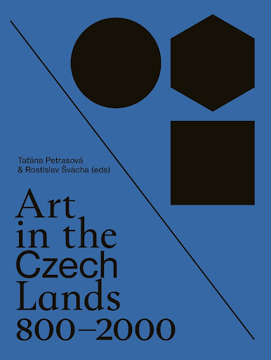
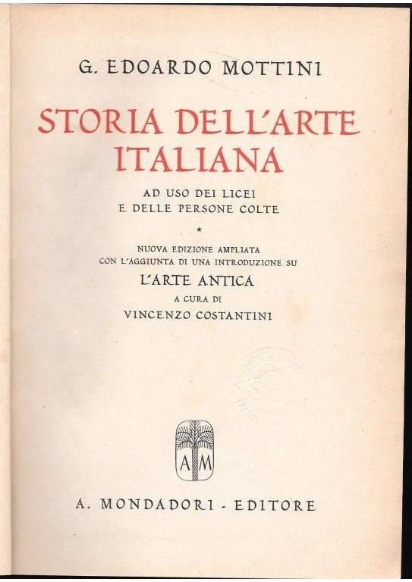
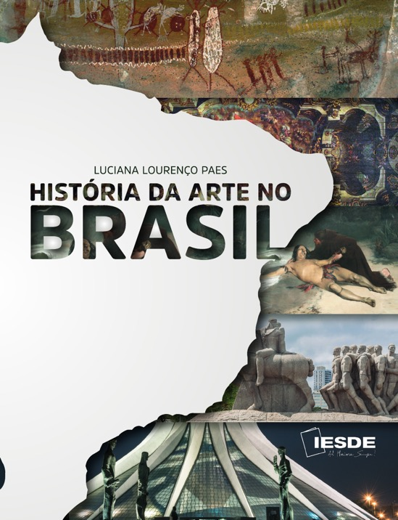
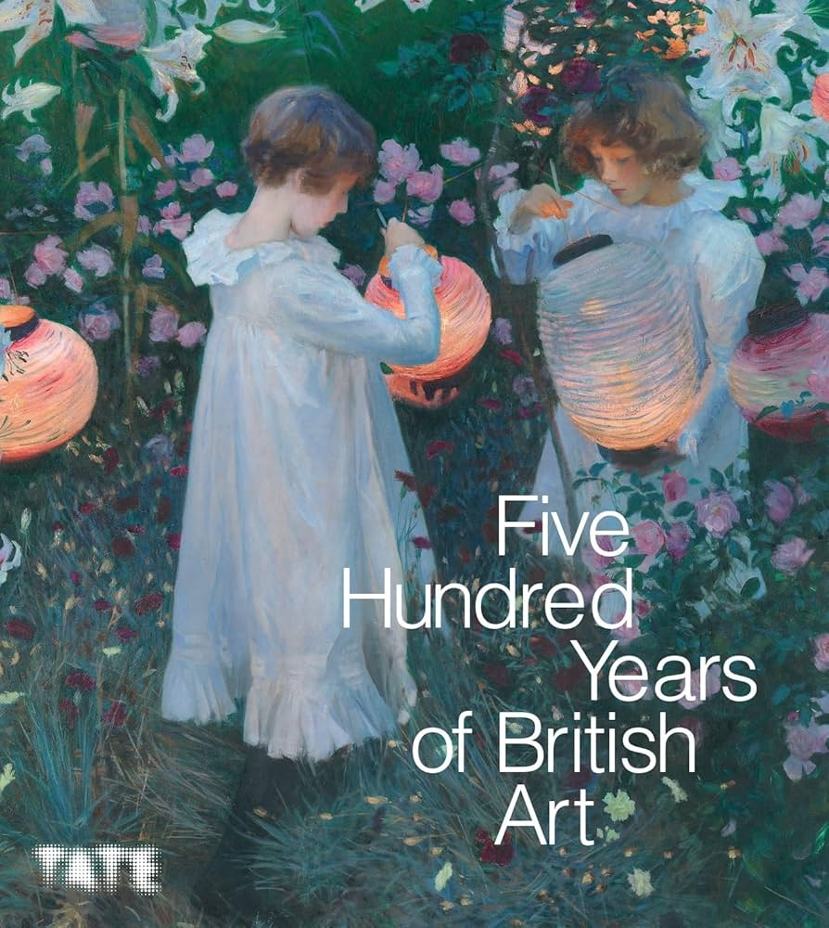

Slide 3
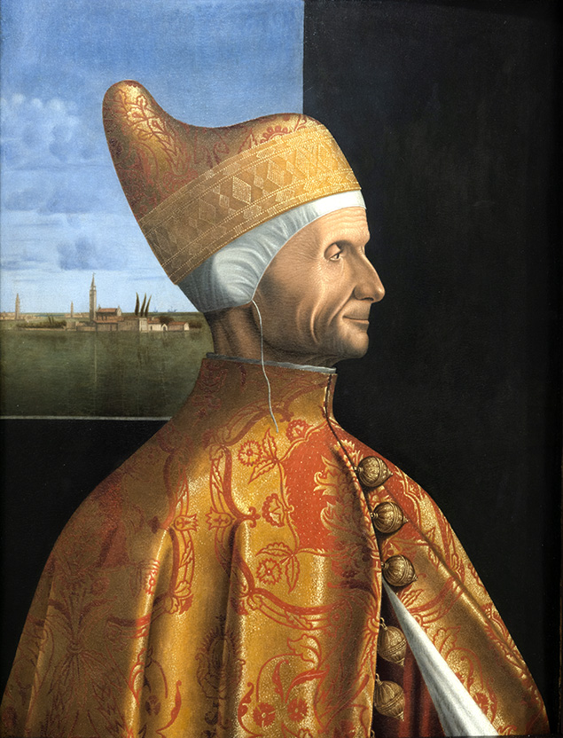
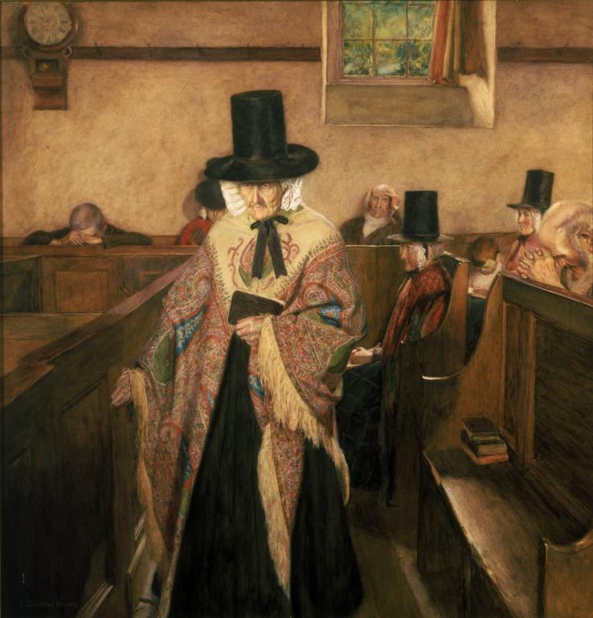
Vittore Carpaccio, Portrait of Doge Leonardo Loredan (1501–05)
Sydney Curnow Vosper, Salem (1908)

Slide 4
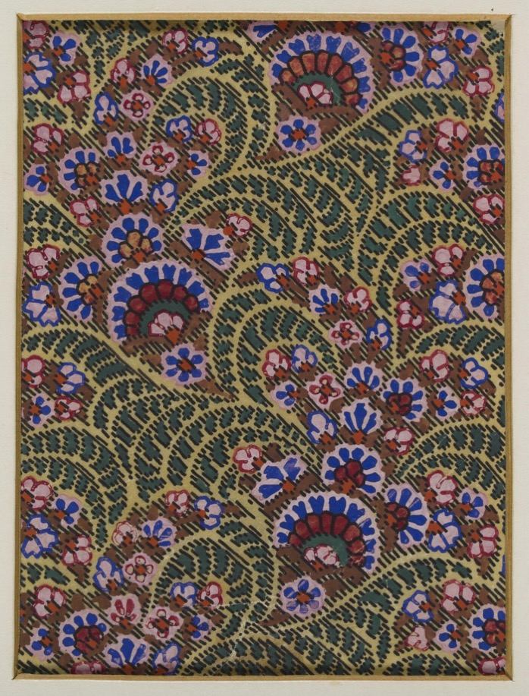
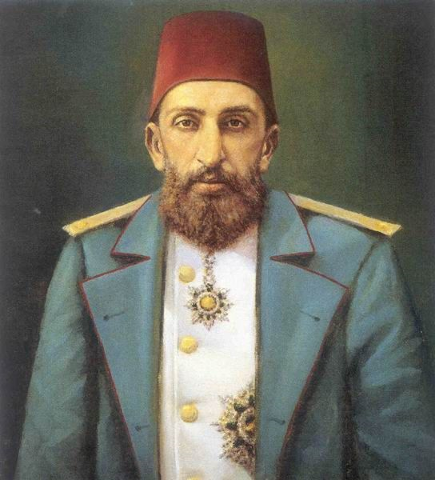
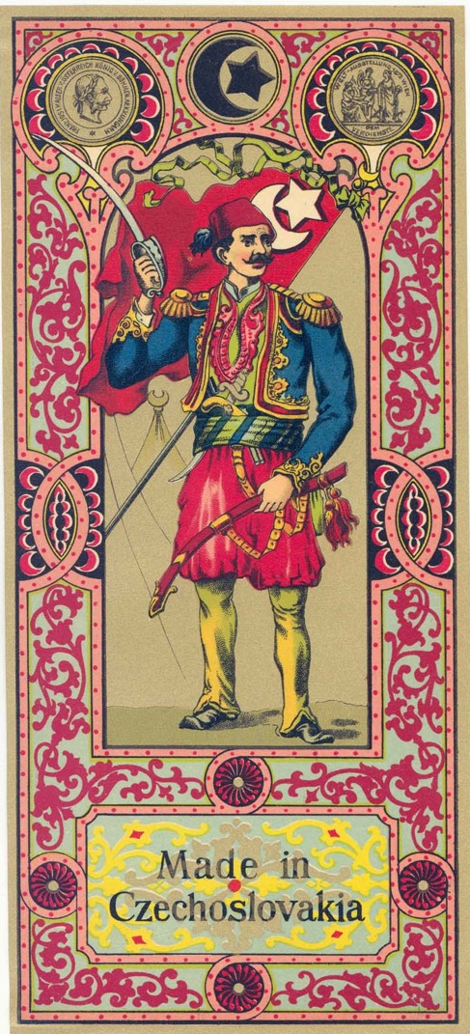
Sultan Gazi Abdül Hamid II (r. 1867-1909)
George Haite, Design for a Paisley Shawl (1850)

Slide 5
Some Key Terms:
The global, the universal and the modern
Critical Regionalism
Hybridity / métissage
Creolization
Glocalization

Slide 6
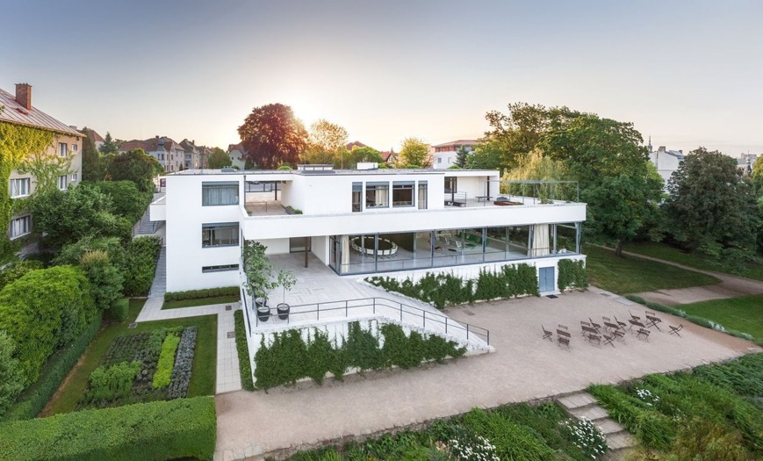
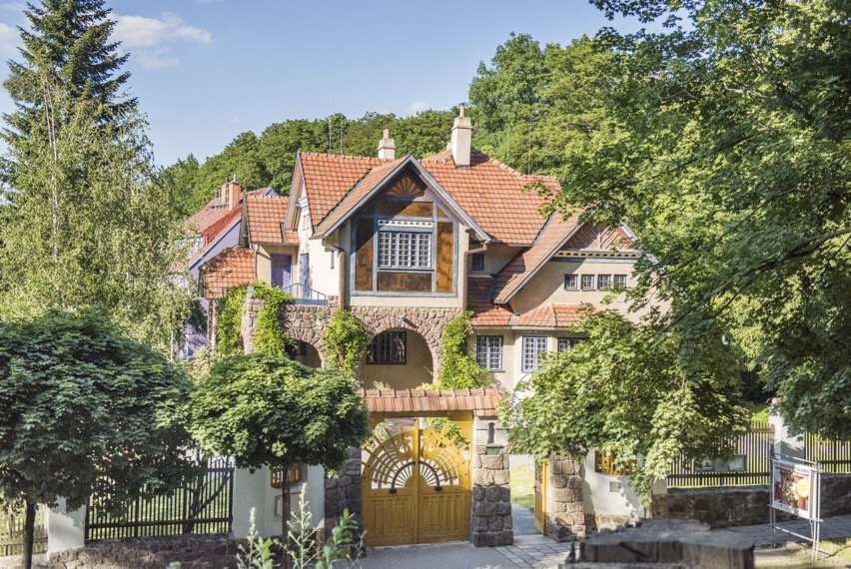
Ludwig Mies van der Rohe, Villa Tugendhat,
Brno (1930)
Dušan Jurkovič, Private Villa, Brno (1906)

Slide 7
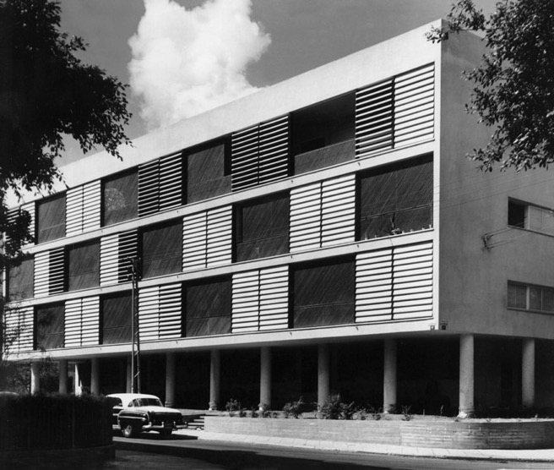
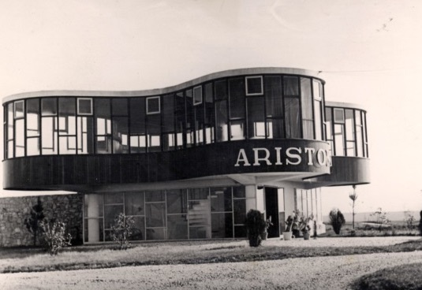
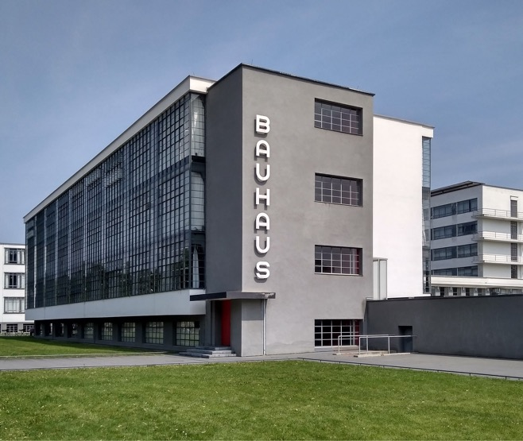
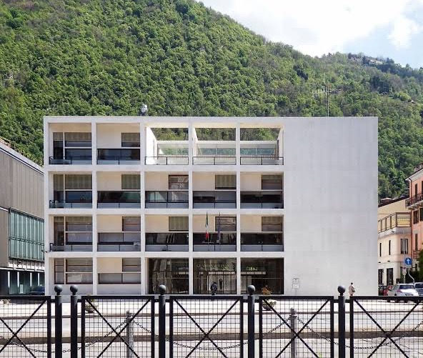
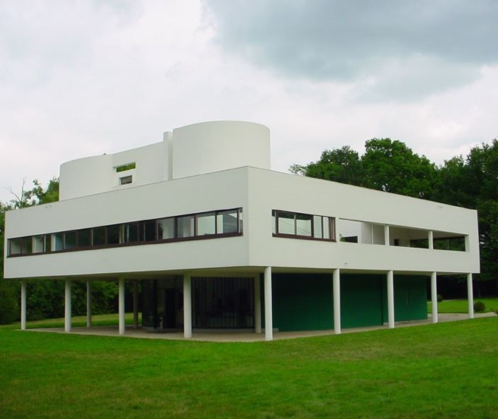
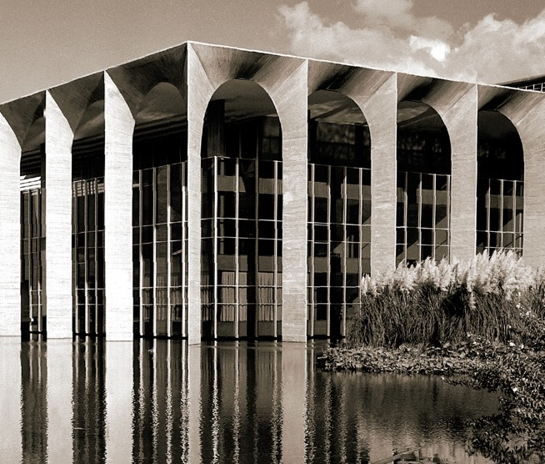
Modernism as a universal / global language

Slide 8
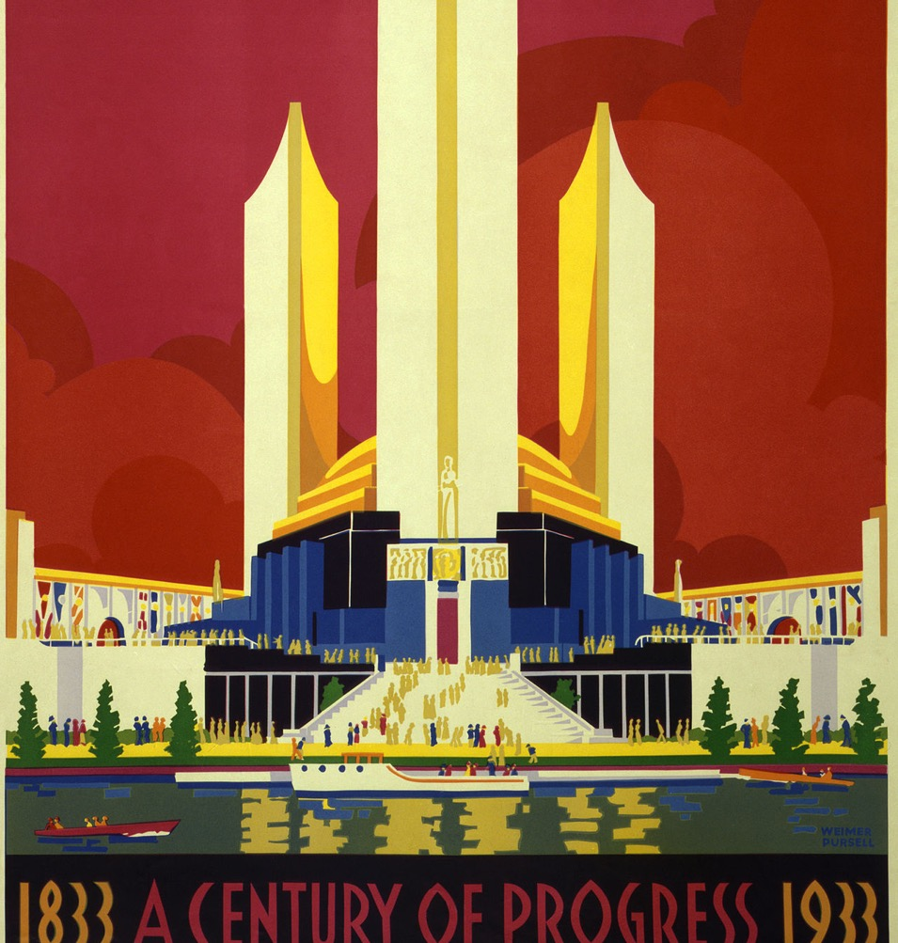
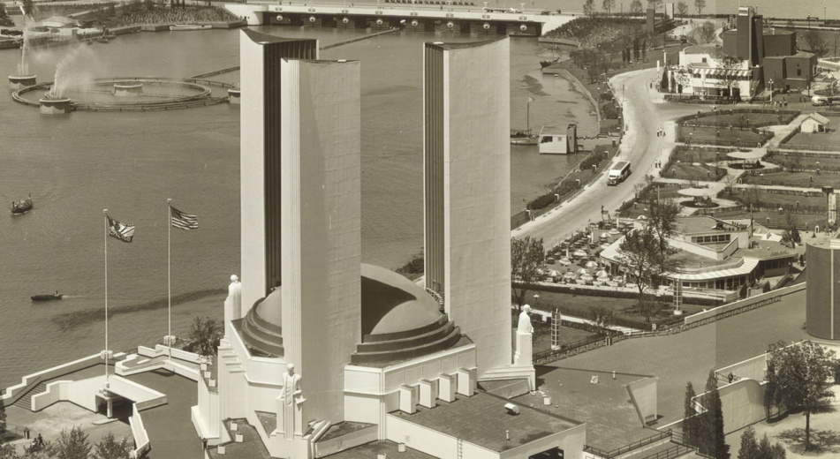
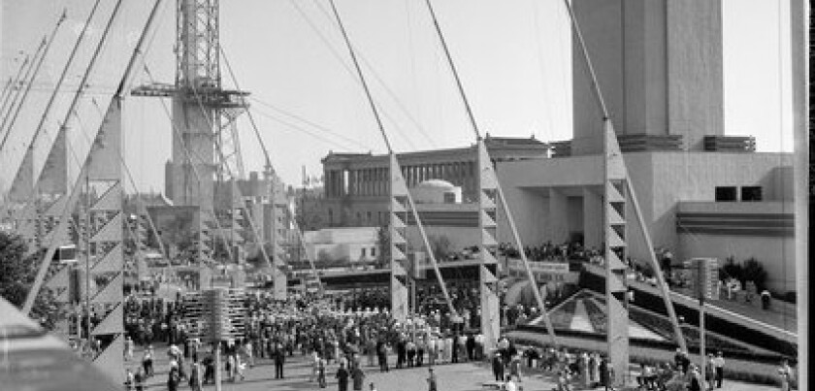

Slide 9
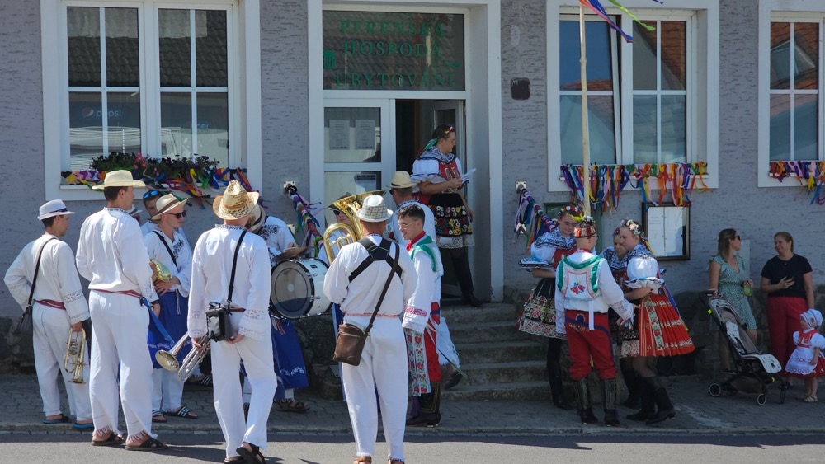
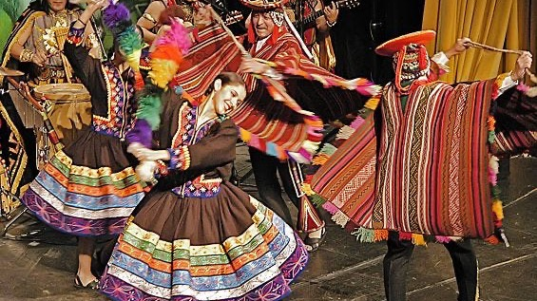
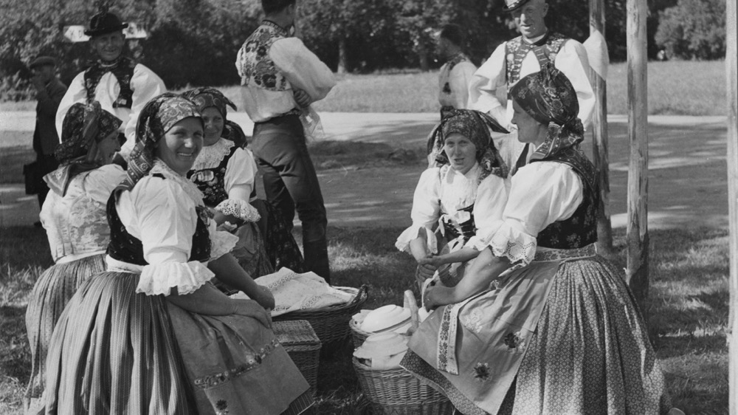
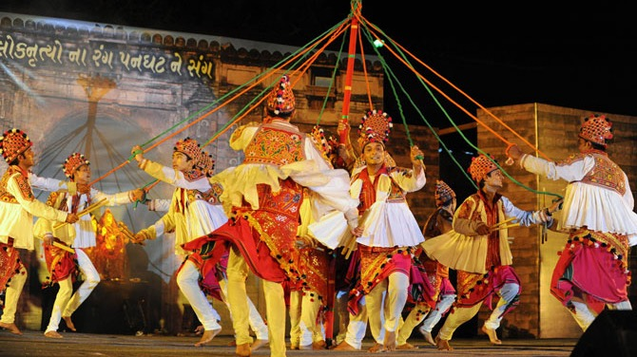

Slide 10
Critical Regionalism
The McDonaldization of Society
Paul Ricoeur, History and Truth (1965) quoted in:
Kenneth Frampton, "Towards a Critical Regionalism: Six points for an architecture of resistance", in "Anti-Aesthetic. Essays on Postmodern Culture." Seattle: Bay Press, 1983

Slide 11
The problem with modernization and modern architecture ….
Kenneth Frampton, "Towards a Critical Regionalism: Six points for an architecture of resistance”.

Slide 12
In other words:
Neither ‘modern’ nor ‘traditional’ or … ‘modern’ and ‘traditional’
Neither ‘universal / global’ nor ‘local’ or …. ‘global’ and ‘local’

Slide 13
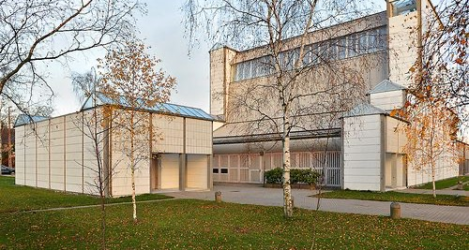
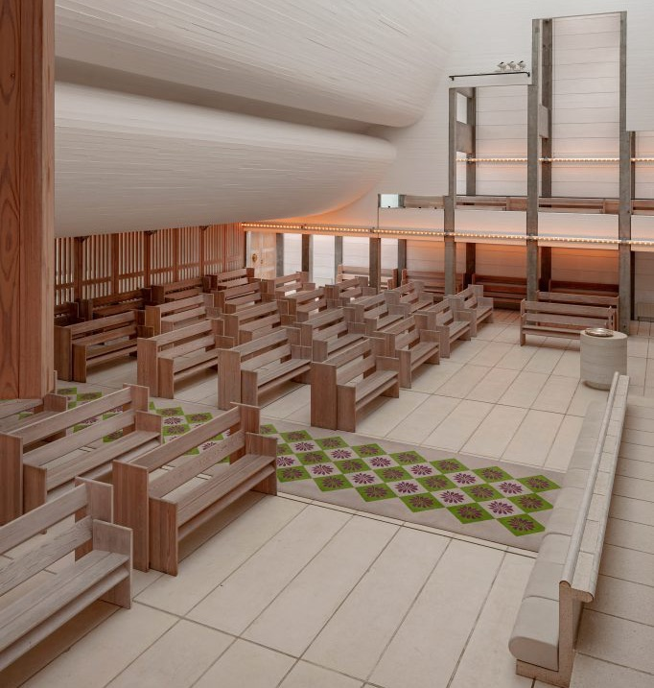
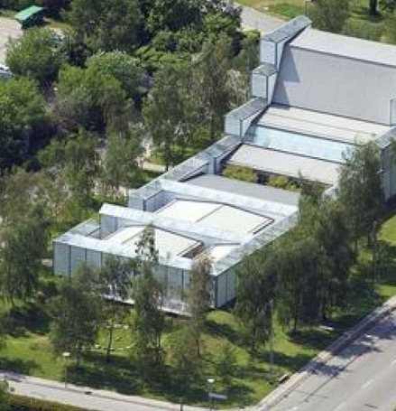
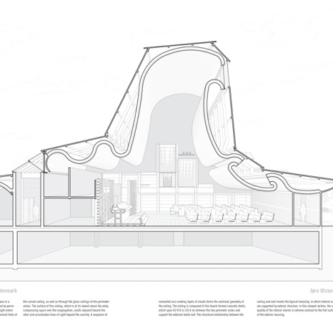
Jørn Utzon, Bagsværd Church, Copenhagen (1968-76)

Slide 14
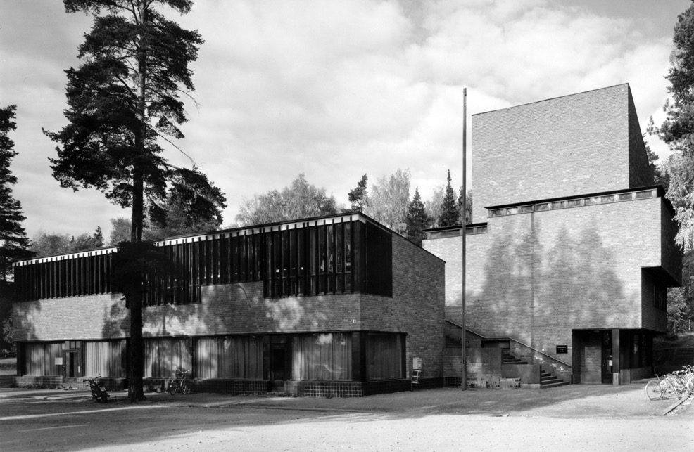
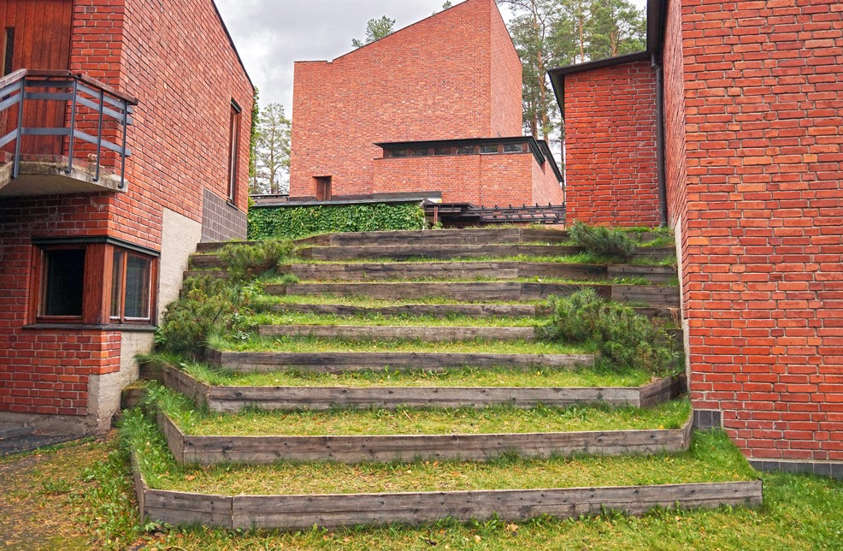
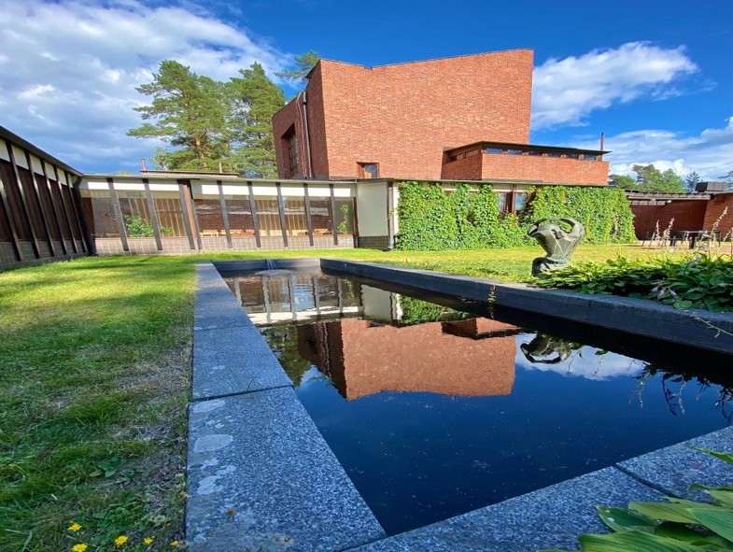
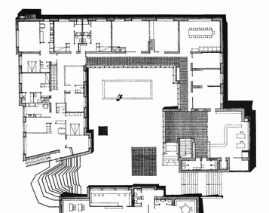
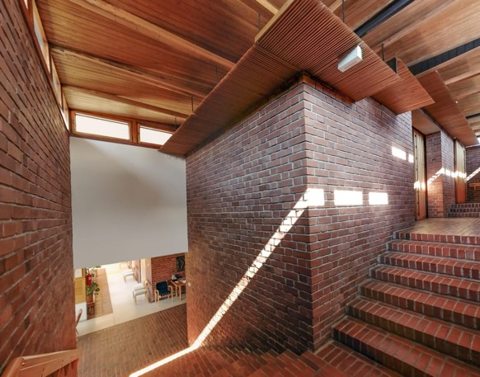
Alvar Aalto, Säynatsalo Town Hall, Jyväskylä, Finland (1952)

Slide 15
Kenneth Frampton, "Towards a Critical Regionalism: Six points for an architecture of resistance", in "Anti-Aesthetic. Essays on Postmodern Culture." Seattle: Bay Press, 1983

Slide 16
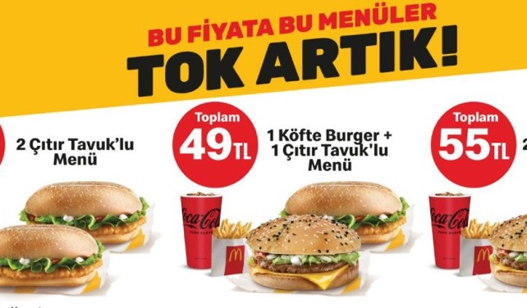
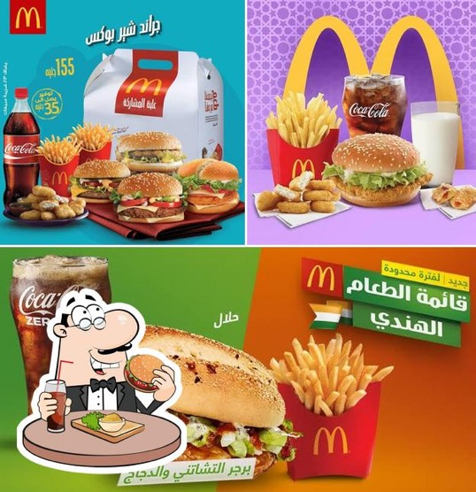
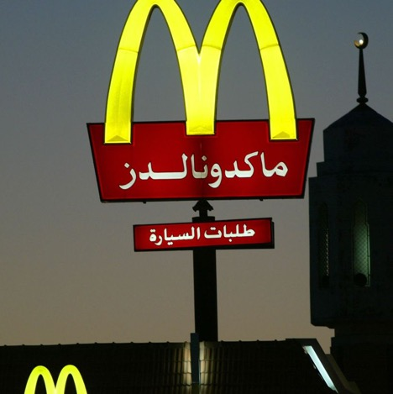
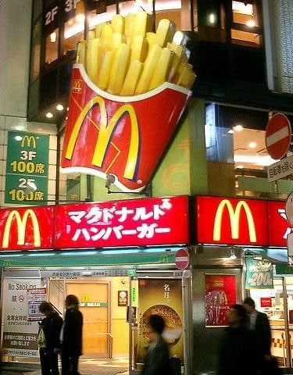
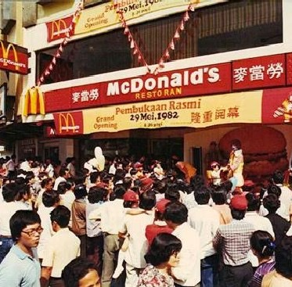
Globalization
George Ritzer, The MacDonaldization of Society (London and New York, 1993)

Slide 17
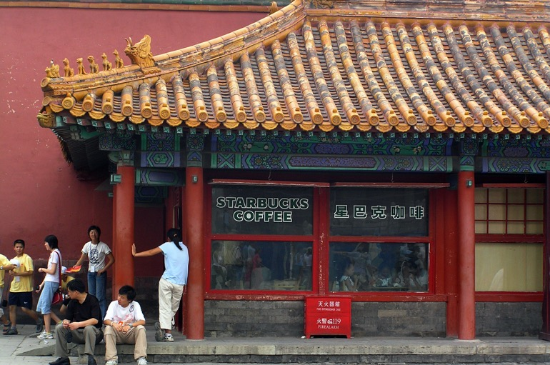
The Glocalization
Origins of the concept:
Japanese term “dochakuka” (from: dochaku = living on one’s own land = adapting to local conditions)
In business jargon – a global outlook adapted to local conditions
In cultural and social theory - the co-presence – of universal and local tendencies

Slide 18
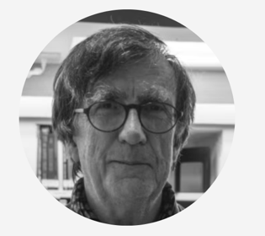
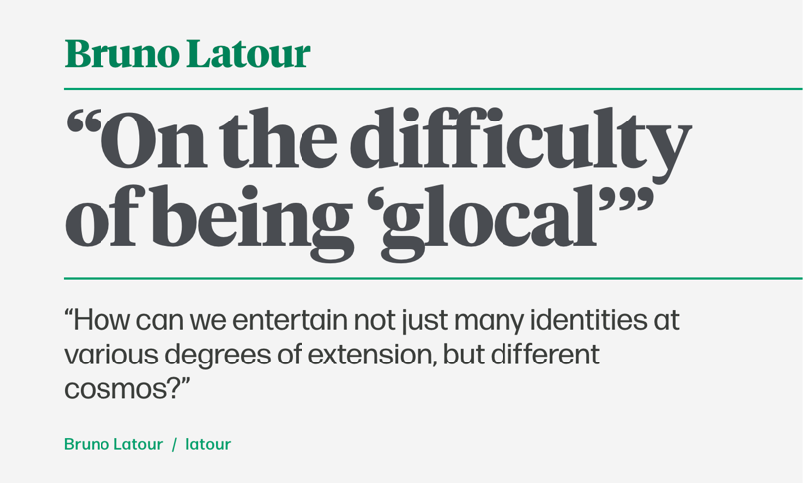
https://www.domusweb.it/en/from-the-archive/2022/10/14/bruno-latour-on-the-difficulty-pf-being-glocal.html

Slide 19
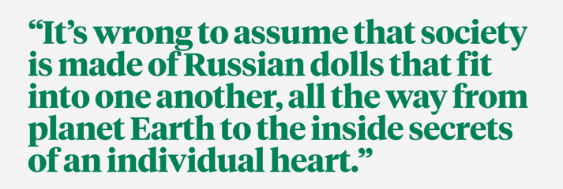

Slide 21
Hybrid / hybridity, Métissage, Creole
‘The word “hybrid” has developed from biological and botanical origins: in Latin it meant the offspring of a tame sow and a wild boar, and hence, as the Oxford English Dictionary puts it, ‘of human parents of different races, half-breed’. As a metaphor, the expression relates to linguistic compositions from different languages or, more generally, everything that is composed of different or incongruent elements.’
Andreas Ackermann, ‘Cultural Hybridity’ in P. W. Stockhammer, ed., Conceptualizing Cultural Hybridization (London, 2012) p. 6

Slide 22
Hybrid, Métissage, Creole
‘The word “Métissage” comes from the root word “Métis”, which has both Latin and Greek origins. Its Latin origin, “mixtus”, means “mixed” … The idea of Métissage originated from Caribbean Creole geo-cultural and linguistic contexts, where it has been used to explore ideas of mixed identities, languages, and ideas around space and place …’
Susan Burke and Rheanna Robinson, ‘Reflections on Métissage as indigenous research practice,’ AlterNative 15.2, 2019, 152.

Slide 23
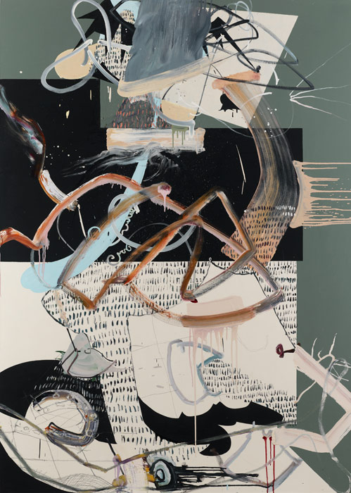
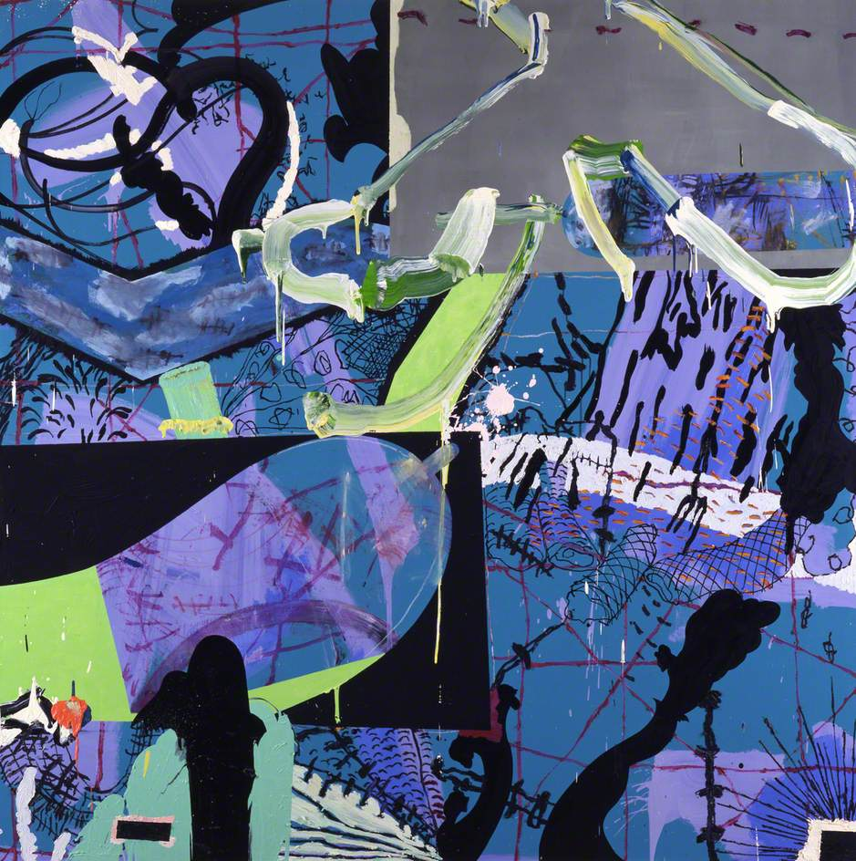
Fiona Rae
L: Untitled: Orange, Green and Black (1991)
R: Untitled: Green, Blue and Black (1991)

Slide 24
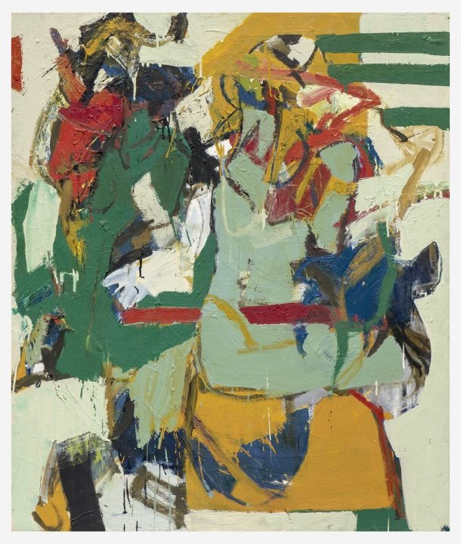
Agnes Martin
Untitled (1977)
Wook-kyung Choi
Untitled (1960s)

Slide 25
Hybrid / hybridity, Métissage, Creole
However …. for the Russian philosopher Mikhail Bakhtin (1895-1975)
‘ … hybridity delineates the way in which language, even within a single sentence, can be double-voiced … With organic hybridization Bakhtin refers to the unintentional, unconscious, everyday mixing and fusing of diverse cultural elements, as for example in language … With intentional hybridity two points of view are not mixed, but set against each other dialogically. This can be used, for2 Cultural Hybridity: Between Metaphor and Empiricism 13 example in the aesthetic domain, ‘to shock, change, challenge, revitalise or disrupt through deliberate, intended fusions of unlike social languages and images … ’
Andreas Ackermann, ‘Cultural Hybridity’ in P. W. Stockhammer, ed., Conceptualizing Cultural Hybridization (London, 2012) p. 6

Slide 26
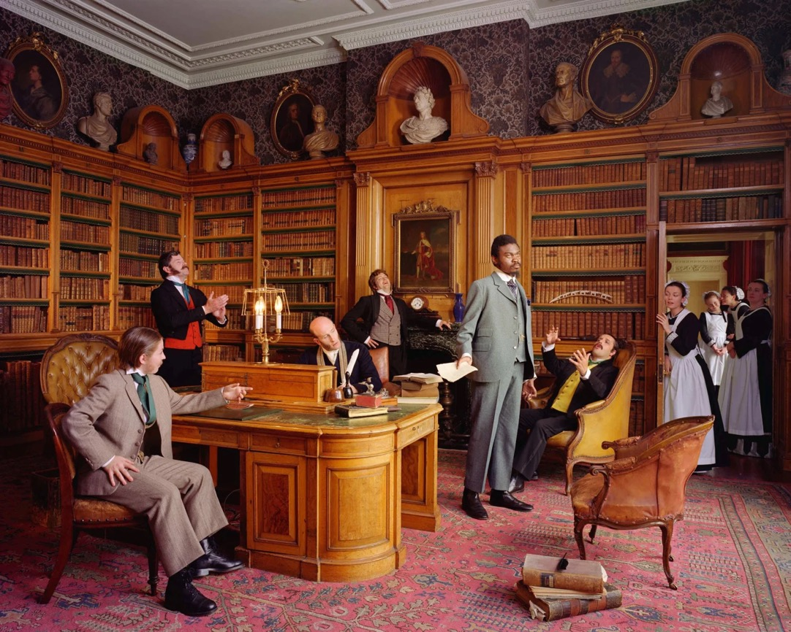
Intentional hybridity
Yinka Shonibare
Diary of a Victorian Dandy (1998)

Slide 27
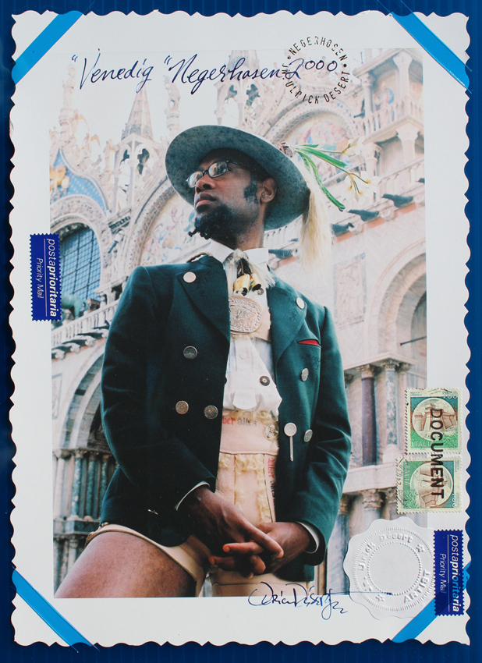
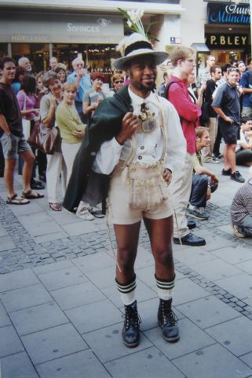
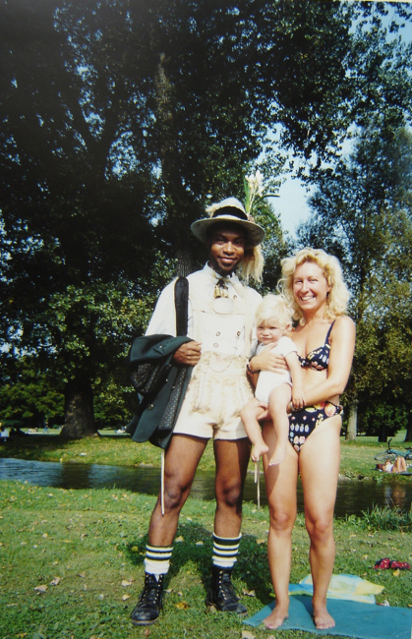
Jean-Ulrich Désert, Negerhosen (2000)

Slide 28
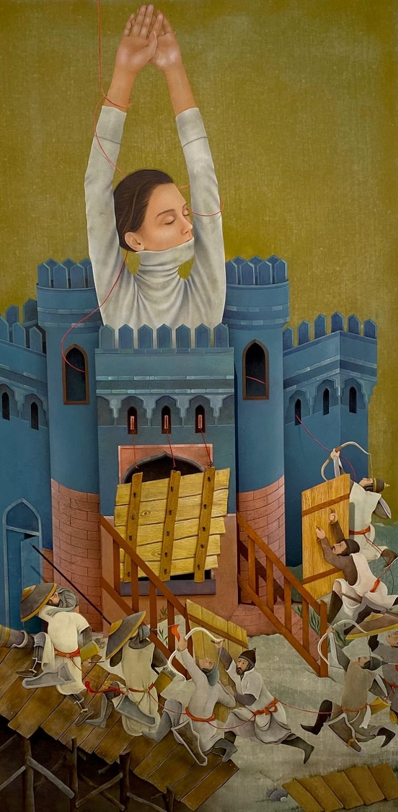
Arghavan Khosravi (1984 - )

Slide 29
Hybrid, Métissage, Creole / creolization
‘The concept of creolization was first formulated through the study of languages in colonial situations— especially in the Americas— where people who met speaking mutually unintelligible tongues developed a linguistic medium to communicate among themselves. They restructured the existing languages of the colonizers and colonized, creating new Creole languages …’
Robert Baron, and Ana C. Cara, eds., Creolization as Cultural Creativity (Jackson, Mississippi, 2011) p. 2

Slide 30
Edwin Lutyens – Viceroy’s House, New Delhi (1911-1929)

Slide 31
Ödön Lechner, Museum of Applied Arts, Budapest (1896)

Slide 32
Bodys Isek Kingelez
Ville Fantôme (1996)
Bodys Isek Kingelez (1948-2015

Slide 33
L: Le Corbusier,
Design for a radiant city (1930)
R: Antonio Sant’ Elia,
Design for a future city (1914)

Slide 34
L: Kinshasha la Belle (2001)
R: La Turpina restaurant (2008)

Slide 35
Some questions

Slide 36
Pablo Picasso
Les Demoiselles d’Avignon (1907)

Slide 37
Ernst Ludwig Kirchner, Male Nude (1921) and studio shots

Slide 38
Seydou Keita, Portrait Photographs (1952-1959)

Slide 39
Seydou Keita, Portrait Photographs (1952-1959)

Slide 40
Henri Matisse
L: Odalisque with Red Pants (1921)
R: Odalisque with Tambourine (1926)

Slide 42
“Biennale Art”
Clockwise from left: Vong Phao Phanit; Sarah Sze; Djon Mundine and the Bandjalung people; Ha Bik Chuen;

