Slide 1
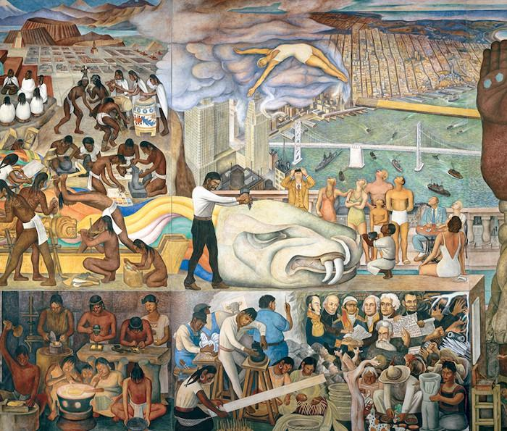
Mexican Modernism
4 October 2024
“The local in the global context”
DU2401

Slide 2
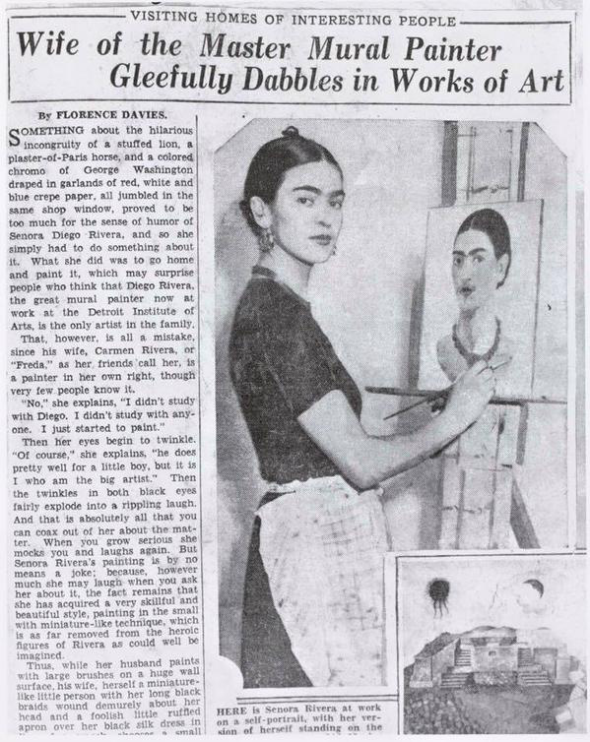
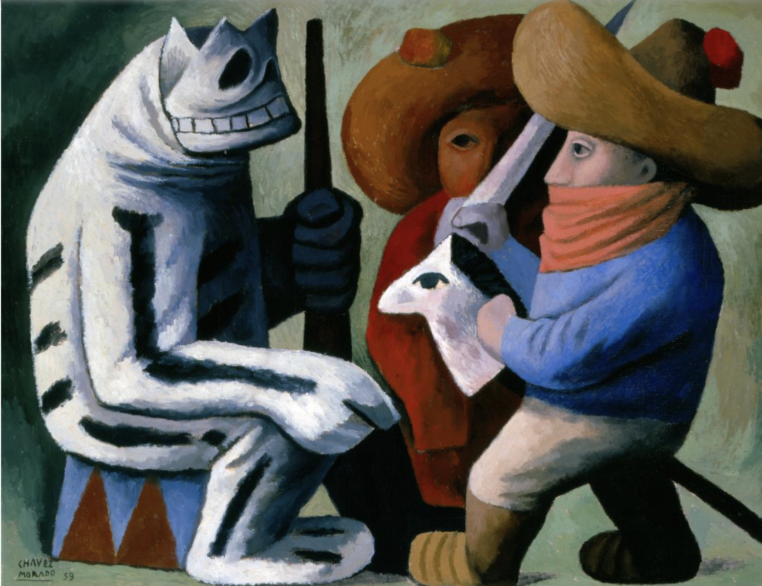
What is Mexican modernism?
José Chávez Morado, Carnival at Huejotzingo, 1939
Truly local – truly global?

Slide 3
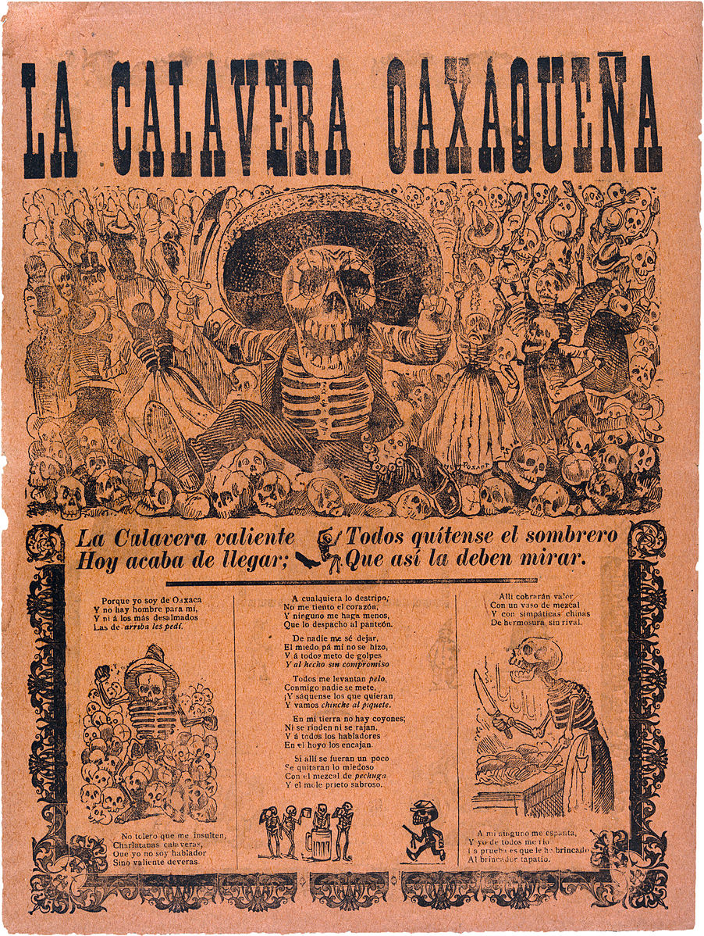
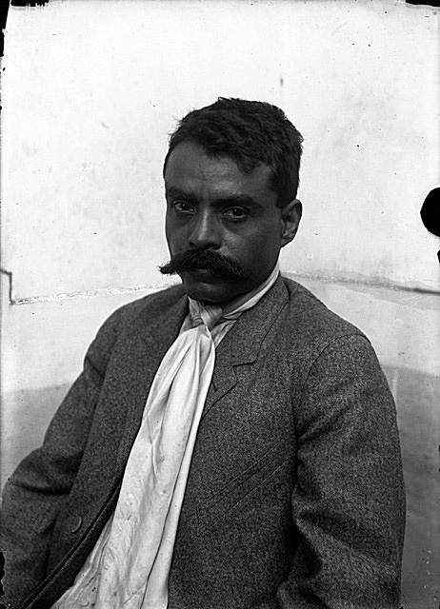
Precursors
The Mexican Revolution as a catalyst (1910–1920)
Popular and print culture: José Guadalupe Posada (1852–1913)
Augistin Casasola, Emiliano Zapata
José Guadalupe Posada, Calavera oaxaqueña, broadsheet, 1903

Slide 4
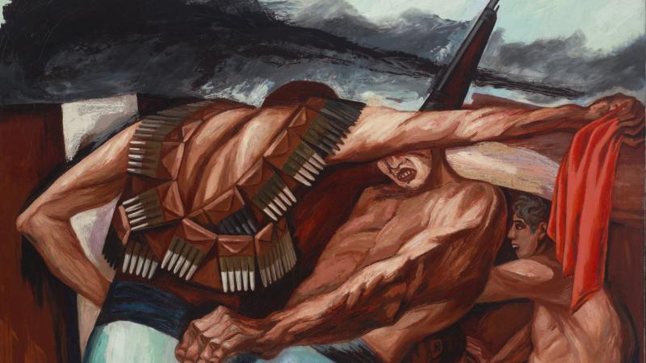
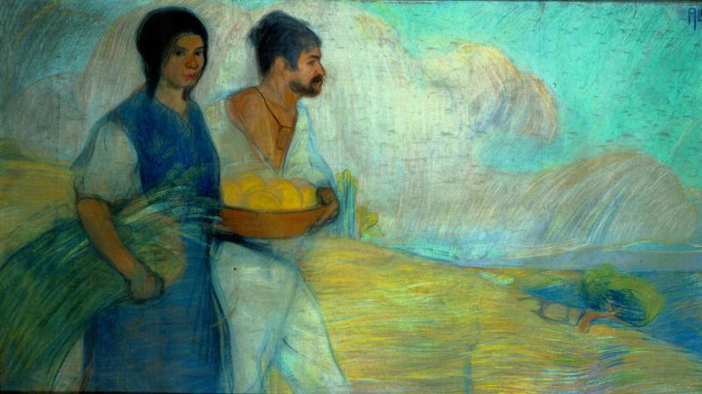
Suspicions towards European imperialist foundations & democratic models: in search for alternatives
Barricade, 1931, by José Clemente Orozco
General Alvaro Obregón and the consolidation period after the Revolution (1920 – 24): José Vasconcelos as Minister of Public Education (1920)
nationalist authoritarianism under President Plutarco Elías Calles and the Maximato (1924 – 34)
socialism under President Lázaro Cárdenas (1934 – 40)
Peasants, c. 1913, by David Alfaro Siqueiros, 1896 – 1974, Pastel on paper, Museo Nacional de Arte, INBA.

Slide 5
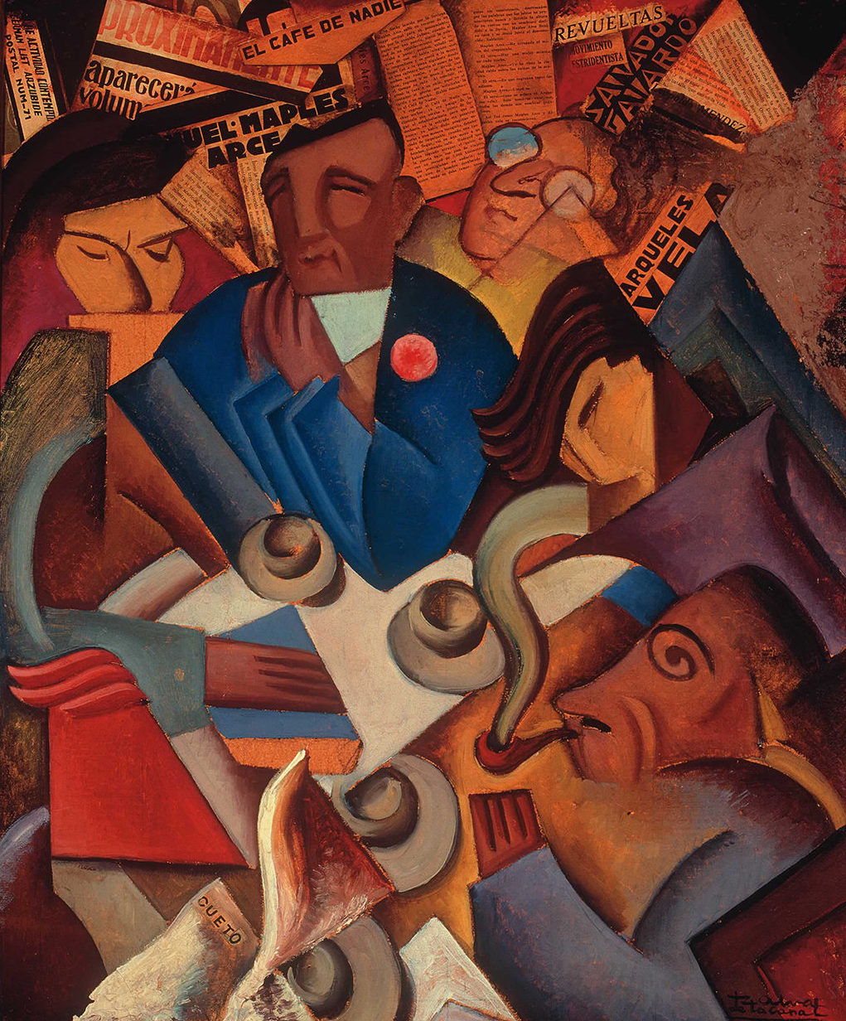
Is there one Mexican Modernism?
Estridentismo
Muralism & politics
Photography
Gendered perspectives
Popular culture and the forging of a modern Mexican nation
Ramón Alva de La Canal, El Café de Nadie, 1924.

Slide 6
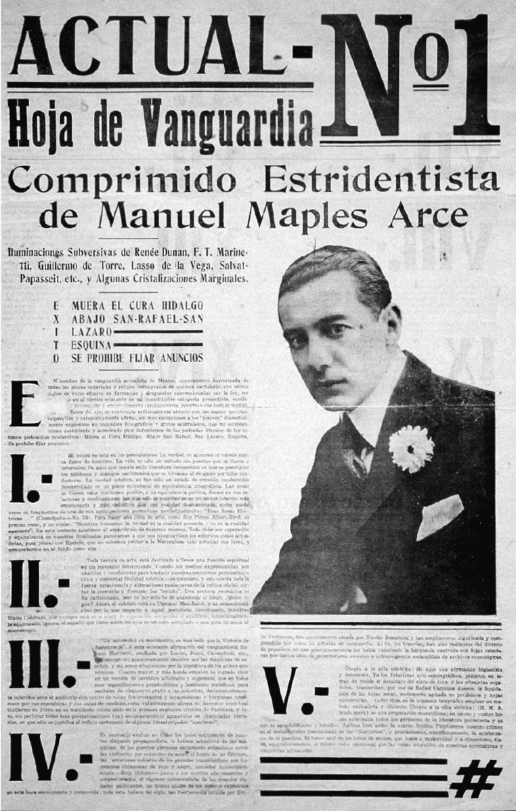
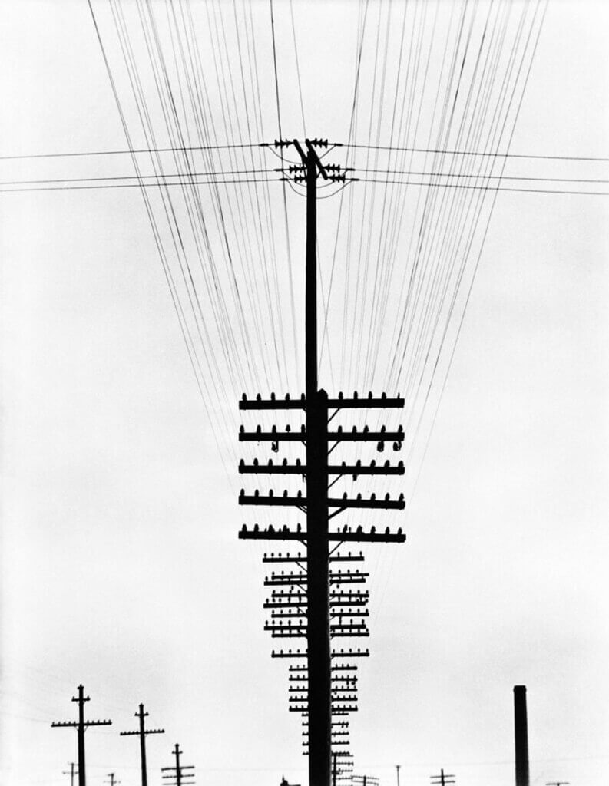
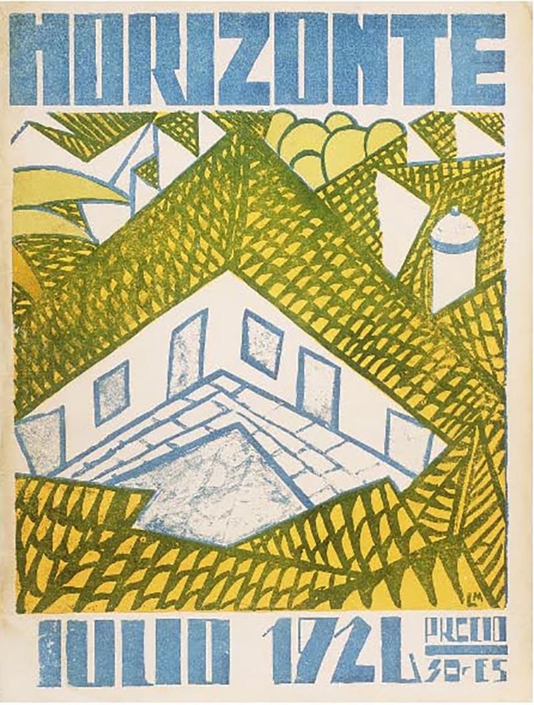
Estridentismo (stridentism)
Cubist – dadaist – futurist ideas, combined with political activism: “the first Mexican avant-garde”, 1921–1927
Tina Modotti, Telegraph lines, 1924
Manuel Maples Arce. Actual No. 1, broadsheet (recto), 59.5 .
40 cm (1921).
Notes:
Fashion for progress and technology
Cosmopolitanism

Slide 7
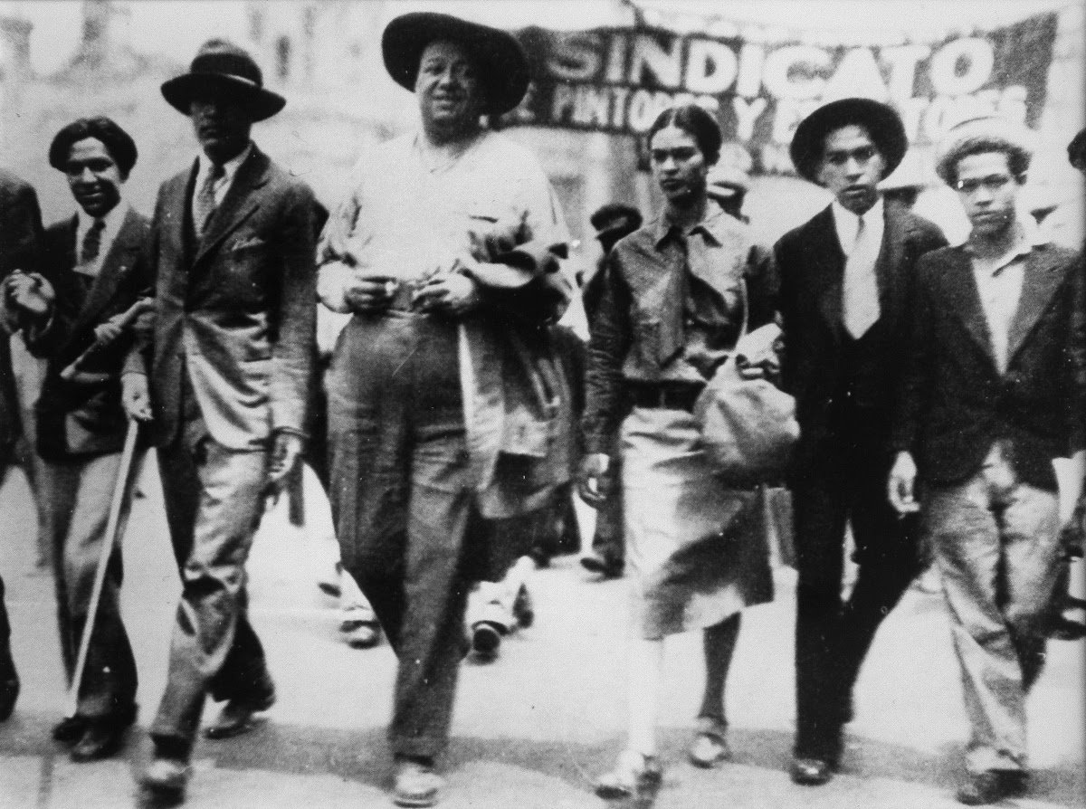
Manifesto of the Syndicate of Technical Workers, Painters and Sculptors
To the Indian race humiliated for centuries; to soldiers made executioners by the praetorians; to workers and peasants beaten by the greed of the rich; to intellectuals uncorrupted by the bourgeoisie.
…
We appeal to common soldiers who, unaware of what is happening or deceived by their traitorous officers, are about to shed the blood of their brothers of race and class. Remember that the bourgeoisie will use the self-same weapons with which the Revolution guaranteed your brother’s land and livelihood to now seize them.

Slide 8
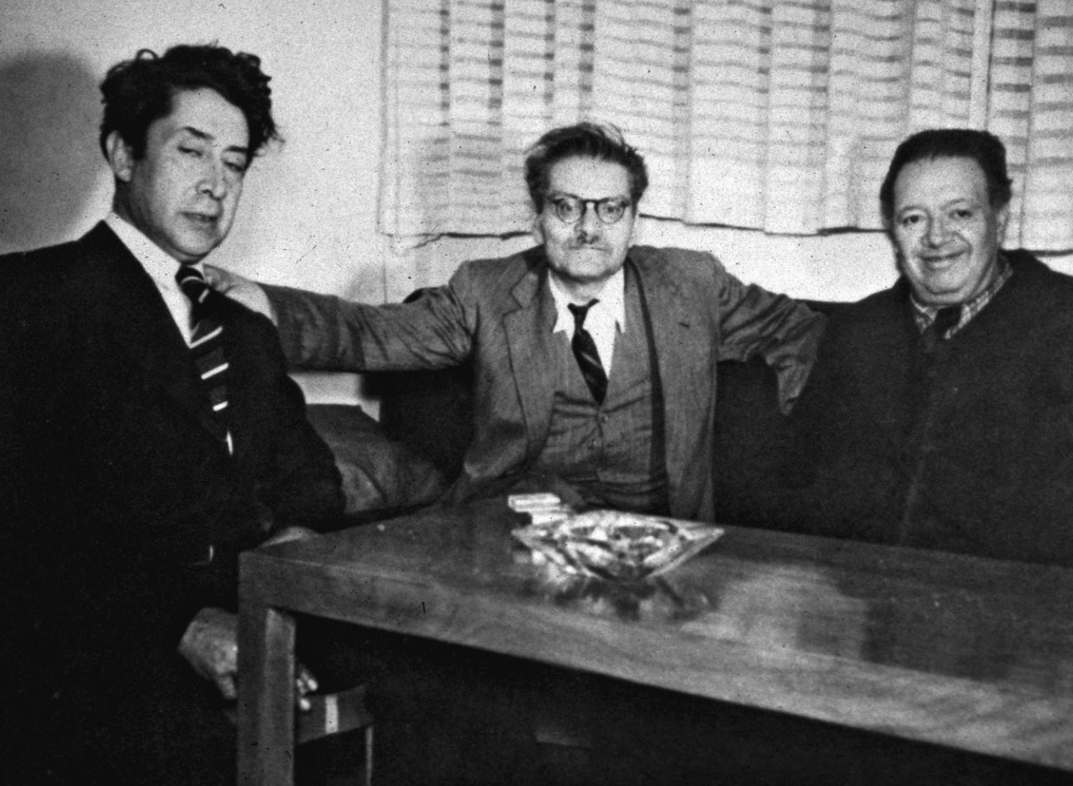
Los Tres Grandes: “the voice of the voiceless”?
The monumental and the epic
Leftist realism for the masses
mestzaje and indigenismo: revisiting notions of what is modern and what is archaic
The “myth of revolutionary nationalism”
Aesthetic production became as a site of public debate about the character of mexicanidad
Siqueiros, Orozco, and Rivera (left to right) at the time of the creation of the National Mural Commission (1947).

Slide 9
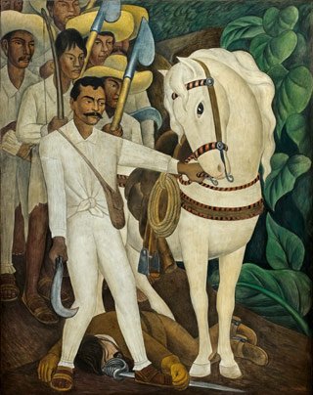
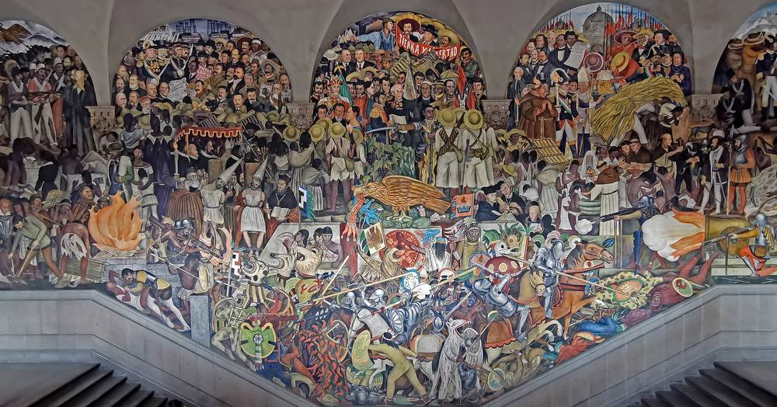
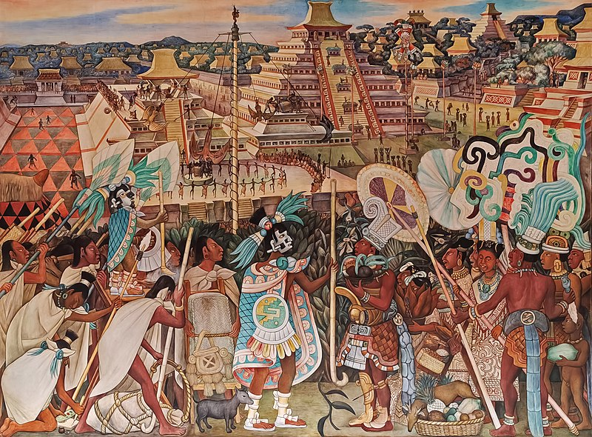
Diego Rivera (1886–1957)
Emiliano Zapata, 1931
Mural at the National Palace, Mexico City, 1929

Slide 10
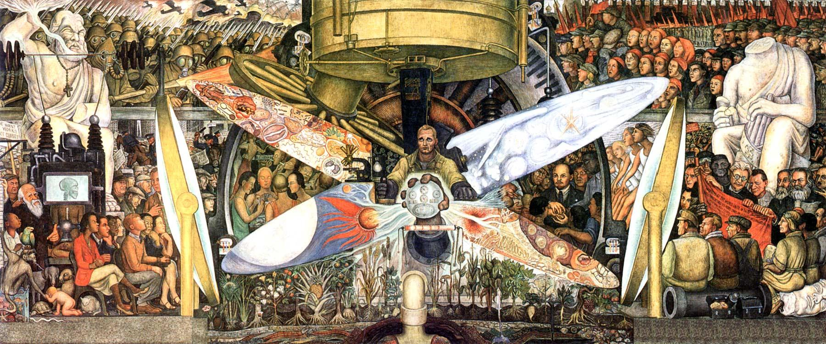
Diego Rivera El Anahuac Mural – Man at the Crossroads, Rockefeller Centre, N.Y., 1930s (destroyed)

Slide 11
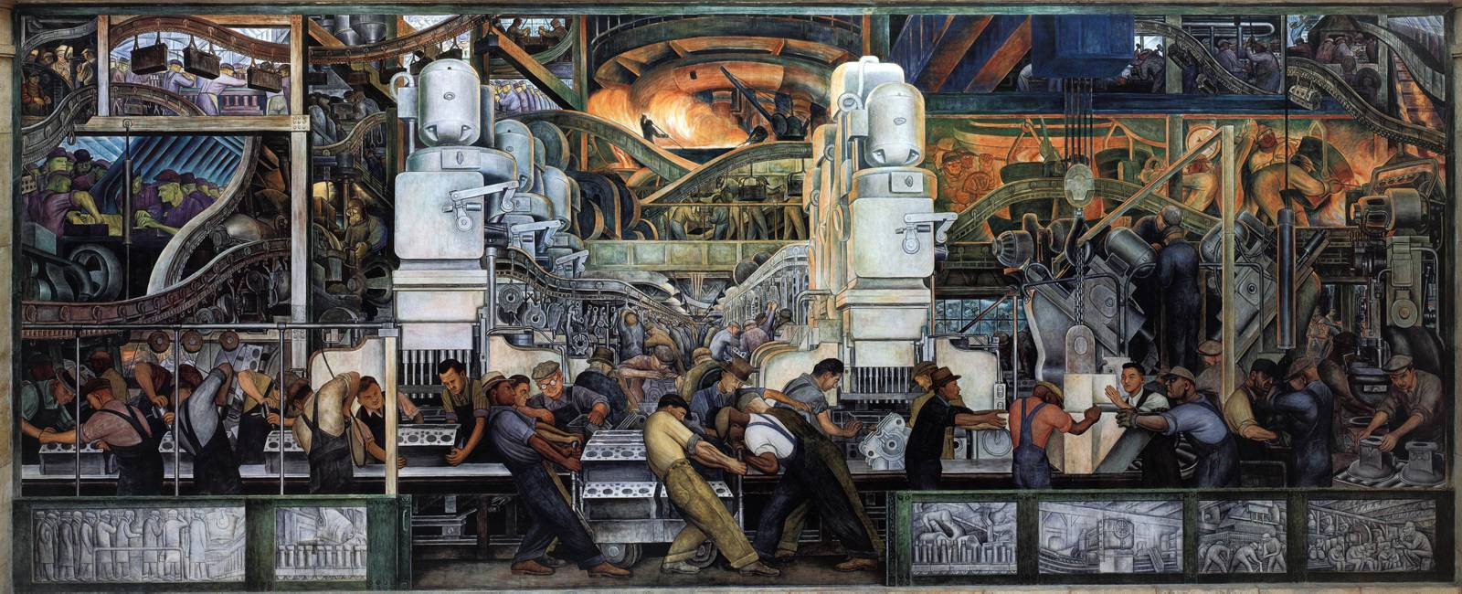
Diego Rivera Detroit Industries Murals (detail), 1930s

Slide 12
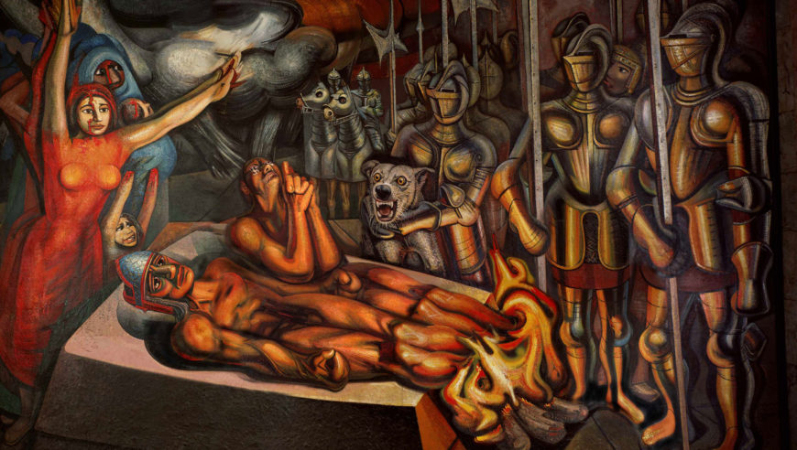
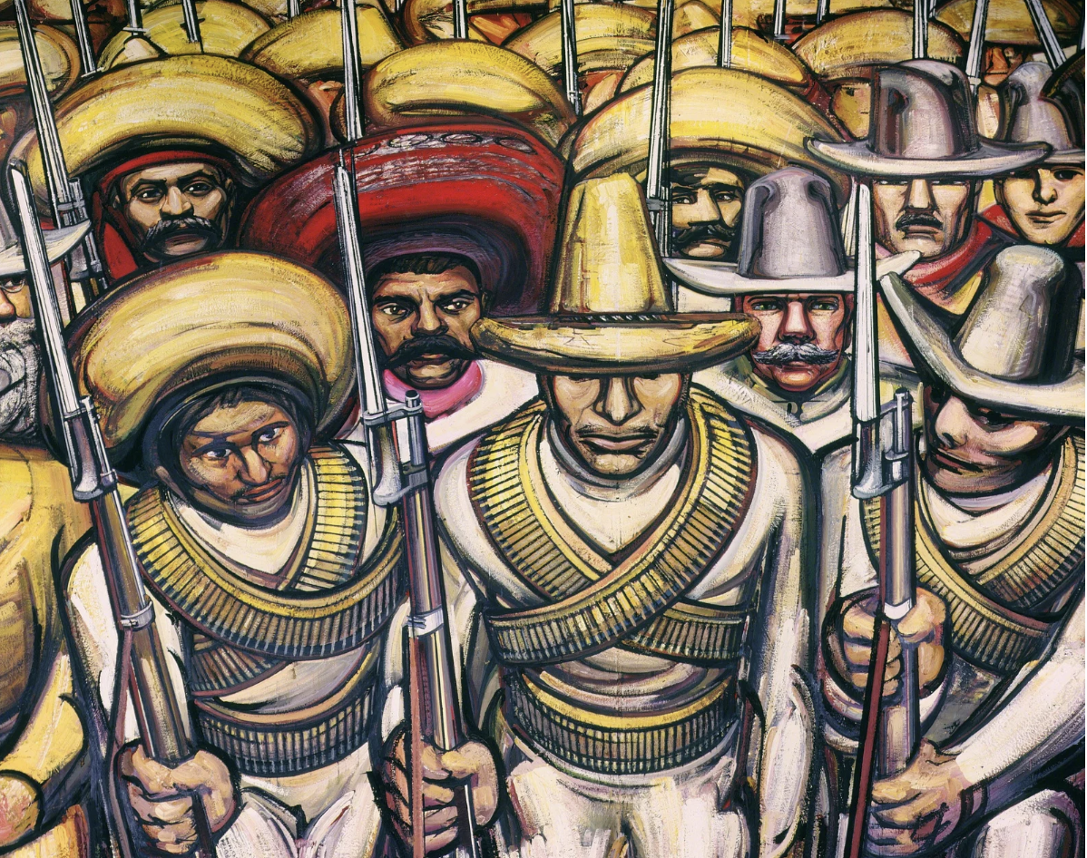
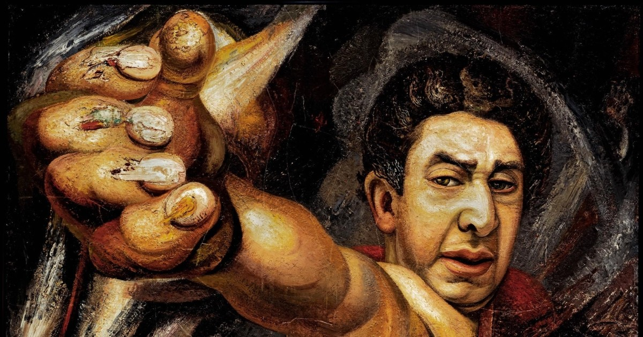
David Alfaro Siqueros (1896–1974)
“We must become universal! Our own racial and regional physiognomy will always show through in our work.”
Torment and Apotheosis of Cuauhtémoc (detail), 1950–51
From Porfirianism to the Revolution (detail), 1964
Self-Portrait, 1945

Slide 13
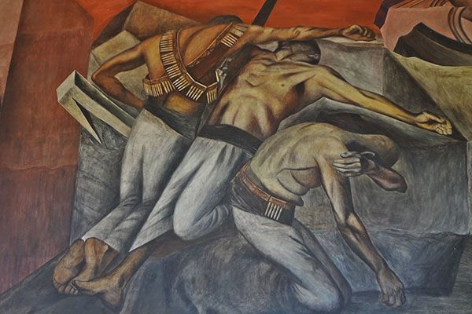
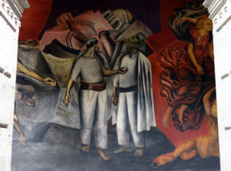
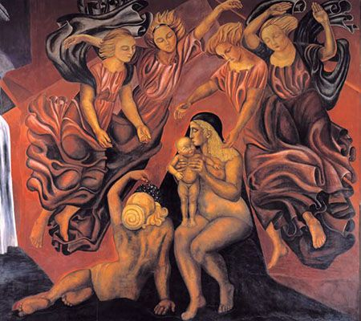
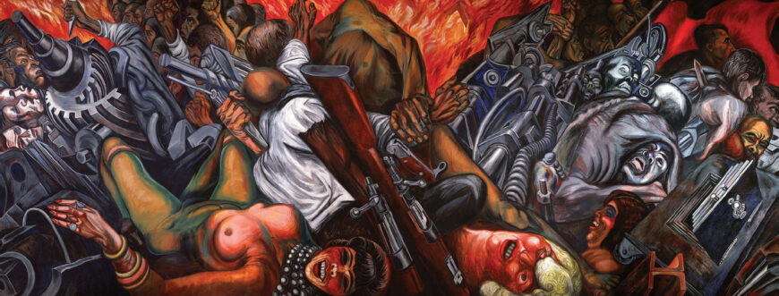
José Clemente Orozco (1883–1949)
The Trench, 1926
Destruction of the Old Order (detail), 1926 (National Preparatory School, Mexico City
Motherhood, 1924/25, National Preparatory School, Mexico
Catharsis (partial view), 1934 (Museum of the Palace of Fine Arts, Mexico City

Slide 14
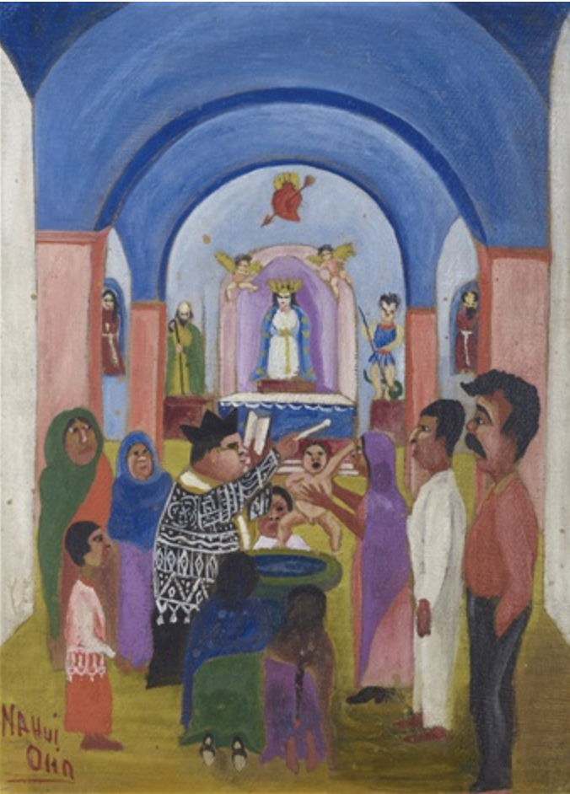
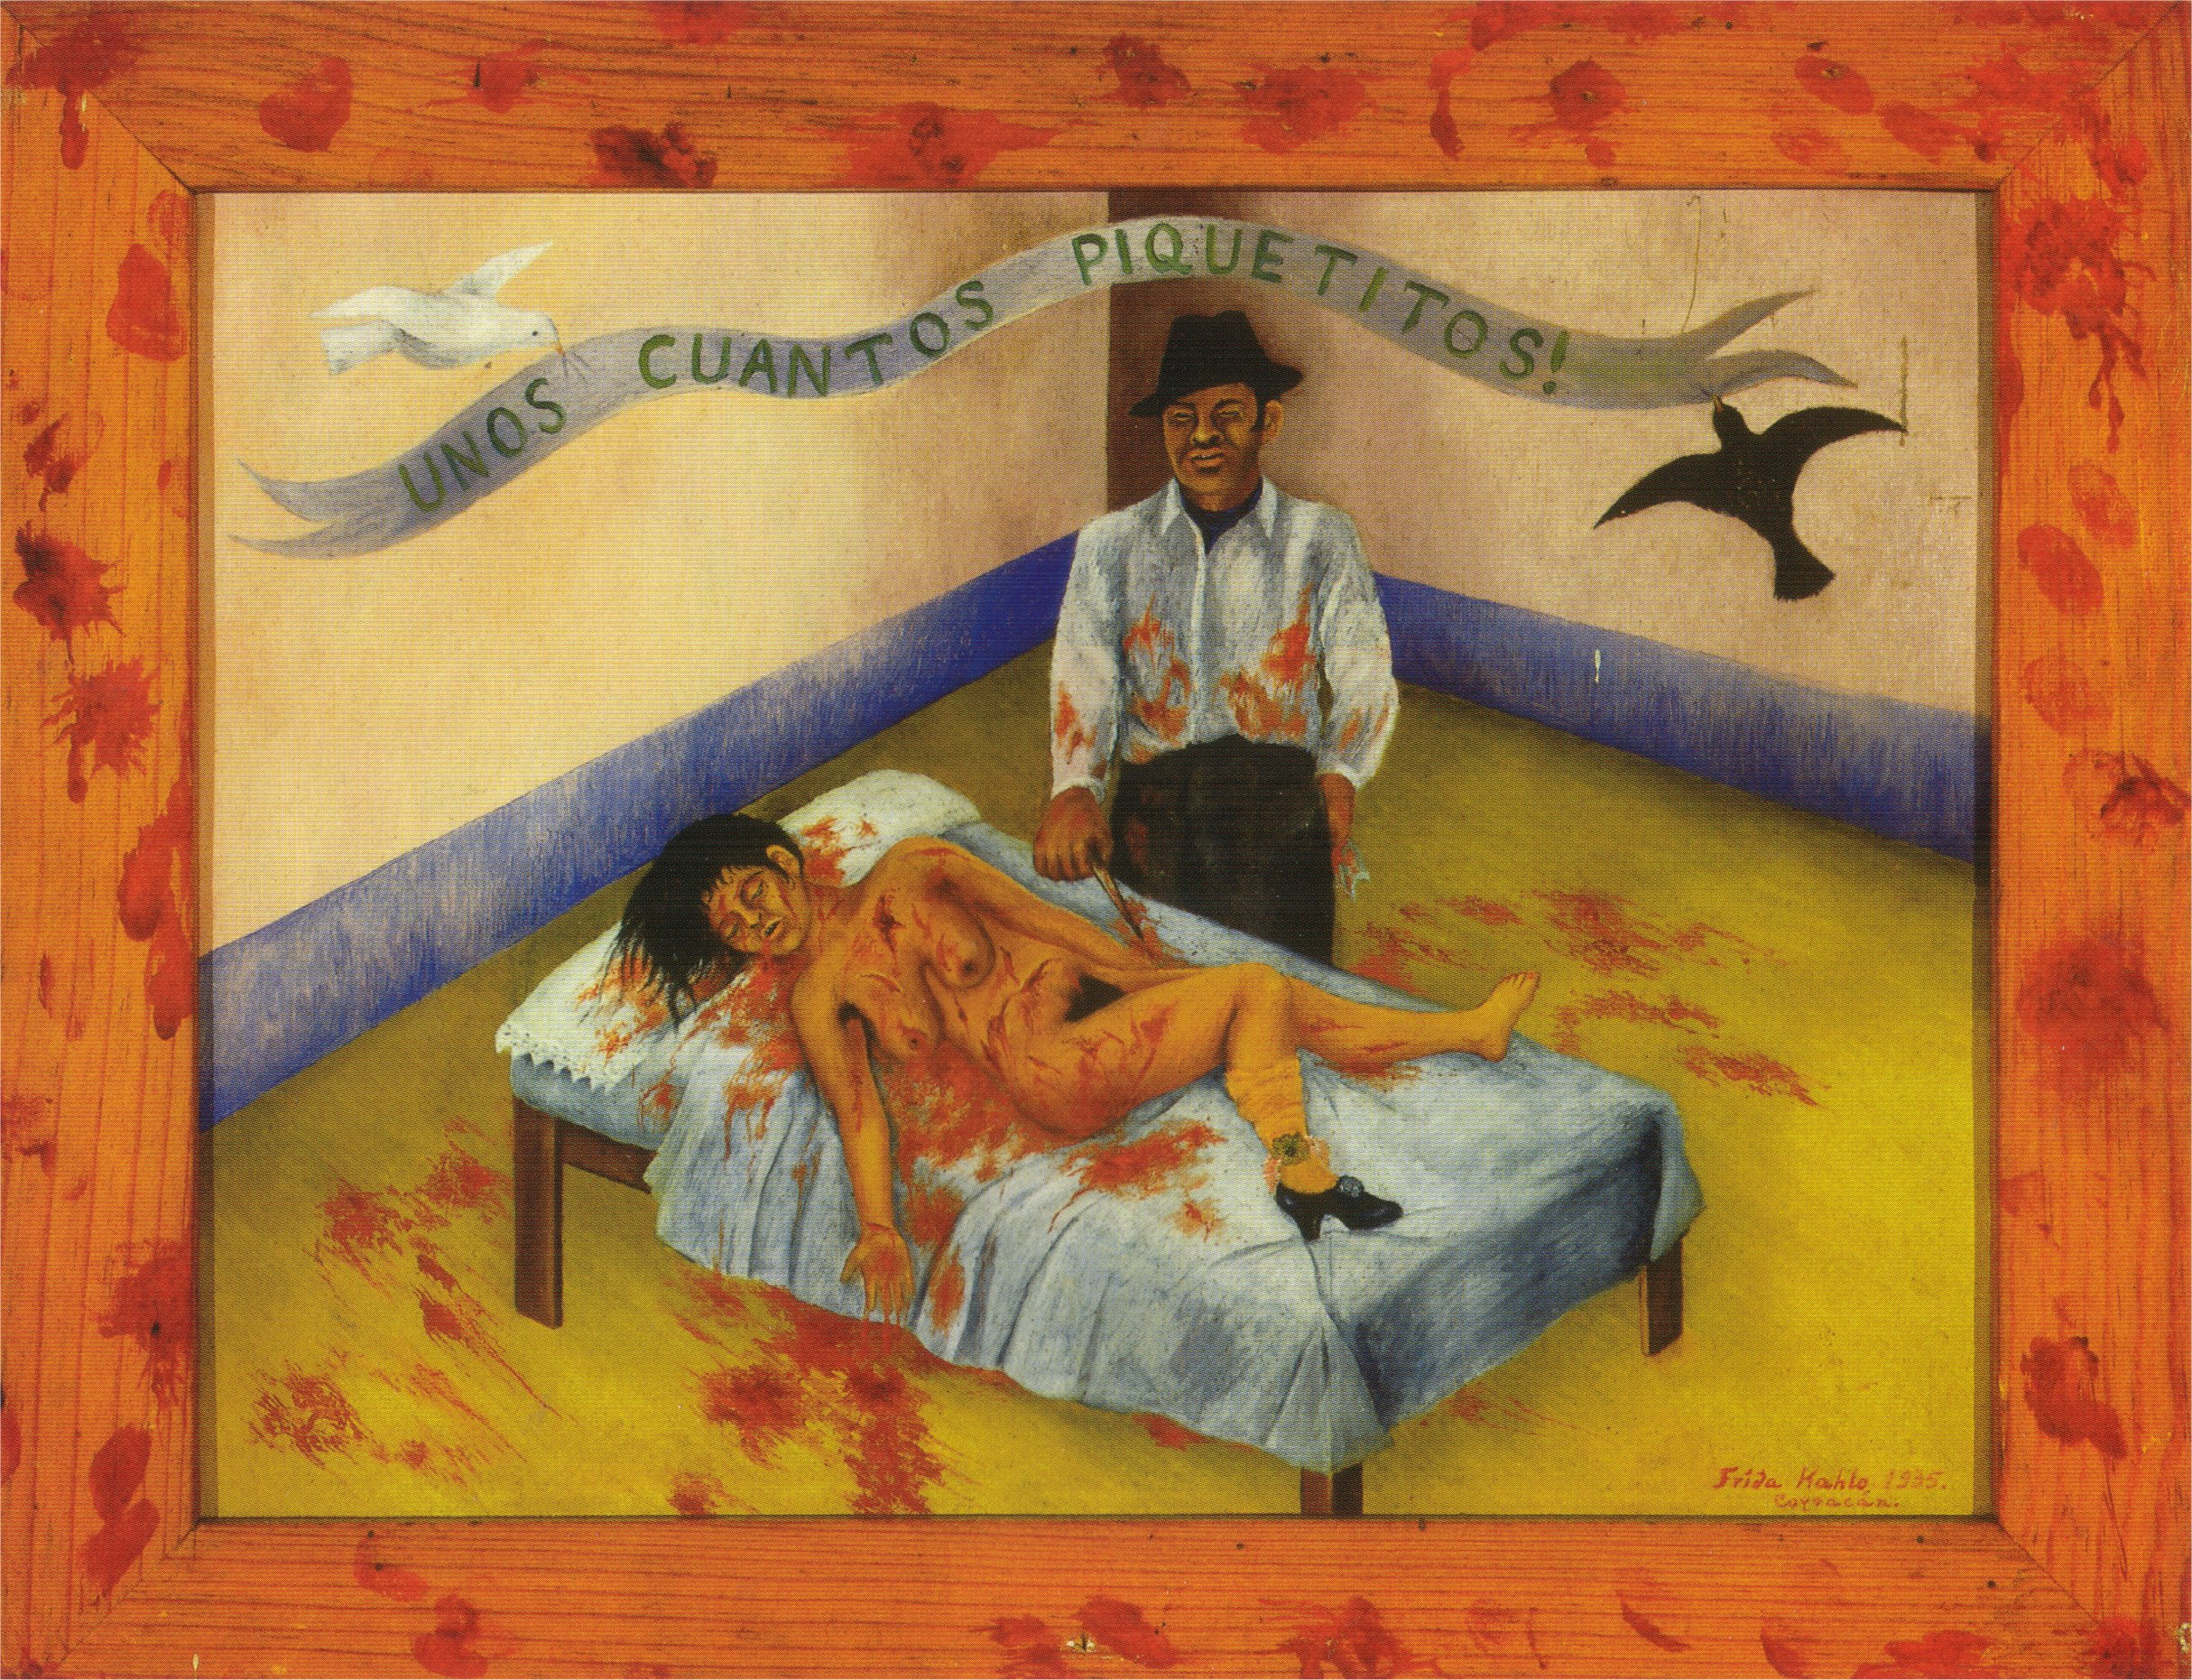
Revisiting Mexican Modernism: through women’s eyes
“Above all women must unite and fight together strongly to improve their condition. Women have to cease being luxury objects and transform themselves into a factor within the class struggle; they ought to evolve socially and participate directly in the revolutionary struggle.”
María Izquierdo, 1936
Nahui Olin, Bautizo, ca. 1935
Frida Kahlo, A few small nips, 1935

Slide 15
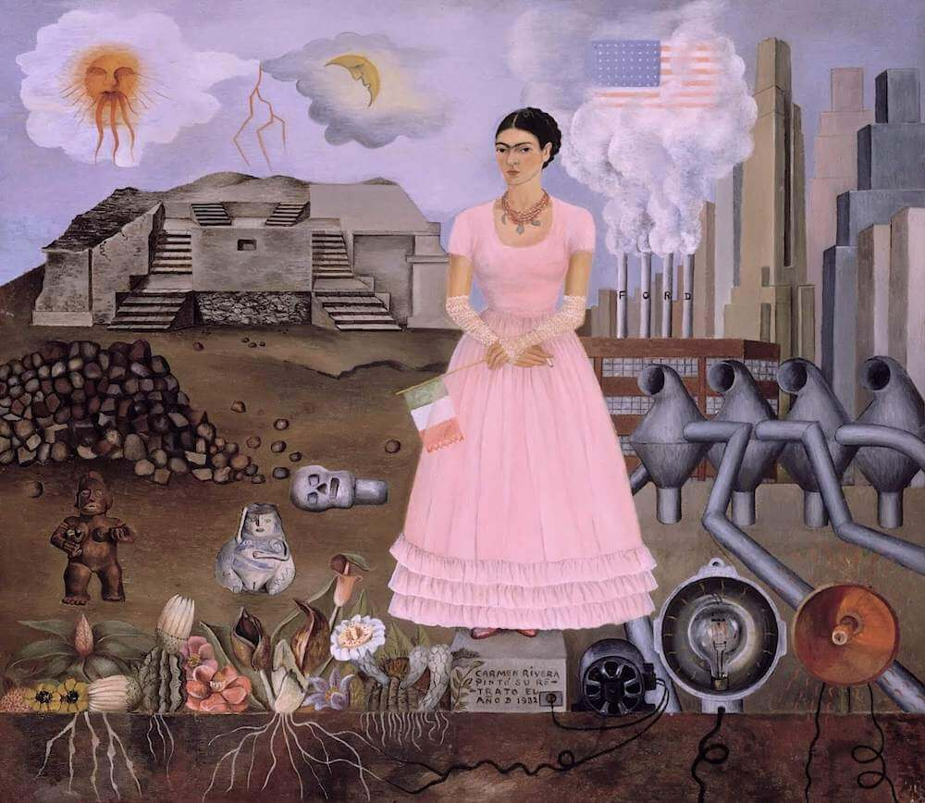
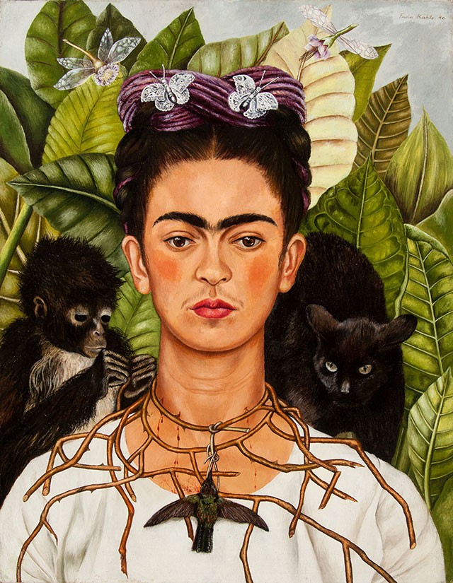
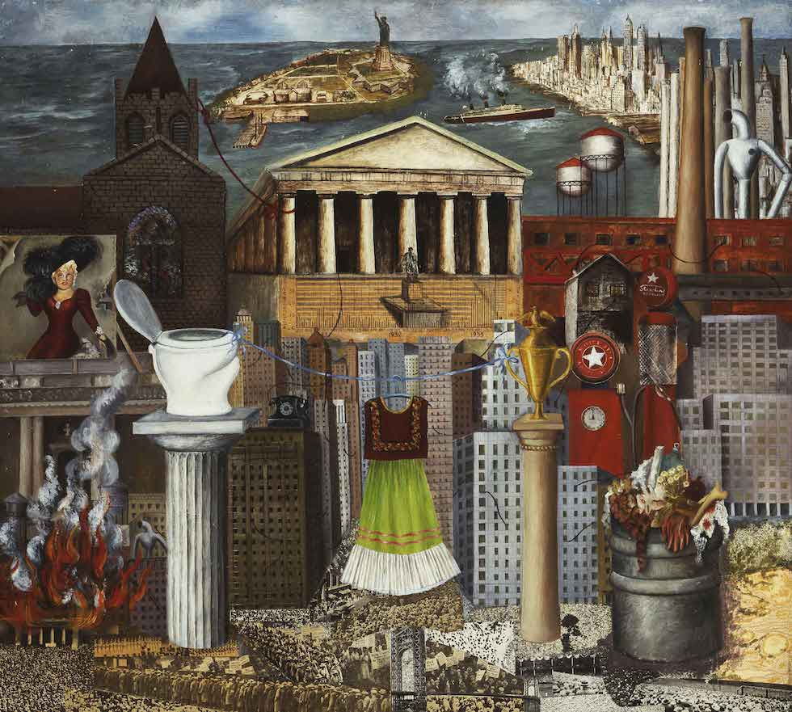
You cannot bypass Frida Kahlo (today)
My dress hangs there, 1933
Self Portrait along the Boarder Line between Mexico and the United States
Untitled [Self-portrait with thorn necklace and hummingbird], 1940.

Slide 16
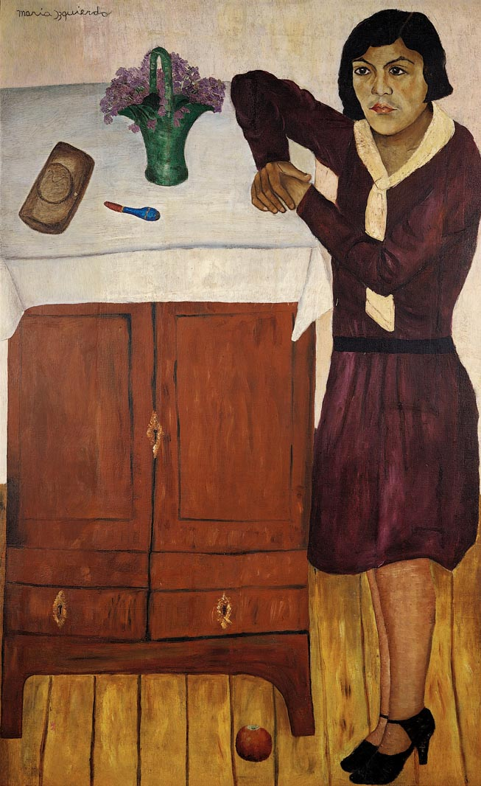
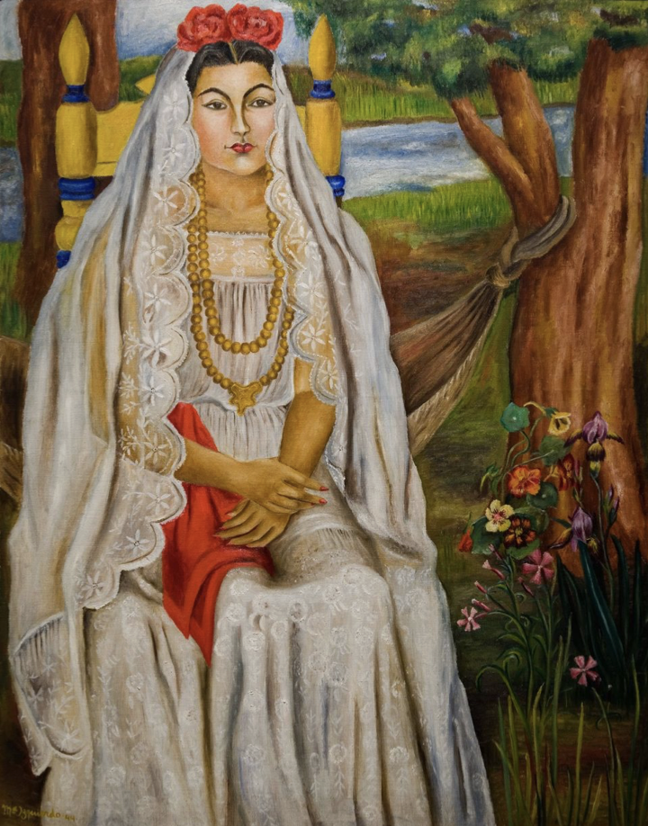
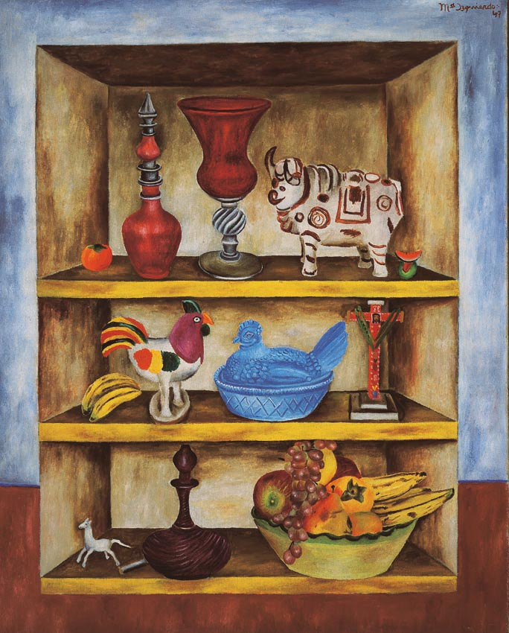
Gendered perspectives of Mexican modernism:
Maria Izqierdo (1902–1955)
Still Life, 1948
Bride from Papantla, 1944
Portrait, 1928

Slide 17
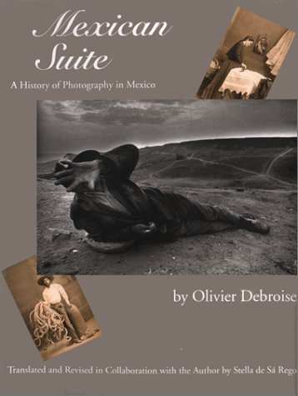
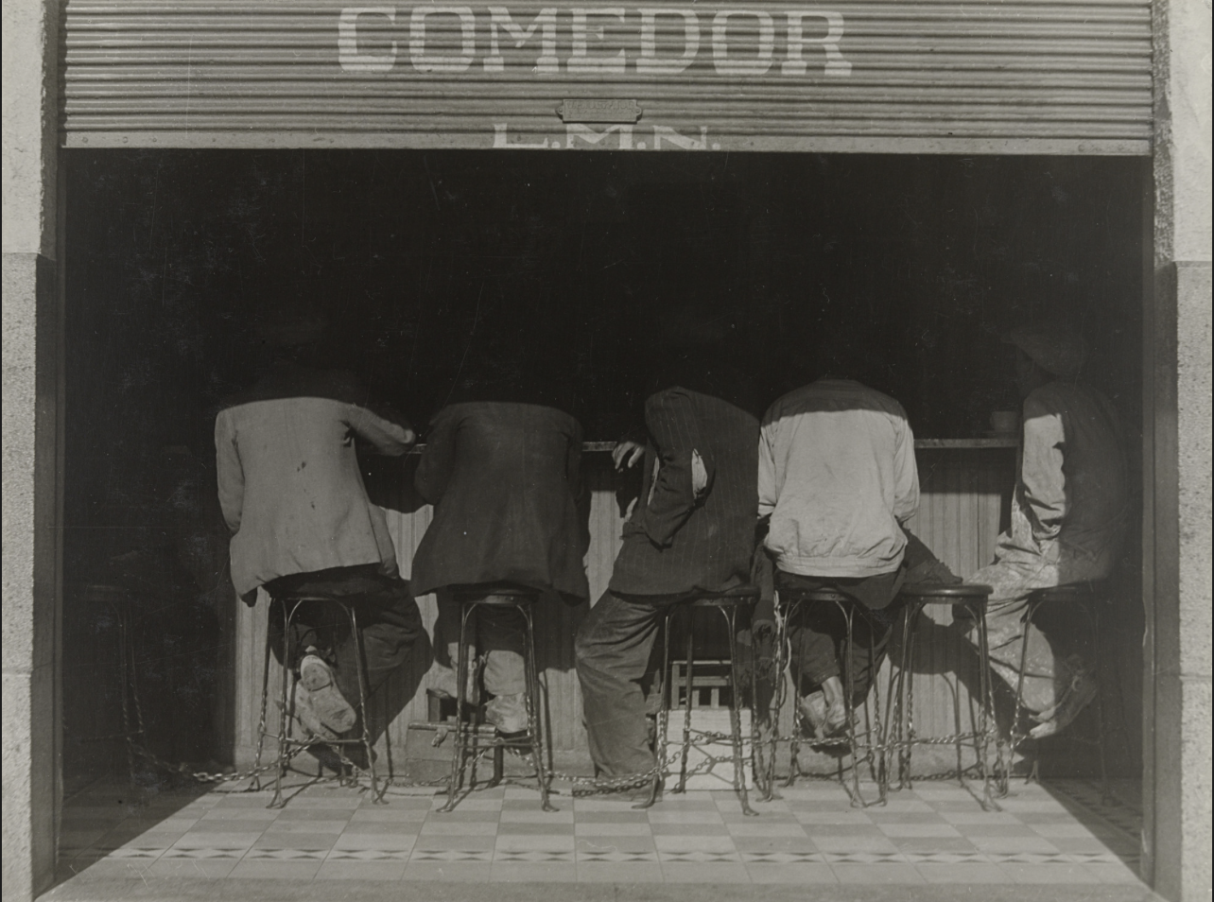
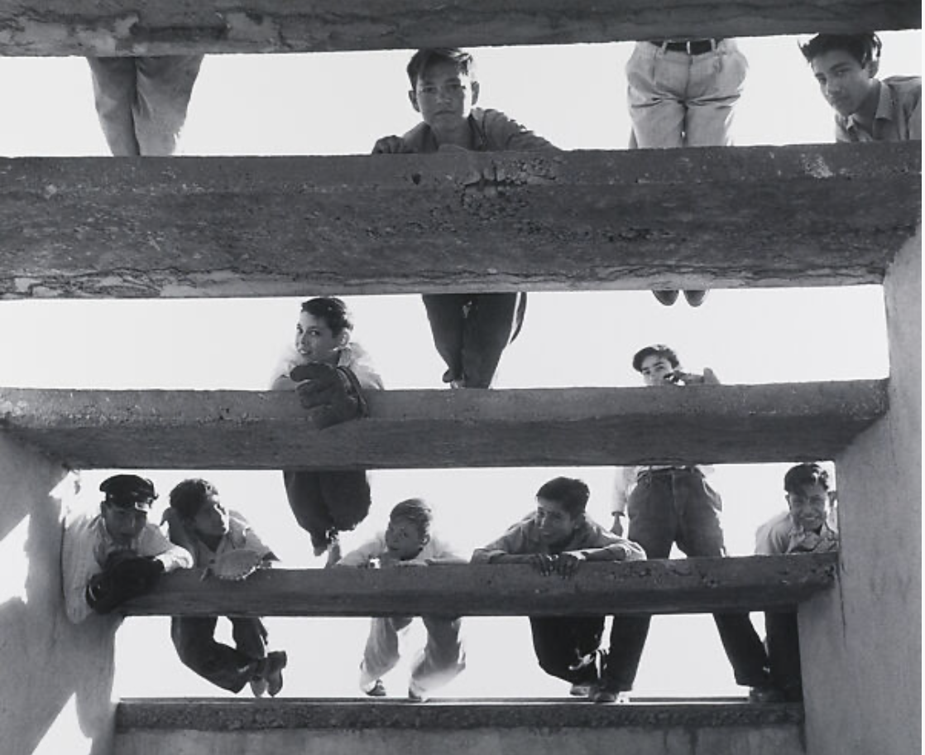
Photography
Manuel Alvarez Bravo, The Crouched Ones (1934)
Lola Alvarez Bravo, The Freeloaders (1955)

Slide 18
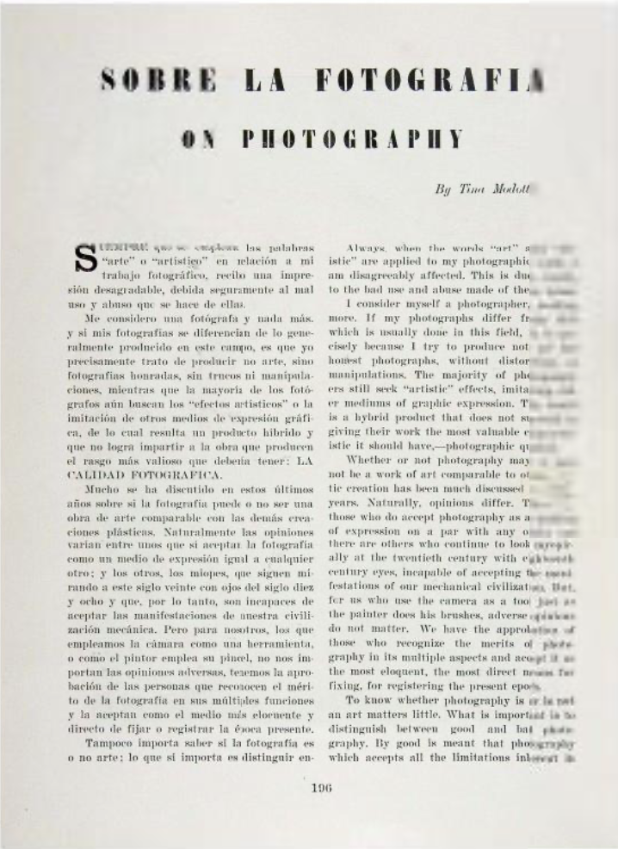
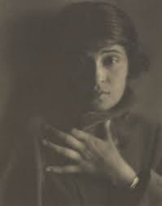
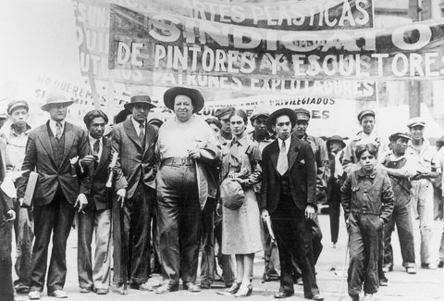
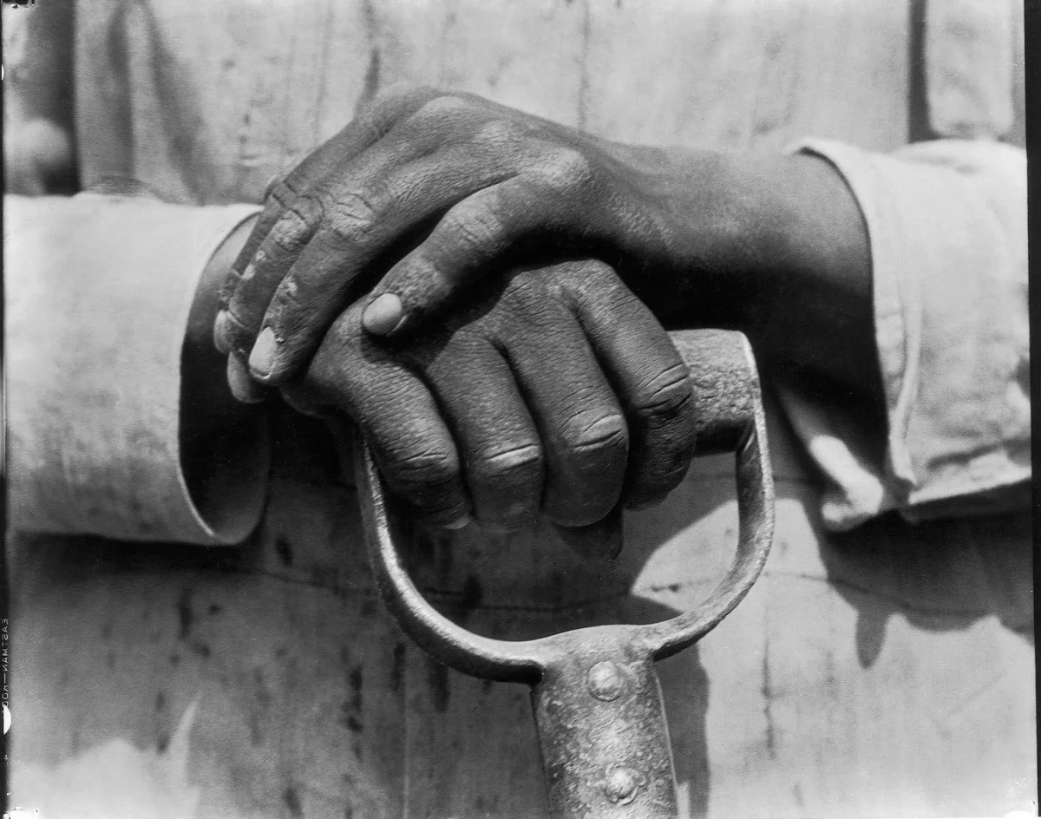
Tina Modotti (1896–1942)
Diego Rivera and Frida Kahlo with members of the Artists’ Union at a May Day march. Mexico City. 1929.Credit

Slide 19
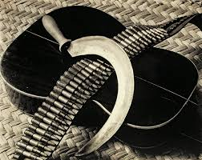
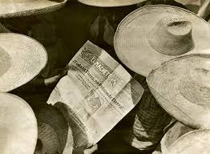
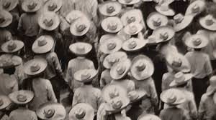
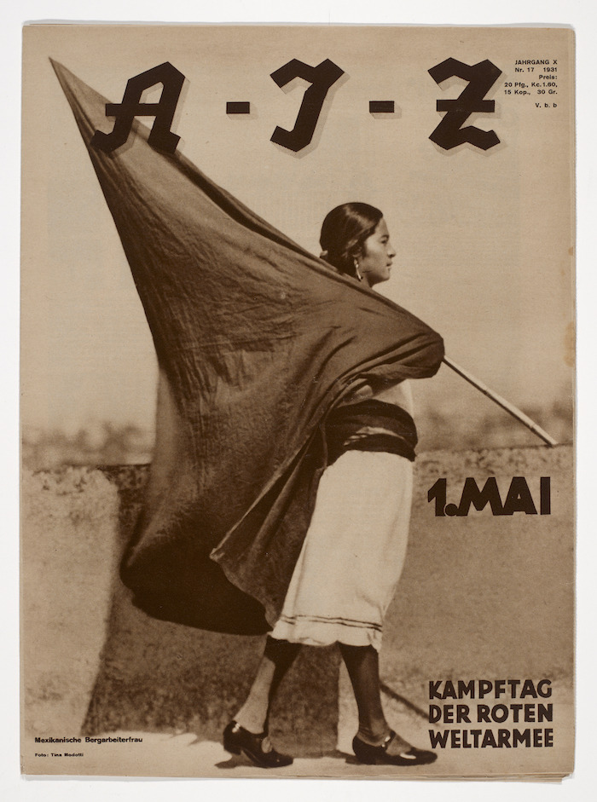
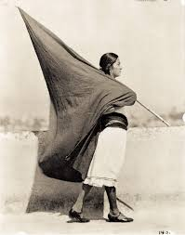
Photography as a socially committed art
Notes:
El Machete, the A-I-Z and Mexican Folkways

Slide 20
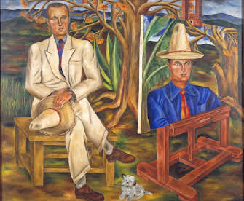
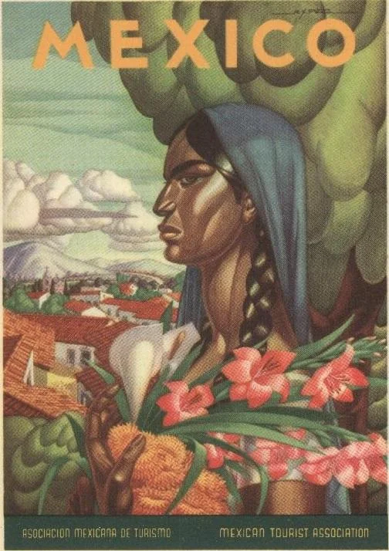
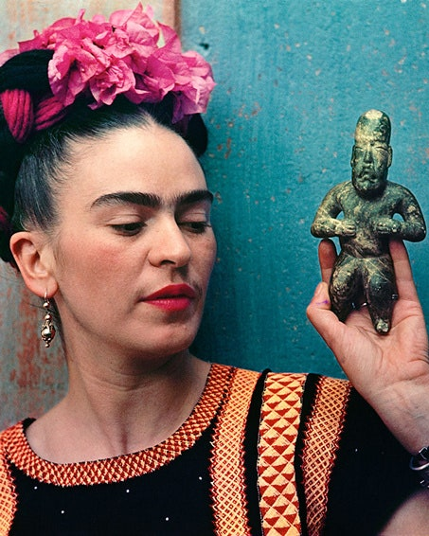
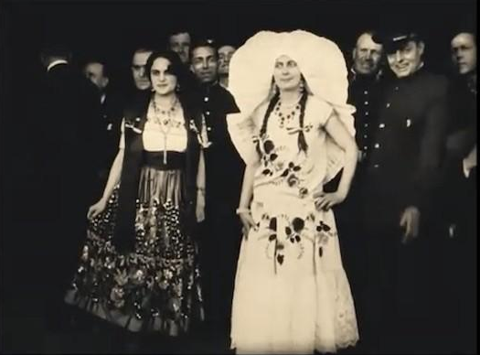
María Izquierdo, The Tourist, 1940
Palatable for the masses?
Women in indigenous-inspired costumes – a Tehuana everyday costume and a Tehuana holiday costume – in the Mexican Pavilion during the Ibero-American Exposition, Seville 1929

