Slide 1
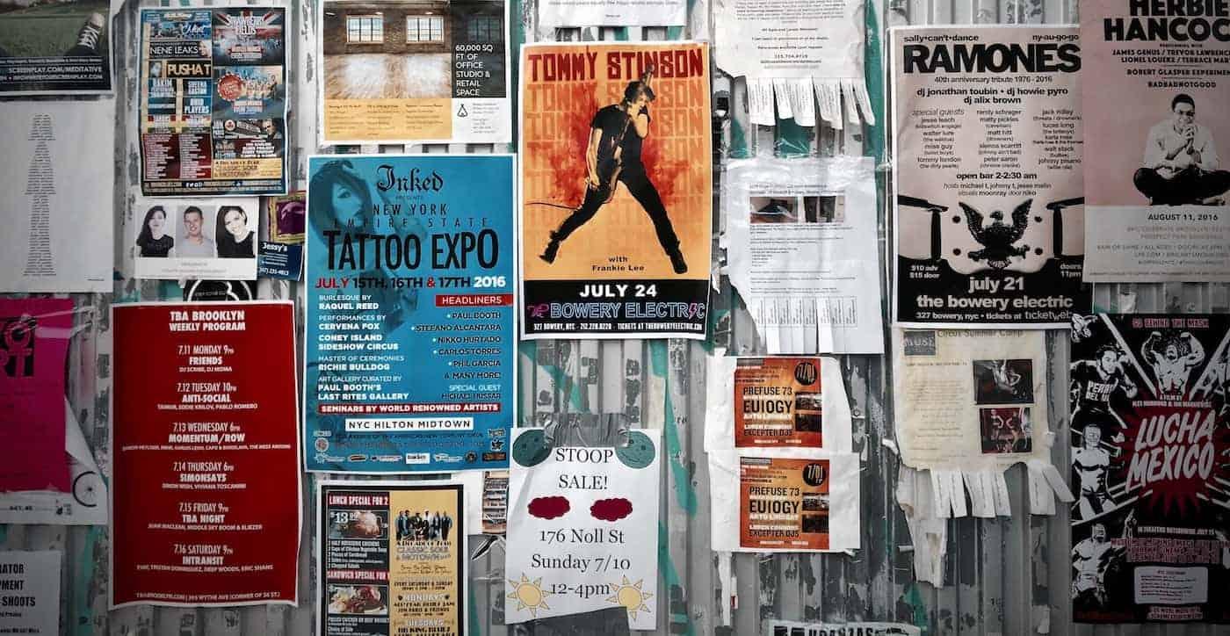
POSTERs

Slide 2
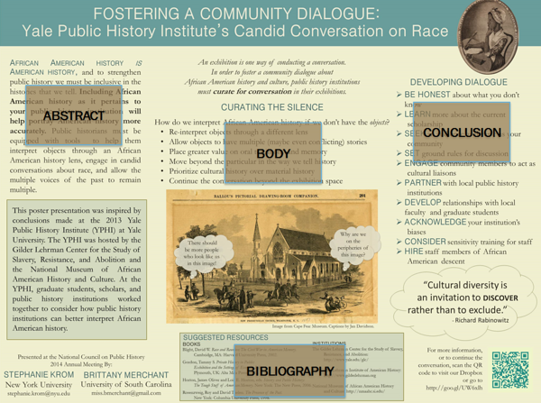
What is poster?
A large-format poster is a big piece of paper or image featuring
a short title
an introduction to your topic
an overview of your approach (body)
your results in graphical form (conclusion)
a list of references (bibliography)
if all text is kept to a minimum (500-1000 words), a person could fully read your poster in 5-10 minutes.
INTRODUCTION

Slide 3
Learning outcomes
Translate what you learnt in lectures and discussions into your own research
Find an original topic and conduct independent research on it
Turn your findings into a brief visual and oral presentation
Think about most important information to include in a poster
Be able to present your poster

Slide 4
Questions to ask
What is the key message from the research that you want to highlight to your audience?
Not just the work of art/artist, but the message
Along with the main image, what other material (texts, graphs, other images) do you need to support the poster theme?
Keep it simple. Choose a lead image and supporting material.
Who is the audience?
Us
What medium?
Handmade collage or software (PowerPoint, Adobe inDesign, Illustrator, Canva…).
Acknowledge software, including AI tools for the poster design.

Slide 5
Practicalities
What size should your poster be?
A2 ideally, landscape or portrait
How many words?
1000 words max. Think of the font and size.
What colours will you use?
Background, letters, images
Plan it.
You have the idea; how will you present it visually and in an interesting way?
Keep it simple. Limit text, focus on images but explain.
Sketch it out.

Slide 6
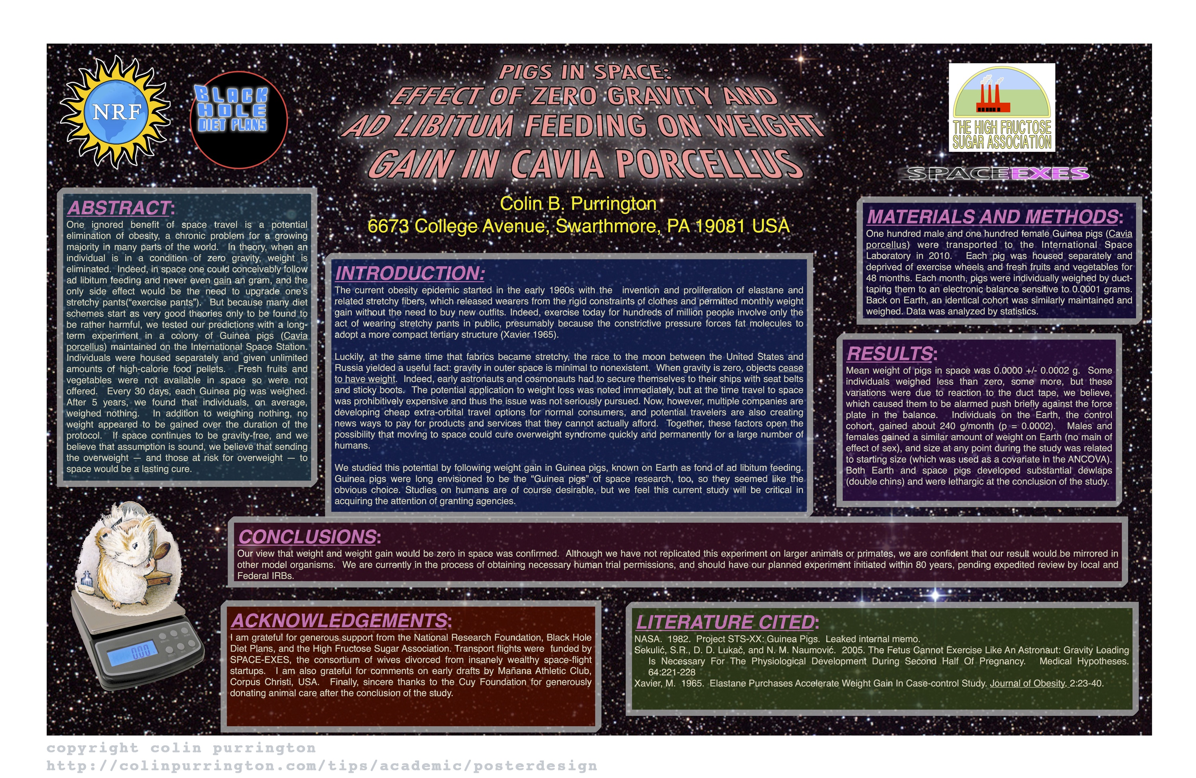

Slide 7


Slide 8
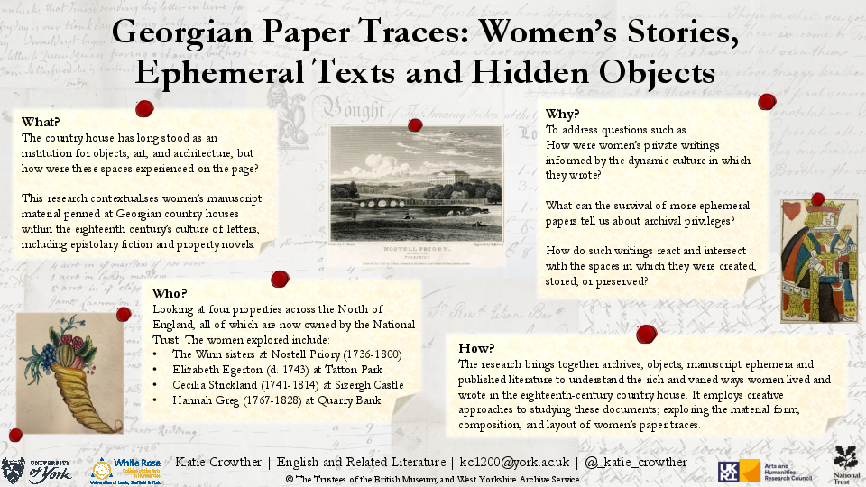

Slide 9
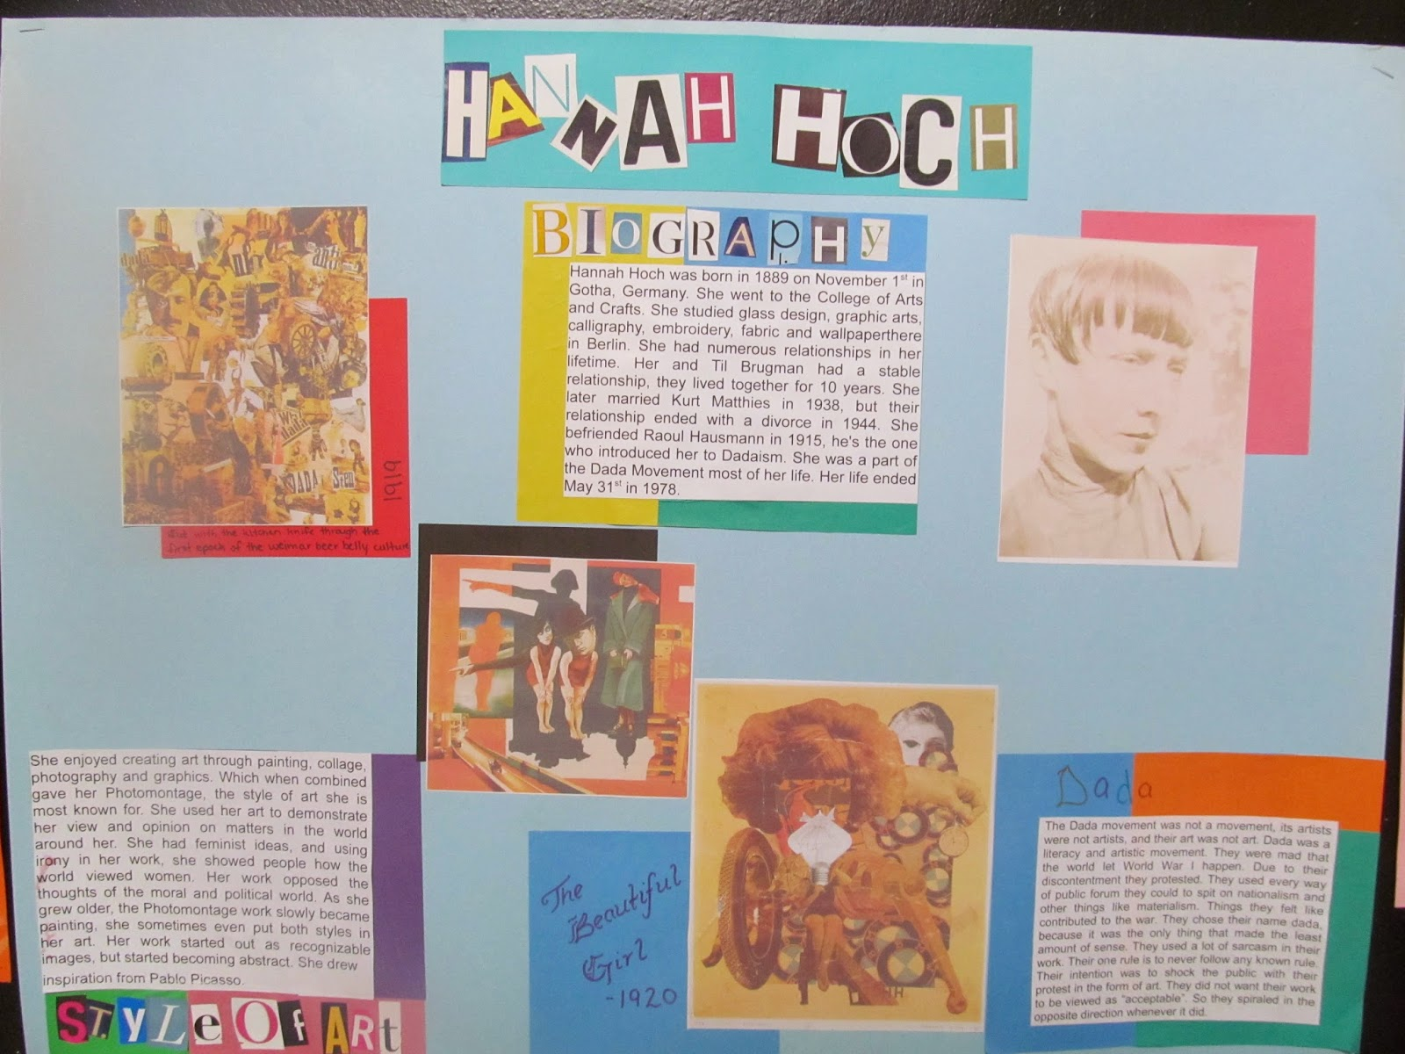

Slide 10
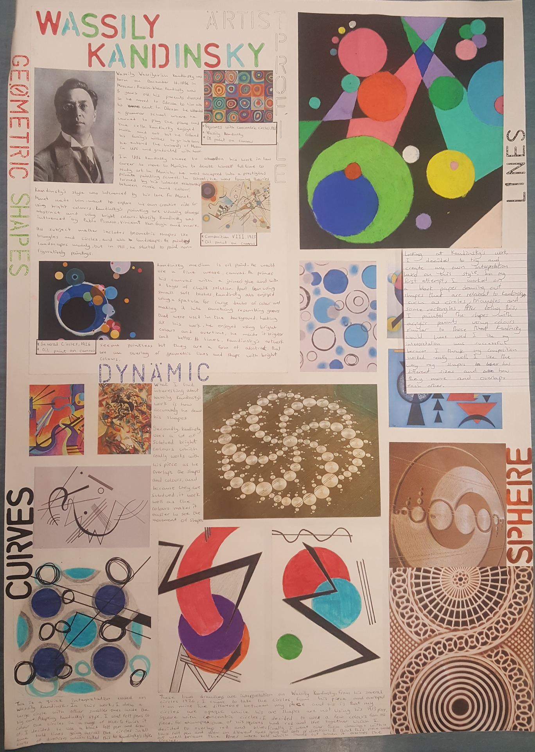
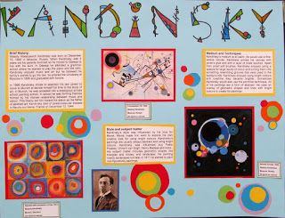

Slide 11
Some resources
Tips for poster creation
Art and Humanities posters
Examples
Software suggestions

Slide 12
Dates
13 December: poster ideas, feedback
20 December: presentations I
10 January: presentation II

