Slide 1
Tropical Modernism

Slide 2
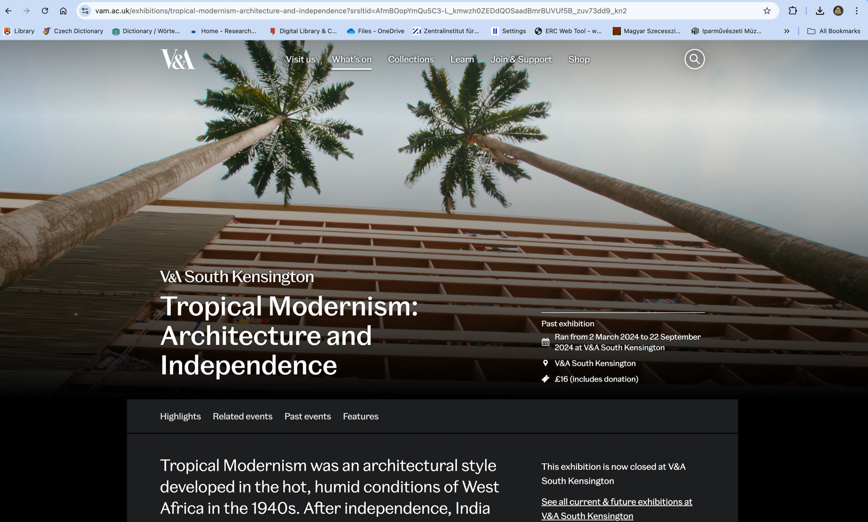

Slide 3
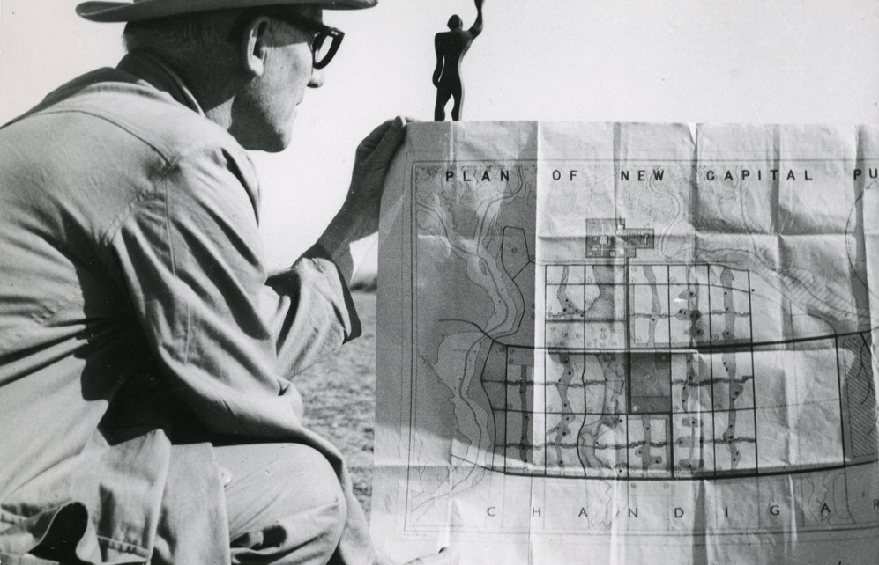
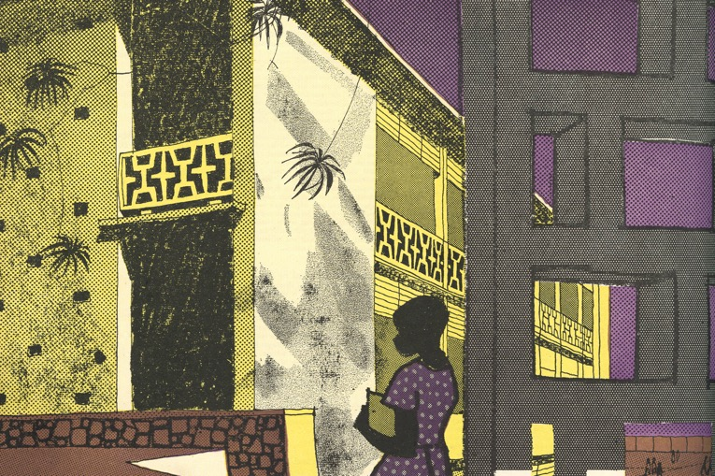
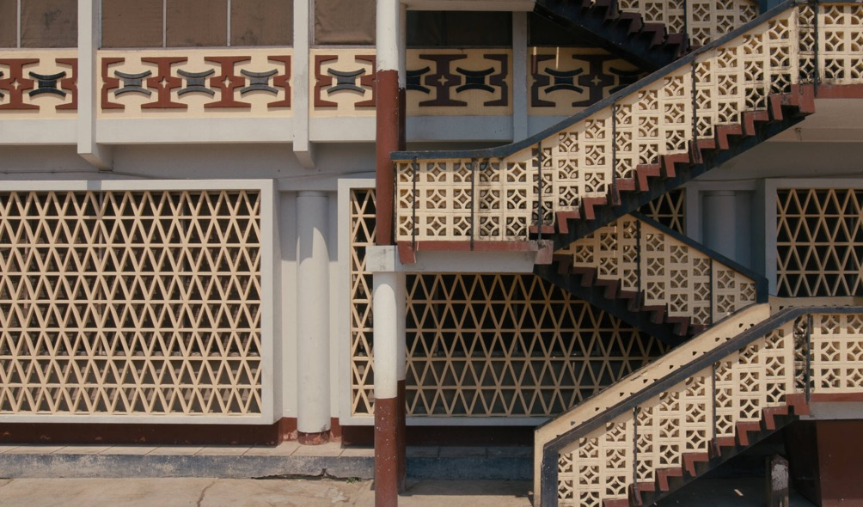
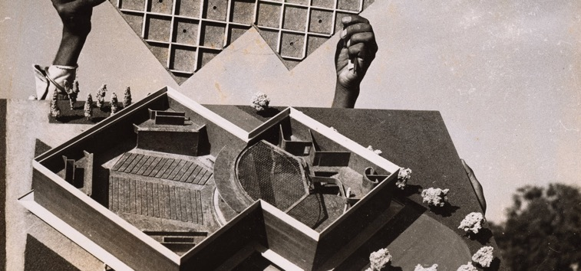

Slide 4
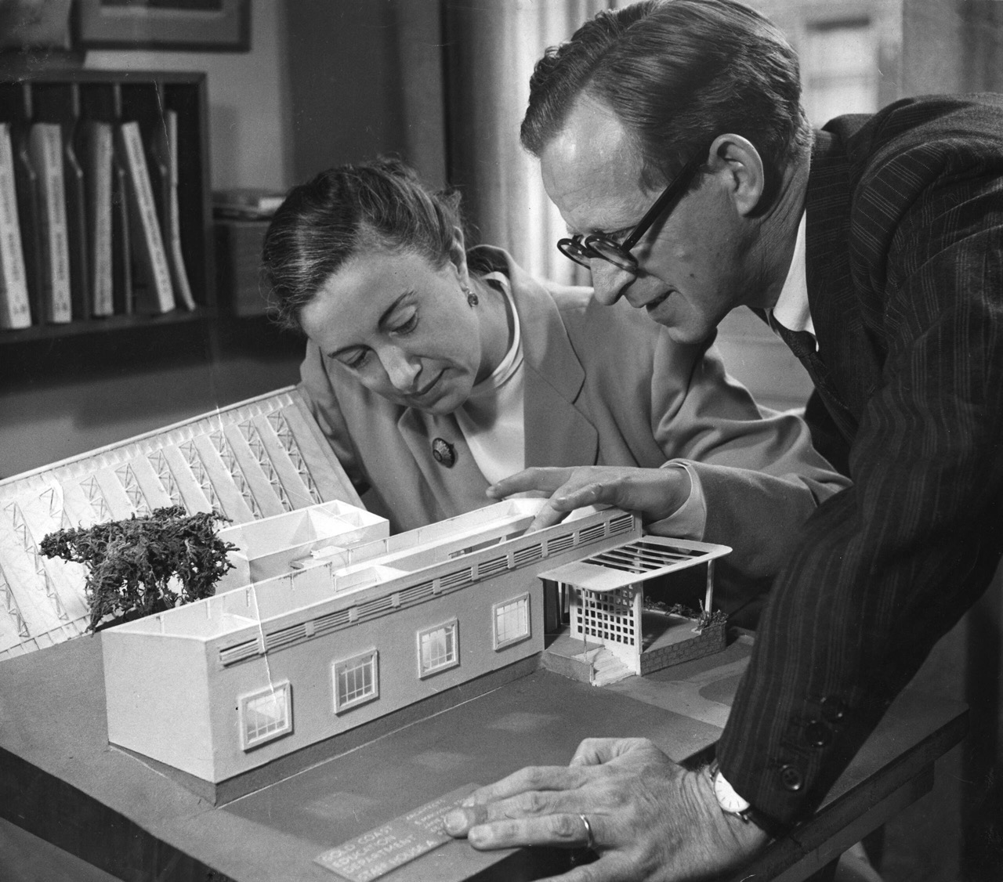
Jane Drew and Maxwell Fry with a model of one of their many buildings for the Gold Coast (1945). Image courtesy RIBA

Slide 5
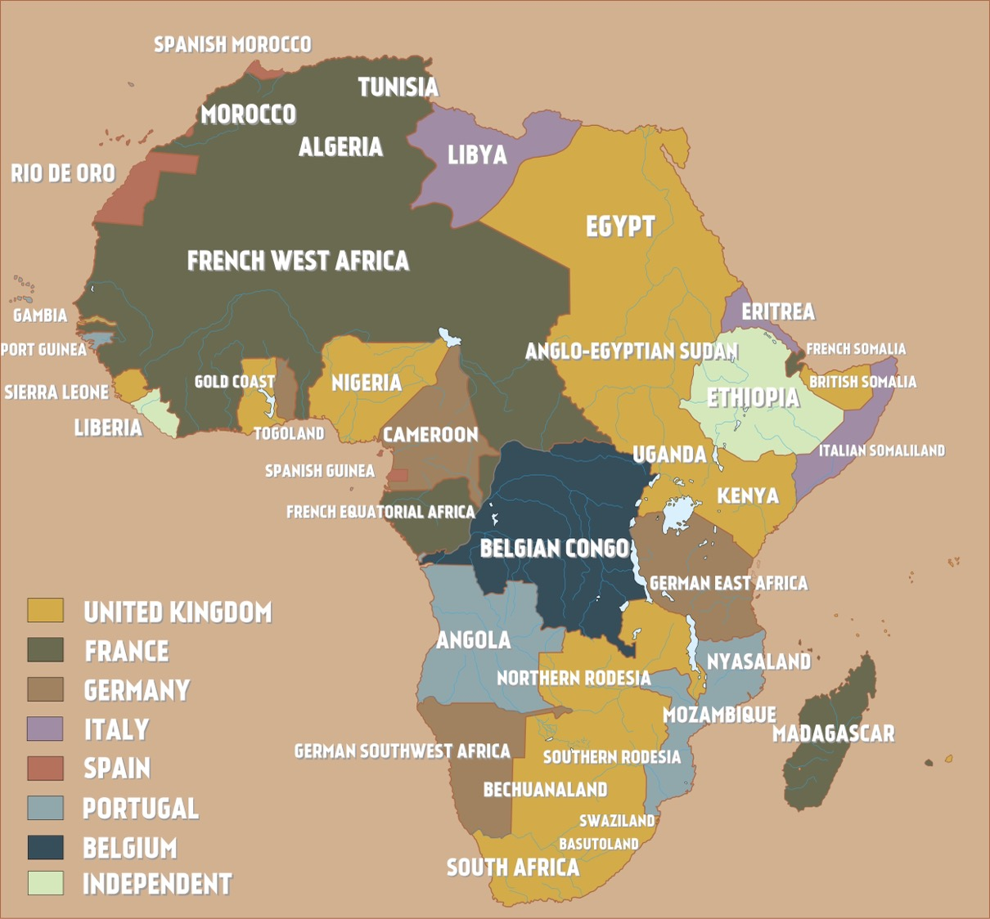
Africa, ca. 1945

Slide 6
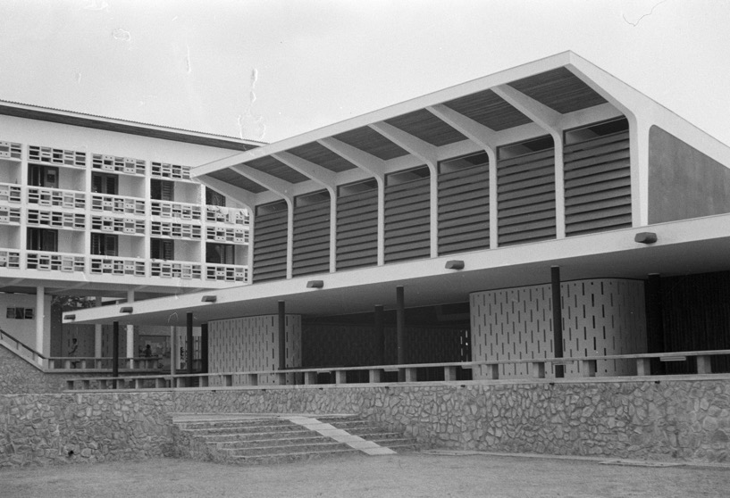
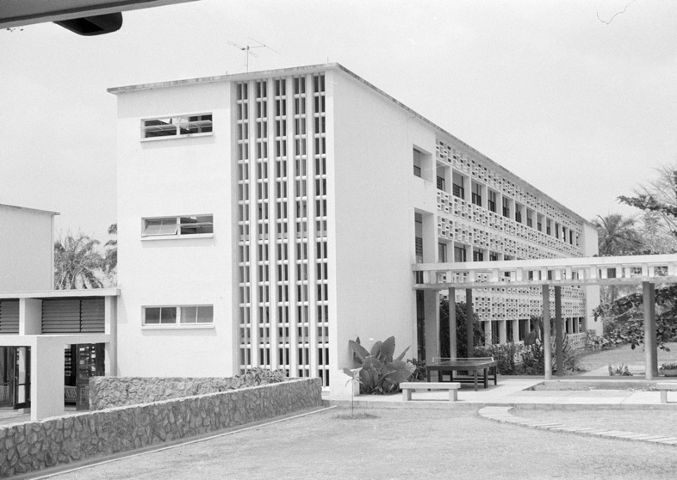
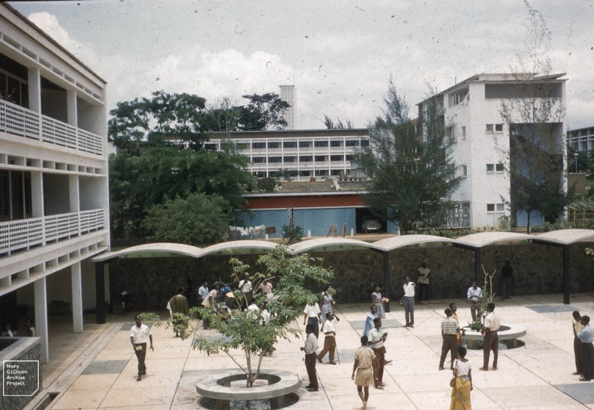
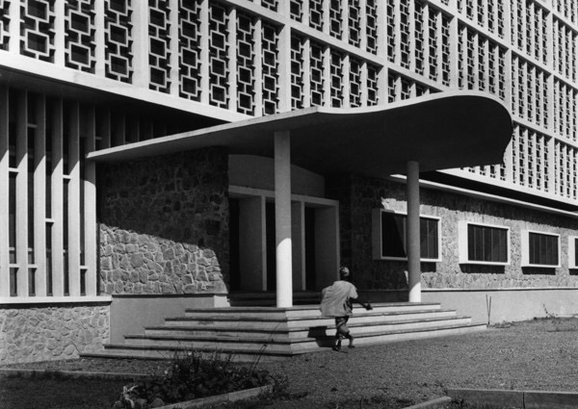
Jane Drew and Maxwell Fry, University of Ibadan Campus (1949-1960)

Slide 7
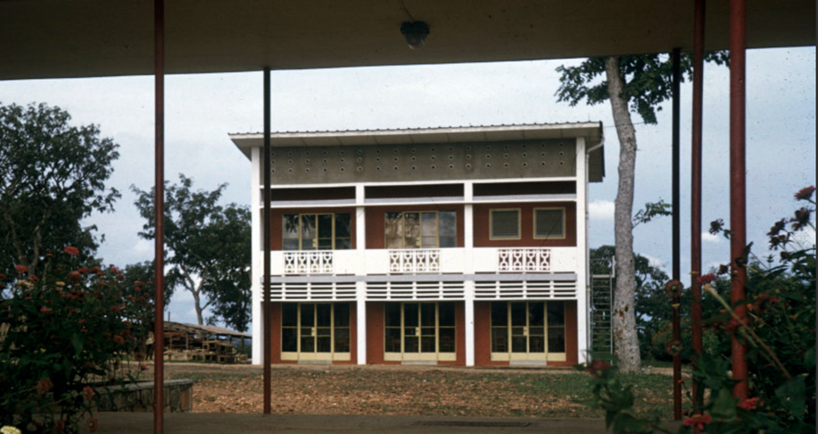
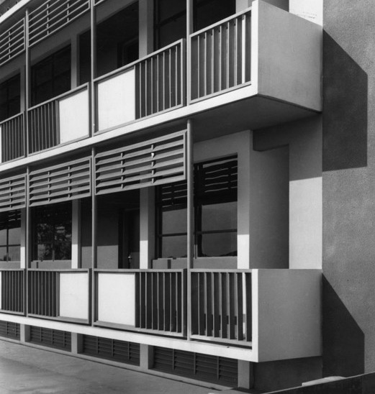
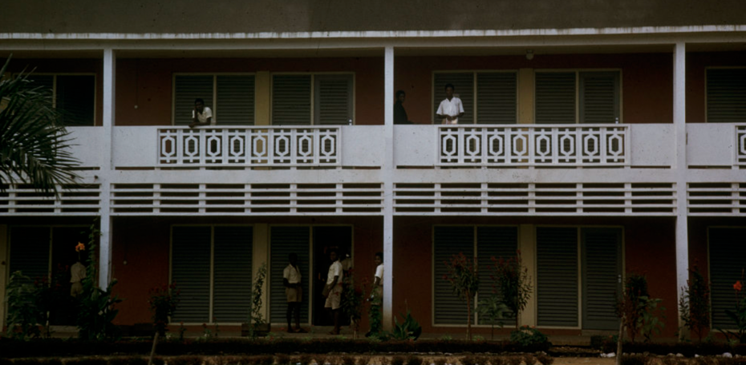
Jane Drew and Maxwell Fry, Mawuli School, Ghana (1955)

Slide 8
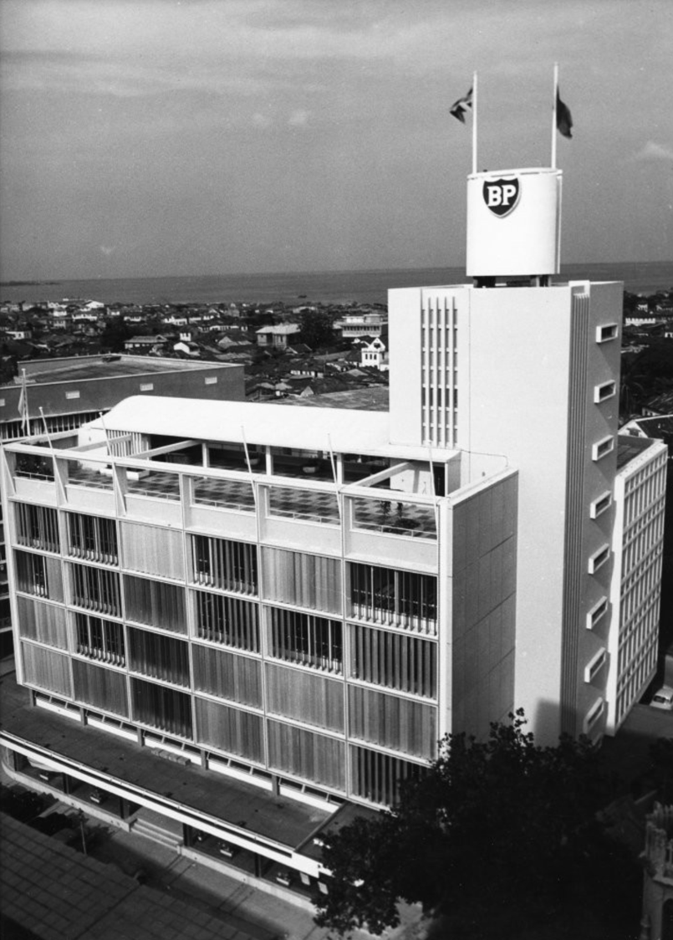
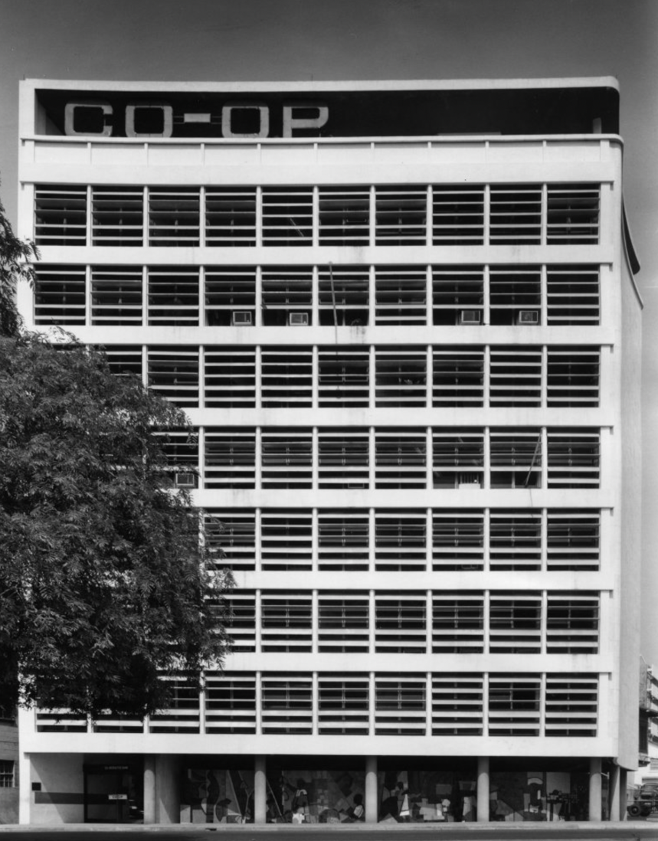
Fry and Drew,
L: BP Building, Nigeria (1961)
R: Co-operative Bank, Lagos (1959)

Slide 9
Tropical Modernism as a Hybrid Practice:
Adaptation of design to environment
Climate (passive cooling)
Ventilation
Wall sunscreens against solar glare
Stylistically, indebted to European modernism, but with the addition of details that gesture to local cultures
“ … while my fellow architects took what I thought to be the easy course in buildings of mass concrete and violent even menacing proportions … I sought for what materials still bore the natural and human impress, using brick, slate, burnt tiles, timber, but of necessity brick in the laying of which the last building skill still flourished.”
Maxwell Fry, Autobiographical Sketches (London, 1975)

Slide 10
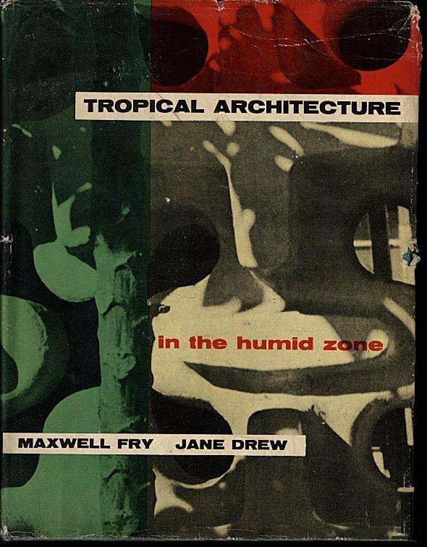
“Modern architecture, and its extension into town planning, has above all the task of interpreting applied science in humanistic terms. Of making industrialism fit for human use; building cities that ennoble life instead of degrading and destroying it; and of creating everywhere, out of the disparate and anti-social manifestations of machine production and centralized power, unities of resolved thought and feeling, in the form of buildings, groups of buildings and larger aggregations, in which life may know its bounds and flourish.”
Fry and Drew, Tropical Architecture in the Humid Zone (London, 1956) p. 22

Slide 11
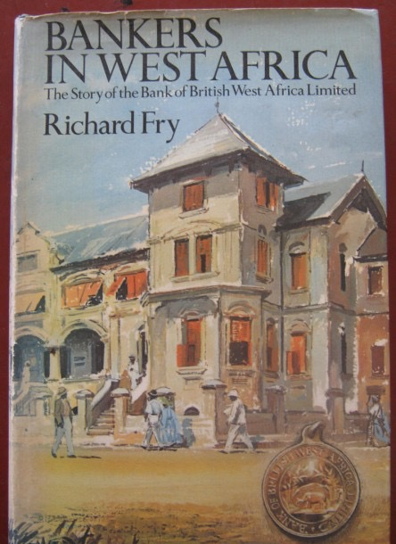
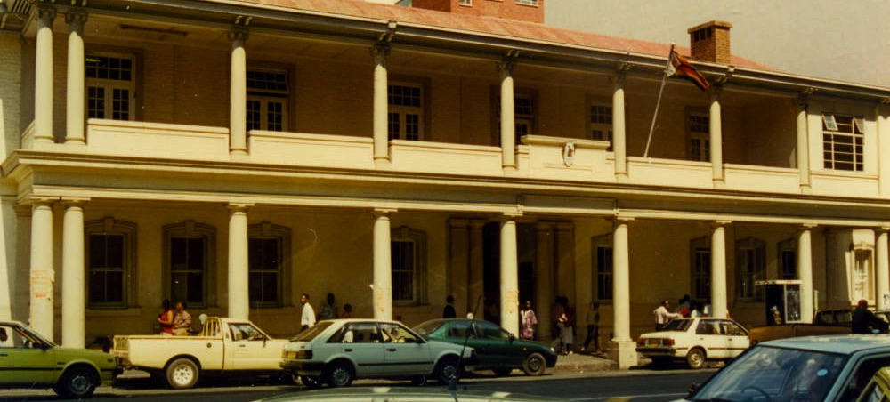
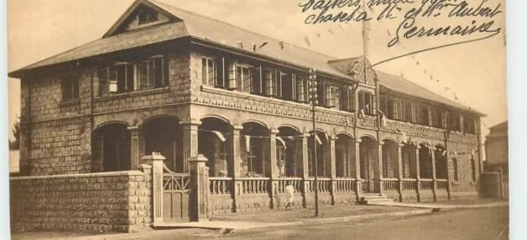
L: The Bank of British West Africa, Lagos; UR: Victoria Falls Hotel, Harare / Salisbury; LR: The Bank of British West Africa, Accra, Gold Coast (Ghana)

Slide 12
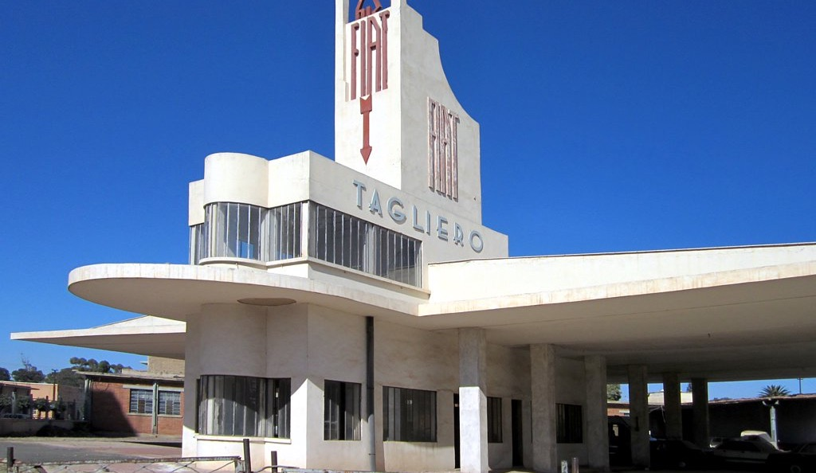
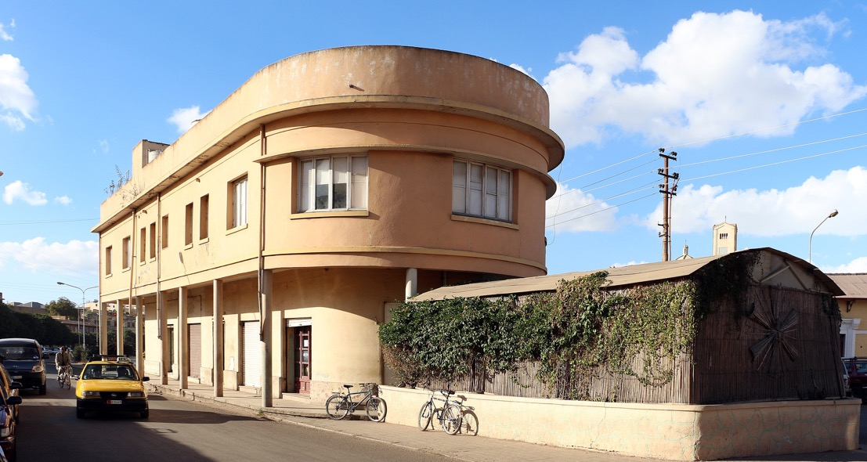
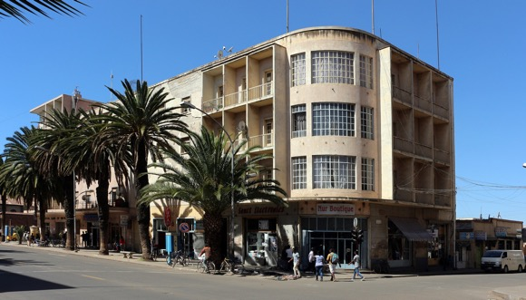
Asmara (“La Piccola Roma”)
Italian Architecture in Asmara, Eritrea (1930s)

Slide 13
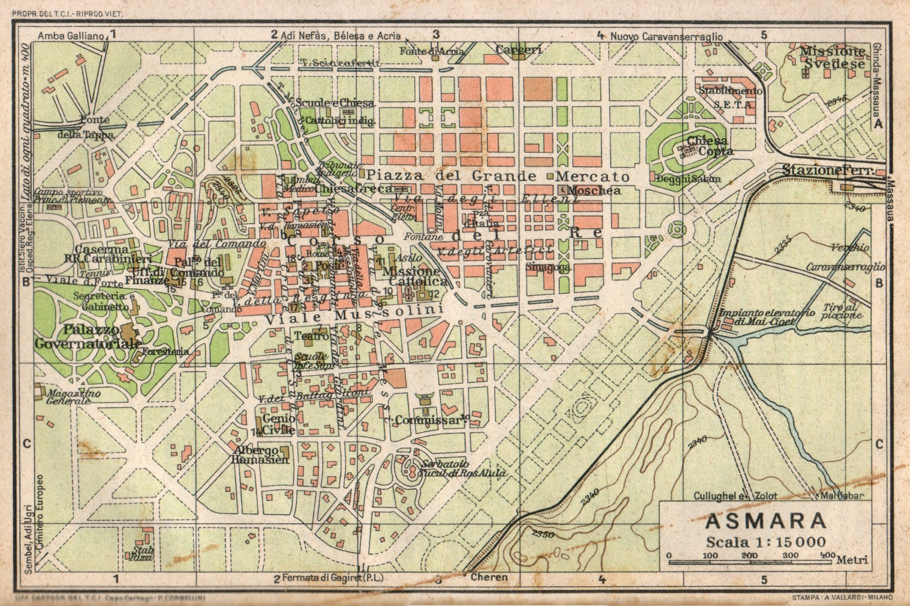
"the Italians built [Asmara] well, like Tripoli, with handsome wide streets, ornate public buildings, and even such refinements of civilization as a modern sewage system ... [Asmara] gives the impression of being a pleasant enough small city in Calabria, or even Umbria.”
John Gunther, Inside Africa (London, 1955) p. 278

Slide 14
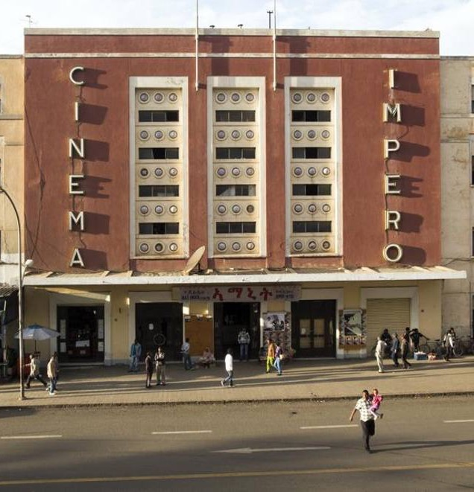
“I consider the following basic principles to be essential:
Without question, the conviction that the white man is the ruler and therefore has the right to all conceivable privileges;
That, consequently, the law is one thing for the whites, and another thing for the natives;
That the houses and dwellings of whites are always the first priority when solving any architectonic problem; indigenous dwellings, on the other hand, are only of interest to the whites if solving a problem with them would improve the wellbeing of the white population;
That there are to be no whites and coloreds living together in the same house;
That the white man's house must be outfitted with the best comforts available as it is preferable if he can enjoy his time in the colony, and because he should be able to enjoy the privileges that come with being white.”
Carlo Quadrelli in Problemi di architettura colonial (Milan, 1936) p. 18. Cited in

Slide 15
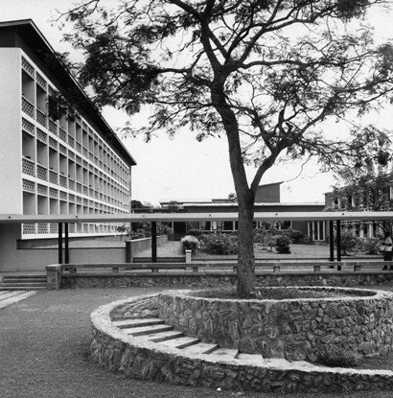
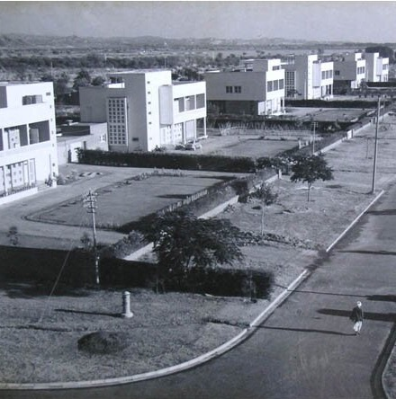
Jane Drew, Housing Designs, Chandigarh, India (1951-53)

Slide 16
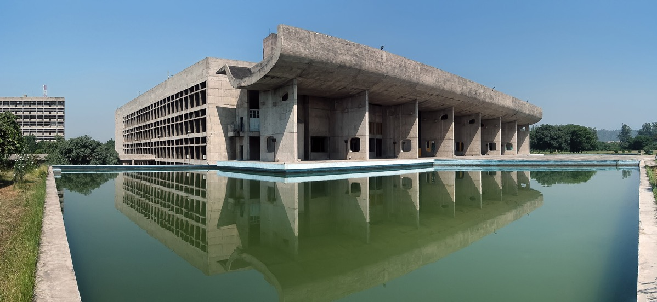
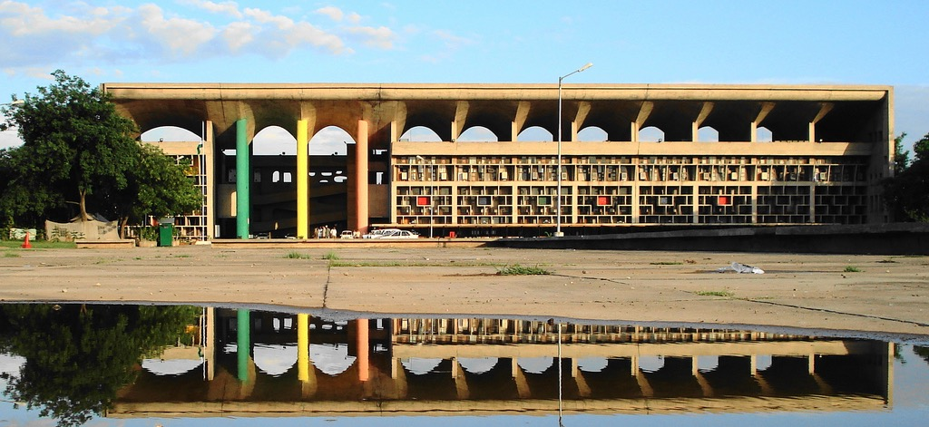
Le Corbusier,
Above: The Assembly Building, Chandigarh, India (1951-1962)
Below: Punjab and Haryana High Court (1956)

Slide 17
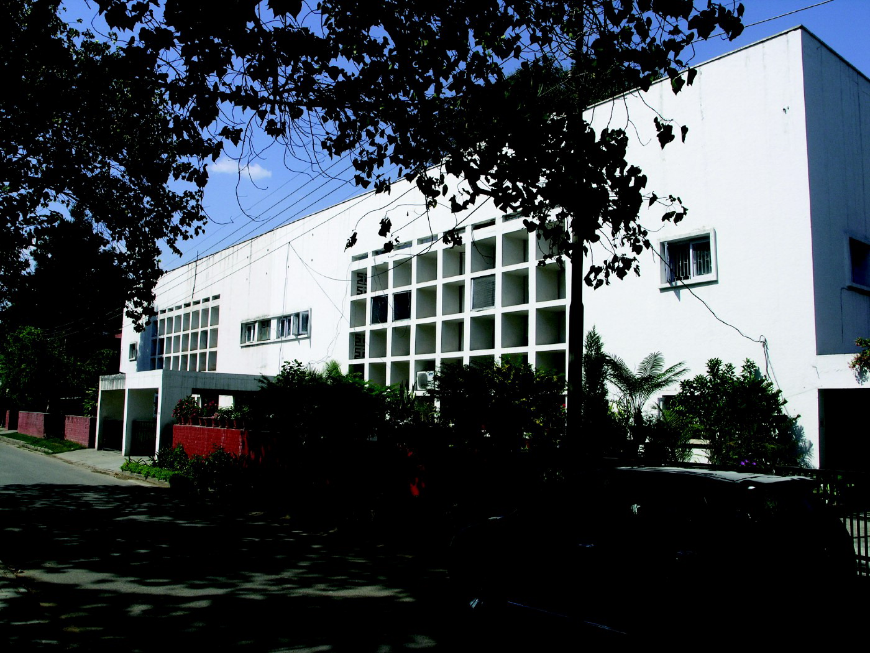
Maxwell Fry, Housing Complex, Chandigarh (1953)

Slide 18
Not-tropical modernism in the tropics

Slide 19
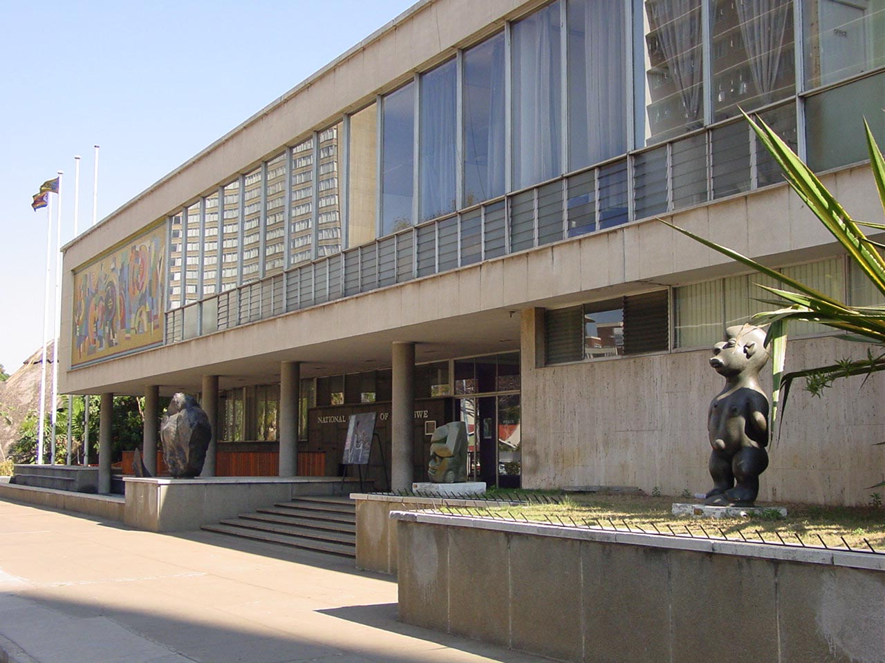
Montgomerie and Oldfield, The National Gallery of Zimbabwe, Harare (1955)

Slide 20
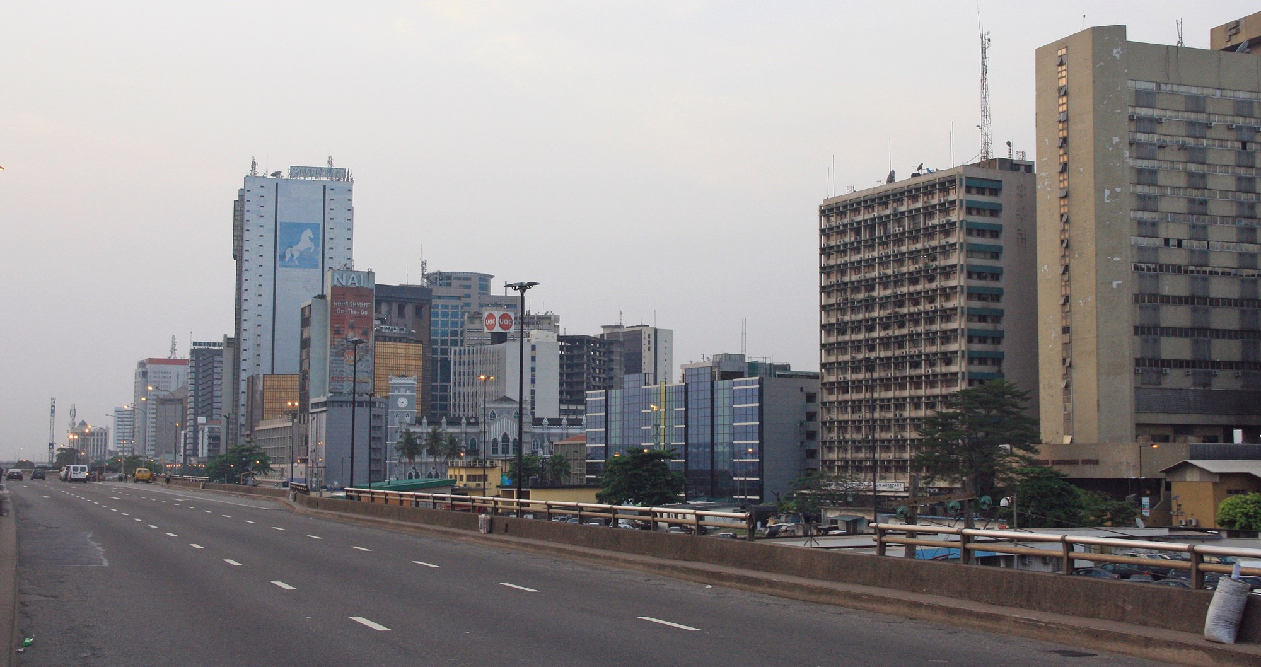
Broad Street, Lagos, Nigeria

Slide 21
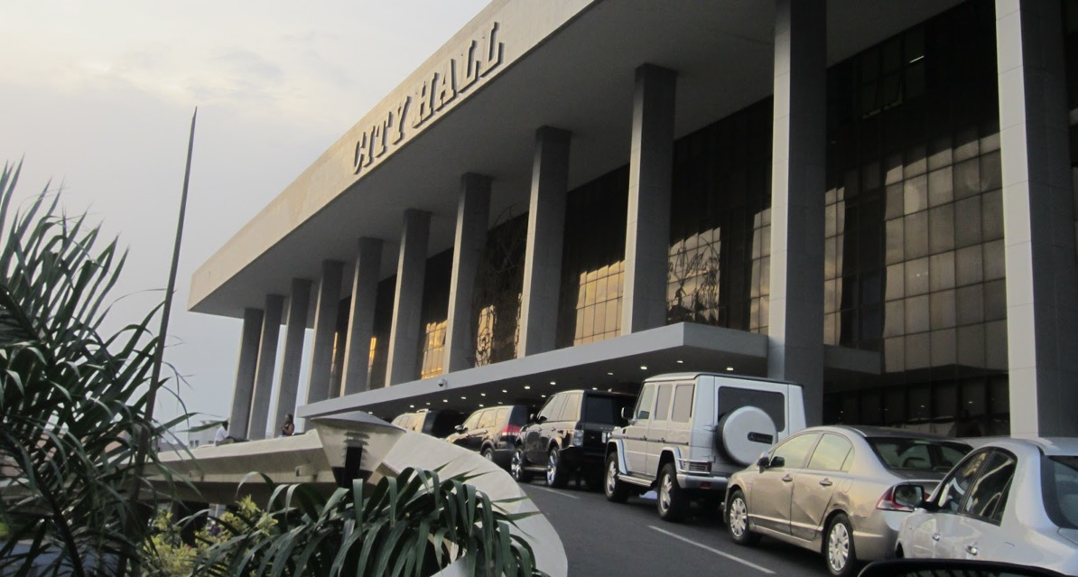
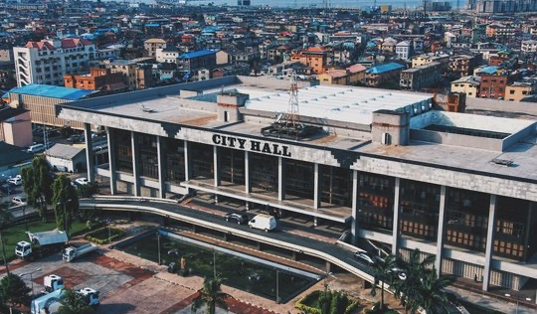
AMY Architects,
Lagos City Hall (1968-70)

Slide 22
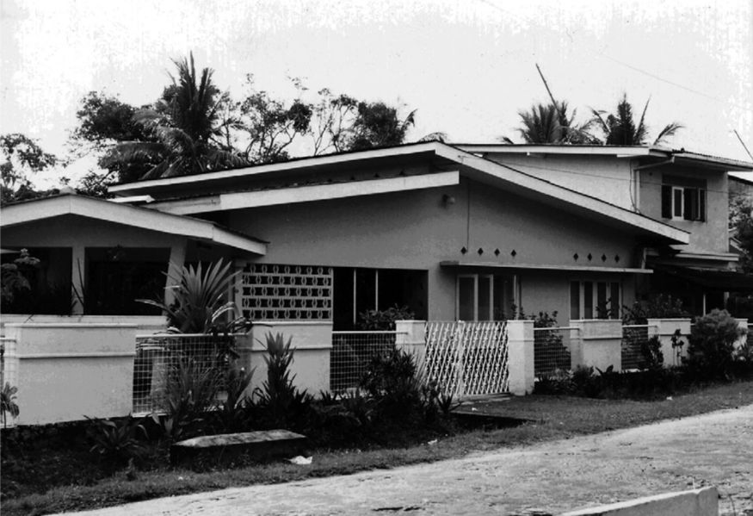
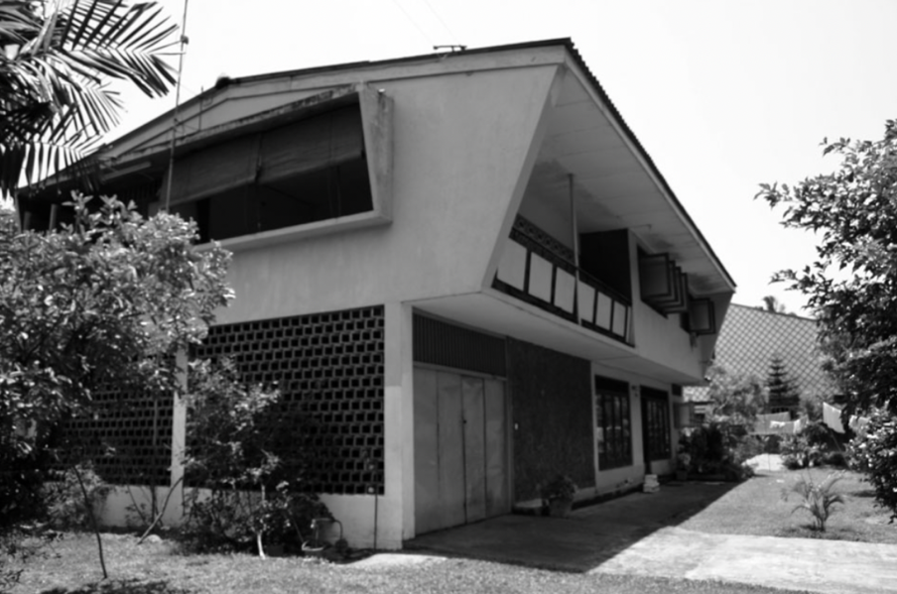
Symbolic value of Modernism:
Signifier of modernity – not being backward
A sign of social class
A sign of wealth – air conditioning
Submission to the cultural dominance of western countries, e.g. suburbanization and the ‘American style’ house in Ceylon / Sri Lanka:

Slide 23
Critique of Modernism

Slide 24
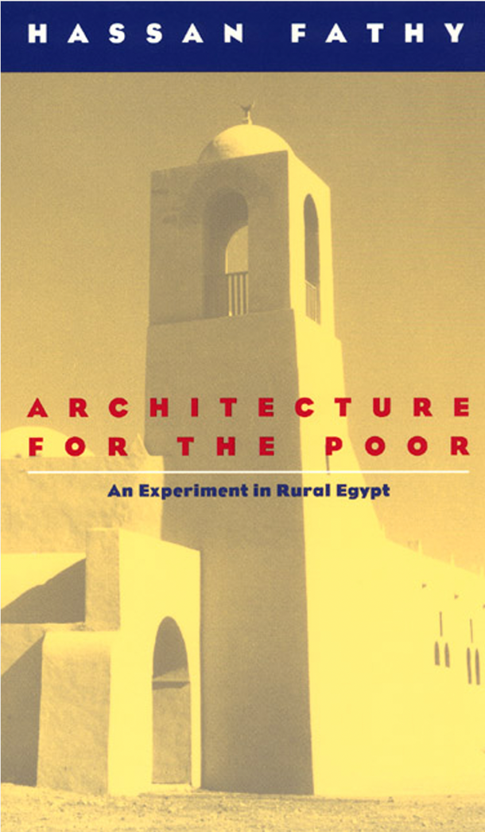
“Mass communications, mass production, mass education are the marks of our modern societies, which, whether communist or capitalist, are in these respects indistinguishable.
A workman who controls a machine in a factory puts nothing of himself into the things the machine makes. Machine-made products are identical, impersonal, and unrewarding, as much to the user as to the machine minder.
Handmade products appeal to us because they express the mood of the craftsman. Each irregularity, oddity, difference is the result of a decision made at the moment of manufacture”
Architecture for the Poor: An Experiment in Rural Egypt (Chicago, 1976) p. 27

Slide 25
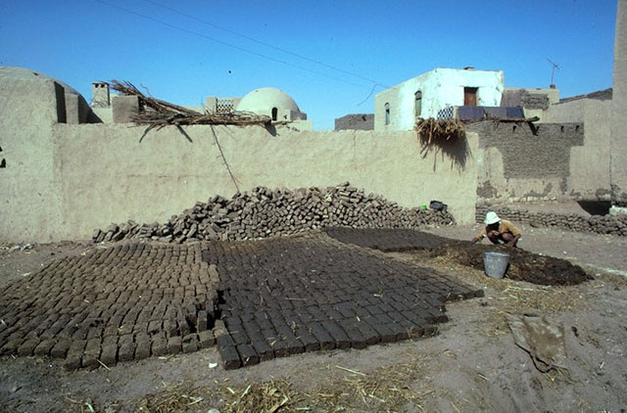
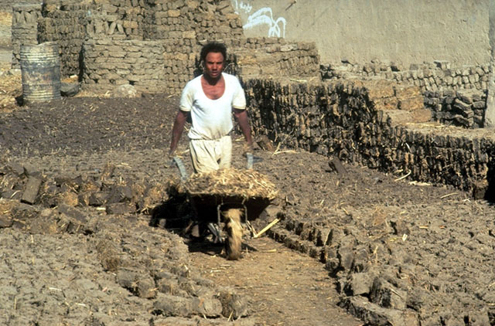
“Modernity does not necessarily mean liveliness, and change is not always for the better. On the other hand there are situations that call for innovation. My point is that innovation must be a completely thought-out response to a change in circumstances, and not indulged in for its own sake. Nobody asks that an airport control tower be built in some peasant idiom, and an industrial structure like a nuclear power station may force a new tradition upon the designer.
Tradition among the peasants is the only safeguard of their culture. They cannot discriminate between unfamiliar styles, and if they run off the rails of tradition, they will inevitably meet disaster. Willfully to break a tradition in a basically traditional society like a peasant one is a kind of cultural murder…”
Architecture for the Poor: An Experiment in Rural Egypt, p. 25

Slide 26
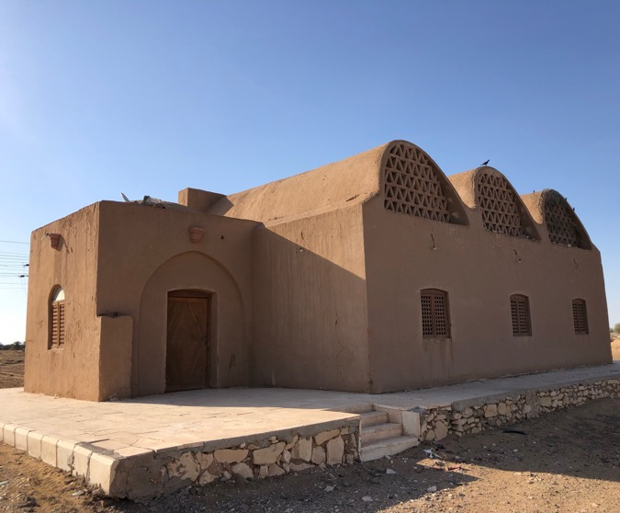
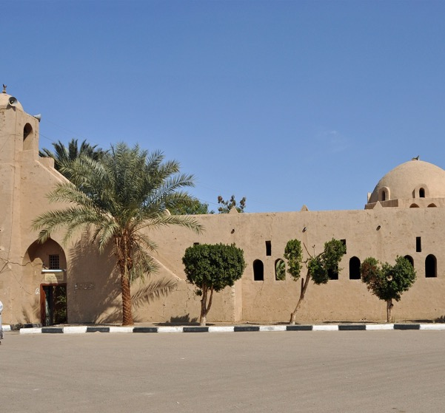
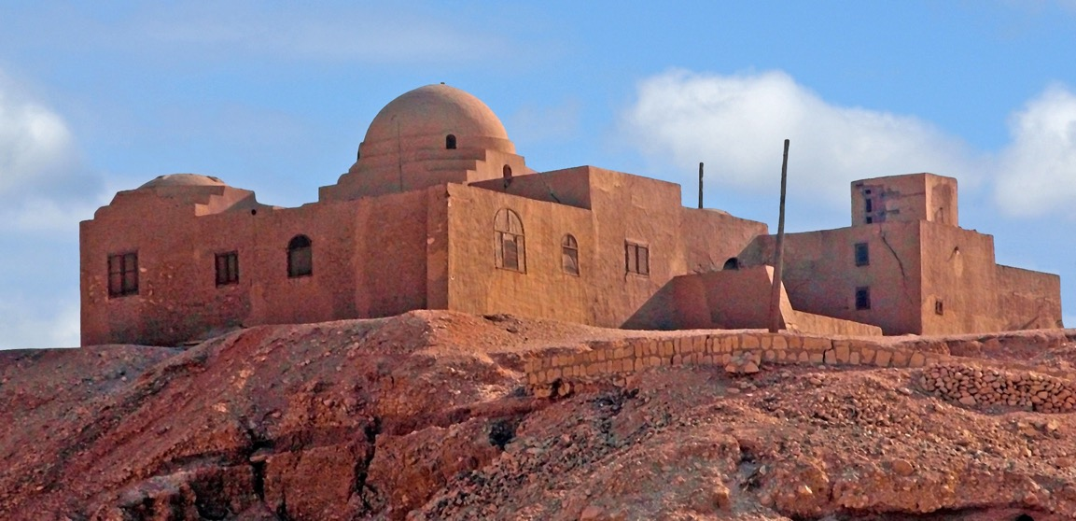
Hassan Fathy
Above Left: Housing in New Baris
Above Right: The Mosque in Kurna, Luxor
Below: The Stoppelaere House

Slide 27
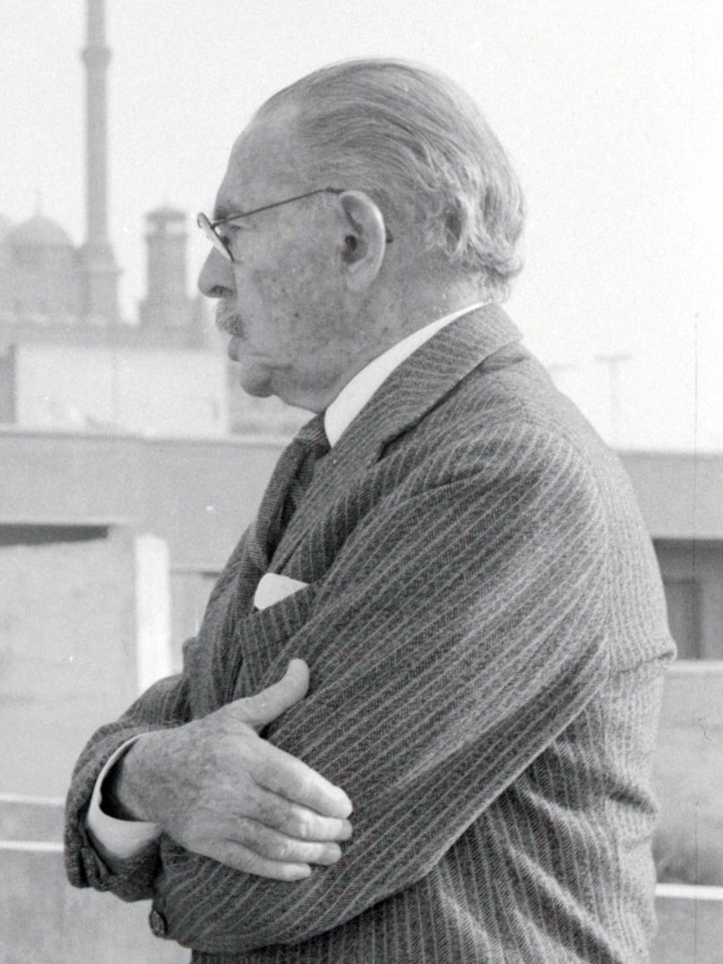
“The modern advance in technology which has given us new materials and methods in building has also necessitated the intrusion of the professional architect … This architect with his expertise has taken all the pleasure of house building away from his client, who is unable to catch up with the rapidly advancing techniques. Now, instead of the unhurried, appreciative discussions with the craftsmen as the house is being built, the owner has the opportunity to exercise his choice over marks on a plan in the architect's office. He doesn't understand the idiom of architectural drawing nor the architect's jargon, so the architect despises him and browbeats him.”
Hassan Fathy (1900-1989)
Architecture for the Poor: An Experiment in Rural Egypt (Chicago, 1976) p. 29

Slide 28
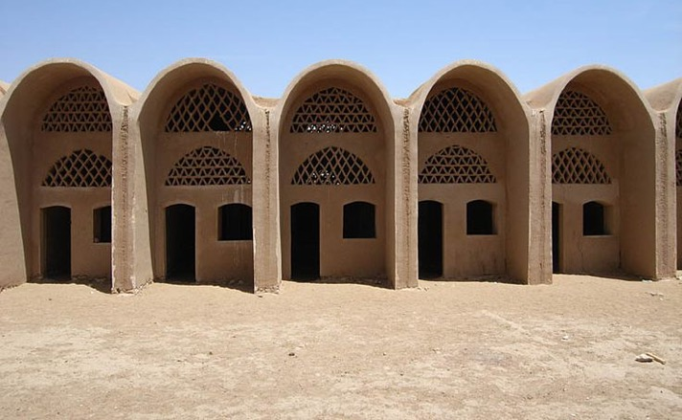
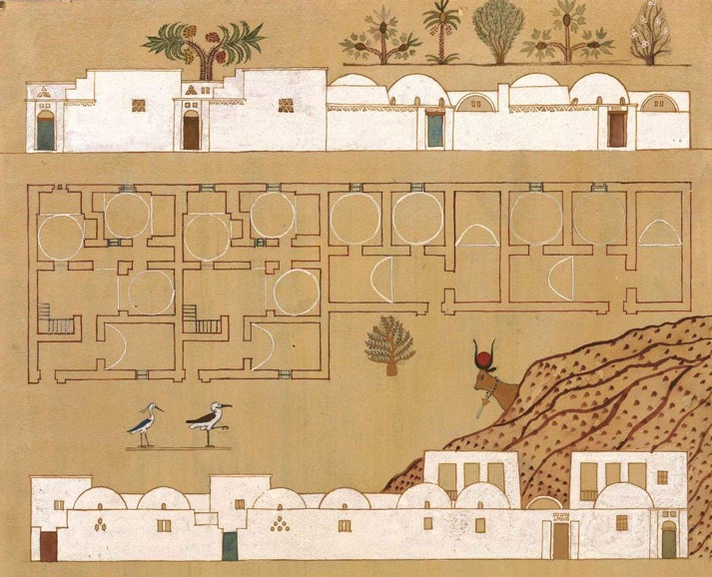
The Economics of Building
The materials given to the peasants must be cheap
The materials given should be such as the peasants will be able to obtain for themselves
The materials should not need skilled labor to handle them
materials such as steel or concrete or even timber should be regarded with the utmost suspicion
“ … no architect normally designs for peasants in the villages. No peasant can ever dream of employing an architect, and no architect ever dreams of working with the miserable resources of the peasant. The architect designs for the rich man and thinks in terms of what the rich man can pay for. Most of the architect's work is in the town ….
he assumes the existence of the experienced building contractors and the sophisticated materials that are always used in town building.”
Architecture for the Poor, p. 114.

Slide 29
Modern vs. National

Slide 30
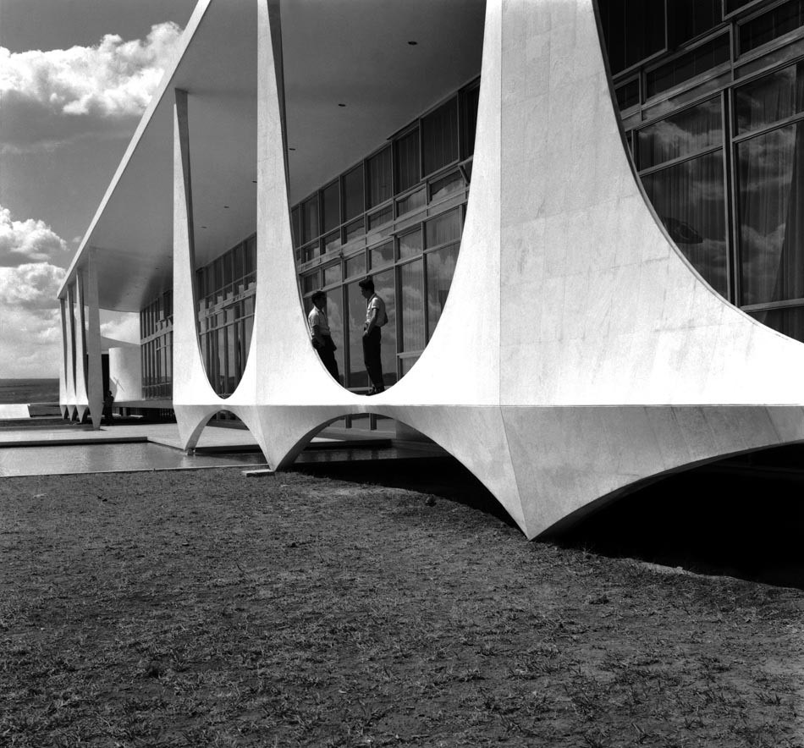
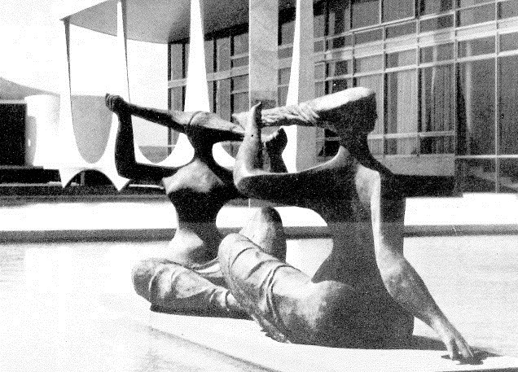
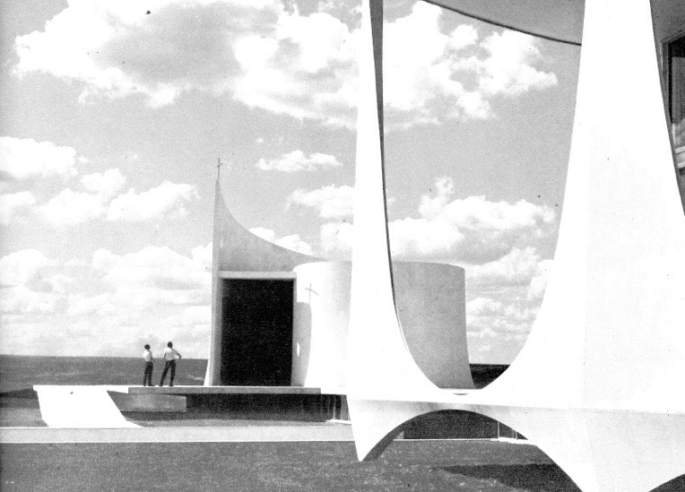
Oscar Niemeyer
Presidential Palace, Brasilia (1957-58)

Slide 31
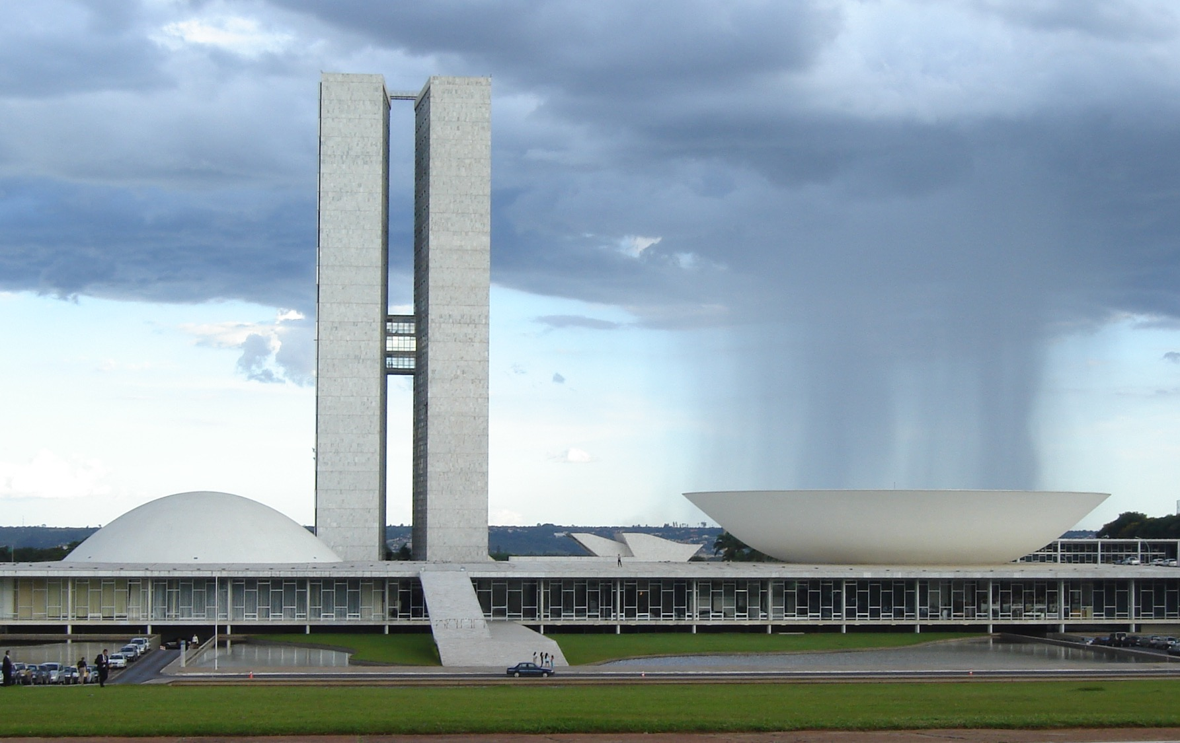
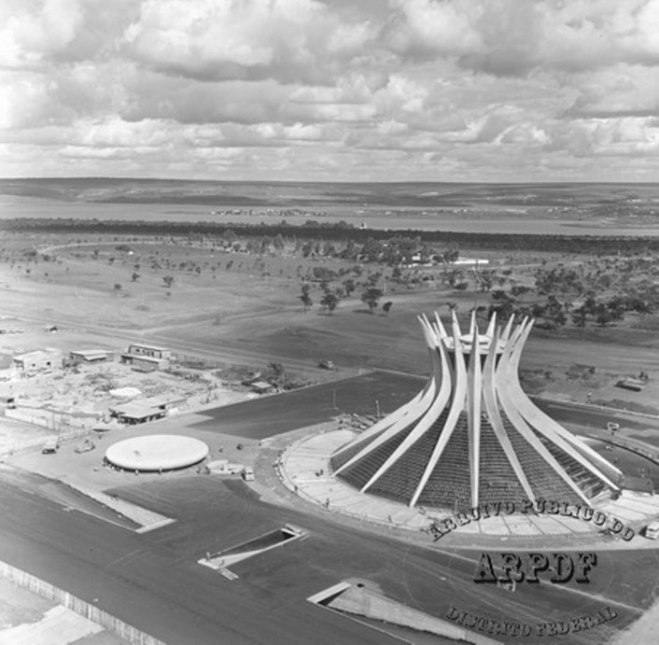
Oscar Niemeyer
The National Assembly Building (1960)
The Metropolitan Cathedral (1970)

Slide 32




Slide 33


Slide 34


Sedad Hakkı Eldem, Social Security Building, Istanbul (1962-64)

Slide 35





Slide 36

Clemens Hozmeister, Turkish Parliament Building (1939-1960)

Slide 37




Jean-François Lamoureux & Jean-Louis Marin, Trade Fair Centre, Dakar, Senegal (1972-74)

Slide 38


ADC Architect, Palace of Culture, Kuala Lumpur, Malaysia (1999)

Slide 39


Ho Kok Hoe, National Museum, Kuala Lumpur (1959-63)

Slide 40

Kumpulan Akitek, The Malaysian National Library, Kuala Lumpur (1994)

Slide 41

Ken Yeang
Singapore National Library (2005)

