Slide 1
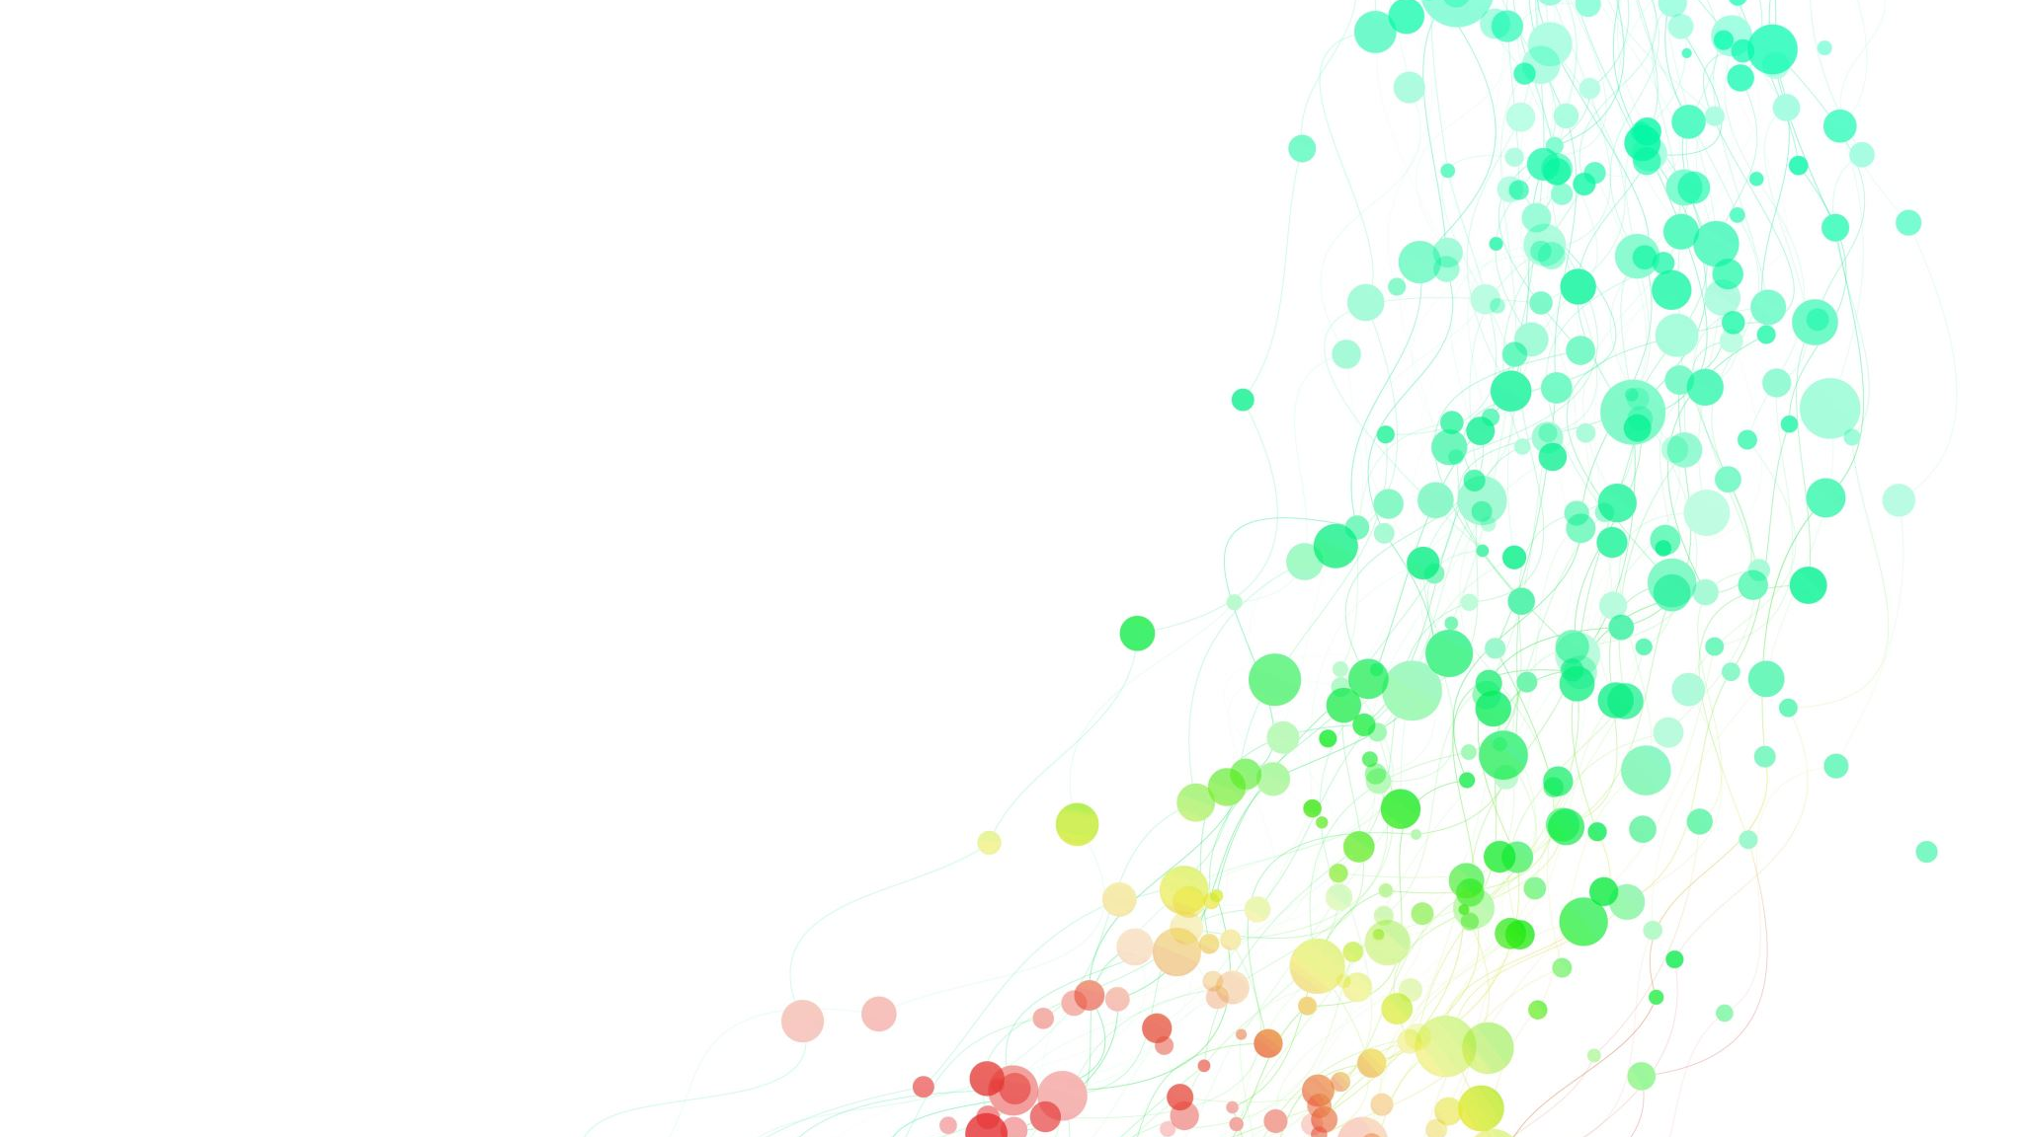
Experience of Awe: An Expansive Approach to Everyday Aesthetics
Thomas Leddy
San Jose State University, tle403@aol.com

Slide 2
Questions
Introduction and Background
What is Thomas Leddy's main argument regarding the definition of everyday aesthetics?
How does Leddy’s definition of everyday aesthetics challenge the restrictive views of Melchionne and Naukkarinen?
What inspired Leddy to adopt an expansive approach to everyday aesthetics?
How does John Dewey's philosophy influence Leddy's perspective on everyday aesthetics?
What is the significance of the book The Extraordinary in the Ordinary in framing Leddy's ideas?
The Expansive Approach to Everyday Aesthetics
What examples does Leddy provide to illustrate the continuity between aesthetics of art, nature, and everyday life?
How does Leddy define "aura," and what role does it play in aesthetic experiences?
Why does Leddy include sublime experiences like childbirth in the domain of everyday aesthetics?
How does Leddy critique the reliance on "negative definitions" in defining everyday aesthetics?
What is Leddy’s critique of Melchionne’s exclusion of interior decoration from everyday aesthetics?
Moments of Awe and Subjective Well-Being
What role does the concept of "awe" play in Leddy's expansive approach to everyday aesthetics?
What evidence does Leddy provide to support the connection between awe and subjective well-being?
How does Leddy view the relationship between high points of aesthetic experience and moments of awe?
Why does Leddy argue for equal importance of everyday, art, and nature aesthetics in enhancing well-being?
How does Leddy critique the hedonic regulation approach in everyday aesthetics?
Serendipity and Broader Inclusion
How does Leddy incorporate serendipitous events into his argument for an expansive definition of everyday aesthetics?
Why does Leddy believe that seasonal and occasional activities, like holidays or tourist experiences, should be included in everyday aesthetics?
How does mindfulness, as discussed by Thich Nhat Hanh, relate to Leddy’s ideas of everyday aesthetics?

Slide 3
Interconnection and Critiques
How does Leddy address the dynamic relationship between the aesthetics of art and everyday life?
Why does Leddy emphasize the value of "low-level" aesthetic experiences, like admiring a neatened backyard?
How does Leddy use humor, such as the "garbage moment," to argue for an expansive view of everyday aesthetics?
What are Leddy’s concerns about the restrictivist approach limiting the potential of everyday aesthetics?

