Slide 1
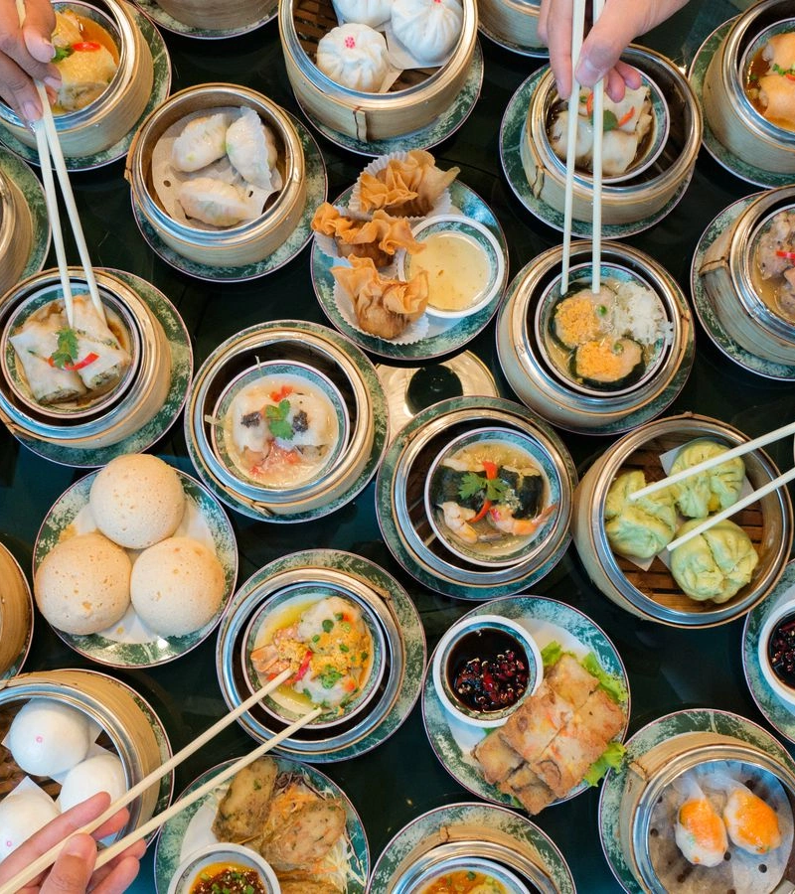
Cantonese I
Week 1

Slide 2
Cantonese I assessments
Attendance: maximum 1 unexcused absence
Conversation (final exam)

Slide 3
What is Cantonese 廣東話
Originates from Canton 廣東 region (Guangzhou 廣州) and its surrounding area in Southeastern China
Also known as Yue 粵語
Spoken in Canton region, Hong Kong, Macau, Singapore, Malaysia, Vietnam, Chinese communities all over the world
Estimated about 70 million Cantonese speakers around the globe
Cantonese varies in different places
This course focuses on Cantonese spoken in Hong Kong
https://www.youtube.com/watch?v=vGJCa12IxeU

Slide 4
Pros and cons……
Pros: no tenses, no genders, no cases!
Cons: many tones and words

Slide 5
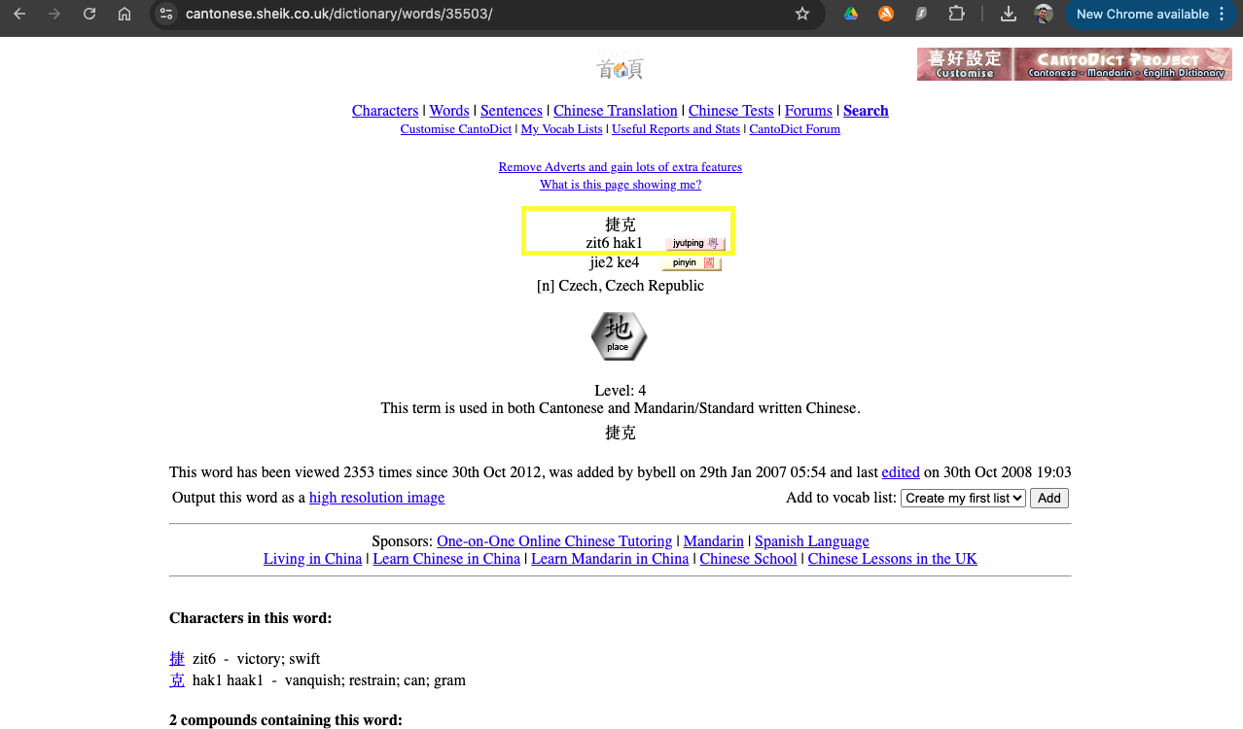
Cantonese dictionary
https://www.cantonese.sheik.co.uk/dictionary/

Slide 6
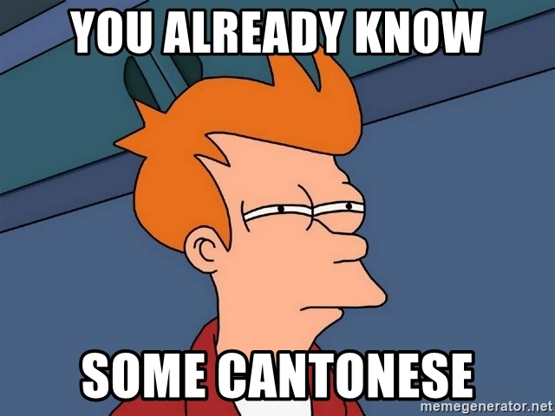

Slide 7
English | Cantonese | Jyutping
Dim sum | 點心 | Dim² sam¹

Slide 8
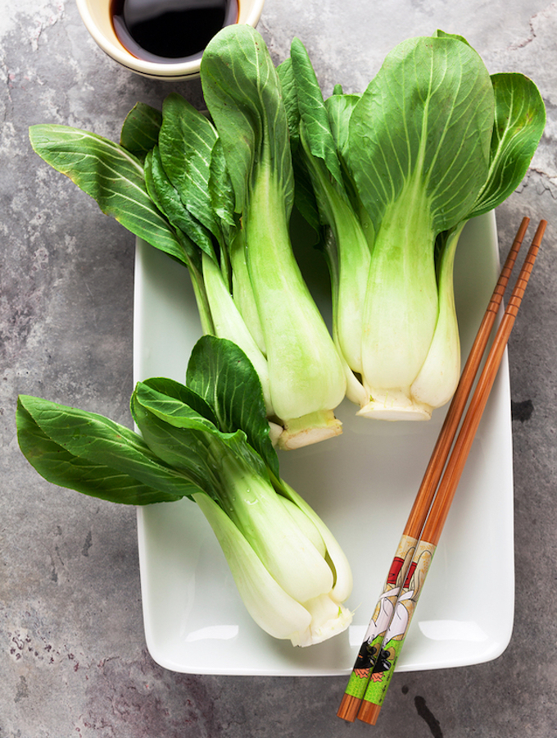
English | Cantonese | Jyutping
Bok Choy | 白菜 | baak⁶ choi³

Slide 9
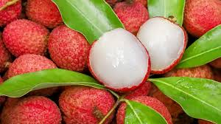
English | Cantonese | Jyutping
lychee | 荔枝 | lai6 zi1

Slide 10
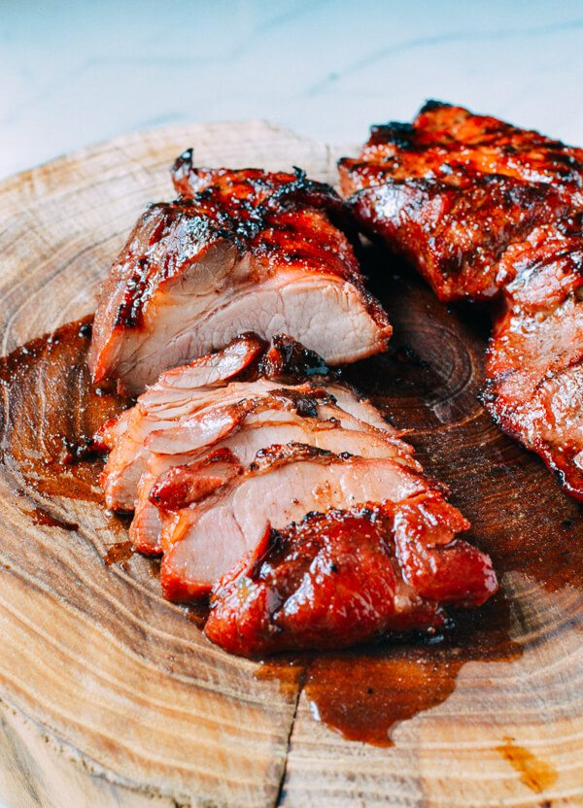
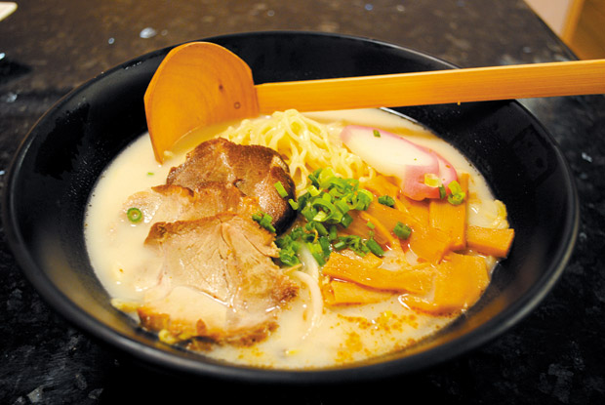
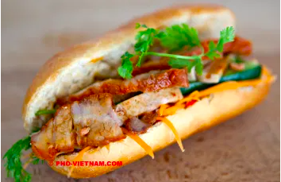
English | Cantonese | Jyutping
Char siu | 叉燒 | Cha¹ siu¹

Slide 11
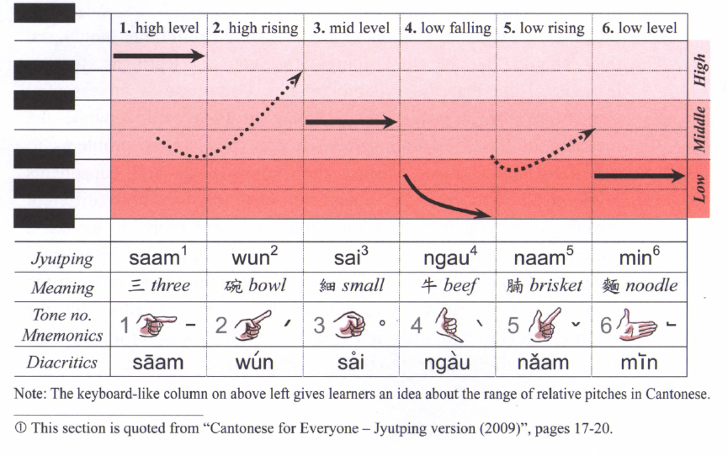
6 Tones

Slide 12
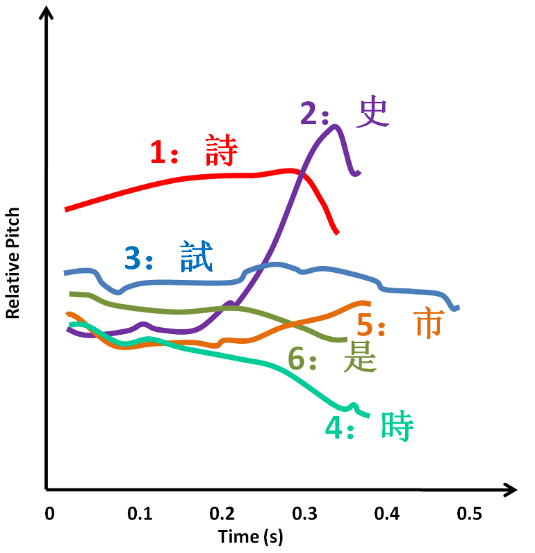
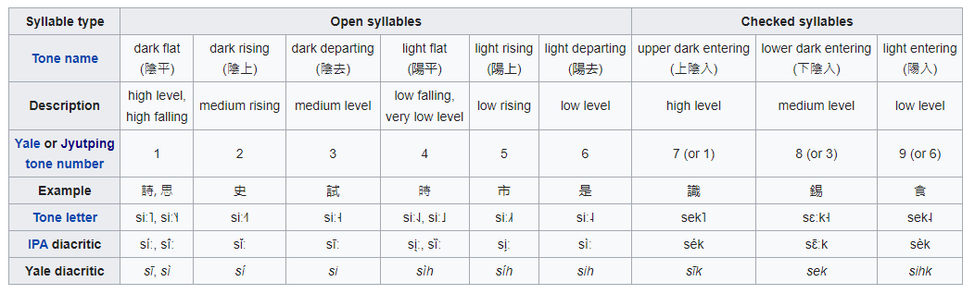
Exercise:
reference: https://en.wikipedia.org/wiki/Cantonese_phonology

Slide 13
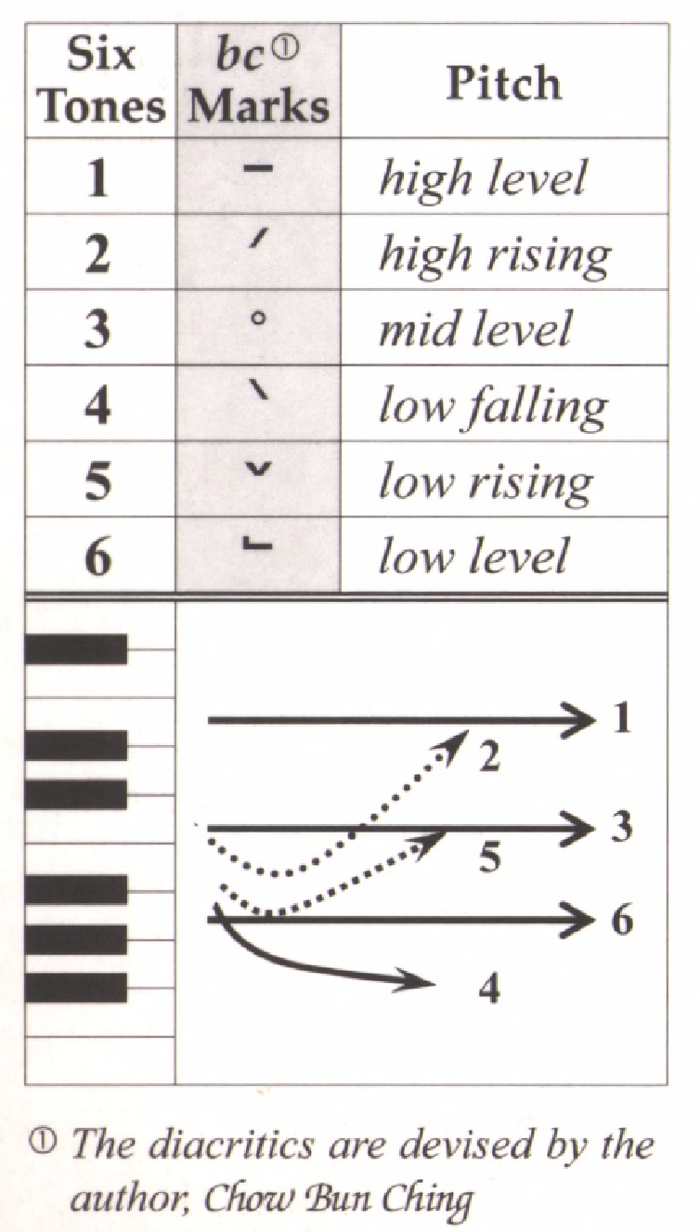
Tone check
diu 鵰diu1 𨳒diu2 吊diu3 diu4 diu5 調diu6
Hai 閪hai1 喺hai2 hai3 兮hai4 匸hai5 係hai6
Sam 心 Sam1 嬸sam2 滲sam3 sam4 sam5 甚sam6
siu 燒siu1 小siu2 笑siu3 迢siu4 siu5 紹siu6
dim dim1 點dim2 掂dim3 dim4 dim5 𠶧dim6

Slide 14
Conversation exercise
A: 你好。最近點呀？ (You good. Recently how ar?)
nei5 hou2. zeoi3 gan6 dim2 aa3?
B: 非常好 (very good)
fei1 soeng4 hou2
幾好 (quite good)
gei2 hou2
一般 (average. normal)
jat1 bun1
唔係幾好 (not quite good)
m4 hai6 gei2 hou2
好差 (very bad)
hou2 caa1

Slide 15
Jyutping or Yale?
Yale romanization of Cantonese
Limitation: unable to describe all vowels being used in Cantonese

Slide 16
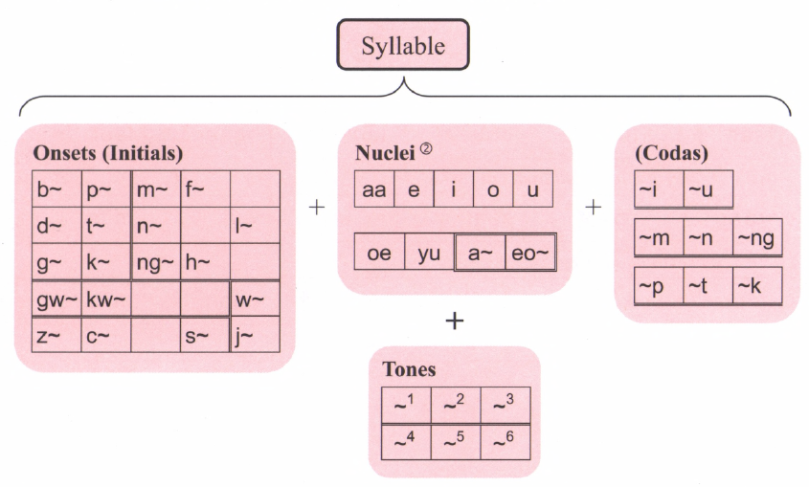

Slide 17
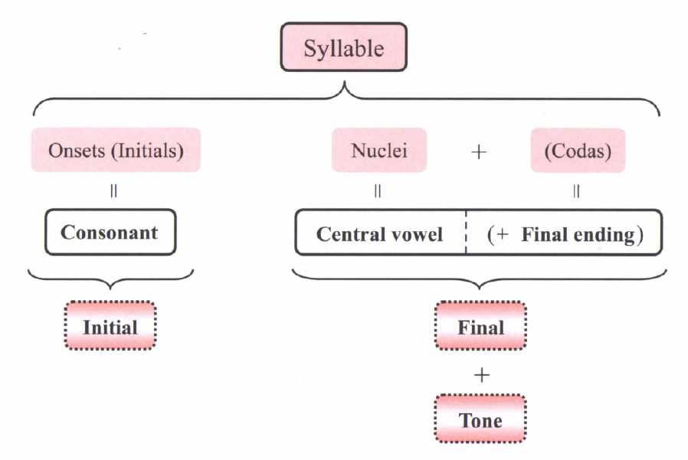
Jyutping
Ngo⁵
我

Slide 18
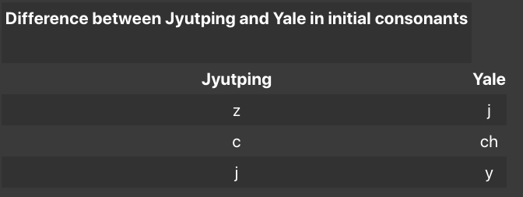
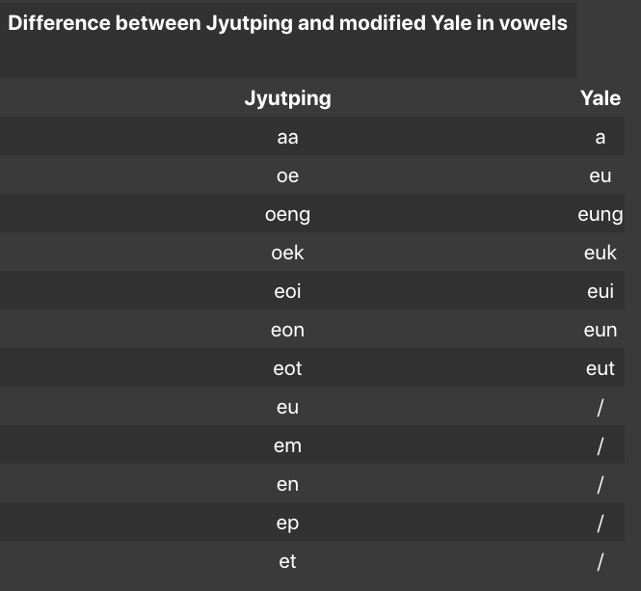
https://hongkongvision.com/tool/cc_py_conv_zh

Slide 19
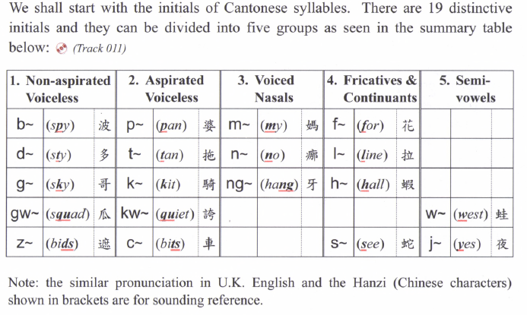
19 Initials

Slide 20
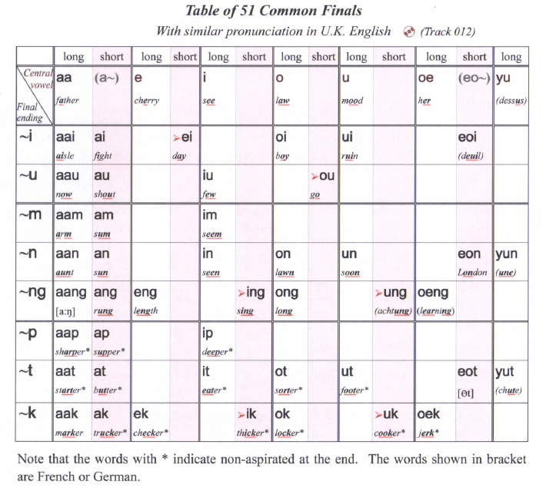
51 Finals

Slide 21
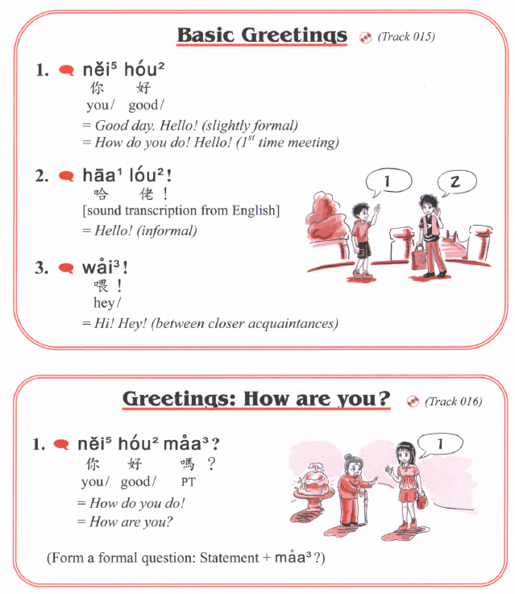
B: 非常好 (very good)
fei1 soeng4 hou2
幾好 (quite good)
gei2 hou2
一般 (average. normal)
jat1 bun1
唔係幾好 (not quite good)
m4 hai6 gei2 hou2
好差 (very bad)
hou2 caa1
zeoi3 gan6 dim2 aa3?
最近點呀？
How are you lately?

Slide 22
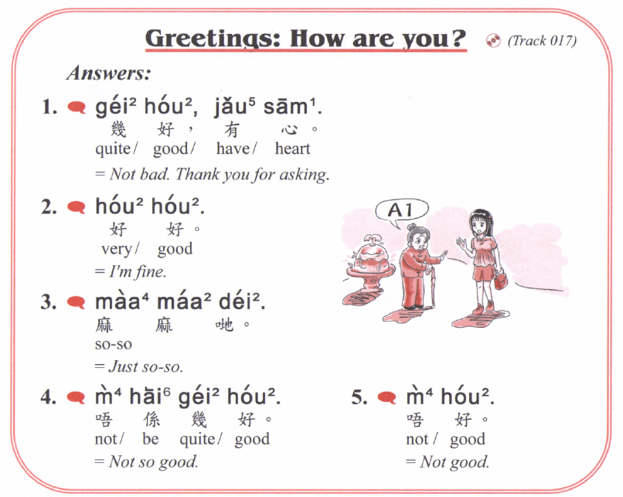
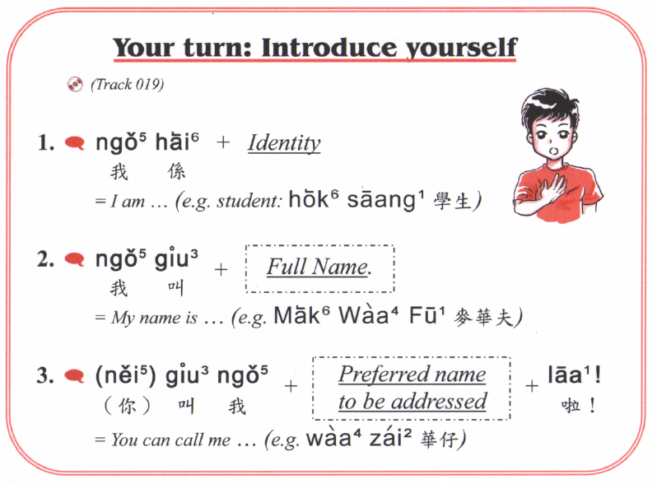
Nei5 ne1？
你呢？
And you?
Nei5 giu3 me1 meng2
你叫咩名
What is your name?
English | Cantonese | Jyutping
Thank you | 多謝 | Do¹ ze⁶
Student | 學生 | hok⁶ saang¹

Slide 23
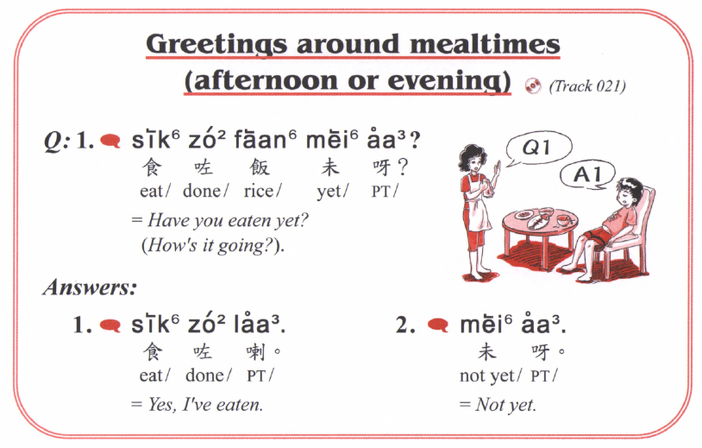
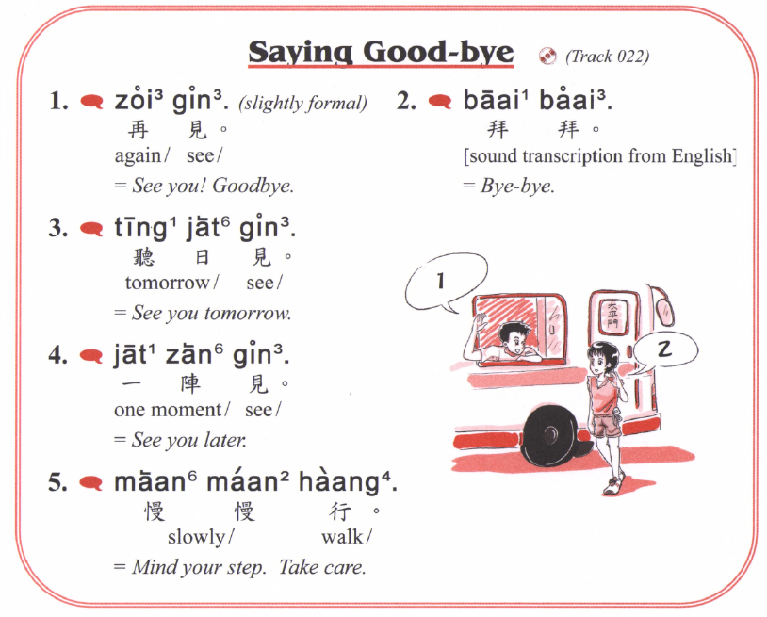
Lan2 撚
English | Cantonese | Jyutping
Good morning | 早晨 | zou² san⁴
Good afternoon | 午安 | ng⁵ on¹
Good evening | 晚安 | maan⁵ on¹
Lan2 撚
Lan2 撚
Gau1 𨳊

