Slide 1
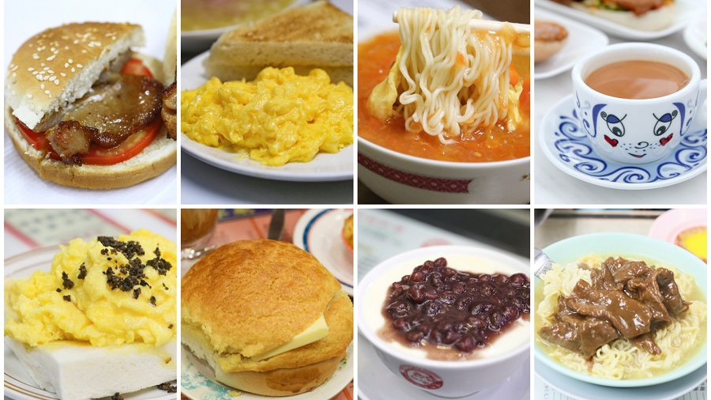
Cantonese I
Week 2

Slide 2
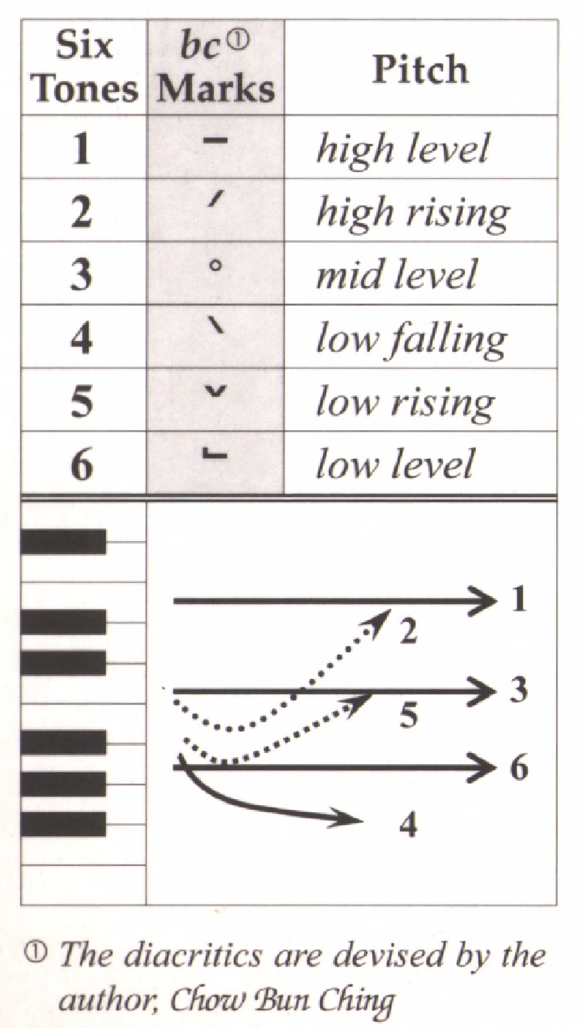
Tone check
diu 鵰diu1 𨳒diu2 吊diu3 diu4 diu5 調diu6
Hai 閪hai1 喺hai2 hai3 兮hai4 匸hai5 係hai6
Sam 心 Sam1 嬸sam2 滲sam3 sam4 sam5 甚sam6
siu 燒siu1 小siu2 笑siu3 迢siu4 siu5 紹siu6
dim dim1 點dim2 掂dim3 dim4 dim5 𠶧dim6

Slide 3
https://www.instagram.com/p/C6uMewzSp0W/
Jimmy Yang’s description about Cantonese

Slide 4
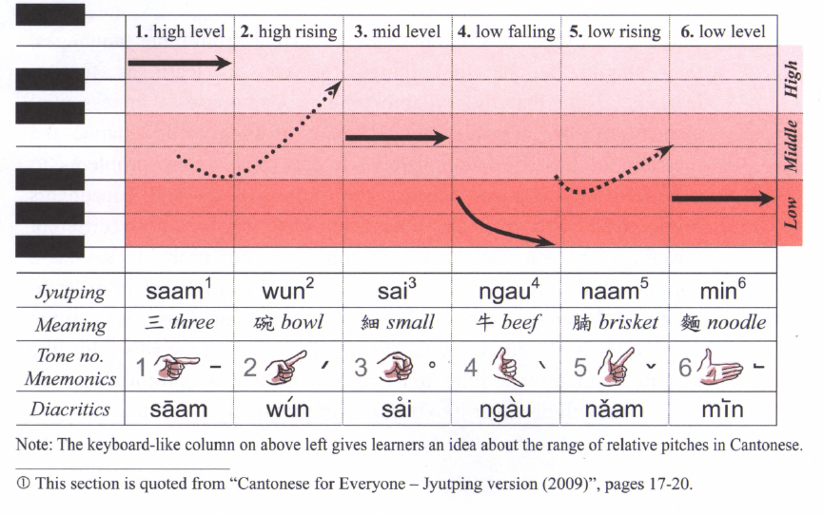
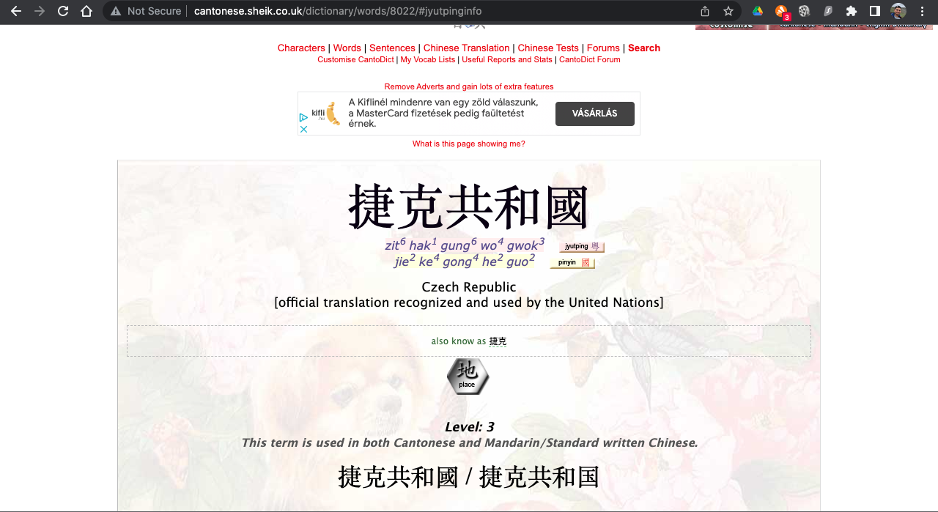
Cantonese dictionary:
http://www.cantonese.sheik.co.uk/dictionary/

Slide 5
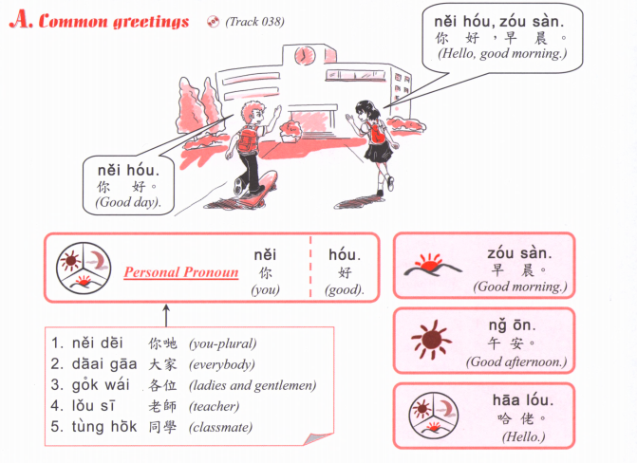

Slide 6
Subjects
我 I, ngo5 我哋 We, ngo5 dei6
你 You, nei5 你哋 you plural, nei5 dei6
佢 He/she/it, keoi5 佢哋 they, keoi5 dei6

Slide 7
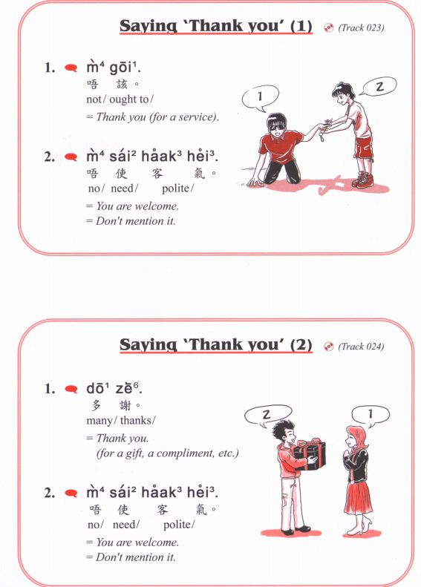

Slide 8
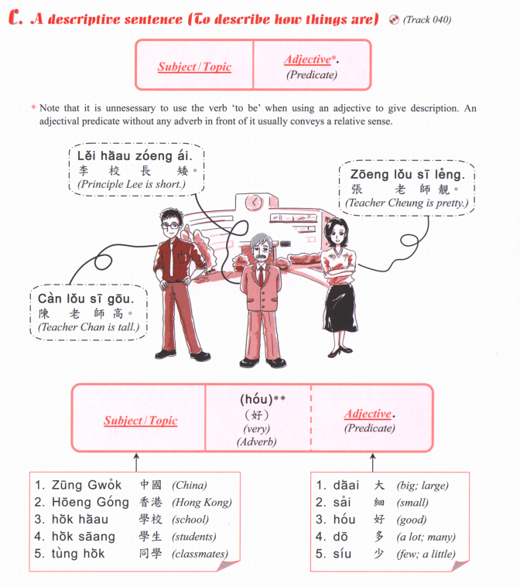
靚女 (pretty girl)
leng³ neoi²
靚仔 (handsome guy)
leng³ zai²
zit6 hak1 捷克 Czech Republic
si1 lok3 fat6 hak1 斯洛伐克 Slovakia
我 I, ngo5 我哋 We, ngo5 dei6
你 You, nei5 你哋 you plural, nei5 dei6
佢 He/she/it, keoi5 佢哋 they, keoi5 dei6

Slide 9
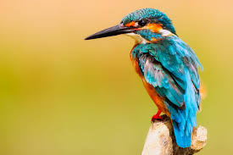
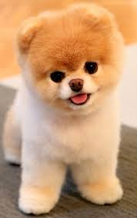
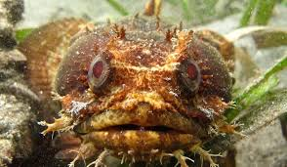
He/ she/ it
佢
keoi⁵
可愛 (cute)
ho² oi³
得意 (cute)
dak¹ ji³
靚 (beautiful)
leng³
醜 (ugly)
cau²

Slide 10

He/ she/ it
佢
keoi⁵
細個 (young)
sai³ go³
後生 (young, “later born”)
hau⁶ saang¹
年青 (young, “year green”)
nin⁴ cing¹
成熟 (mature)
sing⁴ suk⁶
老 (old)
lou⁵

Slide 11
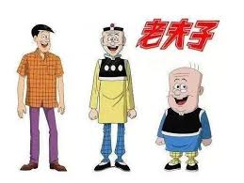
He/ she/ it
佢
keoi⁵
高 (Tall)
gou¹
矮 (Short)
ai²
肥 (Fat)
fei⁴
瘦 (Thin)
sau³

Slide 12
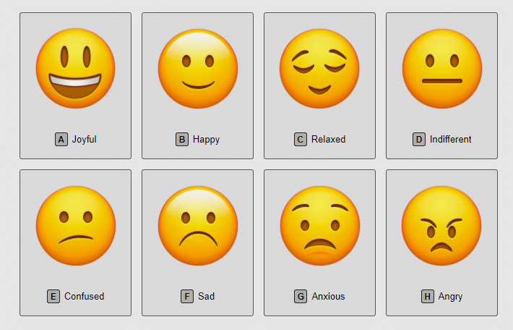
He/ she/ it
佢
keoi⁵
開心 (happy)
hoi¹ sam¹
唔開心 (sad)
m⁴ hoi¹ sam¹
傷心 (heart broken)
soeng¹ sam¹
嬲 (angry)
nau¹

Slide 13

He/ she/ it
佢
keoi⁵
聰明 (clever)
cung¹ ming⁴
叻 (smart)
lek¹
蠢 (stupid / dumb)
ceon²

Slide 14
Adjectives summary
可愛 (cute)
ho² oi³
得意 (cute)
dak¹ ji³
靚 (beautiful)
leng³
醜 (ugly)
cau²
細個 (young)
sai³ go³
後生 (young, “later born”)
hau⁶ saang¹
年青 (young, “year green”)
nin⁴ cing¹
成熟 (mature)
sing⁴ suk⁶
老 (old)
lou⁵
高 (Tall)
gou¹
矮 (Short)
ai²
肥 (Fat)
fei⁴
瘦 (Thin)
sau³
開心 (happy)
hoi¹ sam¹
唔開心 (sad)
m⁴ hoi¹ sam¹
傷心 (heart broken)
soeng¹ sam¹
嬲 (angry)
nau¹
聰明 (clever)
cung¹ ming⁴
叻 (smart)
lek¹
蠢 (stupid / dumb)
ceon²

Slide 15
Conversation exercise - using adjectives
我 I, ngo5 我哋 We, ngo5 dei6
你 You, nei5 你哋 you plural, nei5 dei6
佢 He/she/it, keoi5 佢哋 they, keoi5 dei6
[Subject] + 好 + [adjective] + 呀
你好靚呀! (you very beautiful aa!)
nei5 hou2 leng3 aa3
可愛 (cute)
ho² oi³
得意 (cute)
dak¹ ji³
靚 (beautiful)
leng³
醜 (ugly)
cau²
細個 (young)
sai³ go³
後生 (young, “later born”)
hau⁶ saang¹
年青 (young, “year green”)
nin⁴ cing¹
成熟 (mature)
sing⁴ suk⁶
老 (old)
lou⁵
高 (Tall)
gou¹
矮 (Short)
ai²
肥 (Fat)
fei⁴
瘦 (Thin)
sau³
開心 (happy)
hoi¹ sam¹
唔開心 (sad)
m⁴ hoi¹ sam¹
傷心 (heart broken)
soeng¹ sam¹
嬲 (angry)
nau¹
聰明 (clever)
cung¹ ming⁴
叻 (smart)
lek¹
蠢 (stupid / dumb)
ceon²

Slide 16
Exercise: Count how many words of Hai1
https://www.instagram.com/p/C6Lx5ZGSo1C/
What is the meaning of Hai1?

Slide 17
Tone check
diu 鵰diu1 𨳒diu2 吊diu3 diu4 diu5 調diu6
Hai 閪hai1 喺hai2 hai3 兮hai4 匸hai5 係hai6
Sam 心 Sam1 嬸sam2 滲sam3 sam4 sam5 甚sam6
fei 飛 fei1 斐fei2 fei3 肥fei4 fei5 fei6
ceon 春ceon1 蠢ceon2 ceon3 旬ceon4 ceon5 ceon6
hoi 開hoi1 海hoi2 hoi3 hoi4 hoi5 害hoi6
nau 嬲nau1 扭nau2 nau3 nau4 nau5 膩nau6
daai 獃daai1 歹daai2 帶daai3 daai4 daai5 大daai6

Slide 18
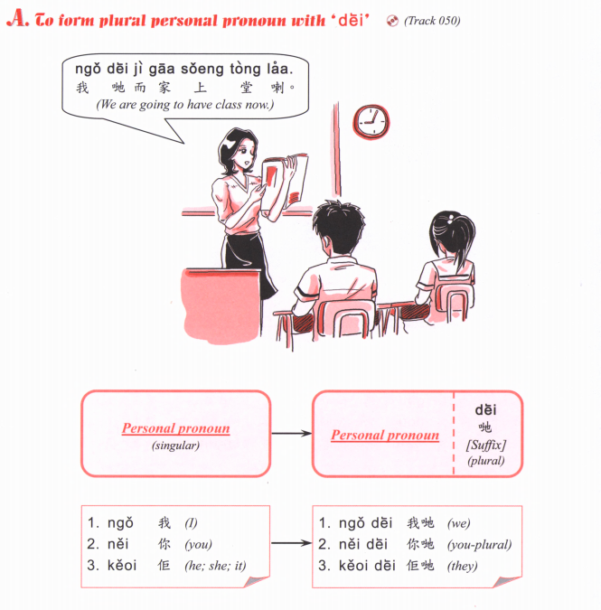

Slide 19
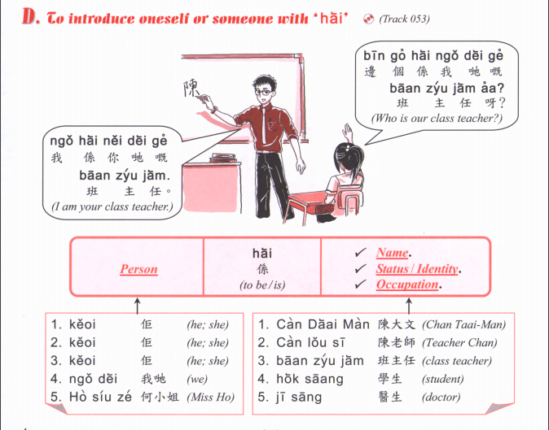

Slide 20
