Slide 1
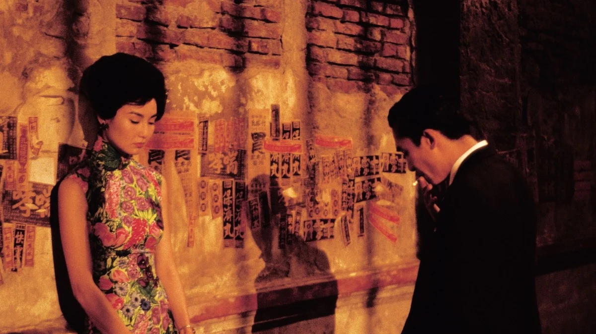
Cantonese I
Week 3
Movie: In the mood for love 花樣年華 faa1 joeng6 nin4 waa4

Slide 2
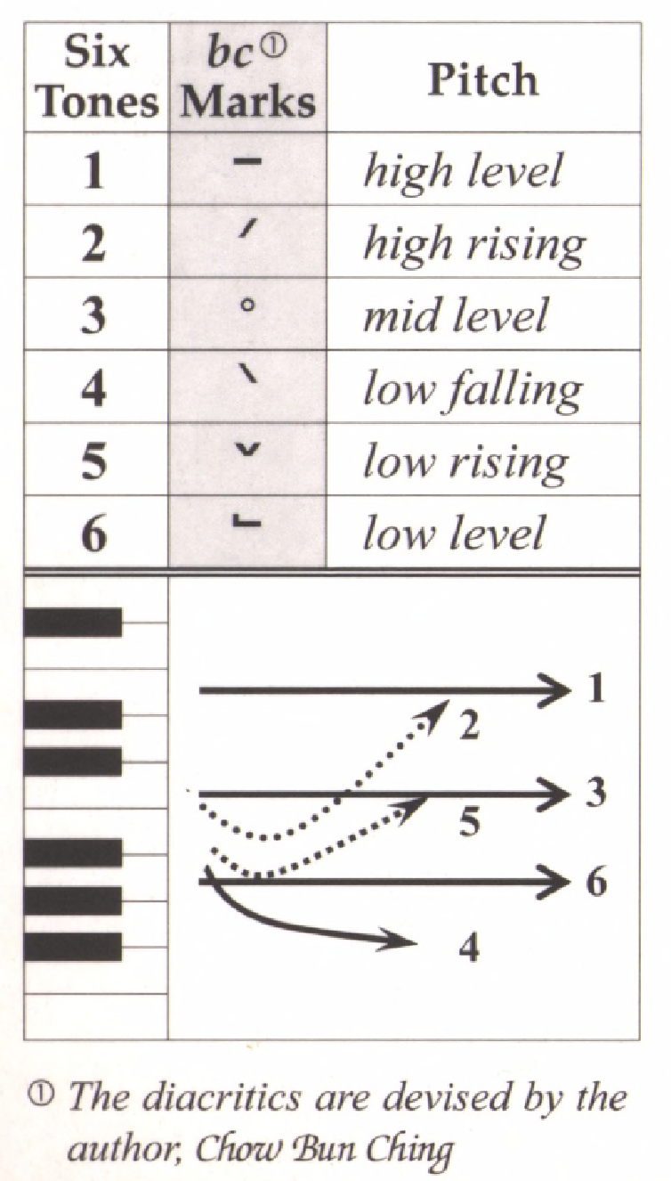
Tone check
diu 鵰diu1 𨳒diu2 吊diu3 diu4 diu5 調diu6
Hai 閪hai1 喺hai2 hai3 兮hai4 匸hai5 係hai6
Sam 心 Sam1 嬸sam2 滲sam3 sam4 sam5 甚sam6
fei 飛 fei1 斐fei2 fei3 肥fei4 fei5 fei6
ceon 春ceon1 蠢ceon2 ceon3 旬ceon4 ceon5 ceon6
hoi 開hoi1 海hoi2 hoi3 hoi4 hoi5 害hoi6
nau 嬲nau1 扭nau2 nau3 nau4 nau5 膩nau6
daai 獃daai1 歹daai2 帶daai3 daai4 daai5 大daai6

Slide 3
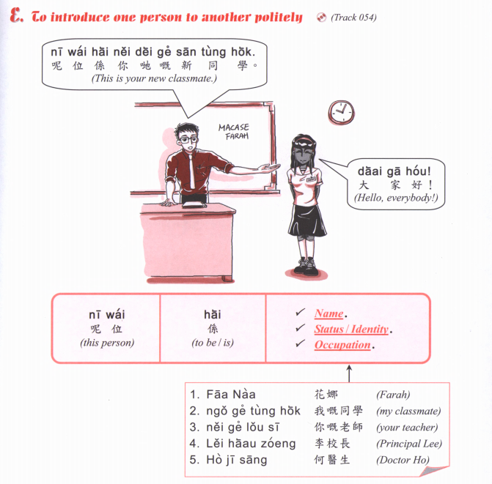

Slide 4
nei¹ go³
go² go³
嗰個
(that person/ that)

Slide 5
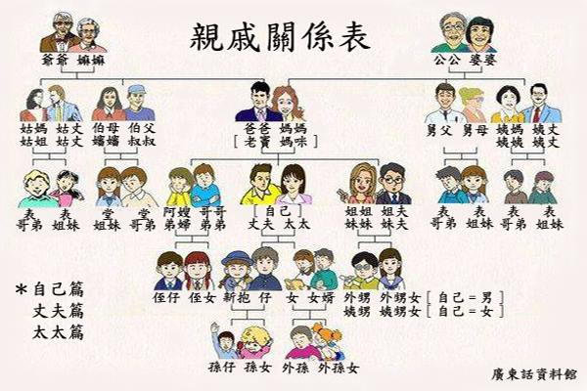

Slide 6
je⁴ je²
maa⁴ maa⁴
gung¹ gung¹
po⁴ po²
Father
Mother
baa⁴ baa¹
maa⁴ maa¹
老母 lou⁵ mou²
lou⁵ dau⁶
maa¹ mi⁴
zoeng⁶ fu¹
ze⁴ ze¹
Sister-in-law
Brother-in-law
aa³ sou²
go⁴ go¹
taai³ taai²
ze² fu¹
mui6 fu1
dai⁶ fu⁵
dai⁴ dai²
mui⁴ mui²
san¹ pou⁵
neoi⁵ sai³
zai²
neoi²
ngoi⁶ syun¹ neoi²
syun¹ zai²
syun¹ neoi²
ngoi⁶ syun¹

Slide 7
I am your 我係你嘅 Ngo⁵ hai⁶ nei⁵ ge³
She/he is my 佢係我嘅 Koei⁵ hai⁶ ngo⁵ ge³

Slide 8
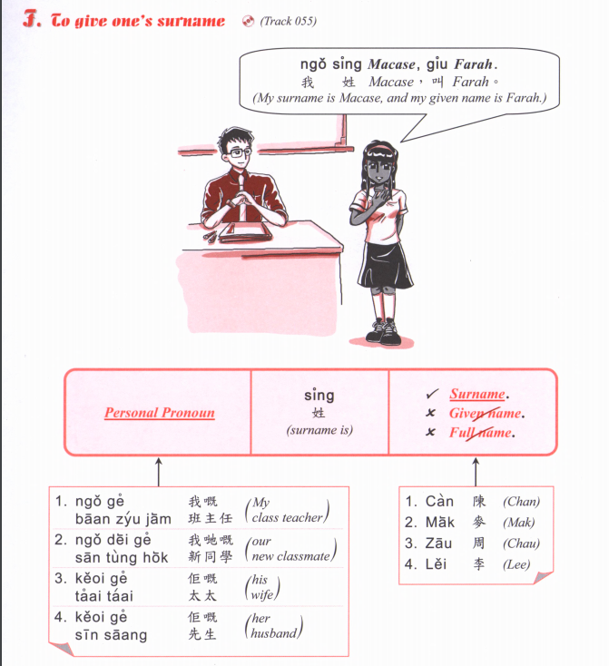

Slide 10
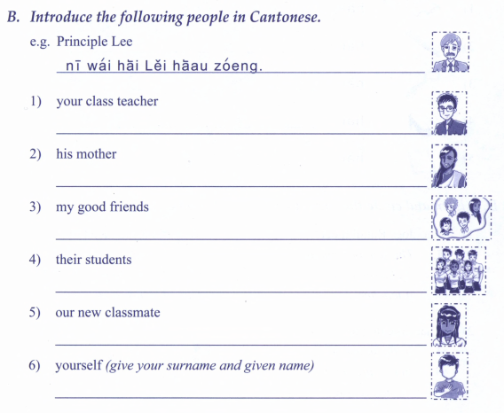

Slide 13
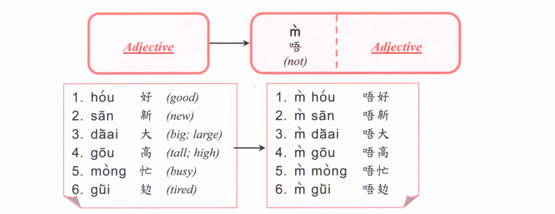

Slide 14
Exercise: Count how many “DLLM”
https://www.instagram.com/p/C9nDImMhrrs/
diu2 nei5 lou5 mo5! 屌你老母 or 𨳒你老母
Meaning??????

