Slide 1
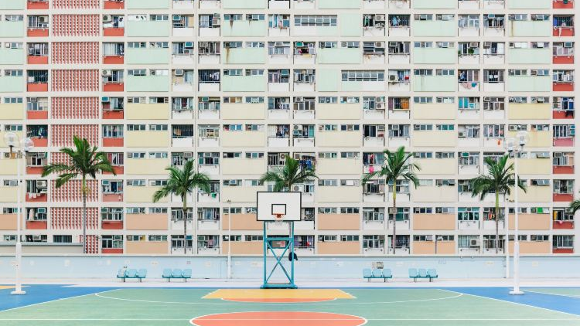
Cantonese I
Week 4

Slide 2
Asking and answering yes/no questions
Notes:
next lesson

Slide 3
zit6 hak1 捷克 (Czech Republic)
si1 lok6 fat6 hak1 斯洛伐克 (Slovakia)

Slide 4
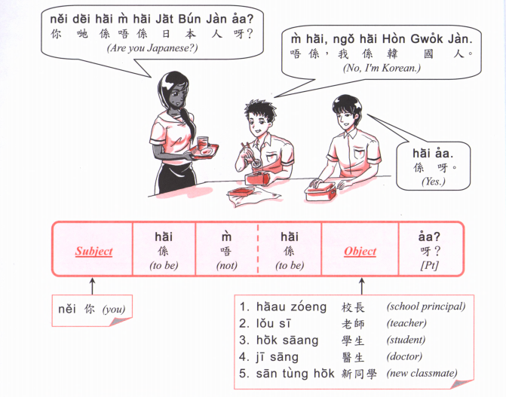
捷克 zit6 hak1
斯洛伐克 si1 lok6 fat6 hak1

Slide 6
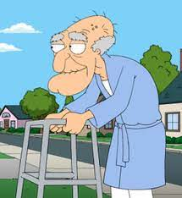
B
D
E
A
C
H
I
F
G

Slide 8
走先喇 (I go first la) zau2 sin1 laa1
係咁先啦 (that’s it la.) hai6 gam3 sin1 laa1
再見啦(喇) (see you again la) zoi3 gin3
唔係啊 (no ar) m4 hai6 aa1
喂呀 (hey) wai3 aa1
咩話? (what?) me1 waa6
https://www.youtube.com/watch?v=S1v_d_e_E_g

Slide 9
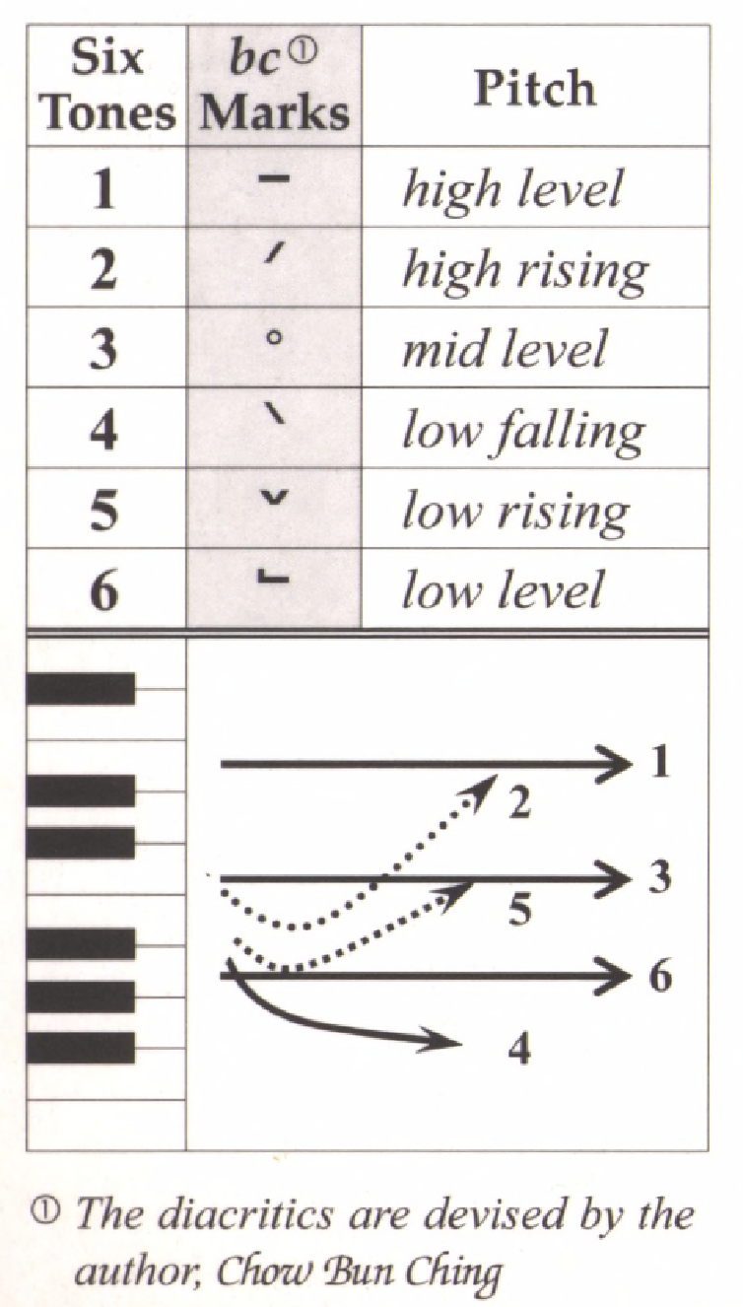
Tone check
diu 鵰diu1 𨳒diu2 吊diu3 diu4 diu5 調diu6
Hai 閪hai1 喺hai2 hai3 兮hai4 匸hai5 係hai6
lou lou1
mo
maa
baa
ge ge3 (possession word)
ji ji1
tung
leng
gui
mong

Slide 12
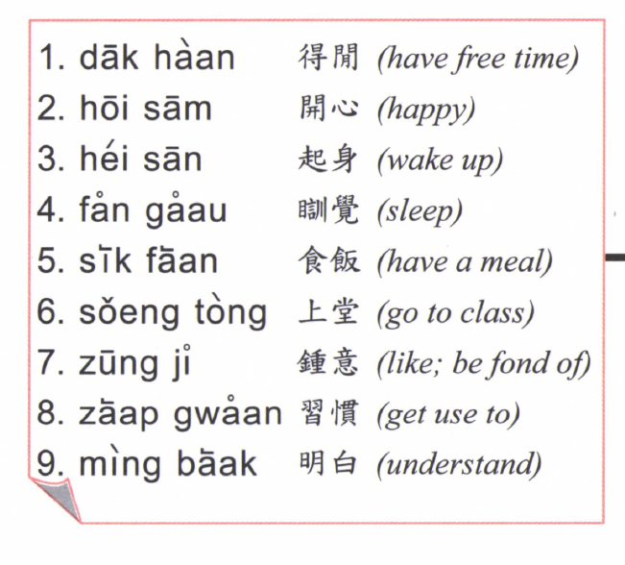
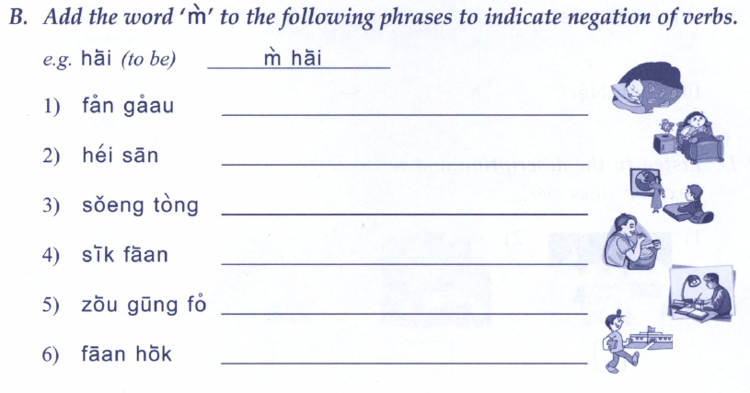

Slide 13
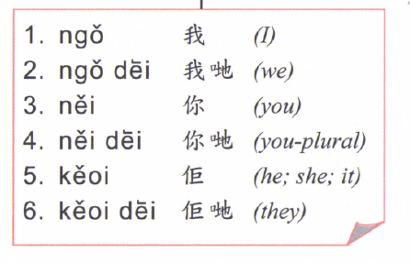
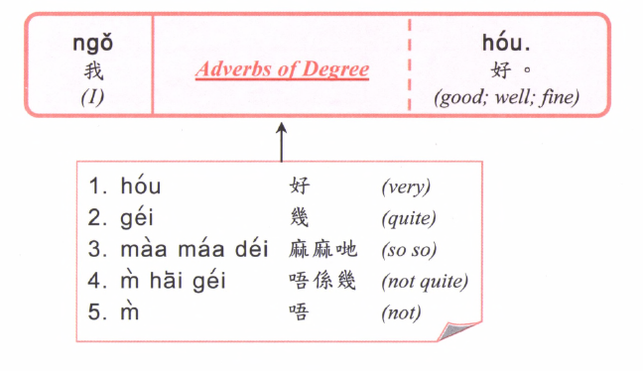

Slide 14
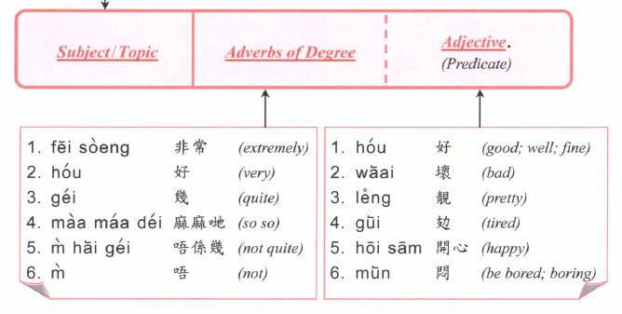
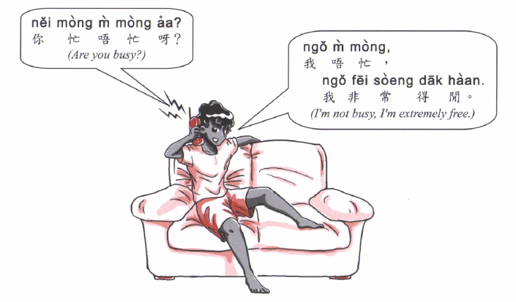

Slide 15
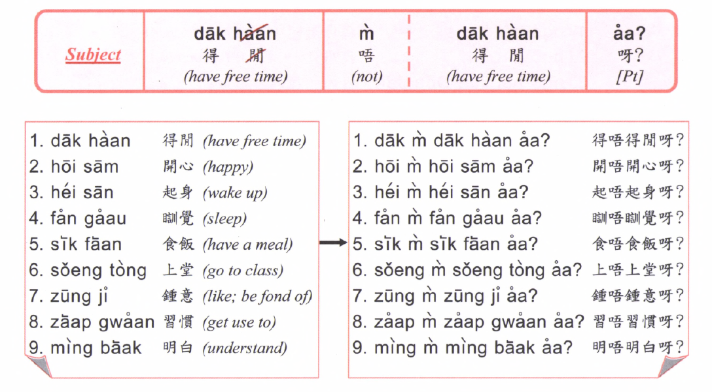

Slide 16
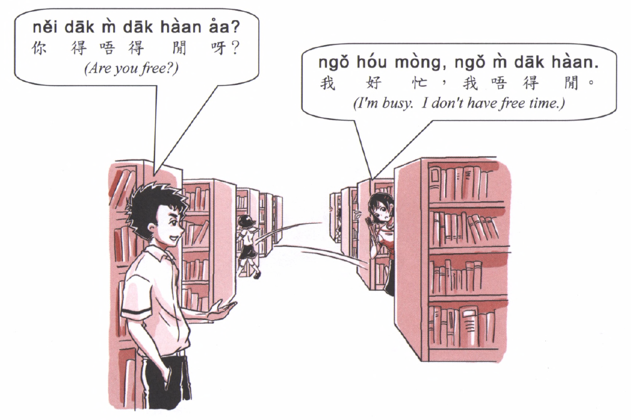

Slide 17
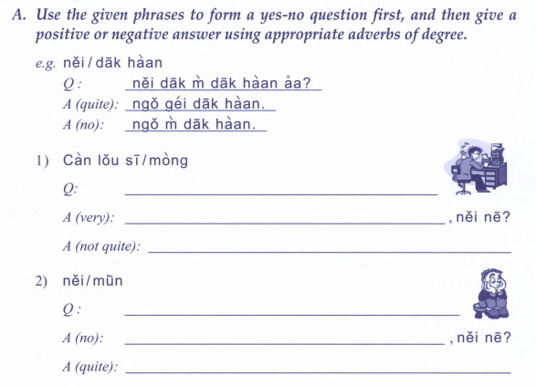
明白 understand

Slide 18
忙 busy
悶 bored

Slide 19
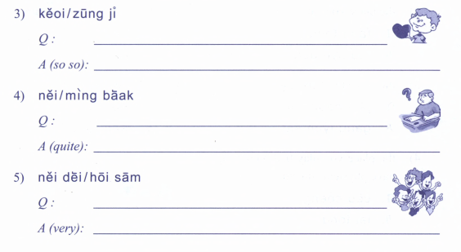
鍾意 like
明白 understand
開心 happy

Slide 20
鍾意 like
明白 understand

