Slide 1
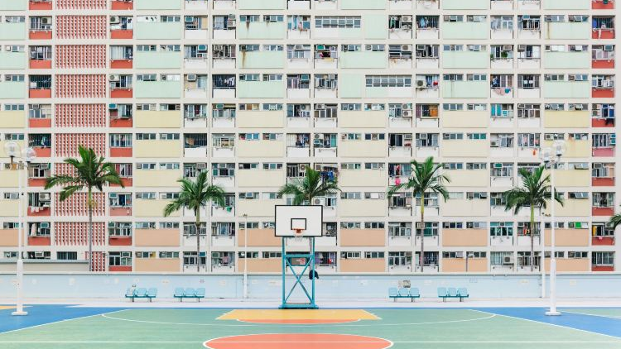
Cantonese I
Week 5
Notes:
oral test: 1. how are you? 2. what is your name? 3. adjective (happy, cute, beautiful) 4. possession word (my friend, my teacher, my student, my classmate, my doctor) 4. verb to be 5. negation to verb 6. negation to adjective 7. where you from 8. yes/no question

Slide 2
Quick check/revision
1. how are you?
2. what is your name?
3. adjective (happy, cute, beautiful)
4. possession word (my friend, my teacher, my student, my classmate, my doctor)
5. verb to be
6. negation to verb
7. negation to adjective
8. where you from
9. yes/no question

Slide 3
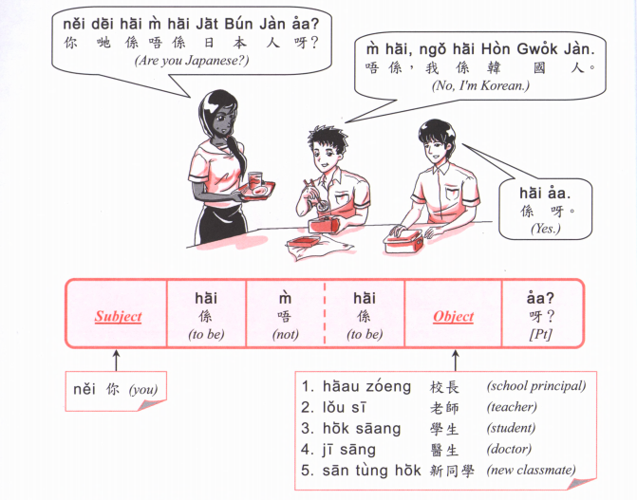
捷克 zit6 hak1
斯洛伐克 si1 lok6 fat6 hak1
Lan2
Gau1
Hai1
Cat6

Slide 4
Lan2
Gau1
Hai1
Cat6

Slide 5
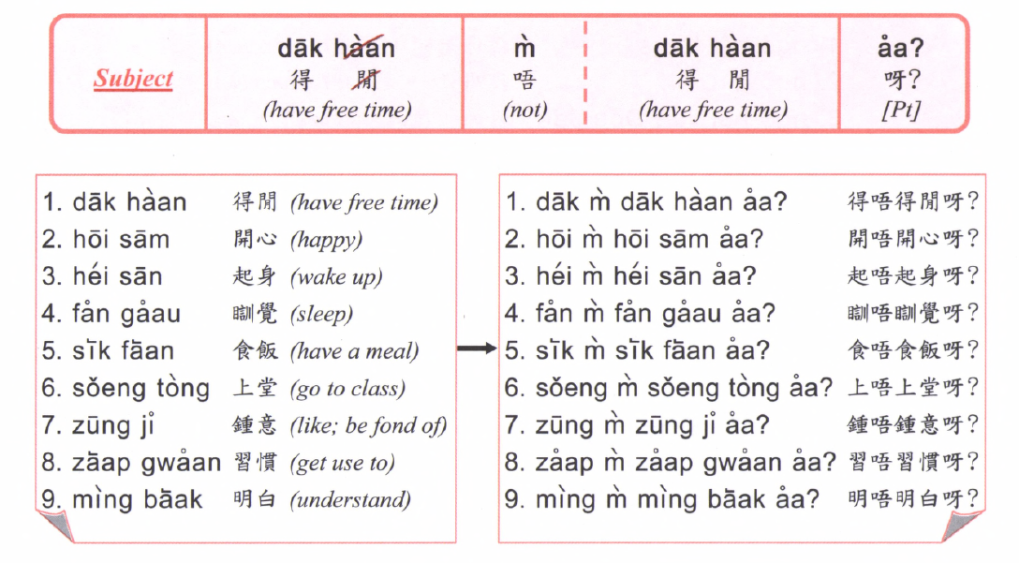
Lan2
Gau1
Hai1
Cat6

Slide 6
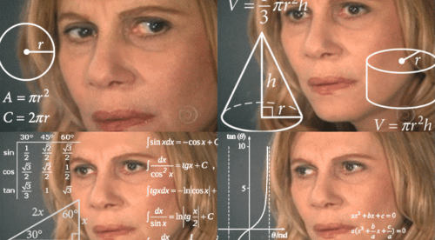
Numbers

Slide 7
What is your phone number? 你電話幾多號？nei5 din6 waa2 gei2 do1 hou6?
My phone number is 我嘅電話係XXXXX ngo5 ge3 din6 waa2 hai6 XXXXX

Slide 8
Class exercise:
768 403 495
495 391 405
394 495 145
245 584 495
948 867 823
985 459 484
938 985 975
954 653 596

Slide 10
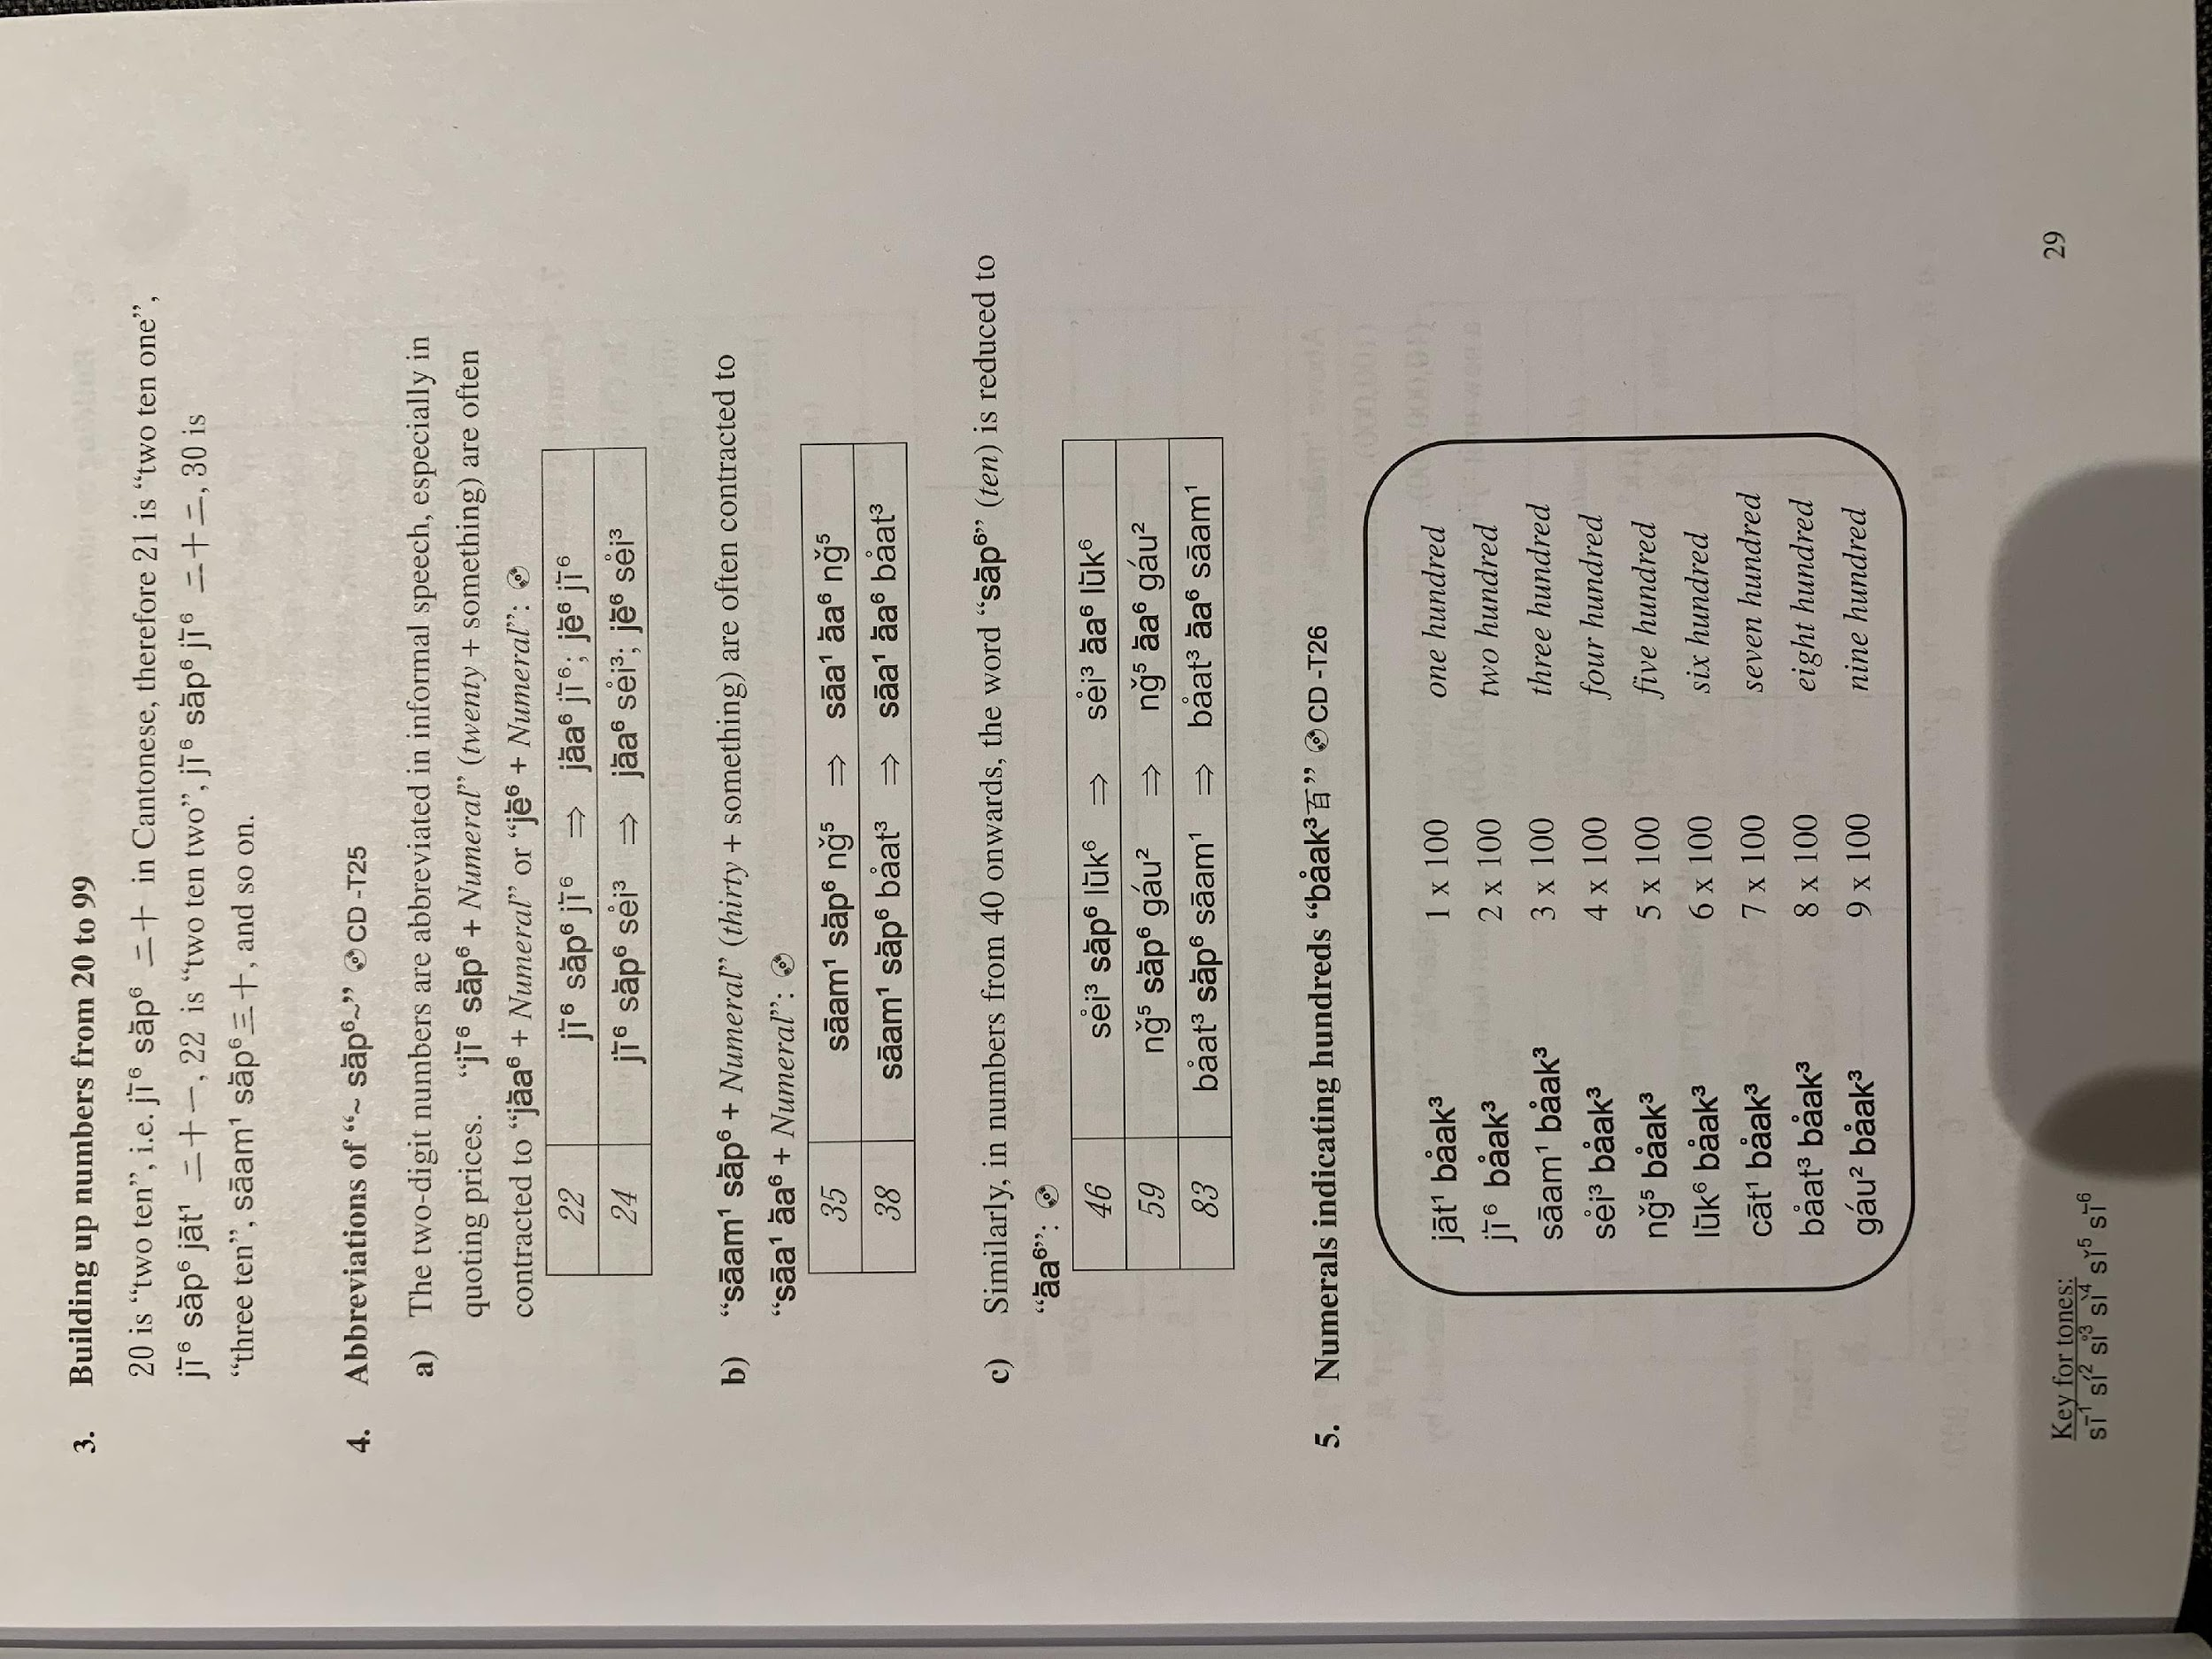
22 -> 2+10+2
34 -> 3+10+4
49 -> 4+10+9

Slide 12
Notes:
finish here

Slide 13
https://youtu.be/Y_y9_Cjp2zM
靚唔靚呀? Beautiful or not? Leng3 m4 leng3 aa3?
好靚呀 very beautiful ar. hou2 Leng3 aa3
你都幾靚 you are quite pretty. Nei5 dou1 gei2 Leng3
冇問題. No problem. mou5 man6 tai4
好 唔該晒 good. Thank you very much. hou2 m4 goi1 saai3
唔得呀嘛? Not working ar ma? m4 dak1 aa3 maa3
係我呀! It is me! Hai6 ngo5 aa3

