Slide 1
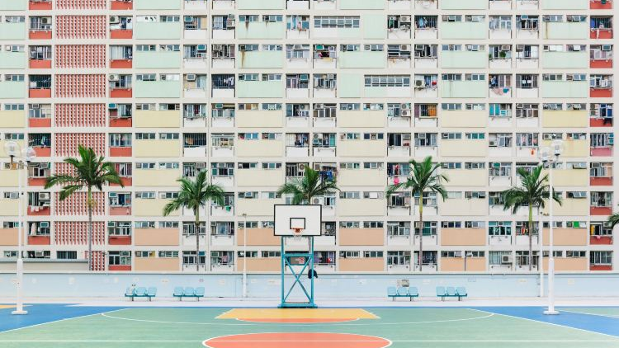
Cantonese I
Week 6

Slide 2
Quick check/revision
1. how are you?
2. what is your name?
3. adjective (happy, cute, beautiful)
4. possession word (my friend, my teacher, my student, my classmate, my doctor)
5. verb to be
6. negation to verb
7. negation to adjective
8. where you from
9. yes/no question

Slide 3
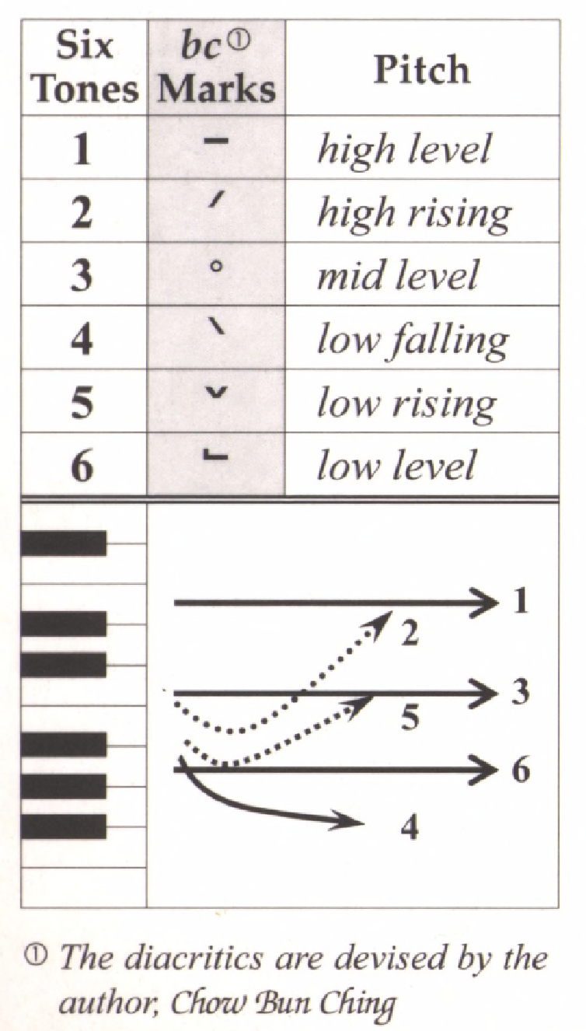
Tone check
diu 鵰diu1 𨳒diu2 吊diu3 diu4 diu5 調diu6
Hai 閪hai1 喺hai2 hai3 兮hai4 匸hai5 係hai6
gau 鳩gau1 九gau2…
cat 七cat1 … 𨳍cat6
soeng 想
zaap 習
gwaan 慣
sei 四
zung 鍾
fan 飯

Slide 4
Auxiliary verbs
Negation +唔 m4
會 wui5 will, would 🡪唔會
可以 ho2 ji5 can, may 🡪唔可以
識 sik1 know (how to) 🡪唔識
應該 jing1 goi1 should, ought to 🡪唔應該
需要/要 seoi1 jiu3/jiu3 want, need 🡪唔需要/唔要
想 soeng2 want to 🡪唔想

Slide 5
Question phrases
verb
食乜嘢? Sik6 mat1/mi1/me1 je5? (eat what things?)
做乜嘢? Zou6 mat1 je5? (do what things?)
聽乜嘢? Teng1 mat1 je5? (hear what things?)
睇乜嘢? Tai2 me1 je5? (see what things?)
去邊度? Heoi3 bin1 dou6? (go where?)
邊個? Bin1 go3? (who?)
點解? Dim2 gaai2 (how explain? 🡪 why?)
點樣? Dim2 joeng2? (how?)
幾時? Gei2 si4? (how time 🡪 when?)
幾多? Gei2 do1? (how many?)

Slide 6
Combination: auxiliary verb x question phrase
你會食乜嘢? Nei5 wui5 sik6 mat1 je5? (you will eat what thing?)
你會去邊度? Nei5 wui5 heoi3 bin1 dou6? (you will go where?)
我可以食乜嘢? Ngo5 ho2 ji5 sik6 mat1 je5? (I can eat what thing?)
我可以去邊度? Ngo5 ho2 ji5 heoi3 bin1 dou6? (I can go where?)
我可以點樣? ngo5 ho2 ji5 dim2 joeng2? (I can how? -> “what should I do?”)
你可以幾時? Nei5 ho2 ji5 gei2 si4? (you can when?)
你識唔識佢係邊個? Nei5 sik1 m4 sik1 keoi5 hai6 bin1 go3? (you know or not know he/she is who?)
你識唔識點解? Nei5 sik1 m4 sik1 dim2 gaai2? (you know or not know why?)
你識講乜嘢話? Nei5 sik1 gong2 mat1 je5 waa2? (you know speak what language?)

Slide 7
Combination: auxiliary verb x question phrase
我應該坐乜嘢車? Ngo5 jing1 goi1 co5 mat1 je5 ce1? (I should sit what thing car?)
我應該去邊度? Ngo5 jing1 goi1 heoi3 bin1 dou6? (I should go where?)
我應該點樣? Ngo5 jing1 goi1 dim2 joeng2? (I should how?)
我應該要幾多杯? Ngo5 jing1 goi1 jiu3 gei2 do1 bui1? (I should need how many cups?)
你要一個乜菜? Nei5 jiu3 jat1 go3 mat1 coi3? (you need one piece what “vegetable” dish?)
你要去邊度? Nei5 jiu3 heoi3 bin1 dou6? (you need go where?)
你想點樣? Nei5 soeng2 dim2 joeng2? (you want how?)
你想幾多錢? Nei5 soeng2 gei2 do1 cin2? (you want how much money? -> “how much do you want to pay for this item?”)

Slide 8
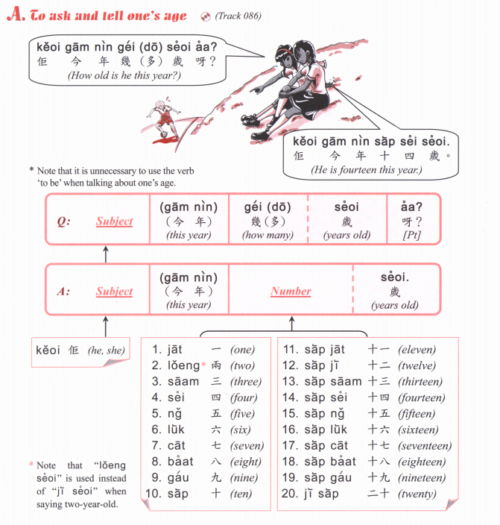
20 ji6 sap6
21 ji6 sap6 jat1
22 ji6 sap6 ji6
23 ji6 sap6 saam1
24 ji6 sap6 sei3
25 ji6 sap6 ng5
26 ji6 sap6 luk6
27 ji6 sap6 cat1
28 ji6 sap6 baat3
29 ji6 sap6 gau2

Slide 9
94,669

Slide 10
25
39
42
11
54
89
67
71
601
566
913
384
104
220
477
852
7601
9566
6913
5384
8104
1220
2477
3852
Notes:
finish week 6

