Slide 1
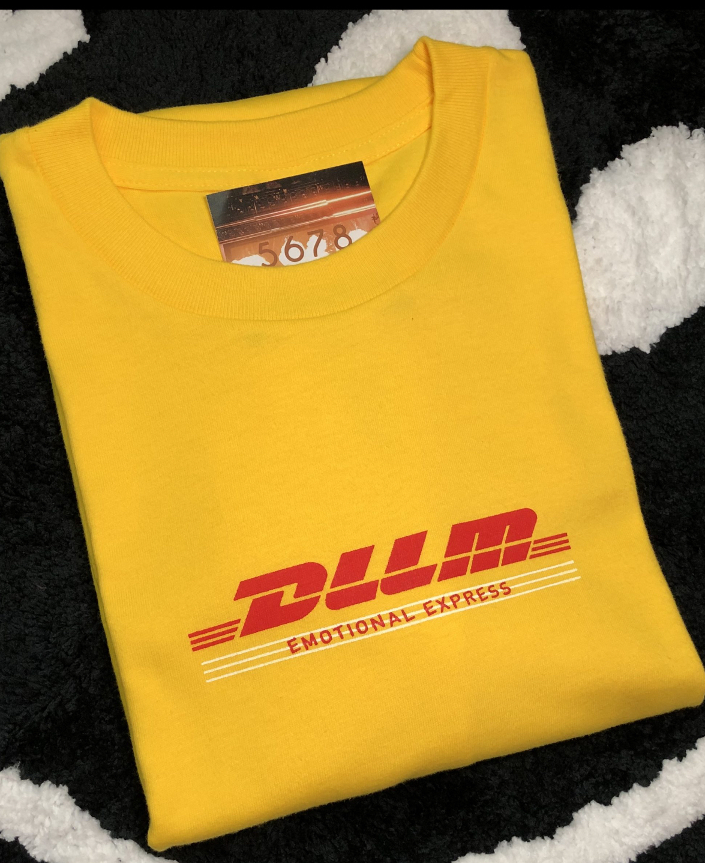
Cantonese I
Week 7

Slide 3
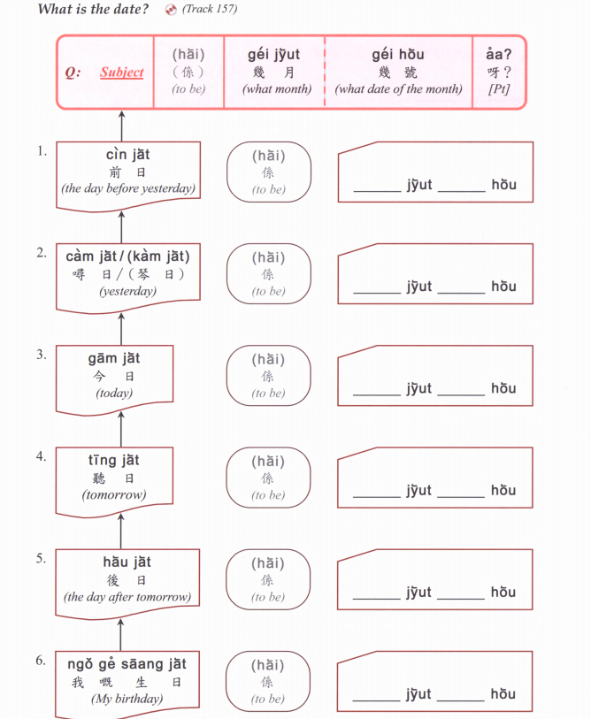

Slide 4
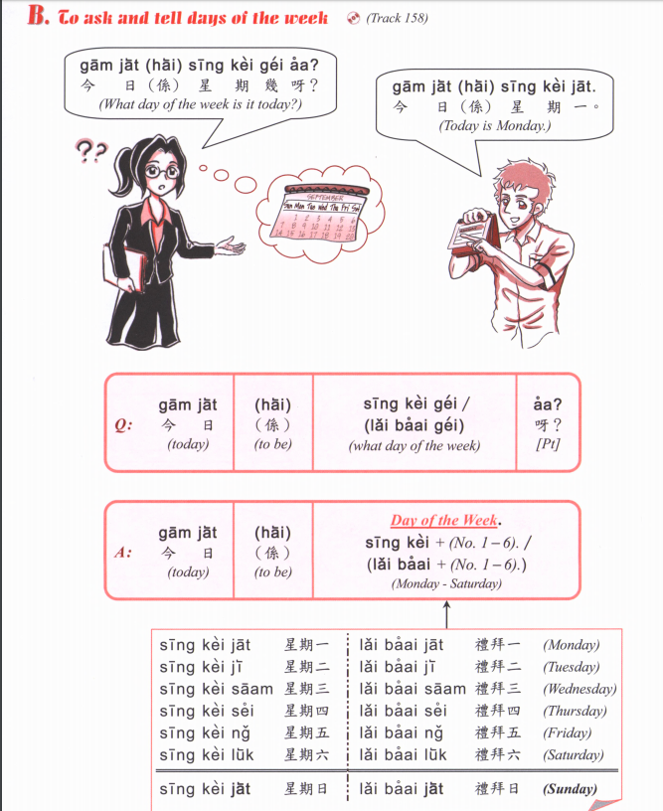

Slide 5
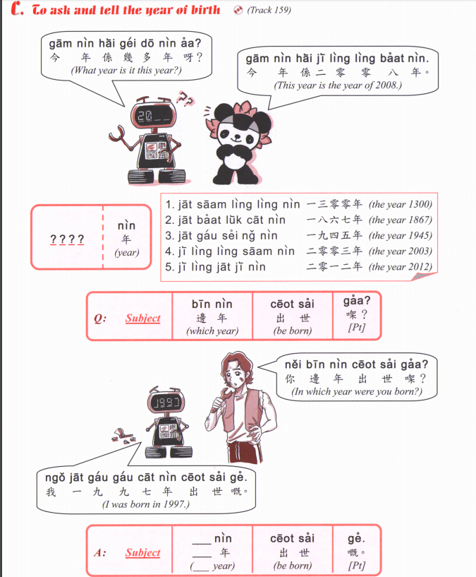

Slide 6
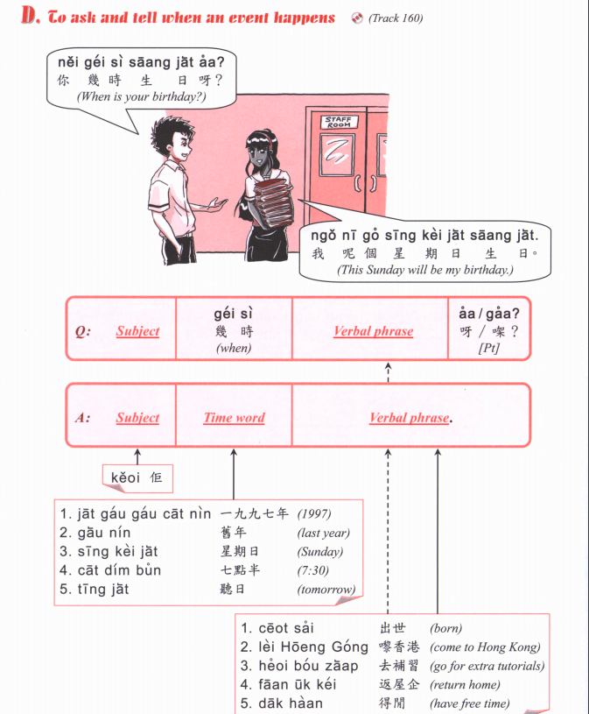
OR
邊年 bin1 nin4
Which year

Slide 7
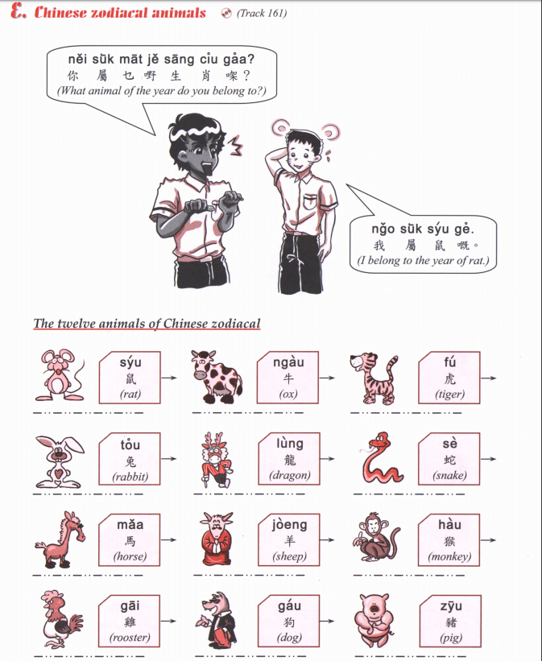

Slide 8
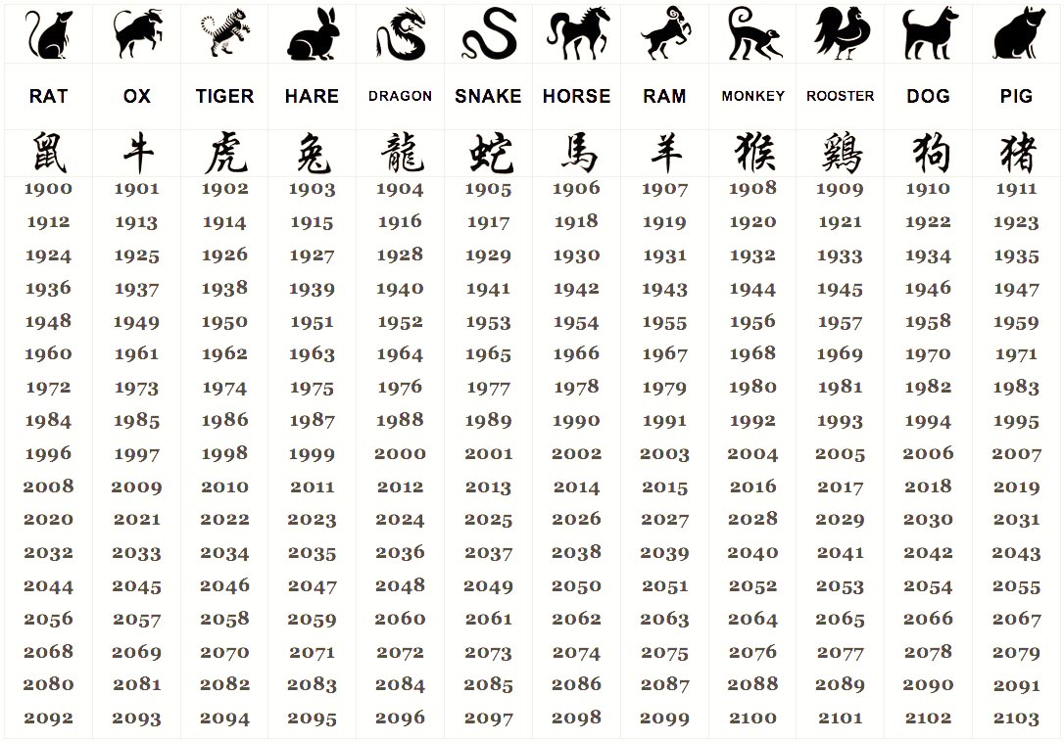

Slide 9
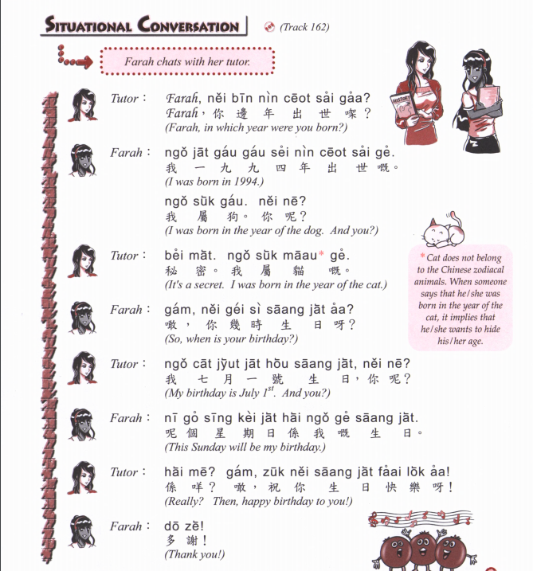

Slide 10
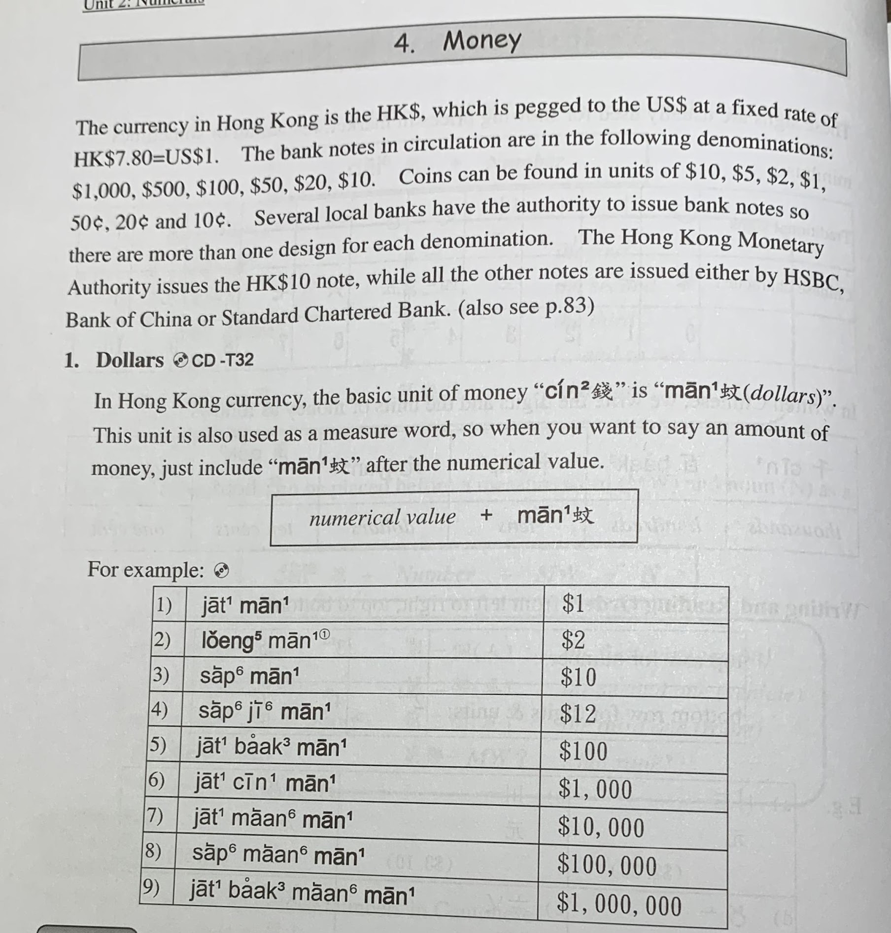

Slide 11
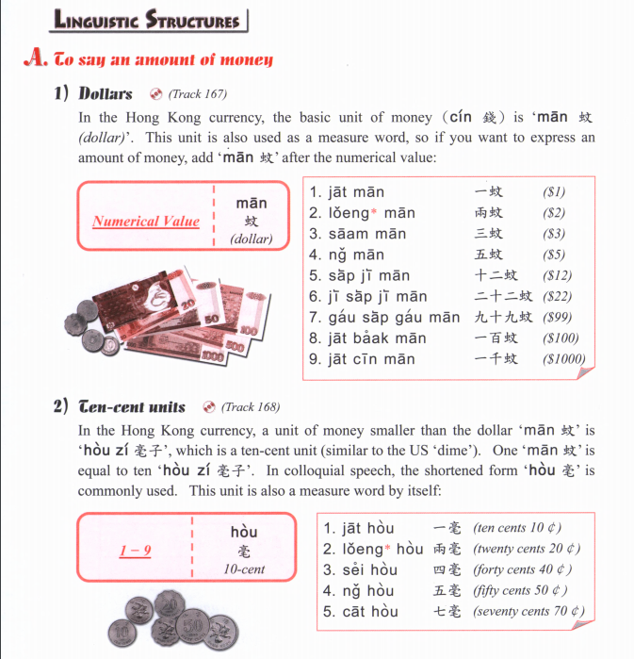
The use of the character 蚊 (mān) originate from the tone change of the currency denomination used in China in imperial times 文 (màn), which was the chief denomination until the introduction of the yuan in the late 19th century.

Slide 12
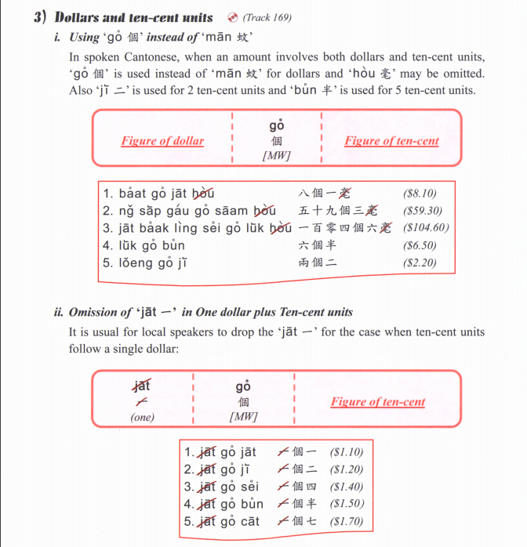

Slide 14
1) $364.3
2) $984.5
3) $1204
4) $260.2
5) $65.5
6) $83.9
7) $888.8
8) $29.9
9) $2.2
10) $510.7

Slide 15
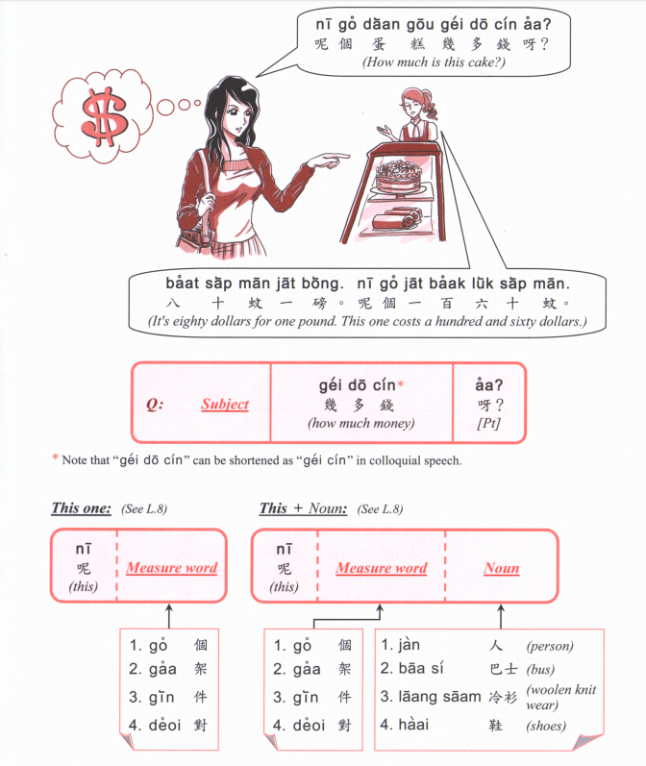

Slide 16
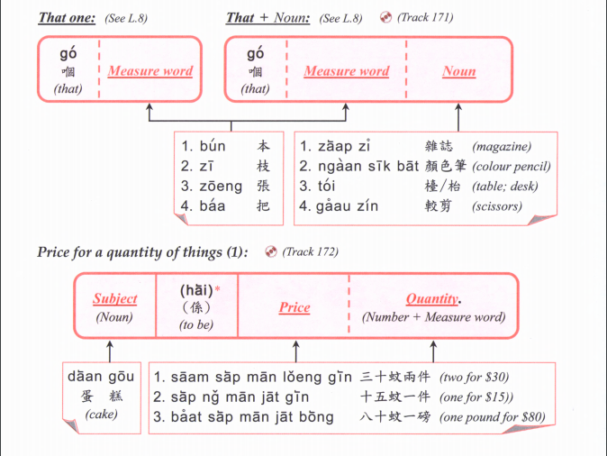

Slide 17
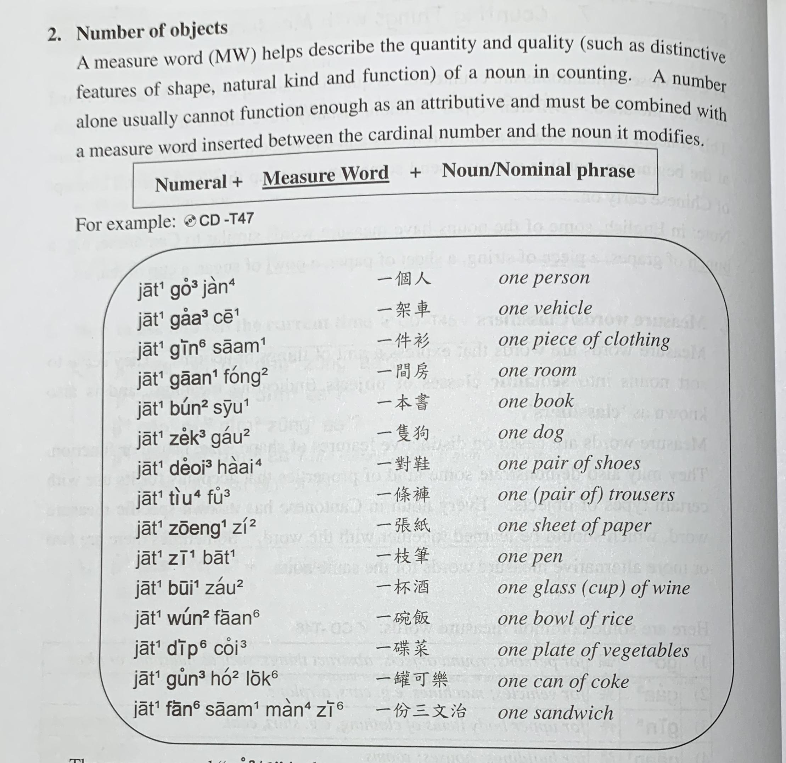

Slide 18
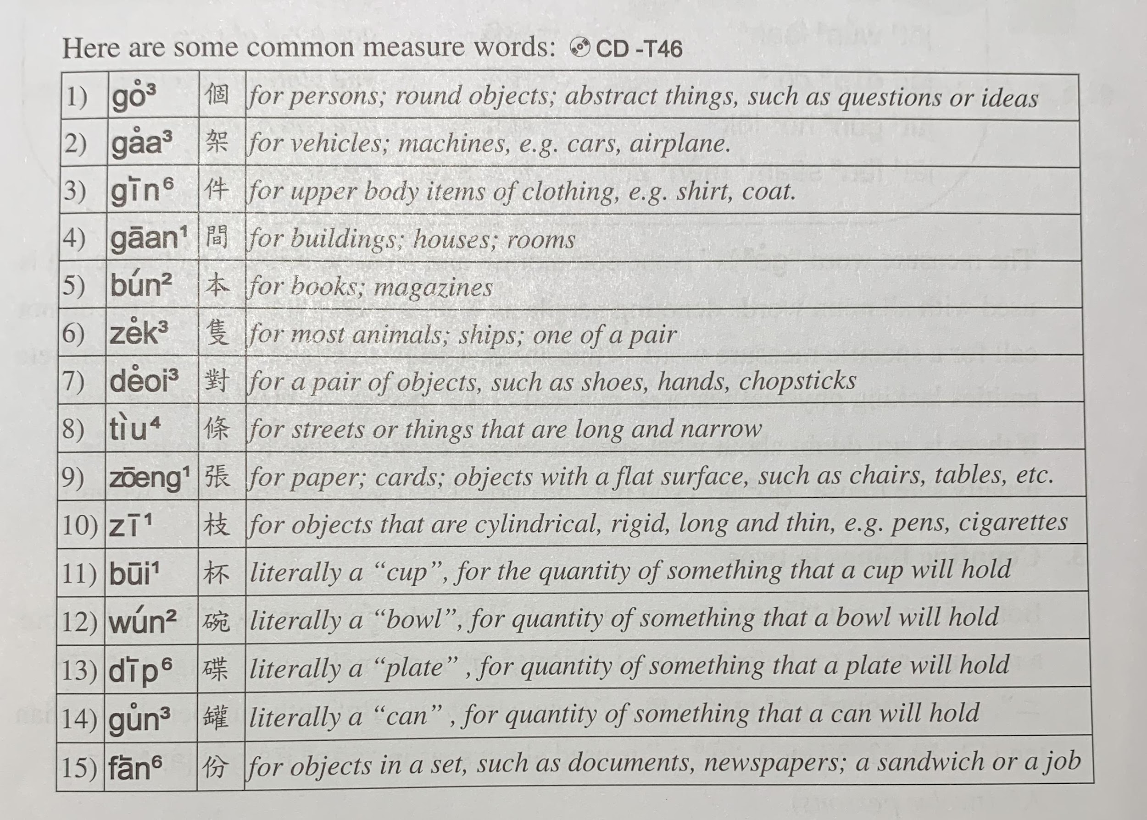

Slide 19
optional

Slide 20
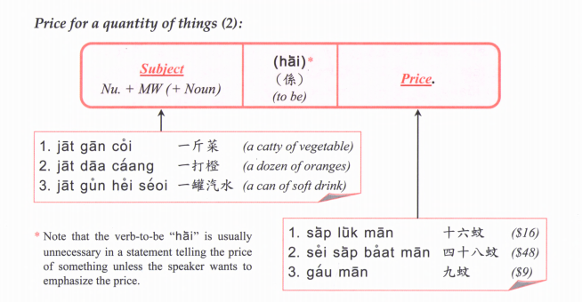
optional
Quantity +

Slide 21
Price for a quantity of things (3):
Subject + quantity + Price
Banana one $2

Slide 23
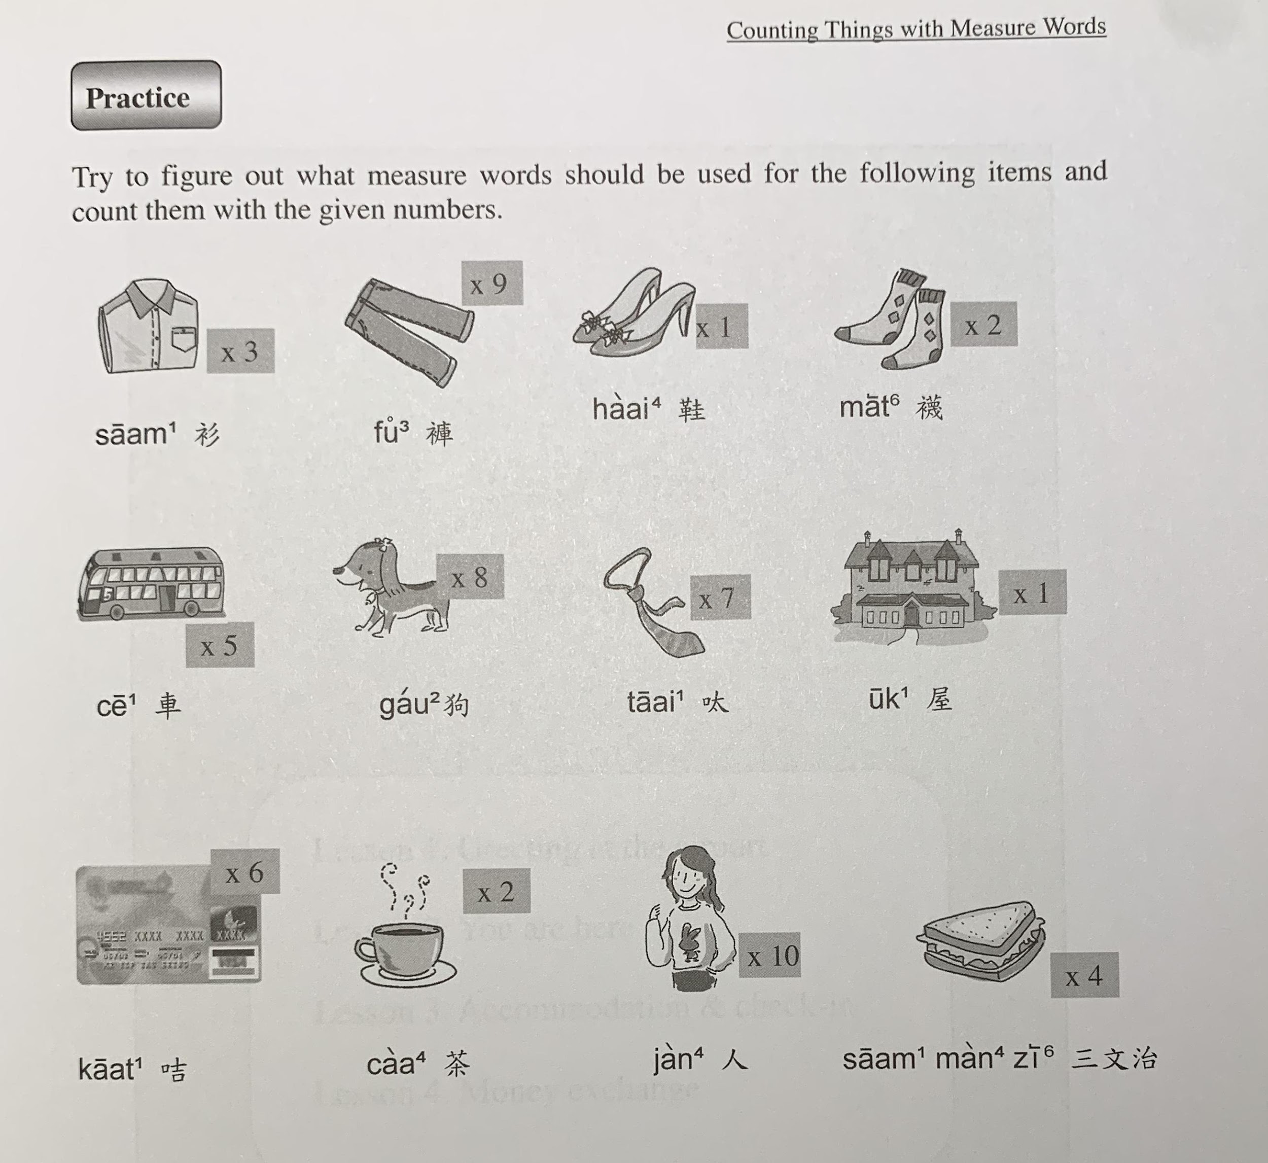

Slide 24
$1423
$540.8
$63.2
$160
tiu4
gin6
deoi3
deoi3
$345.4
$6345
$899.9
$3,700,000
zek3
tiu4
gaan1
gaa3
$26.9
$45
$57
bui1
go3
fan6
zoeng1
Notes:
finished here about the money

Slide 25
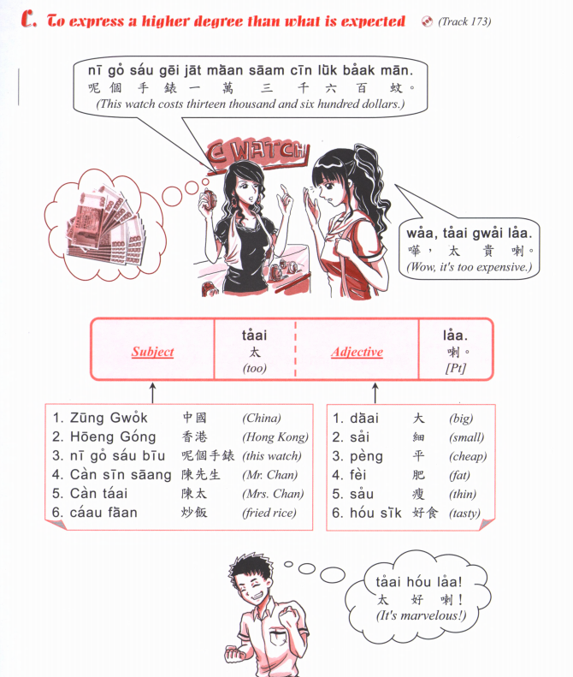
zek3
隻

Slide 26
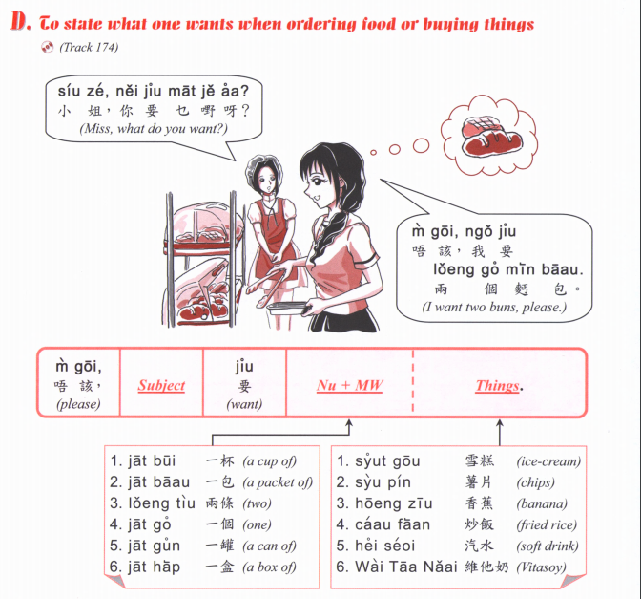

Slide 27
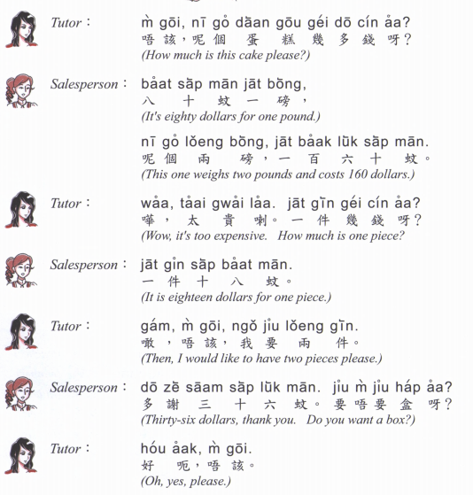
Notes:
We end here

Slide 28
Cantonese Slangs

Slide 30
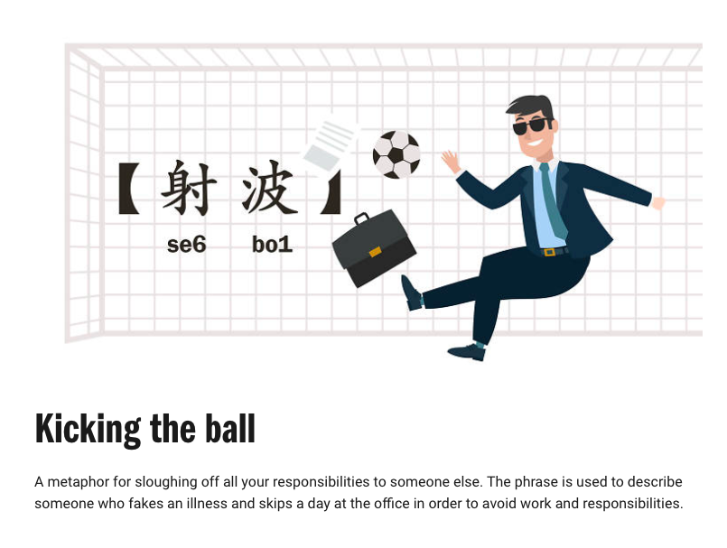

Slide 32
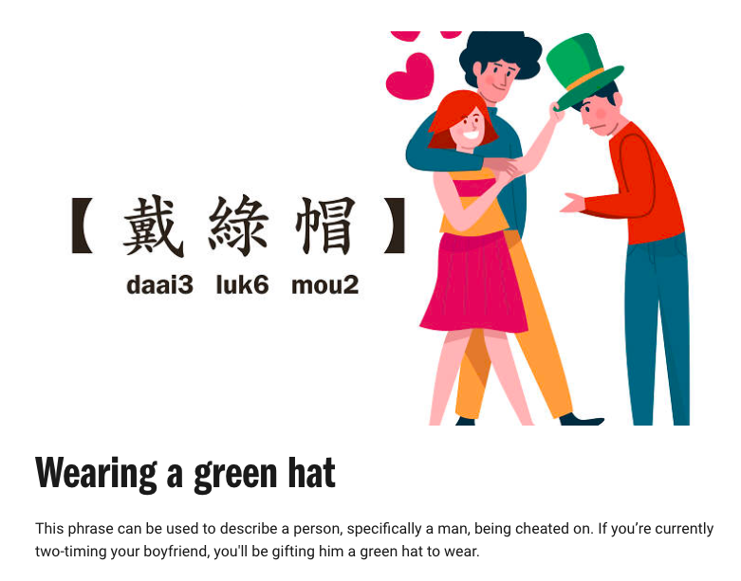

Slide 33
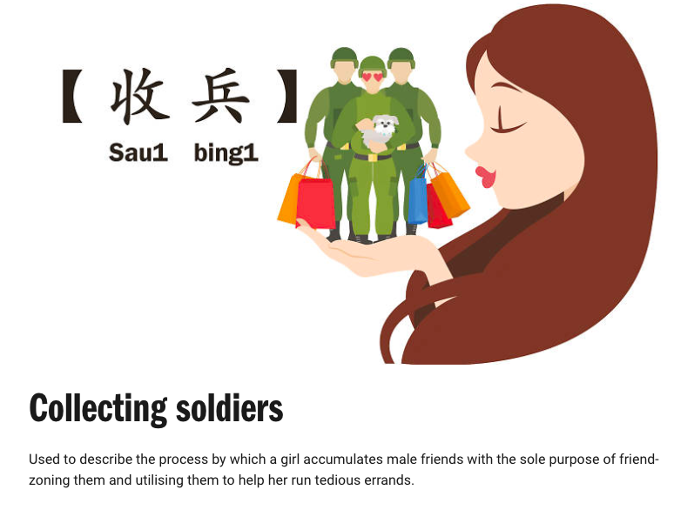

Slide 36
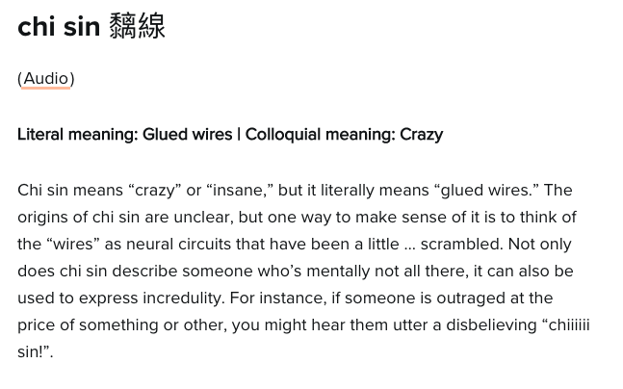
Jyutping: ci¹ sin³

Slide 37
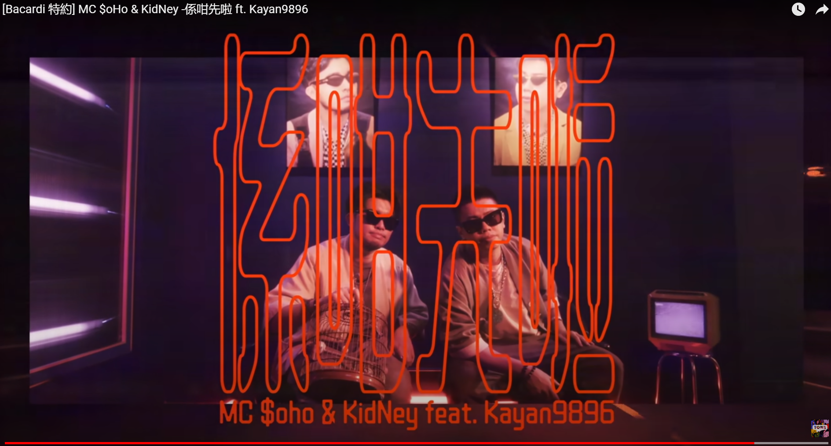
走先喇 (I go first la) zau2 sin1 laa1
係咁先啦 (that’s it la.) hai6 gam3 sin1 laa1
再見啦(喇) (see you again la) zoi3 gin3
唔係啊 (no ar) m4 hai6 aa1
喂呀 (hey) wai3 aa1
咩話? (what?) me1 waa6
https://www.youtube.com/watch?v=S1v_d_e_E_g

