Slide 1
English for Museology Purpose
Mgr. Lenka Vargová, PhD.
lenka.vargova@uniba.sk
lenka.vargov6@gmail.com

Slide 2
Collections care
What type of collections can we find in museums?
How do museums decide what to collect?
How do museums acquire new artifacts?
Should all donations be accepted?
Should they collect only unique, one-of-a-kind objects or also commonplace items?
What are some of the complications in regard to collecting contemporary objects?

Slide 3
Methods of acquisition: donation / bequest, purchase, field-collecting, exchange between museums, loans
Collecting policy - provides the framework within which collections are developed and acquired – answering the What, Where, How, Why & When
Analysing by subject / discipline, or material
Registrar, Collection Manager – processing accessions, collection-related record keeping
Curator – researcher-specialist, collections care and growth, cataloguing

Slide 4
Can museums dispose of their objects? Under what circumstances?
  The object has decayed badly
  It is a fake / wrongly identified
  It does not fit into the museum´s collecting policy
  To sell it to buy a better example
  As an exchange with another museum
  It is a multiplicate
  Order of the state authorities
  Restitution

Slide 5
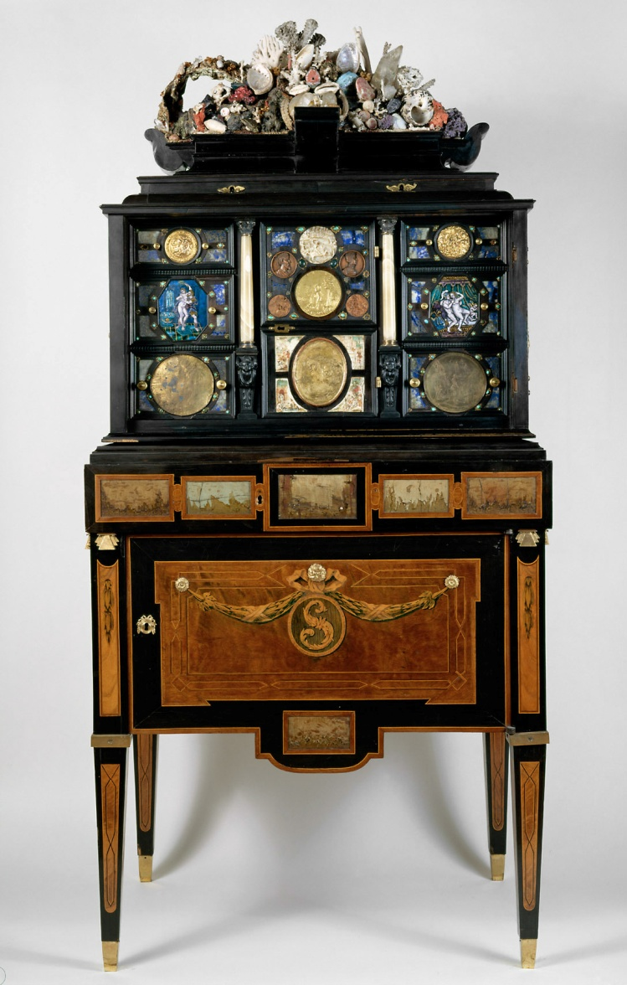
What sort of information do we record with the object?
  Name
  Materials
  Manufacture
  History
  Use
  Description
  The donor
  Documentation
  https://www.khm.at/en/objectdb/detail/89409/?offset=81&lv=list

Slide 6
Documentation systems:
  Registration – entry form
  Accessioning – entered in the accessions register, accession number (year of acquisition, number in the register), identity number
  Cataloguing – catalogue = complete record of everything known about every object, info: name of museum, accession number, name of object – classification, entry method & source, date, history, location + supplementary information file

Slide 7
What is an index? What is its use? What can it be based on?
  Donor, classification, location, provenance, artist
What all is part of movement control?
How can we physically attach the accession numbers to objects? Coin? Clothes? Sabre? Painting? Mineral?
Can we put newly acquired objects directly into storage?
What issues might be involved in cleaning acquisitions?
What are some rules for handling collections?
https://www.youtube.com/watch?v=fV68mgpdsCs&ab_channel=WesternAustralianMuseum

Slide 8
What are some guidelines for storage? What environmental conditions do we have to take into account?
What is preventive conservation?
What´s the difference between conservation and restoration?
How can museums cope with disasters?
What does collection security entail?

Slide 9
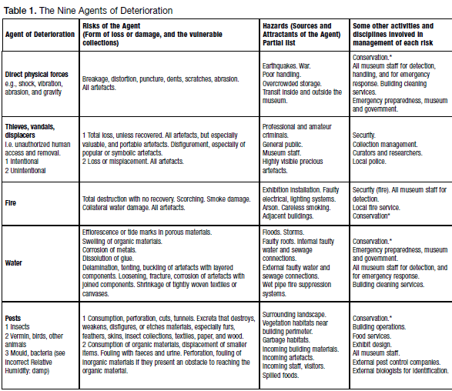
https://www.youtube.com/watch?v=CCnULkJRM50&ab_channel=WesternAustralianMuseum
https://www.youtube.com/watch?v=-UQk7bKf9FI&ab_channel=thebrainscoop

