Slide 1
Text in exhibitions
Video – what advice does it give? (4 points)
Skills that can be developed from exploring objects: description, deduction, interpretation, clarification
Make it interesting to the reader, make it relatable
Aim for an average of 10-20 words per sentence, use short paragraphs – fewer than 50 words
Simple, short words make your text more accessible
Use pictures, diagrams, maps or graphs to get your messages across

Slide 2
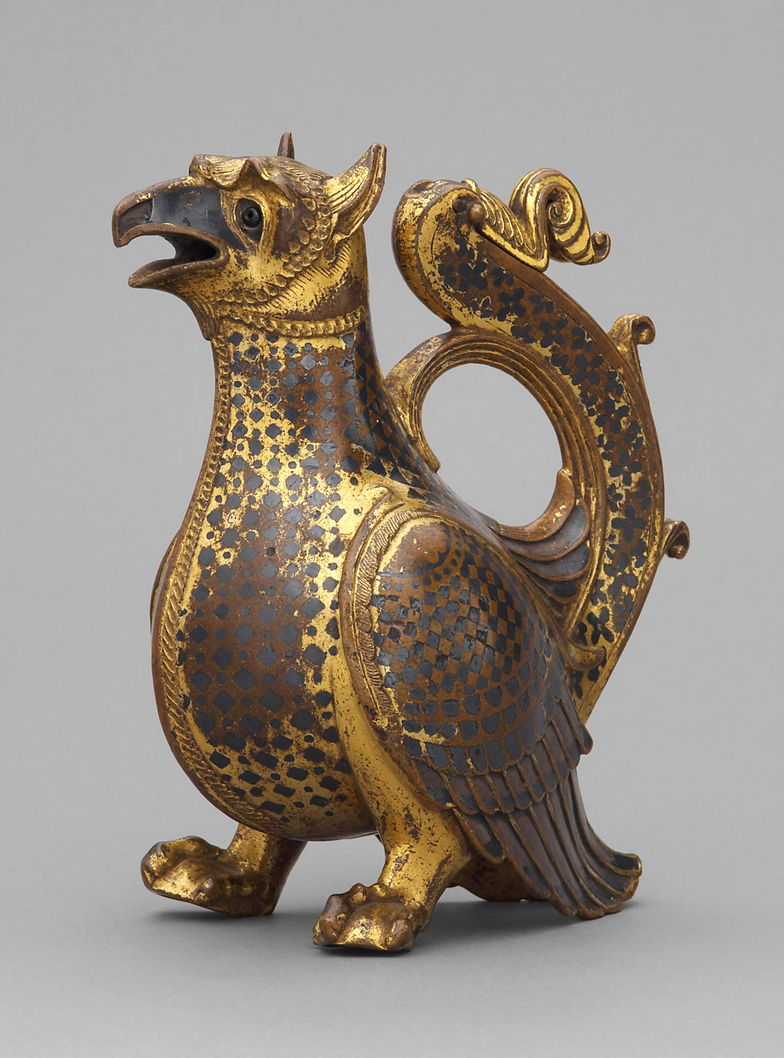
HW – Write a label (45 word limit)
Aquamanile in the Form of a Griffon (KHM), ca. 1120/30
material: Gilded bronze, damascened silver, niello, garnet
H. 17,3 cm, B. 8,5 cm, L. 14,5 cm

Slide 3
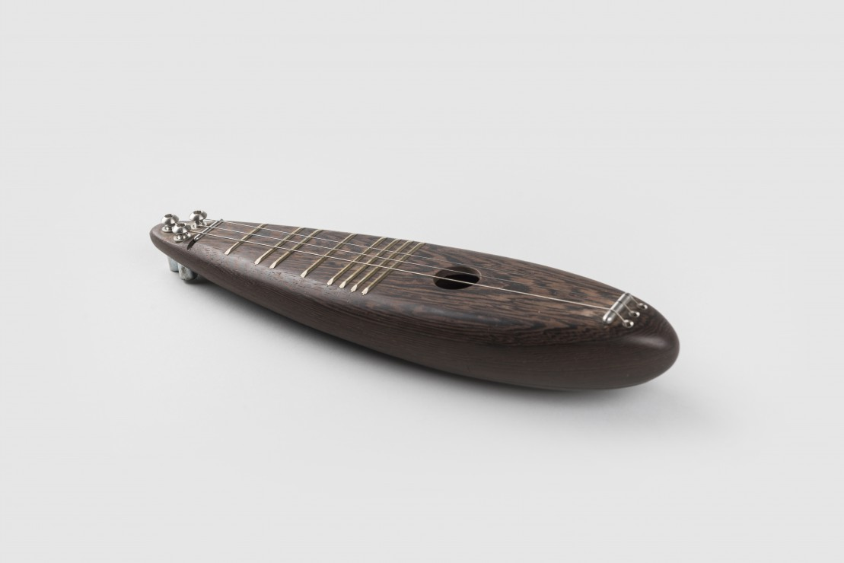
HW 2 – Write a made-up label (45 word limit)
ČUDO (SMD)

