Slide 1
Korean class
Week 3

Slide 2
index
Informal / Polite expression
Learn about number
Basic word
Basic Grammar (order of sentence)
Dialogue
Korea’s Culture

Slide 3
Informal/polite expression
Hi Informal/polite
안녕 / 안녕하세요
{An-nyeong / An-nyeong-ha-sae-yo}
Bye
잘 가 / 안녕히가세요
{Jal-ga / An-nyeong-hee-ga-sae-yo}

Slide 4
Informal/polite expression
Sorry Informal/polite
미안해 / 미안해요 / 죄송합니다.
{Mi-an-hae / Mi-an-hae-yo / Jwae-song-hap-ni-da}
Thank you
고마워 / 고마워요 / 감사합니다.
{Go-ma-wo / Go-ma-wo-yo / Gam-sa-hap-ni-da}

Slide 5
Informal/polite expression
I
Informal/polite
I have coffee.
나는 커피를 가지고 있어.{ Na-neun coffee reul ga ji go it eo}
저는 커피를 가지고 있어요 .{Jeo-neun coffee reul ga ji go it eo yo}

Slide 6
Informal/polite expression
My
Informal/polite
My major is music.
나의 전공은 음악이야 { Na-eu jeon-gong eun eum-ak I ya}
저의 전공은 음악이에요 {Jeo-un jeon-gong eun eum-ak i-e-yo}

Slide 7
Informal/polite expression
Me
Informal/polite
Please give it to me.
그것을 나에게 줘 { Geu-geot-eul na-e-ge gwo}
그것을 저에게 주세요 {Geu-geot-eul jeo-e-ge ju-sae-yo}

Slide 8
Informal/polite expression
You
Informal/polite
You are pretty.
너는 예쁘다 {Neo-neun yae-bbeu-da}
당신은 예뻐요 {Dang-sin-eun yae-bbeo-yo}

Slide 9
Basic grammar
Be – Verb
Am , Are , Is
~다 / ~이다 { da / I –da}
Behind Vowel
Behind
Consonant

Slide 10
Informal expression
야 [Ya]
Hi, I am Jisoo. Are you Jimin?
안녕 나는 지수야. 너는 지민이야?
{Annyeong, na neun jisoo ya. Neo neun Jimin I ya?}
Yes, I am Jimin.
응, 나는 지민이야.
{Eung, na neun jimin I ya.}

Slide 11
Informal expression
야 [Ya]
What is it?
이건 뭐야?
{I geon meo ya?}
This is cup.
이건 컵이야.
{I geon cup I ya.}

Slide 12
Polite expression
예요 [Yeyo] = 이에요 [i-yae-yo]
Hi, I am Jisoo. Are you Jimin?
안녕하세요 저는 지수예요. 당신은 지민이에요?
{Annyeong-ha-sae-yo, jeo-neun jisoo yeyo. Dang-sin-eun Jimin i-yae-yo?}
Yes, I am Jimin.
네, 저는 지민이에요.
{Nea, Jeo-neun Jimin i-yae-yo.}

Slide 13
Polite expression
예요 [Yeyo] = 이에요 [i-yae-yo]
What is it?
이건뭐예요?
{I-geon mwo-yae-yo?}
This is cup.
이건 컵이에요.
{I-geon-cup i-yae-yo}

Slide 14
Basic word - noun
Breakfast – 아침식사 {A-chim-sik-sa}
Lunch – 점심식사 {Jum-sim-sik-sa}
Dinner –저녁식사 {Jeo-nyuk-sik-sa}
Restaurant – 식당 {Sik-dang}
Food – 음식 {Um-sik}
Spoon – 숟가락{suggarak}
수저 – spoon / spoon&chopsticks {soo-jeo}
Chopsticks – 젓가락 {jeot-ga-lak}

Slide 15
Basic word - verb
Eat-먹다[Meog-da]
Go-가다[Ga-da]
Use-사용하다[Sayong-hada]
Wear-입다[Ib-da]
Sleep-자다[Ja-da]

Slide 16
Basic word - adjective
Big -크다 [keu-da]
Small - 작다 [jag-da]
Pretty - 예쁘다 [yep-peu-da]
Delicious -맛있다 [ma-ssit-da]
Funny -재미있다 [jae-mi-it-da]

Slide 17
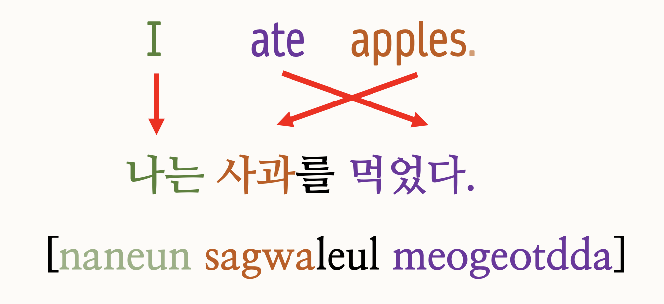
Basic grammar
Korean have a different word order from English

Slide 18
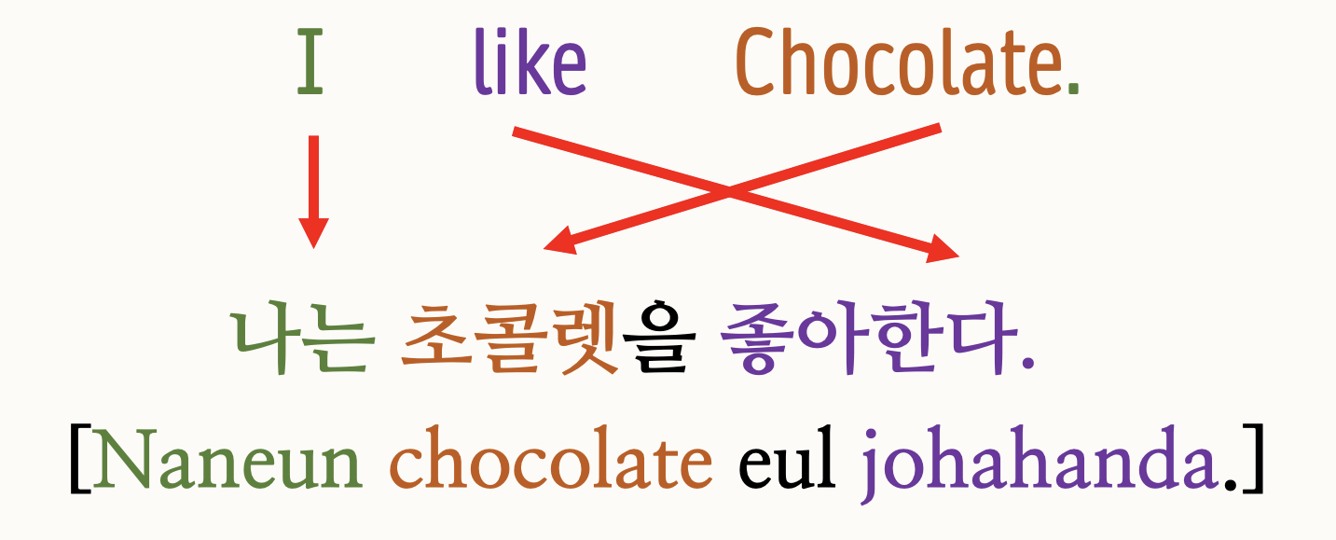
Basic grammar
Korean have a different word order from English

Slide 19
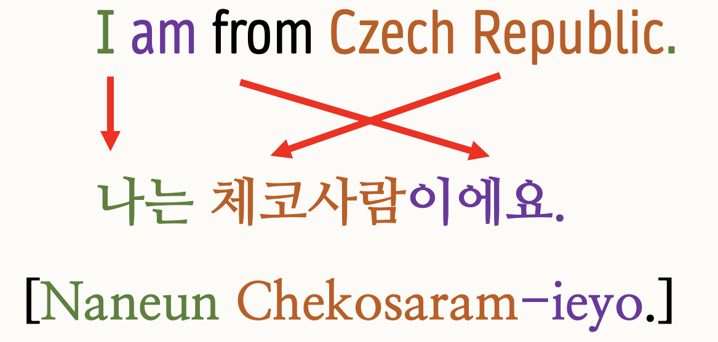
Basic grammar
Korean have a different word order from English

Slide 20
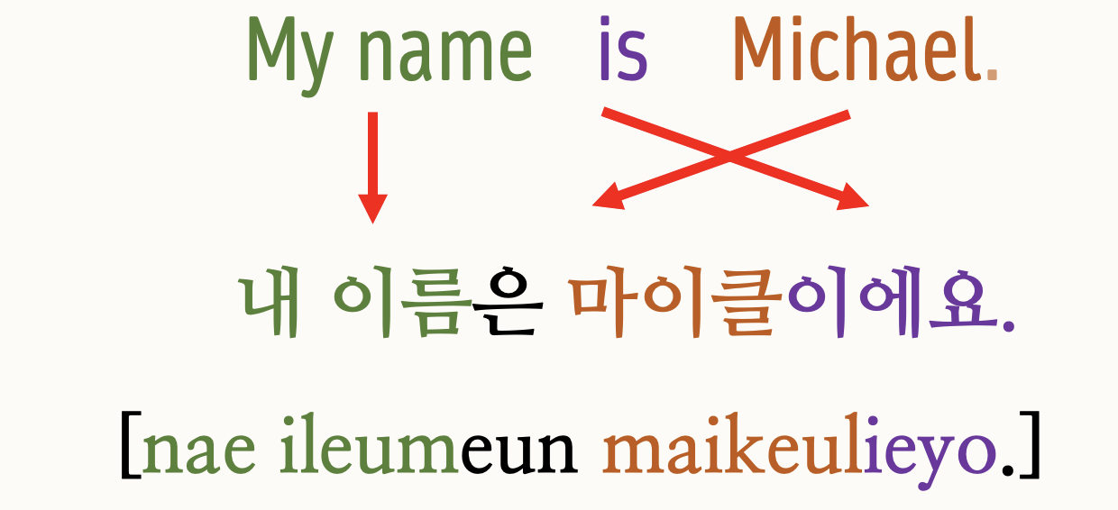
Basic grammar
Korean have a different word order from English

Slide 21
Dialogue
Jisoo – I am hungry
: 나 배고파
(Na-bae-go-pa)
Jimin – Me too, Let’s eat lunch
:나도, 점심먹자
(Na-do , Jeom-sim-meok-ja)

Slide 22
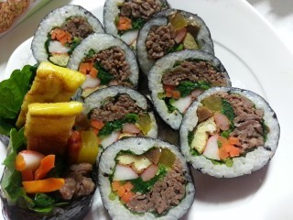
dialogue
Jisoo – What do you want to eat?
: 뭐 먹고싶어?
(Mwo-meok-go-sip-eo?)
Jimin – Let’s eat Kimbap
: 김밥 먹으러 가자
(Kimbap meok-eu-leo-ga-ja)

Slide 23
dialogue
Jisoo – It’s delicious! I’m full now.
:맛있다! 나 이제 배불러
(Ma-ssit-da! Na i-jae-bae-bul-reo)
Jimin – Let’s go café
:카페 가자
(café-ga-ja)

Slide 24
Let’s learn numerals
How to count number
Phone number
Floor - 층{cheung}
Day –날 {nal}
- 0 zero : 영 (Young)

Slide 25
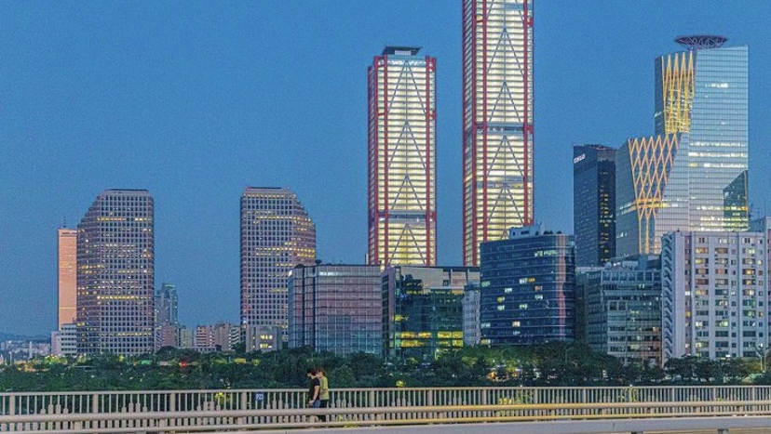
Korea’s culture –Let’s go trip

Slide 26
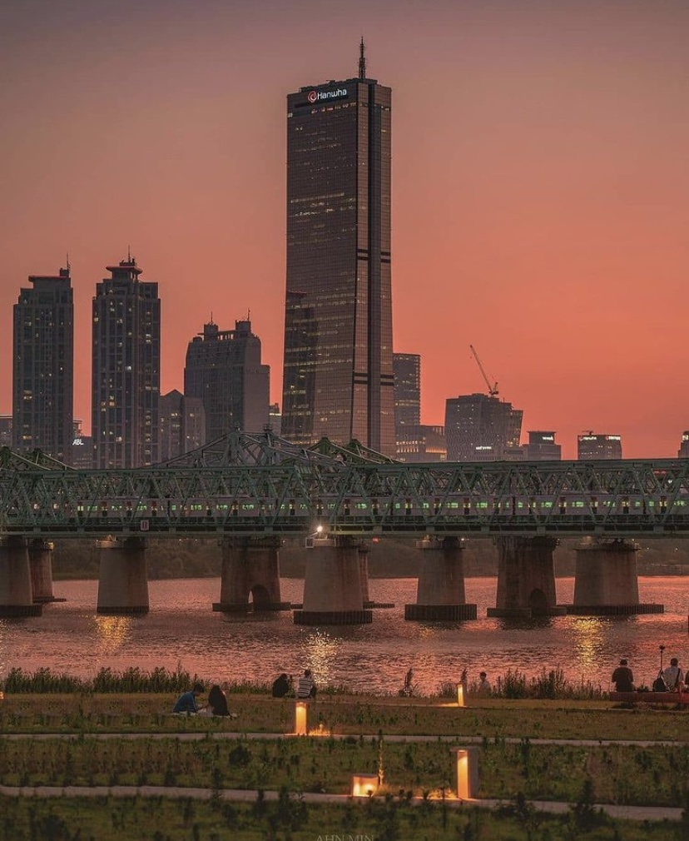
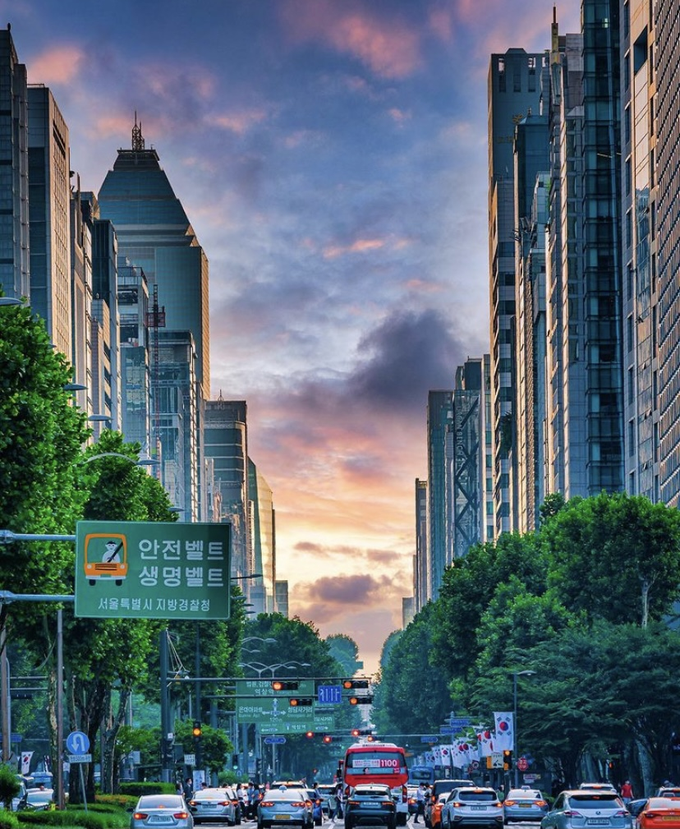
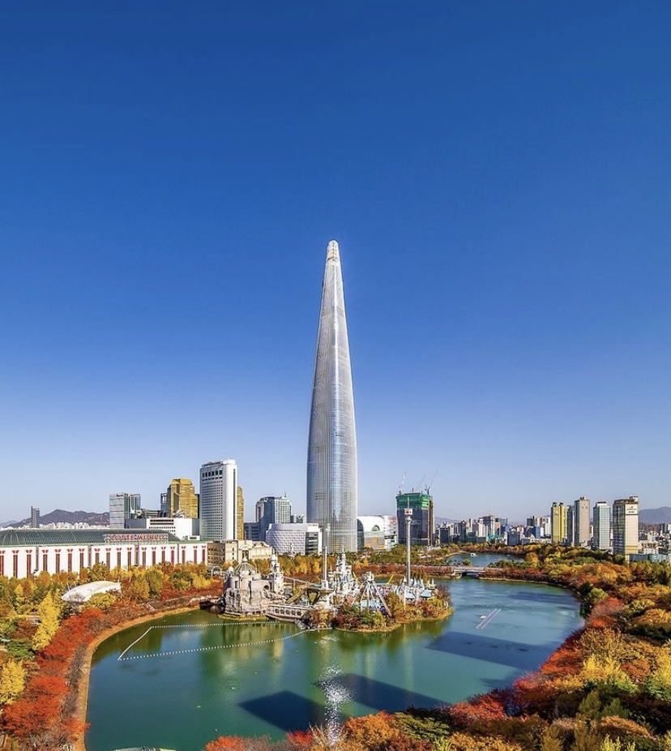
SEOUL

Slide 27
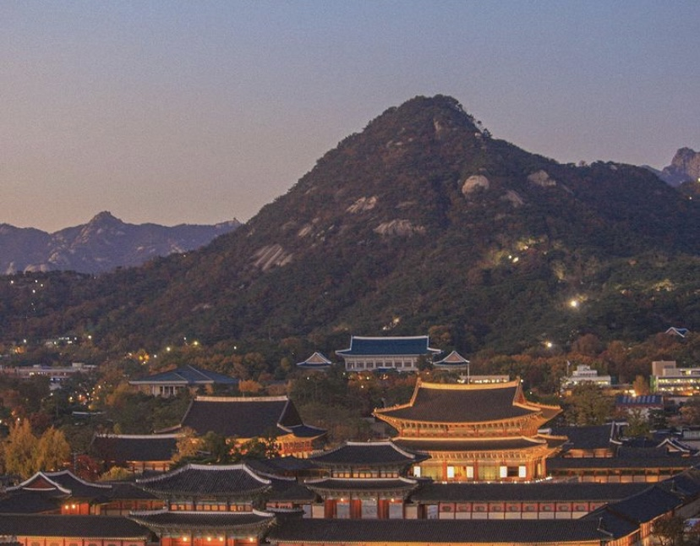
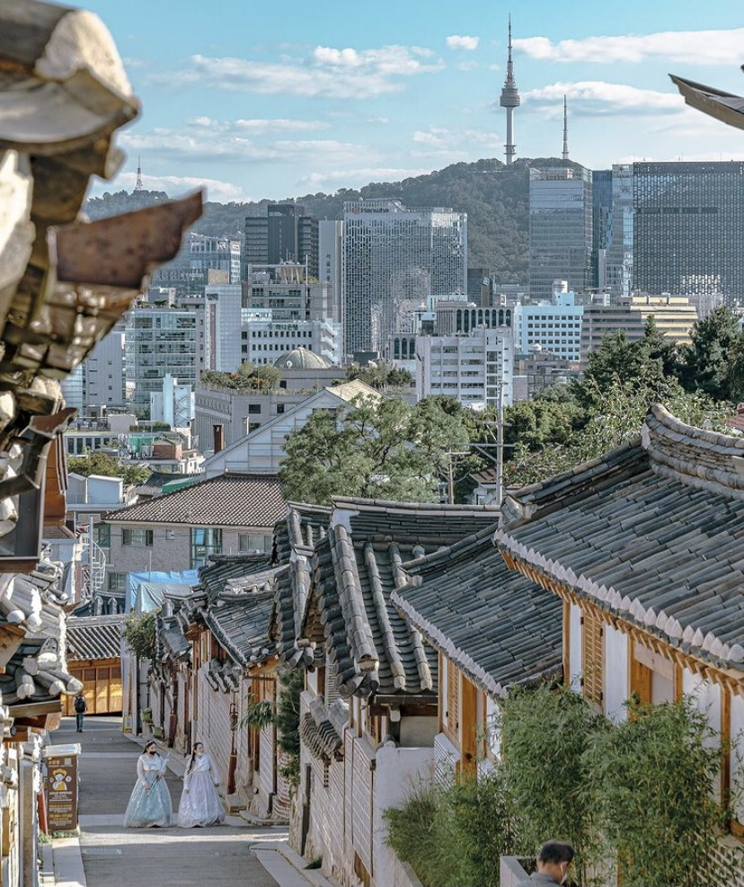
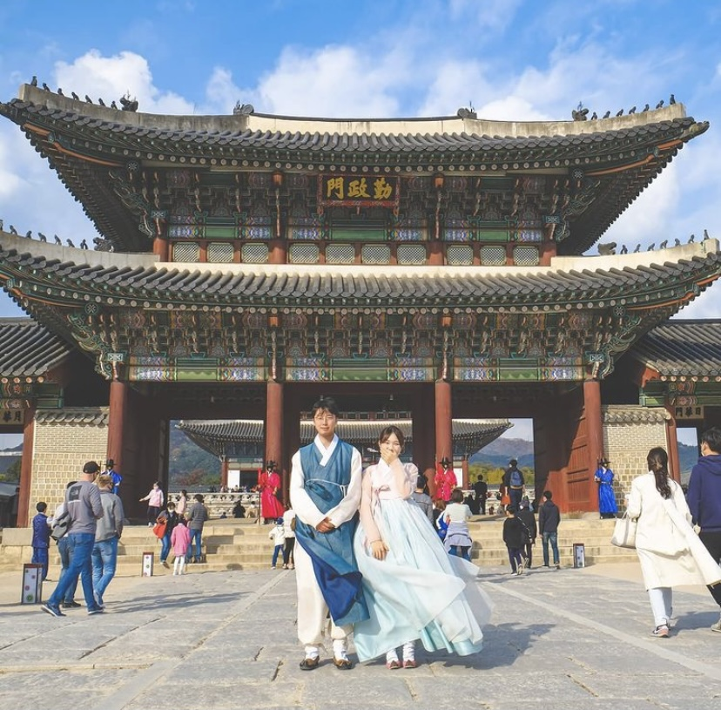

Slide 28
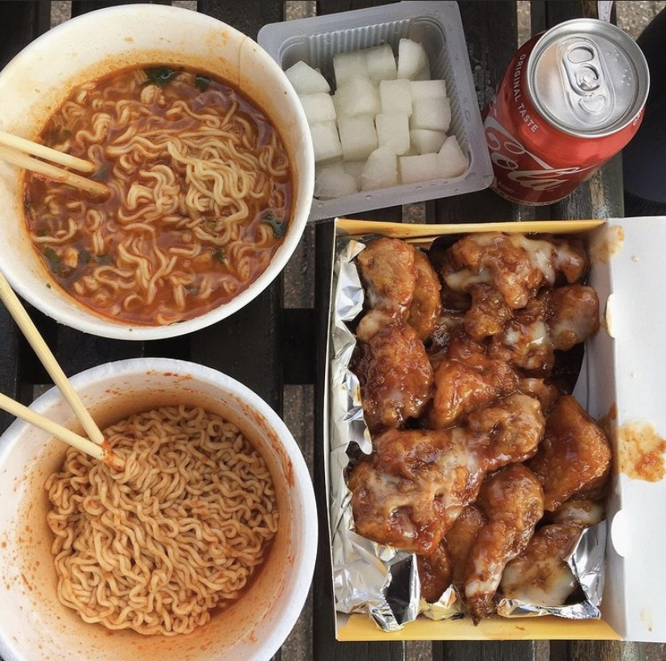
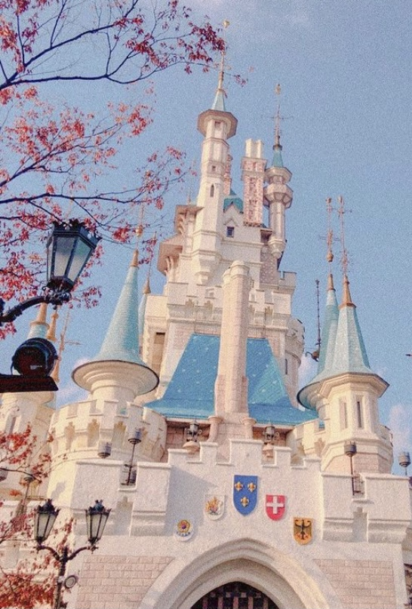
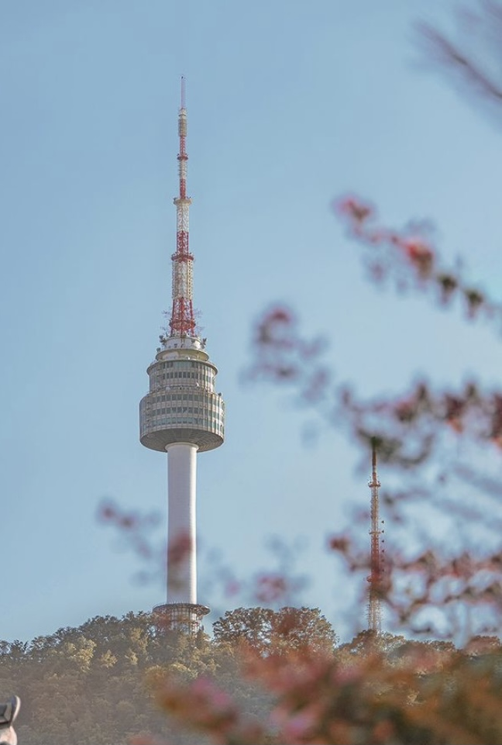
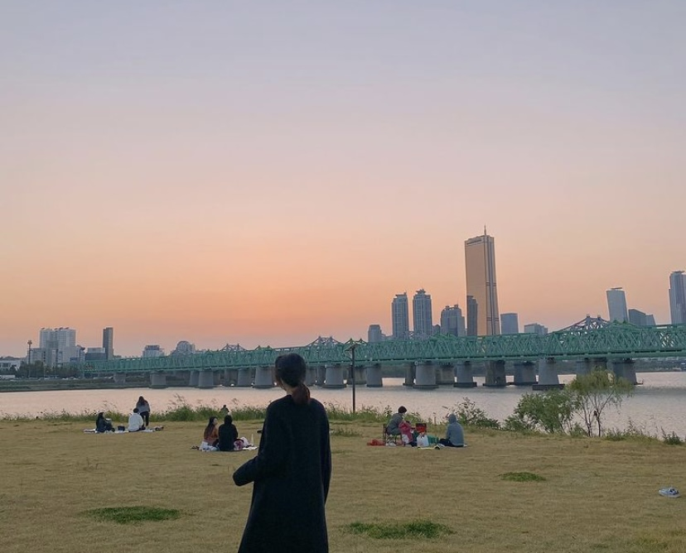

Slide 29
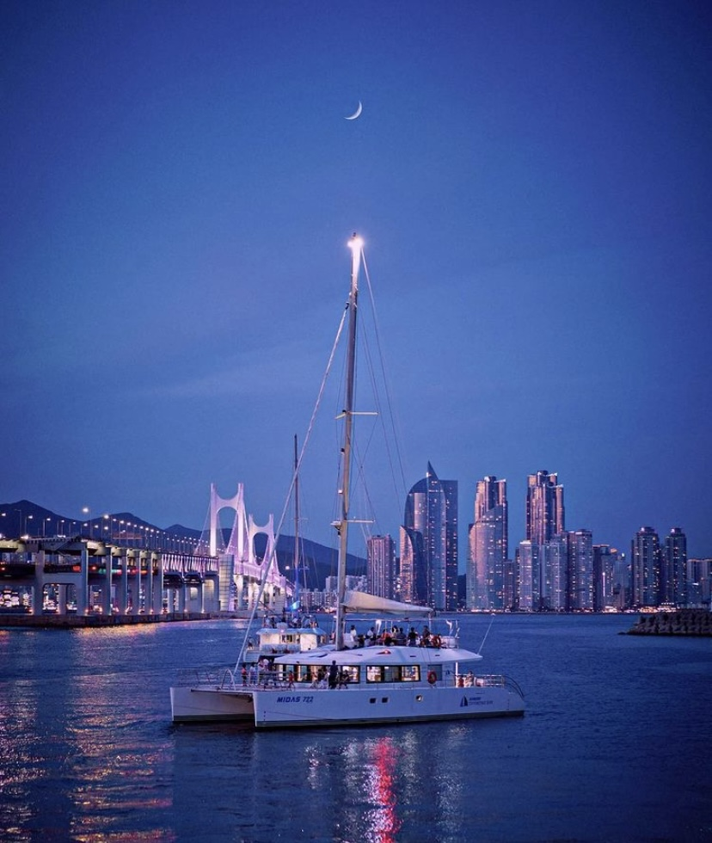
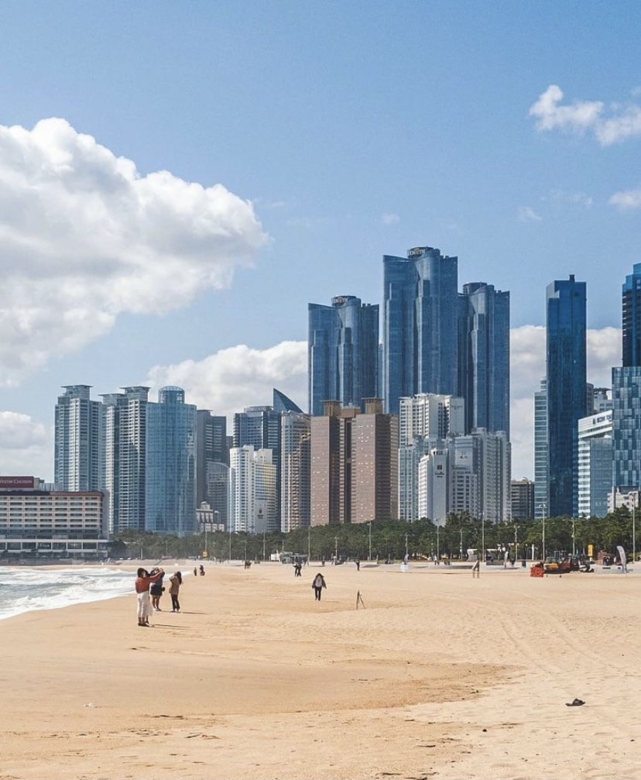
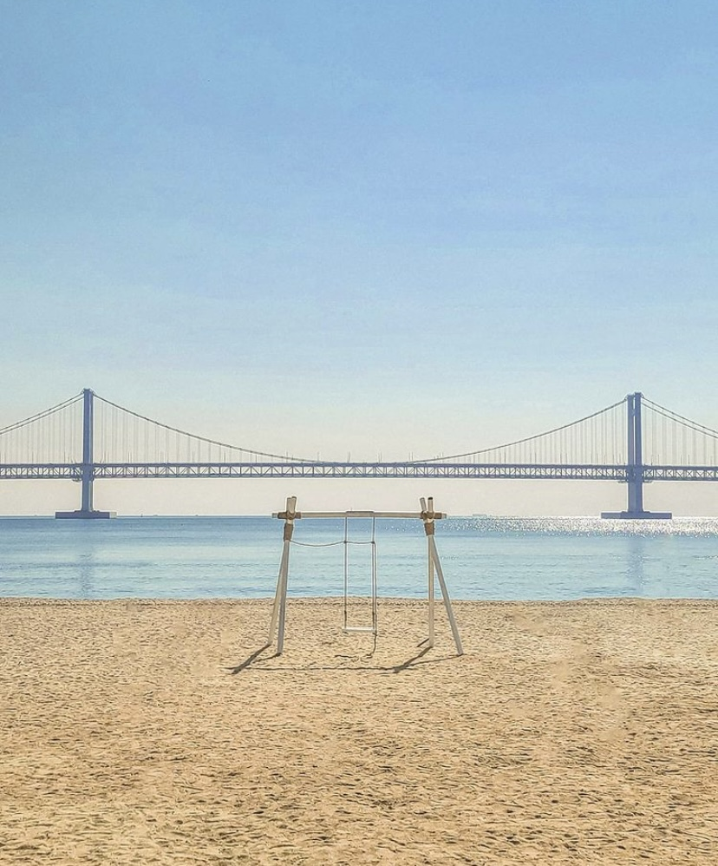
BUSAN

Slide 30
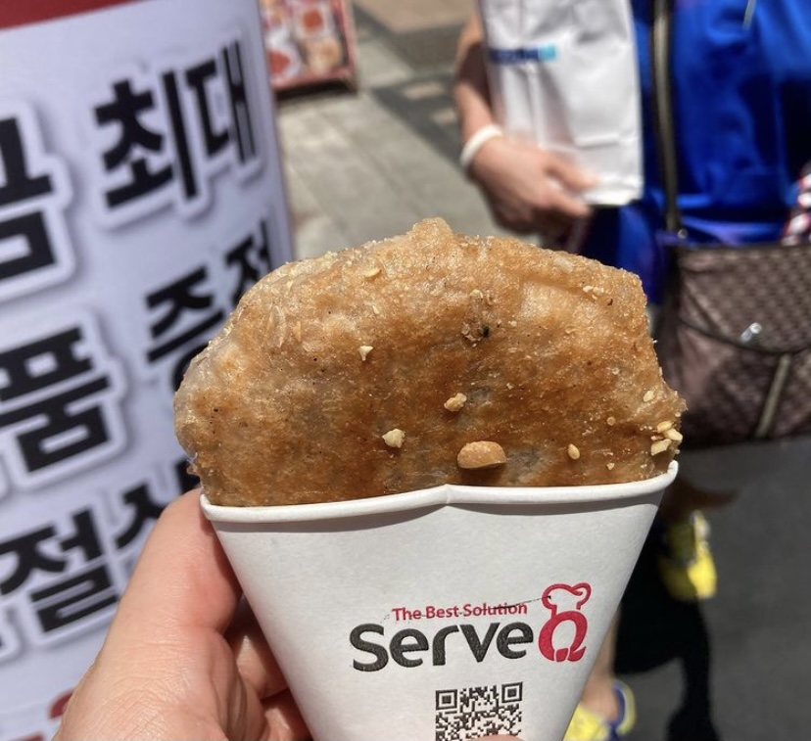
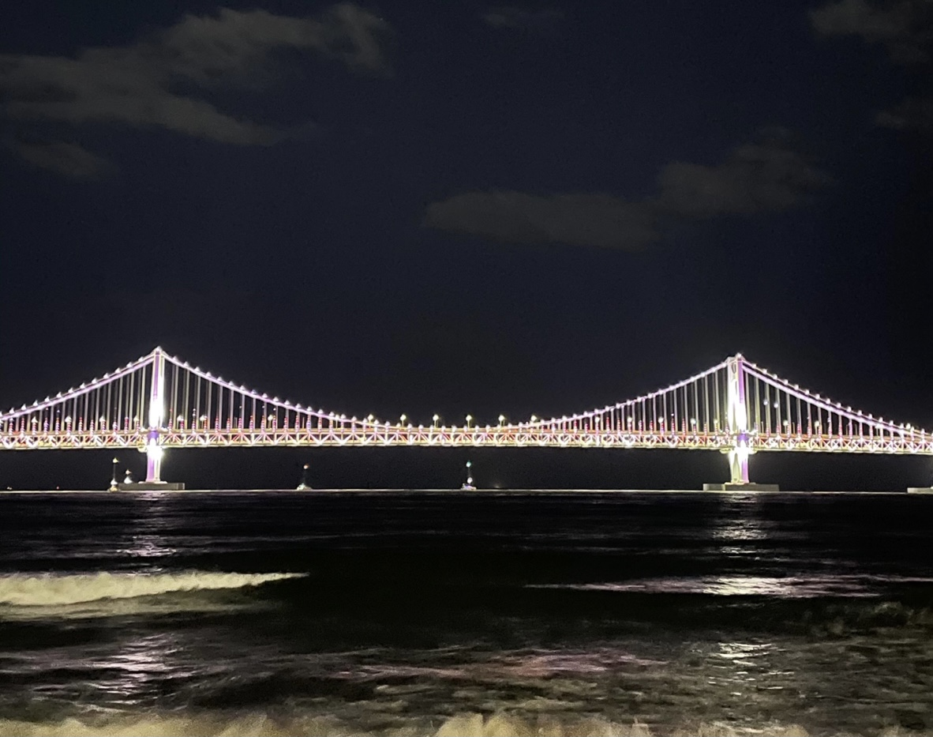
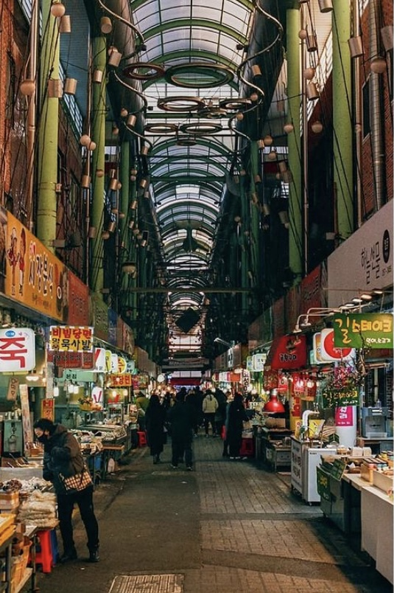
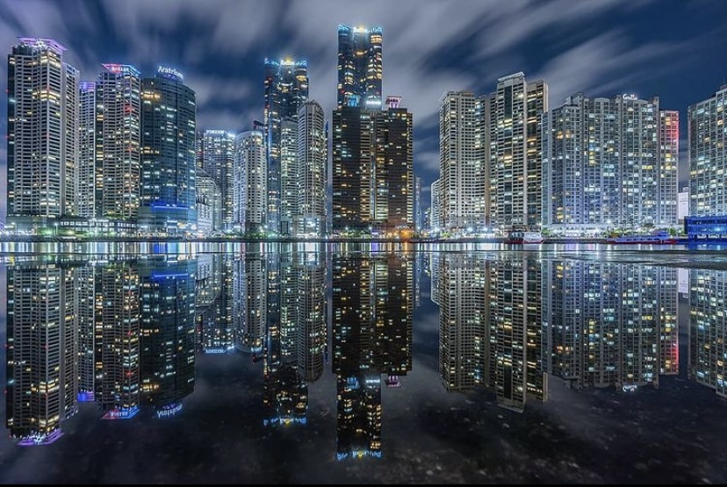
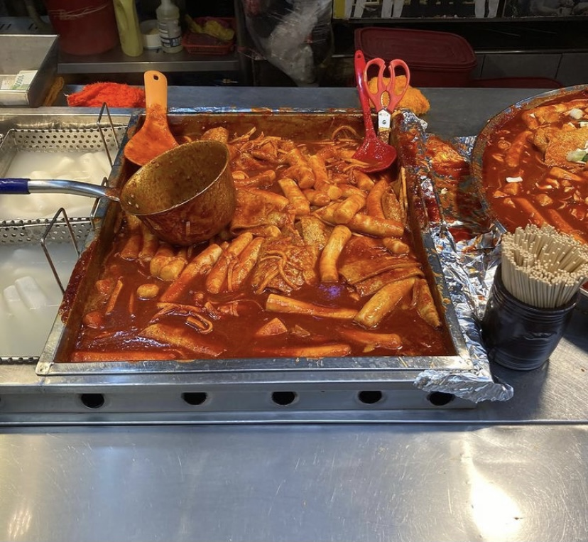

Slide 31
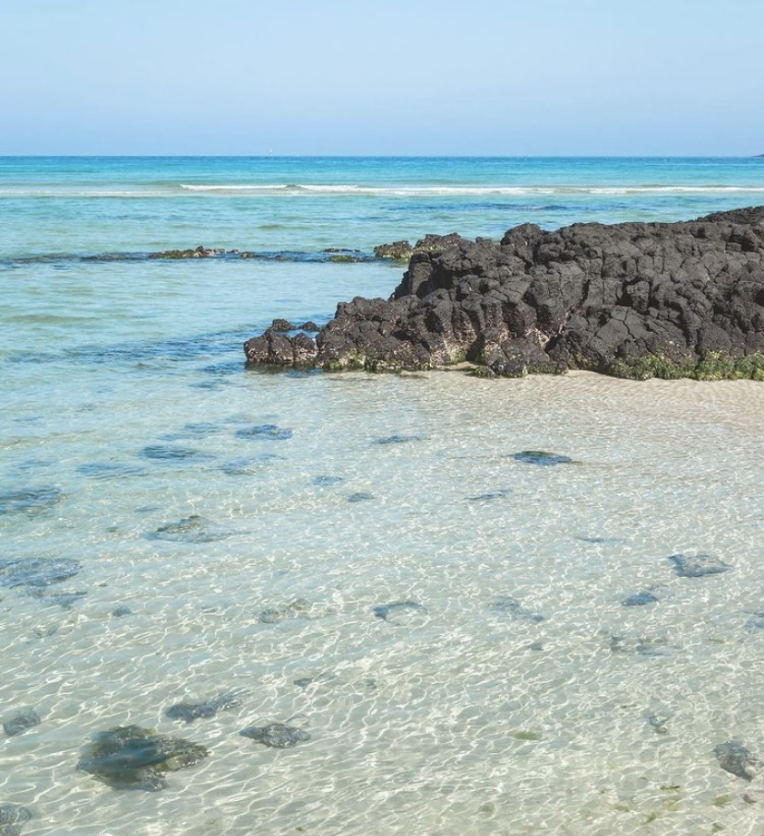
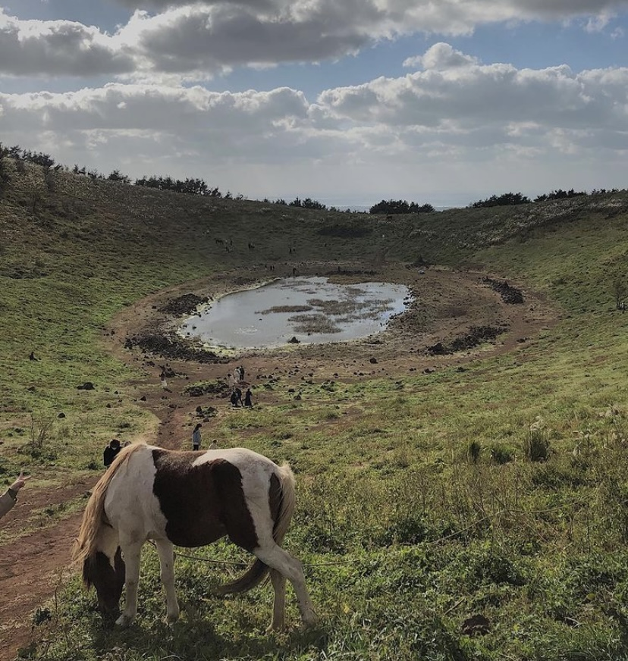
JEJU-DO (island)

Slide 32
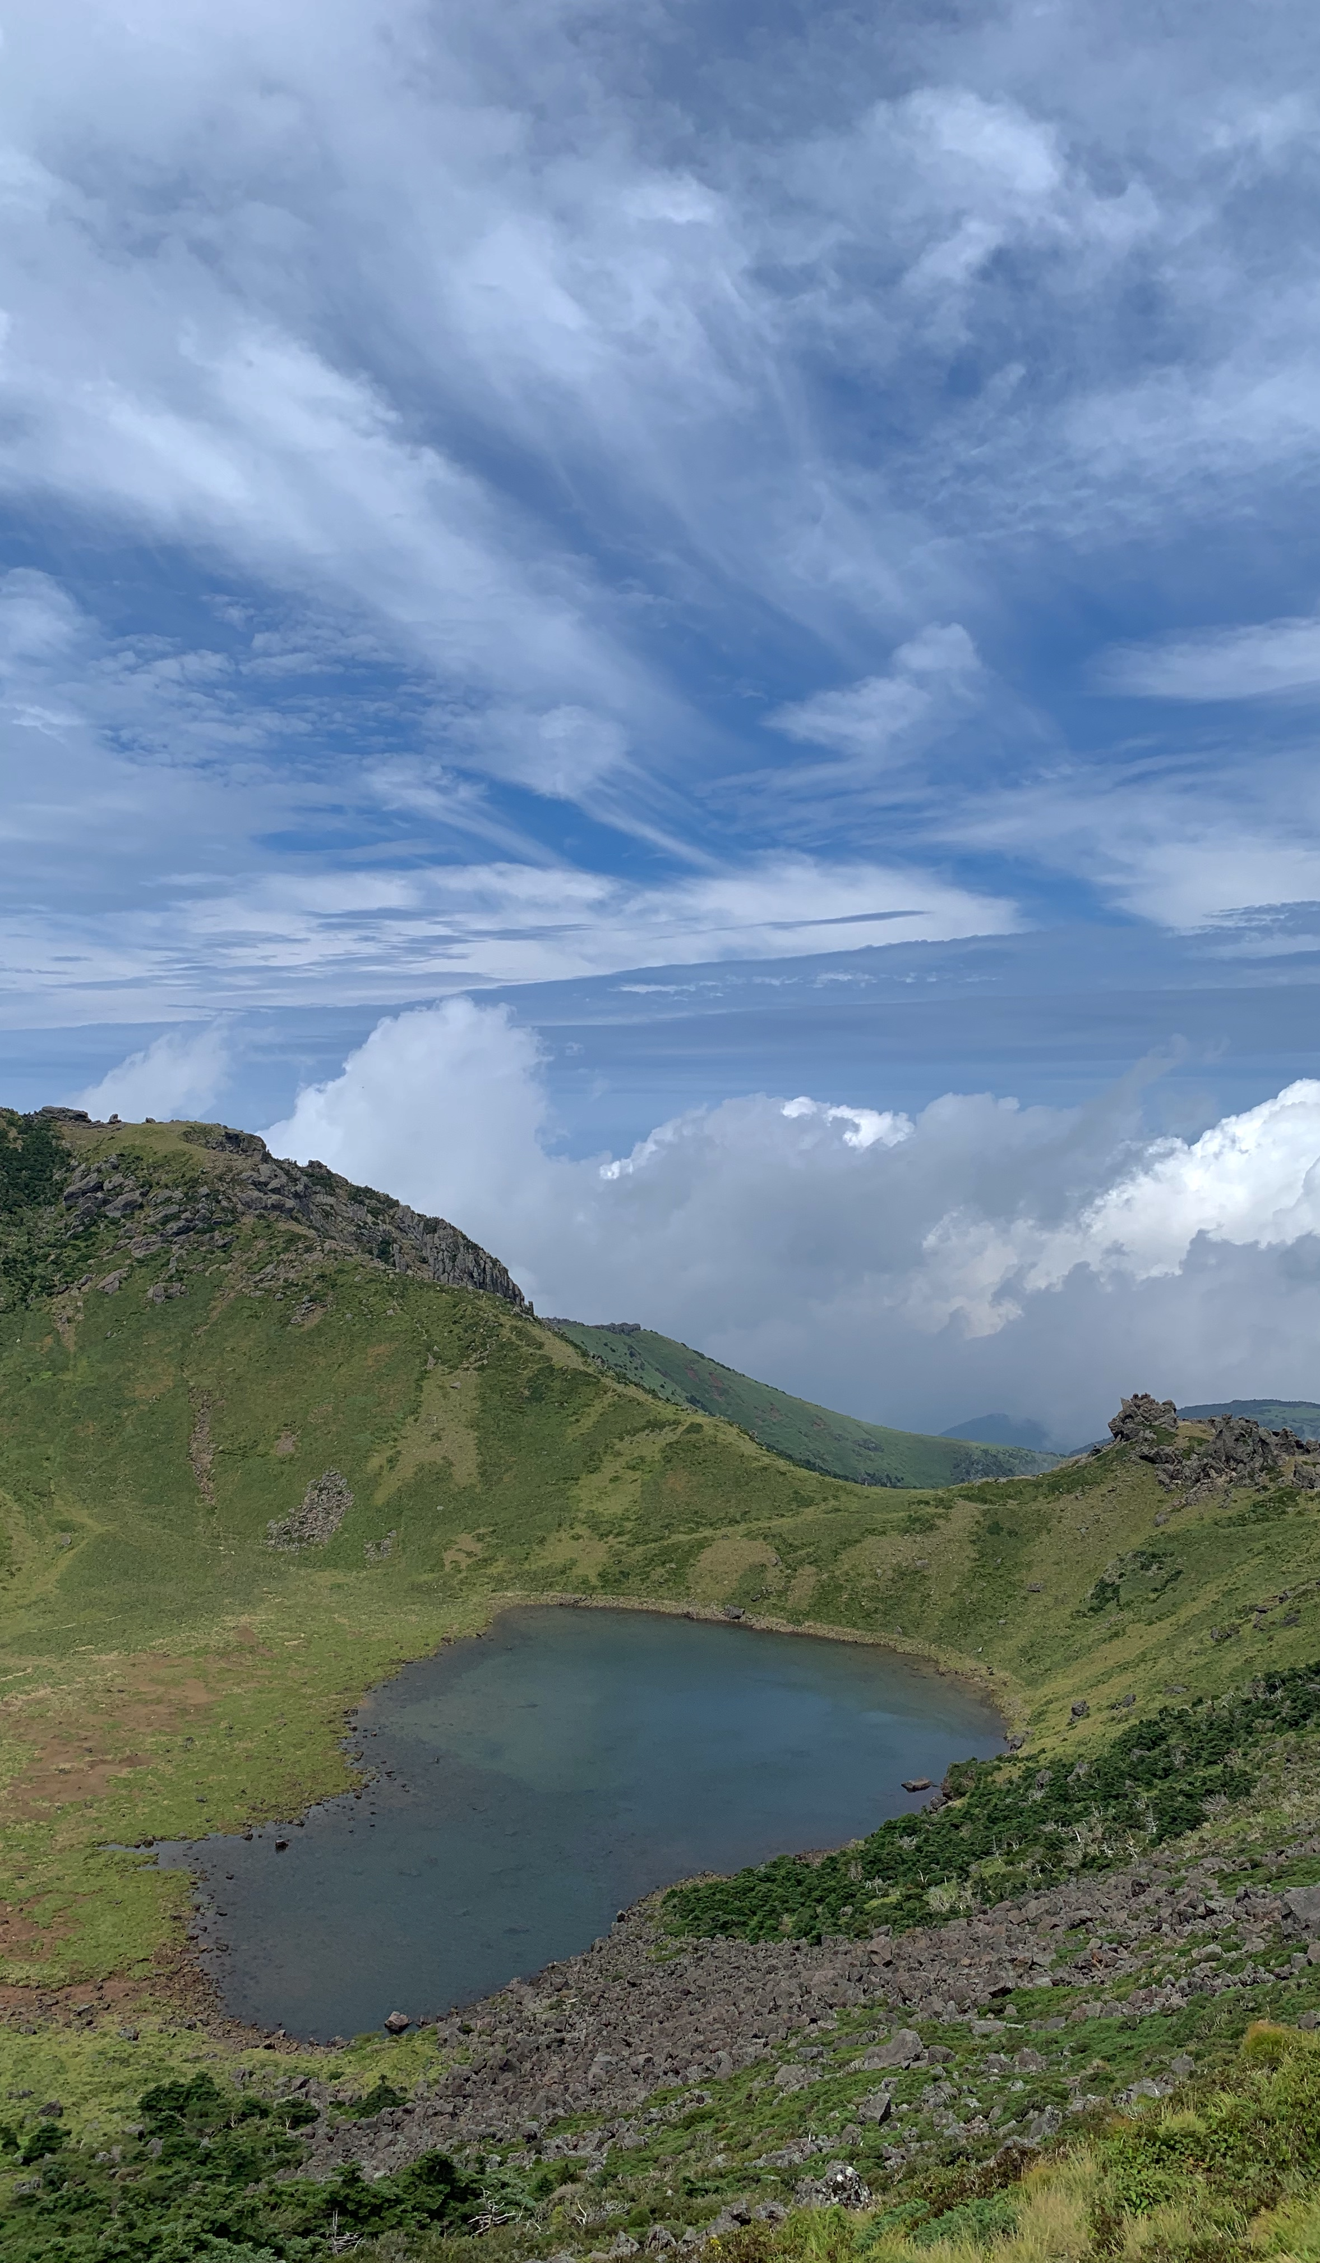
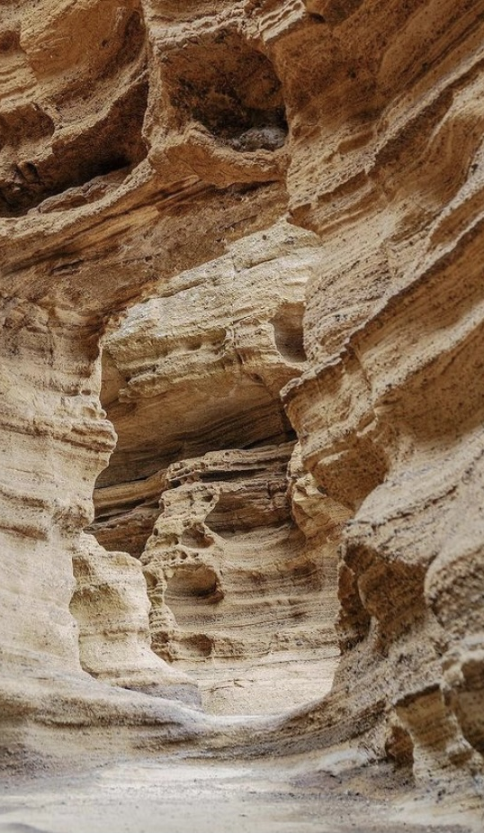
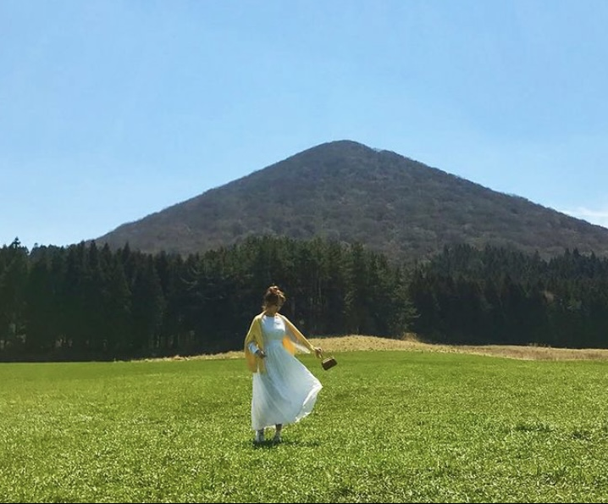
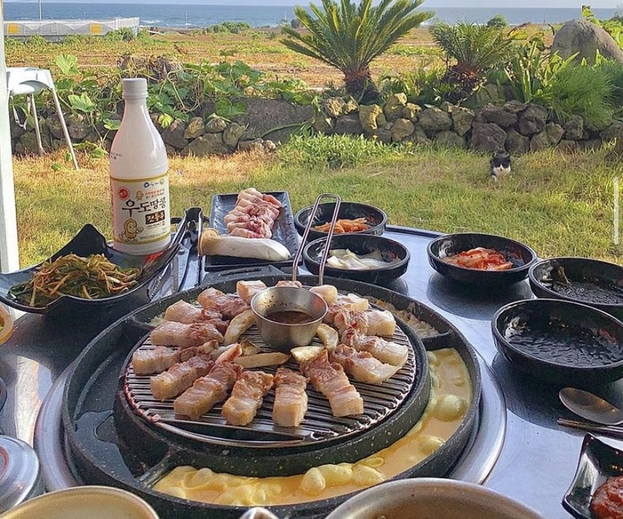

Slide 33
Thank you

