Slide 1
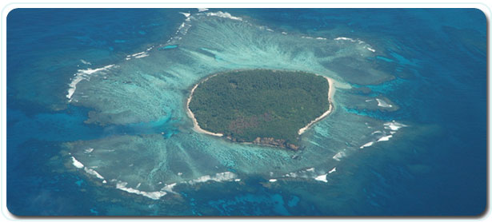
KINGDOM OF TONGA
KECLÍKOVÁ Barbora, 2.ročník UZ-AJ, Brno 2009

Slide 2
Outline
1)Geography
2)History
3)Politics
4)Economy
5)Demography
6)Interesting facts

Slide 3
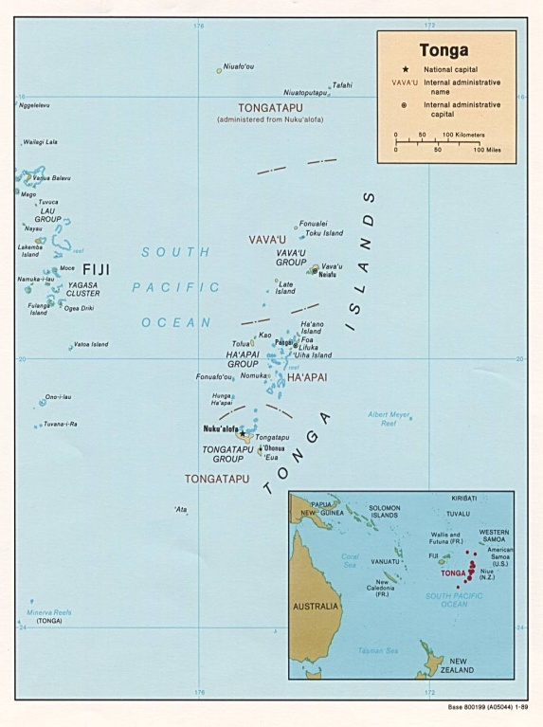
1) Geography
South Pacific Ocean
176 islands, 36 inhabited, 748 km²
Vava´u, Ha'apai , Tongatapu,
´Eua, Niuas
national capital: Nuku´alofa
subtropical climate
limestone base
cyclones , earthquakes and volcanic activity

Slide 4
2) History
Name - from the word Tongahahako
The first settlers – Lapita people (1000 B.C.)
17th century – first European explorers
1773 James Cook – the Friendly Islands
19th century – civil war
1845 – Tonga united into a kingdom
1900-1970 – a British protected state
1970 till now – Commonwealth of Nations

Slide 5
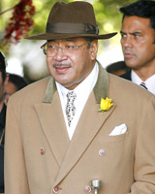
3) Politics
constitutional monarchy
George Tupou V (from 2006)
powerful nobles X rest of the country
inequality between men and women
pro-democracy movement
supported US action in Iraq
mid-2003 – licensing and limiting
freedom of the press
commoner = občan

Slide 6
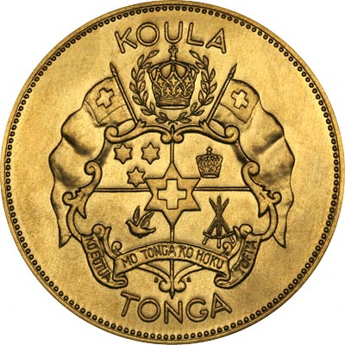
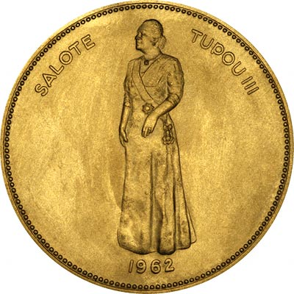
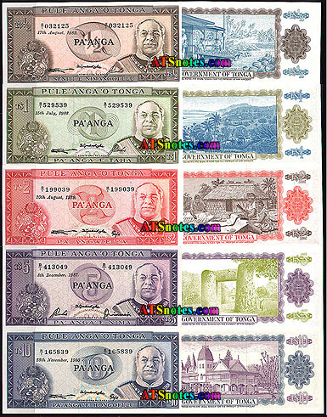
4) Economy
large non monetary sector
monetary sector – nobles and royals
dependence on population living abroad
plantation and subsistence agriculture
Development plans: growing private sector, developing tourism,…
monetary = peněžní

Slide 7
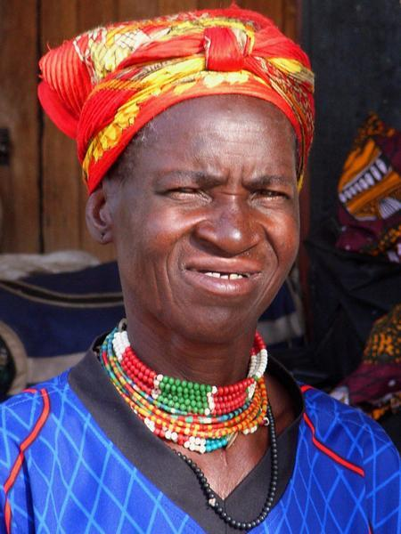
5) Demography
70% - on Tongatapu
98% Tongan people, 1,9% Europeans, 0,1 Chinese
Methodists, Catholic minority
Tongan language, English
Hi=Malo e lelei; Yes=Io; Bye= Alu a
70% of Tongan women (15-85)
are obese

Slide 8
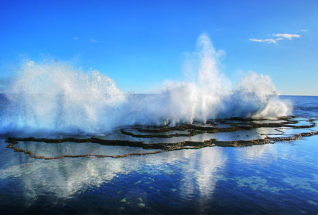
6) Interesting facts
average annual growth of population = 2,0%
Tongan king – the world´s heaviest monarch (160 kg)
Niuafo´ou island = Can island
significant dispersion in other countries
achievements in rugby

Slide 9
Summary
kingdom in the south Pacific Ocean
firstly settled – 1000 B.C.
constitutional monarchy
income dependant on support from abroad
most of the pop. – on the main island Tongatapu
the world´s fattest population

Slide 10
Thank You for Your Attention

