Slide 1
G7481
Magnetometry in geology and archaeology
Lecturer: Vojtěch Šešulka
spring 2010

Slide 2
Geophysical methods
magnetometry
gravimetry
seismic
geoelectric
georadar
geothermic

Slide 3
Magnetic method
of geophysical survey
principal: measuring the Earth‘s magnetic field and its anomalies
observed units:
- total magnetic field T [nT]
- magnetic field gradient ΔT [nT/m]
- magnetic susceptibility κ [n×10e-4]

Slide 4
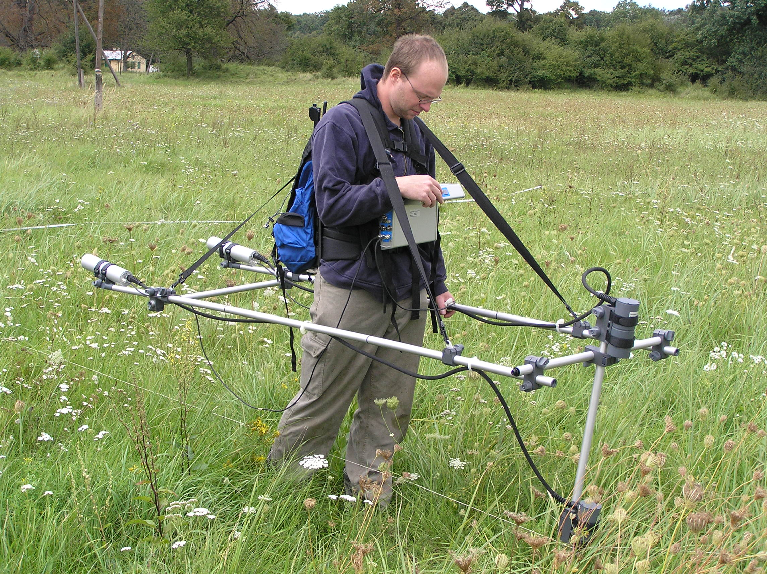
Cesium magnetometer
SM-5 Navmag (Scintrex, Kanada)

Slide 5
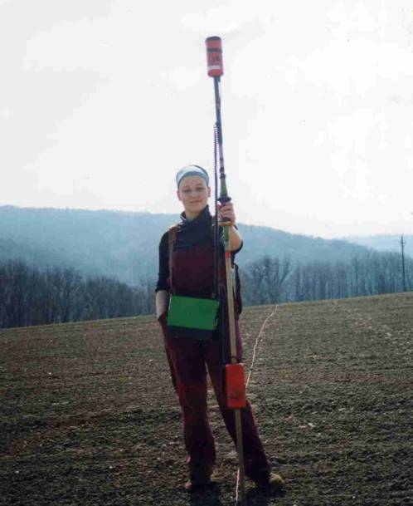
Modes of measurements
gradiometer
(magnetic field gradientΔT [nT/m])
variometer
(total magnetic fieldT [nT] )
Proton magnetometer PMG-1 fa
in gradient mode,
Geofyzika Brno

Slide 6
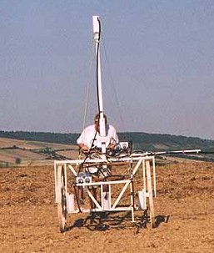
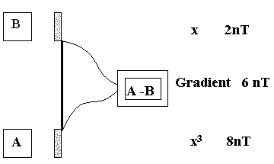
Gradiometer
two vertically placed sensors
prevents the magnetic field variations error
better for shallow objects and structures

Slide 7
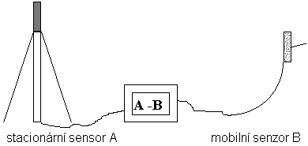
Variometer
data collected with only one sensor
Earth‘s magnetic field variations error → neccesity of correction

Slide 8
Application
of magnetic method
geological structures mapping
mapping buried ferrous metal objects and other burned structures

Slide 9
Magnetometry
in archaeology
suitable:
-countersunk objects
-fireplaces, ovens, furnaces, …
-line objects (ramparts, trenches, palisades, …)
-identification of metal objects
-detection of landfills and terrain formations
less suitable:
-communications
-stone-made object (if is used the stone from the bedrock of the site)

Slide 10
Measurements types
testing measurements
(suitability of the method)
areal measurements
(several days long measurements)
detail measurements
(the most interesting objects)

Slide 11
Presumption
of successful project
physical contrast between the object and surroundings
good state of objects insitu
size, shape, orientation and count of objects
relief and vegetation
absence of structures, which are not in our interest
climatic conditions during the measurement
suitable combination of several geophysical methods

Slide 12
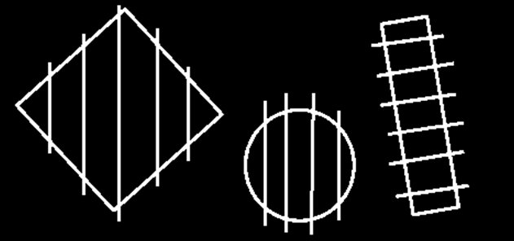
Magnetic method
of the geophysical survey
the measurement runs in squares (often 50×50 m)
suitable profiles orientation to the measured structure (best in N-S direction)
density of recorded data up to 0,5×0,15 m (depend on our interest)

Slide 13
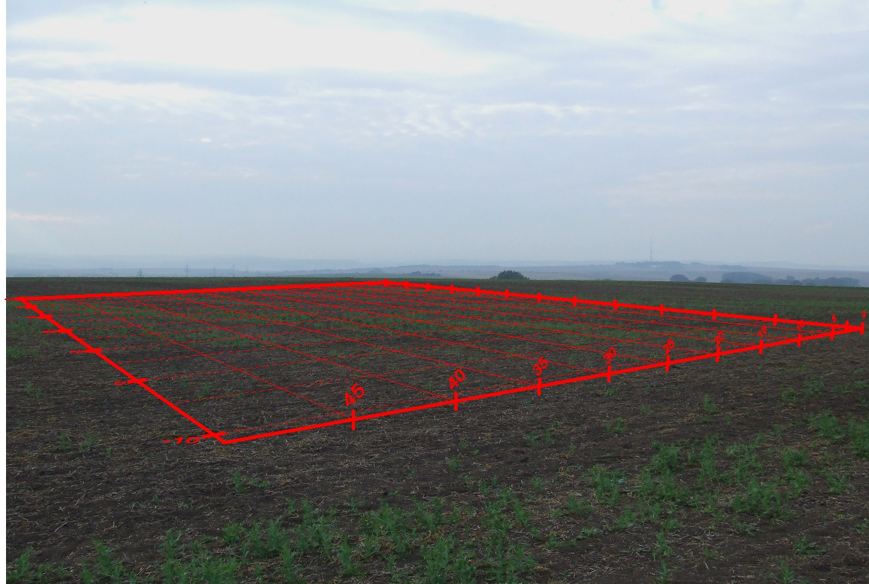
Magnetic method
field work

Slide 14
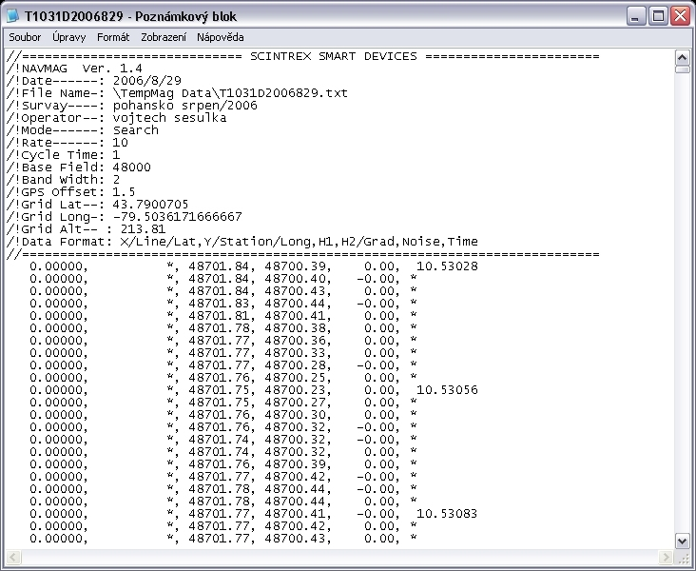
Magnetic method
interpretation

Slide 15
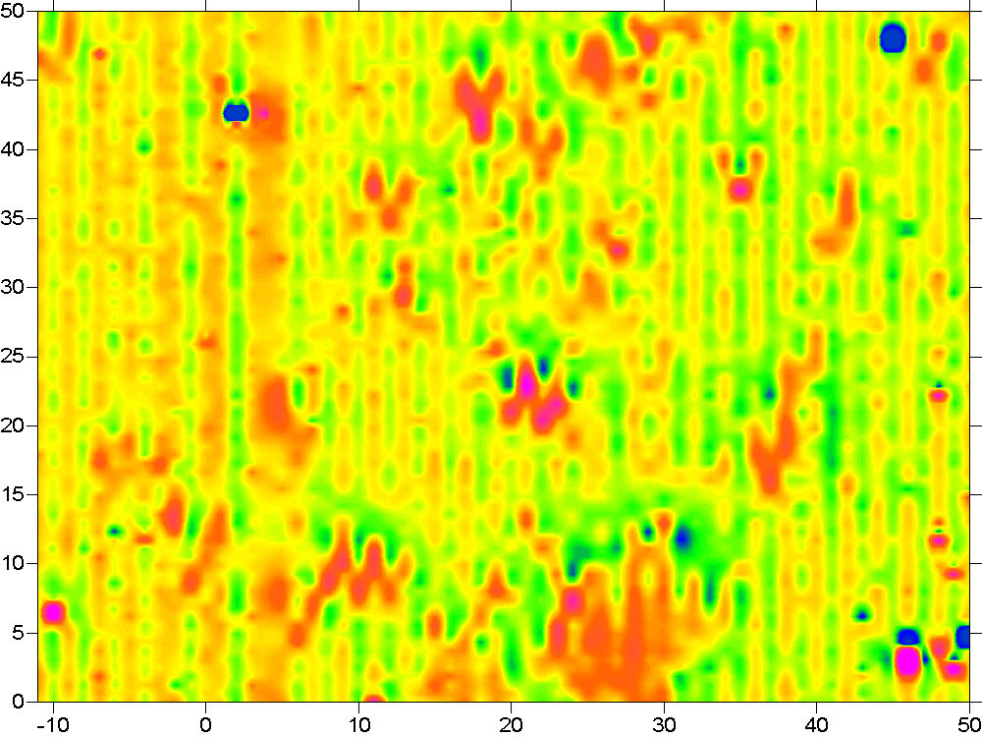
Site: Němčice nad Hanou
Apparature: SM-5 Navmag (Scintrex, Canada)
Author: V. Šešulka
19/09/2006

Slide 16
gradient T [nT/m] on the profile10 before (left) and after (right) the median correction

Slide 17
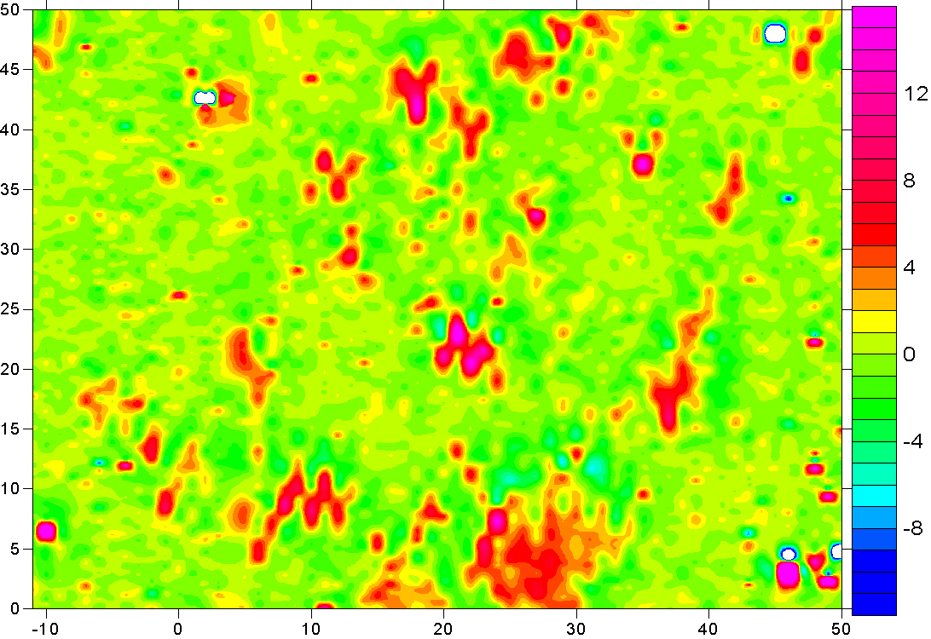
nT/m
Site: Němčice nad Hanou
Apparature: SM-5 Navmag (Scintrex, Canada)
Author: V. Šešulka
19/09/2006

Slide 18
Magnetic method
interpretation
Site: Pohansko near Břeclavi
Apparature: Smartmag – 4g
(Scintrex, Canada)
Author: R. Křivánek
19/09/2006

Slide 19
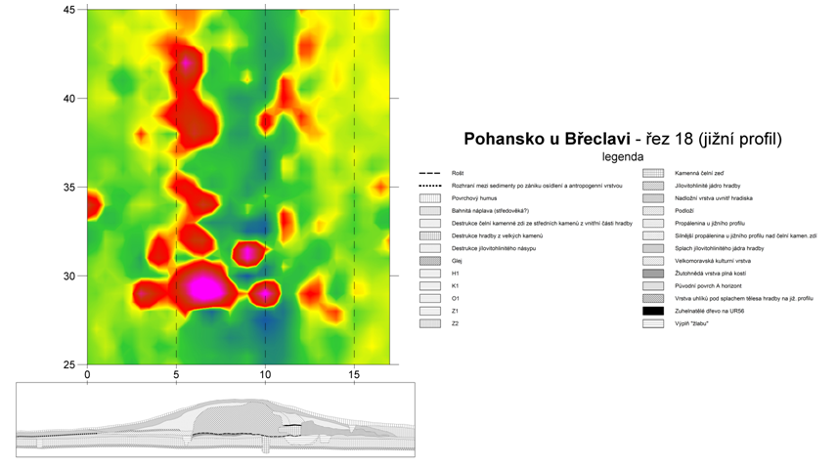
Magnetic method
interpretation
Milo & Šešulka – Pohansko near Břeclavi 28. 3. 2007
Comparison between the measured data and the cross-section across the rampart

Slide 20
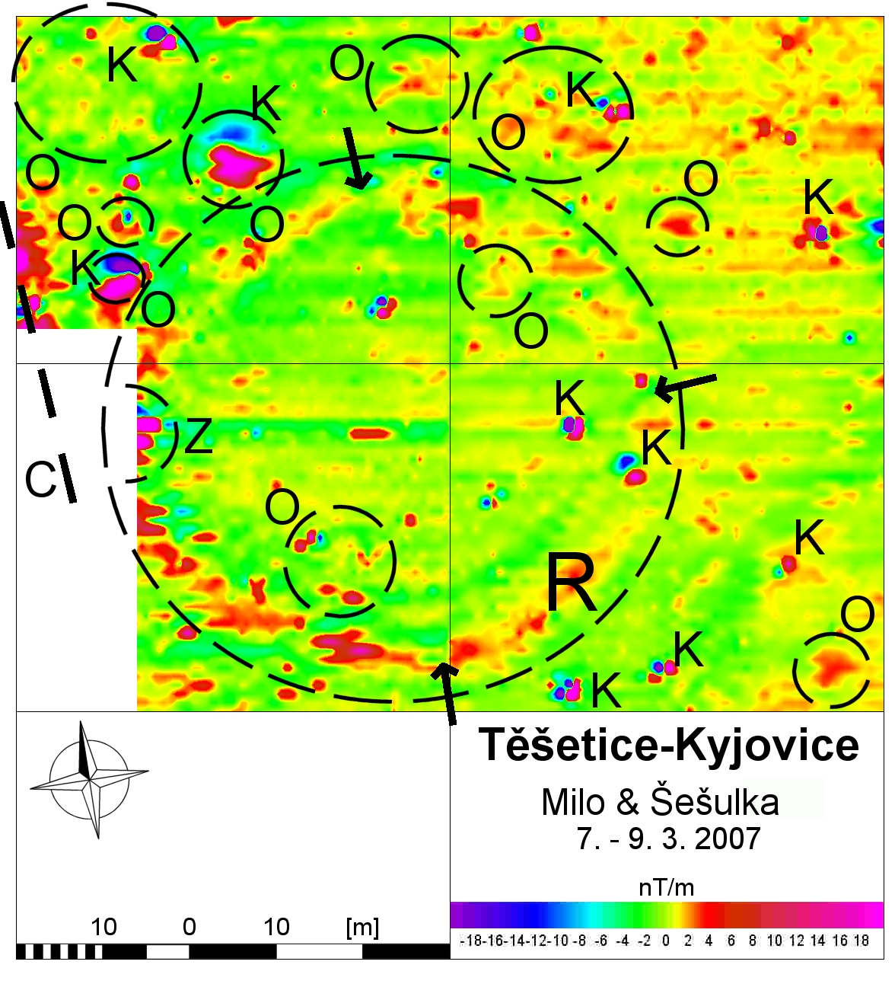
Milo & Šešulka
Těšetice-Kyjovice 7. 3. 2007
(R – roundel; O – object; K –metal; C –path; Z – earth-house)

Slide 21
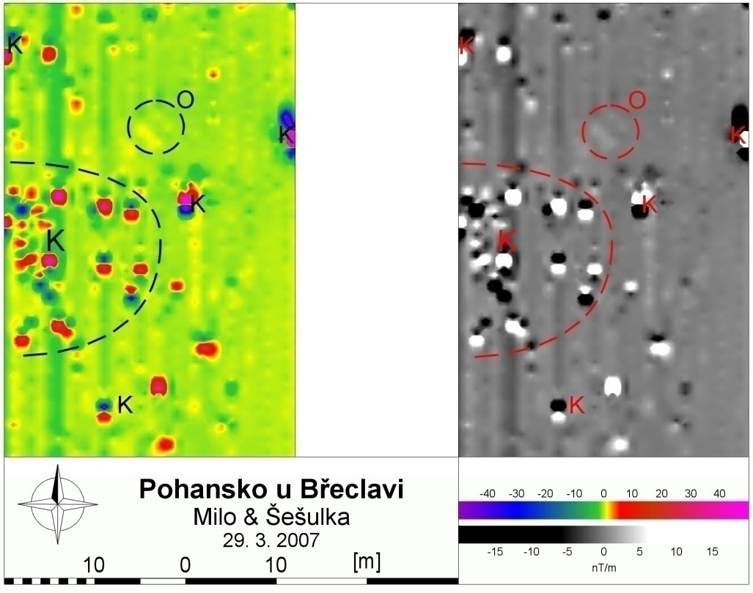
Magnetic method
interpretation
Milo & Šešulka – Pohansko near Břeclav 29. 3. 2007
(O - object; K – metal)

Slide 22
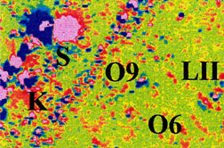
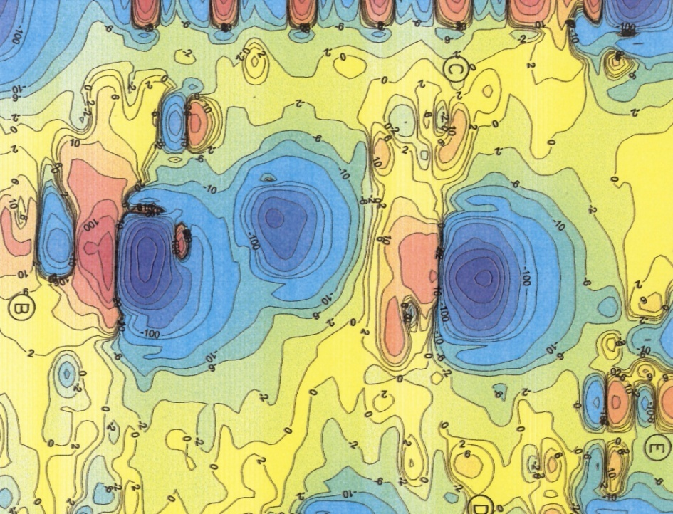
Magnetic method
interpretation
Site: Pohansko near Břeclav
Apparature: Smartmag-4g (Scintrex, Canada)
Author: R. Křivánek
21/08/2001
T_{z} gradient map (Fous et al. 2000)

Slide 23
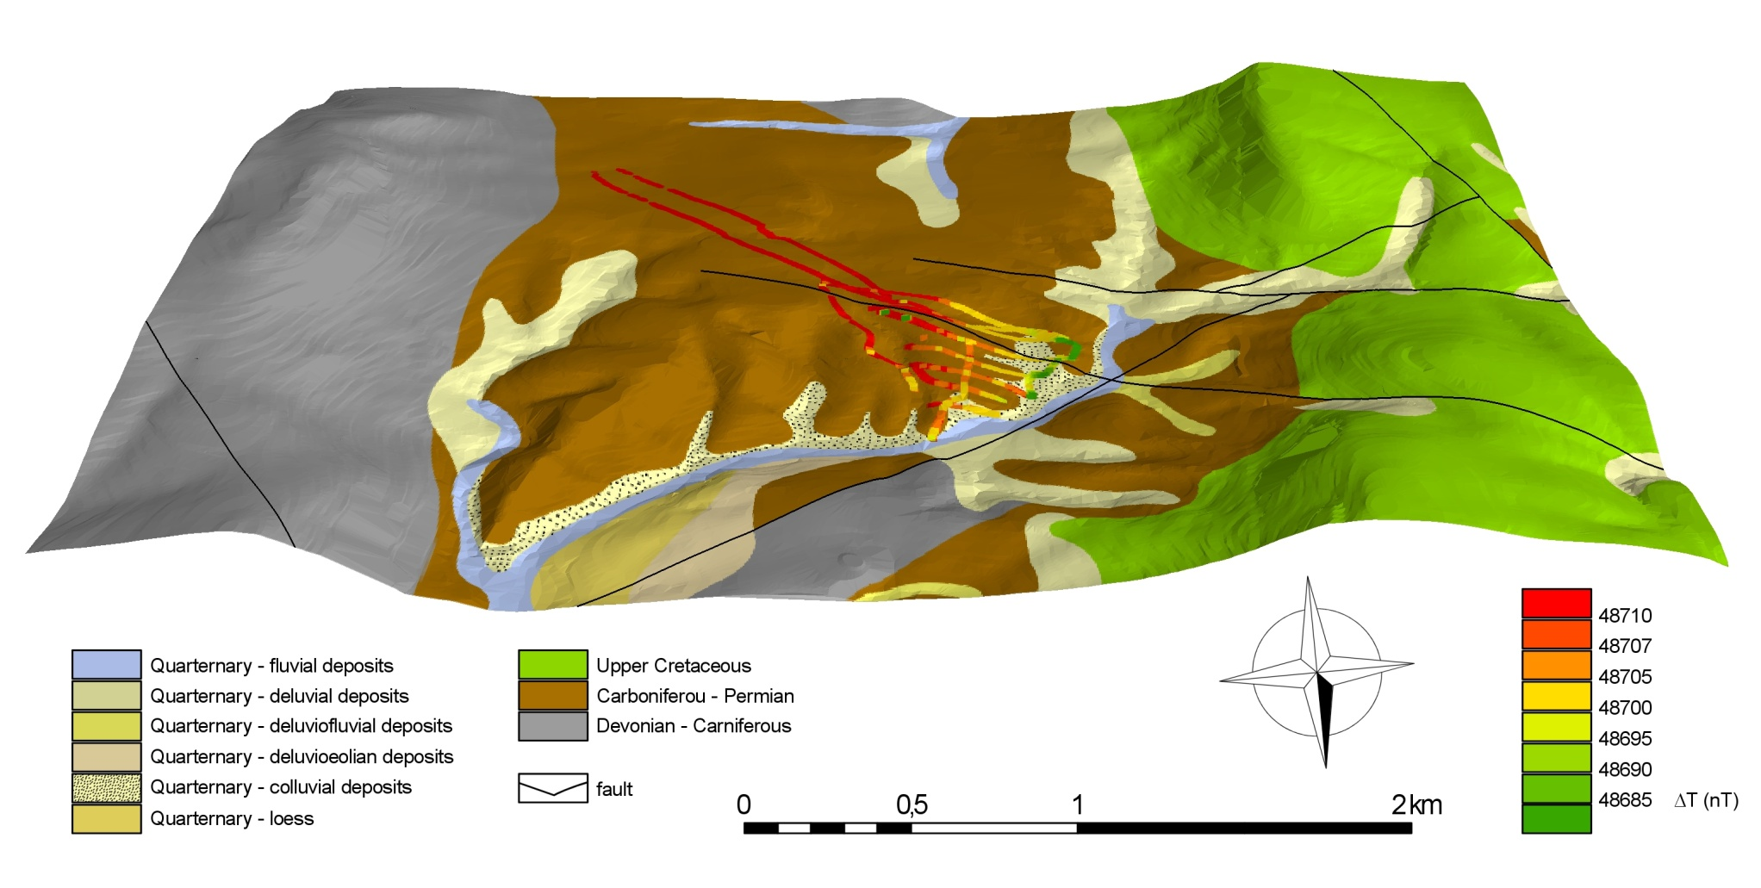
Magnetic method
interpretation
Site Přední Arnoštov, author V. Šešulka

Slide 24
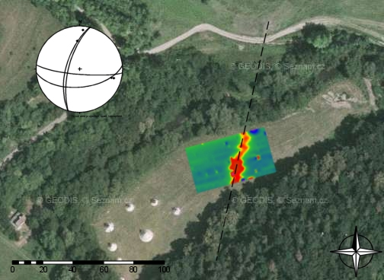
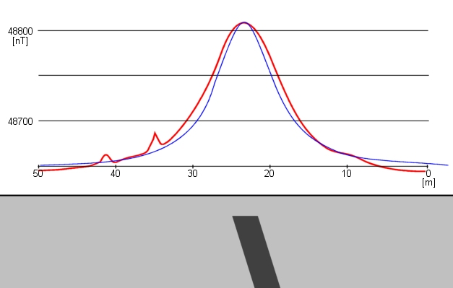
Magnetic method
interpretation
Site Budkovice, author V. Šešulka

Slide 25
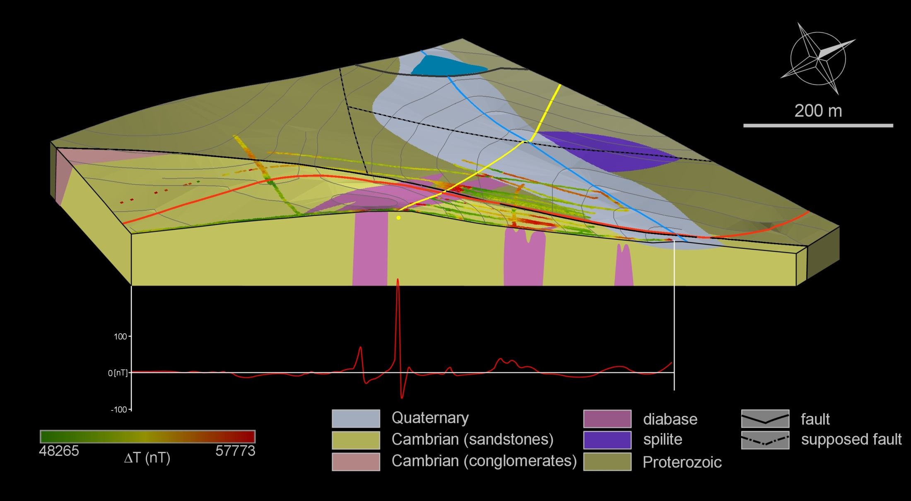
Magnetic method
interpretation
Site Pičín, author V. Šešulka

Slide 26
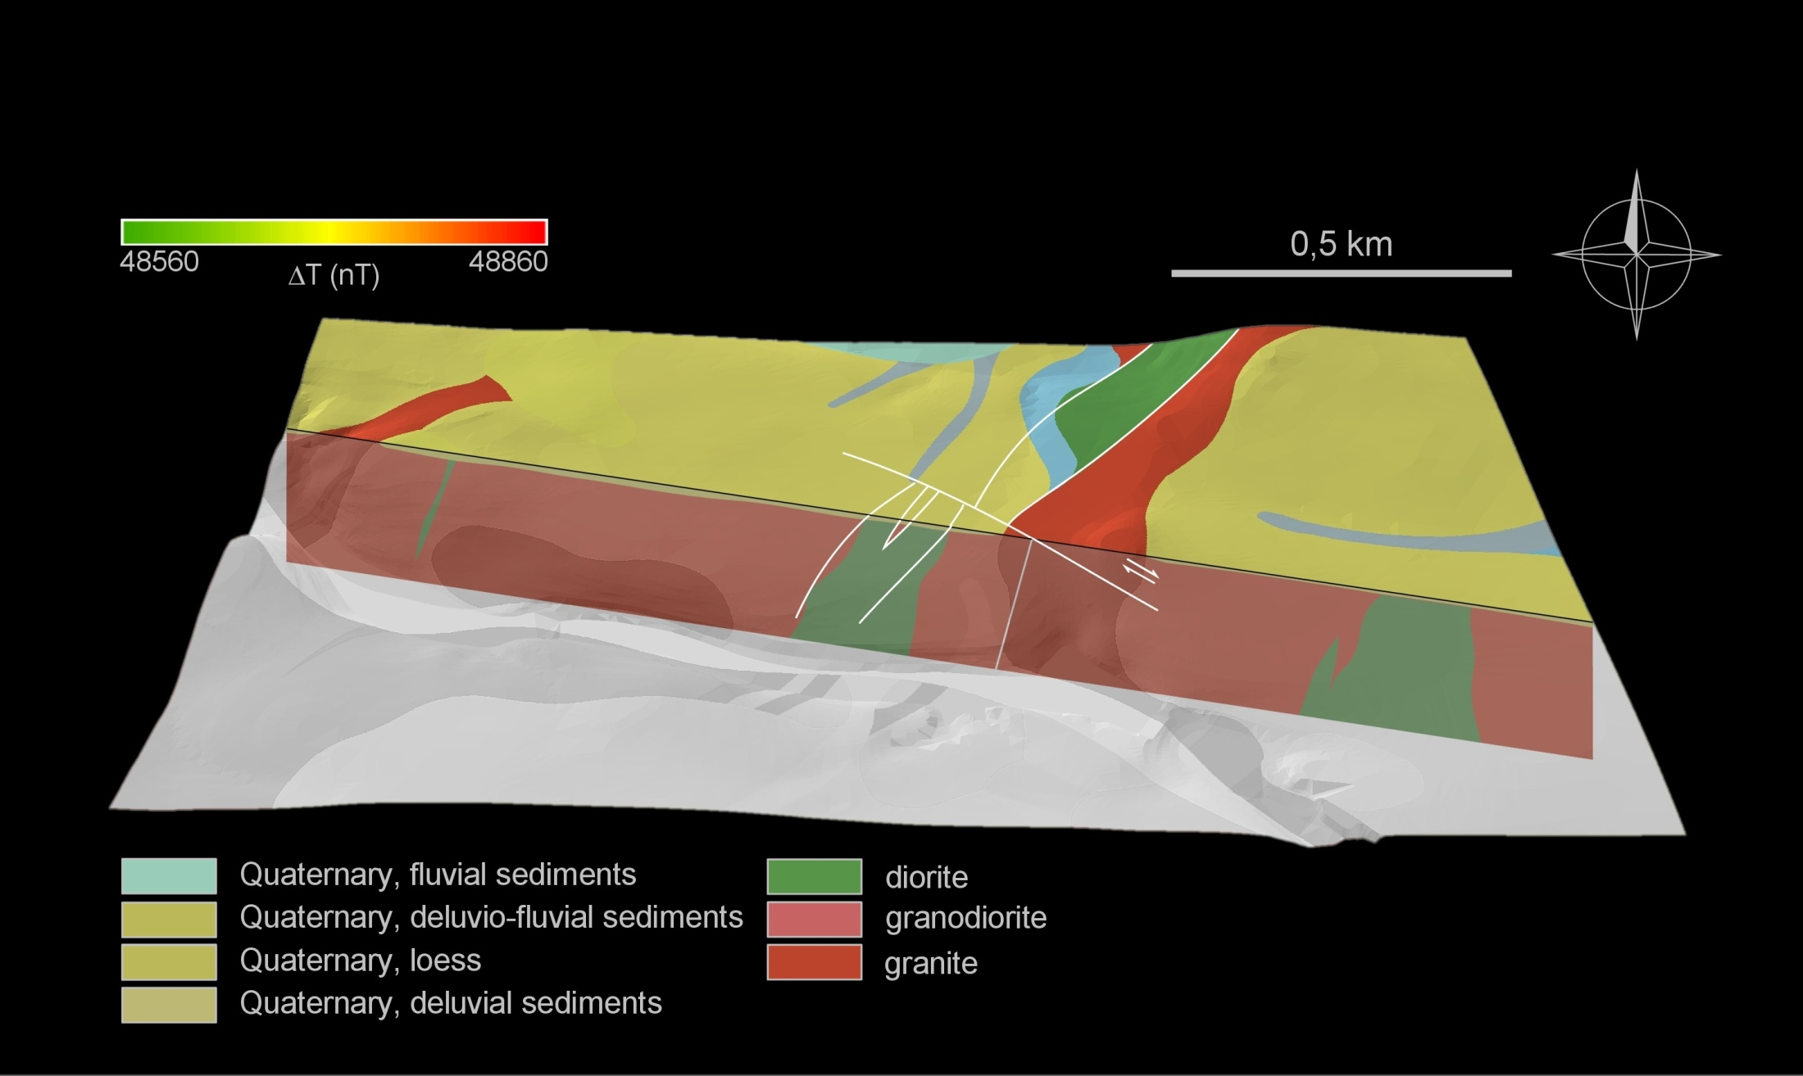
Magnetic method
interpretation
Site Těšetice-Kyjovice, author V. Šešulka

Slide 27
Literature
used and recommended
Fous A., Hašek V. & Záhora R. (2000): Zpráva o archeogeofyzikální prospekci na akci Břeclav-Pohansko. – MS, závěrečná zpráva. Ústav archeologie a muzeologie FF MU v Brně.
Hašek V. & Měřínský Z. (1991): Geofyzikální metody v archeologii na Moravě. – MSV. Brno.
Křivánek R. (2002): Závěrečná zpráva o geofyzikálním průzkumu prováděném na základě HS č. 792/02 na lokalitě Pohansko, okr. Břeclav. – Archiv ArÚ. Praha. č.j. 7486/02.
Křivánek R. (2004): Geofyzikální metody. – In: Kuna M. (ed.): Nedestruktivní archeologie. – Academia. Praha.
Kuna et al. (2004): Nedestruktivní archeologie. – Academia. Praha.

