Slide 1
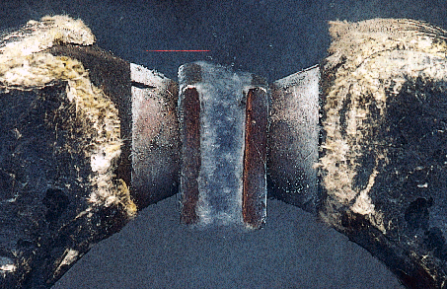
Magnetika

Slide 2
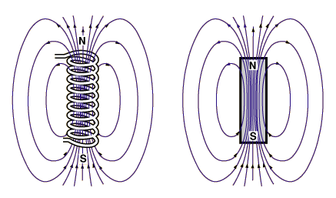
Chování magnetů
v nehomogenním magnetickém poli
μ
μ

Slide 3
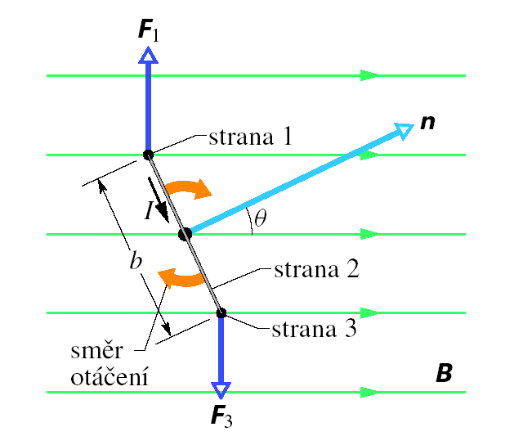
DIPÓL V HOMOGENNÍM POLI

Slide 4
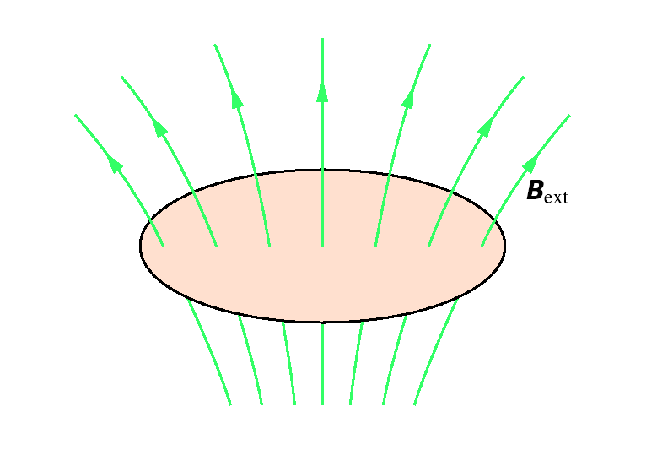
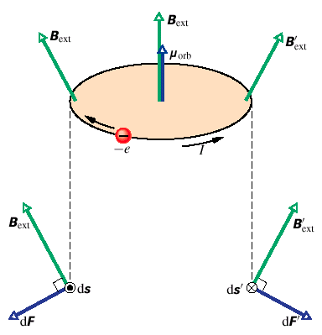
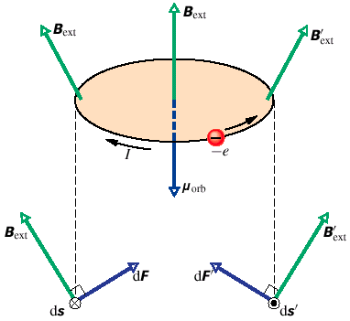
DIPÓL V NEHOMOGENNÍM POLI

Slide 5
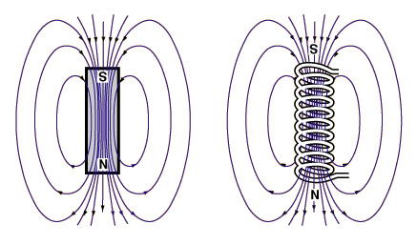
DIPÓL V NEHOMOGENNÍM POLI

Slide 6
DIPÓL V NEHOMOGENNÍM POLI

Slide 7
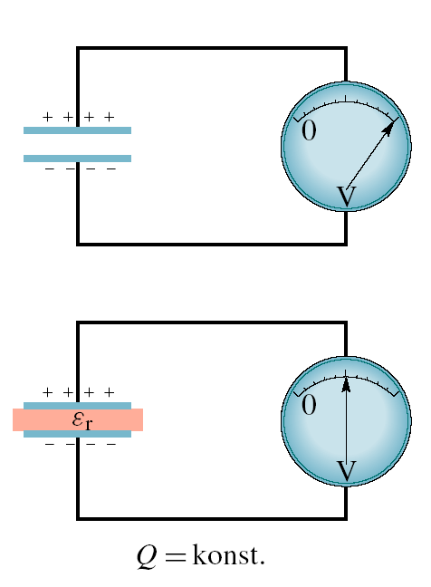
Dielektrikum
?

Slide 8

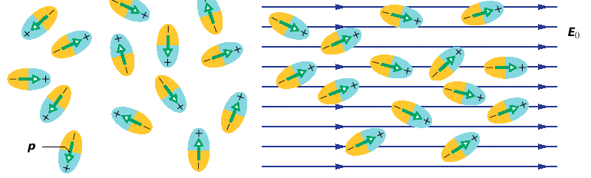
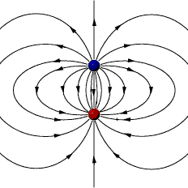

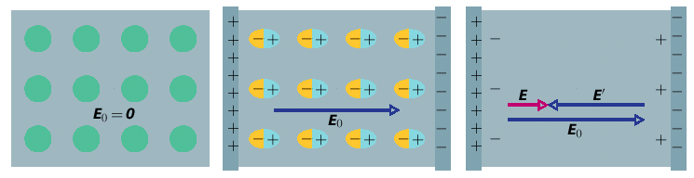
Dielektrika
Rozložení elektronů
elektrický dipól

Slide 9
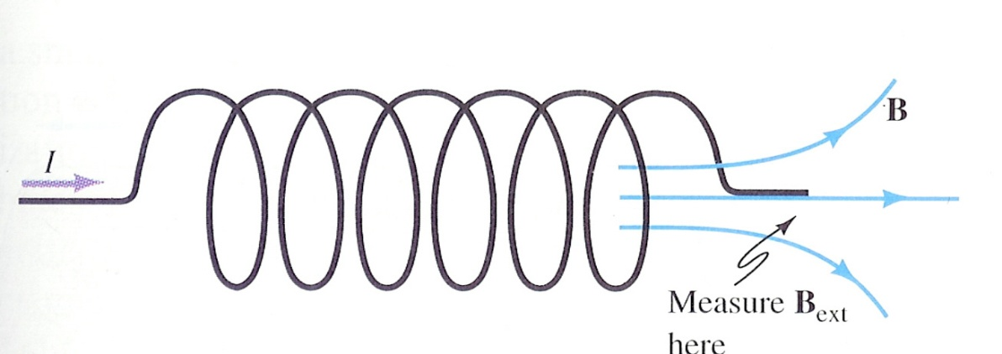
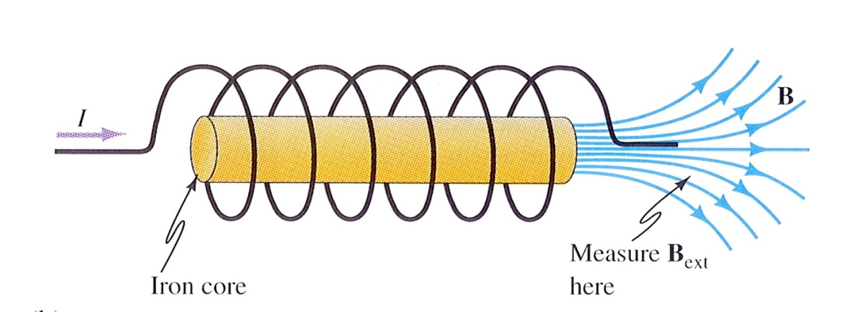
Magnetikum
?

Slide 10
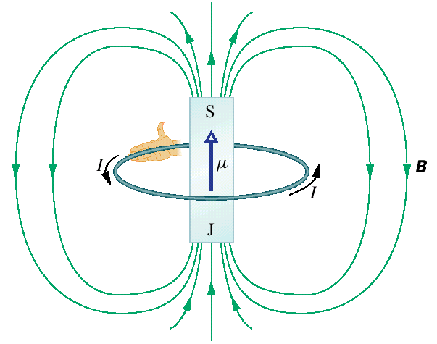
Magnetika
Pohyb elektronů
magnetický dipól
B
B

Slide 11

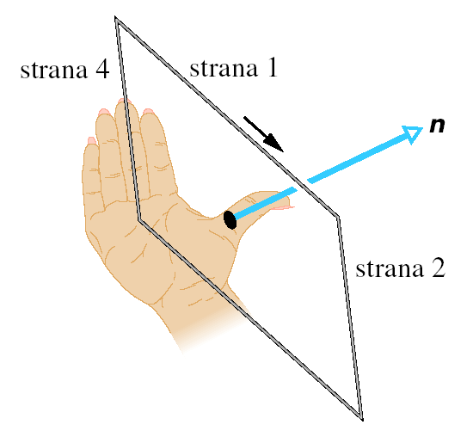
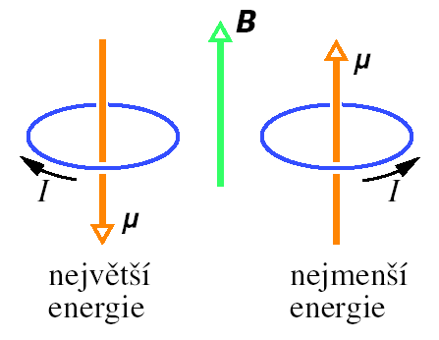
moment síly působící na dipól
potenciální energie dipólu

Slide 12
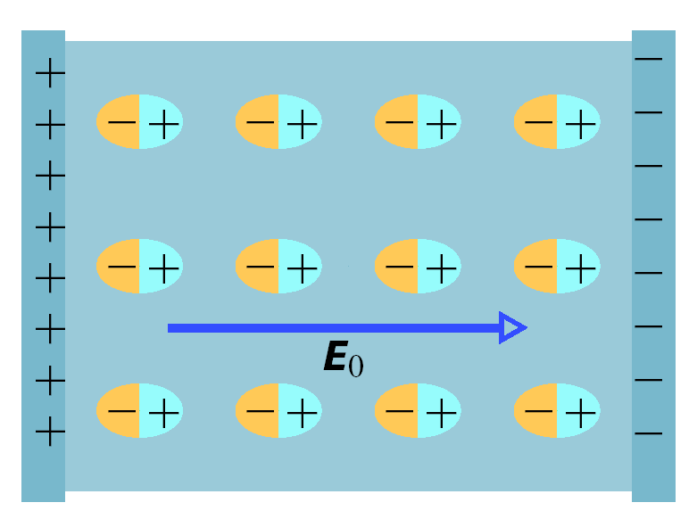
Pole v látce I
E
P
B
B₀
M
E = E₀ – P/ε₀
B = B₀ + μ₀ M
M
B
B₀

Slide 13
Magnetické dipóly v látce:
orbitální moment hybnosti elektronů
spin elektronů

Slide 14
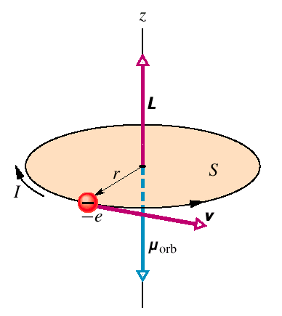
„Smyčkový model“

Slide 15

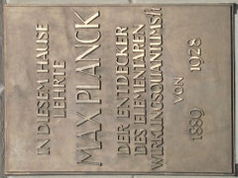

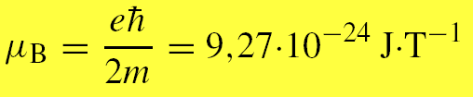

,
Skutečnost 1
orbitální moment hybnosti elektronu
kvantováno
orbitální dipólový magnetický moment
kvantováno
Bohrův magneton

Slide 16



Skutečnost 2
spin elektronu
kvantováno
spinový dipólový magnetický moment
2
kvantováno

Slide 17
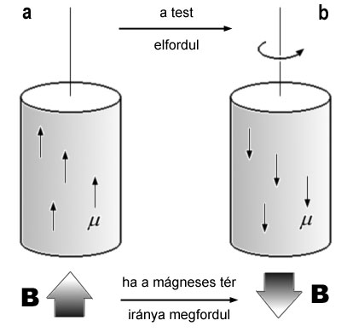
Einsteinův - de Haasův jev

Slide 18
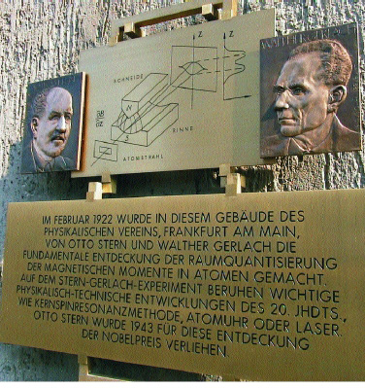
Otto Stern and Walther Gerlach,
Frankfurt, Germany, 1922

Slide 19
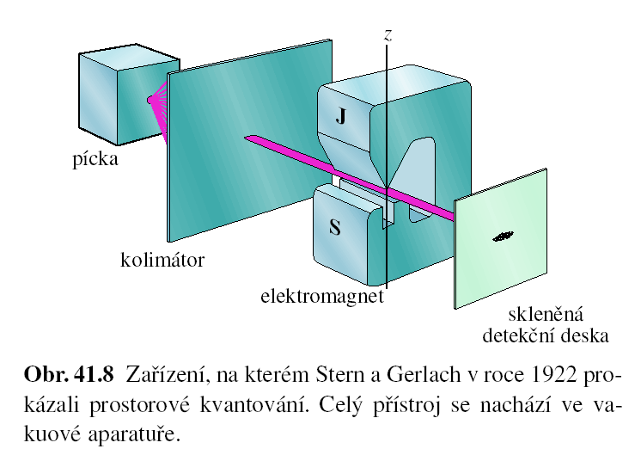
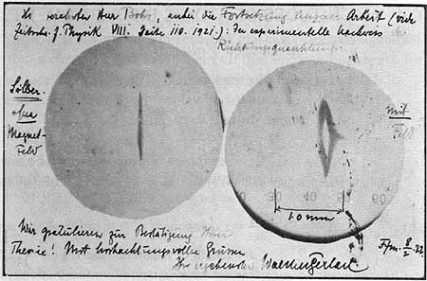
Sternův – Gerlachův experiment (1922)

Slide 20
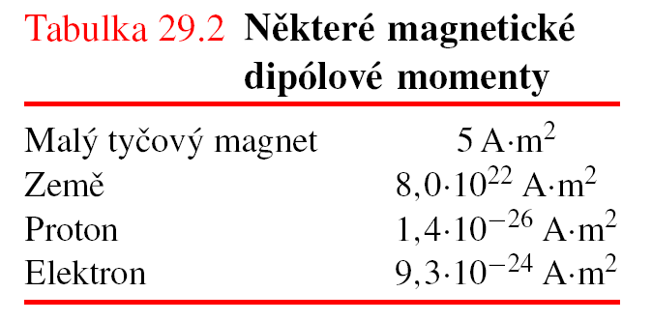
Magnetismus
a
elektrony
a protony

Slide 21
Magnetické dipóly v látce
orbitální a spinové magnetické momenty elektronů
se skládají
magnetický moment atomu/látky
klasifikace látek (magnetik)
DIA
PARA
MAGNETIKUM
FERO

Slide 22
Diamagnetism
is a kind of magnetism characteristic of materials that partly expel from their interior the magnetic field in which they are placed. First observed by S. J. Brugmans (1778) in bismuth and antimony; diamagnetism was named and studied by Michael Faraday (beginning in 1845). He and subsequent experimenters found that some elements and most
compounds exhibit this "negative" magnetism.
Indeed, all substances are diamagnetic: the strong external magnetic field speeds up or slows down the electrons orbiting in atoms in such a way as to oppose the action of the external field in accordance with Lenz's law.
The diamagnetism of some materials, however, is masked either by a weak magnetic attraction (paramagnetism) or a very strong attraction (ferromagnetism).
Diamagnetism is observable in substances with symmetric electronic structure (as ionic crystals and rare gases) and no permanent magnetic moment. Diamagnetism is not affected by changes in temperature. For diamagnetic materials the value of the susceptibility (a measure of the relative amount of induced magnetism) is always negative and typically near negative one-millionth.

Slide 23
DIAMAGNETIKA
B
B
-
E
B
μ
μ
-
E

Slide 24
Paramagnetism
is a kind of magnetism characteristic of materials weakly attracted by a strong magnet, named and extensively investigated by the British scientist Michael Faraday beginning in 1845. Most elements and some compounds are paramagnetic. Strong paramagnetism (not to be confused with the ferromagnetism of the elements iron, cobalt, nickel, and other alloys) is exhibited by compounds containing iron, palladium, platinum, and the rare-earth elements (lanthanides and actinides). In such compounds atoms of these elements
have some inner electron shells that are incomplete. Their unpaired electrons’ spin and orbital magnetic moments make the atoms a permanent magnet tending to align with and hence strengthen an applied magnetic field. Strong paramagnetism decreases with rising temperature because of the re-alignment produced by the greater random motion of the atomic magnets.
Weak paramagnetism is found in many metallic elements in the solid state, such as sodium and the other alkali metals, because an applied magnetic field affects the spin of some of the loosely bound conduction electrons. The value of susceptibility (a measure of the relative amount of induced magnetism) for paramagnetic materials is always positive and at room temperature is typically about 1/100,000 to 1/10,000 for weakly paramagnetic substances and about 1/10,000 to 1/100 for strongly paramagnetic substances.

Slide 25
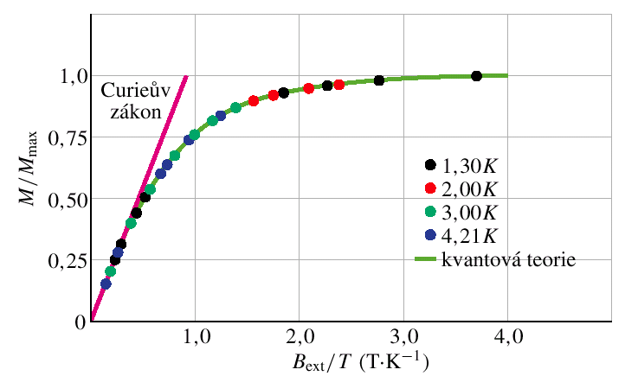

PARAMAGNETIKA
B
B
(síran chromito-draselný)
1,5 T
k_{B} = 1.38.10⁻²³ J/K
300 K

Slide 26
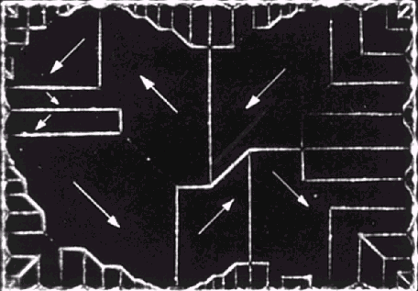
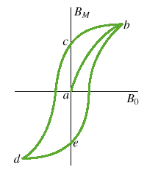
FEROMAGNETIKA
magnetické domény
B
hystereze

Slide 27
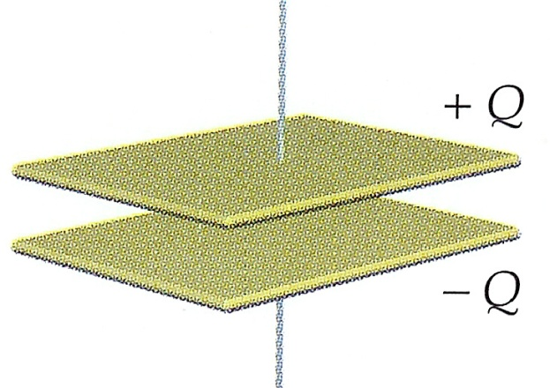
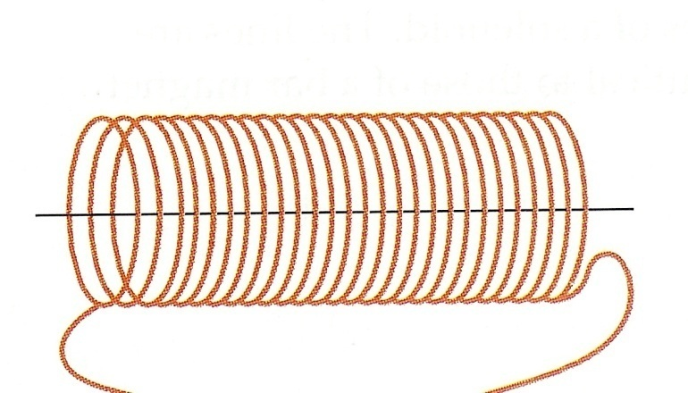
Pole v látce II

Slide 28
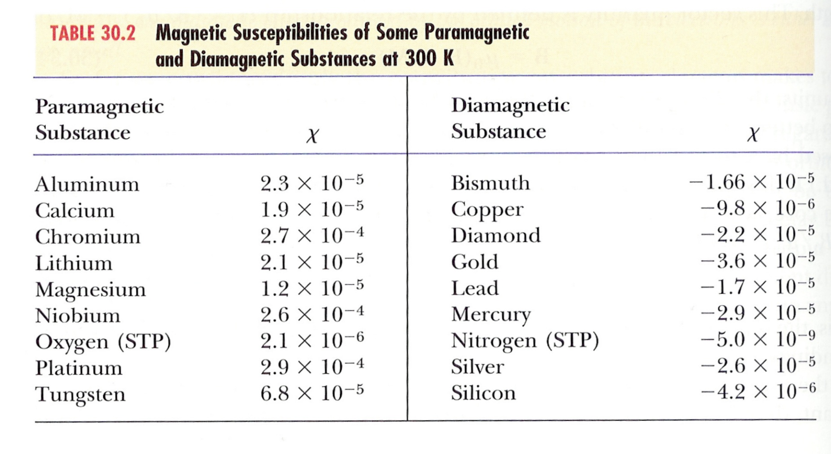

Slide 29
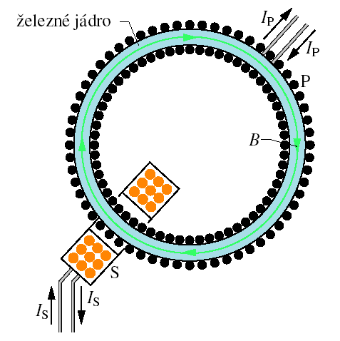
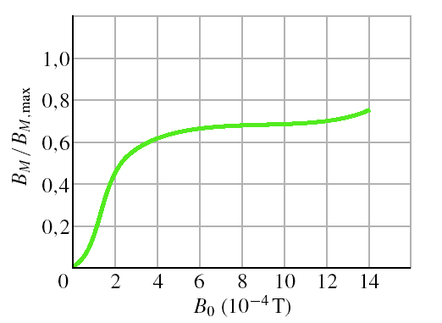
Měření magnetizace

Slide 30
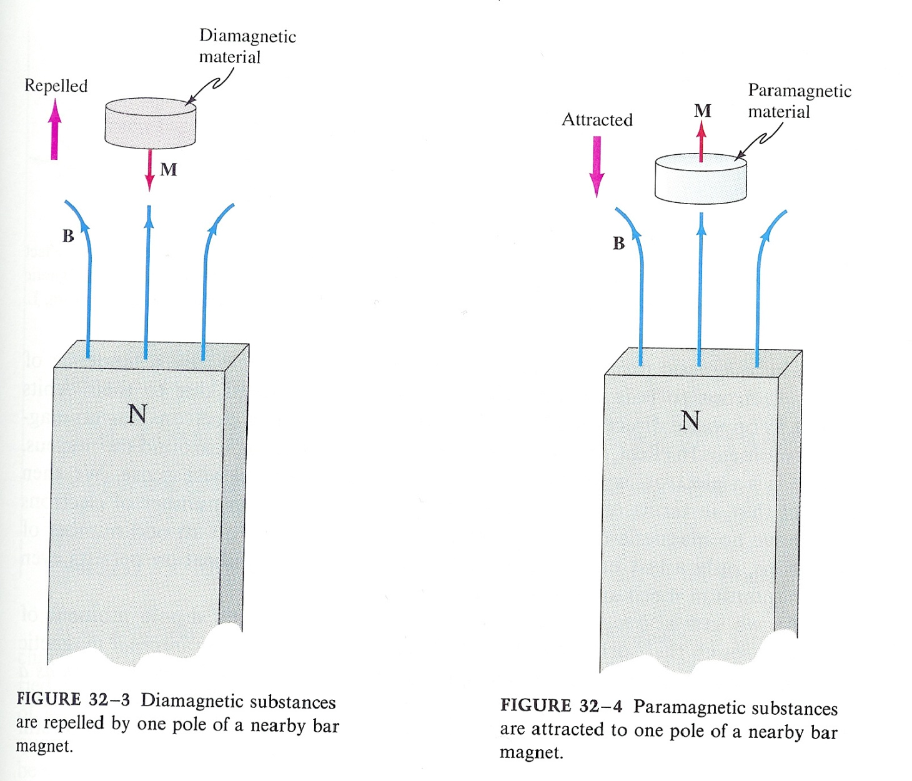
Chování magnetik
v nehomogenním magnetickém poli
Proč ?

Slide 31
DIPÓL V HOMOGENNÍM POLI

Slide 32
DIPÓL V NEHOMOGENNÍM POLI

Slide 33
Chování magnetik
v nehomogenním magnetickém poli
DIAMAGNETICKÁ LÁTKA
je vytlačována z pole ven
PARAMAGNETICKÁ LÁTKA
FEROMAGNETICKÁ LÁTKA
je vtahována do pole

Slide 34
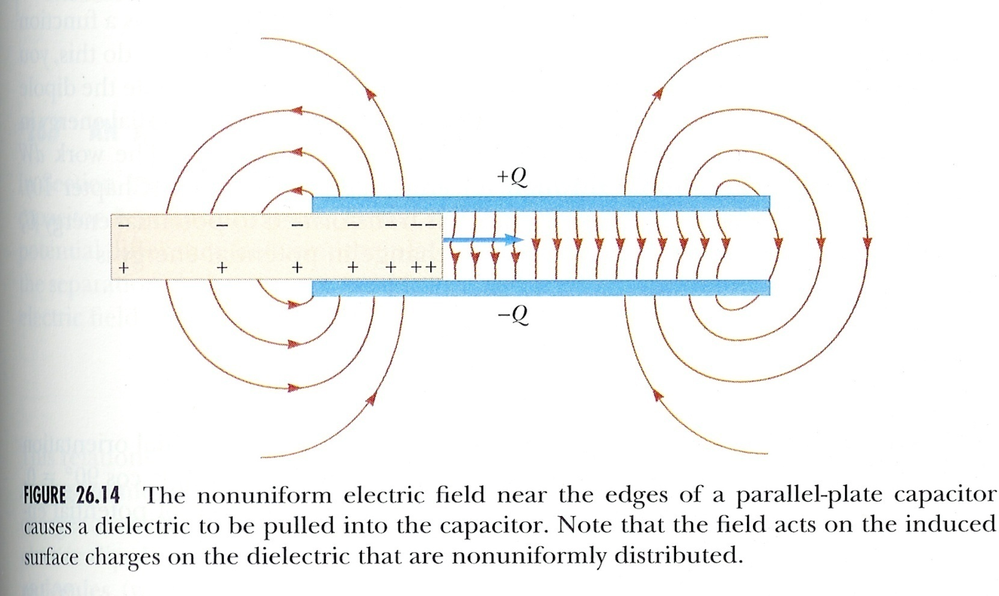
DIELEKTRIKUM
je vtahováno do pole

Slide 35
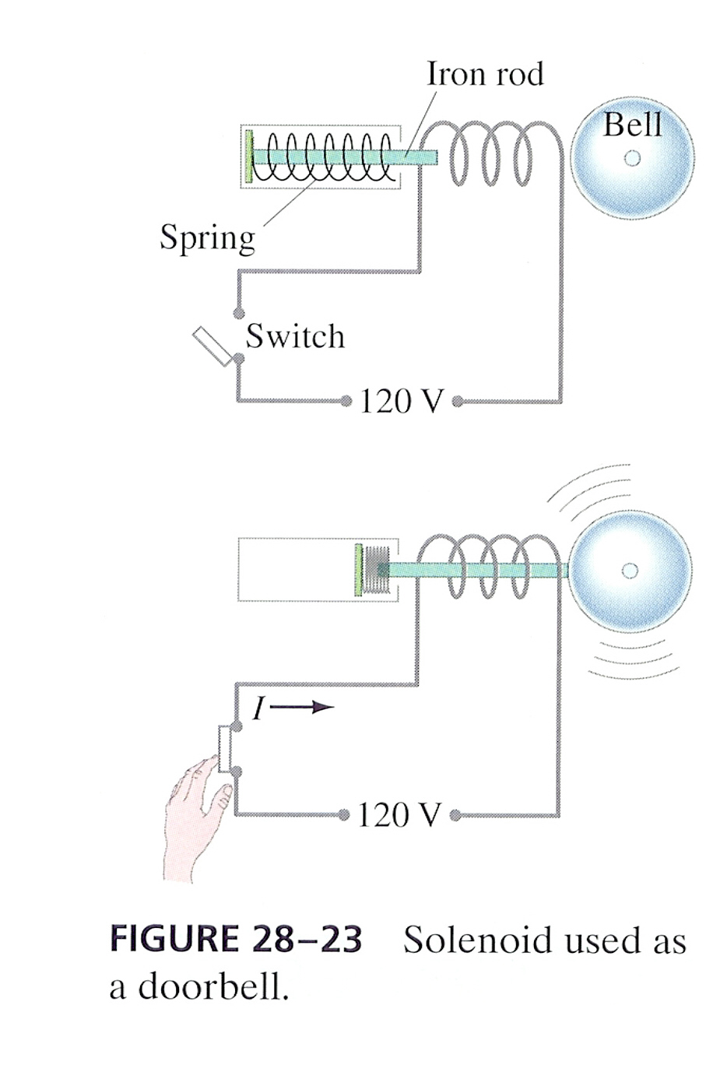
Fyzika v akci

Slide 36
Pole v látce III
Pole na rozhraní dvou prostředí

Slide 37
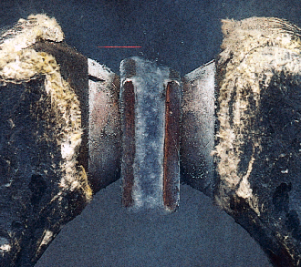
Toroid s jádrem
a vzduchovou
mezerou
B_{1n} = B_{2n}

Slide 38

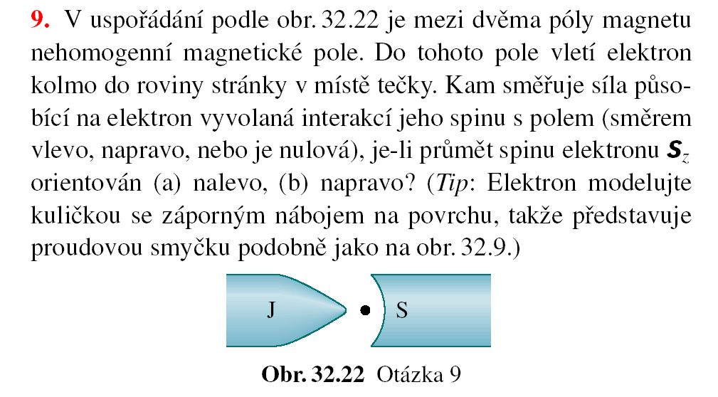

Slide 39
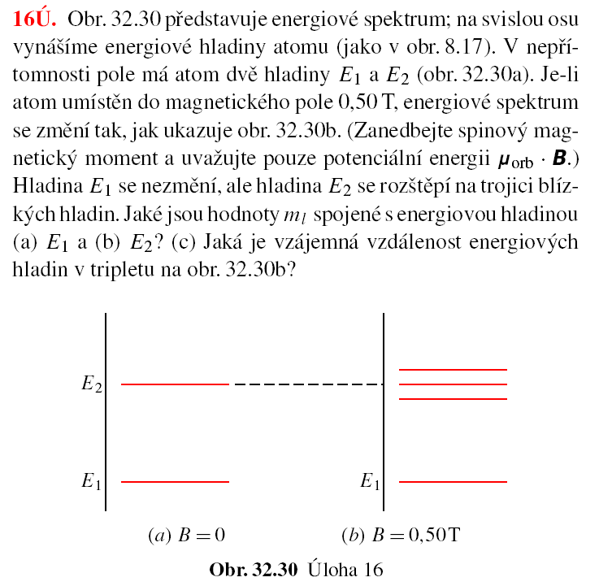

Slide 40
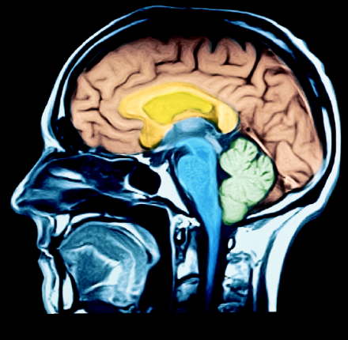
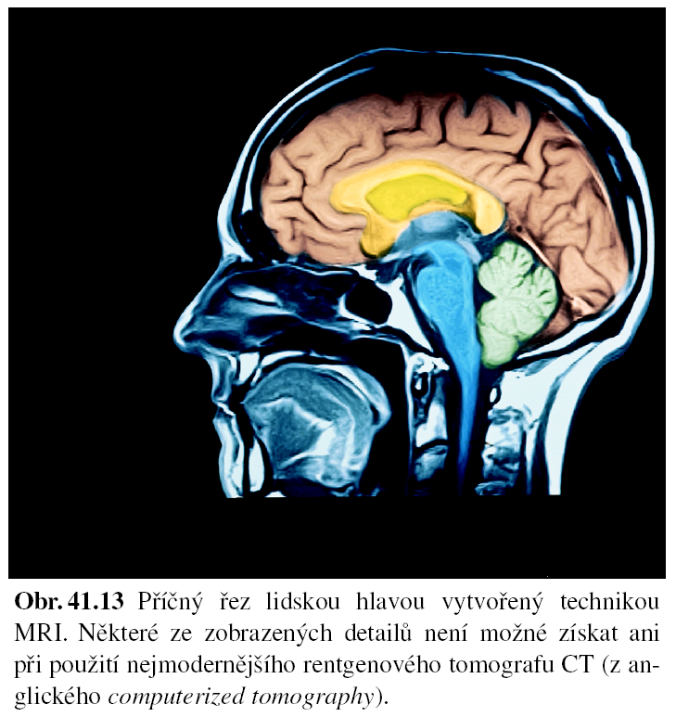
Na závěr…
atomové jádro a magnetismus
Jaderná magnetická rezonance
1,41.10⁻²⁶ J/T
1,80 T
6,63.10⁻³⁴ J.s

Slide 41
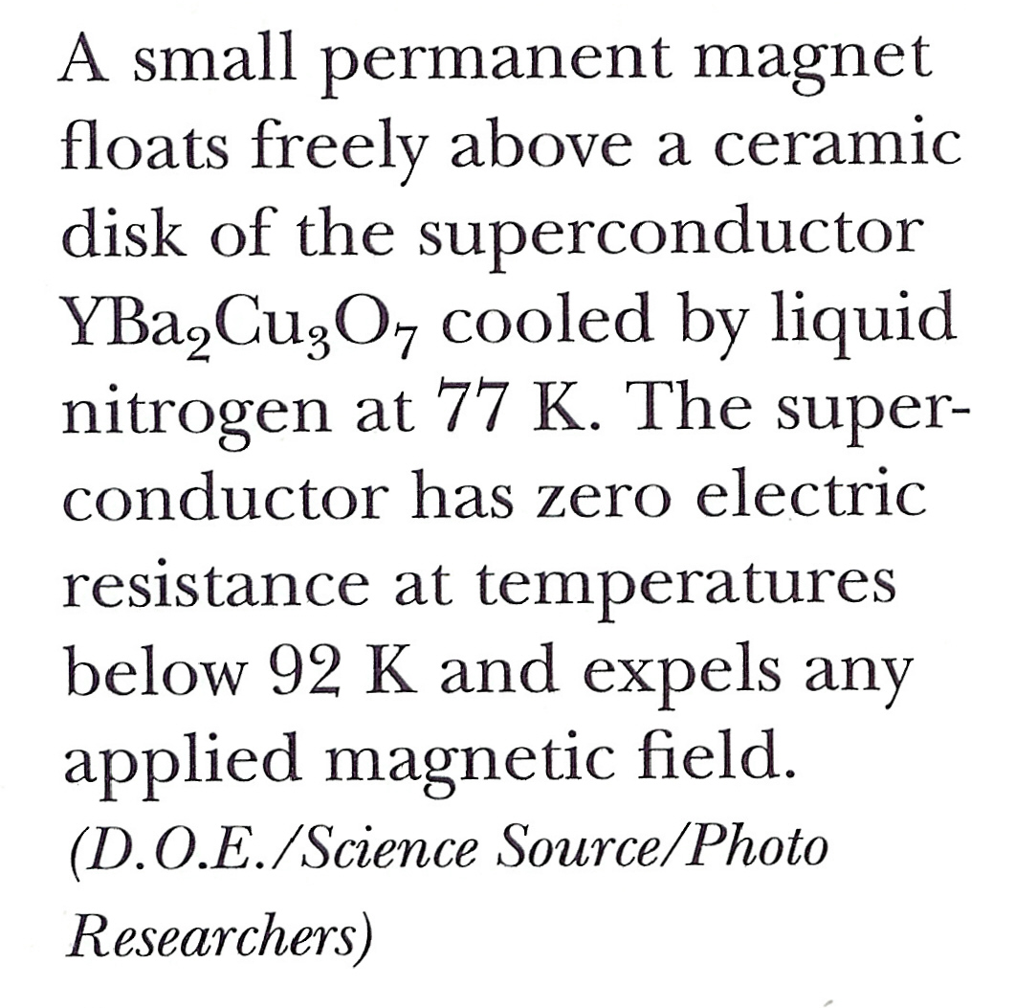
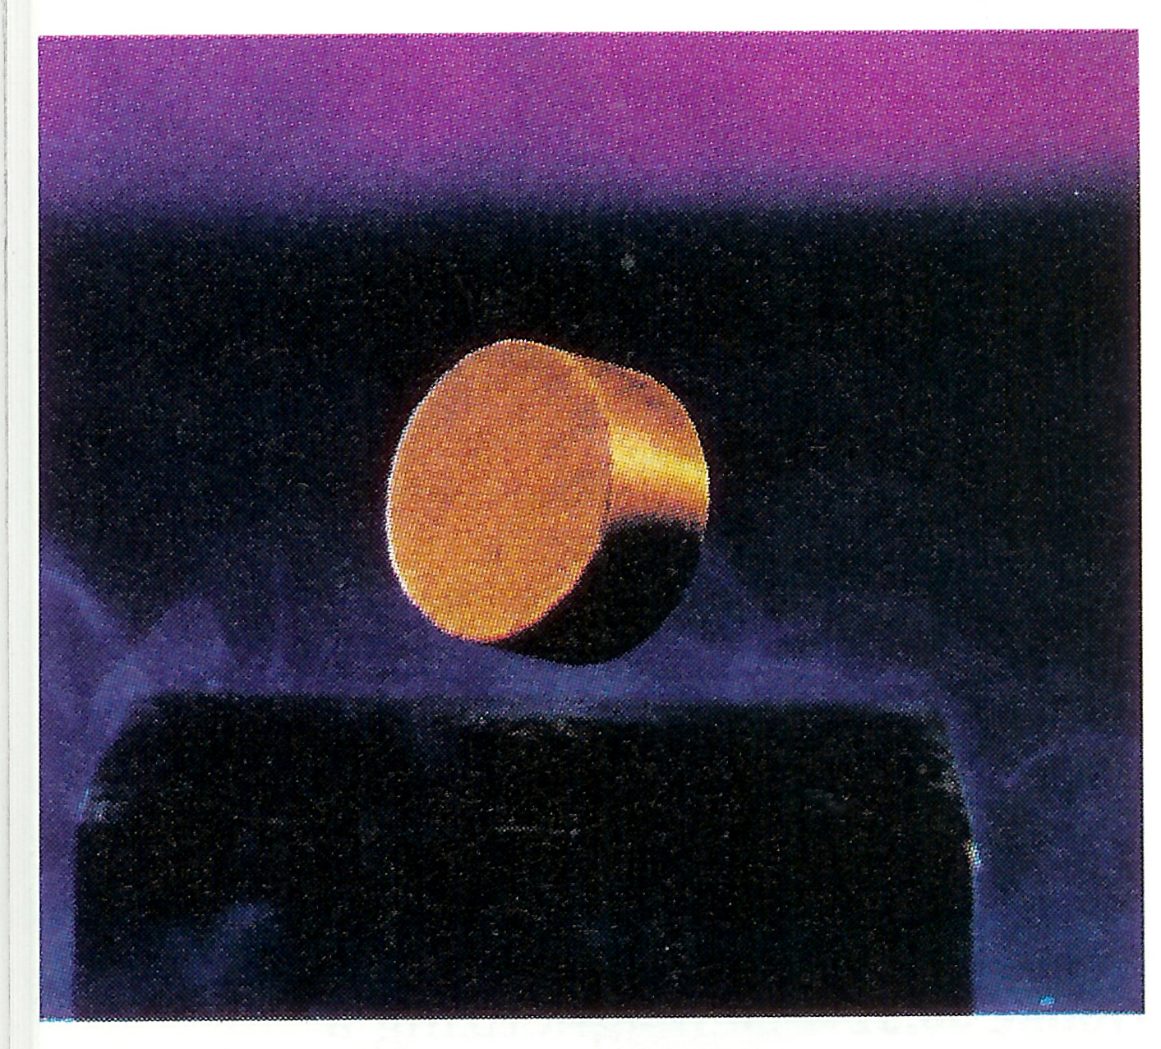
… a na začátek nového

