Slide 1



INSTITUT LADY DAVIS DE RECHERCHES MÉDICALES / LADY DAVIS INSTITUTE FOR MEDICAL RESEARCH
Centre Bloomfield de
recherche sur le vieillissement
Cancer and Aging: Two Faces of the Same Coin
(3) Telomere Biology and Cancer-Part 2
The Bloomfield Centre
for Research in Aging

Slide 2
INSTITUT LADY DAVIS DE RECHERCHES MÉDICALES / LADY DAVIS INSTITUTE FOR MEDICAL RESEARCH
Centre Bloomfield de
recherche sur le vieillissement
The Bloomfield Centre
for Research in Aging
Targeting Telomerase and Telomeres: Valid
Anti-cancer Strategies?
Marie Eve Brault, Johanna Mancini, Hanadi Sleiman, Chantal Autexier

Slide 3
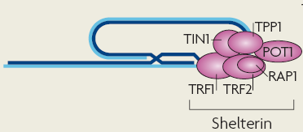
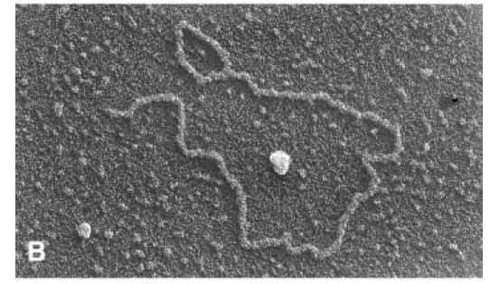
Function of telomeres: cap natural chromosome
ends to make them stable structures
End-to-end fusions
Nuclease degradation
Telomere recognized as DNA breaks
Activation of DNA damage response
Senescence/cell death
Murray, JM and Carr, AM
Nat. Rev. Mol. Cell Biol. 2008
End of chromosome :
Double-strand break:
Griffith, JD et al., Cell 1999

Slide 4
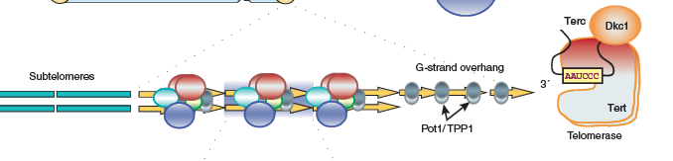
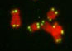
Function of telomeres: to ensure complete DNA replication at chromosome ends via telomerase
Blasco, MA, Nat. Chem. Biol. 2007
5’- GGTTAGGGTTAGGGTTAG
3’- CCAAT
GGTTAG
GGTTAG
5’
GGTTAG
CAAUCCCAAUC
hTR
hTERT
Azzalin et al., 2008
3’

Slide 5
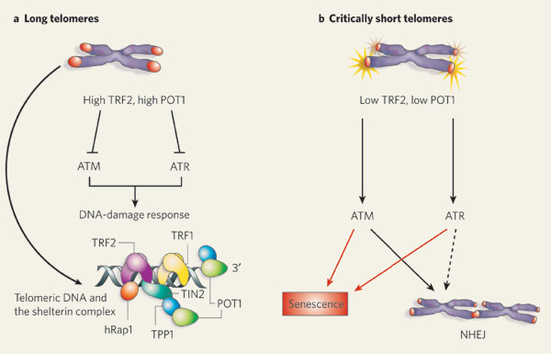
The T-loop structure protects telomeres
CA Azzalin and J Lingner, Nature, 2007

Slide 6
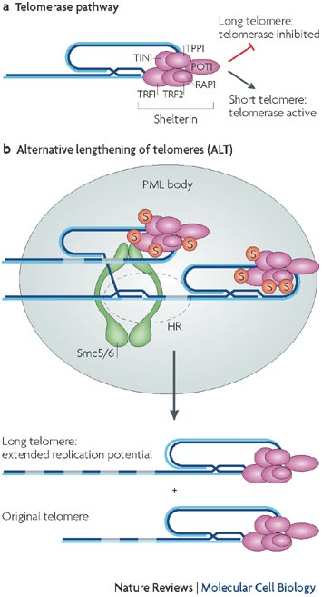
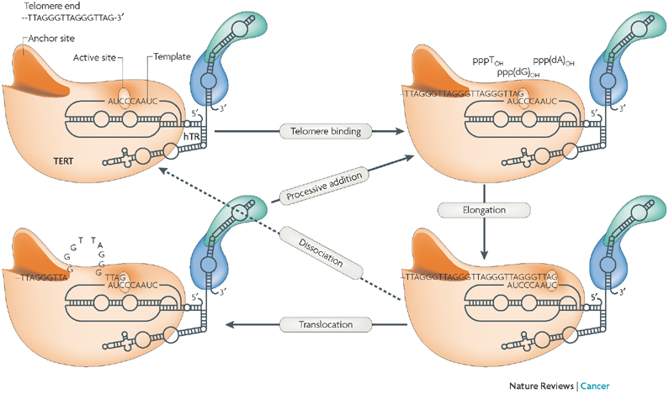
Strategies for telomere length maintenance
85-90%
10-15%
Harley, C.B. Nat. Reviews Canc., 2008
Murray, JM and Carr, AM. Nat. Rev. Mol. Cell Biol. 2008

Slide 7
Why does Telomerase Represent a Good
Anti-cancer Target?
Universal
  85-90% all tumors are telomerase positive
Critical
  Telomerase activity/Telomere maintenance is required for the transformed phenotype
Specific
  Most normal human somatic cells have no or very low telomerase whereas cancer cells upregulate telomerase expression

Slide 8
Issues to Consider When Targeting Telomerase Function
Lag phase
  Lag phase between the time telomerase is inhibited and the time telomeres of the cancer cells will have shortened sufficiently to produce detrimental effects on cellular proliferation
Drug Resistance
  Telomerase inhibitors might result in the emergence of drug-resistant cancer cells (reactivation of telomerase or of the alternative lengthening of telomeres (ALT) pathway)
ALT mechanism
  Alternative ‘recombination based’ mechanisms for telomere maintenance have been reported in 15% of human cancers.

Slide 9

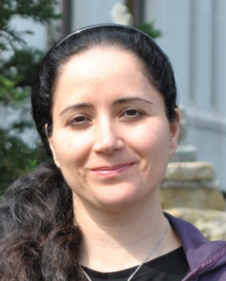



Telomerase and telomeres as
potential targets
Catherine Lauzon
Inhibition of telomere integrity
in combination with chemotherapy
Marie Eve Brault , Nahid Golabi and Johanna Mancini
Regulation of telomere maintenance by recombination
Johanna Mancini and Hanadi Sleiman
Characterization of G-quadruplex ligands as
telomerase inhibitors and/or disruptors
of telomere integrity in cancer cells
May Shawi and Raquel Aloyz
Inhibition of telomerase in combination with
chemotherapy in chronic lymphocytic leukemia

Slide 10

Telomeric recombination as a potential resistance mechanism in
response to telomere dysfunction

Slide 11
Targeting the integrity of telomeres versus telomerase
Telomerase
Telomere
BIBR1532
GRN163L
Q-quadruplex ligands
ex: Telomestatin
Telomere erosion
« slow » pathway
Sensescence (↑p16, p21)
Telomere shortening
Telomere uncapping
Rapid pathway
↑ apoptosis
↑ DNA damage response (↑γH2AX, 53BP1, P-ATM)
Displacement of POT1 and/or TRF2
Chromosome fusions
Specific for cancer cells?
Adapted from :
Kelland L. Clin. Cancer. Res., 2007
Harley, C.B. Nat. Reviews Canc., 2008
Murray, JM and Carr, AM
Nat. Rev. Mol. Cell Biol. 2008
Decrease proliferation
Decreased tumor growth in vivo
Enhance the response to cancer drug treatment

Slide 12
Telomere disturbance through the expression of a telomerase RNA with a point mutation in the template region (MuA-hTR)
Telomerase-based anti-cancer approach:
Wild-Type telomerase RNA template 5’-CUAACCCUAA-3’ specifies TTAGGG repeats
G
G
T
A
G
T
G
T
A
G
5’ -GGTTAGGGTTAGGGTTAGGGTTAGGGTTAG
3’ -CCAAT
T
G
G
A
G
T
T
G
Mutant telomerase RNA template 5’-CAAACCCAAA-3’ specifies TTTGGG repeats
T
T
T
G
T
G
G
T
G
G
T
5’ -GGTTAGGGTTAGGGTTAGGGTTAGGGTTAG
3’ -CCAAT
T
G
G
G
T
T
G
Tumor specific
(telomerase-dependent)
- No lag phase
- General

Slide 13
Anticancer strategies targeting telomere
function by expression of template-mutated hTR
Growth inhibition
Altered cell cycle
Apoptosis
Senescence
No effect on telomerase-negative lung fibroblasts
Loss of tumor growth in xenografts
Dependent on assembly of an active enzyme
DNA damage response at telomeres
Chromosome fusions
Anaphase bridges
Independent of p53 status
Can be ATM dependent
Marusic L. et al. (1997) Mol. Cell. Biol. 17: 6394-6401; Guiducci, C. et al. (2001) Oncogene 20: 714-725; Kim MM. et al.
(2001) Proc. Natl. Acad. Sci. 98: 7982-7987; Li S. et al. (2004) Cancer Res. 64:4833-4840; Goldkorn, A. and Blackburn, E.H.
(2006) Cancer Res. 66: 5763-5771; Cerone, MA et al. (2006) Oncogene 25: 7411-7420; Stohr, B.A. and Blackburn, E.H.
(2008)Cancer Res. 68: 5309-5317; Mahalingam, D. et al. (2011) FEBS J. 278, 3724-3738.

Slide 14

Generation of cancer cell lines with various telomere
lengths expressing template-mutated hTR
YCC-B1
YCC-B2
MCF-7
GM-847
Telomere length (kb) 3.2 (short) 11 (long) 7 (intermediate) >20 (ALT)
Telomerase + + + -
Determine effects on cell viability and proliferation upon treatment with chemotherapeutic drugs
Cerone, M.A., Londoño-Vallejo, J.A. and Autexier, C. 2006 Mutated telomeres sensitize tumor cells to anticancer drugs independently
of telomere shortening and mechanisms of telomere maintenance. Oncogene 25, 2411-2420.

Slide 15
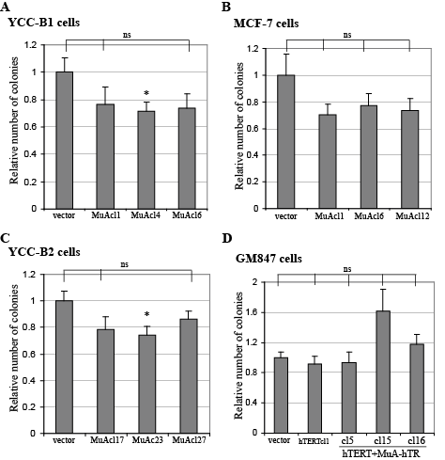
MuA-hTR has a mild effect on cell viability
and proliferative ability
Cerone, M.A., Londoño-Vallejo, J.A. and Autexier, C. Oncogene, 2006.

Slide 16
MuA-hTR expression increases the sensitivity of cancer cells to chemotherapeutic drugs independently of telomere length and initial telomerase status
YCC-B1 (short TRF)
YCC-B2 (long TRF)
Relative number of colonies
Relative number of colonies
***
**
**
***
vector
MuAcl1
MuAcl4
MuAcl6
***
***
**
***
**p<0.01; ***p<0.0001
vector
MuAcl17
MuAcl23
MuAcl27
MCF-7 (intermediate TRF)
**p<0.01; ***p<0.0001
GM847 (ALT)
Relative number of colonies
Relative number of colonies
*
***
***
vector
hTERTcl1
cl5
cl15
cl16
vector
MuAcl1
MuAcl6
MuAcl12
hTERT+MuA-hTR
**p<0.01; ***p<0.0001
*p<0.05; ***p<0.001
Cerone, M.A., Londoño-Vallejo, J.A. and Autexier, C. Oncogene, 2006.

Slide 17
MuA-hTR expression alters the cell cycle profile of YCC-B2 cells after drug treatment perhaps leading to the increased sensitization to drugs
G1/G2-M ratio
Cell cycle distribution
*
*
*
vector
MuAcl17
MuAcl23
MuAcl27
SubG1 fraction
vector
MuAcl17
MuAcl23
MuAcl27
**
**
*
Cerone, M.A., Londoño-Vallejo, J.A. and Autexier, C. Oncogene, 2006.
vector
MuAcl17
MuAcl23
MuAcl27

Slide 18
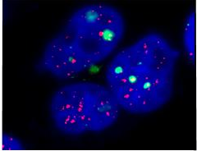
DNA damage response at the telomeres : Telomere Dysfunction-Induced Foci (TIFs)
Telomere dysfunction induced-foci (TIFs)
53BP1
γH2AX
p-ATM
MRN
MDC1
CA Azzalin and J Lingner, Nature, 2007

Slide 19
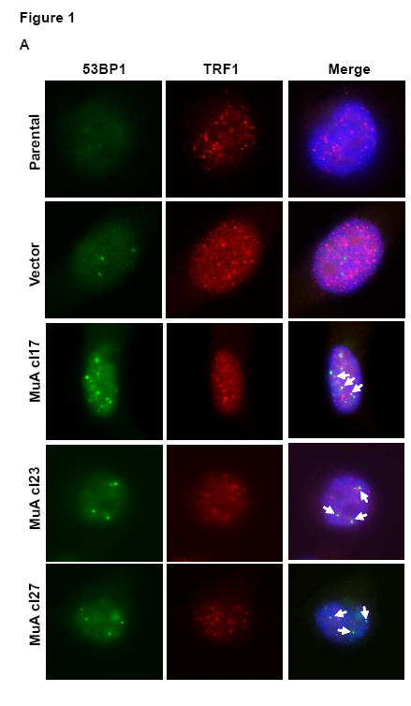
MuA-hTR induces the formation of TIFs containing
TRF1 and 53BP1 in YCC-B2 cells
Brault and Autexier, MBC, 2011

Slide 20
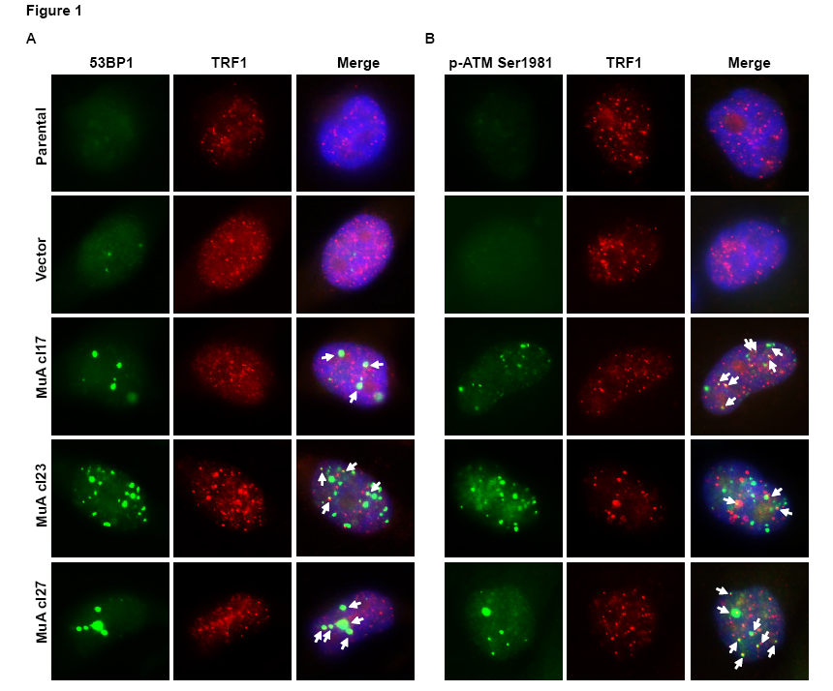
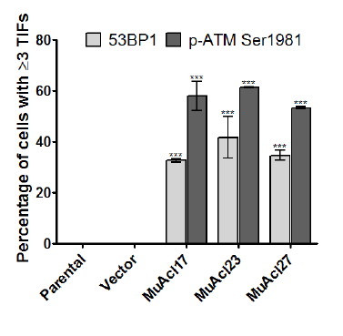
MuA-hTR induces the formation of TIFs containing TRF1 and P-ATM Ser 1981 in YCC-B2 cells
Brault and Autexier, MBC, 2011

Slide 21
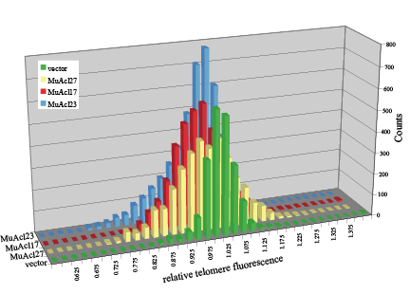
Observed a broader distribution of relative telomere lengths within cells carrying the mutant RNA, suggesting possible telomeric recombination events
vector
MuA cl23
MuA cl17
MuA cl27
Cerone, M.A., Londoño-Vallejo, J.A. and Autexier, C. Oncogene, 2006.

Slide 22
Characteristics of ALT cells
Homologous recombination (HR) mediated events leading to:
1. exceptionally long and heterogeneous telomeres, ranging from
<2kb to >50kb
2. High levels of telomeric sister chromatid exchange (T-SCE)
3. Altered pq-ratios
4. extrachromosomal telomeric DNA, of circular (termed t-circles) forms
ALT-associated promyelocytic leukemia bodies (APBs) which may be the sites
of recombination

Slide 23
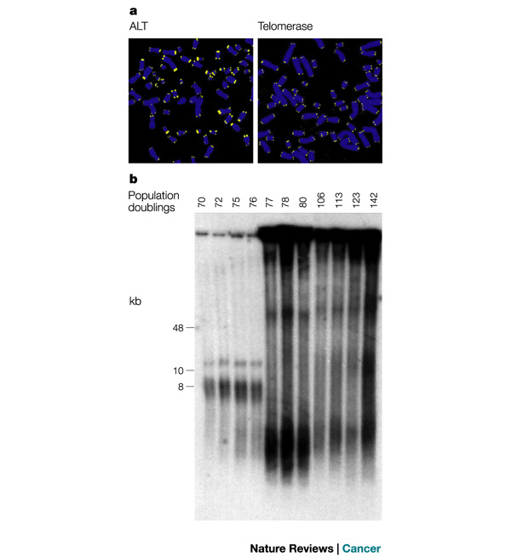
The telomeres in ALT cells are highly
heterogeneous and extremely long

Slide 24
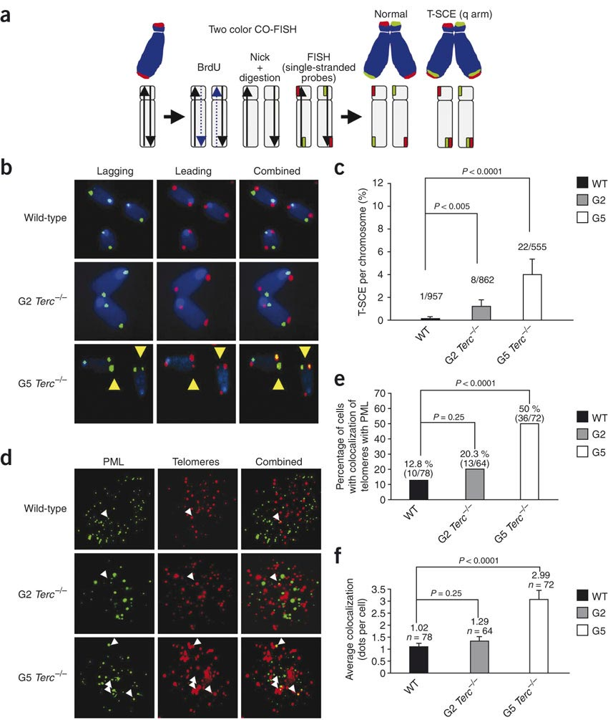
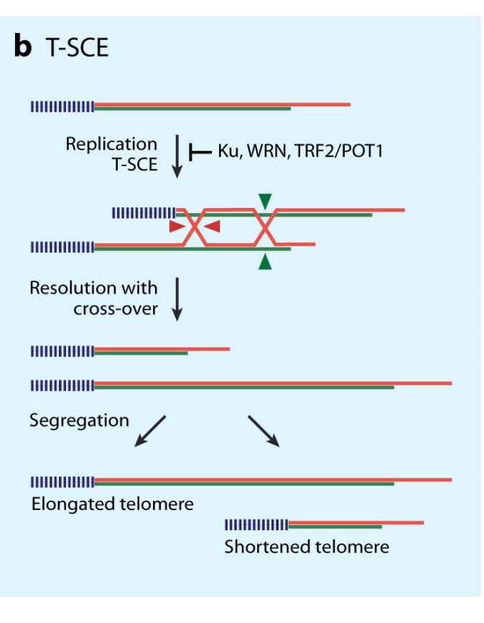
Measuring Telomere-Sister Chromatid Exchanges
(T-SCEs) : the CO-FISH Technique
Palm, W. and de Lange, T. Annu.
Rev. Genet. 2008.

Slide 25
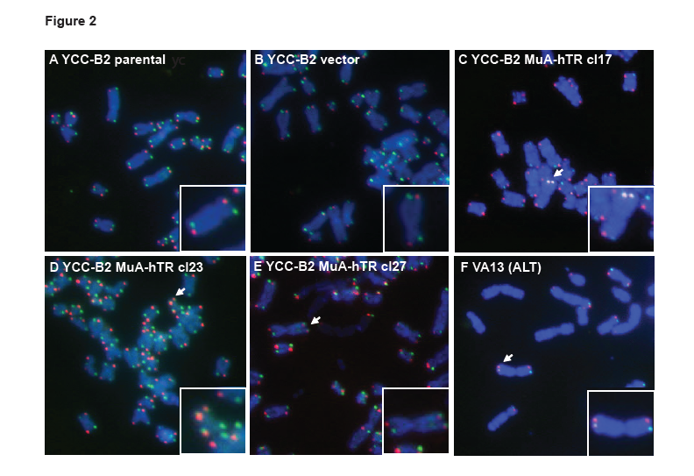
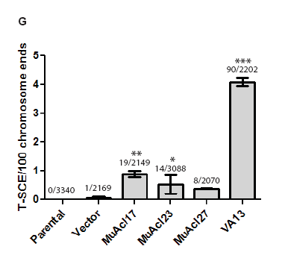
Increased frequency of T-SCEs in the YCC-B2 cells after MuA-hTR expression
Brault and Autexier, MBC, 2011

Slide 26
Changes in pq-ratios indicate telomeric recombination
No recombination Recombination
Cell divisions
Ratio q/p = 3/3
Ratio q/p = 3/3
Ratio q/p = 2/2
Ratio q/p = 2/4
Ratio q/p = 1/1
Ratio q/p = 2/5
Ratio q/p is constant
Ratio q/p changes

Slide 27
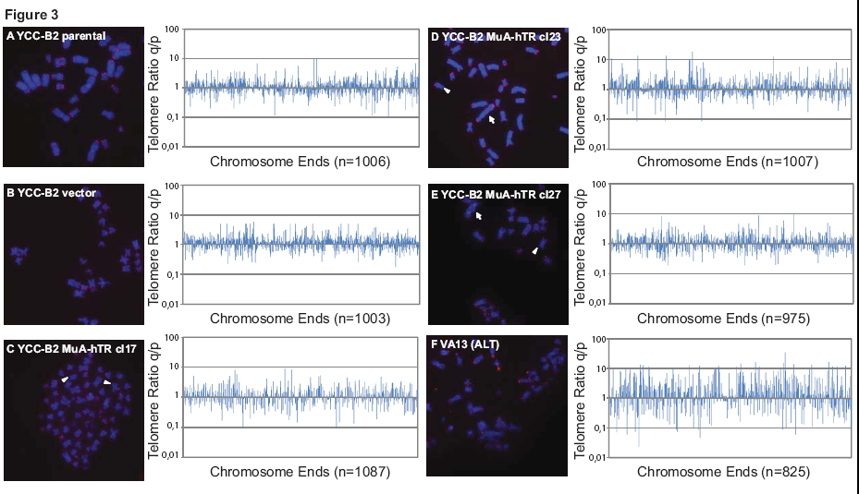
Mutant telomerase RNA expression is associated with changes in telomere pq-ratios
Brault and Autexier, MBC, 2011

Slide 28
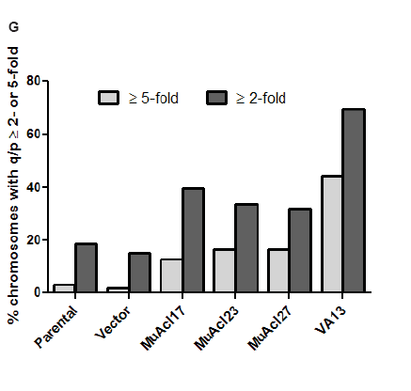
Mutant telomerase RNA expression is associated with changes in telomere pq-ratios
Brault and Autexier, MBC, 2011

Slide 29

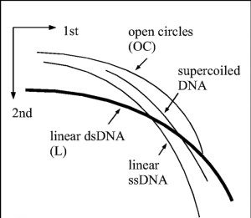
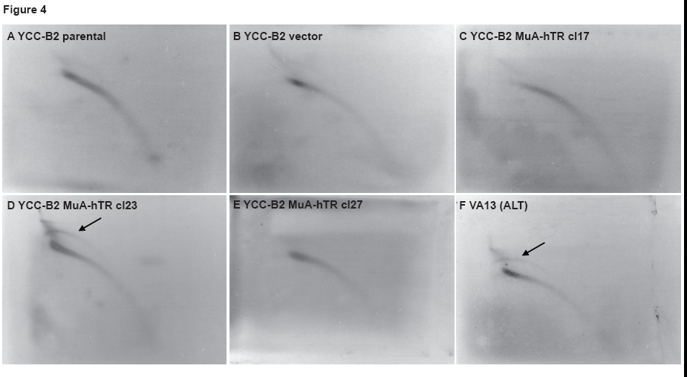
MuA-hTR expression results in the accumulation of circular extrachromosomal telomeric DNA
Palm, W. and de Lange, T.
Annu. Rev. Genet. 2008.
Brault and Autexier, MBC, 2011

Slide 30
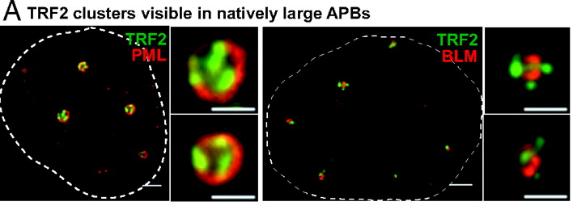
ALT cells contain a high level of ALT associated promyelocytic leukemia bodies (APBs)
Irena Draskovic et al., PNAS, 2009.
Murray, JM and Carr, AM. Nat. Rev. Mol. Cell Biol. 2008

Slide 31
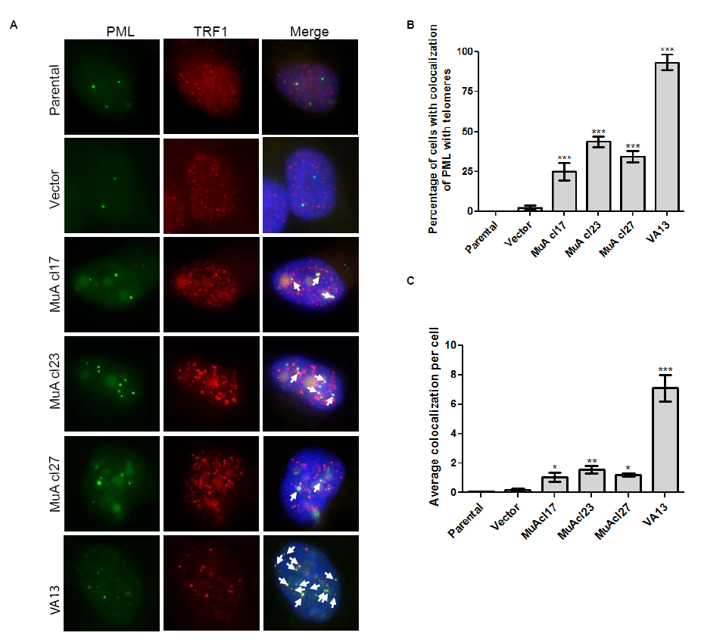
Increased formation of PML bodies associated with telomeric DNA in telomerase-positive cells expressing mutant telomerase RNA
Brault and Autexier, MBC, 2011

Slide 32
Telomeric recombination induced by dysfunctional telomeres
  Elevated DNA damage response located at the telomeres (Telomere dysfunction-induced foci), suggesting that the incorporation of mutant repeats disturbs the telomere cap
  Increased frequency of Telomere Sister Chromatid Exchange (T-SCEs), elevated pq-ratios and extrachromosomal telomeric DNA fragments were observed in the MuA-expressing cells, which are consequences of homologous recombination between telomeres
  First report of telomere dysfunction inducing telomeric recombination in
  mammalian cells without telomerase inhibition and of endogenous telomerase and telomeric recombination pathways coexisting spontaneously in cancer cells
Conclusion
Our results suggest that after telomere destabilization, there is a strong selection pressure for the emergence of resistant cells with increased telomeric recombination and telomeric recombination could be a potential resistance mechanism in response to telomere dysfunction
However, the use of chemotherapeutic drugs decreases the proliferation of the MuA-expressing cells, despite the presence of a recombination-based mechanism for telomere maintenance

Slide 33
Model
Telomere maintenance independent of telomerase
and survival
↓proliferation
↑apoptosis
MRN
HR proteins favors telomere recombination rather than T-loop formation
Rad52
↑instability
TRF1, TRF2 and POT1 cannot bind to mutant sequences
Drugs

Slide 34
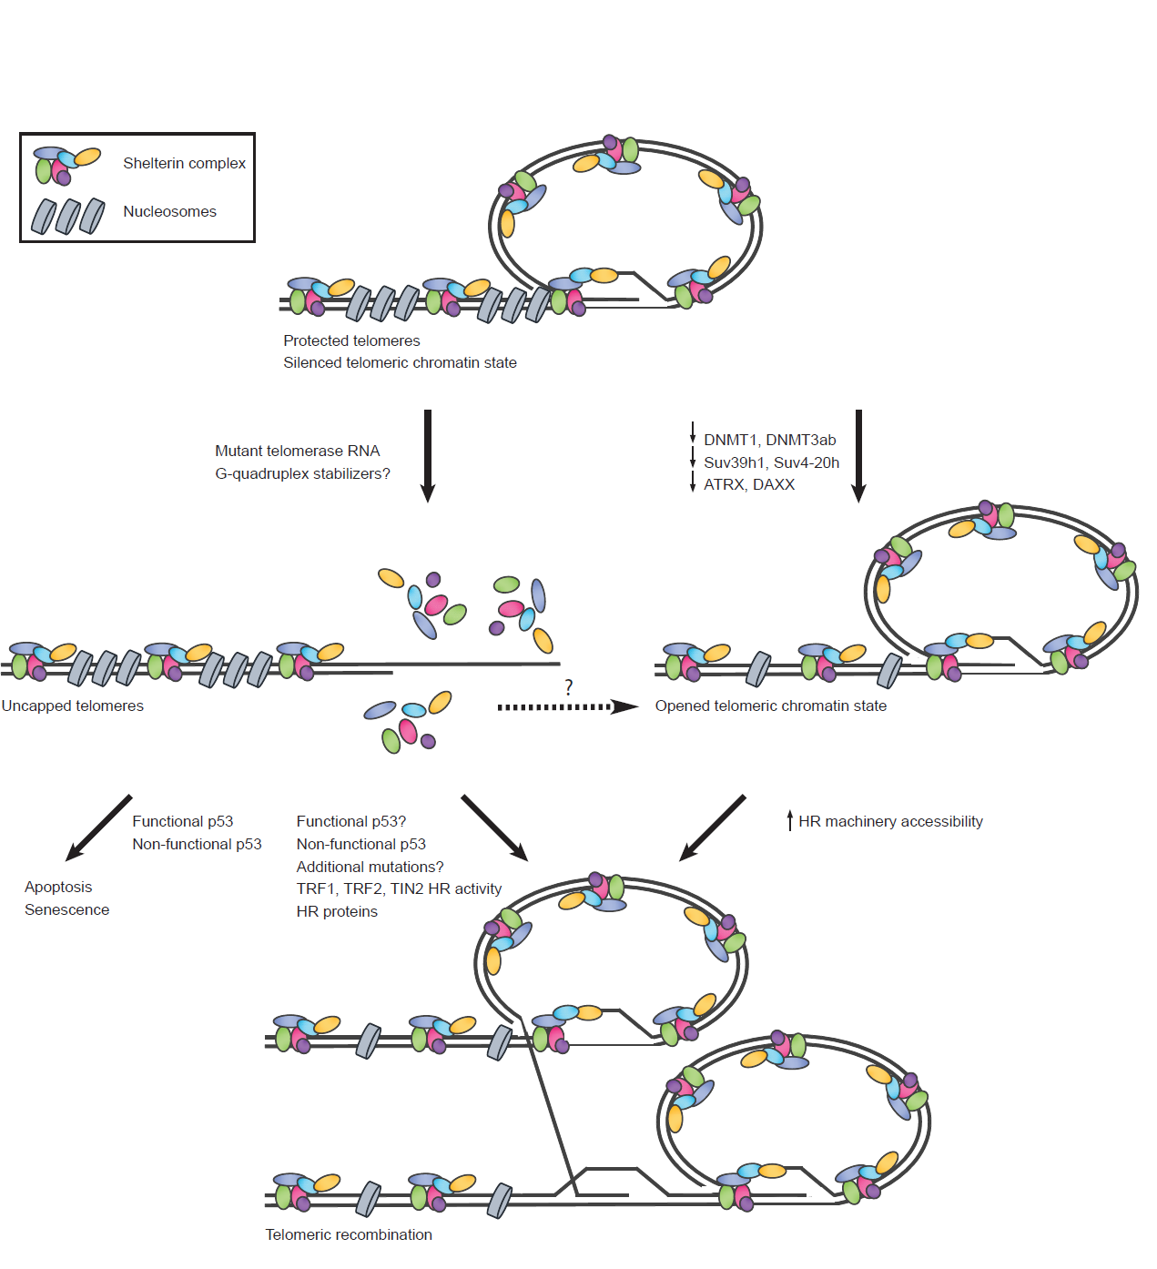
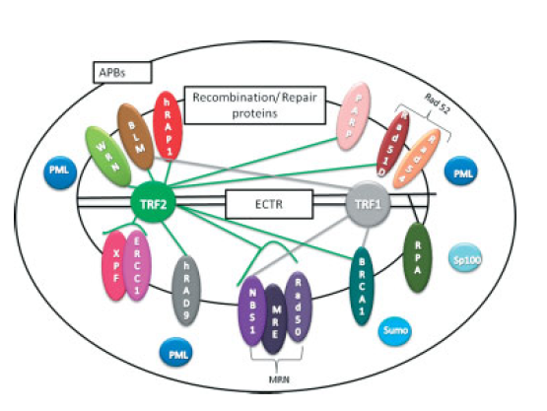
Perspective
The factors involved in resistance to induced-telomere dysfunction could include the impaired p53 status of YCC-B2 and additional proteins which regulate or may regulate ALT or telomeric recombination
Ku70
Pot1
p53?
SMC5/6
Protected telomeres
Mutant telomerase RNA
Uncapped telomeres
p53 status
Additional mutations?
Shelterin HR
HR proteins
Apoptosis
Senescence
?
Telomeric recombination
Cancer resistance
Adapted from Brault and Autexier, Cell Cycle, 2011
Adapted from De Boeck, G. et al. J. of Path. 2008.

Slide 35
Inhibiting telomerase and telomere function in cancer cells
with G-quadruplex ligands

Slide 36
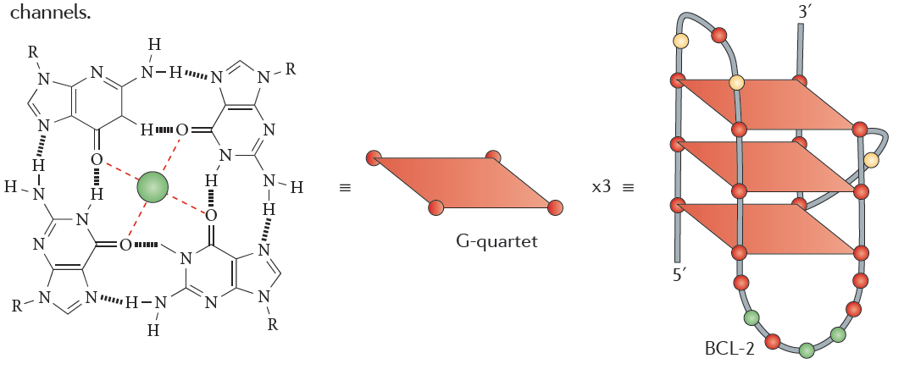
G-quartet
Bang 1910
Gellert et al 1962
4 Guanines
Stabilized by Hoogsteen Hydrogen bonds
Stacked = G-quadruplex
Stabilized by K ⁺ and Na⁺
Balasubramanian et al Nature Reviews Drug Discovery (2011)

Slide 37
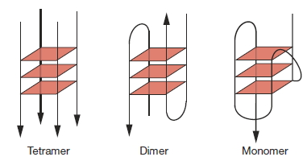
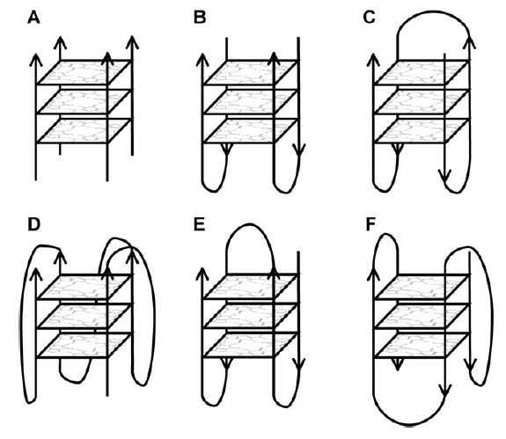
G-quadruplex
Forms determined by:
  Strand number
    Monomer, Dimer, Tetramer
  Strand direction
    Parallel, anti-parallel
  Loops
    Lateral/Edgewise
    Diagonal
    Chain-reversal/Propeller
  D, E, & F formed in human telomeric repeats
Unimolecular
Parallel
Propeller
Unimolecular
Anti/Parallel
Diagonal
Unimolecular
1Anti/3Parallel
Huppert J. Chem Soc Rev (2008)

Slide 38
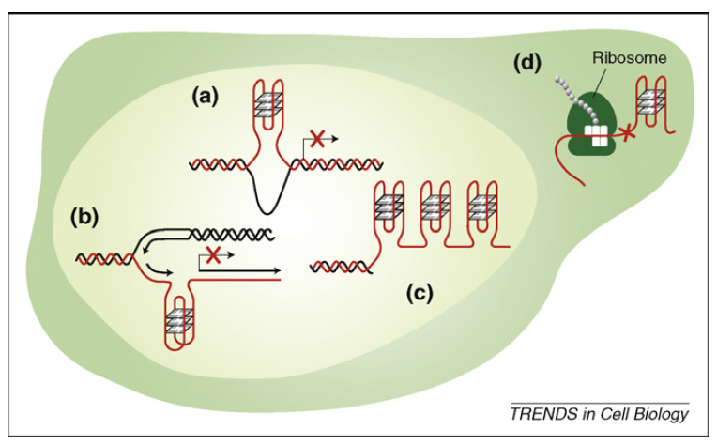
Location of G-quadruplexes
Genome-wide sequence analysis identified 376 000 putative sequences (not homogenously distributed)
Within the nucleus:
a) promoter region of genes
b) during replication
c) telomeric 3’
G-overhangs
Outside of nucleus:
d) 5’ UTR of mRNA
Lipps & Rhodes. Trends in Cell Biology (2009)

Slide 39
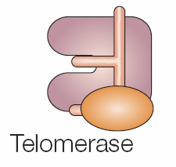
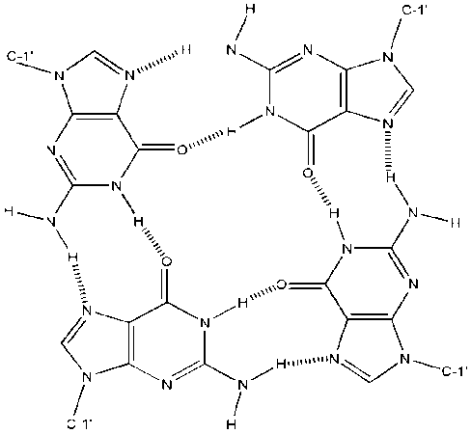
G-Quadruplex Stabilization Leads to Telomerase Repression
G
G
G
G
G
G
G
G
G
G
G
G
G
G
G
G
G
G
3’
G
G
G
G
G
G
G
G
G
5’
G
G
G
G
G
G
G
G
G
5’
3’
G
G
G
G
G
G
G
G
G
G
G
G
Adapted from Fakhoury, J, Nimmo, G, Autexier, C. Anticancer Agents in Medicinal Chemistry, 2007

Slide 40
Phenotypes elicited by G-quadruplex ligands
Telomerase inhibition
Telomere shortening
Lag phase dependent antiproliferative response in cancer cells
Rapid telomere shortening-independent antiproliferative effects
Loss of the G-rich overhang
Dissociation of TRF2 and Pot1 from the telomere
Increased DNA damage foci at telomeres
Activation of DNA damage response
Apoptosis
Antitumor activity in mouse tumor models
Antiproliferative response restricted to cancer cells
Reviewed in De Cian, A. et al. Biochimie, 2008.

Slide 41
Transition metal-based G-quadruplex binders
Many advantages to implementing metals:
Modular/tunable
Multiple metal geometries/inherent positive charge
Ease of synthesis
Potential reduction in overall synthetic time
Meunier, JACS 2007, 129, 1502
Neidle, Vilar, JACS 2006, 128, 5992
Haq, Thomas, JACS 2006, 12, 4611

Slide 42
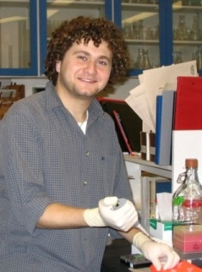
Platinum phenanthroimidazoles as G-quadruplex binders
Challenge: Make DNA binders selective for G-quadruplexes using square planar transition metals to extend the π-surface
R. Kieltyka, Fakhoury J., Moitessier N., Sleiman H., Chem. Eur. J., 2008, 14, 1055.

Slide 43
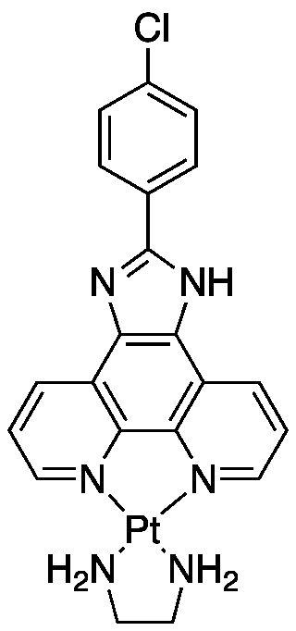
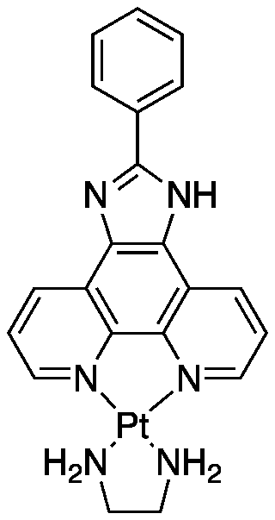
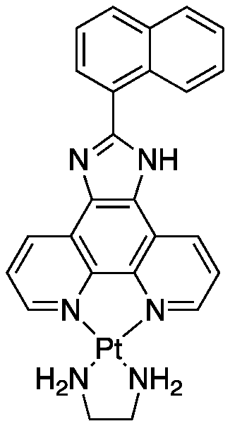
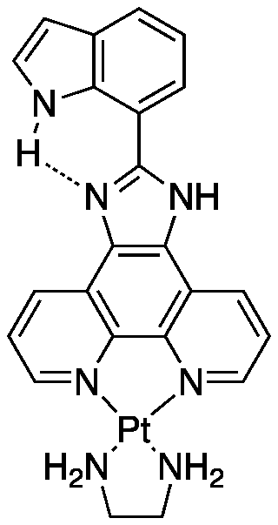
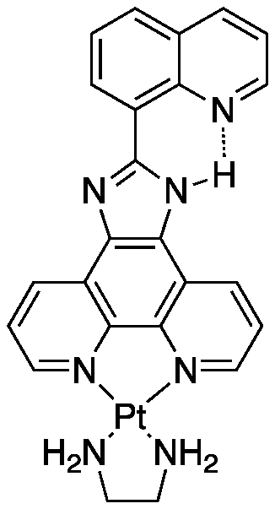
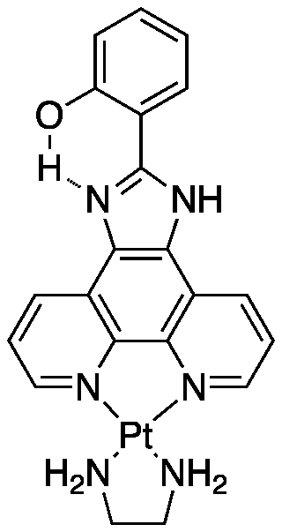
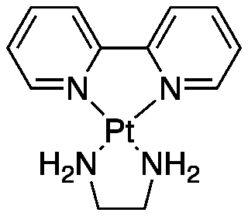
Q-quadruplex Ligands
BPY
PIP
PIN
PII
PIQ
SIP
CLIP
Bipyridine ethylenediamine platinum(II)
Reduced binding – Negative control
Naphtylphenanthroimidazole ethylenediamine platinum(II)
Introduce Naphtyl but lowered binding affinity
Bigger surface increased stacking but introduced twist
Phenylphenanthroimidazole ethylenediamine platinum(II)
Parent complex with Phenyl - increase π surface
Indolylphenanthroimidazole ethylenediamine platinum(II)
New class with attached aryl substituent, preventing twist through H-bonding
Quinolinylphenanthroimidazole ethylenediamine platinum(II)
Quinoline N acts as H-bond acceptor to imidazole N-donor
Increased binding affinity and selectivity
Salicylphenanthroimidazole ethylenediamine platinum(II)
Less π extended phenol acting as H-donor to imidazole N
Less selectivity – closest to PIP but with better affinity
p-chlorophenylphenanthroimidazole ethylenediamine platinum(II)
Added a Halogen, shifting electron density towards Cl
Increased binding affinity and selectivity
Pt based complexes with extended Π surfaces afford greater binding affinity and selectivity to G-quadruplex over duplex DNA

Slide 44
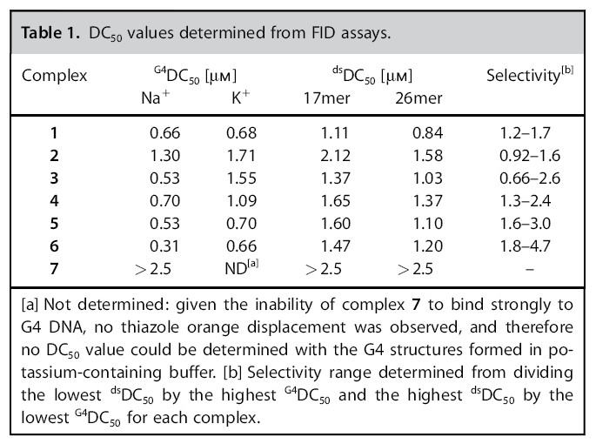
Ligand Binding Affinity & Selectivity
Binding Affinity assessed by FID
fluorescence intercalator displacement assay
Compared to 17mer & 26mer
Binding affinity measured by ^{ds}DC50/^{G4}DC50
DC 50 concentration of cmplx req to give 50% decrease in fluorescence
PIP
PIN
PII
PIQ
SIP
CLIP
BPY
Castor K et al. ChemMedChem (2012)

Slide 45
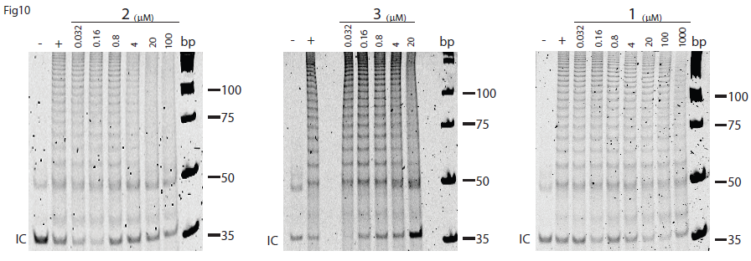
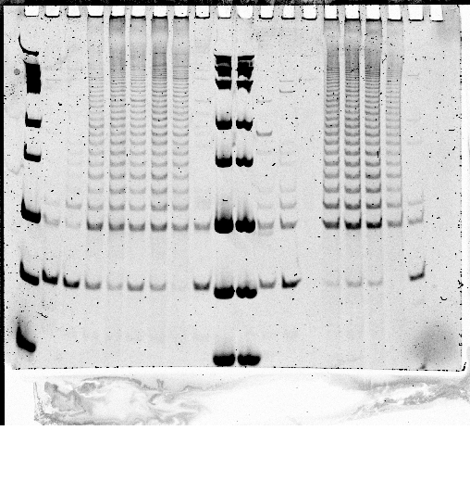
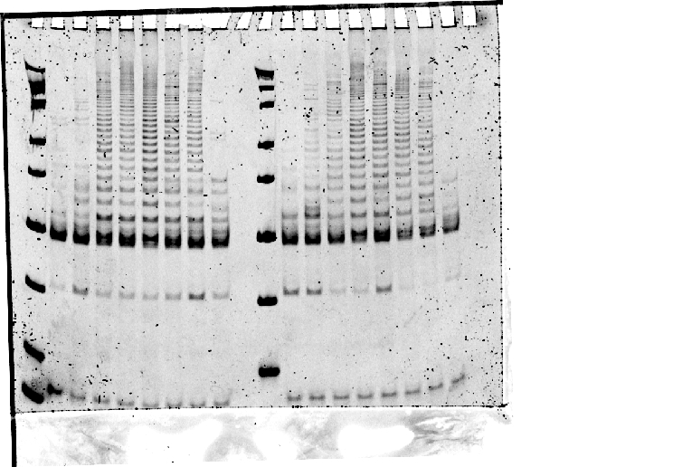
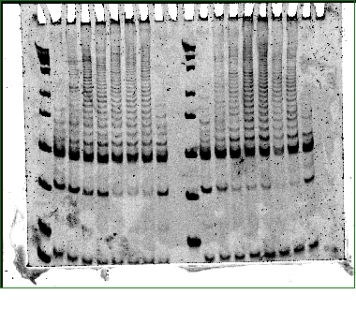
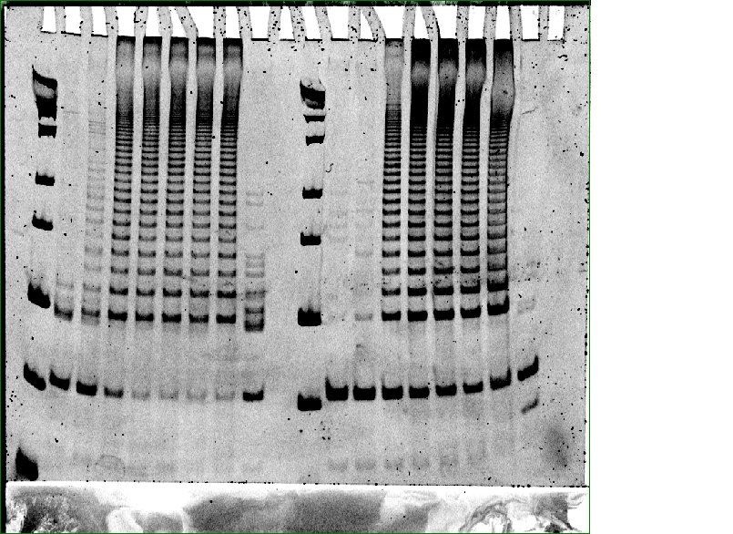
In vitro Telomerase Inhibition
BPY (µM)
PIN (µM)
PIP (µM)
PII (µM)
0.032
0.16
100
-
+
0.8
4
20
bp
100
75
50
35
PIQ (µM)
SIP (µM)
CLIP (µM)
Ligand | TRAP-Lig IC₅₀ (μM)
BPY | ND
PIP | 0.46 ± 0.29
PIN | 6.81 ± 5.84
PII | 0.93 ± 1.78
PIQ | 2.48 ± 1.49
SIP | 11.6 ± 1.78
CLIP | 5.71 ± 1.55
BRACO-19 | 6.30
Telomestatin | 0.60
0.032
0.032
0.032
0.16
100
0.16
100
0.16
100
-
+
0.8
4
20
bp
-
+
0.8
4
20
bp
-
+
0.8
4
20
bp
100
100
100
75
75
75
50
50
50
35
35
35
Castor K et al. Chem Eur J (2011) Submitted

Slide 46
Short term cytotoxicity assay suggest cancer cell specific effects
MTS (72h) – Proliferation |  | IC ₅₀
Cell Type | Cell Line | BPY (µM) | PIP (µM) | CLIP (µM)
Cancer Telomerase + | A549 | N/A | 21.91 ± 1.20 | 13.41 ± 1.23
 | HUH7 | N/A | 11.45 ± 1.09 | 16.70 ± 1.14
 | MCF7 | N/A | 42.91 ± 1.17 | 18.37 ± 1.11
Cancer, ALT Telomerase - | GM847 | N/A | 27.73 ± 1.04 | 9.33 ±1.02
Normal Primary | MRC-5 | N/A | 50.00 | 57.61 ± 2.85
 | WI-38 | N/A | 70.85 | 53.63
MTS: Metabolic activity assay

Slide 47
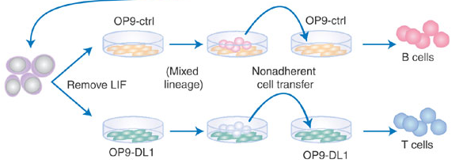
Cell Studies: Experimental Design
1x10⁵ cells
+ Cpd
[1X, 0.5X, 0.1X IC50]
1x10⁵ cells
1) Seeding
D1
D4, D8, D11, D15, D18, D22, etc
2) Promoter
1x10⁵ cells
+ Cpd
[1X, 0.5X, 0.1X IC50]
D4, D8, D11, D15, D18, D22, etc

Slide 48
Cell Studies: Seeding Experiment

Slide 49
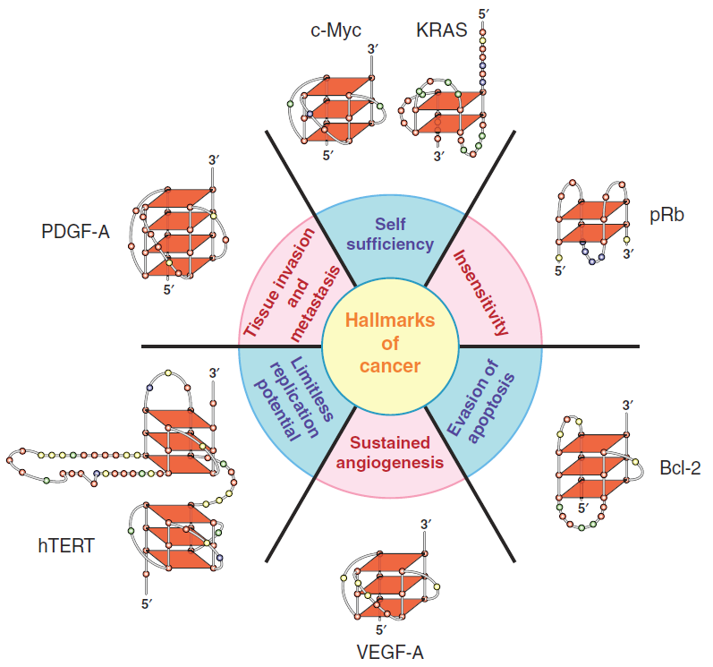
Cell Studies: qPCR
c-myc
  most studied G4-forming promoter region
  upregulated in many cancers
  is a regulator of hTERT
hTERT
  forms 2 different G4 in the promoter region
  expression is required for telomerase activity

Slide 50
Conclusions and perspectives
Molecules with distinct structural features that target G-quadruplex
can be generated using supramolecular self-assembly
phenanthroimidazole platinum(II) complexes are G-quadruplex
stabilizers and telomerase inhibitors
We will further evaluate improved ligands with increase binding affinity and selectivity
to the G-quadruplex substrate (telomeric or promoter)
Ligands are currently being tested for cancer cell specific antiproliferative effects
Mechanism of action to be determined: telomere length dependent or independent,
effect on G-quadruplex containing promoters relevant to telomerase (c-myc, hTERT)
Best molecule will be tested for antitumor activity in xenograft mouse model

Slide 51



Acknowledgements
Collaborators and Colleagues
Hanadi Sleiman
José-Arturo Londoño-Vallejo
Sun Young Rha
Titia de Lange
Lab members
Shusen Zhu
Yasmin D’Souza
Marie-Eve Brault
May Shawi
Catherine Lauzon
Sanjida Khondaker
Johanna Mancini
Josephine Chu
Nahid Golabi
Ricky Kwan
Alumni
Maria A. Cerone
Johans Fakhoury

