Slide 1
Causes of sprawl: A portrait from space
Burchfield M., Oversman H., Puga M., Turner M., 2005

Slide 2
I. Introduction
Sprawl definition
Residential Sprawl
Commercial Sprawl
Advantages and Disadvantages of Sprawl

Slide 3
Urban Sprawl
“Low-density development beyond the edge of service and employment, which separates where people live from where they shop, work, recreate and educate — thus requiring cars to move between zones.” (http://www.sierraclub.org/)
Urban Sprawl - беспорядочно застроенная территория

Slide 4
Residential Sprawl
Single-family detached homes…
…occupied by households that commute to work, and
…built at low density
…beyond walking distance of goods and services
…more than critical response time from fire services
Heavy reliance on private automobiles as the primary transportation mode

Slide 5
Residential sprawl
Low density, auto-dependent development outside compact urban and village centers, along highways and in rural countryside.

Slide 6
Urban Sprawl
No centralized planning or control of land uses
Signiﬁcant ﬁscal disparities among localities
Reliance on a “trickle-down” or ﬁltering process to provide housing to low-income housholds

Slide 7
Urban sprawl
“Leapfrog" development which occurs when developers choose to build on less expensive land farther away from the city, bypassing vacant land located closer to the city

Slide 8
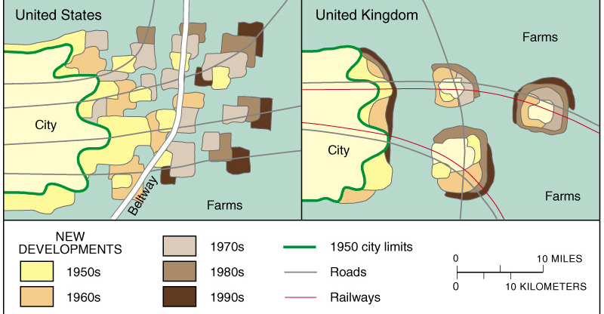
Europe versus U.S. Cities: Sprawl
European cities, including this hypothetical U.K. example, tend to restrict suburban development, thereby concentrating new development in and around existing concentrations. This leaves large rings of open space, so-called greenbelts.
Notes:
8

Slide 9
Urban Sprawl
Segregation of land use types into different zones
Strip or ribbon development, which involves extensive commercial development in a linear pattern, which contributes to traffic congestion

Slide 10
Commercial sprawl
Auto-oriented development…
…built at a low floor area ratio
…in strips along major routes or in isolated business parks
…separated from other land uses.

Slide 11
Commercial sprawl

Slide 12
ADVANTAGES AND DISADVANTAGES OF SPRAWL
Social
Economic
Environmental
Health
….

Slide 13
ADVANTEGES OF SPRAWL
Advantages
improvement of life quality in range of flat (housing estate with block of flats vs. own detached house)
improvement of life quality in range of environment and landscape (housing estate with block of flats vs. own detached house)
nearness of recreation space;
improvement of life quality in terms of safety

Slide 14
ADVANTEGES OF SPRAWL
improvement of life quality in range of flat (housing estate with block of flats vs. own detached house)

Slide 15
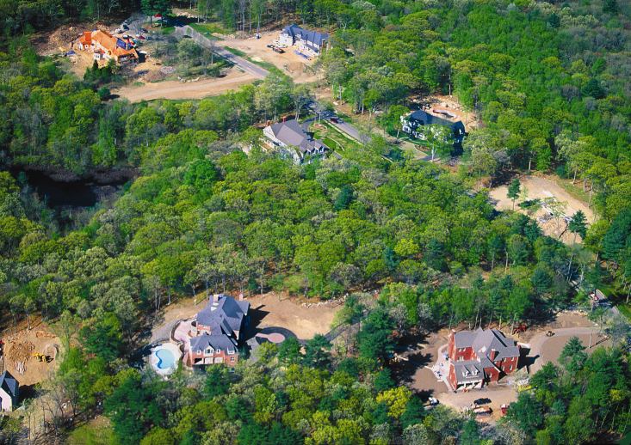
ADVANTEGES OF SPRAWL
improvement of life quality in range of environment and landscape (housing estate with block of flats vs. own detached house)
nearness of recreation space;
improvement of life quality in terms of safety

Slide 16
DISADVANTEGES OF SPRAWL
Social
Economical
Environmental
Health
…

Slide 17
Some recent conclusions about sprawl…
“The vast majority of metropolitan areas experienced a significant decline in metropolitan density (between 1982-1997) and therefore can be described as sprawling.” (Fulton et al. 2001)
“Sprawl is ubiquitous and it is continuing to expand.” (Glaeser and Kahn 2003)
“Many extended urbanized areas are very sprawl-like on some dimensions, but not so sprawl-like on others.” (Galster et al. 2005)
“The extent of sprawl has remained roughly unchanged between 1976 and 1992.” (Burchfield et al. 2006)

Slide 18
II. Measurements of Sprawl
Methodology
Analyzing Landscape Change with Satellite Remote Sensing and Geographic Information Systems
Data Source
Land Use and Land cover Digital Data (derived from high attitude aerial photography, 1972)
National Land Cover Data (derived from satellite imagery, 1990)
Land Use Classification
Urban Land
Sprawl Index

Slide 19
Data Source: Satellite Imagery

Slide 20
Data units
Square cells of 30×30 meters situated on a regular grid (8.7 billions cells)
For each cells predominant land cover was assigned
Land Cover Codes
Residential development;
Commercial and industrial development and transportation networks;
Water;
Bare rock and sand;
Forest;
Range and grassland;
Agricultural land;
Wetlands

Slide 21
Urban Land in US

Slide 22
Urban Land in US
1.9 % of the United States was developed in 1992 (Burchfield, 2005)
(2.5 % of US was classified as “urban” by Census Bureau in 1990)
two-thirds of this developed land is already in urban use in 1976
Developed area grew by 48 percent over 16 years

Slide 23
Urban Land in US: Large Differences across States
State | % of state land area urbanized by 1992 | % of state non urban land urbanized by 1976- 1992
Arizona | 0.79 | 0.35
DC | 68.13 | 2.8
Massachusetts | 17.34 | 5.7
Wayoming | 0.21 | 0.09

Slide 24
Sprawl Index
Cell-based measure of sprawl:
SI = average % undeveloped land within 1 km² of residential cells in metropolitan area
Notes:
Limitations of analysis
Use remotely sensed data (NLCD) to detect urban land development between 1976-1992
Compare disparate datasets
Measurement is limited to single spatial scale
Analysis is aspatial: average measure of sprawl for metro area is regressed on metropolitan characteristics
Ignore land use pattern outside metro areas

Slide 25
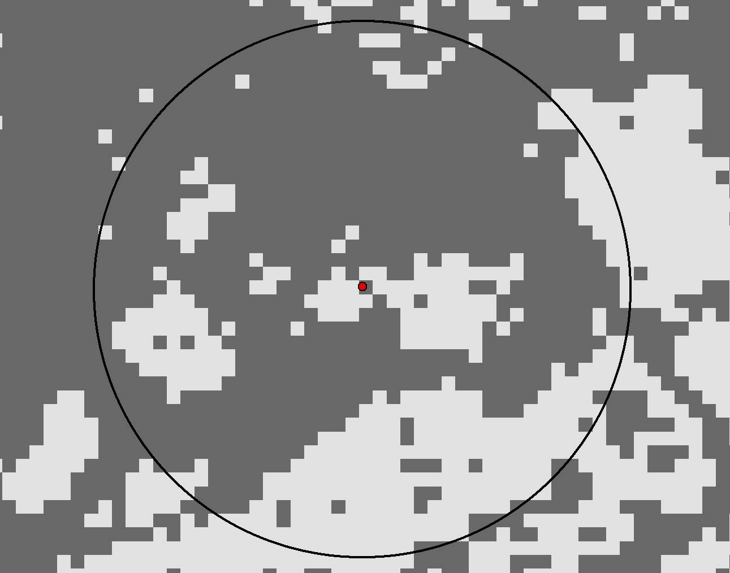
Sprawl Index
240 undev. pix
= 20%
1200 total pix
560 m
Urban
0-50%
Developed pixels
are dark gray

Slide 26
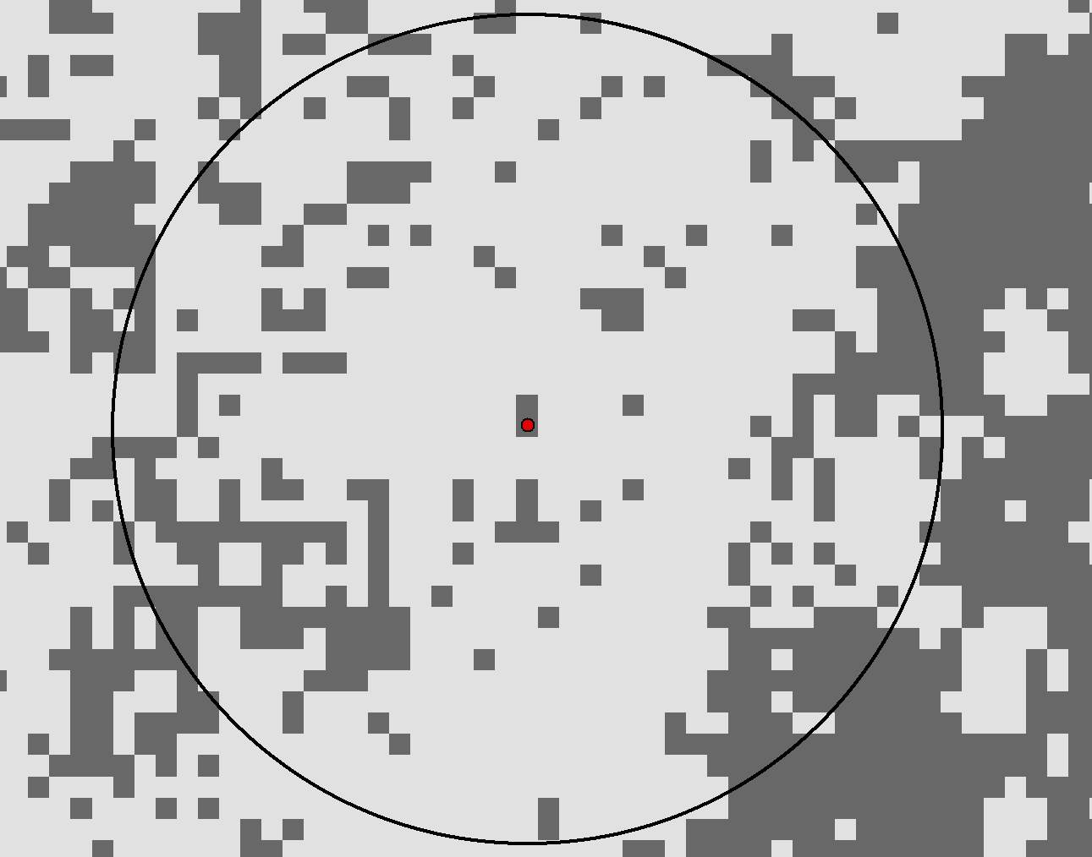
Sprawl Index
960 undev. pix
= 80%
1200 total pix
560 m
Suburb
50 – 80%
Developed pixels
are dark gray

Slide 27
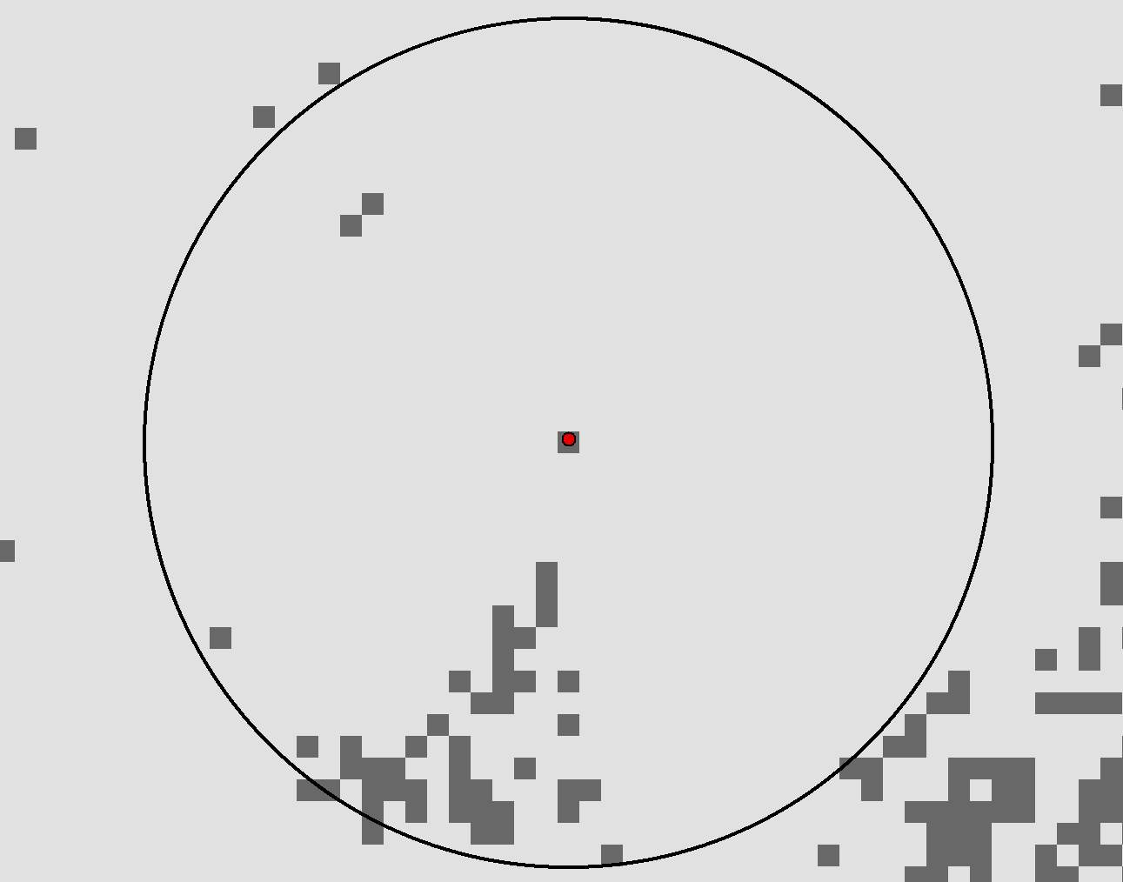
Sprawl Index
1160 undev. pix
= 97%
1200 total pix
560 m
Rural
90 – 100%
Developed pixels
are dark gray

Slide 28
Sprawl Index
Spatial scale choice (1 km² - radius 560 m)
Only 0.3 % of residential development was more than 1 km from other residential development in 1992
Notes:
Limitations of analysis
Use remotely sensed data (NLCD) to detect urban land development between 1976-1992
Compare disparate datasets
Measurement is limited to single spatial scale
Analysis is aspatial: average measure of sprawl for metro area is regressed on metropolitan characteristics
Ignore land use pattern outside metro areas

Slide 29
Sprawl Across United states
Sprawl Index (1992) =0.43
Measure of sprawl shows that 43 percent of the square kilometer surrounding an average residential development is undeveloped
Sprawl Index (1976) =0.42
Average residential development was essentially unchanged between 1976 and 1992
Notes:
Limitations of analysis
Use remotely sensed data (NLCD) to detect urban land development between 1976-1992
Compare disparate datasets
Measurement is limited to single spatial scale
Analysis is aspatial: average measure of sprawl for metro area is regressed on metropolitan characteristics
Ignore land use pattern outside metro areas

Slide 30
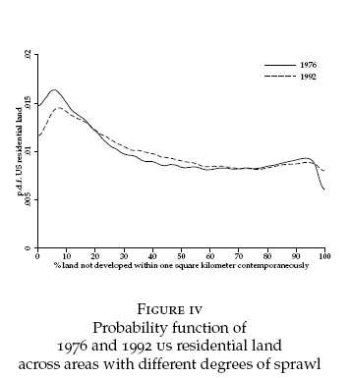
Sprawl as scattered residential development
Cell-based measure of sprawl = average %undeveloped land within 1km² of residential cells in metro
“The extent of (residential) sprawl has remained roughly unchanged between 1976 and 1992.”
Notes:
Limitations of analysis
Use remotely sensed data (NLCD) to detect urban land development between 1976-1992
Compare disparate datasets
Measurement is limited to single spatial scale
Analysis is aspatial: average measure of sprawl for metro area is regressed on metropolitan characteristics
Ignore land use pattern outside metro areas

Slide 31
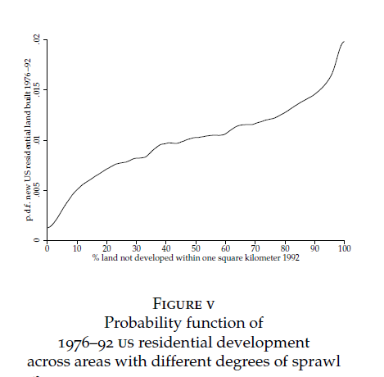
Sprawl as scattered residential development
Cell-based measure of sprawl = average %undeveloped land within 1km² of newly residential cells in metro
Flow of new residential development between 1976 and
1992 was biased towards sprawling areas
Notes:
Limitations of analysis
Use remotely sensed data (NLCD) to detect urban land development between 1976-1992
Compare disparate datasets
Measurement is limited to single spatial scale
Analysis is aspatial: average measure of sprawl for metro area is regressed on metropolitan characteristics
Ignore land use pattern outside metro areas

Slide 32
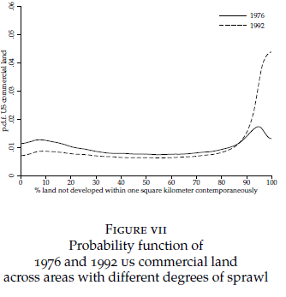
Sprawl as scattered commercial development
Cell-based measure of sprawl = average %undeveloped land within 1km² of commercial cells in metro
Flow of new residential development between 1976 and
1992 was biased towards sprawling areas
Notes:
Limitations of analysis
Use remotely sensed data (NLCD) to detect urban land development between 1976-1992
Compare disparate datasets
Measurement is limited to single spatial scale
Analysis is aspatial: average measure of sprawl for metro area is regressed on metropolitan characteristics
Ignore land use pattern outside metro areas

Slide 33
Sprawl Index for metropolitan areas
Metropolitan area | SI, 1992 | SI, 1976
Atlanta | 55.57 | 57.77
Boston | 47.64 | 44.72
Miami | 20.73 | 20.23
Los Angeles | 35.41 | 32.95
New York | 28.75 | 33.92
“Sprawl varied dramatically across metropolitan areas.”
“Even at the metropolitan area level the extent of sprawl is very stable over time”

Slide 34
Another Sprawl Measures
Median Lot Size (S₁)
Miles Driven per Person (S₂)
% Employment over 3 miles from CBD (S₃)

Slide 35
Correlation matrix for various sprawl measures
S₁ - Median Lot Size (S₁)
S₂ - Miles Driven per Person (S₂)
S₃ - % Employment over 3 miles from CBD – (USA Today’s sprawl index published in 2001)
 | SI | S1 | S2 | S3
SI | 1.000
S1 | 0.521 | 1.000
S2 | 0.271 | 0.187 | 1.000
S3 | -0.070 | 0.011 | -0.073 | 1.000

Slide 36
Urban sprawl variables (other authors)
Residential density
Neighborhood mix of homes, jobs, and services;
Accessibility of the street network.
Overall mobility
Public transport
Road traffic
Accessibilities
Strength of activity centers and downtowns
...

Slide 37
Some critique (E. Irwin, N. Bockstael and H. J. Cho)
Measurement of sprawl is highly dependent on data and spatial scale of analysis
Aggregate pattern analysis masks important variations

Slide 38
III. Causes of Sprawl
The Monocentric City Model
proportion of jobs located in CBD and employment decentralization
transport costs
Open space & amenities
Space is not Featureless Plain
Aquifers
Physical landscape
Political Geography
Jurisdictional fragmentation
Zoning

Slide 39
Monocentric city
The monocentric city model assumes that all employment in the city takes place at a single center, the central business district.
Residential development around that center is then shaped by the tradeoff between convenient commuting close to the center and affordable housing further away.
Substitution in response to declining land and housing prices leads to larger dwellings with lower capital to land ratios (i.e., less tall, more spacious units and larger yards) as one moves away from the center.

Slide 40
Monocentric city
Cities specializing in sectors where employment tends to be more centralized will be more compact.
Lower transport costs within a city will result in more dispersed development.

Slide 41
Monocentric city
Standard monocentric city model cannot explain leapfrog development.
Amenity value of public open space:
characteristics that make public open space more attractive will increase sprawl;
cities that have been growing faster will tend to experience less sprawl;
Housing is durable and redevelopment costly => construction lag
leapfrogging is greater the greater the uncertainty about future urban growth

Slide 42
When Space Is Not a Featureless Plain
Example. Municipal water systems
wherever aquifers underly the urban fringe, household water can be obtained without the large increasing returns associated with public water systems and this facilitates scattered development.
We would expect rugged terrain to naturally encourage scattered development.
In contrast, high mountains in the urban fringe are likely to make development more compact.
Cities with a pleasant temperate climate experience more sprawl.

Slide 43
Political Geography
Jurisdictional Fragmentation
Zoning
To the extent that there are unincorporated areas on the urban fringe, developers can escape municipal regulation by building outside municipal boundaries, and this facilitates sprawl.
sprawl should be more prevalent where local tax payers pay a smaller share of local government expenses.

Slide 44
Causes of Sprawl
Cities will sprawl more if:
they specialize in sectors where employment is not typically located close to the city center,
they were built around the car rather than around public transport,
they have experienced slow population growth,
there is greater uncertainty regarding their future population growth,

Slide 45
Causes of Sprawl
Cities will sprawl more if:
aquifers underlie a greater fraction of their urban fringe,
they are not surrounded by high mountains,
terrain in their urban fringe is rugged,
their climate is temperate,
they begin with substantial unincorporated areas on the urban fringe,
local tax payers pay a smaller share of local government expenses.

Slide 46
The determinants of sprawl
Sample: N=275 metropolitan areas
SI _{newly} – Sprawl Index for newly developed cells 1976-1992
SI ₁₉₉₂ – Sprawl Index, 1992
X1 – Centralized sector employment, 1977
X2 – Steetcar passenger per capita, 1992
X3 – Mean % pop.growth 1920-70
X4 – S.d. pop.growth
X5 – % of urban fringe overlaying aquifers
X6 – Elevation range in urban fringe
X7 – Terrain ruggedness index
X8 – Mean cooling degree-days
X9 – Mean heating degree-days
X10 – % of urban fringe incorporate 1980
X11 – Intergov. Transfer, % of local revenues, 1967

Slide 47
The determinants of sprawl (1)
SI _{newly} – Sprawl Index for newly developed cells 1976-1992
X1 – Centralized sector employment, 1977
X2 – Steetcar passenger per capita, 1992
X3 – Mean % pop.growth 1920-70
X4 – S.d. pop.growth
X5 – % of urban fringe overlaying aquifers
X6 – Elevation range in urban fringe
X7 – Terrain ruggedness index
X8 – Mean cooling degree-days
X9 – Mean heating degree-days
X10 – % of urban fringe incorporate 1980
X11 – Intergov. Transfer, % of local revenues, 1967

Slide 48
The determinants of sprawl (4)
SI ₉₂– Sprawl Index,1992
X1 – Centralized sector employment, 1977
X2 – Steetcar passenger per capita, 1992
X3 – Mean % pop.growth 1920-70
X4 – S.d. pop.growth
X5 – % of urban fringe overlaying aquifers
X6 – Elevation range in urban fringe
X7 – Terrain ruggedness index
X8 – Mean cooling degree-days
X9 – Mean heating degree-days
X10 – % of urban fringe incorporate 1980
X11 – Intergov. Transfer, % of local revenues, 1967

