Slide 1
Direct reprogramming
Jana Bartoňková
Lukáš Bálek

Slide 2
Direct reprogramming
= transdiferenciace

Slide 3
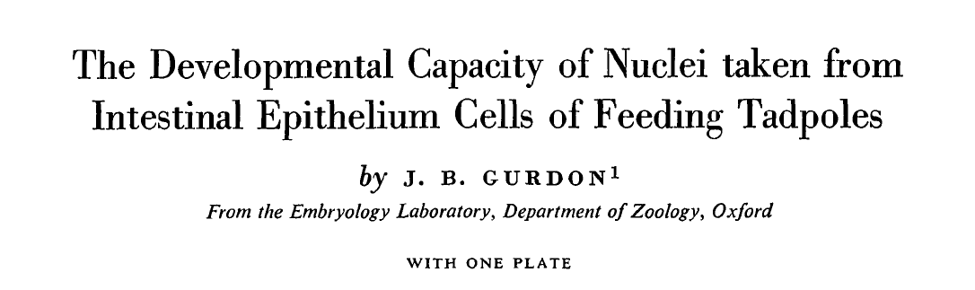
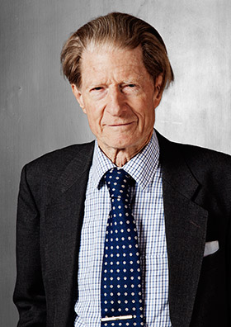
Nobelova cena 2012 (S. Yamanaka)

Slide 4
ICM
tisíce let
Fibroblast
Neuron

Slide 5
ICM
tisíce let
Fibroblast
hESC
1998
Neuron

Slide 6
ICM
tisíce let
Fibroblast
hESC
1998
iPSC
2006
Neuron

Slide 7
ICM
tisíce let
Fibroblast
hESC
1998
iPSC
2006
Neuron
můžeme…?!

Slide 8
náhrada/oprava buněk, tkání a orgánů
model nemoci na buněčné úrovni

Slide 9
Medicína
IN VITRO
IN VITRO
IN SITU
iPSC
Diferencovaná buňka
Transdiferenciace in vivo
Diferencovaná buňka
Transdiferencovaná buňka in vitro
Implantace
Implantace

Slide 10
Jak na to?
transkripční faktory
epigenetické regulátory
miRNA
malé chemické molekuly

Slide 11
Jak na to?
transkripční faktory
- hodiny po transfekci
stabilní i po odstranění stimulu

Slide 12
Jak na to?
epigenetické regulátory
Dnmt1 (Dhawan et al., 2011)
Baf60c (Takeuchi and Bruneau, 2009)
- polycomb repressor complex 2 (PRC2) (Patel et al., 2012)

Slide 13
Jak na to?
miRNA
miR-9/9 and miR-124 (Yoo et al., 2011)
není tak efektivní jako TF

Slide 14
Jak na to?
malé chemické molekuly
především u iPSC
předmět výzkumu

Slide 15
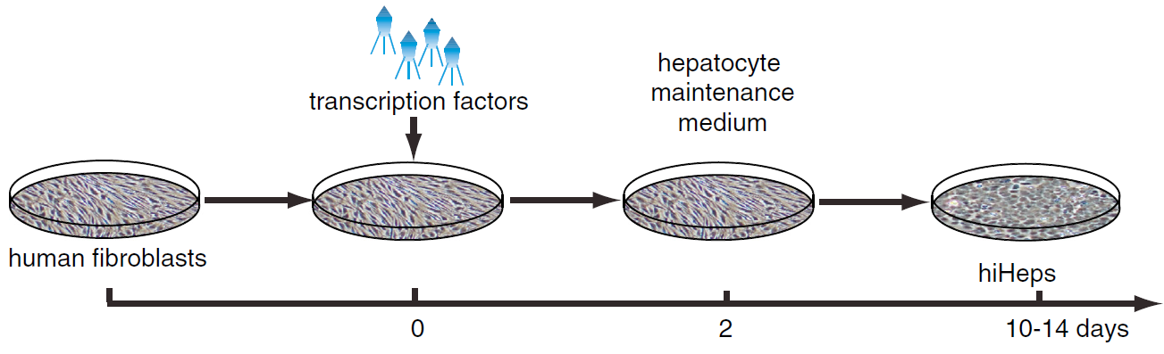
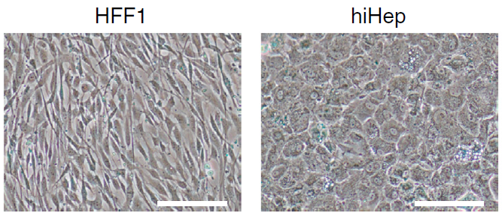
HFF = human fetal limb fibroblast
Huang P., Zhang L., Gao Y. et al. (2014). Cell Stem Cell 14, 370–384

Slide 16
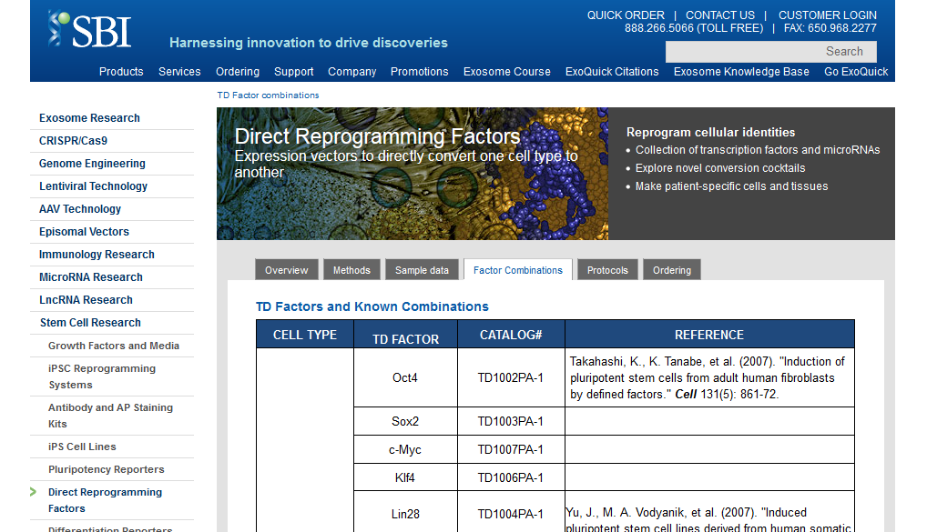
www.systembio.com

Slide 17
IN VITRO
Ieda, M., J. D. Fu, et al. (2010). "Direct reprogramming of fibroblasts into functional cardiomyocytes by defined factors." Cell 142(3): 375-86.
Tbx5, Mef2c, Gata-4, Mesp1
Kardiomyocyty
Efe, J. A., S. Hilcove, et al. (2011). "Conversion of mouse fibroblasts into cardiomyocytes using a direct reprogramming strategy." Nat Cell Biol 13(3): 215-22.
Oct4, Sox2, Klf4, C-Myc
Zhou, Q., J. Brown, et al. (2008). "In vivo reprogramming of adult pancreatic exocrine cells to beta-cells." Nature 455(7213): 627-32.
Pankreas
Ngn3, Pdx1, MafA, VP16
Krevni
progenitory
Oct4, Gata1, Gata2, Gata3, Gata-4
Szabo, E., S. Rampalli, et al. "Direct conversion of human fibroblasts to multilineage blood progenitors." Nature 468(7323): 521-6
Ivey, K. N. and D. Srivastava (2011). MicroRNAs as regulators of differentiation and cell fate decisions." Cell Stem Cell 7(1): 36-41.
Osteoblasty
Mir-2861

Slide 18
IN VITRO
Vierbuchen, T., et al. (2010). "Direct conversion of fibroblasts to functional neurons by defined factors." Nature 463(7284): 1035-41.
Brn2, Ascl1, Mytl1, Zic1
Brn2, Ascl1, Mytl1, NeuroD1
Pang, Z. P., et al. (2011). "Induction of human neuronal cells by defined transcription factors." Nature 476(7359): 220-3.
Mir-9, Mir-124, Ascl1, Mytl1
Yoo, A. S., et al. (2011). "MicroRNA-mediated conversion of human fibroblasts to neurons." Nature 476(7359): 228-31.
Neurony
Ascl1, Brn2, Mytl1, Lmx1a, FoxA2
Caiazzo, M.et al. (2011). "Direct generation of functional dopaminergic neurons from mouse and human fibroblasts." Nature 476(7359): 224-7.
Ambasudhan, R., M. Talantova, et al. (2011). "Direct Reprogramming of Adult Human Fibroblasts to Functional Neurons under Defined Conditions." Cell Stem Cell 9(2): 113-8.
Mytl1, Brn2, Mir-124
Kim, J., J. A. Efe, et al. (2011). "Direct reprogramming of mouse fibroblasts to neural progenitors." Proc Natl Acad Sci. 108(19): 7838-43.
Oct4, Sox2, Klf4, C-Myc

Slide 19
IN VITRO
Dopaminergní
neurony
Pfisterer, U., A. Kirkeby, et al. (2011). "Direct conversion of human fibroblasts to dopaminergic neurons." Proc Natl Acad Sci.108(25):10343-8.
Ascl1, Brn2, Mytl1, Foxa2, Lmx1a
Motorické
neurony
Lhx3, Ascl1, Brn2, Mytl1, Ngn2, Hb9, Isl1, NeuroD1
Son, E. Y., J. K. Ichida, et al. (2011). "Conversion of Mouse and Human Fibroblasts into Functional Spinal Motor Neurons." Cell Stem Cell.
Huang, P., Z. He, et al. (2011). "Induction of functional hepatocyte-like cells from mouse fibroblasts by defined factors." Nature 475(7356): 386-9.
Gata-4, HNF1-alpha, Foxa3
Sekiya, S. and A. Suzuki (2011). "Direct conversion of mouse fibroblasts to hepatocyte-like cells by defined factors." Nature 475(7356): 390-3.
Hepatocyty
HNF4-alpha, Foxa1, Foxa2, Foxa3
Huang P., Zhang L., Gao Y. et al.(2014). Direct Reprogramming of Human Fibroblasts to Functional and Expandable Hepatocytes. Cell Stem Cell 14, 370–384
Foxa3, HNF1A, HNF4A

Slide 20
IN SITU
2008 D. Melton: exokrinní buňky slinivky břišní > beta buňky (Ngn3, Pdx1 a Mafa)
2012 D. Srivastava: fibroblasty z jizvy srdce po infaktu > bijící kardiomyocyty (Gata4, Mef2c and Tbx5)
2014 Guo: gliové buňky > neurony (NeuroD1)
2015 Weider: satelitní gliové buňky > oligodendrocyte-like buňky (Sox10)

Slide 21
Překážky ve využítí
udržení/expanze buněk
nízká efektivita
bezpečnost použití

Slide 22
