Slide 1
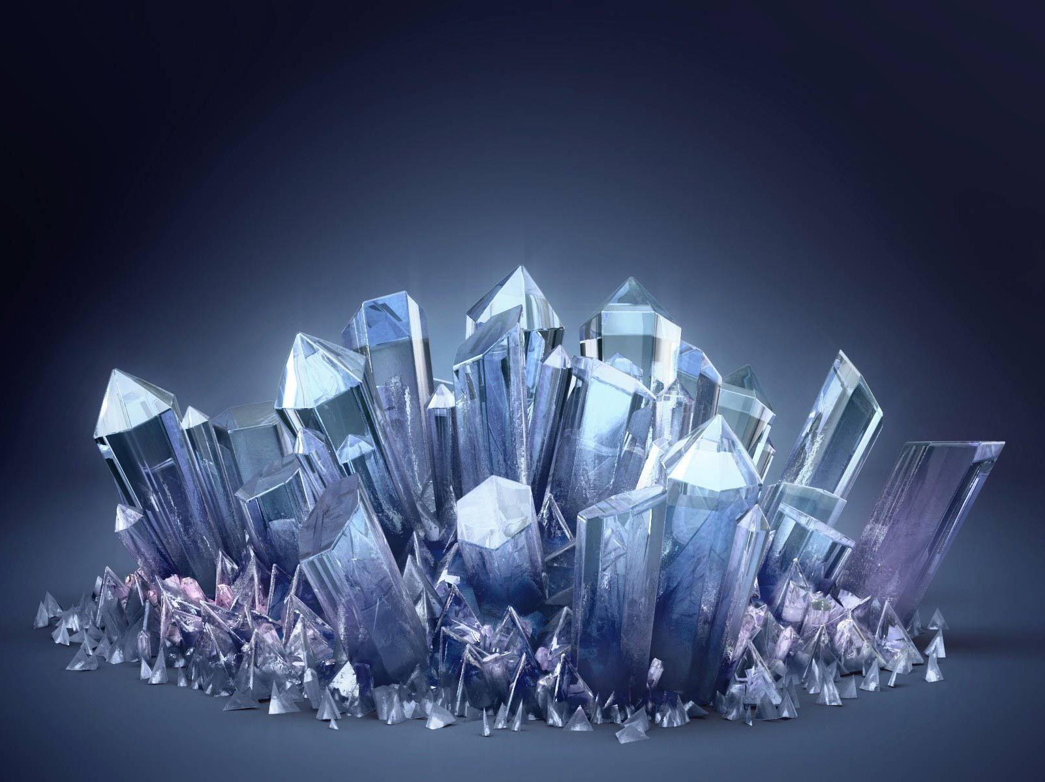
Winter School on Structural Cell Biology
Protein crystallization
Josef Houser

Slide 2
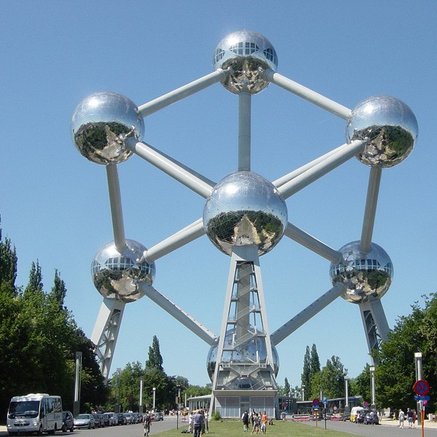
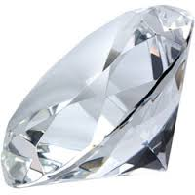
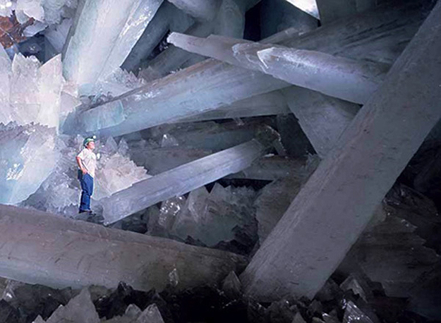
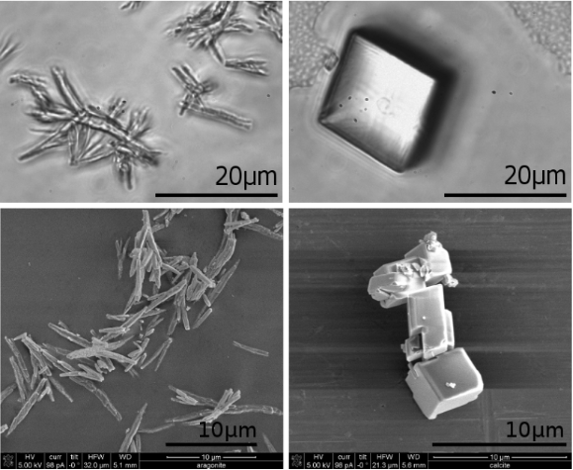
Crystal
2 mm
102 m
2 m

Slide 3
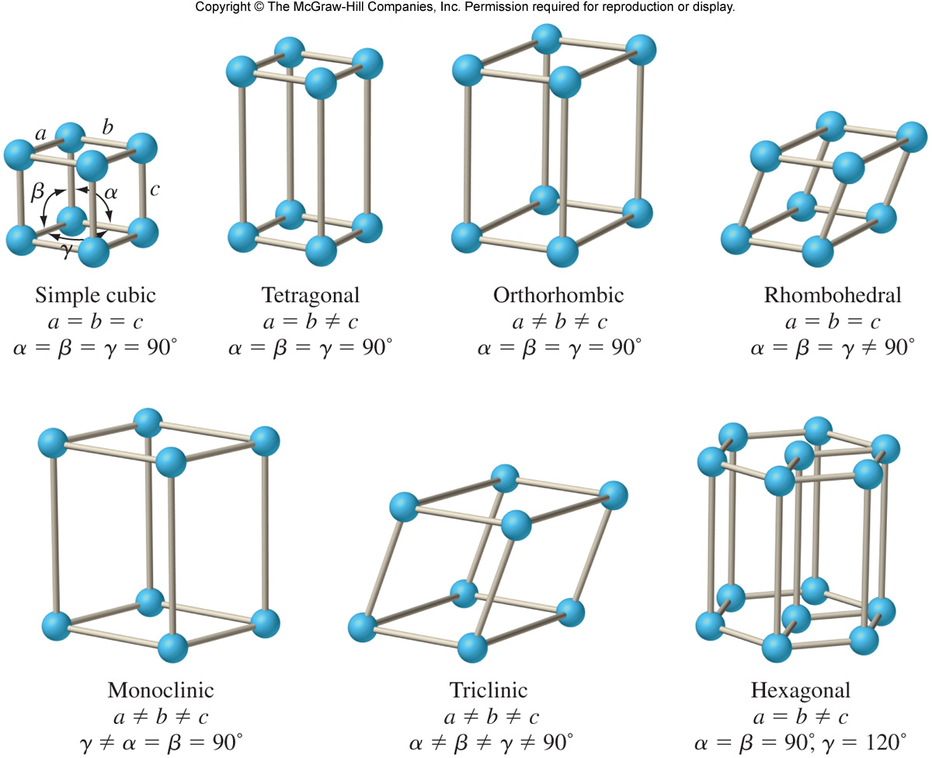
7 Crystal lattices

Slide 4
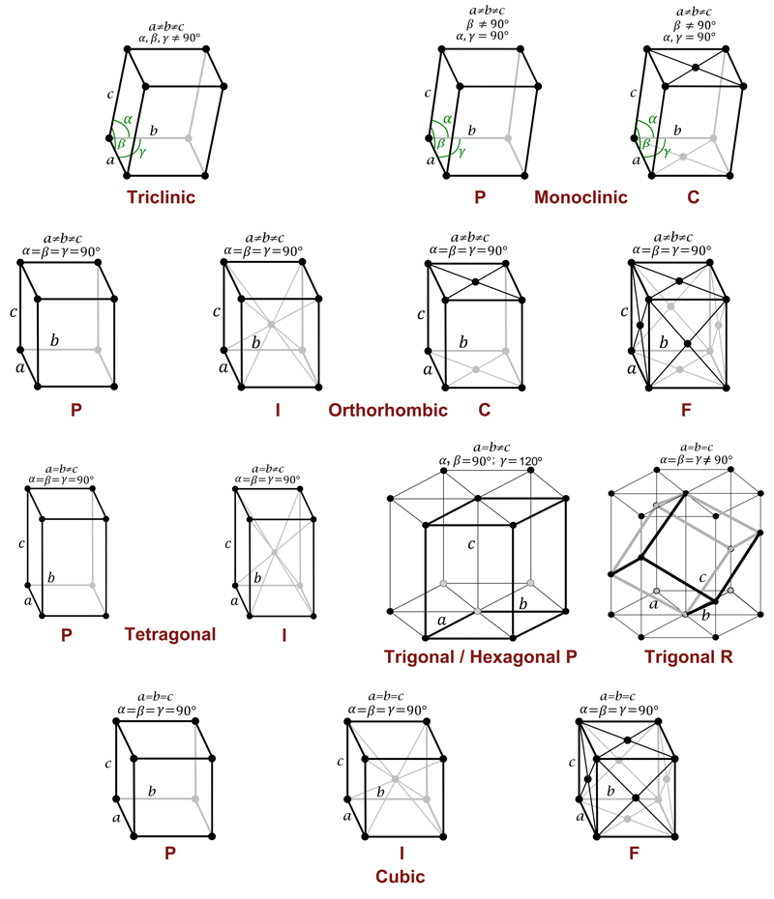
14 Bravais lattices

Slide 5
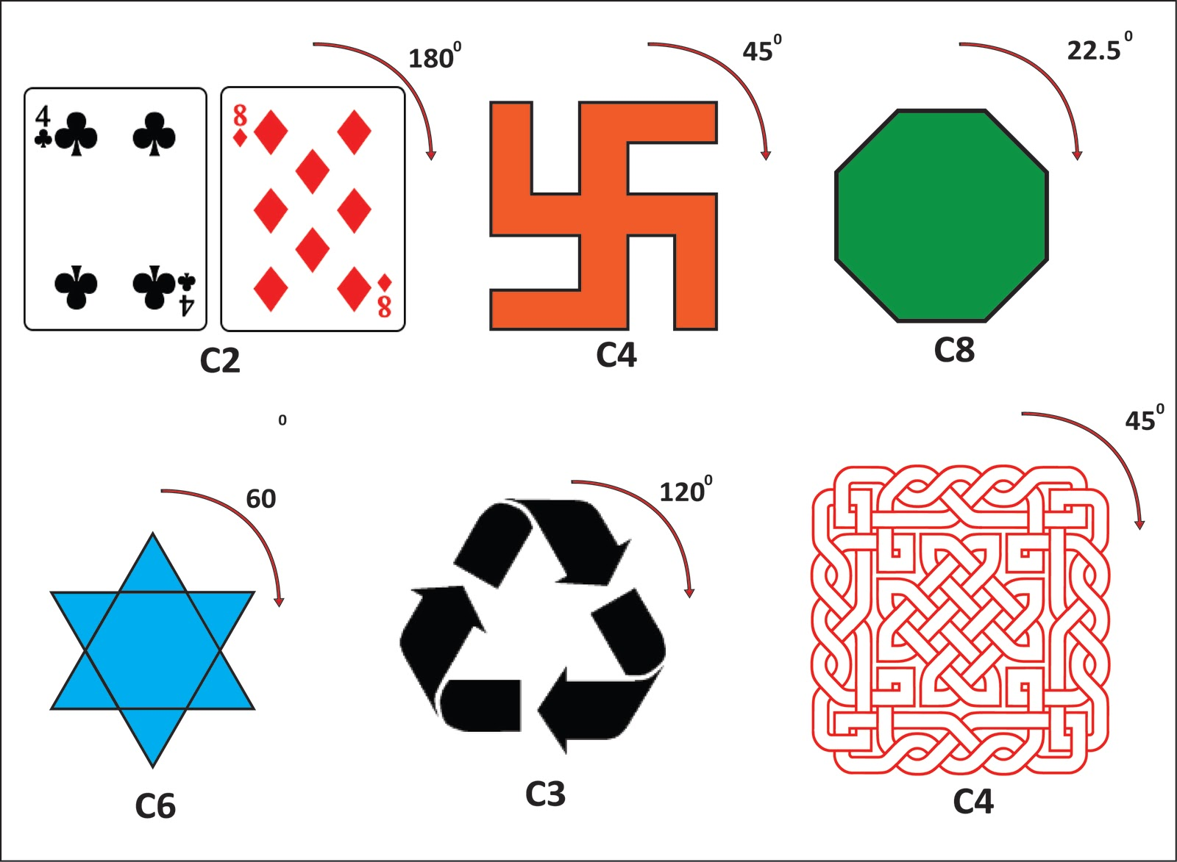
Symmetry – Space groups
2D symmetry
3D symmetry
Proteins are chiral – no mirror symmetry
Screw axis
Combination of Bravais lattices and symmetry operations leads to 230 possible space groups (not all for proteins).

Slide 6
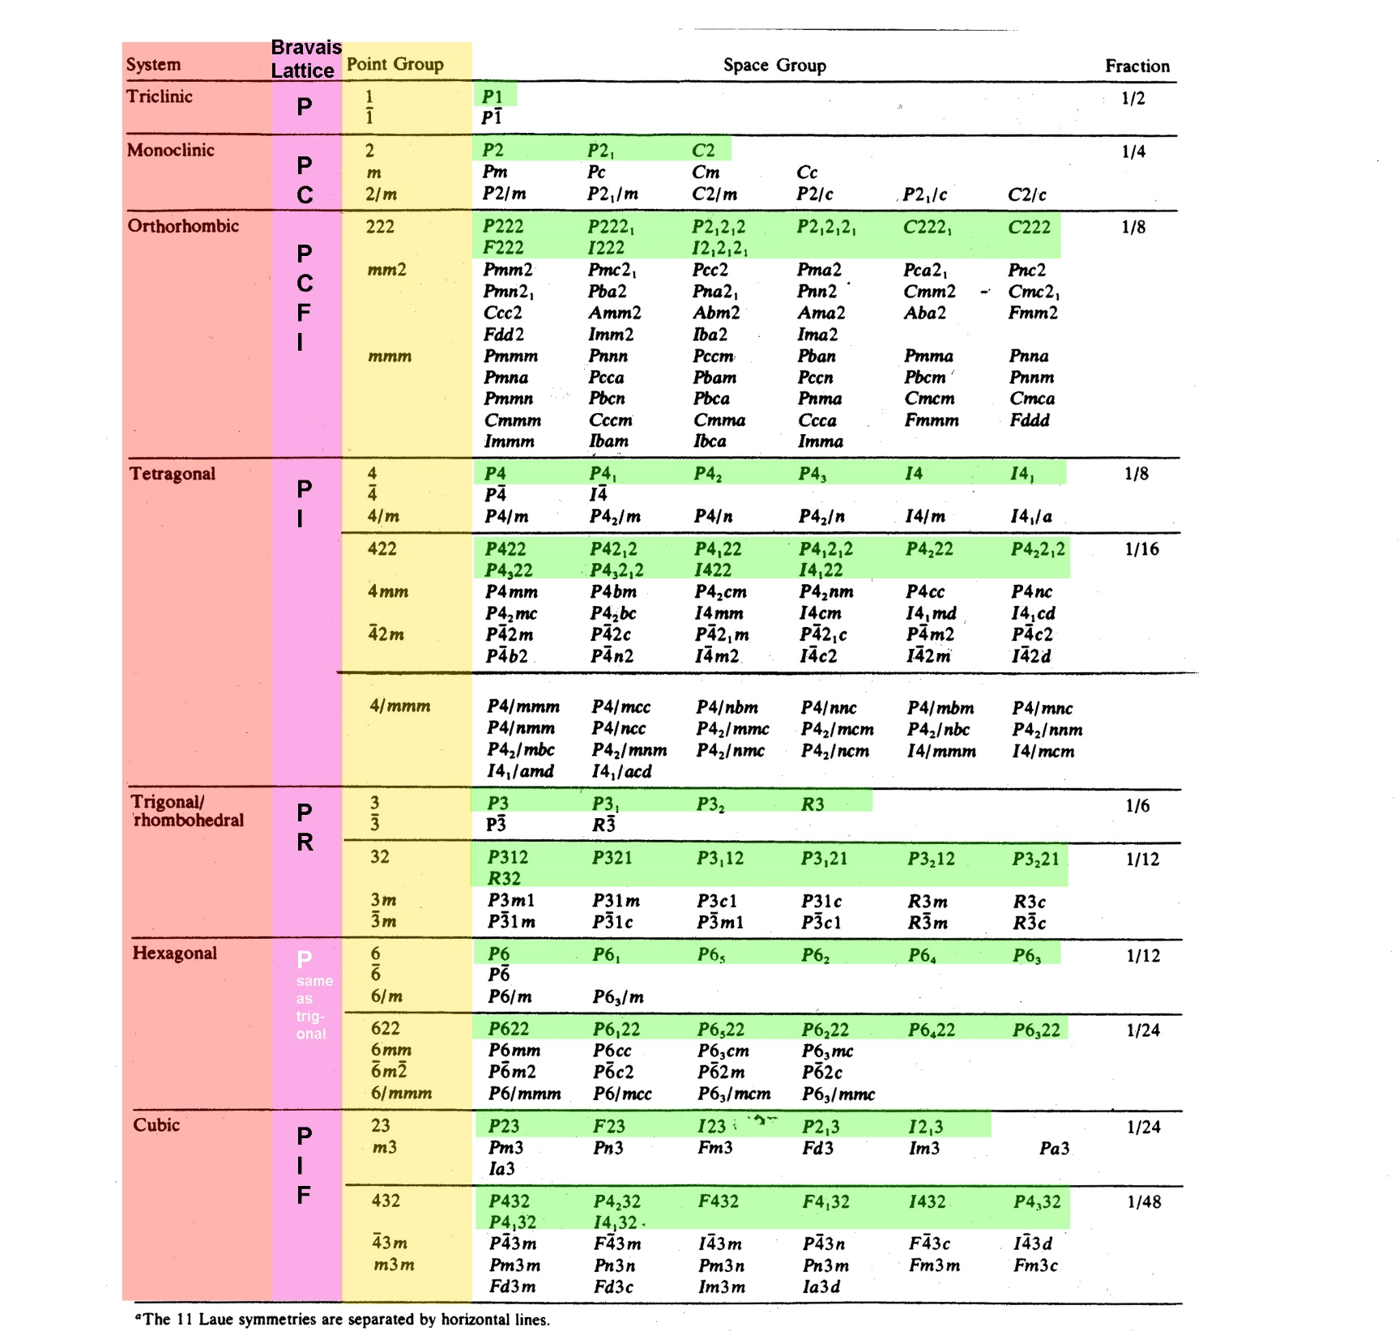
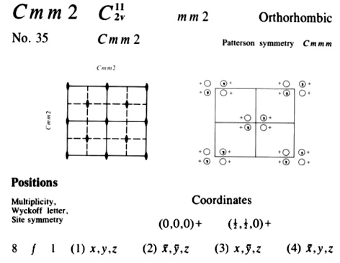
Example of space group information from International Crystallographic Tables

Slide 7
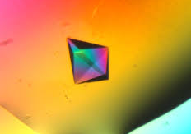
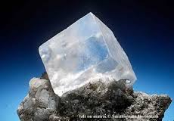
Protein
Big molecule
Temperature sensitive
Hundreds-thousands of rotating bonds
Weak interactions mostly involved
High solvent content (30-70 %)
Fragile crystals
Inorganic salt (ev. organics)
Small molecule
Thermostable
None/few rotating bonds
Strong (coulombic) interactions frequent
Low/none solvent content
Hard crystals

Slide 8
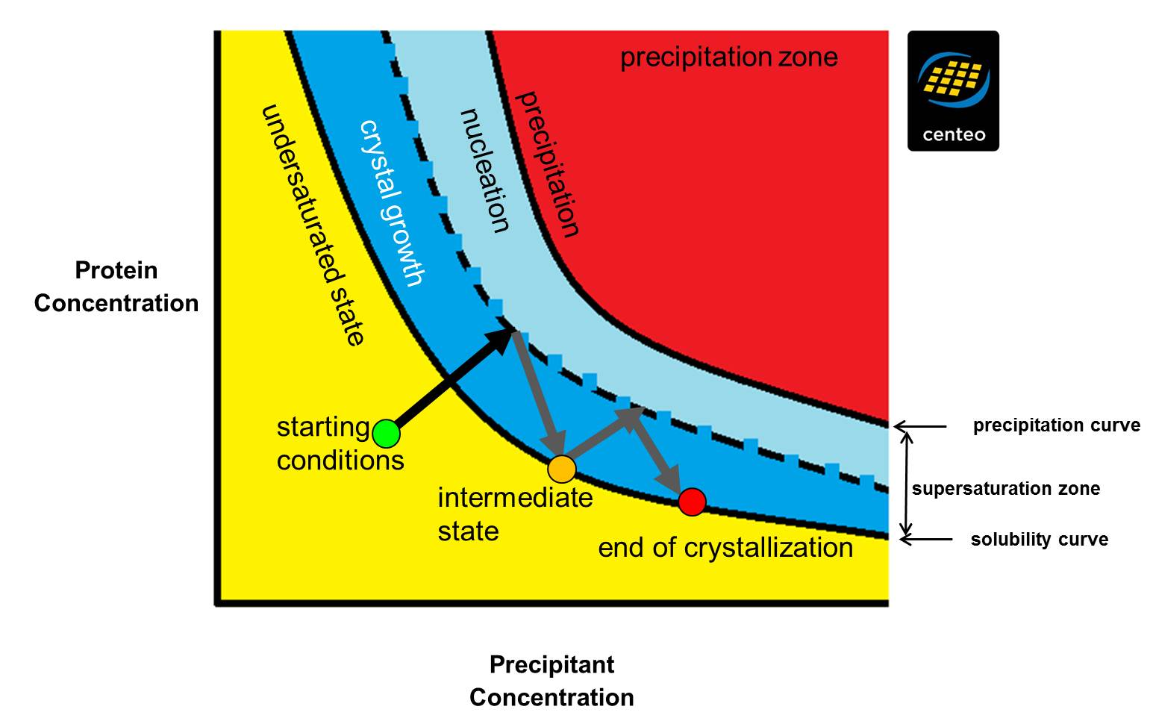
Phase diagram

Slide 9
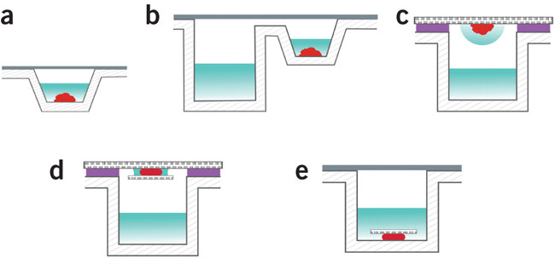
Protein crystallization techniques
Protein crystallization by counter diffusion in capillaries.
Protein crystallization by vapour diffusion: (a) microbatch, (b) sitting drop and (c,d) hanging drop. In d and e, a sandwich is made of the mesophase (red) by placing a small glass coverslip (hatched) (d) below or (e) above the bolus. From Nature Protocols
Protein crystallization by dialysis.

Slide 10
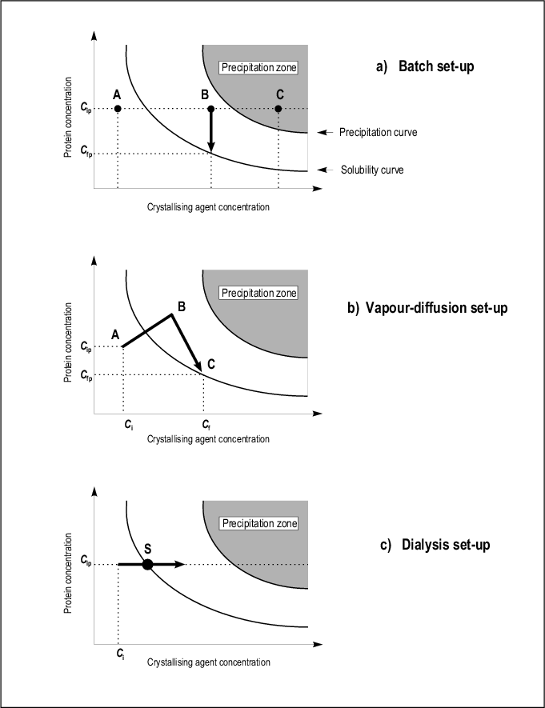
Various techniques = various path in the phase diagram

Slide 11
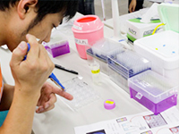
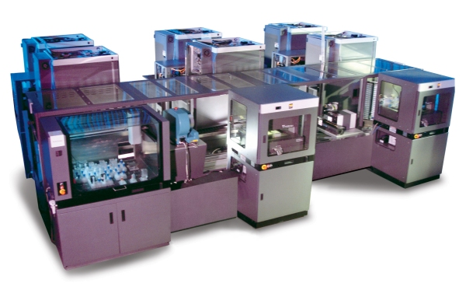
Automatization vs. manual work
High-throughput
Low volumes (20-150 nl)
Reproducibility
Individual design
Immediate visual control
Complex sample handling

Slide 12
Further reading
http://journals.iucr.org/
Naomi E. Chayen: Protein Crystallization Strategies for Structural Genomics, 2007
Terese M. Bergfors: Protein Crystallization, 2009
Alexander McPherson: Introduction to Macromolecular Crystallography, 2011
etc.

