Slide 1
FLASH FLOODS IN NE MORAVIA IN JUNE 2009

Slide 2
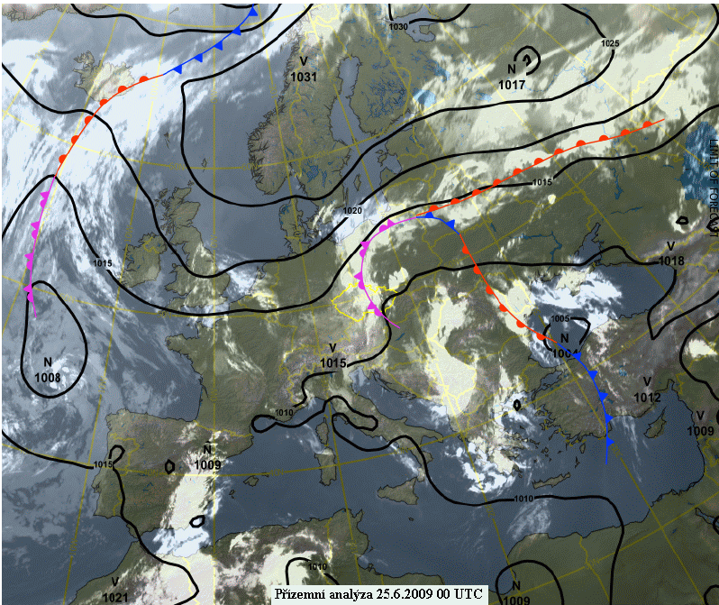
SYNOPTIC SITUATION
Eastern cyclonic circulation
Position and stacionarity of preasure systems, high temperature, high relative humidity

Slide 3
FLASH FLOODS
Good conditions for creating convection
Saturation of soil
Low clouds enhancing the precipitation

Slide 4
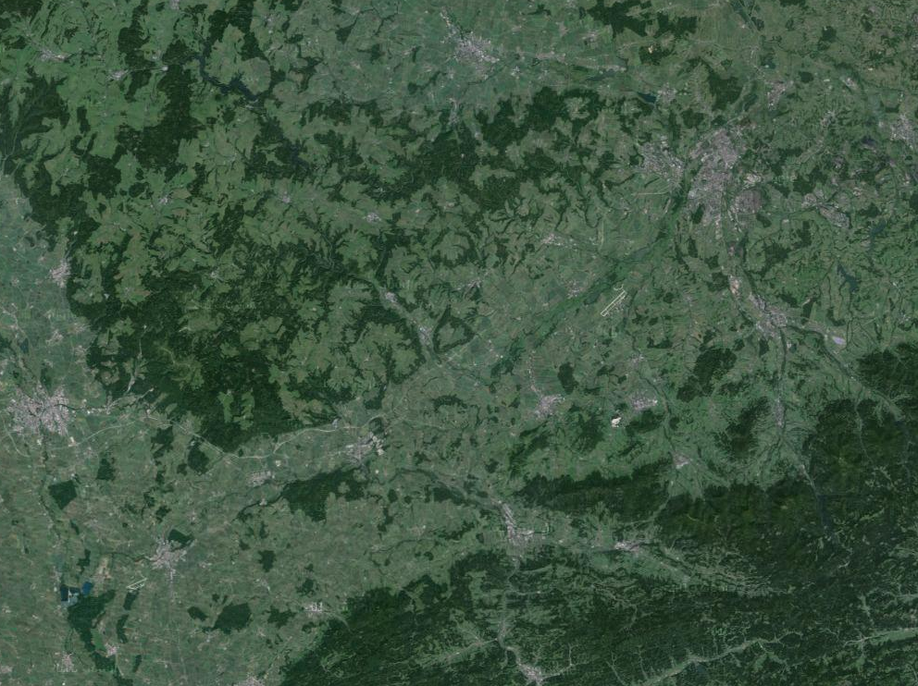

Slide 5
FLASH FLOODS NEAR NOVÝ JIČÍN
THE CONVECTIVE CELLS - 50 Dbz
-not too massive targets (50 dBZ)
-problem 1: TRAIN EFFECT (renewation, movement to SW - along the convergence line)
-problem 2: probably partially orographically

Slide 6
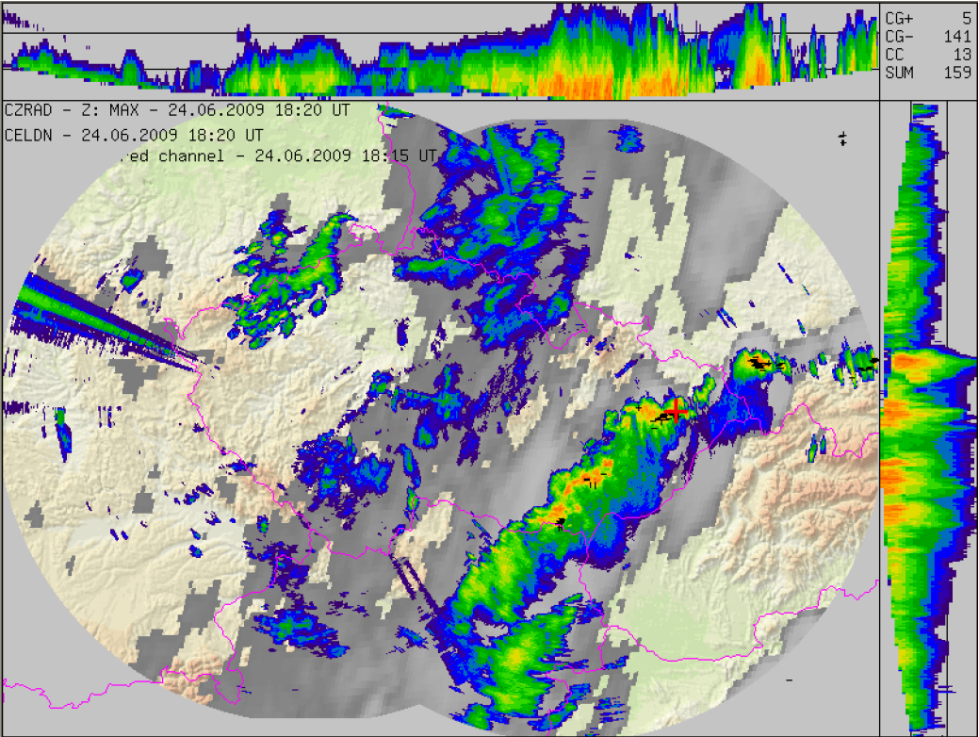

Slide 7
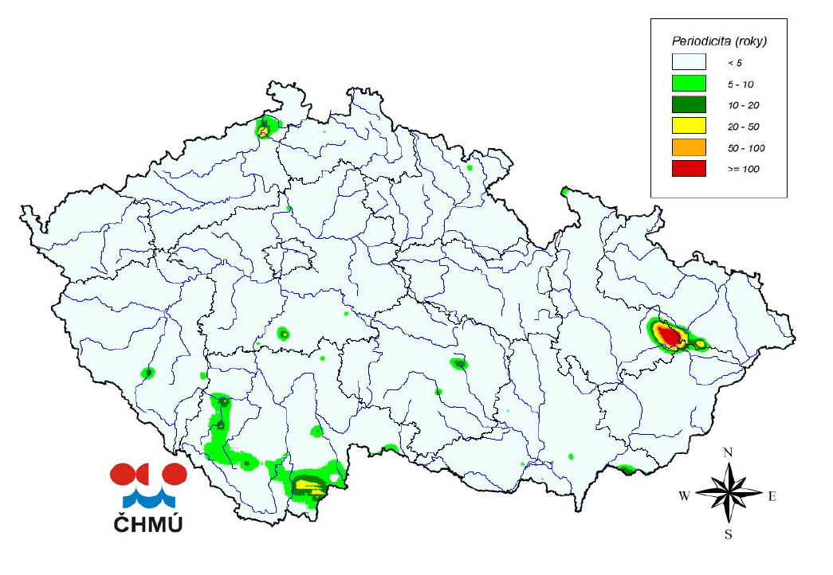
Periodicity of maximal daily sums of precipitation
20. 6. – 6. 7. 2009

Slide 8
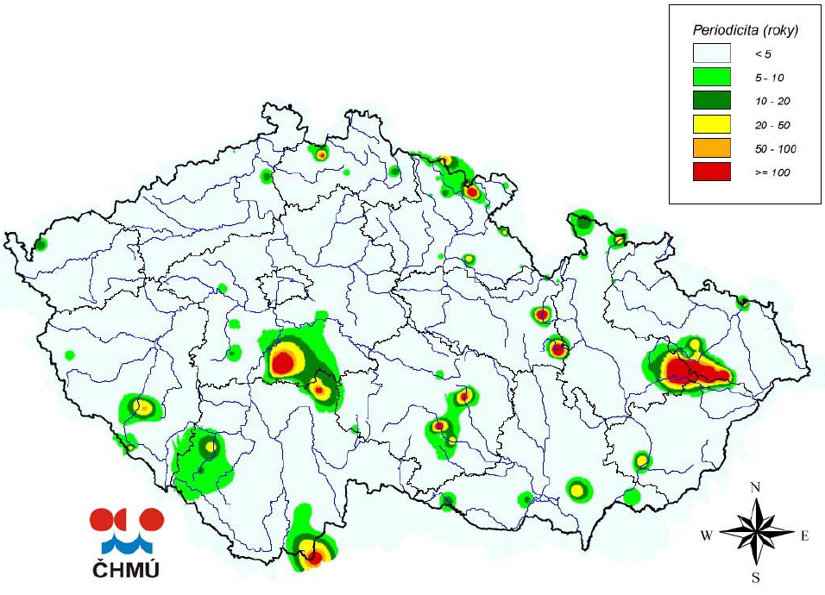
Periodicity of 3-hour sum of precipitation
20. 6. – 6. 7. 2013

Slide 9
Night 24th – 25th June 2009
Catchments of the Jičínka creek and the Luha creek
Jičínka (L = 25,8 km, A = 113,9 km²)
Luha (L = 29,2 km, A= 95,6 km²)
The catchments had been already saturated
The precipitation fell on the middle segments of the catchments (max. 123,8 mm) → 24th June evening during 2-3 hours!

Slide 10
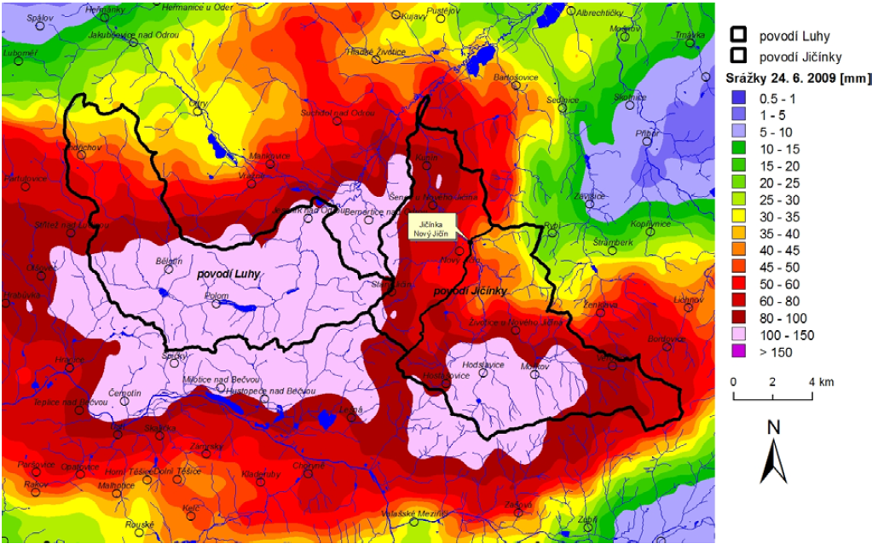
Streams could not catch so much water…

Slide 11
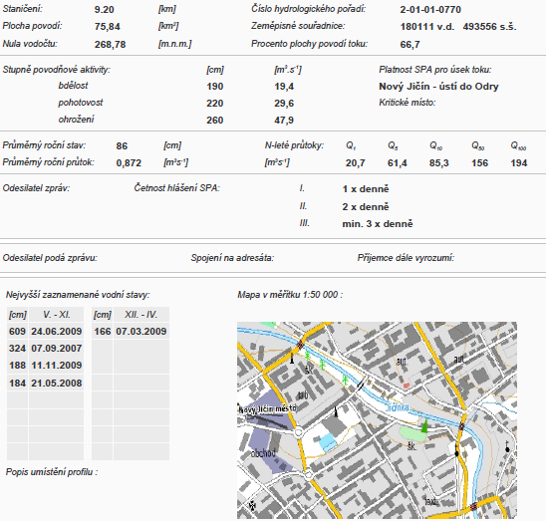
The Jičínka creek – in Nový Jičín – during 2 hours the water stage ca +500 cm !!!
N = 500 years

Slide 12
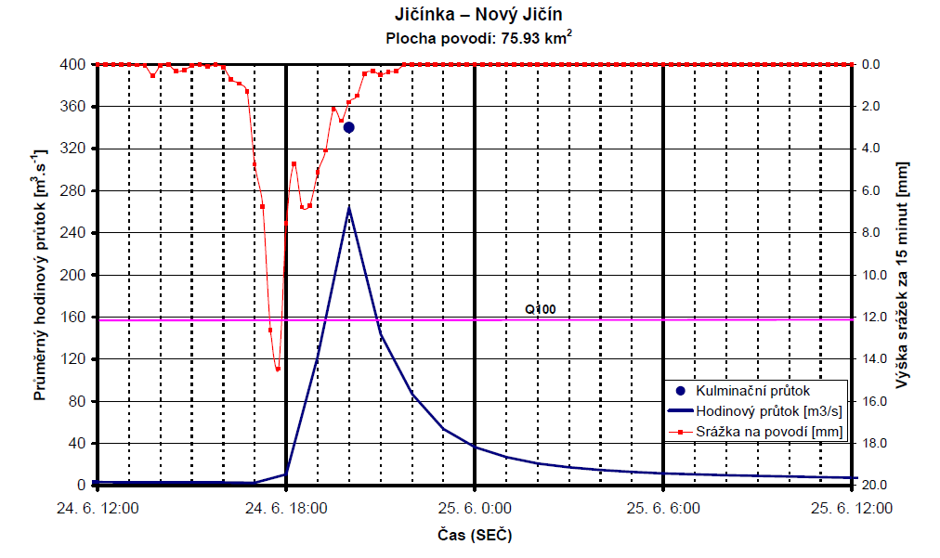

Slide 13
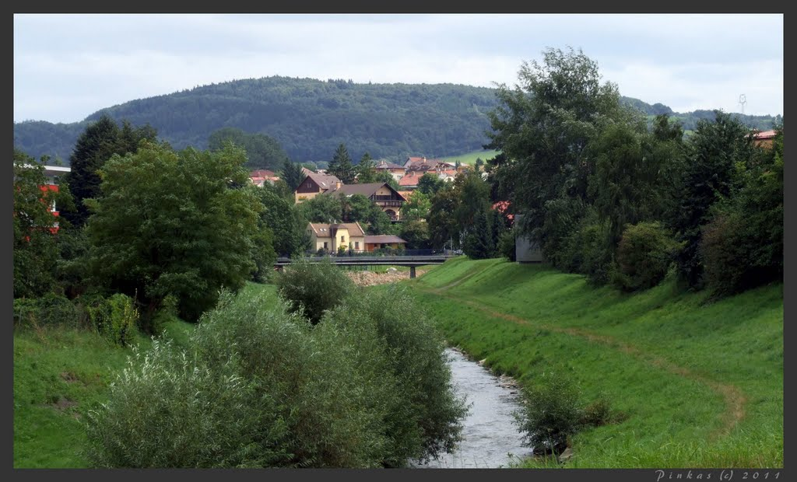

Slide 14
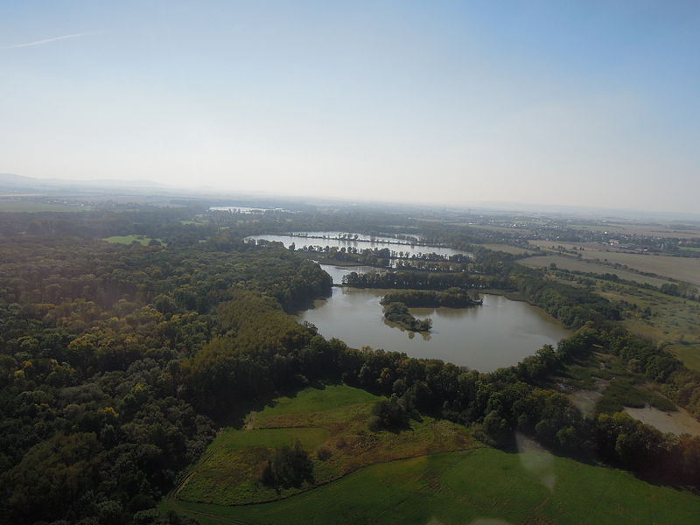
Lower donw the stream the water empyes into the Oder river which is somewhat greater and streams through wider floodplain with grasslands and forests (the Poodří landscape protected park) → transformation of the flood → max. Q in Ostrava one day later, N=2.

Slide 15
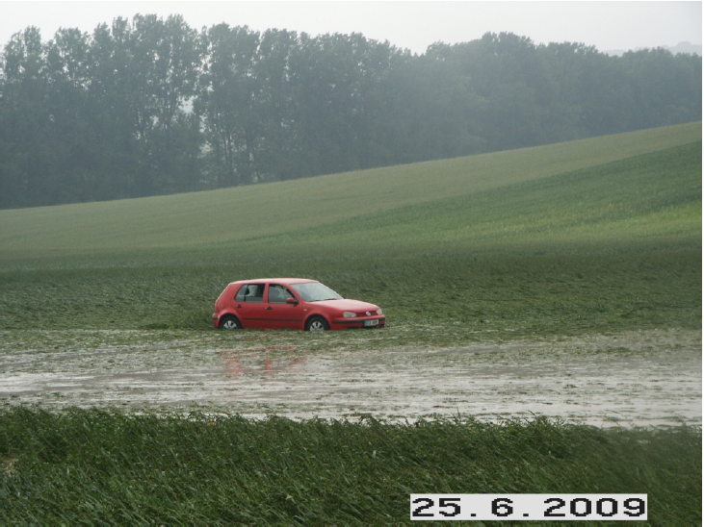

Slide 16
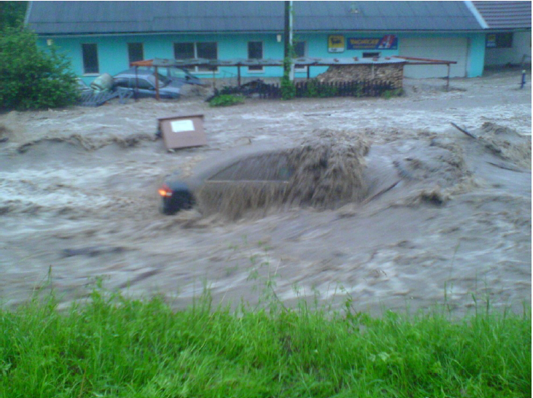

Slide 17
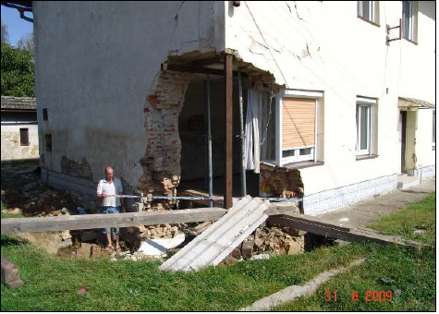
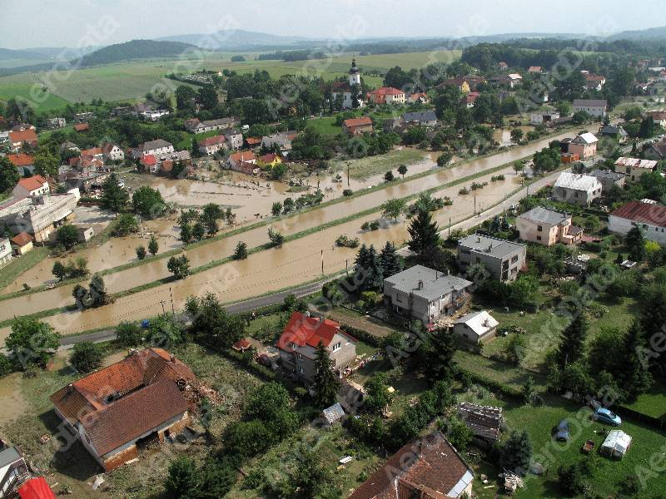
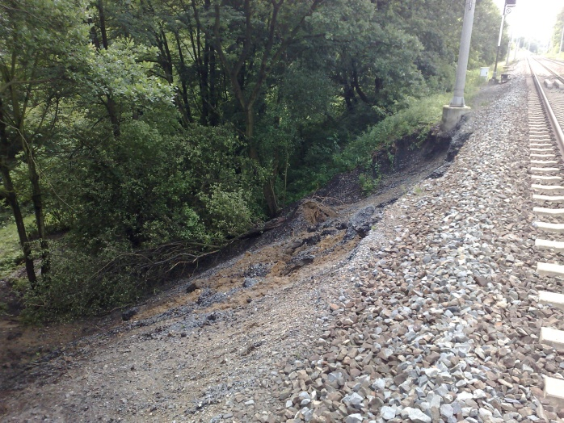
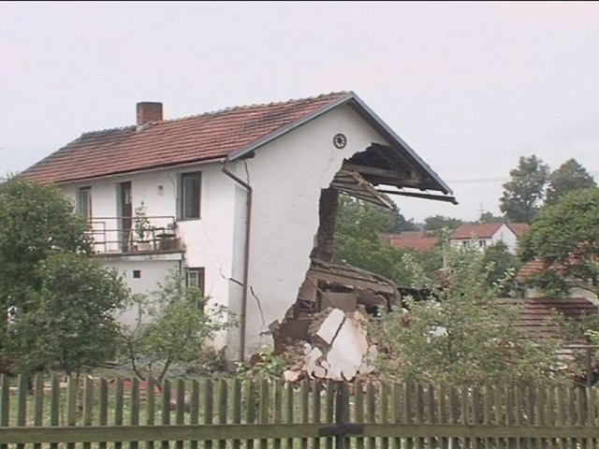

Slide 18
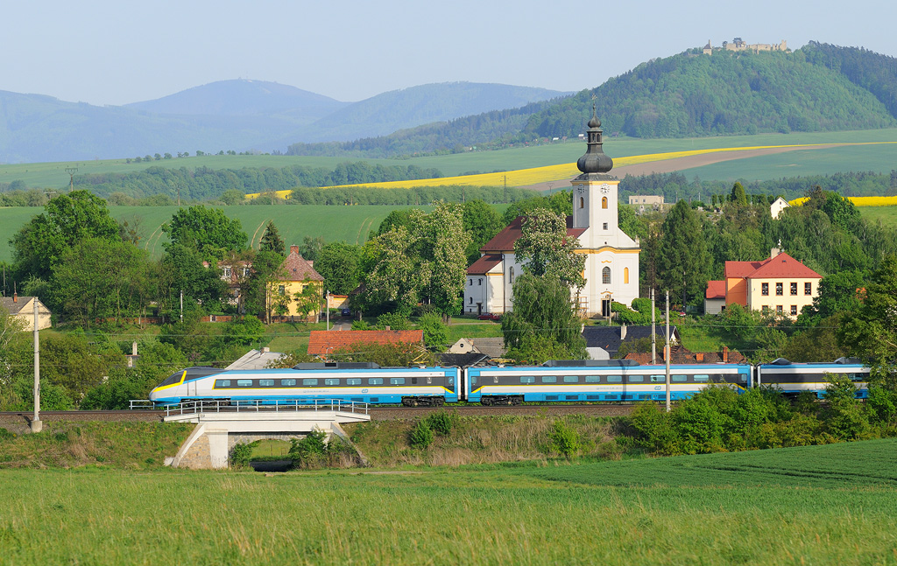
Thank you for your attention!

