Slide 1
Microbial activity in the soil and its seasonal changes: The picture provided by metatranscriptomics and metaproteomics
Petr Baldrian
Institute of Microbiology, Prague, Czech Republic

Slide 2
Ecology of forest topsoil
Nutrients
leaf and root litter - major source of organic matter in soil
- cellulose, lignin, hemicellulose, pectin, proteins
- numerous enzymes required for degradation
- root exudates - nutrient source in mineral and organic soil
            - more readily available C
Microorganisms
- saprotrophic fungi - obtain carbon by organic matter decomposition
- production of extracellular degradative enzymes
- mycorrhizal fungi - obtain carbohydrates from symbiotic plants
- provide soil nutrients to plants
- saprotrophic abilities vary
- bacteria - preferential utilization of easily available compounds
        - degradation of biopolymers by some taxa

Slide 3
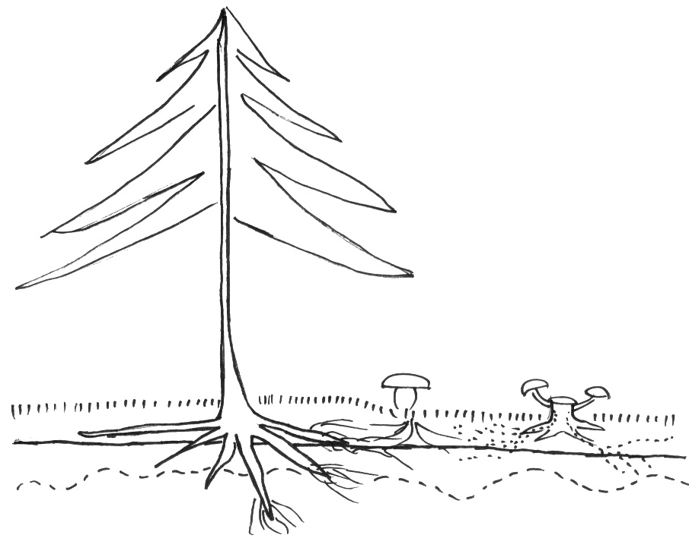
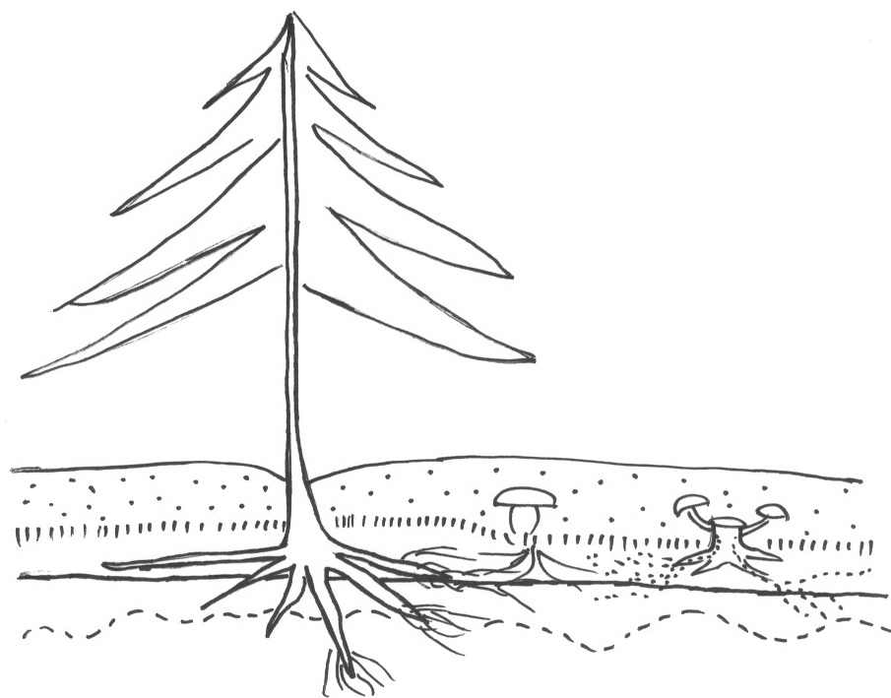
Fungal activity in litter and soil in contrasting seasons
CO₂
September March
CO₂
(CHO)_{n}
litter
(CHO)_{n}
photosynthates
CO₂
Snow
Litter
saprotrophic
fungi
Org. horizon
mycorrhizal
fungi
saprotrophic
fungi
mycorrhizal
fungi
High share of fungi in the ecosystem is reflected by high fungal contribution to transcription and protein production, especially in litter
Fungal activity is important for decomposition of complex organic matter
Seasonal differences in rhizodeposition affect the share of root-associated / saprotrophic fungi
Activity of root-associated fungi decreases in winter

Slide 4
Methods choice and methodology

Slide 5
Exploring ecosystem functioning
Stable isotope probing – indication of microorganisms involved in certain processes containing incorporation of C (stable isotope 13C) or N (stable isotope 15N), need for labelled substrate. Microorganisms building biomass on incorporated substrate get their biomolecules (PLFA, DNA, RNA) labelled. There is danger of cheating (comensalism) and cross-feeding (predation on microorganisms accummulating labelled isotope). Leads to „label dillution“ over time.
Metaproteomics – isolation of total protein and „sequencing“ of peptides. Peptides can be identified, but carry less information than nucleic acids (degenerated code). Difficulty with sequence assignment + different stability of proteins in the environment over time. Can be extremely powerfull in combination with metatranscriptomics or metagenomics but difficult to be used alone.
Microarray technologies – hybridization of DNA or RNA with chips can avoid reverse transcription bias or PCR bias. High resolution across levels of expression. However, microarrays only cover the genes used for their desing. Excellent for study of individual taxa in the environment where sequenced genomes are available.
Isolation and analysis of microbial strains – challenging but can be very useful.

Slide 6
Exploring ecosystem functioning - metagenomics
Pros:
can indicate genetic potential of the community
DNA community relatively stable over time (good representation of the ecosystem)
can theoretically reveal co-occurrence of genes (when longer contigs of DNA covering several genes are assebled)
sometimes gives exact identity of the gene source (when the gene sequence and 16S co-occur on an assebled molecule)
powerfull for exploration of bacteria / archaea
Cons:
eukaryota (e.g. fungi) contain much of noncoding DNA (up to over 90%)
eukaryotic genes contain introns
due to the above, short reads of eukaryotic genes can give no information (noncoding DNA) or be difficult to assign (contains both exons and introns)
need for assembly
potential is not the function, presence is not activity (extracellular DNA, pseudogenes, levels of expression…)
for diverse ecosystems, high depth of sequencing required

Slide 7
Metatranscriptomics - opportunities
- can indicate real activity in the studied ecosystem; fast response to disturbance / experimental treatment
little danger of „ancient“ RNA from dead cells – such RNA decomposes rapidly
avoids the problem with noncoding DNA
for gene-coding sequences, functional and taxonomic assignment is more simple than for DNA, even for shorter reads
powerfull for exploration of both prokaryota and eukaryota
in the case eukaryota, ease of isolation and purification by „fishing“ the poly-A tails of mRNA molecules (but does not always work)
metatranscriptomes much less complex than metagenomes - results in easier assembly (higher coverage with the same number of reads)
with sufficient depth of sequencing, relative importance of individual processes can be analysed to some depth by comparison of transcription level
while metagenomics tell which genes may be involved, metatranscriptomics tell which genes actually are involved (expressed)

Slide 8
Metatranscriptomics - limitations
expression is highly regulated and corresponds to „actual“ conditions, not „mean“ conditions of the site; for example, transcription increases by orders of magnitude when dry soil is moistened
mRNA is short-lived so the metatranscriptome reveals what happened within last tens of minutes
the amount of extracted RNA usually makes amplification necessary; PCR amplification of cDNA brings bias
extracted RNA contains much rRNA that can be difficult to remove
genes with low level of expression are difficult to recover
there is little (if any useful) information on mRNA stability in time and translation rate and thus the amount of protein molecules synthesized per mRNA molecule in its lifetime
metagenomics can theoretically deliver long contigs - chromosome fragments with multiple genes that are from the same genome; this is impossible for metatranscriptomics

Slide 9
Workflow
Sampling
sample collection
stabilization
storage
Library preparation
RNA isolation
RNA purification
DNA removal
rRNA removal (to recover all mRNA) or capture of eukaryotic mRNA (poly A)
RNA fragmentation
cDNA synthesis
RNA removal
adapter ligation (with barcodes when multiple samples will be sequenced)
amplification
selection of molecules of approppriate size
Sequencing
Data analysis
long sequences – direct annotation (function, binning to microbial taxa)
short sequences – sequence assembly and annotation of contigs (scaffolds)

Slide 10
Sample collection and storage
Each study site 64 m²
Eight 4.5 cm soil cores at defined locations, approx. 2.0 m from each other
After core collection (within 30 min, on site):
collection of core material
vegetation, roots and mineral soil discarded
litter material and soil organic horizon separated into two composite samples (each containing materials from all cores)
sieving of soil (0.5 mm sieve), cutting of litter (scissors)
aliquoting into tubes
flash-freezing in liquid nitrogen
Storage for transport on dry ice
Storage upon arrival at -80 °C

Slide 11
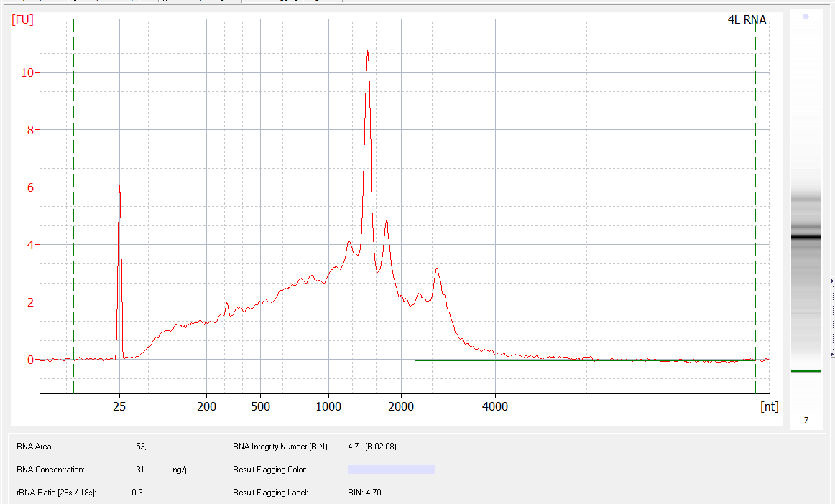
RNA isolation and purification
- sample homogenization by mortar and pestle in liquid nitrogen
MoBio RNA PowerSoil Kit used for isolation in combination with Zymo Research OneStep PCR Inhibitor Removal Kit (PVPP removal of humic and fulvic acids)
DNA removal (DNAse)
verification of DNA removal (no PCR amplification of 16S)
check of RNA yield (Qubit)
check of RNA quality (BioAnalyzer)
- storage of isolated total RNA (-80 °C)

Slide 12
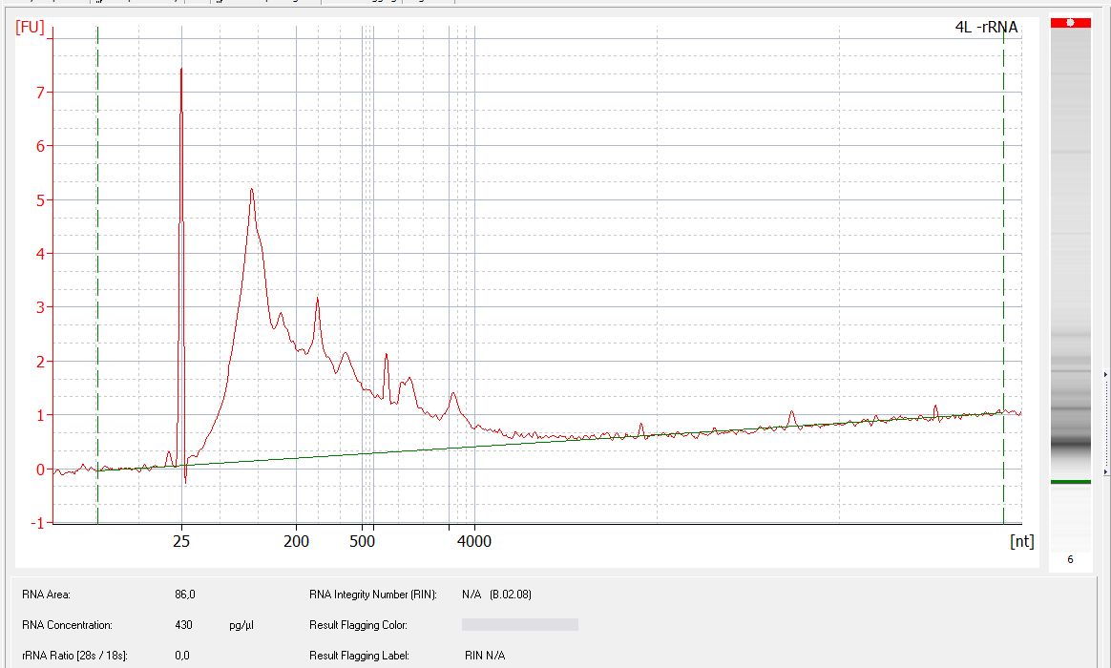
Removal of ribosomal RNA
16S
use of Epicentre RiboZero kits
to remove both bacterial and eukaryotic rRNA, RiboZero Metabacterial and RiboZero Human/Mouse/Rat kits were combined
efficiency of rRNA removal verified on Bioanalyzer
18S
28S
16S
28S

Slide 13
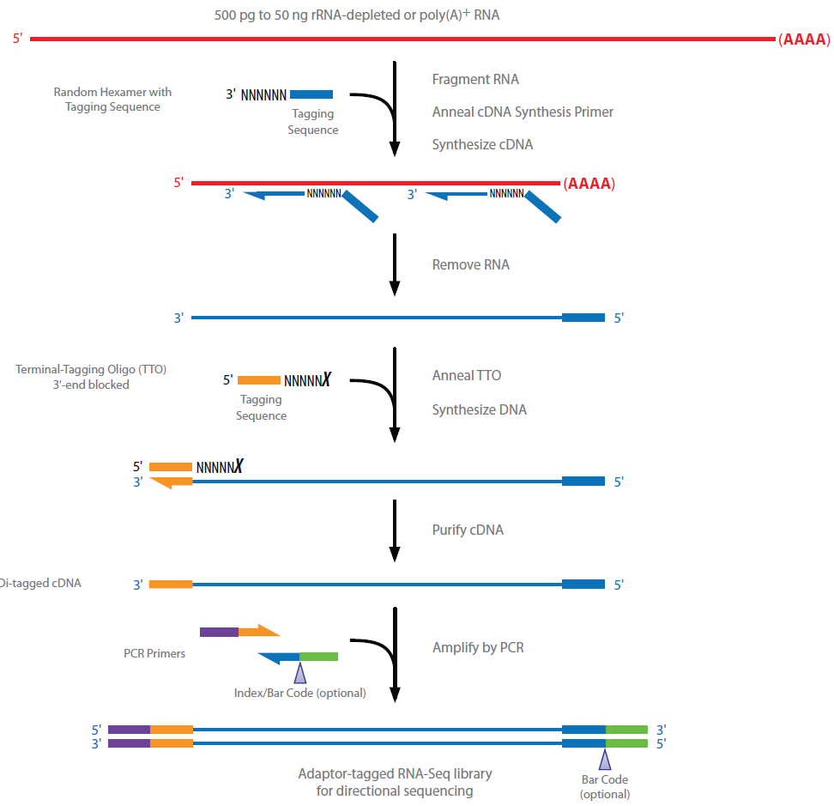
Library preparation: ScriptSeq™ v2 RNA-Seq Kit (Epicentre)

Slide 14
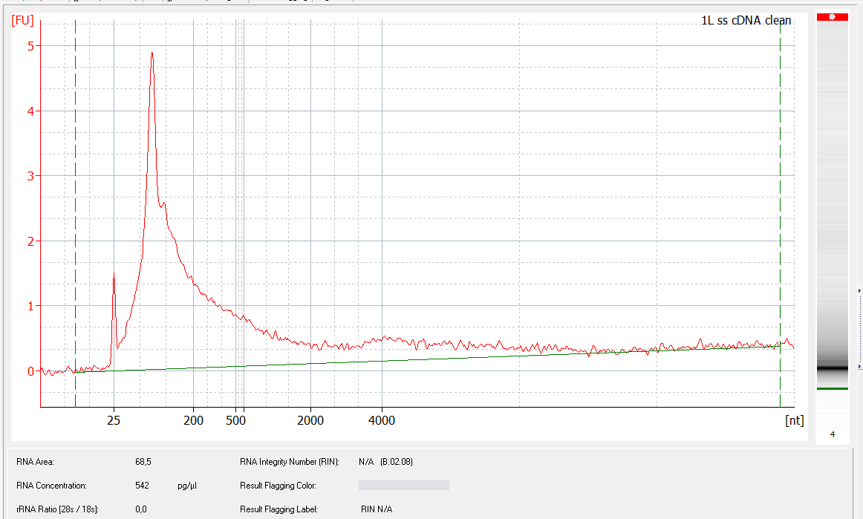
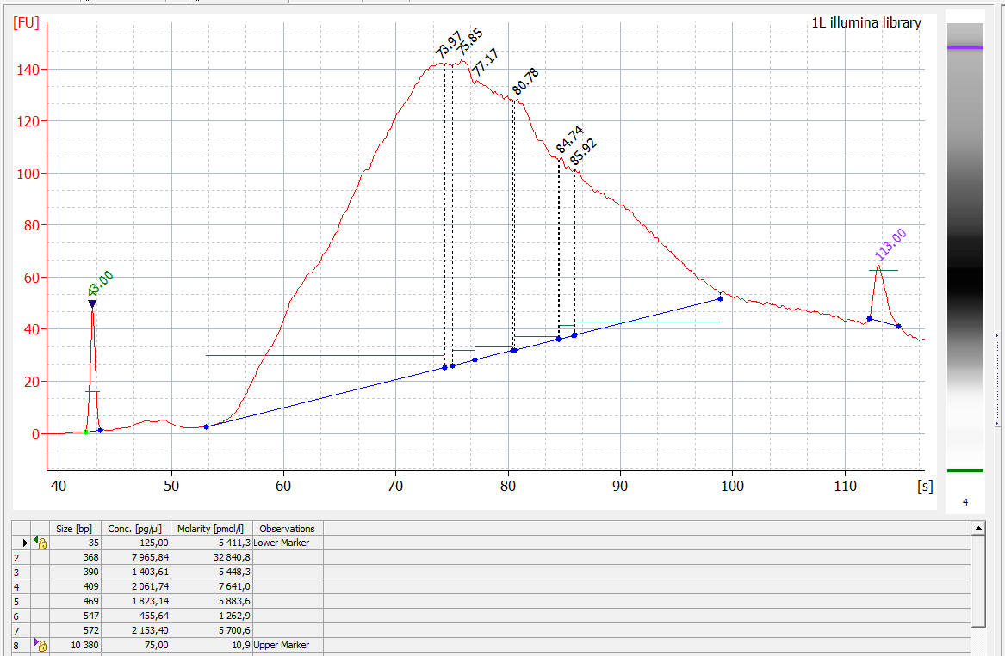
Library preparation
RNA fragmentation to get desired size distribution of molecules
cDNA synthesis (reverse transcription); success check by amplification of 16S from cDNA
RNA removal (RNAse treatment)
Illumina adaptor ligation to cDNA
amplification from Illumina adaptors with barcodes for each sample (10-15 cycles)
check of DNA yield and size distribution
removal of short fragments (Agencourt AMPure beads) and long fragments (cut from gel)
equimolar combination of samples into one common library
desired size of fragments
650 bp
200 bp

Slide 15
Sequencing
Samples were sequenced on Illumina HiSeq (2x150 bases pair-end reads)
Library for one lane contained 12 samples (6x sample from litter + 6x sample from soil – summer); another lane for winter samples
Theoretically, one lane should deliver up to 350 millions pair-end sequences (some 30 millions per sample).
Data analysis and interpretation
Pair end 2x 150-base reads were used for assembly of contigs (scaffolds) – assembly (Velvet) performed externally, we do not have enough computing power at the moment
Contigs were taxonomically binned and functionally annotated (in MG Rast)
Individual sequence reads were mapped to contigs
Transcript abundance in each sample expressed as coverage per base = sequence count x sequence length/ contig length

Slide 16
The seasonality project

Slide 17
Analysis of microbial activity in summer and winter
Sampling
6 sites x 2 horizons (litter, soil) x 2 seasons (September, March) = 24 samples
Community analysis
Amplicon sequencing of DNA and RNA-deriver ITS2 sequences (MiSeq)
Metatranscriptomics: Shotgun sequencing of rRNA-depleted RNA
Isolation of total RNA
Deletion of bacterial rRNA and eukaryotic rRNA
(communities analysed by 16S and ITS sequening of DNA and RNA)
Sequencing on Illumina HiSeq – 2 lanes, 2x150 b 673 000 000 sequences
Assembly of reads from all samples together 4 500 000 contigs >200 bases
Annotation using MG-RAST and GenBank
44% reads mapped to contigs, 21% to identified contigs (taxon, function)
Metadata: Microbial biomass, enzyme activity, chemistry
Metaproteomics: Identification of fungal / bacterial proteins

Slide 18
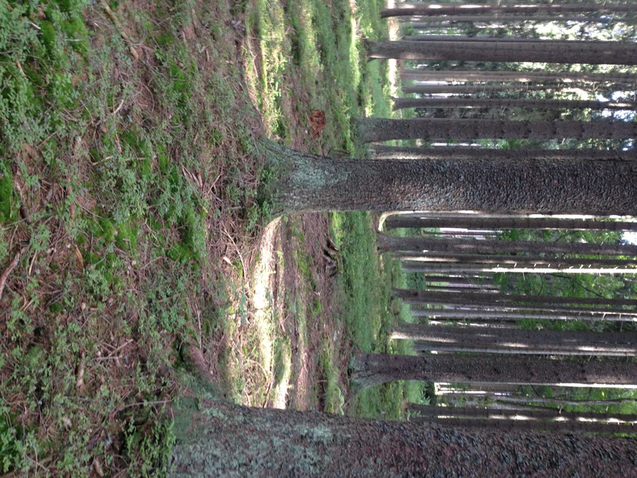
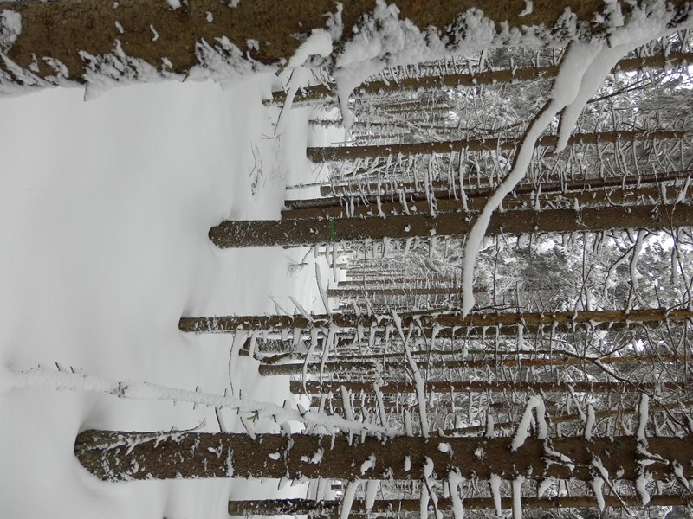
Sampling
September - soil temperature 15°C March - soil temperature 2°C

Slide 19
Identification of active microbes by 16S / ITS sequencing from RNA
Prokaryota (bacteria) Eukarota (fungi)
5.8S
16S
tRNA
23S
5S
tRNA
18S
ITS1
ITS2
28S
DNA
PCR product
(derived from DNA)
PCR product
(derived from DNA)
transcription
transcription
RNA
transcript
PCR product
(derived from RNA)
PCR product
(derived from RNA)
cleavage
cleavage
mature
RNA
PCR product
(derived from RNA)
ribosome
PCR product
(derived from RNA)
RNA amplicons:
microorganisms possessing ribosomes
RNA amplicons:
microorganisms producing ribosomes

Slide 20
Community composition and activity of bacteria
Genomes Ribosomes mRNA rib. proteins all mRNA
S W S W S W S W S W S W S W S W
Litter Soil Litter Soil Litter Soil Litter Soil
Žifčáková et al.
Environ. Microbiol. 2016

Slide 21
Composition of total (DNA) and active (RNA) communities of fungi
S W S W S W S W
DNA RNA DNA RNA
Litter Soil
Žifčáková et al.
Environ. Microbiol. 2016

Slide 22
Exploring microbial activity: assignment of mRNA taxonomy and function
Functional annotation of predicted genes works well for bacteria but far less well for fungi and archaea. There, many hits are to „hypothetical proteins“.
The situation is even worse for nonmicrobial sequences (protozoa, invertebrates…)
Size of charts corresponds to numbers of transcripts.
Žifčáková et al.
Environ. Microbiol. 2016

Slide 23
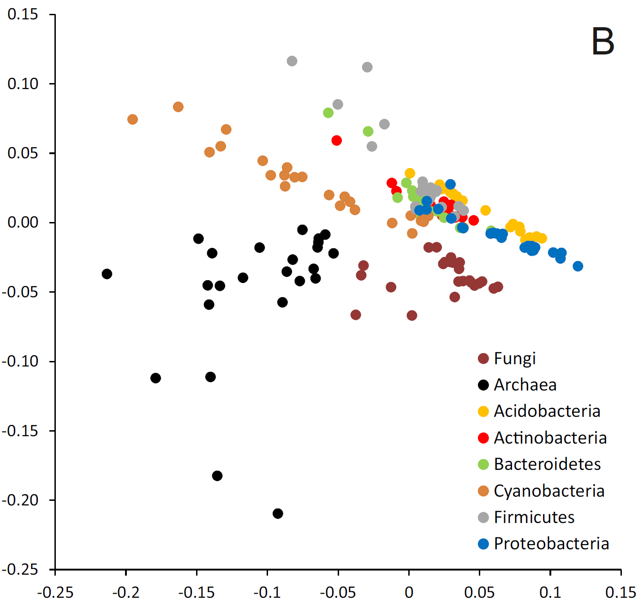
Exploring microbial activity: combining taxonomy and function
Bacterial (but not fungal) reads can be reliably identified on the level of phyla.
NMDS shows that profiles of functions of various microbial taxa differ

Slide 24
Seasonal contribution of microbial taxa to mRNA production
All transcripts Transcripts with identified function
summer winter summer winter summer winter summer winter
Litter Soil Litter Soil
The share of fungal transcripts is higher in litter than in soil.
Many fungal reads are unidentified „hypothetical“ proteins.
In soil, fungal share of fungal transcripts dramatically decreases in winter.

Slide 25
Involvement of microbial taxa in soil processes
Contributions to activity in litter/summer, litter/winter, soil/summer and soil/winter

Slide 26
Involvement of taxa in the decomposition of cellulose
endocellulase exocellulase β-glucosidase
Fungi are dominant producers of cellulolytic enzymes in litter
and important (but not dominant) producers in soil.

Slide 27
Functional biodiversity: high redundance of functions
(starch and sucrose metabolism as an example)
Numbers indicate transcript counts for each function.
(one species may produce one or more transcripts)

Slide 28
Seasonal changes in fungal expression are more intensive in soil
10-fold
increase in summer
Transcript abundance
increase in winter
Transcripts: green – litter, brown – soil

Slide 29
Seasonal changes in expression
Archaea Bacteria Fungi
Žifčáková et al.
Environ. Microbiol. 2016
29-51% of dominant transcripts show seasonal changes in relative abundance

Slide 30
Fungal transcription profiles
soil summer
Fungal transcription in soil
Increased in summer:
Spliceosome components
Ribosome components
Phenylalanine metabolism
Increased in winter:
Fatty acid biosynthesis
DNA repair
RNA degradation
Amino acid metabolism
Yeast-specific cell processes
litter summer
soil winter
litter winter
Transcription profiles differ among litter and soil.
Seasonal pattern of transcription is more apparent in soil than in litter.

Slide 31
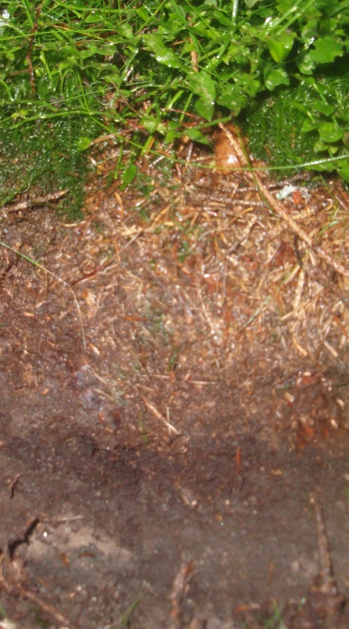
Seasonal activity of fungal divisions: transcription of beta-tubulin
Summer Winter
Litter
Ascomycota
Basidiomycota
Soil
Beta tubulin can be reasonably assigned to fungal phyla.
Relative share of transcripts of Basidiomycota (most ectomycorrhizal fungi) decreases in winter.

Slide 32
Fungal genes involved in mycorrhizal symbiosis
Transcripts with high similarity
(tblastx, E < 10⁻⁵⁰)to Lacccaria laccata genes involved in mycorrhizal symbiosis are more frequently transcribed in summer.
Over 50% of them are exclusively transcribed in summer.
Exclusively transcribed in summer in winter
Transcription increased in summer in winter
No seasonal difference in trancription

Slide 33
Functional biodiversity: high redundance of functions
(starch and sucrose metabolism as an example)
Numbers indicate transcript counts for each function.
(one species may produce one or more transcripts)

Slide 34
Metaproteomics

Slide 35
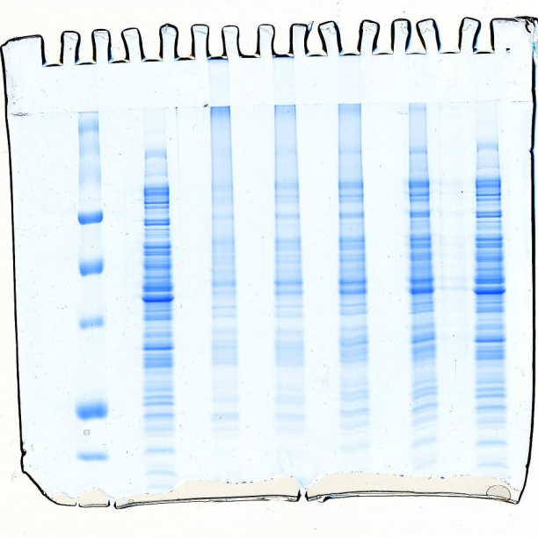
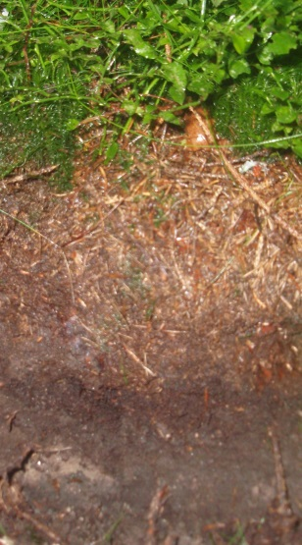
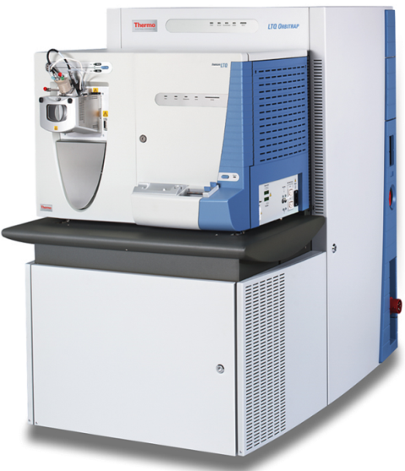
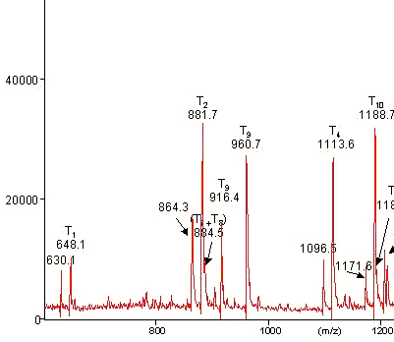
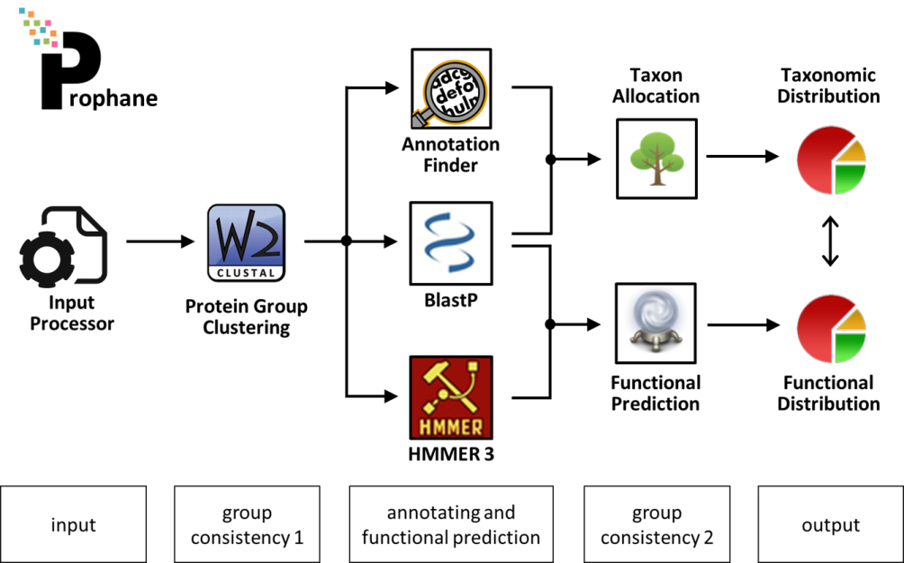
INTRO
Analysis of microbial proteins by metaproteomics
Extraction of proteins Separation and fragmentation Mass spectrometry
Identification of peptide fragments Functional and taxonomic annotation
Illustrationsby Katharina Riedel and Stephan Fuchs, Greifswald

Slide 36
Metatproteomics - opportunities
measures proteins produced, not genes transcribed (better proxy for function)
proteins can be stable, so that the picture of metaproteomics represents a longer period of time (but how long?)
protein extraction from litter or soil is no more a technical problem
Metatproteomics - limitations
difficult annotation (complex metatranscriptomes can be only annotated when metatranscriptome or metagenome assembly is available)
sequencing of peptides, not proteins, unclear which peptides originate from the same protein
only a fraction of proteins is typically annotated
annotation is extremely computationally demanding
some proteins can be too much stable
high costs (>1000 EUR for one metatranscriptome sample) force into shallow replication

Slide 37
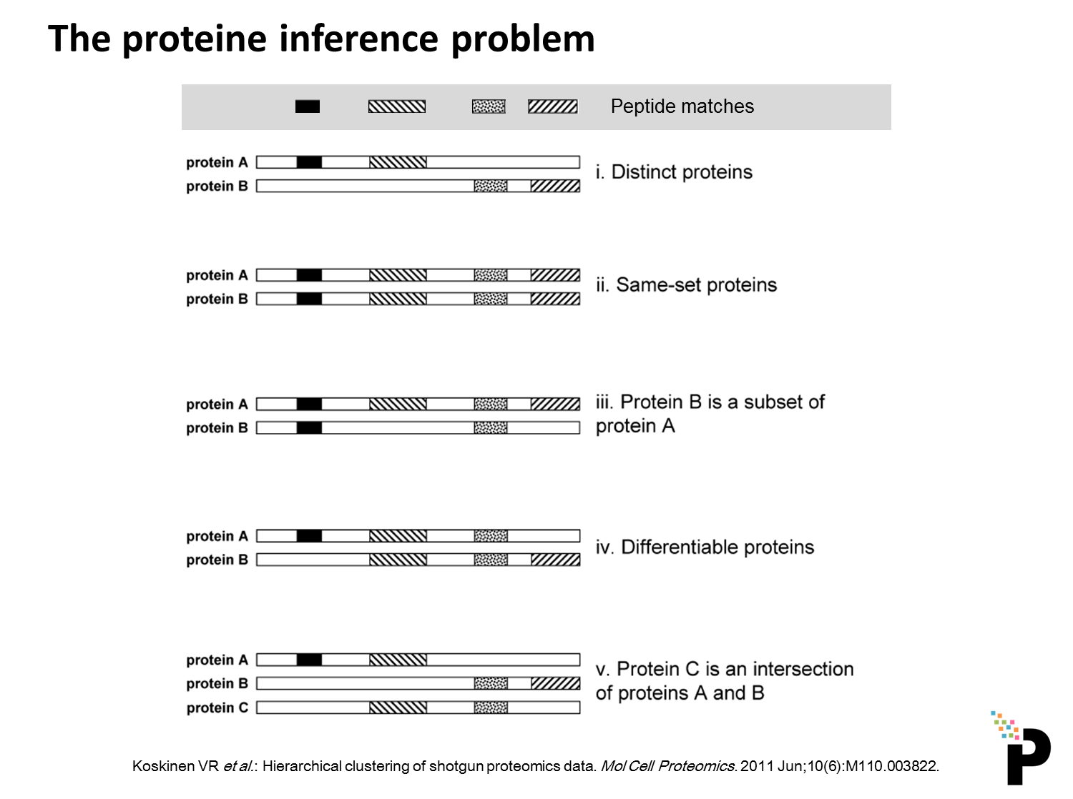
Metaproteome annotation
Slide provided by Stephan Fuchs, Greifswald

Slide 38
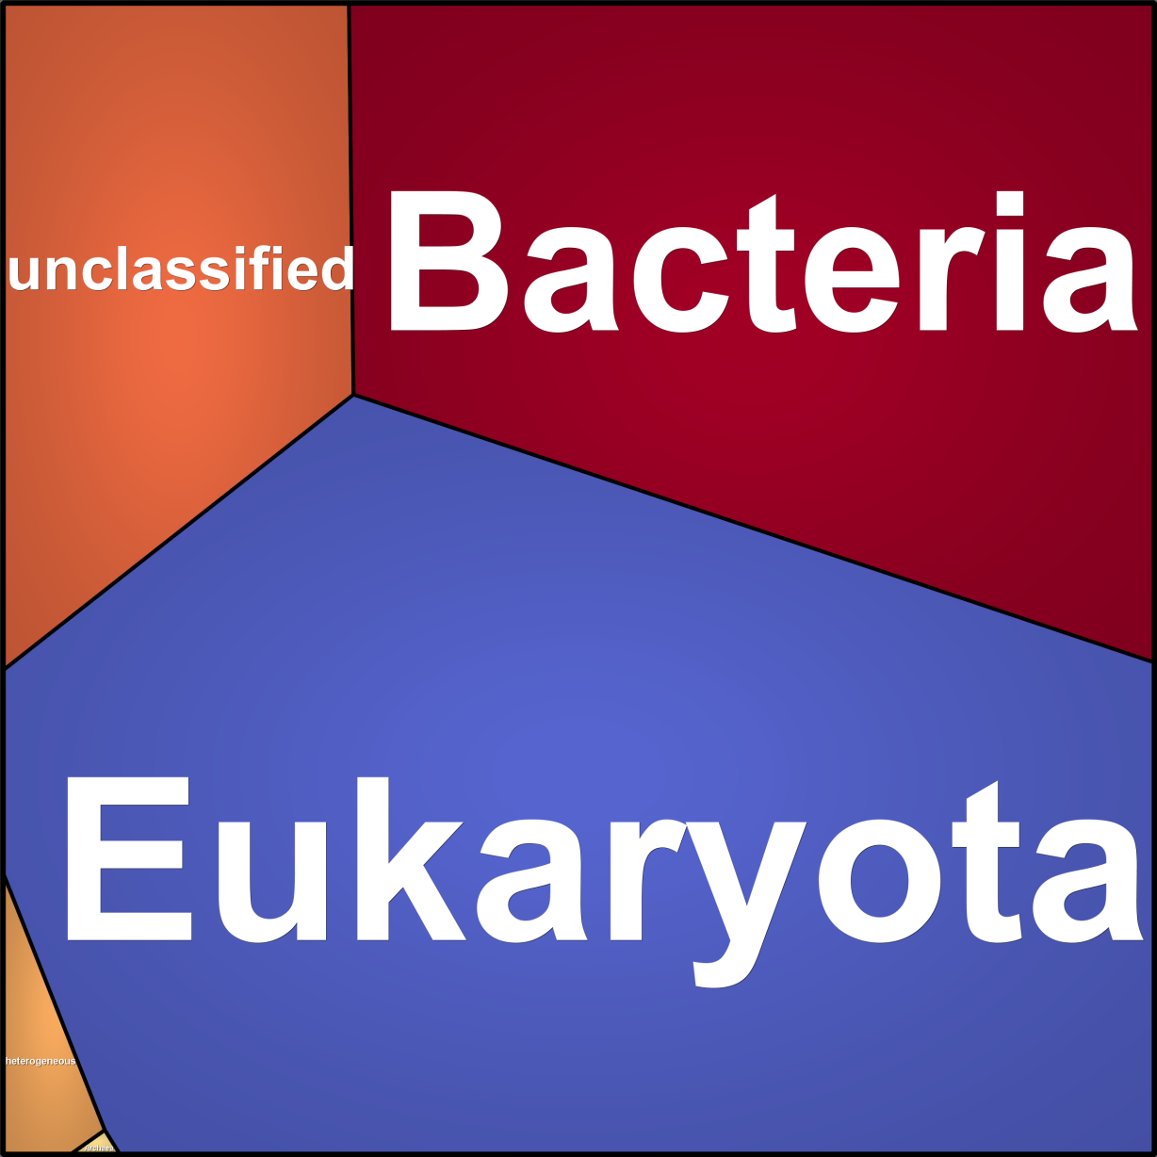
Eukaryotic proteins are quantitatively important in soils
Illustration by Stephan Fuchs, Greifswald

Slide 39
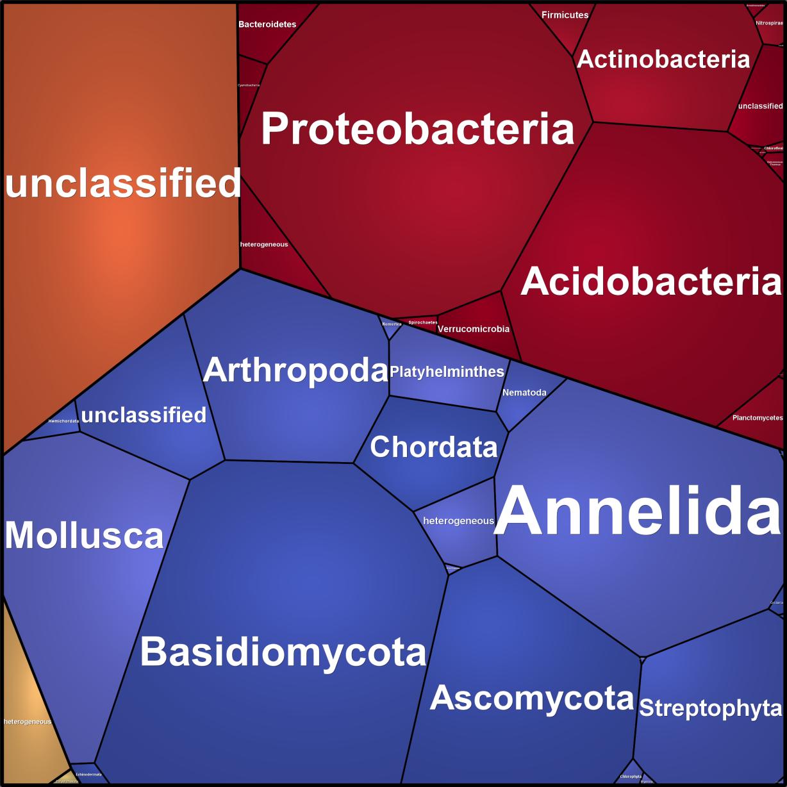
The share of annotated fungal proteins in litter
is comparable to those of bacteria
Illustration by Stephan Fuchs, Greifswald

Slide 40
Microbial community composition and activity as reflected
in the metagenome, metatranscriptome and metaproteome
(only annotated reads considered)
Litter
Soil

Slide 41
Methodological challenges:
annotation of eukaryotic genes in soils is challenging
Illustration by Stephan Fuchs, Greifswald

Slide 42
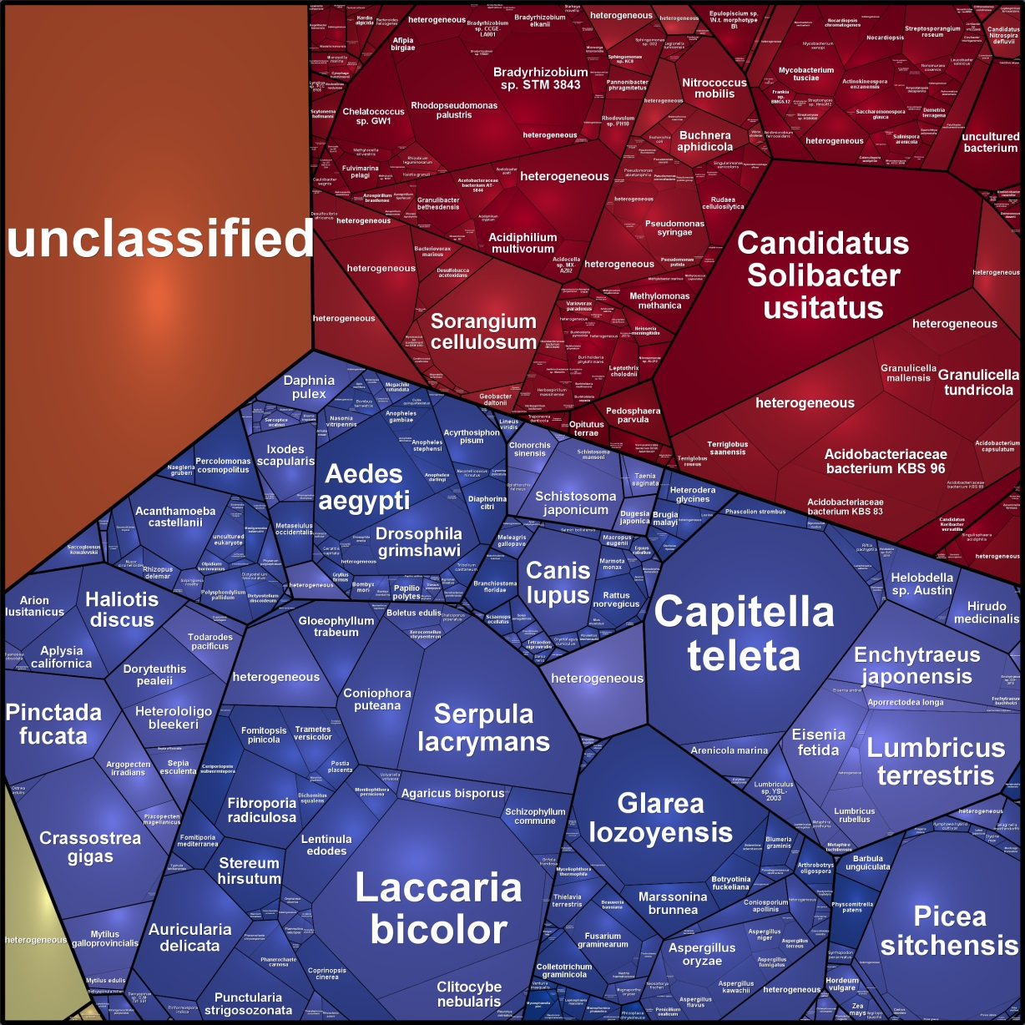
Methodological challenges:
annotation of eukaryotic genes in soils is challenging
Illustration by Stephan Fuchs, Greifswald

Slide 43
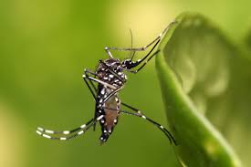
Methodological challenges:
annotation of eukaryotic genes in soils is challenging
Illustration by Stephan Fuchs, Greifswald

Slide 44
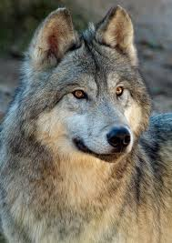
Methodological challenges:
annotation of eukaryotic genes in soils is challenging
Illustration by Stephan Fuchs, Greifswald

Slide 45
Other methods to detect microbial activity

Slide 46
Stable Isotope Probing (SIP)
Po přidání substrátu, značeného stabilním isotopem ¹³C, se značený isotop akumuluje v biomase aktivně metabolizujících mikroorganismů. Složení „aktivního“ společenstva lze pak vyhodnotit při analýze lipidů anebo – po separaci „těžkých“ (značených) a „lehkých“ molekul DNA pomocí molekulárních metod.
Separace nukleových kyselin mezi ¹²C a ¹³C není obvykle v praxi úplně bezproblémová, protože část mikroorganizmů je značena pouze částečně. Proto mezi frakcemi s ¹²C a ¹³C obvykle bývá postupný přechod.
Notes:
The separation between 12C and 13C is not usually this perfect in reality, because organisms are often partially labeled. So then you see more of a smear between the 12C and 13C bands.
Different community analysis methods are used to examine the fractions. DGGE is very popular and is probably the least expensive. T-RFLP may be more sensitive but is also complex to run. After using community analysis to confirm the presence of heavy RNA, then you can taxonomically identify it by either -cutting out and sequencing DGGE bands or –cloning and sequencing the entire heavy fraction.

Slide 47
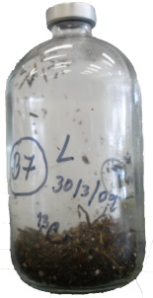
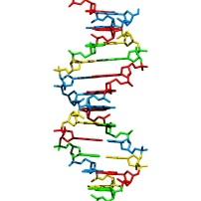
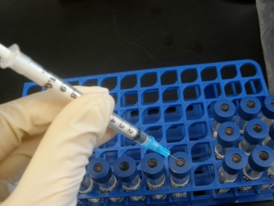
Stable Isotope Probing (SIP)
13C-značená celulóza
Rozdělení DNA ultracentrifugací na základě vznášivé hustoty
DNA
extrakce
DGGE
T-RFLP
Sekvenace
neoznačená ¹²C-DNA
¹³C DNA
Mikrobiální společenstvo
Vzorek CO₂
vzorky obsahující ¹³C, nebo ¹²C DNA
vysráženi DNA ve frakcích
identifikace frakcí v kterých je přítomna DNA pomocí qPCR
¹³C DNA
Podíl ¹³C-CO₂
Celková respirace
Notes:
47
Tyto analzy-molecular metody dgge, trflp, sekvenovaní nebudu popisovat, jednak byly nekolikarat zmineny v prubehu konf a budu predpokladat ye vsichni o nich maji alespon pribliynou predatavu. Delali jsme analyzy houboveho i bakterialniho spolecenstva, krome CO2 a delta 13 prezentovane vysledky se týkají hub
Culture independent; Soil DNA extractions: Fast DNA Spin Kit for soil from MPBio
Bacteria-1108F and 1132R (qPCR)
T-RFLP: Bacteria-16Seu27f-HEX and 1492R
Fungi-ITS1f-HEX and ITS4-FAM
Primers:
Fungi ITS1f and ITS2*

Slide 48
Příklad: Bakteriální rozkladači celulózy
Bakterie označené ¹³C patří hlavně mezi Betaproteobacteria a Bacteroidetes.
Rody Mucilaginibacter a Herminiimonas akumulovaly nejvíce ¹³C uhlíku z celulózy.
Figure 2 Distribution of fungal orders (as identified by PlutoF pipeline) based on relative abundance* of 291 most abundant fungal OTUs (A) and distribution of bacterial phyla (as identified by) based on relative abundance* of most abundant bacterial OTUs (B) representative of following samples representative of following samples: L= litter horizon, H= organic horizon, 13= 13C-labeled community, 12= non-labeled community
*Relative abundance (number of sequences in sample type normalized as parts per thousand for each OTU, total abundance then expressed as sum of normalized abundances in all samples per OTU

Slide 49
Stable Isotope Probing (SIP)
Výhody a nevýhody metody
rozlišuje aktivní a neaktivní mikroorganismy (biomasu)
umožňuje selektivně sledovat využití určitého (značeného) substrátu
- ve spojení s RT-PCR je extrémně citlivá a umožňuje detekci složení nerostoucího společenstva
vyžaduje spojení s dalšími technikami (PCR nebo RT-PCR a DGGE, RFLP nebo FAME)
nutné speciální vybavení (ultracentrufuga a nejlépe také RT-PCR)
substráty značené stabilními isotopy jsou drahé (13C glukóza – 2.000 Kč/g, ¹³C celulóza – 36.000 Kč/g, 13C lignin – 500.000 Kč/g) a je jich k dispozici omezený počet

Slide 50
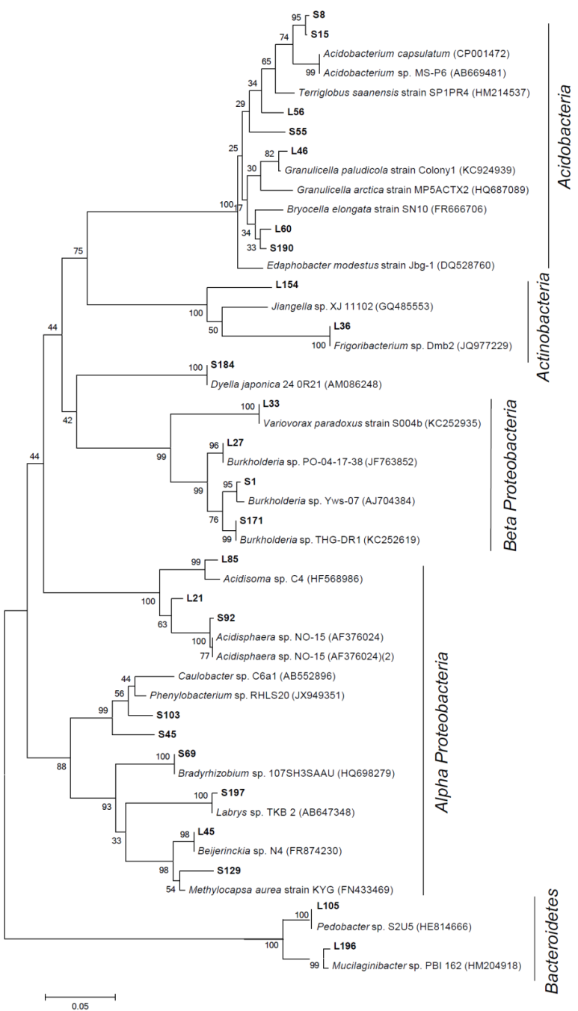
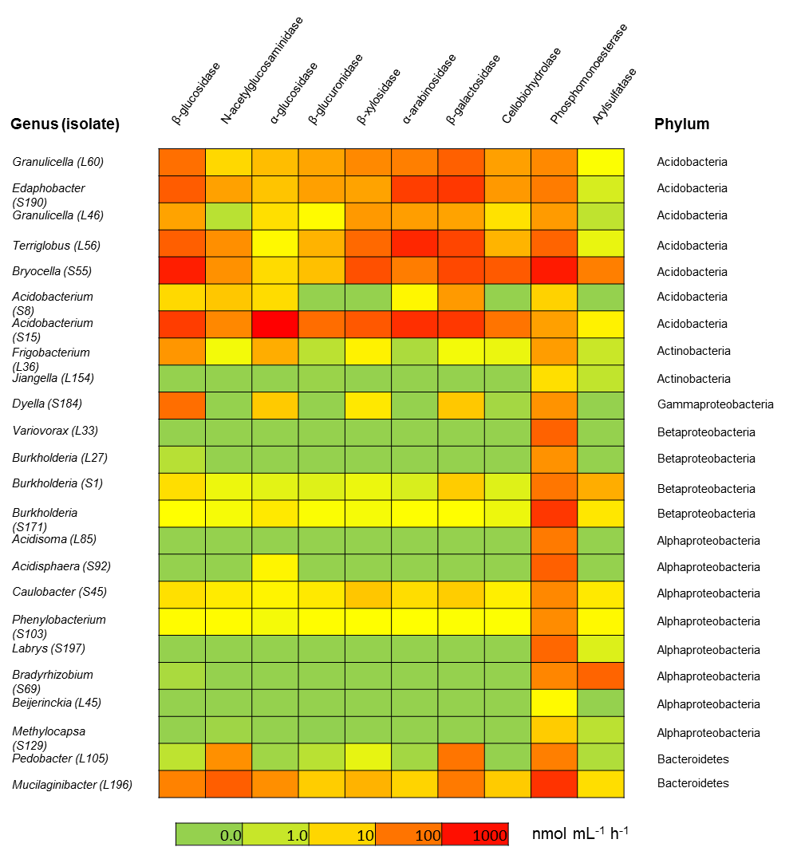
Isolation and characterization of bacterial strains: enzyme activity
SEE MORE IN THE LECTURE OF SALVADOR LLADÓ ON WEDNESDAY Lladó et al. Biol. Fertil. Soils in press

Slide 51
Isolation and characterization of bacterial strains: carbon sources
Most versatile taxa belong to Proteobacteria.
Acidobacteria and Bacteroidetes can grow on multiple mono- and oligosaccharides.
SEE MORE IN THE LECTURE OF SALVADOR LLADÓ ON WEDNESDAY Lladó et al. Biol. Fertil. Soils in press

Slide 52
Dominant bacteria: Expression in forest soil and litter across seasons
Isolated major bacteria from forest litter and soil were genome sequenced
Genome sequences were used to identify transcripts belonging to the isolated taxa
Between 10 and 300 genes were identified as transcripts in litter and soil
Bacteria expressed similar genes in litter and soil
Spectra of expressed genes differed between summer and winted
SEE MORE IN THE LECTURE OF SALVADOR LLADÓ ON WEDNESDAY

Slide 53
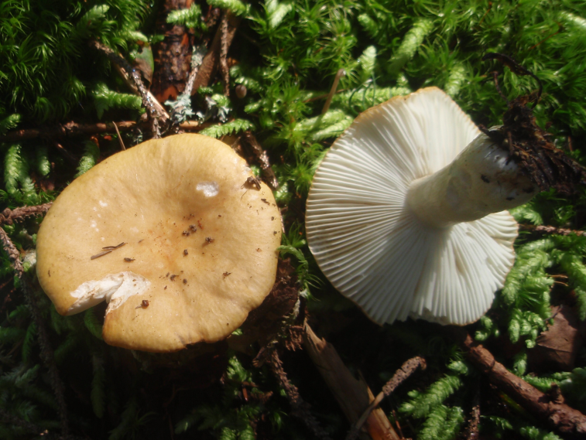
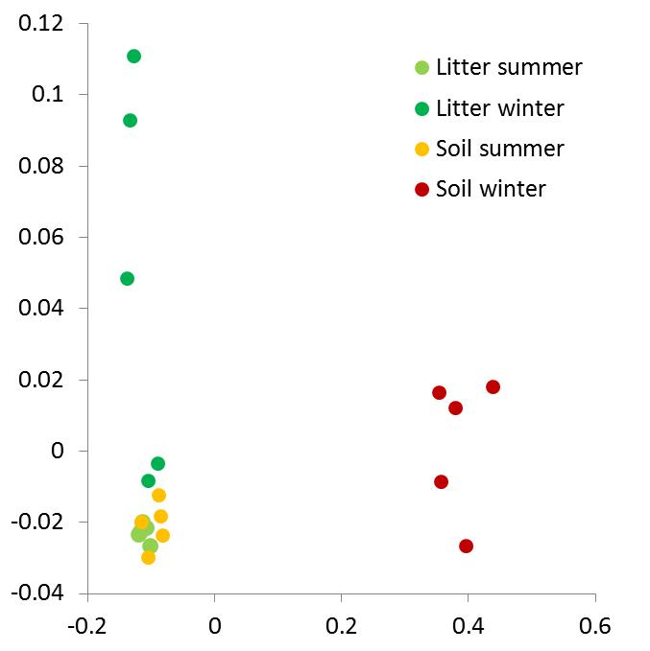
Activity of the dominant fungus, mycorrhizal Russula ochroleuca
Russula ochroleuca represents the second most abundant fungal taxon in the studied forest soil
As mycorrhizal symbiont, it does not grow in culture
Genome was obtained by shotgun sequencing DNA, isolated from a fresh fruitbody
Composition of expressed genes differs among seasons
The vast majority of predicted genes does not have clear relatives for which producer and function are known

Slide 54
Metatranscriptomics – summary
higher percentage of reads receive taxonomy annotation than functional annotation (due to hypothetical proteins known from sequenced genomes)
functional annotation is more reliable than taxonomic annotation
in fungi, most transcripts can not be reliably assigned to either Ascomycota or Basidiomycota
current resources for annotation (GenBank, MG Rast) contain still little fungal sequences (and genomes), in reality, many more genomes are sequenced, but it is difficult to use them for annotation
most microbial transcripts/functions represent basic metabolism which can be of limited value for the exploration of environmental processes
Soil metatranscriptomics is currently technically feasible and can deliver interesting data.

