Slide 1
Příprava celometagenomových knihoven (shotgun)
Petra Vídeňská, Ph.D.

Slide 2
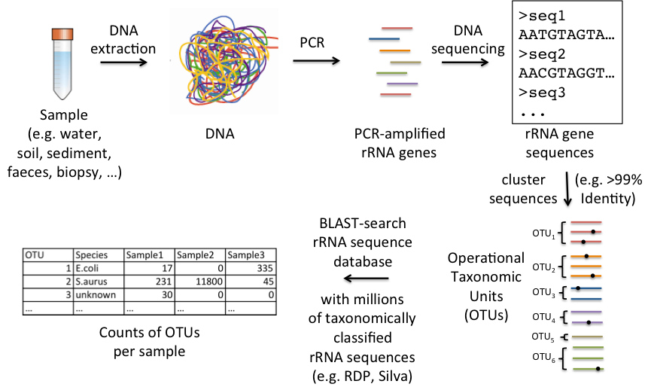
Sekvenace 16S rRNA

Slide 3
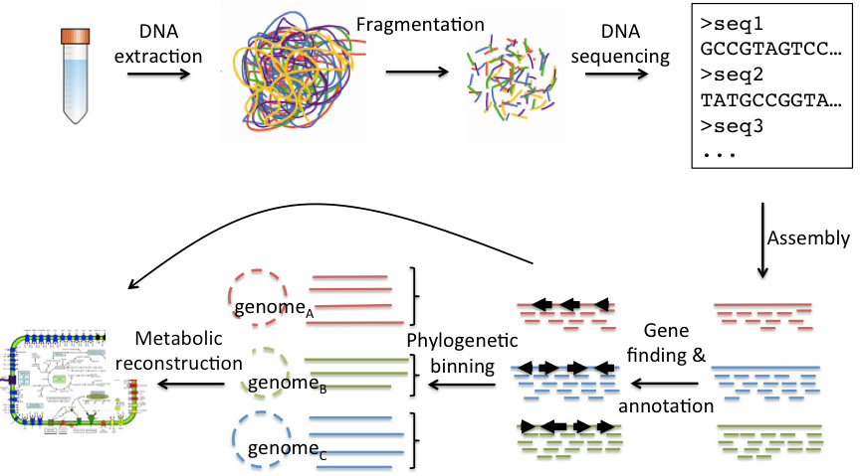
Celometagenomová sekvenace

Slide 4
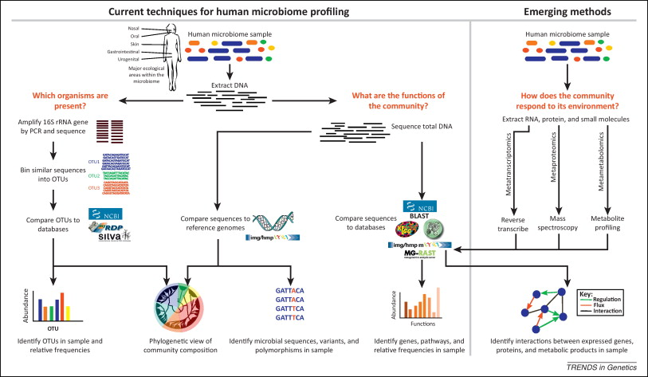
16S rDNA vs. celometagenom

Slide 5
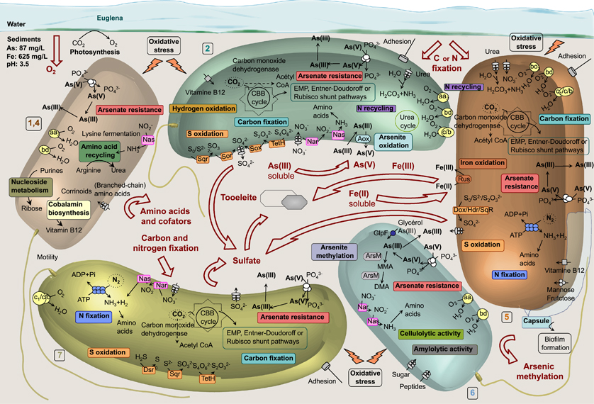
Celometagenomové sekvenování

Slide 6
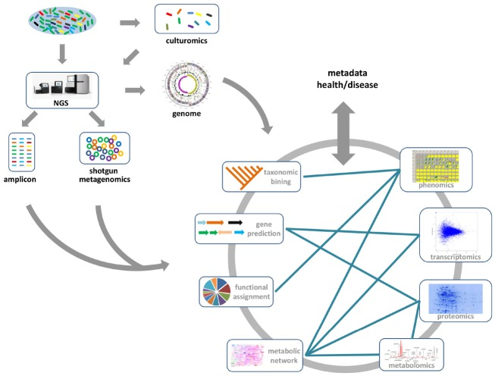
Vše souvisí se vším

Slide 7
Příprava celometagenomových knihoven
Beckman SPRIworks HT (for the Illumina platform)
Beckman SPRIworks Fragment Library (for the Illumina platform)
Illumina TruSeq DNA PCR-Free (for the Illumina platform)
IntegenX PrepX ILM DNA (for the Illumina platform)
NEB NEBNext Ultra DNA (for the Illumina platform)
NuGEN Encore Rapid Library (for the Illumina platform)
Illumina Nextera DNA (for the Illumina platform)
Kapa DNA Library (for the Illumina platform)
Homebrew (for the 10X Genomics platform)
Life Tech Ion Plus Fragment (for the Ion platform)
Illumina Nextera XT (for the Illumina platform)
NEB NEBNext DNA (for the Illumina platform)
Bioo Scientific NEXTflex Rapid DNA (for the Illumina platform)
Bioo Scientific NEXTflex PCR-Free (for the Illumina platform)
Bioo Scientific NEXTflex DNA (for the Illumina platform)
Illumina TruSeq DNA (for the Illumina platform)
PacBio DNA Template Prep (for the PacBio platform)
https://genohub.com/ngs-library-preparation-kit-guide/

Slide 8
Kontrola DNA
Kontrola integrity DNA na gelu
Kontrola koncentrace vyizolované DNA (NanoDrop, Qubit…)

Slide 9
Příprava knihoven
Enzymatic
Fragmentation
Mechanical
Fragment
Amplification
Adapter

Slide 10
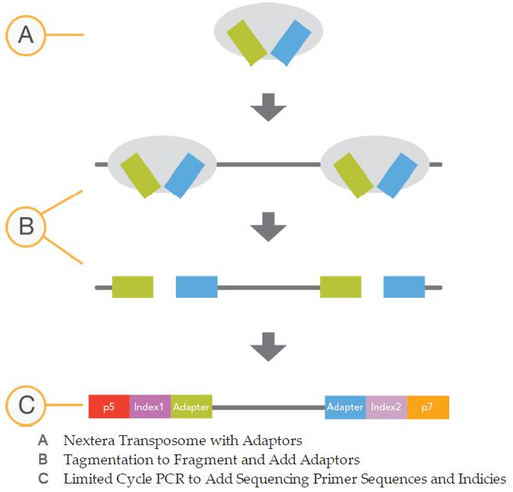
Enzymatická fragmentace
Separate fragmentation not required
Tag with enzyme mix
PCR
Polishes fragment ends and incorporates optional indices

Slide 11
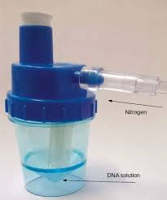
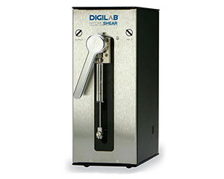
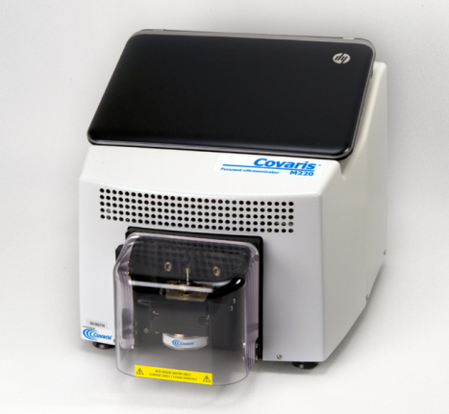
Mechanická fragmentace
Sonikace
Nebulizace
Hydroshear

Slide 12
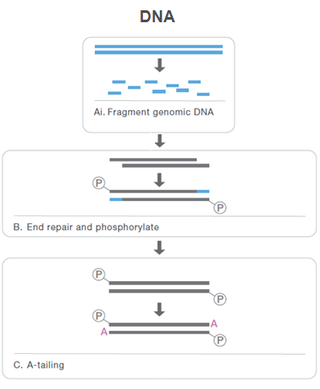
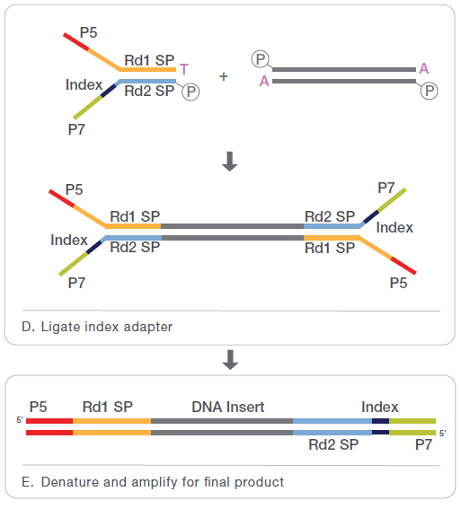
Mechanická fragmentace

Slide 13
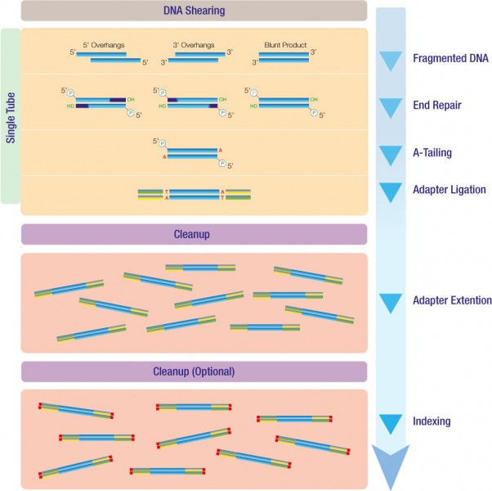

Obecný postup
JetSeq Library Preparation workflow
The fast, one-tube JetSeq Library Preparation protocol offers the fastest turnaround time, with minimal cleanup steps reducing hands-on time and significantly reducing the total time required for preparation of library DNA

Slide 14
Nextera XT DNA Sample
Prep Kit
Rapid sample preparation- complete sample prep in 90 minutes
  Fastest and easiest sample prep workflow
  Innovative sample normalization
  Flexible multiplexing
Optimized for many application
  Small genomes, plazmids and PCR amplicons
  Low amount of input DNA (1 ng)
  High coverage

Slide 15
TruSeq DNA PCR-Free
Prep Kit
Simple ½ day PCR-free workflow
  All-inclusive kit w/gel-free size-selection
  Tunable to a variety of read lengths
  Low (24spl) and High (96spl) Throughput Options
Premier genome coverage
  Lowest & smallest number of gaps
  No duplicates from PCR
  Enhanced coverage of high GC/AT rich regions

Slide 16
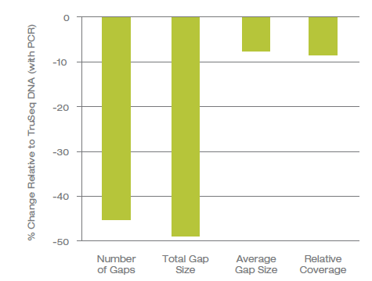
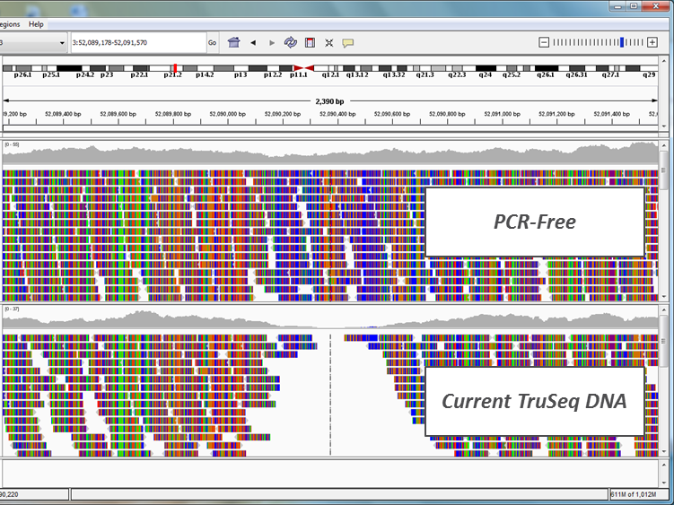
TruSeq DNA PCR-Free
Data Quality
Access more of the genome with reduced library bias and gaps

Slide 17
TruSeq Nano DNA
Prep Kit
Simple less then one day workflow
  All-inclusive kit w/gel-free size-selection
  Tunable to a variety of read lengths
  Low (24spl) and High (96spl) Throughput Options
Premier genome coverage
  Low sample input (100 ng)
  Lowest & smallest number of gaps
  Enhanced coverage of high GC/AT rich regions

Slide 18
Další možnosti příprav knihoven DNA, RNA - Illumina

Slide 19
TruSeq Synthetic Long-Read
DNA Library Prep Kit
Designed for two applications: preparing DNA libraries for long-read assembly and phasing analysis from whole genome sequencing data
Leverages TruSeq and Nextera chemistries with the high accuracy of short sequencing reads to construct long synthetic fragments with high assembly accuracy or efficient phasing
Enables phasing of de novo mutations and the identification of co-inherited alleles in a population

Slide 20
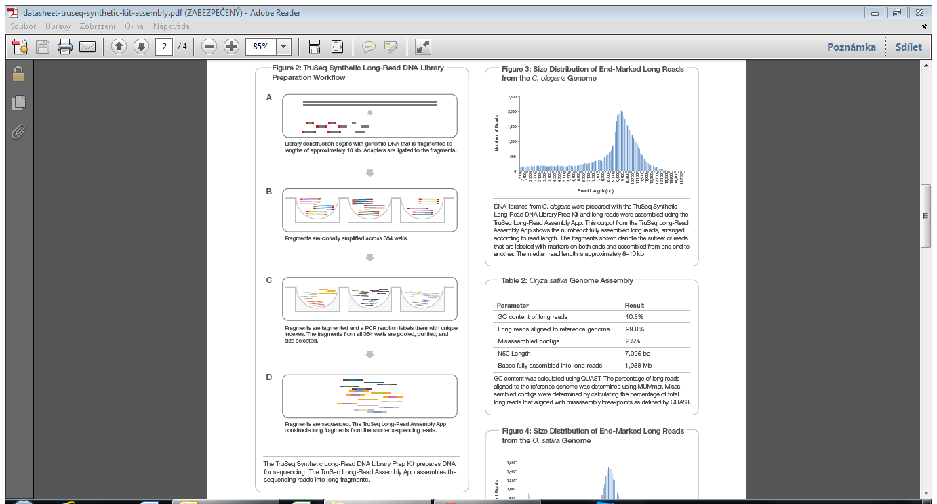
TruSeq Synthetic Long-Read
DNA Library Prep Kit

Slide 21
Příprava RNA knihoven
TruSeq RNA Sample Prep Kit v2
TruSeq Stranded mRNA HT Sample Prep Kit
TruSeq Stranded Total RNA LT Sample Prep Kit
TruSeq Small RNA Sample Prep Kit

Slide 22
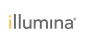
1. TruSeq® RNA Sample
Prep Kit V2
Simple 12 hours workflow
  All-inclusive kit w/gel-free size-selection
  Tunable to a variety of read lengths
High-Troughput Gene Expression studies
  Improvements in the RNA to cDNA conversion
  polyA selection of mRNA

Slide 23
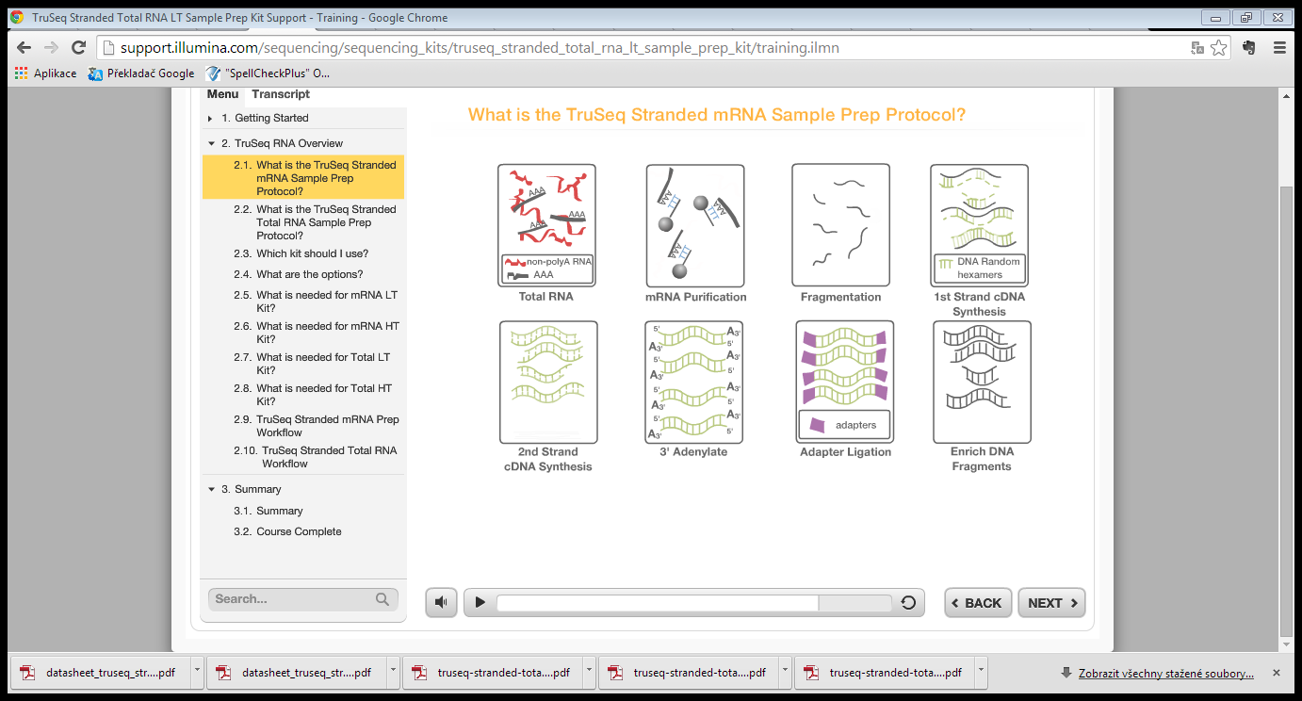
1. TruSeq® RNA Sample
Prep Kit V2

Slide 24
2. TruSeq® Stranded mRNA
Sample Prep Kit
Simple less than 2 days workflow
  All-inclusive kit w/gel-free size-selection
  Tunable to a variety of read lengths
High-Troughput Gene Expression studies
  Improvements in the RNA to cDNA conversion
  polyA selection of mRNA
  Precise measurement of strand orientation
  Compatible with many sample types including low-quality and FFPE

Slide 25
2. TruSeq® Stranded mRNA
First strand
cDNA synthesis
(w random hex)
RNA
First Strand
cDNA
Incorporates dUTP instead of dTTP
Second strand
cDNA synthesis
(w random hex)
First Strand
Second Strand
Ligate
Adapters
Enrich DNA fragments / Amplify
High-fidelity Taq
’
3
Notes:
First, you’re starting with first strand synthesis. Here your single stranded RNA template is reverse transcribed to form a complimentary strand of cDNA. With the TruSeq method, random hexamers are used to prime first strand synthesis. Random hexamers are essentially random six-mers of sequence, with the idea being to ensure an equal chance of priming occurring at any given position along a transcript.
Next, you do second strand synthesis. Here, you’re transcribing a second cDNA strand complimentary to the first. And again, importantly, you’re using random hexamers in order to ensure that priming has an equal chance of occurring across the transcript.
It’s at second strand synthesis where the dUTP method got its name. During second strand cDNA synthesis, dUTP, rather than dTTP is incorporated into the elongating strand.
This difference comes into play later in the process. After adapter ligation, cDNA with adapters ligated on both ends are enriched via PCR. At this step a high fidelity taq is used. Since high fidelity taq can’t elongate past dUTP-incorporated template, only the first strand product is successfully amplified. And because the P5 and p7 adapters are fixed in a single orientation for the first strand product, the orientation of the original RNA strand will be the opposite of that for which sequence is generated.
So again - first, and second strand synthesis are driven by random hexamer-based priming, this is followed by strand-specific amplification based on high-fidelity taq’s failure to extend dUTP-incorporated template. Together, this combination provides high coverage quality and precise strand information.

Slide 26
3. TruSeq® Stranded Total RNA
Sample Prep Kit
Simple less than 2 days workflow
  All-inclusive kit w/gel-free size-selection
  Tunable to a variety of read lengths
Sequencing of mRNA and broad range of non-coding RNA (lincRNA, snRNA, snoRNA and other RNA)
  Improvements in the RNA to cDNA conversion
  RiboZero kits remove rRNA – rRNA depleted RNA
  Precise measurement of strand orientation
  Compatible with many sample types including low-quality and FFPE

Slide 27
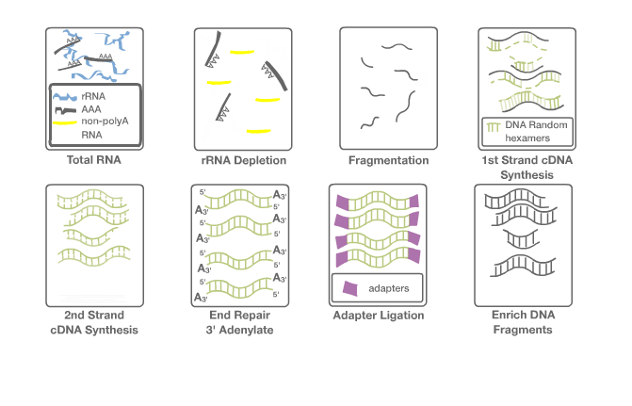
3. TruSeq® Stranded Total RNA
Total RNA
Add rRNA Removal
Solution
B
B
B
B
B
B
B
Add rRNA
Removal Beads
Remove RRB-
bound rRNA
B
B
B
B
B
B

Slide 28
TruSeq Small RNA Sample
Prep Kit
Simple less than 2 days workflow
Sequencing of small mRNA – for small RNA discovery and profiling applications
  Enables preparation of a variety of RNA species, using total RNA or purified small RNA as input.
  Takes advantage of the natural structure common to most known microRNA molecules
  Characterize variations such as isomiRs with single-base resolution

Slide 29
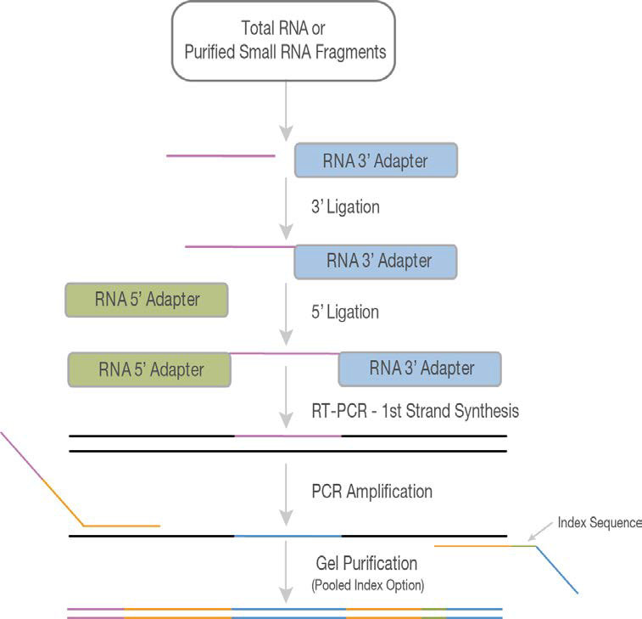
TruSeq Small RNA Sample
Prep Kit

Slide 30
Cíleně obohacené knihovny
1. Multiplexové PCR
2. Obohacení pomocí sond

Slide 31
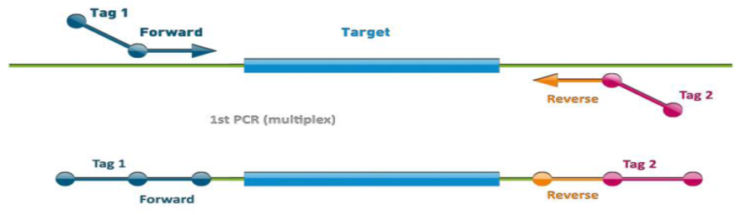
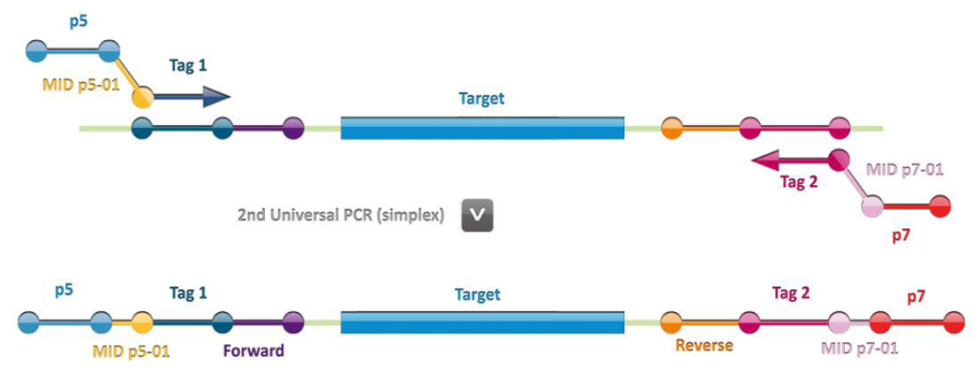
Ukázka multiplexové PCR (Multiplicom)
DNA isolation
QC
MASTR PCR
Dilution 1:1000
Universal PCR
Pooling
Purification
Sequencing

Slide 32
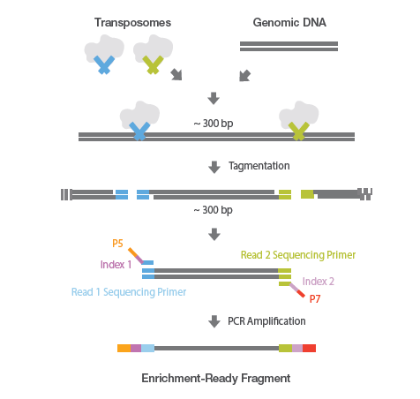
Ukázka obohacení pomocí sond

Slide 33
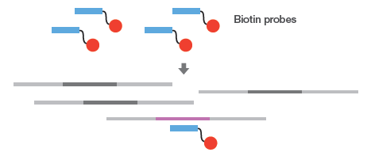
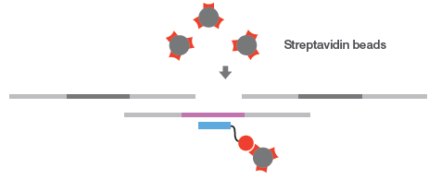
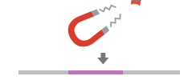
Ukázka obohacení pomocí sond

Slide 34
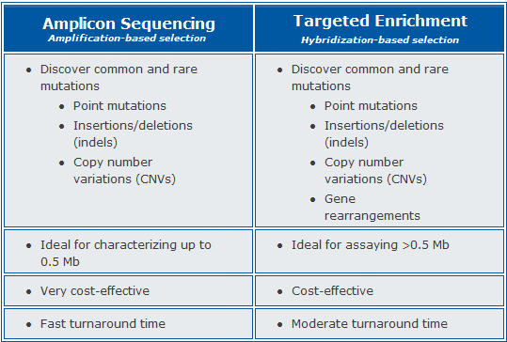
Srovnání obou přístupů

Slide 35
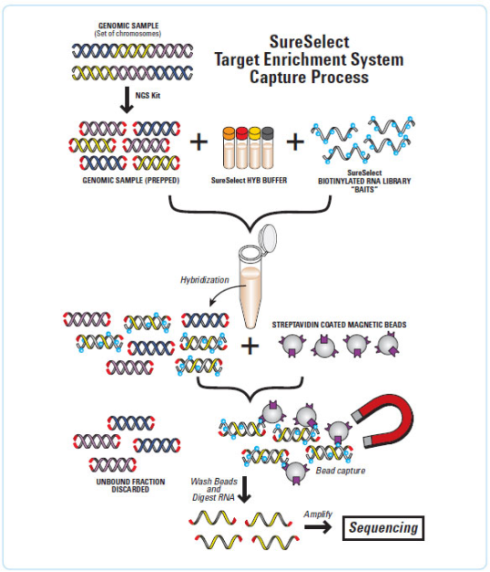
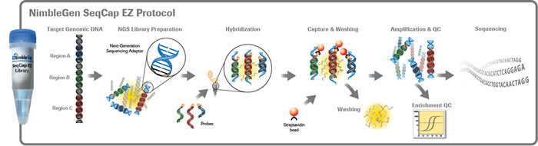
Firmy na trhu
Illumina – TruSeq Custom Amplicon, Nextera Rapid Capture Custom Enrichment
Roche – NimbleGen SeqCap
Agilent – SureSelect

Slide 36
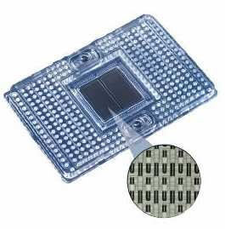
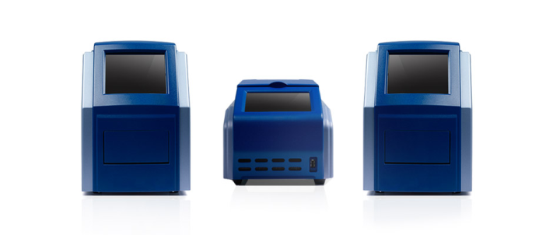

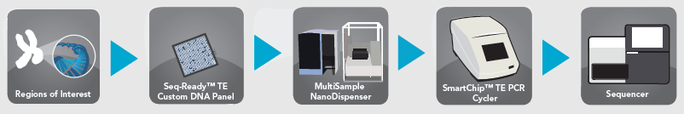
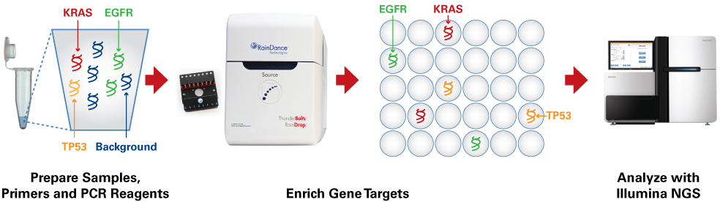
Další možnosti
Fluidigm
Wafergen SmartChip
RainDance technology

Slide 37
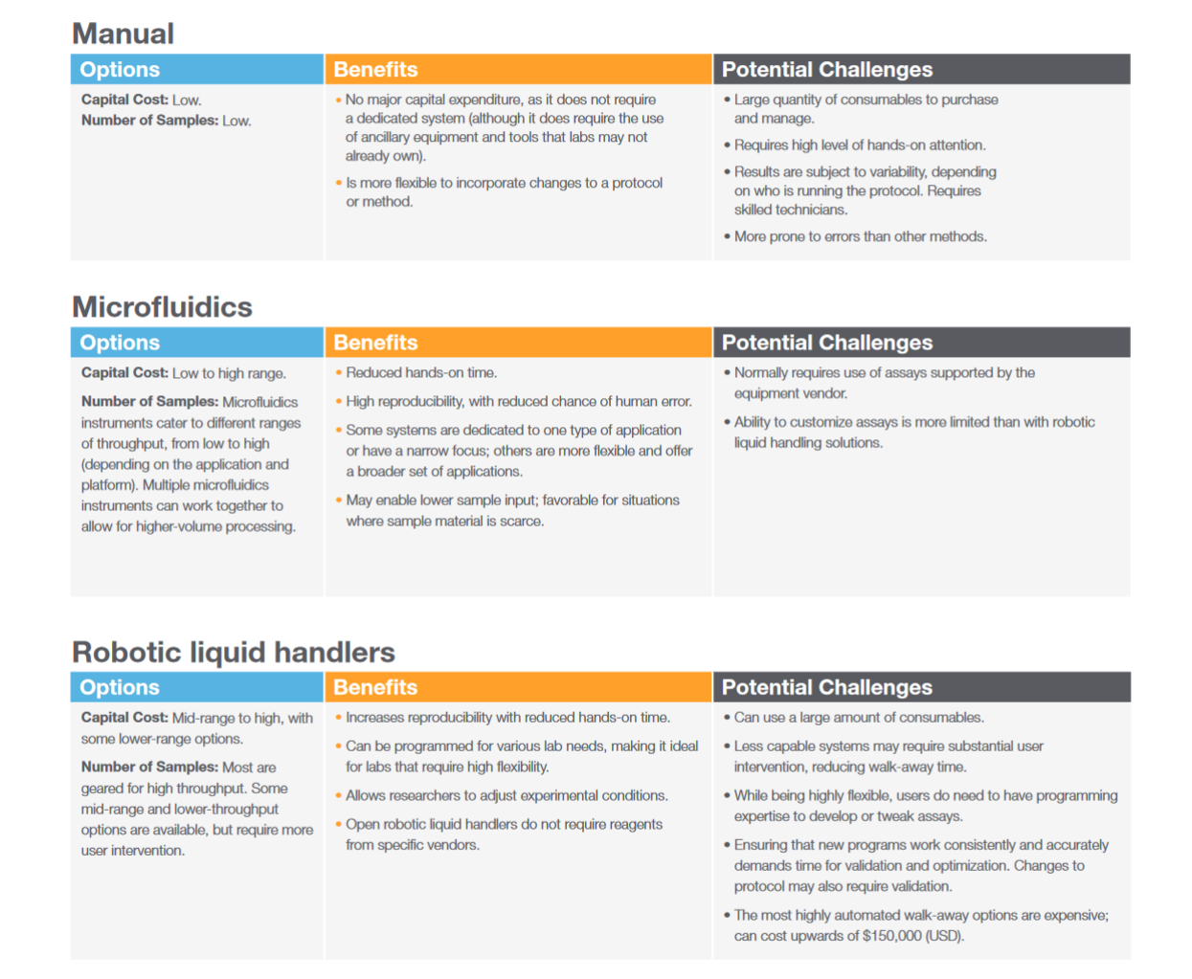
Automatizace přípravy knihoven

Slide 38
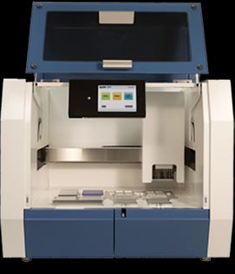
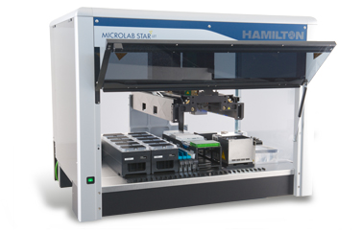
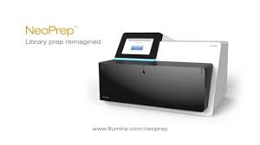
Automatizace přípravy knihoven
http://www.illumina.com/systems/neoprep-library-system.html

