Slide 1
Vliv chladu a mrazu
Effects of low and freezing temperature
Miloš Barták
OFAR ÚEB PřF MU,
Extreme Enviroments Life Laboratory
fdroje obrázků a informací v prezentaci uvedených: ac.ksu.edu.sa/sites, Schaberg 2010 (USDA Forest Service), Pearce 2001(Ann. Bot.), MIZ MEDI Hosp. Preservation of Germs, Jiří Zámečník, Iva Faberová (VÚRV), Lukatkin et al. (2012), Kawahara (INTECH Open)

Slide 2
    Teplotní stress / temperature stress
Temperature stress: Low or high temperature, called frost injury or heat injury, respectively.
2.1 Frost ( freezing )injury
The injury is caused by low temperature below freezing point (〈 0℃）,companied with frost.

Slide 3
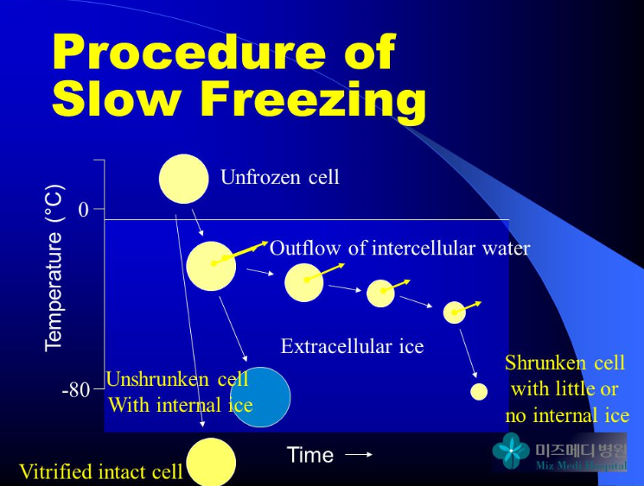

Slide 4
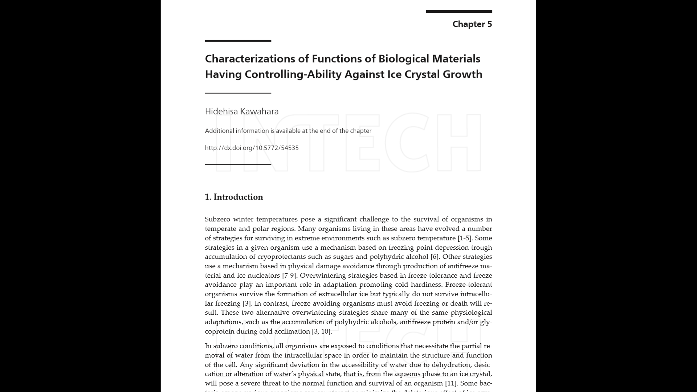
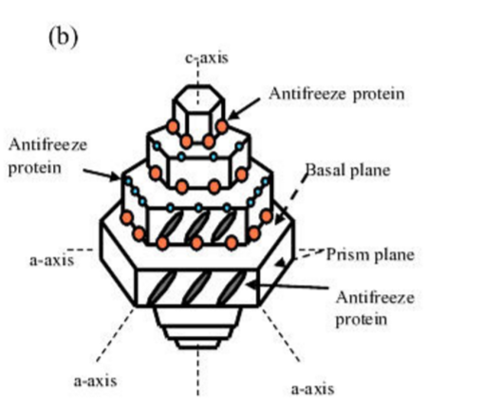
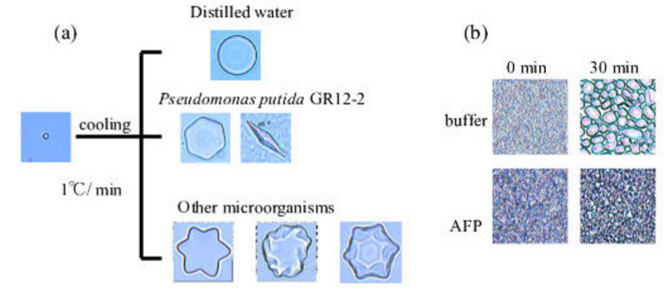
INTECH OPEN, 2013

Slide 5

2.1.1 Mechanism of freezing (frost )injury
2.1.1.1.Freezing:(intercellular and intracellular freezing)
(1) Intercellular freezing
Freezing
ice
Intercellular freezing occurs when temperature falls gradually.

Slide 6
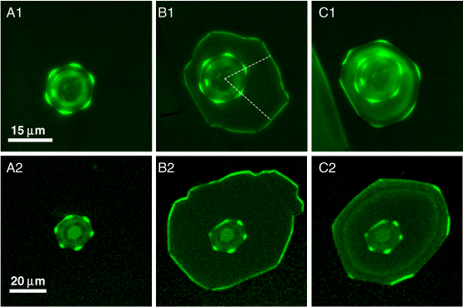
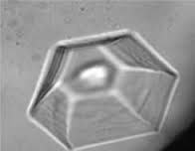
Growth–melt asymmetry in ice crystals under the influence of spruce budworm antifreeze protein
Natalya Pertaya¹, Yeliz Celik¹, Carlos L DiPrinzio¹, J S Wettlaufer^{2,3}, Peter L Davies⁴ and Ido Braslavsky^{1,5}
Published 10 September 2007

Slide 7
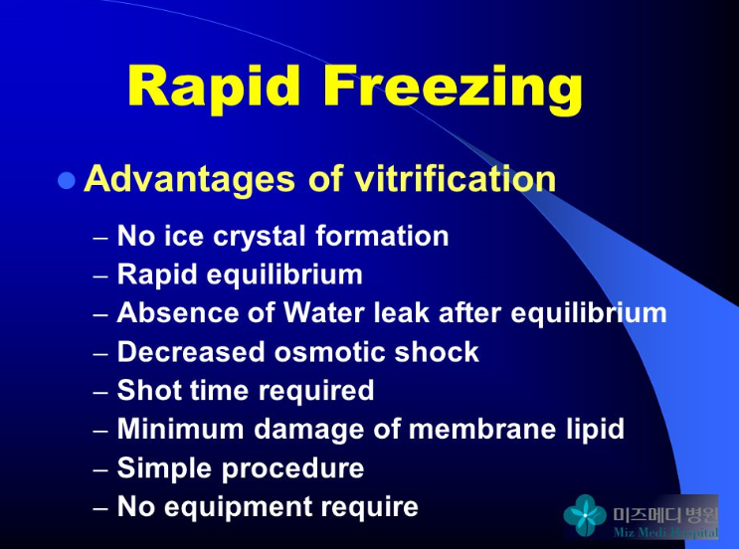

Slide 8
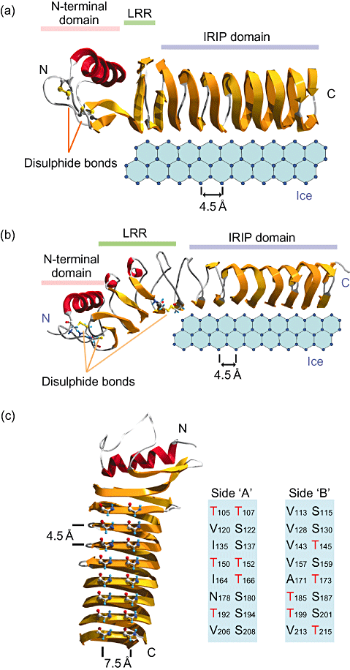
John et al. (2009): Ice recrystallization
inhibition proteins (IRIPs) and freeze tolerance
in the cryophilic Antarctic hair grass
Deschampsia antarctica E. Desv.

Slide 9
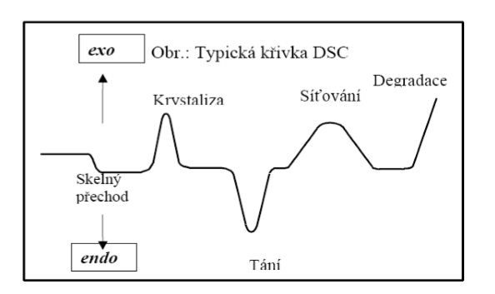
Diferenční skanovací kalorimetrie

Slide 10
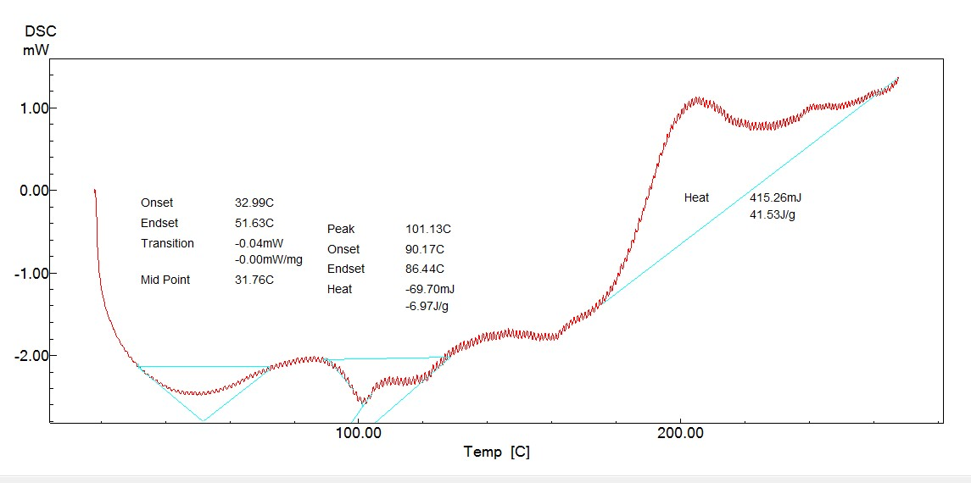
Diferenční skenující kalorimetr (DSC) je vhodný přístroj pro měření a interpretaci fázových přechodů vody v rostlinách. DSC se většinou používá pro přímé měření skelných přechodů a teploty ledové nukleace s následným vyhodnocením pomocí termické analýzy. Teplotní podmínky a úrovně hydratace při kterých se začíná tvořit sklo byly porovnány na základě rozdílných mechanismů tolerance nízkých teplot rostlin z přirozených podmínek.

Slide 11
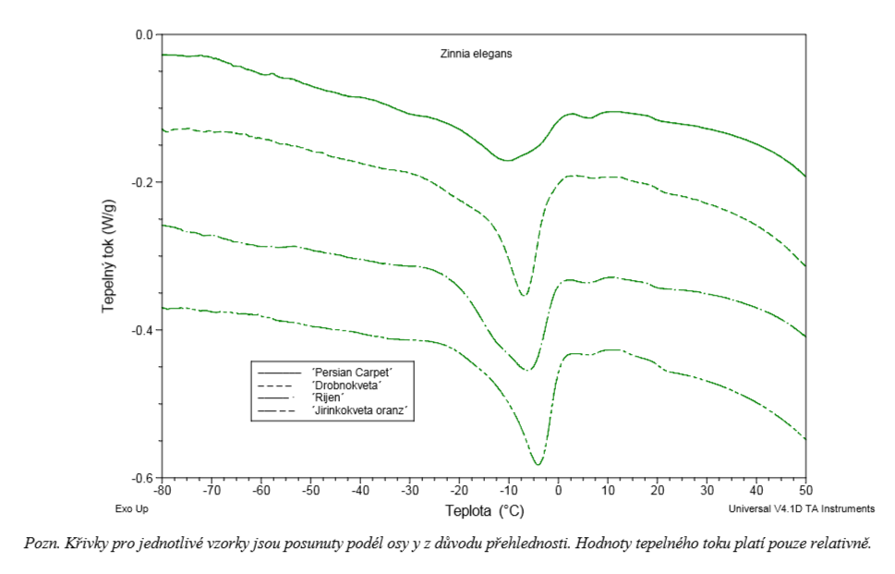

Slide 12
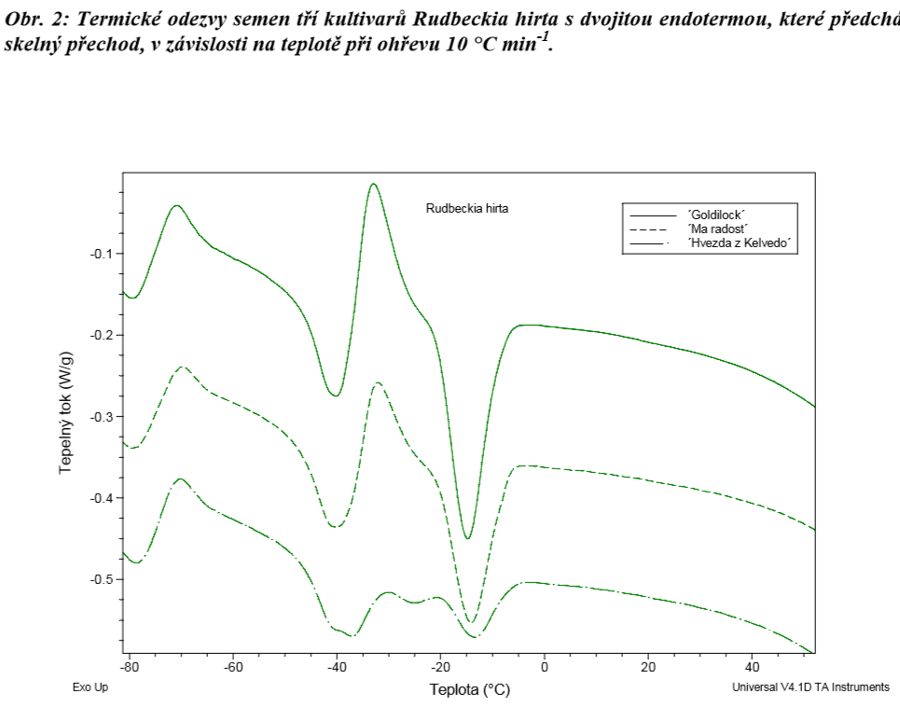

Slide 13
（2）Intracellular Freezing :
Intracellular freezing often occurs when temperature falls suddenly.
Ice results in the direct injury in cytoplasm, biomembrane and organelle, and damages to cell compartmentation and metabolic disorder.
Much more serious damage is caused by Intracellular Freezing than by Intercellular Freezing.
2.1.1.2 damage of protein:
Sulfhydryl group hypothesis（disulfide bridge hypothesis ）

Slide 14
—SH HS—
Before freezing
frozen
defrozen
S
S
—SH H S—
HS—
—S—S—
SH
S
—S—S—
—S—
—S—S—
SH
—S—S—
—S—S—
Illustration of sulfhydryl group hypothesis

Slide 15
Supported Exp：
(1) －S－S一increase and soluble －SH decrease after plant tissue faces to freezing.
(2) Less－S－S－and －SH of protein in the resistant-freeze plants.
(3) The plant with free－SH,glutathione, is more resistant to freeze.
(4) Artificial －SH,mercapthanol increases resistance of plant to low temperature.

Slide 16
2.1.1.3.Damage of biomembrane
Electric conductivity↑，cell material leakage↑，photochemical activity and ATP production ↓, while photoinhibition ↑，CF1 and PC depart from membrane.
Change in state of lipid and protein denuturation

Slide 17
2.1.2 Chilling injury
Chilling injury in tropical or subtropical plants is caused by temperature above 0℃ (freezing point )..
Maize, cotton rice seedling——10℃。
Rice pollen-mother cell division，23℃ for O. sativa and 20℃ for O. japonica.
Banana tree——13℃。
Oak tree——5℃。

Slide 18
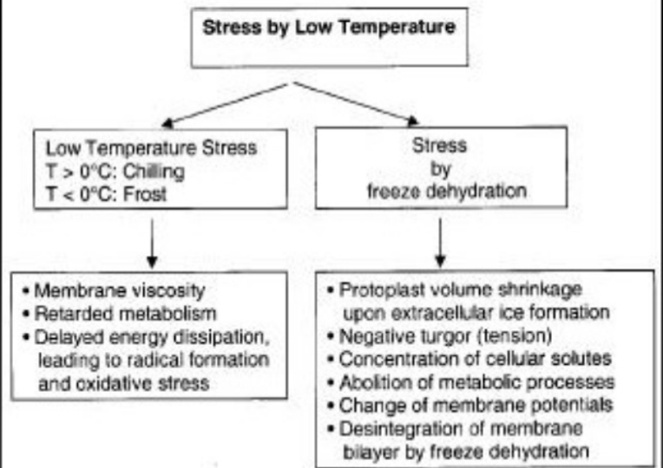
Chilling stress
Freezing stress

Slide 19
2.1.2.1. Change in state of lipid
liquid-crystalline state
Low temperature
Solid-gel state
Electric conductivity as an index for resistance to low temperature in pruduction

Slide 20
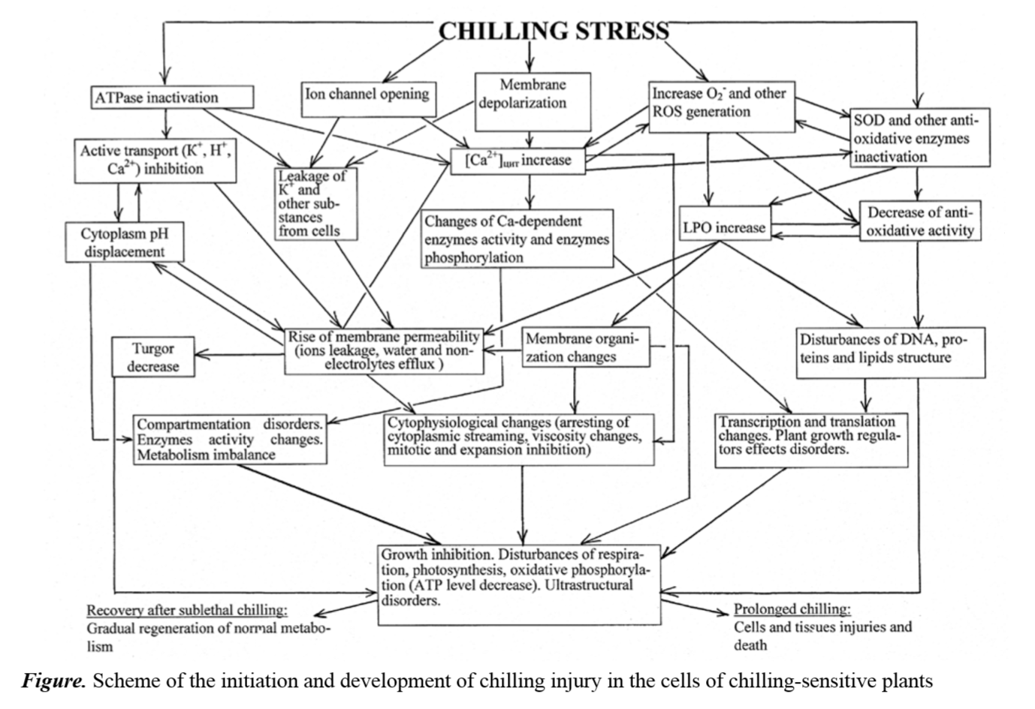

Slide 21
Metabolism disorder
（1）Uptake function of roots declines and water balance disorders
Transpiration>water absorption. The plant loss water and leaf curl 。
（2）Photosynthetic rate lowers 。
Photosynthesis< respiration, starvation to death
Rubisco losses activity under low temperature，PSP uncouples and free radicals breaks suddenly.

Slide 22
（3）Aerobic respiration decreases and anaerobic respiration increases。
Cytaa₃ activity ↓, respiratory electron transport and phosphorylation activities ↓. Ethanol poison.
（4） Organic substance degrades。
protease↑，protein↓，RNA、ATP ↓.

Slide 23
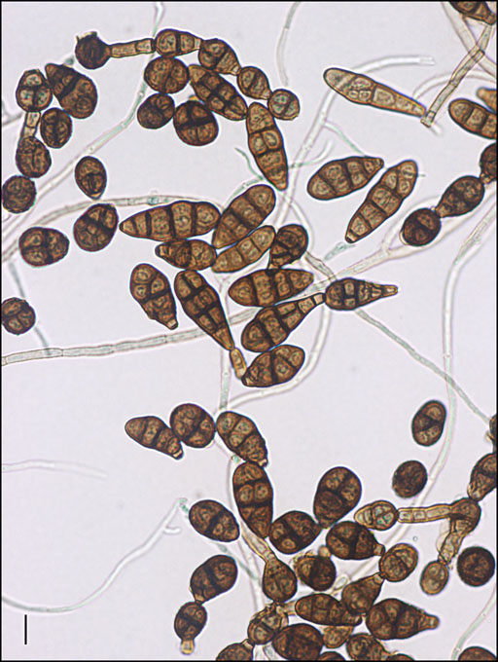
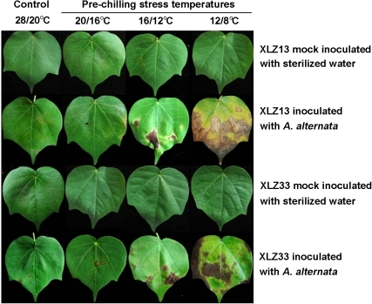
Čerň střídavá je druh vřeckovýtrusné houby,
způsobující skvrny na listech nebo poškození
různých orgánů u celé řady druhů rostlin
Chilling stress--the key predisposing factor for causing Alternaria alternata infection and leading to cotton
(Gossypium hirsutum L.) leaf senescence.
Zhao J, Li S, Jiang T, Liu Z, Zhang W, Jian G, Qi F - PLoS ONE (2012)

Slide 24
Physiological reaction of plant to low temperature
(1) Water content, metabolism, growth decrease .
Total water content↓，bound water↑，free water and ratio (free water/bound water) ↓。
(2) Protective substances increase。
NADPH——reduces－S－S－ to － SH，ATP and sugar↑, bound water↑.

Slide 25
(3) Unsaturated fatty acid increase in membrane。
Unsaturated fatty acid↑ and saturated one ↓.
(4) ABA↑，GA↓, dormancy appears.
(5) Proteins-resistant to freezing accumulations.
Freezing resistant protein —— Ice-Box——The genes expression induced by freeze——freeze-resistant protein.

Slide 26
Methods to increase the resistance to low temperature。
(1) The resistant cultivars.
(2) Low temperature hardening.
(3) Chemical control.
ABA ,CCC，PP₃₃₀，Amo-1618).
(4) Others.
PK application, keep warm with artificial things.

Slide 27
Total photosynthetic rate
Respiration rate
Pn

Slide 28
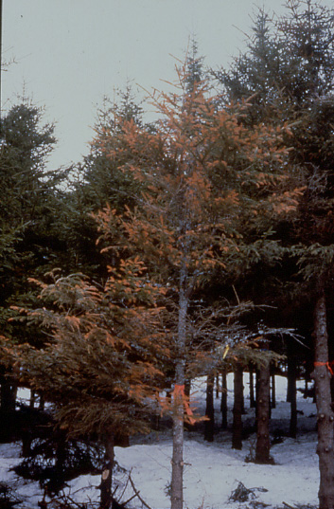
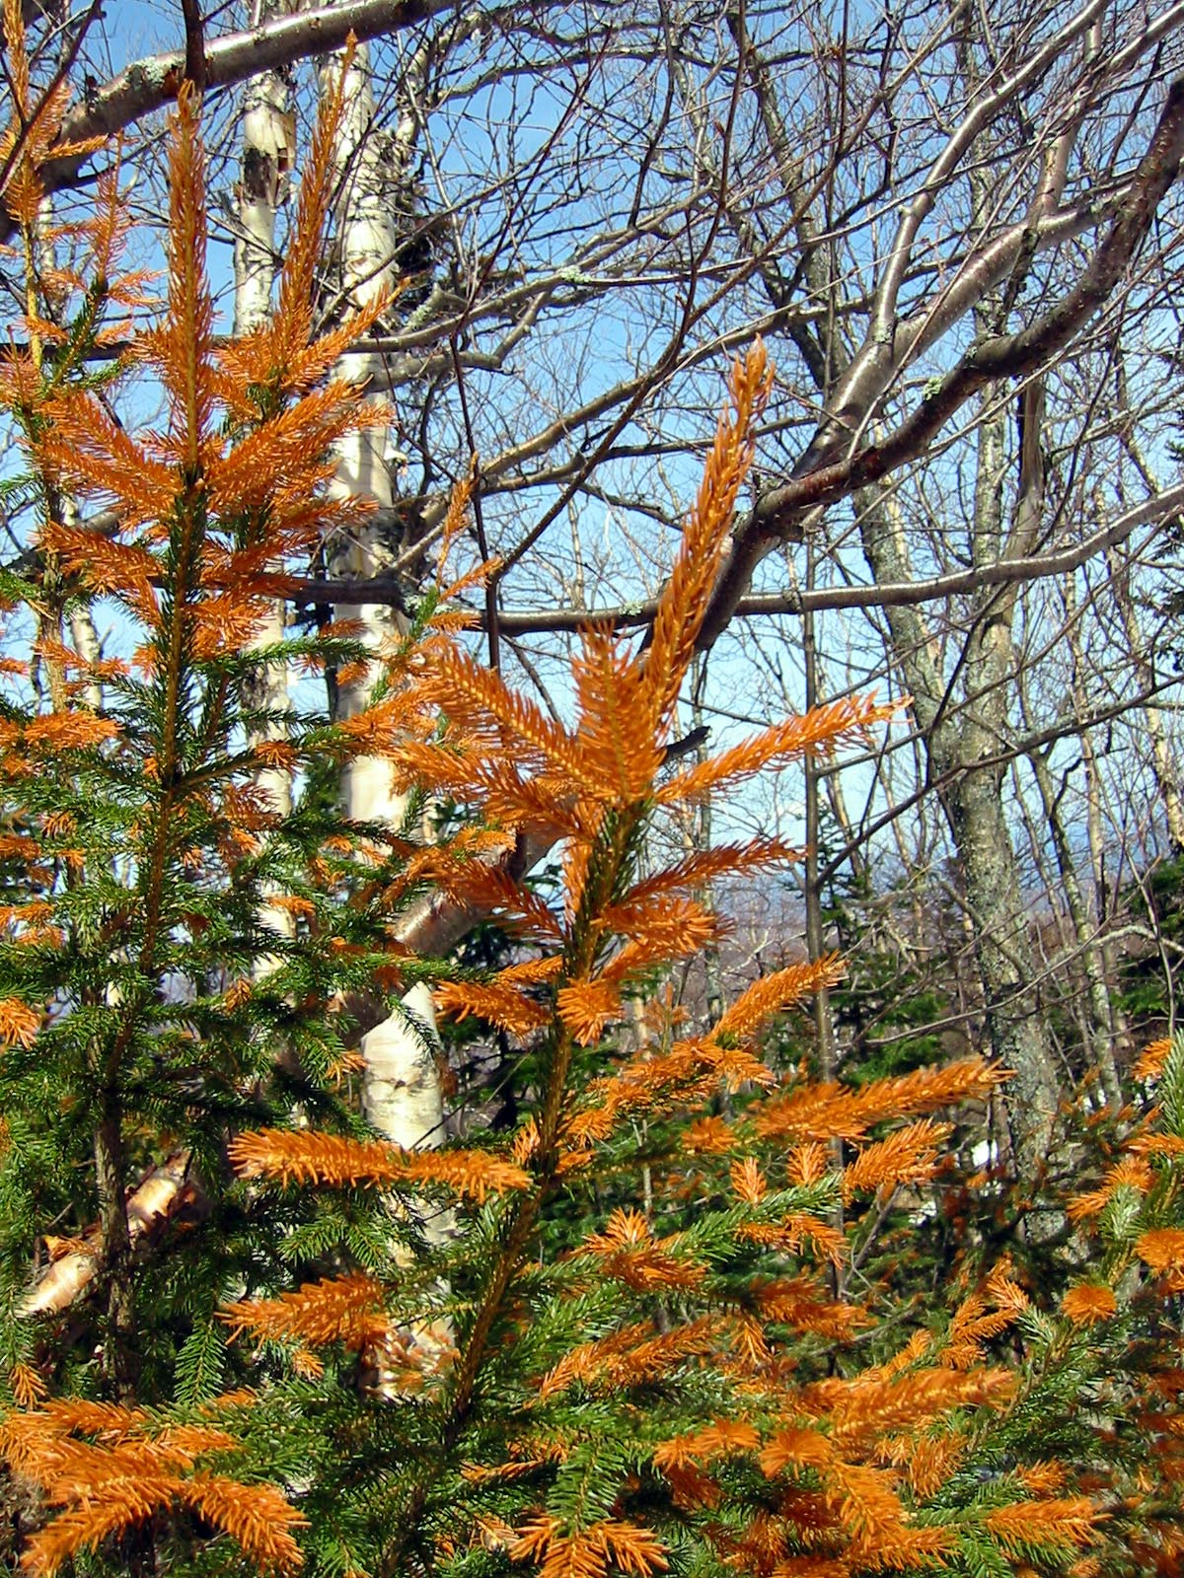
Zimní poškození

Slide 29
Cold tolerance of several north temperate conifers
(sampled in Wolcott, VT on March 3, 1998)
Species
Mean cold tolerance (ºC)
Red spruce
-38.1
White pine
-59.5
Eastern hemlock
-61.0
White spruce
-90.0
Red pine
-90.0
DeHayes et al. 2001

Slide 30
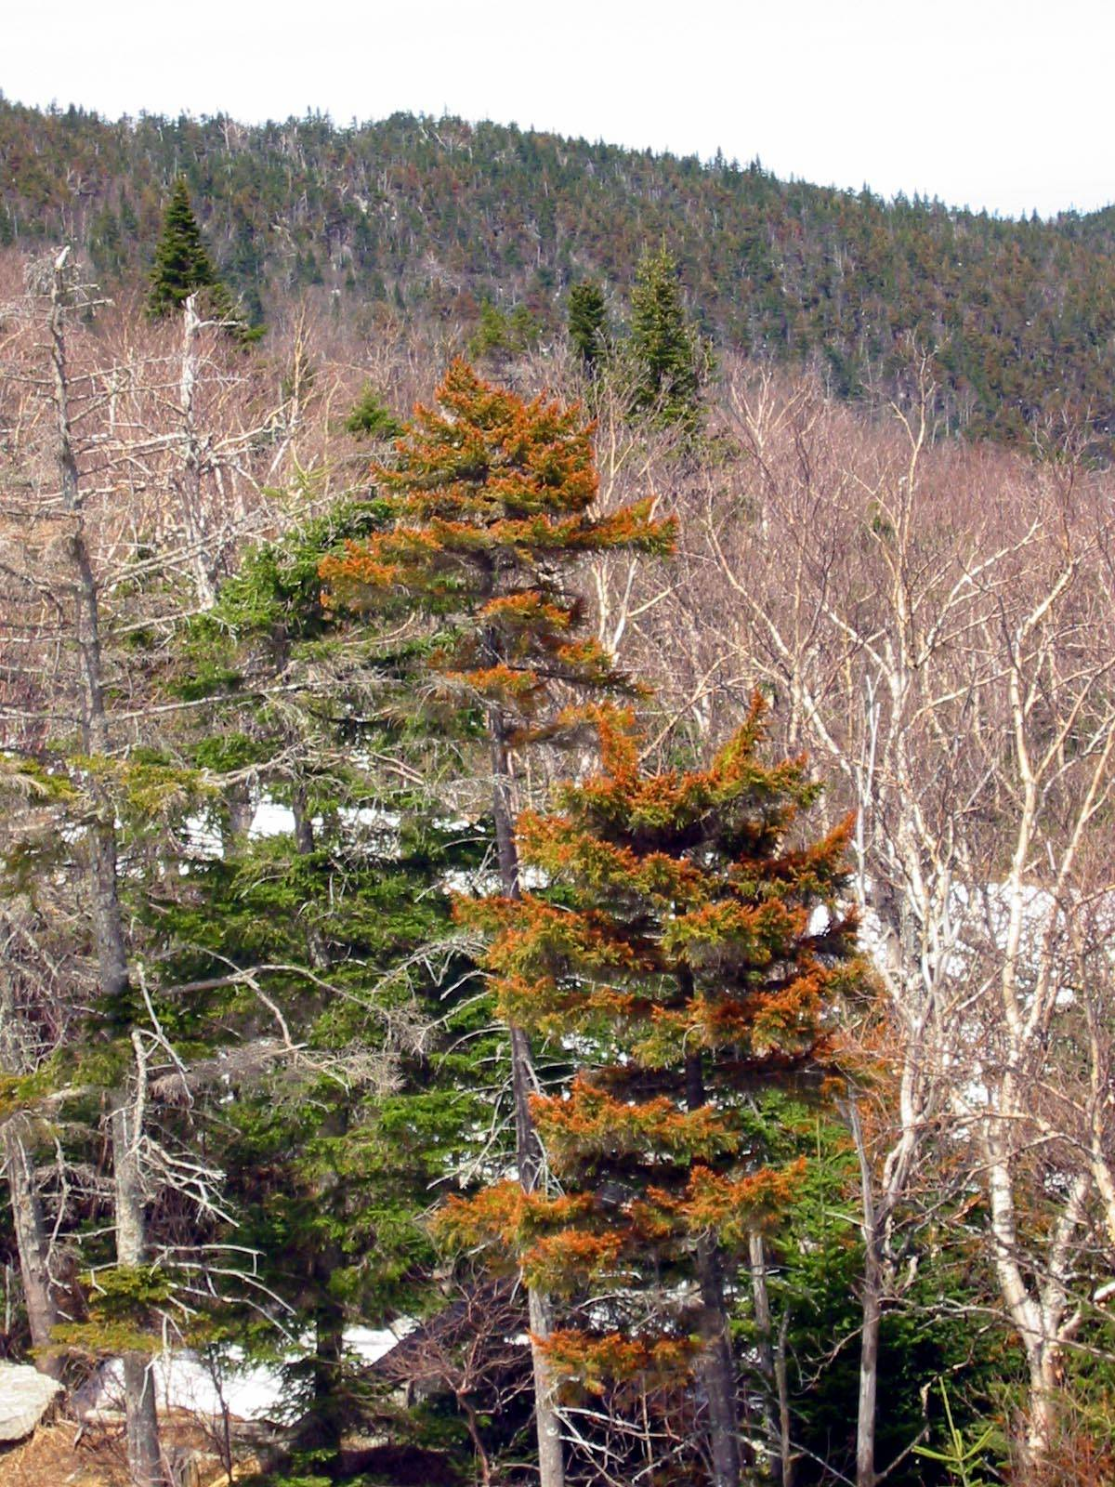
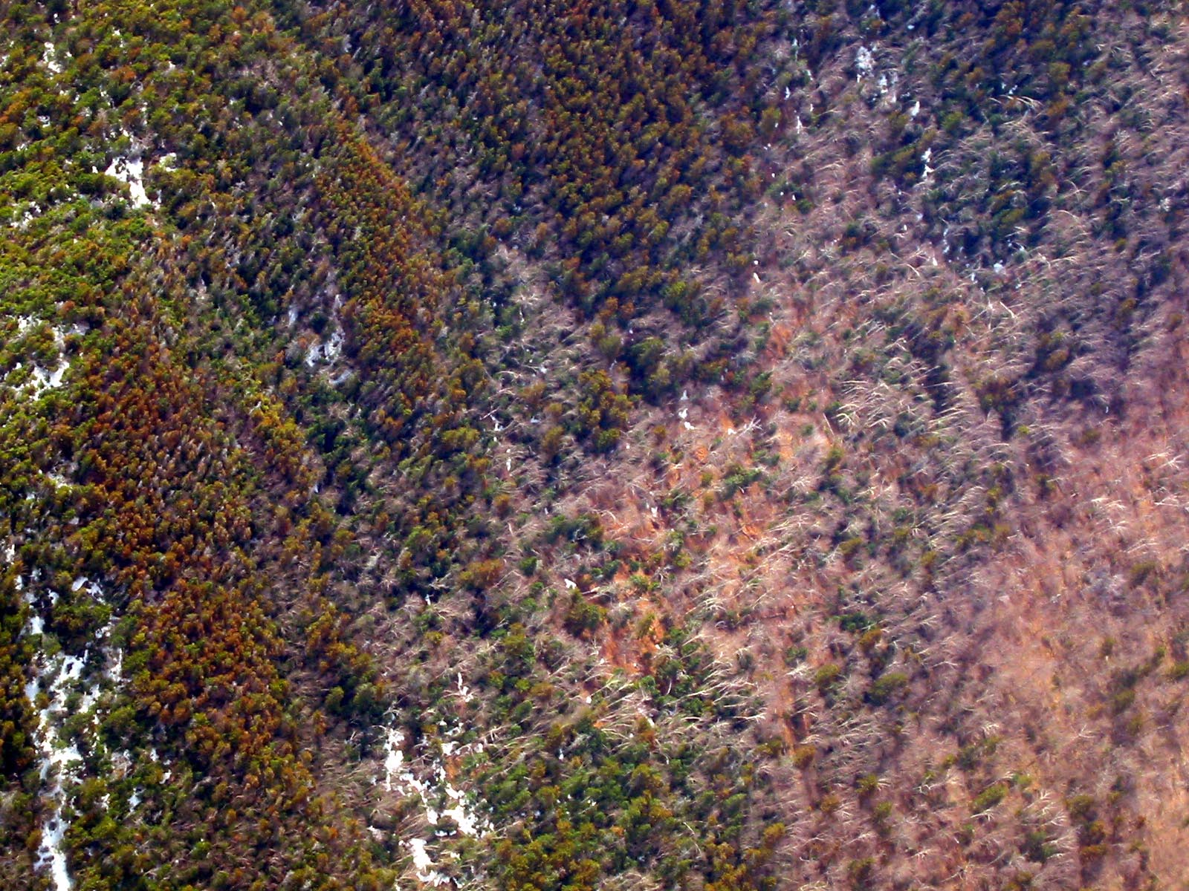
2003 – high winter injury year
Picea rubra

Slide 31
Mechanisms for acid-induced
freezing injury of red spruce
H⁺ displacement
of membrane-associated Ca
(-20%, P<0.05)
Acid deposition (H⁺)
Foliar Ca leaching
(2-8X increase, P<0.05)
Membrane destabilization
(+20%, P<0.05)
& reduction in messenger Ca
Reduced cold tolerance
(-10%, P<0.05)
Increased susceptibility
to freezing injury
DeHayes et al. 1999, Schaberg et al. 2000, Schaberg et al. 2001

Slide 32
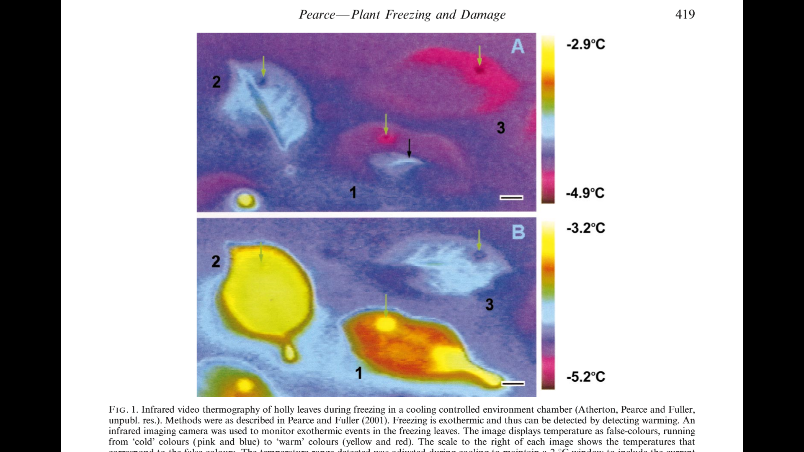

Slide 33
Responses to Chilling
Lipid composition of a plant’s membranes can help predict whether the plant will be sensitive or resistant to chilling
  The more unsaturated the membrane lipids are, the more resistant the plant is to chilling
Supercooling – survive as low as –40ºC
  Limits ice crystal formation to extracellular spaces
Antifreeze proteins

Slide 34
Dámy a pánové,
Děkuji Vám za
pozornost

